Slide 1
Statistics – O. R. 881 Object Oriented Data Analysis
Start
Recording
Steve Marron
Dept. of Statistics and Operations Research
University of North Carolina

Slide 2
Current Sections in Textbook
Today:
Section 8.3
Next Class:
Section 8.6

Slide 3
Shape Representations
Major Approaches for Shape Data Objects:
Landmark Representations
Boundary Representations
Skeletal Representations

Slide 4
Skeletal Representations
Main Idea:
Represent Objects as:
Discretized skeletons (medial atoms)
Plus spokes from center to edge
Which imply a boundary
Very accessible early reference:
Yushkevich, et al (2001)
Volume Gives Better Representation
In 3d than Boundary Surface

Slide 5
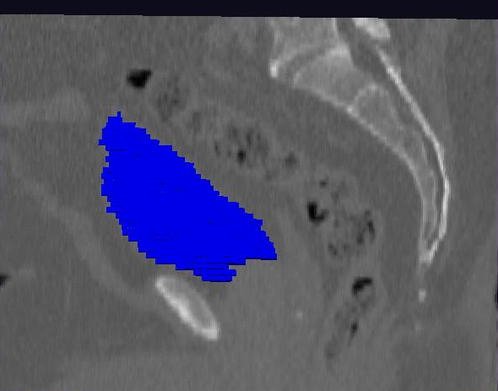
Male Pelvis – Raw Data
Bladder:
manual segmentation
Slice by slice
Reassembled

Slide 6
Male Pelvis – Raw Data
Bladder:
Slices:
Reassembled in 3d
How to represent?
Thanks: Ja-Yeon Jeong

Slide 7
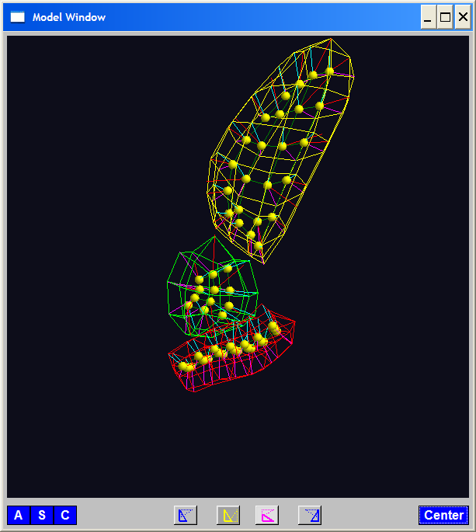
Skeletal Representations
3-d S-Rep Example: From Ja-Yeon Jeong
Bladder – Prostate - Rectum
Atoms - Spokes - Implied Boundary
Notes:
OODA.ppt

Slide 8
3-d s-reps
S-rep model fitting
Easy, when starting from binary (blue)
But very expensive (30 – 40 minutes technician’s time)
Want automatic approach
Challenging, because of poor contrast, noise, …
Need to borrow information across training sample
Use Bayes approach: prior & likelihood → posterior
~Conjugate Gaussians, but there are issues:
Major HLDSS challenges
Manifold aspect of data
Handle With Variation on PCA
Careful Handling Very Useful

Slide 9
Data Lying On a Manifold
Major issue: s-reps live in $ℝ^{3}×ℝ^{+}×S^{2}×S^{2}$
(locations, radii and angles)
Note on Terminology:
Manifold Data ≠ Manifold Learning
Data Naturally Lie on Known Manifold

Slide 10
Data Lying On a Manifold
Major issue: s-reps live in $ℝ^{3}×ℝ^{+}×S^{2}×S^{2}$
(locations, radii and angles)
Note on Terminology:
Manifold Data ≠ Manifold Learning
Try to Find Low-d Aprox’ing Manifold

Slide 11
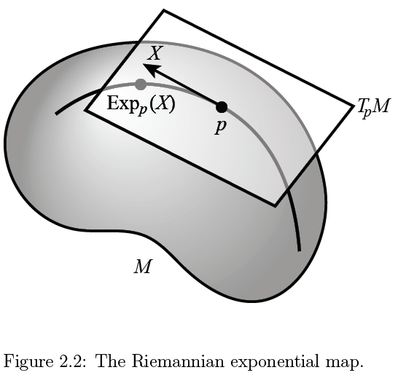
Manifold Feature Spaces
Main Idea:
Curved Surface,
With “Approximating
Tangent Plane”
At Each Point, $p$
(In Limit of Shrinking
Neighborhoods)

Slide 12
Manifold Feature Spaces
Important Mappings:
Plane → Surface:
$\exp_{p}$
Surface → Plane
$\log_{p}$

Slide 13
Manifold Feature Spaces
Log & Exp Memory Device:
Complex Numbers
Exponential:
Tangent Plane → Manifold
Logarithm:
Manifold → Tangent Plane

Slide 14
Manifold Feature Spaces
Extrinsic vs. Intrinsic Centerpoints
Compare on
Unit Circle, $S^{1}$
Ambient Space $\overline{X}=\frac{1}{n}\sum_{i=1}^{n}{X_{i}}$
& Project Back to Manifold
E.g. Fréchet Mean

Slide 15
Manifold Feature Spaces
Extrinsic vs. Intrinsic Centerpoints
Often Similar
Note Big Difference!
Which is Better?

Slide 16
PCA for s-reps
Text: Sec. 8.3
PCA on manifold spaces?
(e.g. on Lie Groups / Symmetric Spaces)
T. Fletcher: Principal Geodesic Analysis
(2004 UNC CS PhD Dissertation
& Fletcher et al. (2004))

Slide 17
PCA for s-reps
PCA on manifold spaces?
(e.g. on Lie Groups / Symmetric Spaces)
T. Fletcher: Principal Geodesic Analysis
Idea: replace “linear summary of data”
With “geodesic summary of data”…

Slide 18
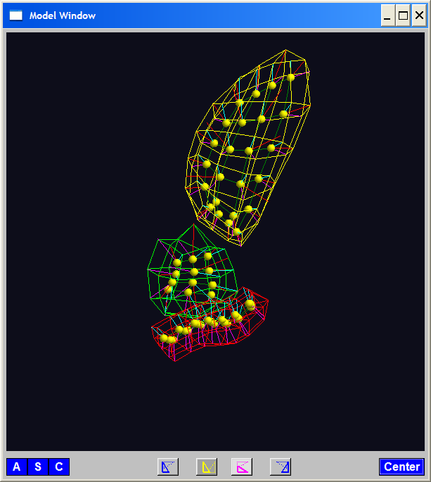
PGA for s-reps, Bladder-Prostate-Rectum
Bladder – Prostate – Rectum, 1 person, 17 days
PG 1 PG 2 PG 3
(analysis by Ja Yeon Jeong)

Slide 19
PGA for s-reps, Bladder-Prostate-Rectum
Bladder – Prostate – Rectum, 1 person, 17 days
PG 1 PG 2 PG 3
(analysis by Ja Yeon Jeong)

Slide 20
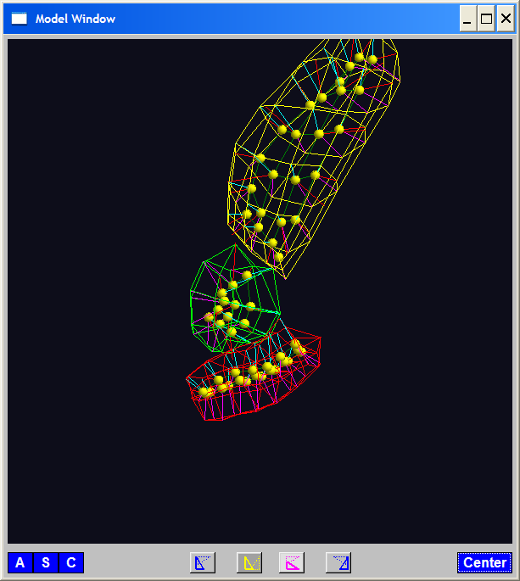
PGA for s-reps, Bladder-Prostate-Rectum
Bladder – Prostate – Rectum, 1 person, 17 days
PG 1 PG 2 PG 3
(analysis by Ja Yeon Jeong)

Slide 21
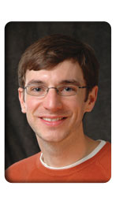
PCA Extensions for Data on Manifolds
Fletcher (Principal Geodesic Anal.)
Best fit of geodesic to data

Slide 22
PCA Extensions for Data on Manifolds
Fletcher (Principal Geodesic Anal.)
Best fit of geodesic to data
Constrained to go through geodesic mean

Slide 23
PCA Extensions for Data on Manifolds
Fletcher (Principal Geodesic Anal.)
Best fit of geodesic to data
Constrained to go through geodesic mean
Happens
Naturally
in $ℝ^{d}$
Mean
Contained
in Best
Fit Line

Slide 24
PCA Extensions for Data on Manifolds
Fletcher (Principal Geodesic Anal.)
Best fit of geodesic to data
Constrained to go through geodesic mean
Extreme
3 Point
Examples
Equator is Best Fitting Geodesic in All Frames
Yet Fréchet Mean(s) Often Far Away
By Sungkyu Jung

Slide 25
Challenge for Principal Geodesic Analysis
Data
On $S^{2}$
(Sphere)
Scattered
Along
Equator
Somehow
Single
Mode of
Variation

Slide 26
Challenge for Principal Geodesic Analysis
Data
On $S^{2}$
Geodesic
Mean(s)

Slide 27
Challenge for Principal Geodesic Analysis
Data
On $S^{2}$
Geodesic
Mean(s)
Tangent Plane

Slide 28
Challenge for Principal Geodesic Analysis
Data
On $S^{2}$
Geodesic
Mean(s)
Tangent Plane
Projections ($log$)
Requires 2
Modes of
Variation

Slide 29
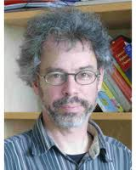
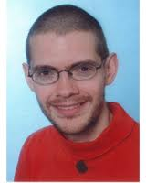
PCA Extensions for Data on Manifolds
Fletcher (Principal Geodesic Anal.)
Best fit of geodesic to data
Constrained to go through geodesic mean
Huckemann, Hotz & Munk (Geod. PCA)
Huckemann et al (2011)

Slide 30
PCA Extensions for Data on Manifolds
Fletcher (Principal Geodesic Anal.)
Best fit of geodesic to data
Constrained to go through geodesic mean
Huckemann, Hotz & Munk (Geod. PCA)
Best fit of any geodesic to data

Slide 31
PCA Extensions for Data on Manifolds
Fletcher (Principal Geodesic Anal.)
Best fit of geodesic to data
Constrained to go through geodesic mean
Huckemann, Hotz & Munk (Geod. PCA)
Best fit of any geodesic to data
Counterexample:
Data follows Tropic of Capricorn
Realizations of Spoke in
Blad.-Prost.-Rect. Simulator

Slide 32
PCA Extensions for Data on Manifolds
Fletcher (Principal Geodesic Anal.)
Best fit of geodesic to data
Constrained to go through geodesic mean
Huckemann, Hotz & Munk (Geod. PCA)
Best fit of any geodesic to data
Jung, Foskey & Marron (Princ. Arc Anal.)
Jung et al (2011)

Slide 33
PCA Extensions for Data on Manifolds
Fletcher (Principal Geodesic Anal.)
Best fit of geodesic to data
Constrained to go through geodesic mean
Huckemann, Hotz & Munk (Geod. PCA)
Best fit of any geodesic to data
Jung, Foskey & Marron (Princ. Arc Anal.)
Best fit of any circle to data
(motivated by conformal maps)

Slide 34
PCA Extensions for Data on Manifolds
Note:
“Backwards
Mean” of $S^{1}$
Projections
Gives Better
“Center”
“Bad” Since
Require 2
Modes to
Represent
Data

Slide 35
Principal Arc Analysis
Jung, Foskey & Marron (2011)
Best fit of any circle to data
Can give better fit than geodesics

Slide 36
Principal Arc Analysis
Jung, Foskey & Marron (2011)
Best fit of any circle to data
Can give better fit than geodesics
Observed for simulated s-rep example

Slide 37
Challenge being addressed
Interesting
Results:
Kim (2018)

Slide 38
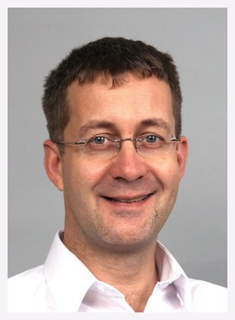
Principal Nested Spheres
Main Goal:
Extend Principal Arc Analysis ($S^{2}$ to $S^{k}$)
Jung, Dryden & Marron (2012)

Slide 39
Principal Nested Spheres
Main Goal:
Extend Principal Arc Analysis ($S^{2}$ to $S^{k}$)

Slide 40
Principal Nested Spheres
Jung et al (2012)
Context:
$d$ – dim
Sphere
(in $ℝ^{d+1}$)
$$S^{d}$$

Slide 41
Principal Nested Spheres
For data $∈S^{d}$
Consider an
$S^{d−1}$ for a
“Rank $d−1$
Approxi’n”
$$S^{d}$$
Determined by a Slicing Plane

Slide 42
Principal Nested Spheres
For data $∈S^{d}$
Find Projec’ns
Onto $S^{d−1}$
$$S^{d}$$
Along Surface (Geodesic Distance)

Slide 43
Principal Nested Spheres
Move plane
To Minimize
$\sum_{i}{{resid}_{i}^{2}}$
Keep signed
${resid}_{i}$ as
PNS-$d$ scores
$$S^{d}$$
And Projections as Rank $d−1$ Approximations

Slide 44
Principal Nested Spheres
Now consider
Projections
As Data in
Subsphere
$S^{d−1}$
Repeat for
PNS $d−1$
Scores
$$S^{d−1}$$

Slide 45
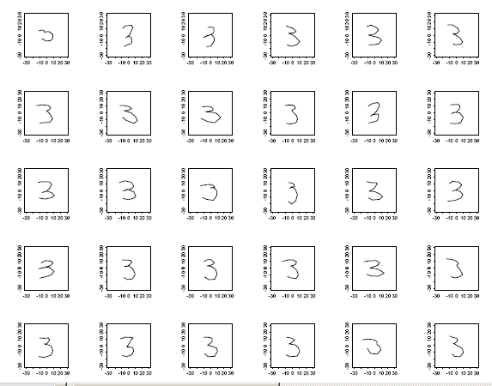
Digit 3 data: Principal variations of the shape
Recall Data
From Above

Slide 46
Digit 3 data: Principal variations of the shape
Princ. geodesics by PNS
Principal arcs by PNS

Slide 47
Digit 3 data: Principal variations of the shape
Principal Geodesics:
1st Mode: Center&Ends go Left&Right
2nd Mode: Fat vs. Skinny, Large Variation
Points Move Linearly
Principal Nested Spheres:
1st Mode: Traverses Long Curved Path
2nd Mode: Less Variation Left to Explain
Points Follow Curved Paths
Better “Signal Compression”

Slide 48
Composite Principal Nested Spheres
Idea: Use Principal Nested Spheres
Over Large Products of $S^{2}$ and $ℝ^{d}$
Then do PCA on Euclideanized Data
Terminology: Pizer et al. (2013)
Vectors whose Entries are
Angles on Sphere and Reals

Slide 49
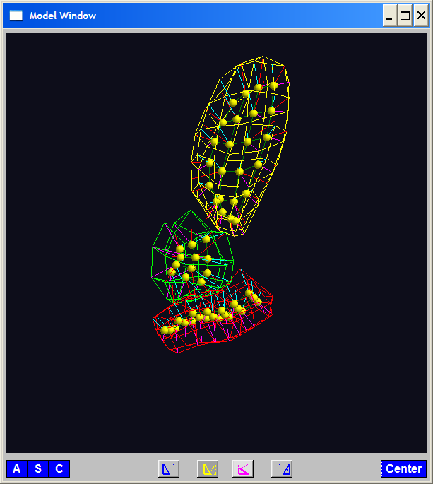
Composite Principal Nested Spheres
Idea: Use Principal Nested Spheres
Over Large Products of $S^{2}$ and $ℝ^{d}$
Motivation:
s-reps

Slide 50
Composite Principal Nested Spheres
Idea: Use Principal Nested Spheres
Over Large Products of $S^{2}$ and $ℝ^{d}$
Approach: Use Principal Nested Spheres
to Linearize $S^{2}$ Components
Needs 2 Modes to
Capture Variation

Slide 51
Composite Principal Nested Spheres
Idea: Use Principal Nested Spheres
Over Large Products of $S^{2}$ and $ℝ^{d}$
Approach: Use Principal Nested Spheres
to Linearize $S^{2}$ Components
PNS Explains All
With One Mode

Slide 52
Composite Principal Nested Spheres
Idea: Use Principal Nested Spheres
Over Large Products of $S^{2}$ and $ℝ^{d}$
Approach: Use Principal Nested Spheres
to Linearize $S^{2}$ Components
Then Concatenate All & Use PCA

Slide 53
Composite Principal Nested Spheres
From Pizer et al. (2017, 2020) Impact on Segmentation:
PGA Segmentation: used ~20 comp’s
CPNS Segmentation: only need ~13
Resulted in visually better fits to data
Recall Bladder-Prostate-Rectum Data

Slide 54
Extension to s-rep Space
Challenge:
Vectors of $S^{2}$ Directions as Data Objects
$$\left(\begin{matrix}\left(θ_{1},φ_{1}\right) \\ ⋮ \\ \left(θ_{d},φ_{d}\right)\end{matrix}\right)∈{\left(S^{2}\right)}^{d}$$
Polysphere Type Space

Slide 55
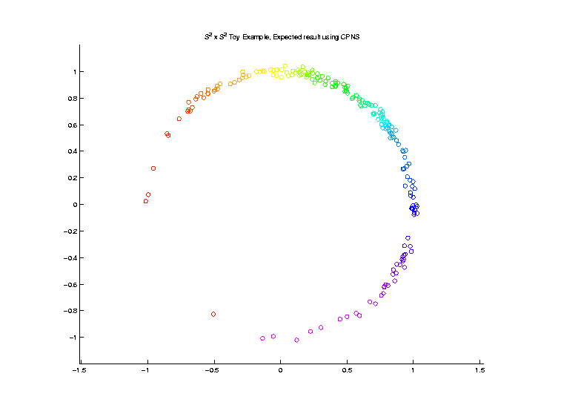
Extension to s-rep Space
Challenge: $S^{2}×S^{2}$ Polysphere Space
Generator Of
Toy Example
Wrap $x$ around
1st Copy of $S^{2}$
Wrap $y$ around
2nd Copy of $S^{2}$

Slide 56
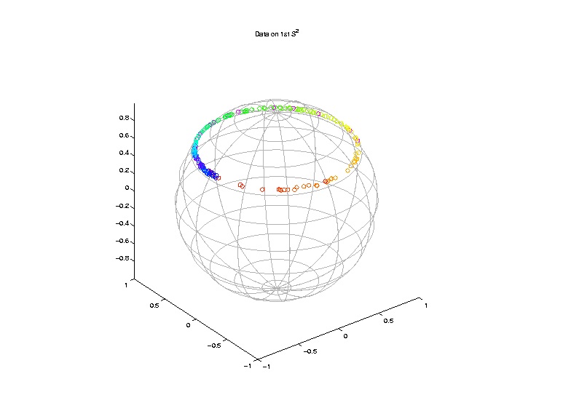
Extension to s-rep Space
Challenge: $S^{2}×S^{2}$ Polysphere Space
Note Colors
From $x$ In
Generator

Slide 57
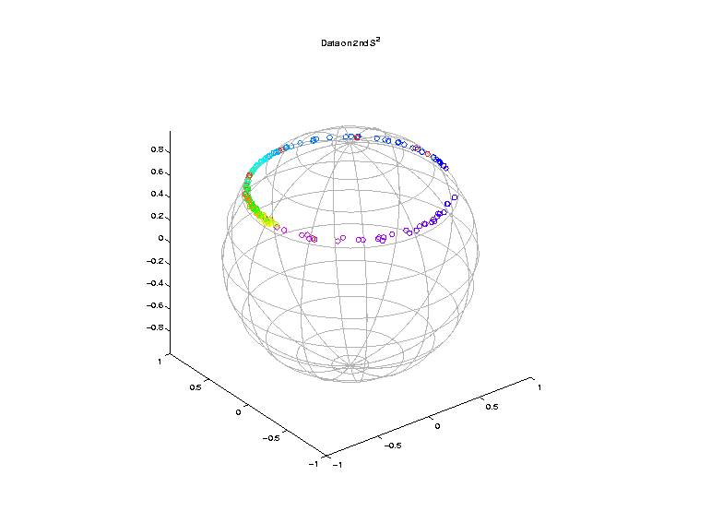
Extension to s-rep Space
Challenge: $S^{2}×S^{2}$ Polysphere Space
Note Colors
From $y$ In
Generator

Slide 58
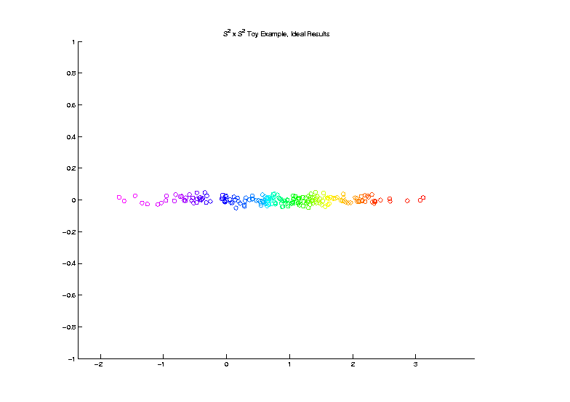
Extension to s-rep Space
Challenge: $S^{2}×S^{2}$ Polysphere Space
Desired Answer
From a PCA

Slide 59
Extension to s-rep Space
Challenge: $S^{2}×S^{2}$ Polysphere Space
CPNS:
Gets 1-d Comps,
But Wrong
Dependence
(Strong Distortion)
Thanks to Sungkyu Jung

Slide 60
Polysphere PCA
Deeper New Methodology: PPCA
For Polysphere Spaces (e.g. s-reps)
Find Approximating (Higher $d$) Sphere
Then do PNS (Better Signal Compression)

Slide 61
Polysphere PCA
Deeper New Methodology: PPCA
For Polysphere Spaces (e.g. s-reps)
Reference: Elzner et al (2015)
Benjamin Eltzner Stephan Huckemann Sungkyu Jung

Slide 62
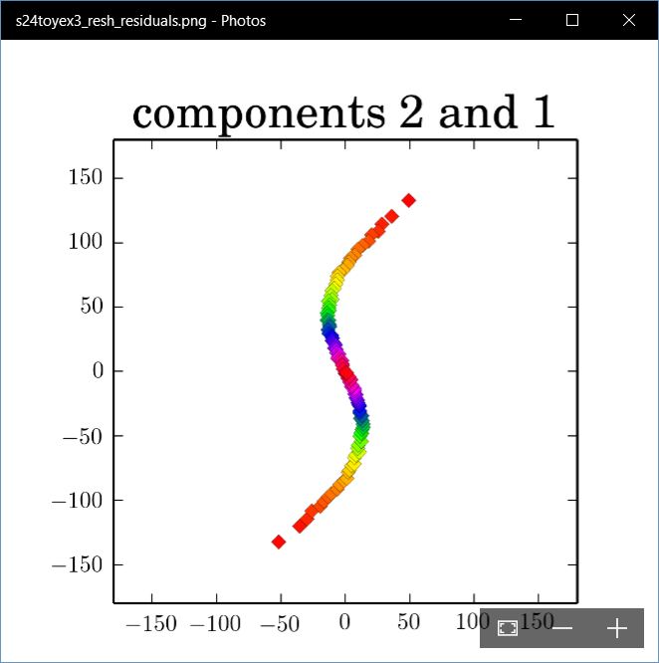
Polysphere PCA-type Analysis
Deeper New Methodology: PPCA
For Polysphere
~Toy Example
Pretty Good But
Still Some
Distortion
Thanks to B. Eltzner

Slide 63
Topologically Different Space
Vectors of Angles as Data Objects
$$\left(\begin{matrix}θ_{1} \\ ⋮ \\ θ_{d}\end{matrix}\right)∈{\left(S^{1}\right)}^{d}$$
Torus Type Spaces

Slide 64
Torus Spaces
Vectors of Angles as Data Objects
Natural Examples Include:
Structural Chemistry
(Sequences of Bond Angles)
Meteorology
(Wind Directions at Multiple Sites)
Astronomy
(Sunspots Moving Over Time)

Slide 65
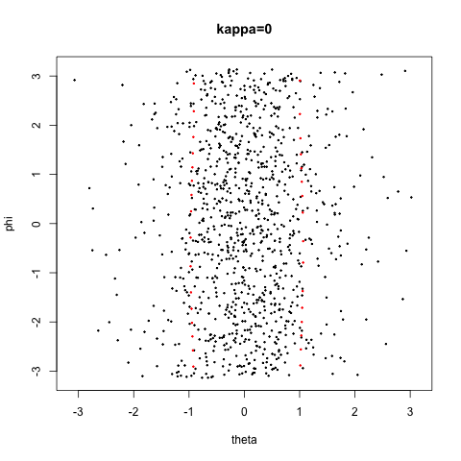
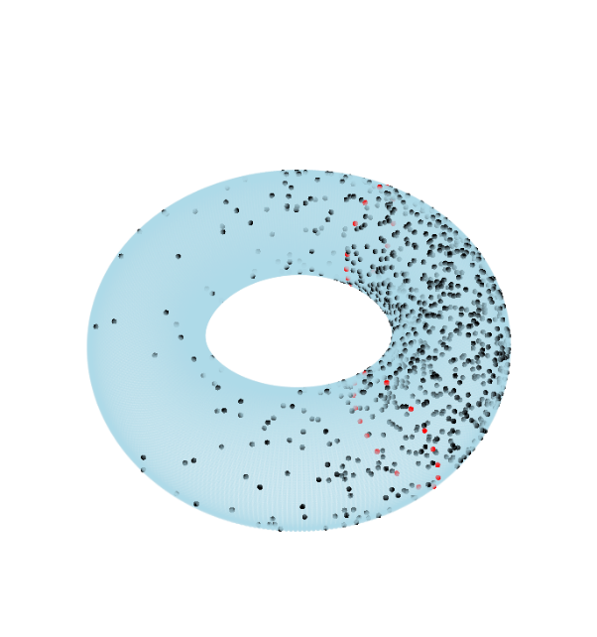
Torus Space Views
Toy Example in $T^{2}$
${\left[−π,π\right]}^{2}$ Square Representation
Donut Representation
Edges are Identified
Use Different Radii
To View Topology
Thanks to Eduardo García-Portugués

Slide 66
Torus PCA
Motivation:
“Sphere is most perfect geometric shape”
Eltzner, Huckemann & Mardia (2018)
Approach:
Deform Data to Sphere & Use PNS

Slide 67
Torus PCA
Eltzner, Huckemann & Mardia (2018)
Approach:
Deform Data to Sphere & Use PNS

Slide 68
Torus PCA
Eltzner, Huckemann & Mardia (2018)
Approach:
Deform Data to Sphere & Use PNS
Major Challenges:
Find A Good Cutpoint
Heavy Distortion
Approach: Specifically
Minimize Distortion

Slide 69
Multi-Dimensional Scaling
For Data Objects $𝓧_{1},⋯,𝓧_{n}$ in Metric Space,
Given a rank $r$:
Find Representers $w_{1},⋯,w_{n}∈ℝ^{r}$, Whose Distance Matrix “Best” Approximates $𝔇$
Typical Algorithms: Think of $w_{i}$ as
“PCA-like” Vectors of Scores
Note: This Representation Is
Called “Auto-Encoder” In AI literature

Slide 70
Multi-Dimensional Scaling
Ezra Miller Idea
(SAMSI Program on OODA):
For Strongly Non-Euclidean Data Space,
Embed Representers $w_{1},⋯,w_{n}$
In a Space with Less Distortion

Slide 71
Multi-Dimensional Scaling
For Data Objects $𝓧_{1},⋯,𝓧_{n}$ in Torus $T^{d}$
Find Representers $w_{1},⋯,w_{n}∈{C∙S}^{d}$, Whose Distance Matrix “Best” Approx’s $𝔇$,
Then Apply PNS
Also Optimize Over Tuning Parameter: $C$
(For $C$ Large, ${C∙S}^{d}≈ℝ^{d}$)

Slide 72
Scaled Torus PCA
Collaborators (Zoubouloglou et al. (2021)):
Pavlos Zoubouloglou
UNC, Statistics & OR
Eduardo García-Portugués
U. Carlos III, Madrid

Slide 73
Toy Example
Three Clusters in $T^{3}$:
MDS
PNS
1st Mode Captures 3 Clusters,
Much Better Than PCA
Inverse Image of 1st Mode

Slide 74
Participant Presentation
12:05 Taebin Kim: Stain Normalization
12:10 Sherry Shuxian Wang: Rreconstruction and modeling from colonoscopy video

