Slide 1
Statistics – O. R. 881 Object Oriented Data Analysis
Start
Recording
Steve Marron
Dept. of Statistics and Operations Research
University of North Carolina

Slide 2
Current Sections in Textbook
Today:
Section 8.6, 9.1
Next Class:
Section 9.2, 11.1

Slide 3
PCA for s-reps
PCA on manifold spaces?
(e.g. on Lie Groups / Symmetric Spaces)
T. Fletcher: Principal Geodesic Analysis
Idea: replace “linear summary of data”
With “geodesic summary of data”…

Slide 4
PCA Extensions for Data on Manifolds
Fletcher (Principal Geodesic Anal.)
Best fit of geodesic to data
Constrained to go through geodesic mean
Happens
Naturally
in $ℝ^{d}$
Mean
Contained
in Best
Fit Line

Slide 5
Challenge for Principal Geodesic Analysis
Data
On $S^{2}$
Geodesic
Mean(s)
Tangent Plane
Projections ($log$)
Requires 2
Modes of
Variation

Slide 6
PCA Extensions for Data on Manifolds
Fletcher (Principal Geodesic Anal.)
Best fit of geodesic to data
Constrained to go through geodesic mean
Huckemann, Hotz & Munk (Geod. PCA)
Best fit of any geodesic to data

Slide 7
PCA Extensions for Data on Manifolds
Fletcher (Principal Geodesic Anal.)
Best fit of geodesic to data
Constrained to go through geodesic mean
Huckemann, Hotz & Munk (Geod. PCA)
Best fit of any geodesic to data
Counterexample:
Data follows Tropic of Capricorn
Realizations of Spoke in
Blad.-Prost.-Rect. Simulator

Slide 8
Principal Nested Spheres
Move plane
To Minimize
$\sum_{i}{{resid}_{i}^{2}}$
Keep signed
${resid}_{i}$ as
PNS-$d$ scores
$$S^{d}$$
And Projections as Rank $d−1$ Approximations

Slide 9
Composite Principal Nested Spheres
From Pizer et al. (2017, 2020) Impact on Segmentation:
PGA Segmentation: used ~20 comp’s
CPNS Segmentation: only need ~13
Resulted in visually better fits to data
Recall Bladder-Prostate-Rectum Data

Slide 10
Extension to s-rep Space
Challenge: $S^{2}×S^{2}$ Polysphere Space
CPNS:
Gets 1-d Comps,
But Wrong
Dependence
(Strong Distortion)
Thanks to Sungkyu Jung

Slide 11
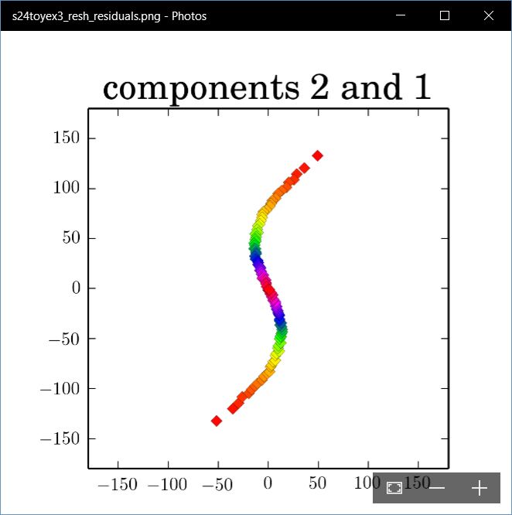
Polysphere PCA-type Analysis
Deeper New Methodology: PPCA
For Polysphere
~Toy Example
Pretty Good But
Still Some
Distortion
Thanks to B. Eltzner

Slide 12
Torus Spaces
Vectors of Angles as Data Objects
Natural Examples Include:
Structural Chemistry
(Sequences of Bond Angles)
Meteorology
(Wind Directions at Multiple Sites)
Astronomy
(Sunspots Moving Over Time)

Slide 13
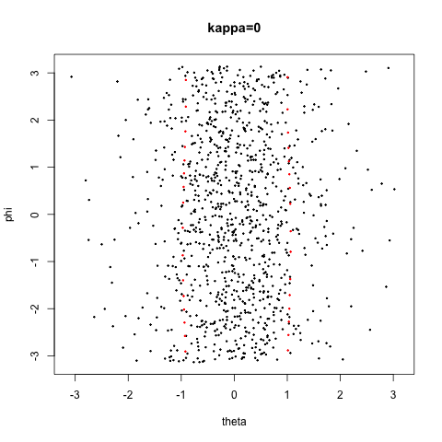
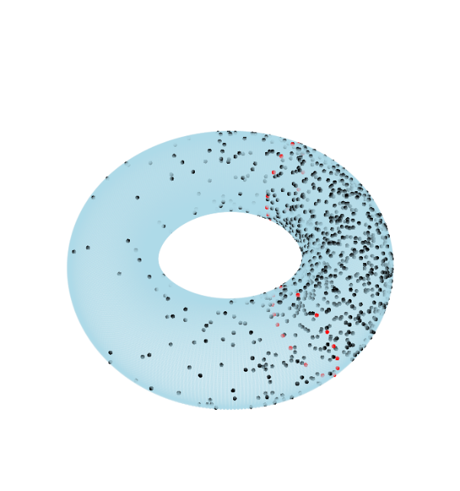
Torus Space Views
Toy Example in $T^{2}$
${\left[−π,π\right]}^{2}$ Square Representation
Donut Representation
Edges are Identified
Use Different Radii
To View Topology
Thanks to Eduardo García-Portugués

Slide 14
Torus PCA
Motivation:
“Sphere is most perfect geometric shape”
Eltzner, Huckemann & Mardia (2018)
Approach:
Deform Data to Sphere & Use PNS

Slide 15
Torus PCA
Eltzner, Huckemann & Mardia (2018)
Approach:
Deform Data to Sphere & Use PNS
Major Challenges:
Find A Good Cutpoint
Heavy Distortion
Approach: Specifically
Minimize Distortion

Slide 16
Multi-Dimensional Scaling
For Data Objects $𝓧_{1},⋯,𝓧_{n}$ in Metric Space,
Given a rank $r$:
Find Representers $w_{1},⋯,w_{n}∈ℝ^{r}$, Whose Distance Matrix “Best” Approximates $𝔇$
Typical Algorithms: Think of $w_{i}$ as
“PCA-like” Vectors of Scores
Note: This Representation Is
Called “Auto-Encoder” In AI literature

Slide 17
Multi-Dimensional Scaling
For Data Objects $𝓧_{1},⋯,𝓧_{n}$ in Torus $T^{d}$
Find Representers $w_{1},⋯,w_{n}∈{C∙S}^{d}$, Whose Distance Matrix “Best” Approx’s $𝔇$,
Then Apply PNS
Also Optimize Over Tuning Parameter: $C$
(For $C$ Large, ${C∙S}^{d}≈ℝ^{d}$)

Slide 18
Sunspots Data
Time Lagged Locations of Sunspots
Q: Linear
Relationship?
Recall Faces
Identified

Slide 19
Sunspots Data
TPCA Fit “Line”
TPCA Scores
Appears Clustered (Non-Linear)

Slide 20
Sunspots Data
STPCA Fit “Line”
STPCA Scores
Clearly Follows Line

Slide 21
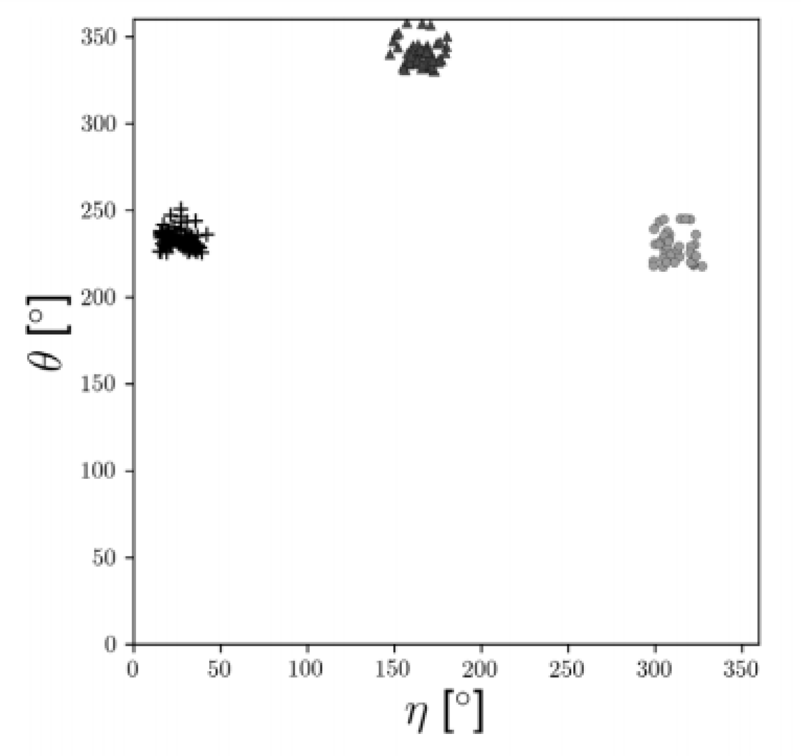
RNA Torsion Angle Data
Goal: Find Clusters Here,
Using Only 7 Other Angles, i.e. in $T^{7}$
Will Show
These Labels
As Colors
In PCAs

Slide 22
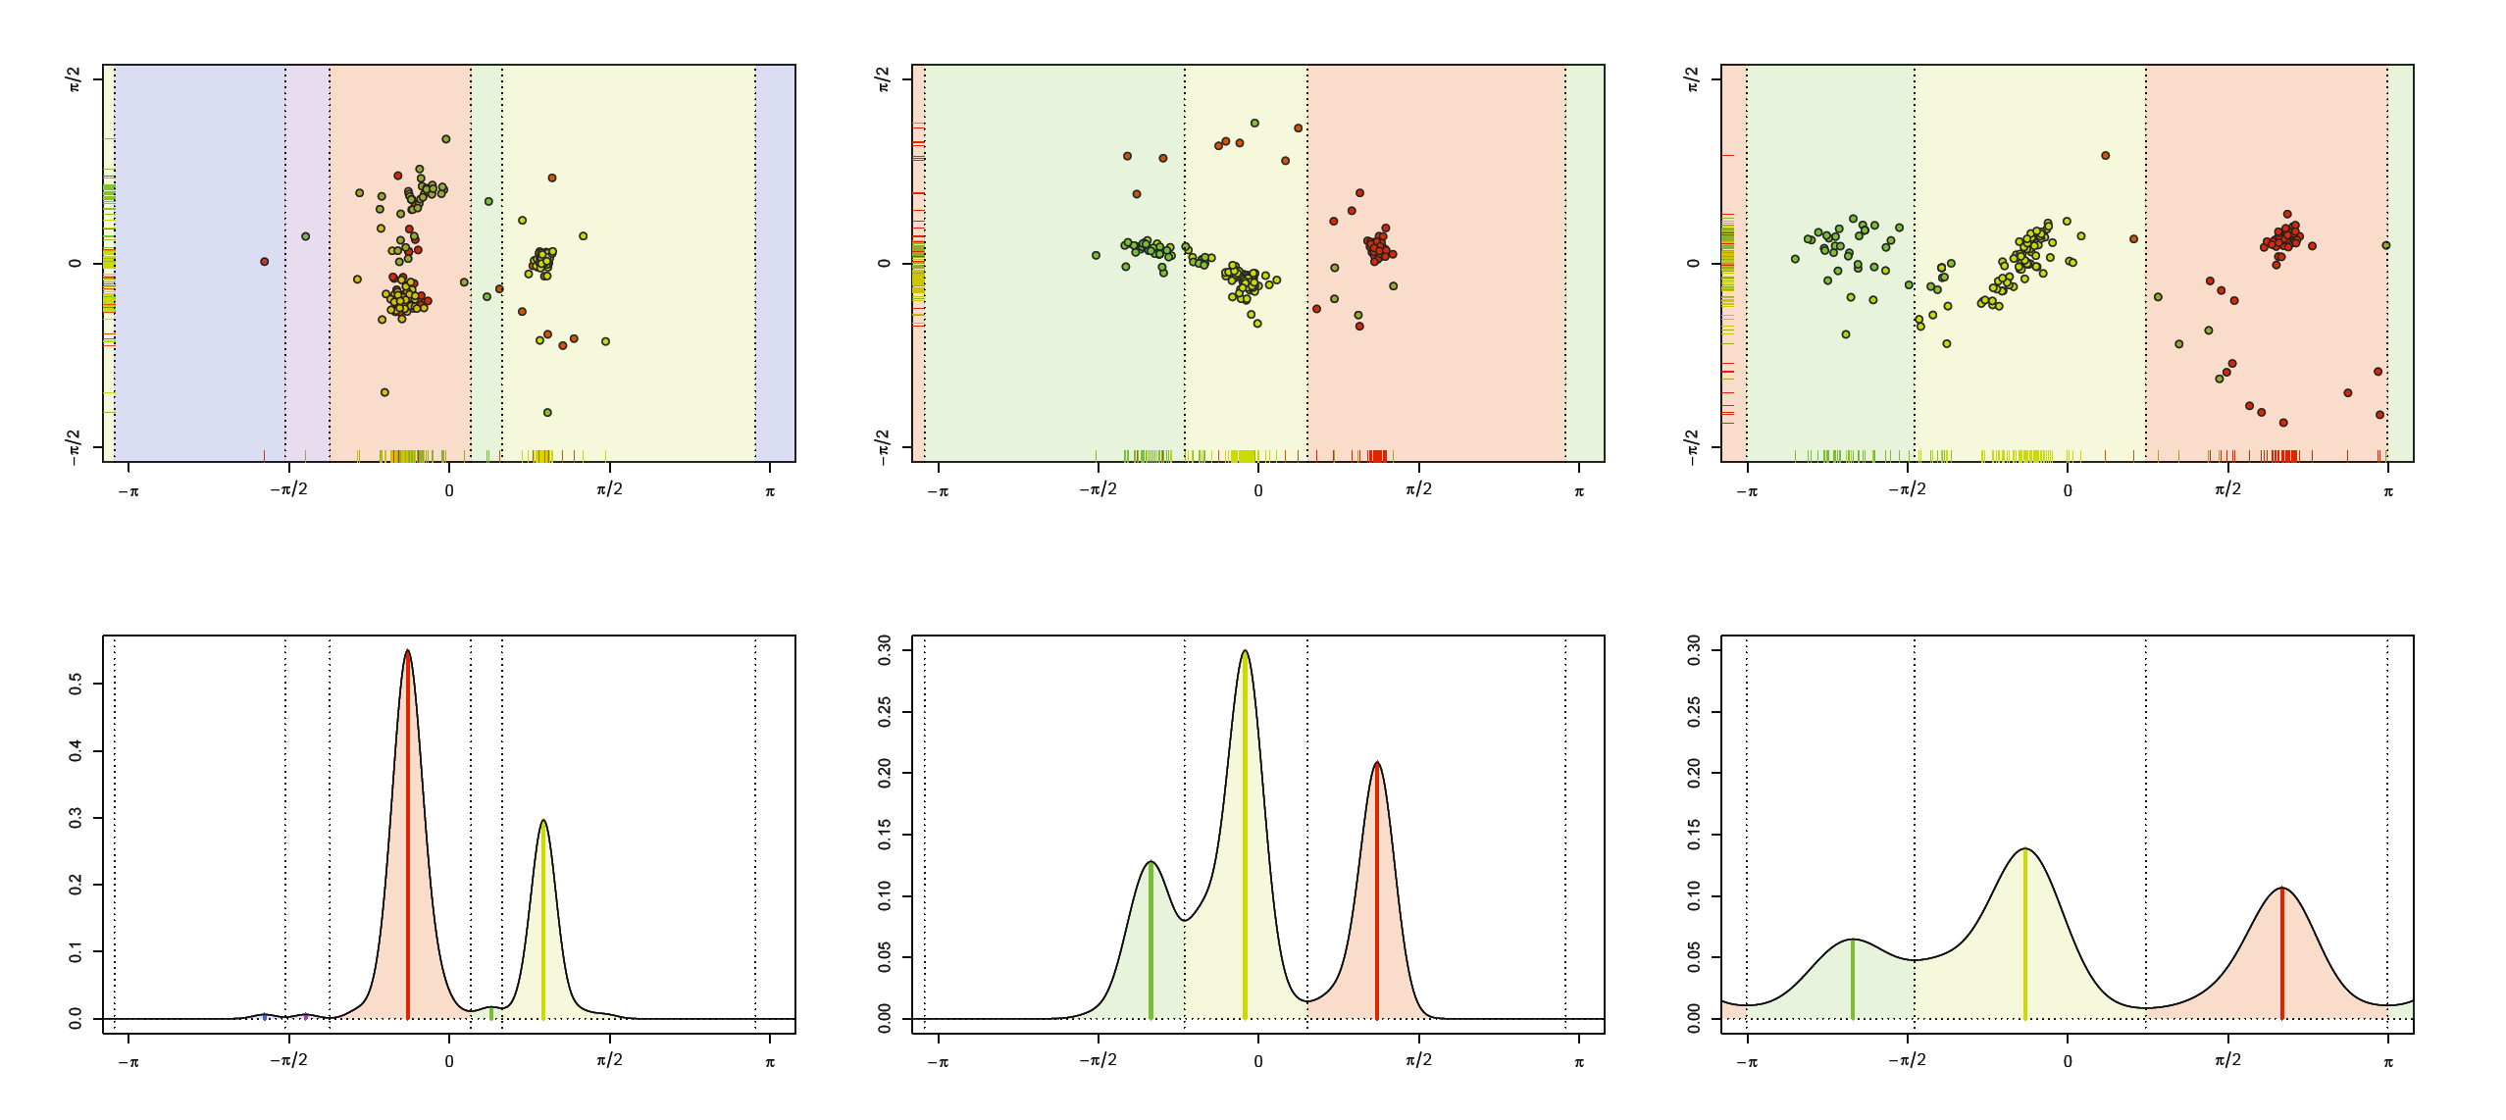
RNA Torsion Angle Data
Goal: Find Labelled Clusters in $T^{7}$
STPCA Tends to Put
Clusters into 1st PC
TPCA-1 Scores
TPCA-2 Scores
STPCA Scores
PC1 - KDE Based Clustering
Much Better
Correspondence
of Target Labels

Slide 23
Principal Nested Spheres
Main Goal:
Extend Principal Arc Analysis ($S^{2}$ to $S^{k}$)
Jung et al (2012)
Important Landmark:
This Motivated Backwards PCA

Slide 24
Backwards PCA
Text: Sec. 8.6
Key Idea:
Replace usual forwards view of PCA
With a backwards approach to PCA

Slide 25
Terminology
Multiple linear regression:
Stepwise approaches:
Forwards: Start small, iteratively add variables to model
Backwards: Start with all, iteratively remove variables from model

Slide 26
Illust’n of PCA View: Recall Raw Data
Notes:
EgView1p1RawData.ps

Slide 27
Illust’n of PCA View: PC1 Projections
Notes:
EgView1p51proj3dPC1.ps

Slide 28
Illust’n of PCA View: PC2 Projections
Notes:
EgView1p52proj3dPC2.ps

Slide 29
Illust’n of PCA View: Projections on PC1,2 plane
Notes:
EgView1p54proj3dPC12.ps

Slide 30
Backwards PCA
Replace usual forwards view of PCA
Data → PC1 (1 dim approx)
→ PC2 (1 dim approx of Data-PC1)
→ PC1 U PC2 (2 dim approx)
$⋱$
→ PC1 U … U PCr
(r dim approx)

Slide 31
Backwards PCA
With a backwards approach to PCA
Data → PC1 U … U PCr (r dim approx)
→ PC1 U … U PC(r-1)
$⋱$
→ PC1 U PC2 (2 dim approx)
→ PC1 (1 dim approx)

Slide 32
Backwards PCA
Euclidean Settings:
Forwards PCA = Backwards PCA
(Pythagorean Theorem,
ANOVA Decomposition)
So Not Interesting
But Very Different in Non-Euclidean Settings
(Backwards is Better !?!)

Slide 33
Backwards PCA
Important Property of PCA:
Nested Series of Approximations
$$\left\{{PC}_{1}\right\}⊆\left\{{PC}_{1}{,PC}_{2}\right\}⊆\left\{{PC}_{1}{,PC}_{2},{PC}_{3}\right\}⊆⋯$$
(Often taken for granted)
(Desirable in Non-Euclidean Settings)

Slide 34
Backwards PCA
Desirability of Nesting:
Multi-Scale Analysis Makes Sense
Scores Visualization Makes Sense
Since Scores = Residuals
at Each Stage

Slide 35
An Interesting Question
How generally applicable is
Backwards approach to PCA?
Discussion:
Jung et al (2010)
Pizer et al (2013)

Slide 36
An Interesting Question
How generally applicable is
Backwards approach to PCA?
Anywhere this is already being done???

Slide 37
An Interesting Question
How generally applicable is
Backwards approach to PCA?
An Application:
Nonnegative Matrix Factorization
= PCA in Positive Orthant
Think $X ≈LS$
With ≥ 0 Constraints (on both $L$ & $S$)

Slide 38
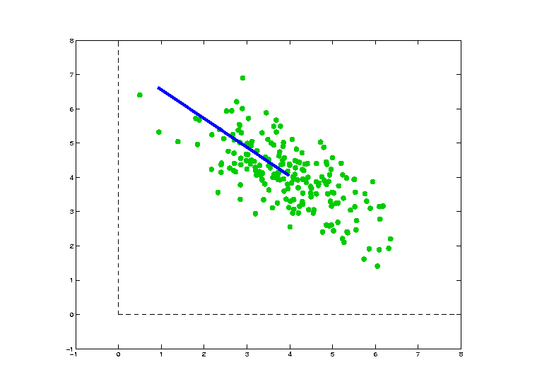
Nonnegative Matrix Factorization
Isn’t This
Just PCA?
In the
Nonnegative
Orthant?
No, Most PC Directions Leave Orthant

Slide 39
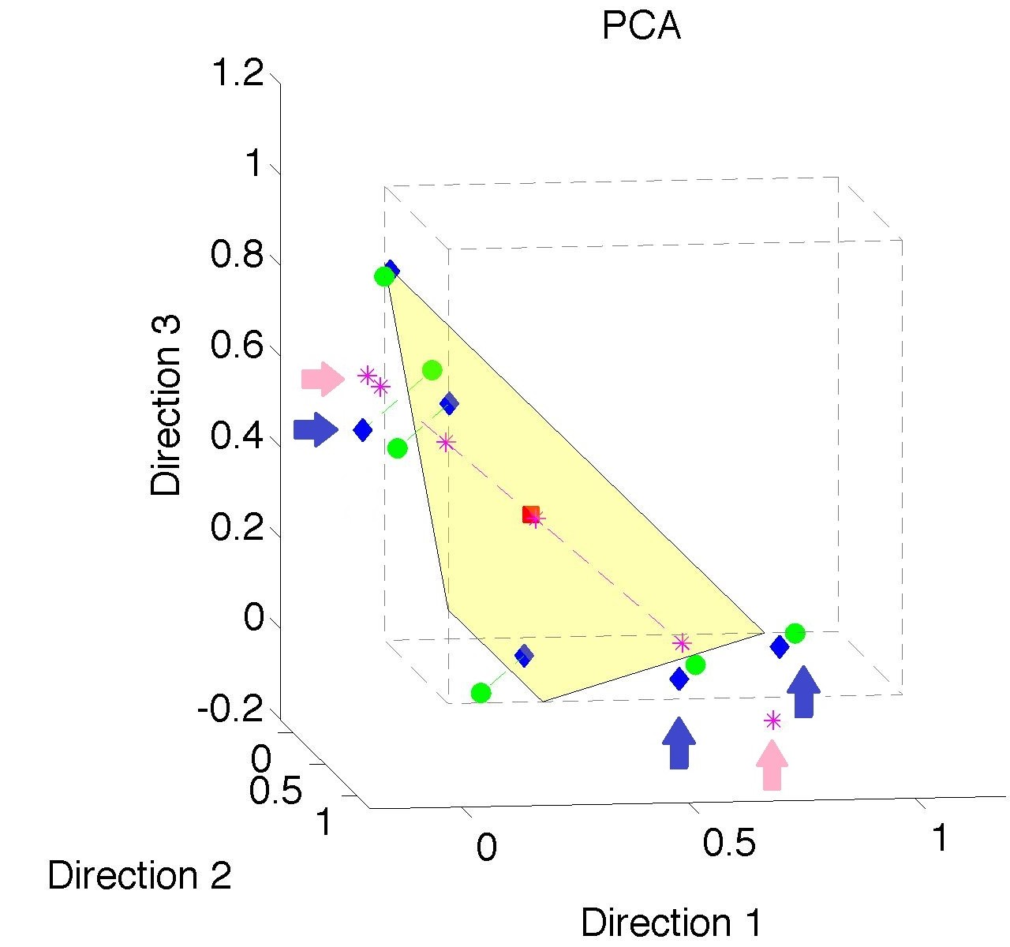
Nonnegative Matrix Factorization
Isn’t This
Just PCA?
Data
(Near
Orthant
Faces)
Thanks to Lingsong Zhang

Slide 40
Nonnegative Matrix Factorization
Isn’t This
Just PCA?
Data
Mean
(Centered
Analysis)

Slide 41
Nonnegative Matrix Factorization
Isn’t This
Just PCA?
Data
Mean
PC1 Projections
Leave Orthant!

Slide 42
Nonnegative Matrix Factorization
Isn’t This
Just PCA?
Data
Mean
PC1 Projections
PC1 $⋃$ 2 Proj’ns
Leave Orthant!

Slide 43
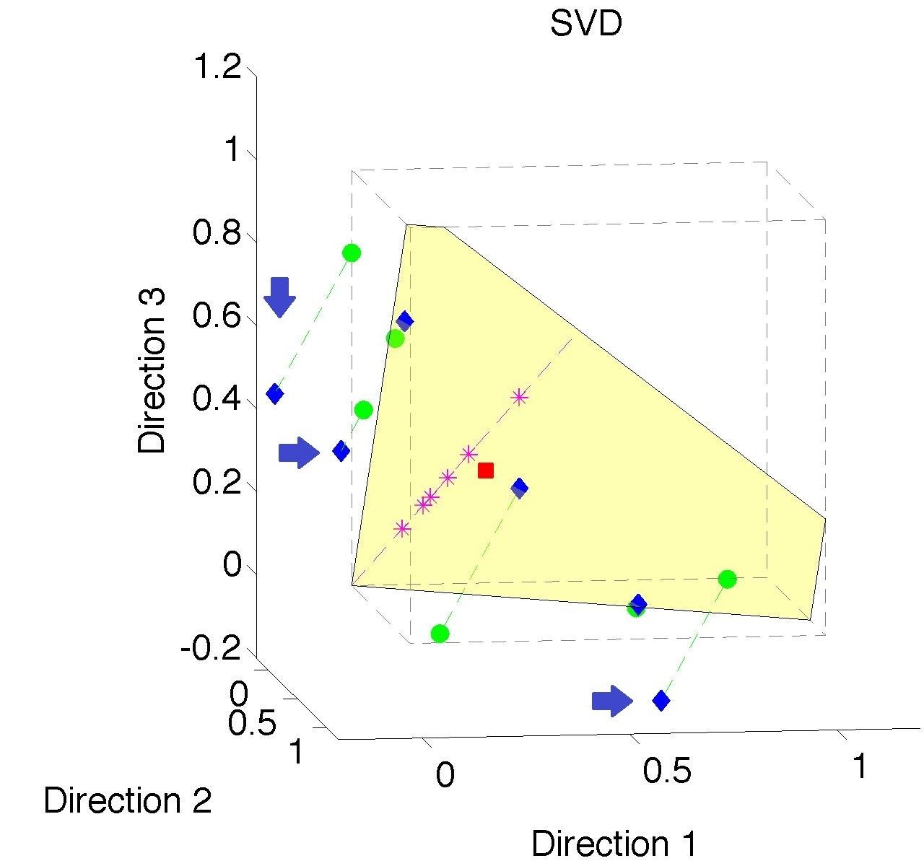
Nonnegative Matrix Factorization
Note:
Problem not
Fixed by
SVD
(“Uncentered
PCA”)
Orthant Leaving Gets Worse

Slide 44
Nonnegative Matrix Factorization
Standard Approach:
Lee & Seung (1999):
Formulate & Solve Optimization
Major Challenge:
Not Nested, ($k=3 ≉ k=4$)

Slide 45
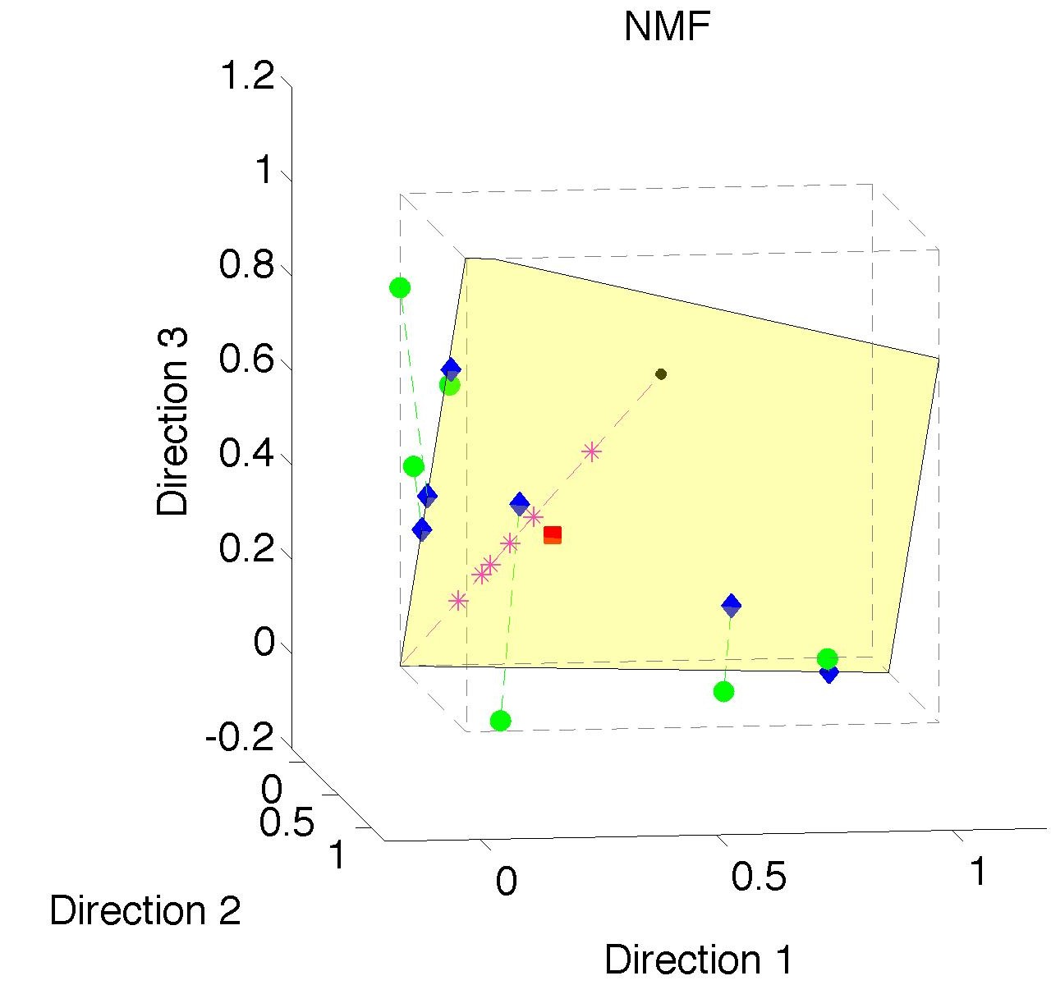
Nonnegative Matrix Factorization
Standard NMF
(Projections
All Inside
Orthant)

Slide 46
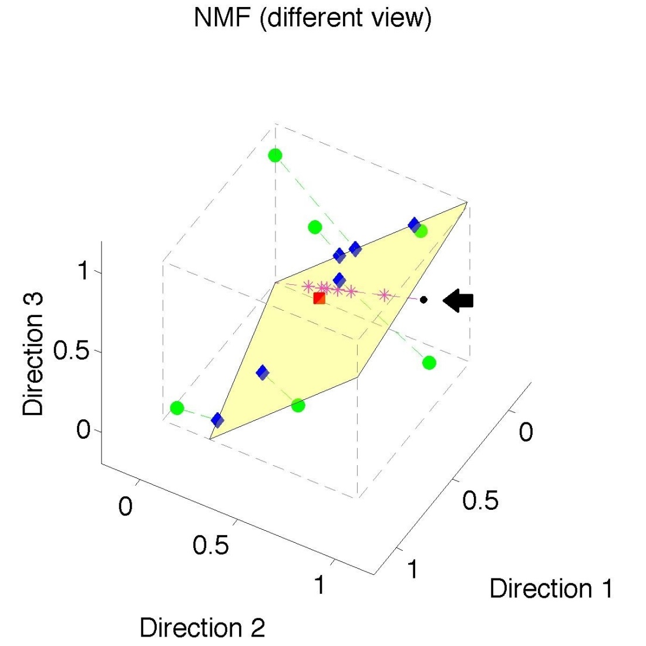
Nonnegative Matrix Factorization
Standard NMF
But Note
Not Nested
No “Multi-scale”
Analysis Possible
(Scores Plot?!?)

Slide 47
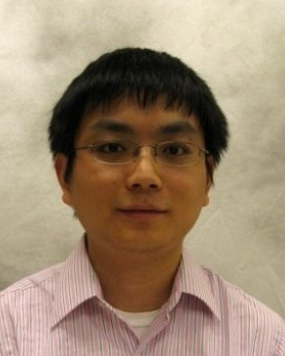
Nonnegative Matrix Factorization
Improved Version:
Use Backwards PCA Idea
“Nonnegative Nested Cone Analysis”
Collaborator:
Lingsong Zhang (Purdue)
Zhang, Lu, Marron (2015)

Slide 48
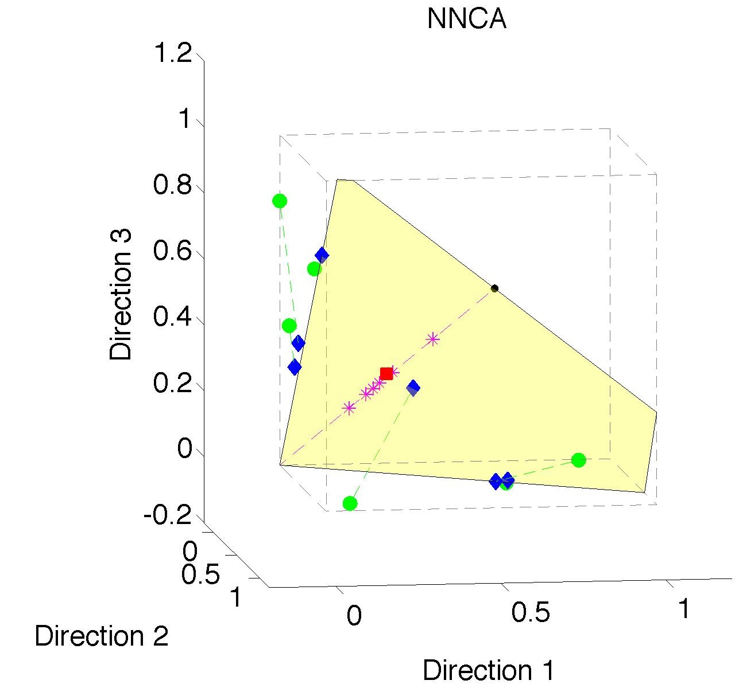
Nonnegative Nested Cone Analysis
Same Toy
Data Set
All
Projections
In Orthant

Slide 49
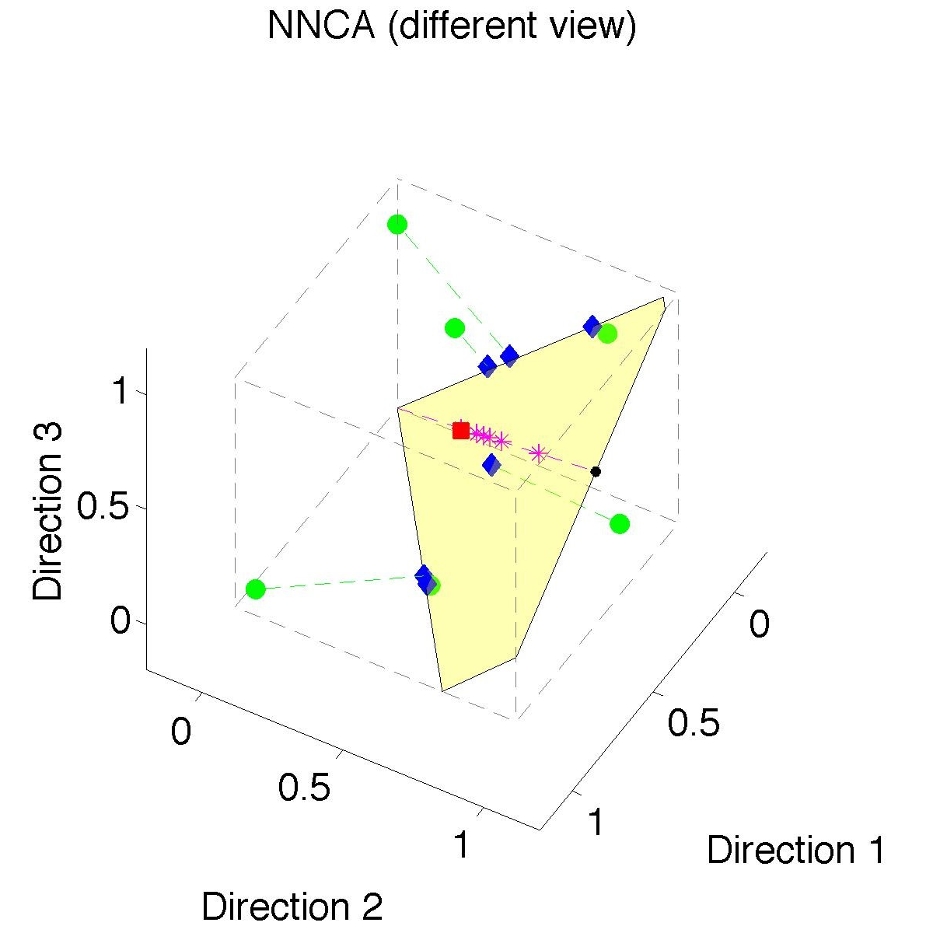
Nonnegative Nested Cone Analysis
Same Toy
Data Set
Rank 1
Approx.
Properly
Nested

Slide 50
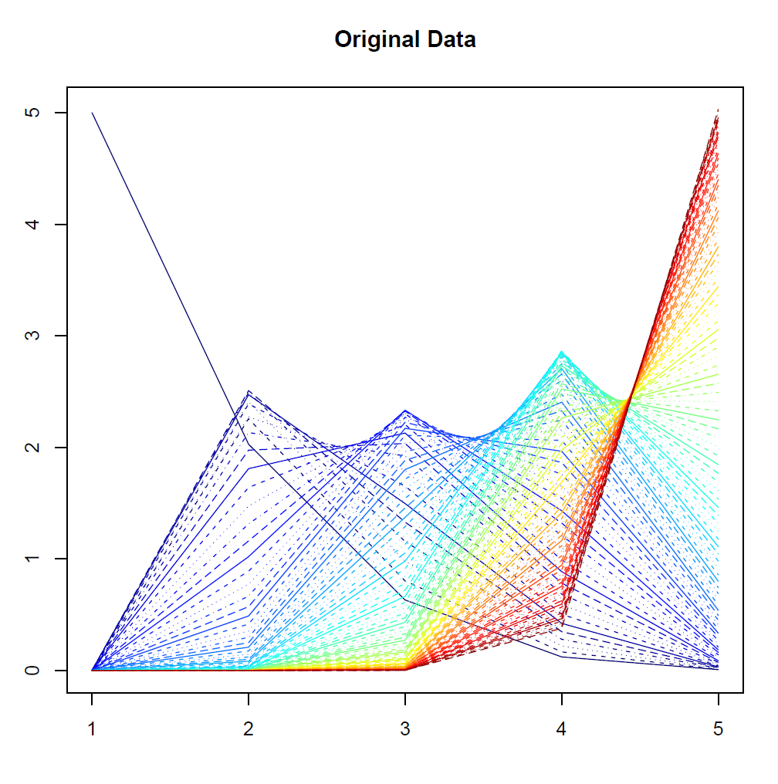
Nonnegative Nested Cone Analysis
5-d Toy
Example
(Rainbow
Colored
by Peak
Order)

Slide 51
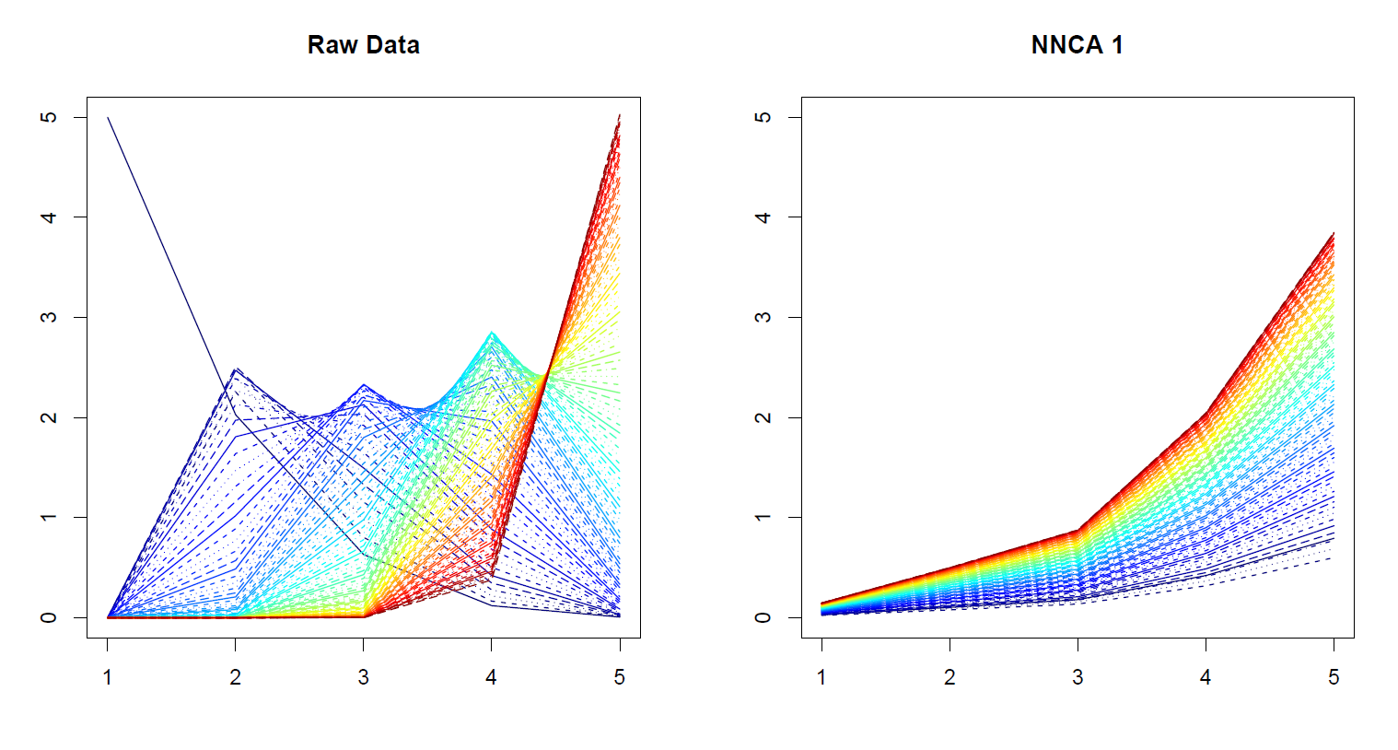
Nonnegative Nested Cone Analysis
5-d Toy Example Rank 1 NNCA Approx.

Slide 52
Nonnegative Nested Cone Analysis
5-d Toy Example Rank 2 NNCA Approx.

Slide 53
Nonnegative Nested Cone Analysis
5-d Toy Example Rank 2 NNCA Approx.
Nonneg.
Basis
Elements
(Not Trivial)

Slide 54
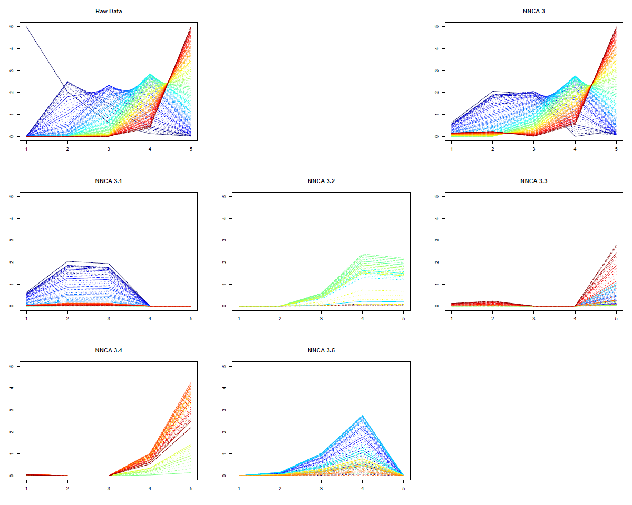
Nonnegative Nested Cone Analysis
5-d Toy Example Rank 3 NNCA Approx.
Current
Research:
How Many
Nonneg.
Basis El’ts
Needed?

Slide 55
An Interesting Question
How generally applicable is
Backwards approach to PCA?
Potential Application: Principal Curves
Hastie & Stuetzle, (1989)
(Foundation of Manifold Learning)

Slide 56
Manifold Learning
Goal: Find lower dimensional manifold that well approximates (high-dimensional) data
ISOmap
Tenenbaum, et al (2000)
Local Linear Embedding
Roweis & Saul (2000)

Slide 57
Manifold Learning
Tenenbaum, et al (2000)
Canonical Example:
Photographs (2-d) of Statue (3-d)
Different Viewpoints
Different Light Source Locations
Digitization of Photos is “Low-Dimensional”
But Not in a Subspace (Findable by PCA)
In a manifold (curved
surface) sense

Slide 58
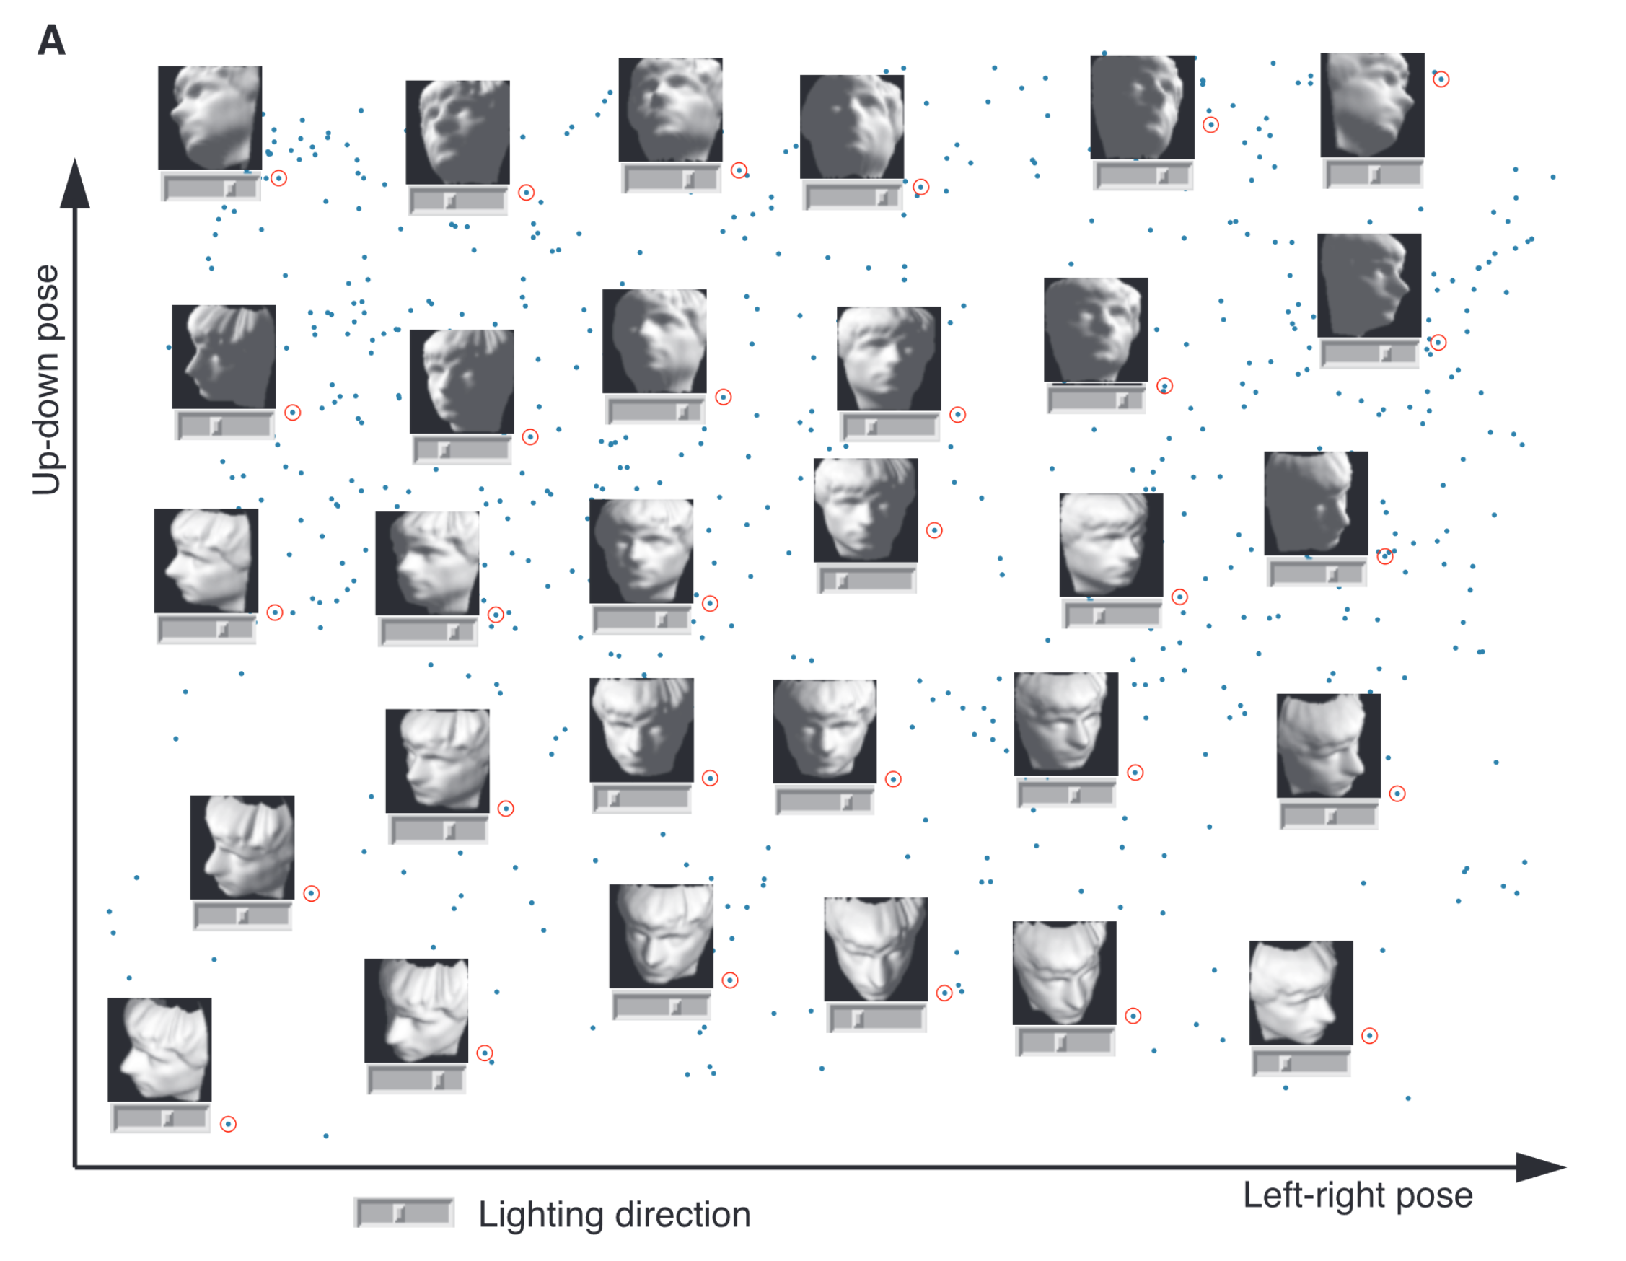
Manifold Learning
Tenenbaum, et al (2000)
Reveals
Two
Interesting
Modes Of
Variation

Slide 59
1st Principal Curve
Linear Reg’n
Usual Smooth

Slide 60
1st Principal Curve
Linear Reg’n
Proj’s Reg’n
Usual Smooth

Slide 61
1st Principal Curve
Linear Reg’n
Proj’s Reg’n
Usual Smooth
Princ’l Curve

Slide 62
Manifold Learning
How generally applicable is
Backwards approach to PCA?
Potential Application: Principal Curves
Perceived Major Challenge:
How to find 2nd Principal Curve?

Slide 63
Manifold Learning
Key Component:
Principal Surfaces
LeBlanc & Tibshirani (1996)
Challenge:
Can have any dimensional surface,
But how to nest???
Proposal: Backwards Approach

Slide 64
An Interesting Question
How generally applicable is
Backwards approach to PCA?
Another Application:
HDLSS Robust PCA
L¹ Backwards PCA:
Brooks, Dulá, Boone (2013)

Slide 65
Participant Presentation
12:05 SooHyun Kim:
Reading the Stars of Online Reviews: A Look into the Boundary Conditions of Helpfulness
12:10 Sam Ehrenstein:
Non-Contrast Ultrasound Imaging of Blood Microvessels using SVD

