Slide 1
Statistics – O. R. 881 Object Oriented Data Analysis
Start
Recording
Steve Marron
Dept. of Statistics and Operations Research
University of North Carolina

Slide 2
Current Sections in Textbook
Today:
Section 8.6, 8.7, 9.1
Next Class:
Section 9.2, 11.1

Slide 3
Principal Nested Spheres
Main Goal:
Extend Principal Arc Analysis ($S^{2}$ to $S^{k}$)
Jung et al (2012)
Important Landmark:
This Motivated Backwards PCA

Slide 4
Backwards PCA
Text: Sec. 8.6
Key Idea:
Replace usual forwards view of PCA
With a backwards approach to PCA

Slide 5
Backwards PCA
Euclidean Settings:
Forwards PCA = Backwards PCA
(Pythagorean Theorem,
ANOVA Decomposition)
So Not Interesting
But Very Different in Non-Euclidean Settings
(Backwards is Better !?!)

Slide 6
An Interesting Question
How generally applicable is
Backwards approach to PCA?
An Application:
Nonnegative Matrix Factorization
= PCA in Positive Orthant
Think $X ≈LS$
With ≥ 0 Constraints (on both $L$ & $S$)

Slide 7
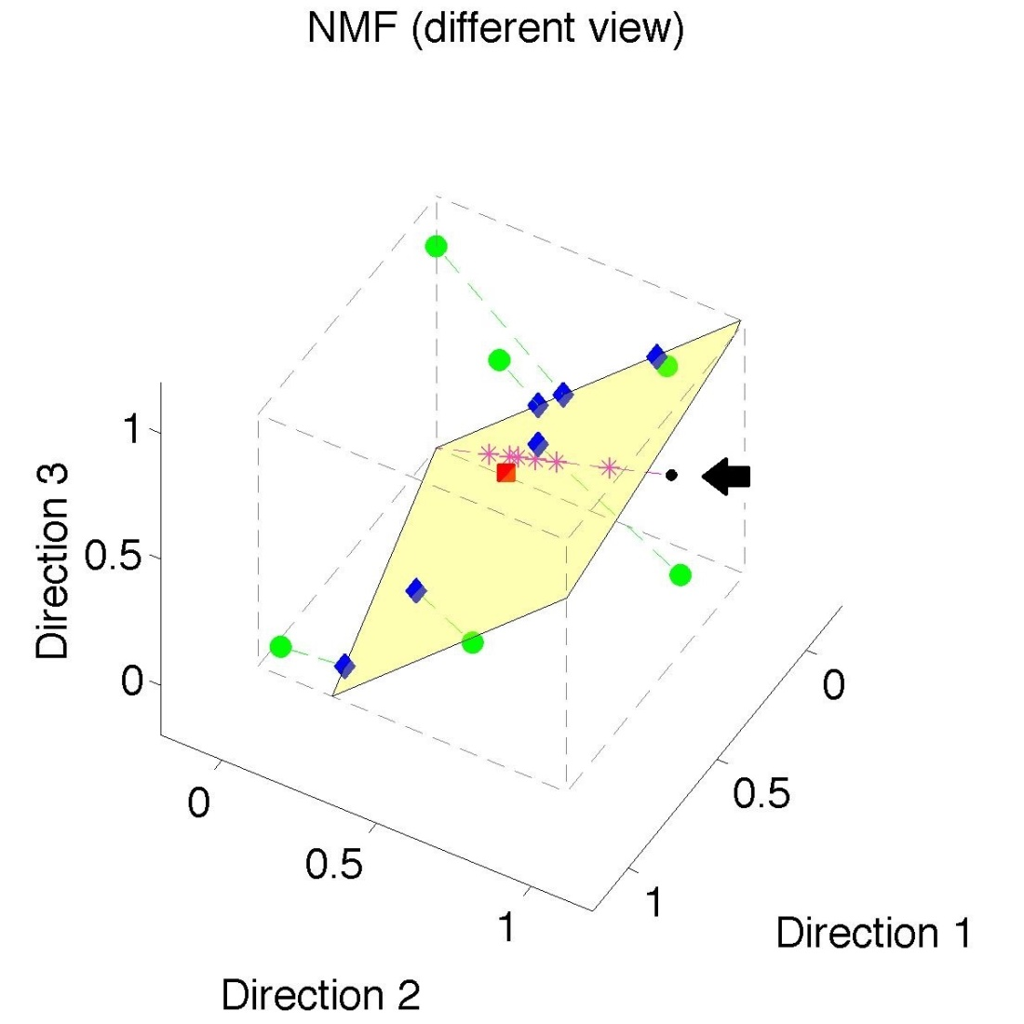
Nonnegative Matrix Factorization
Standard NMF
But Note
Not Nested
No “Multi-scale”
Analysis Possible
(Scores Plot?!?)

Slide 8
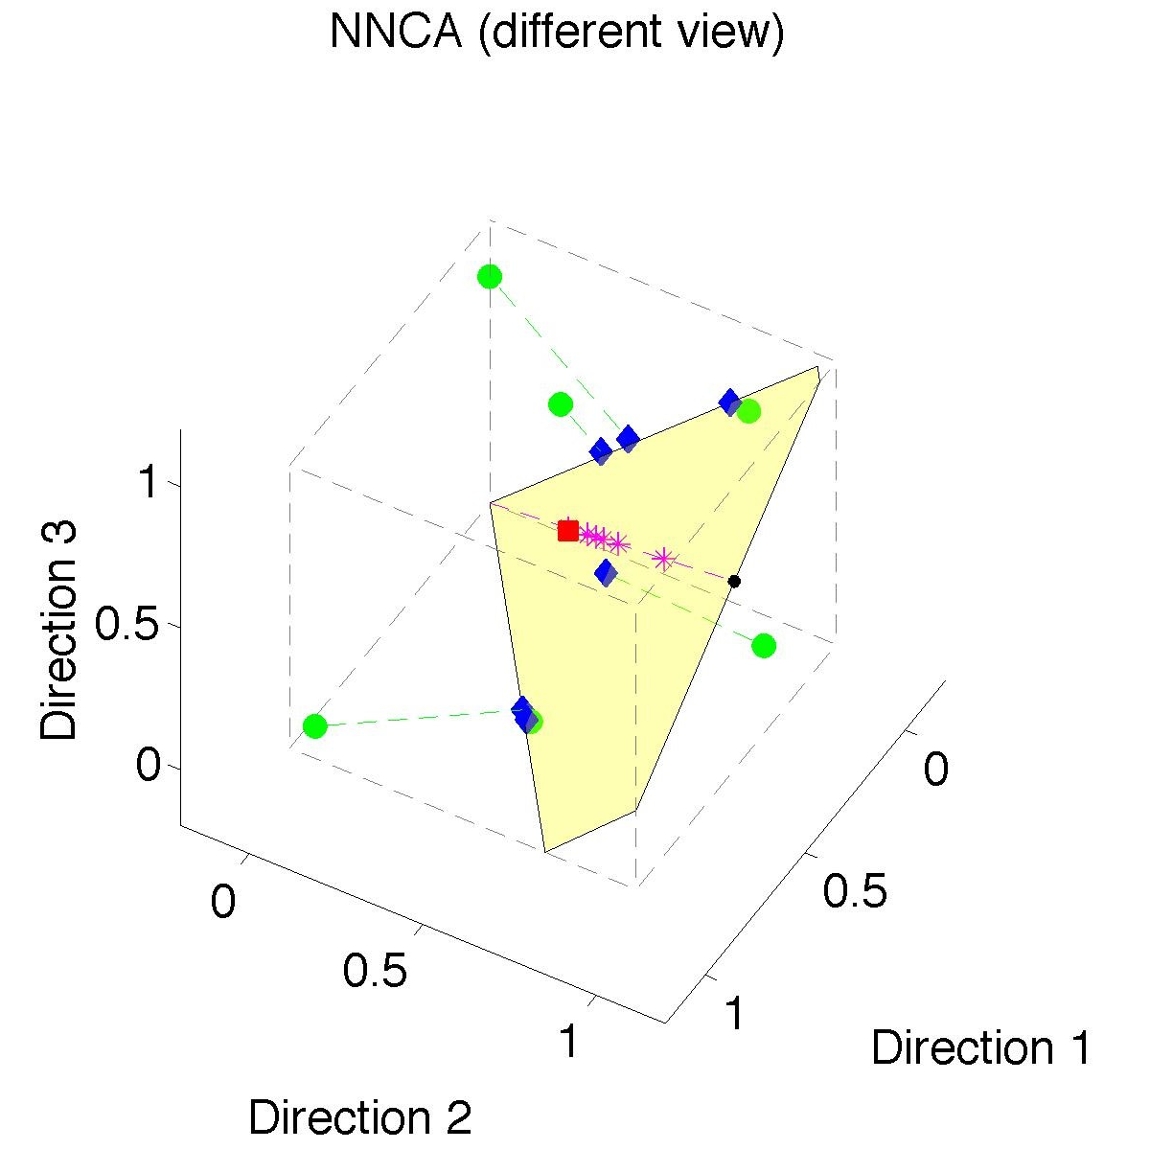
Nonnegative Nested Cone Analysis
Same Toy
Data Set
Rank 1
Approx.
Properly
Nested

Slide 9
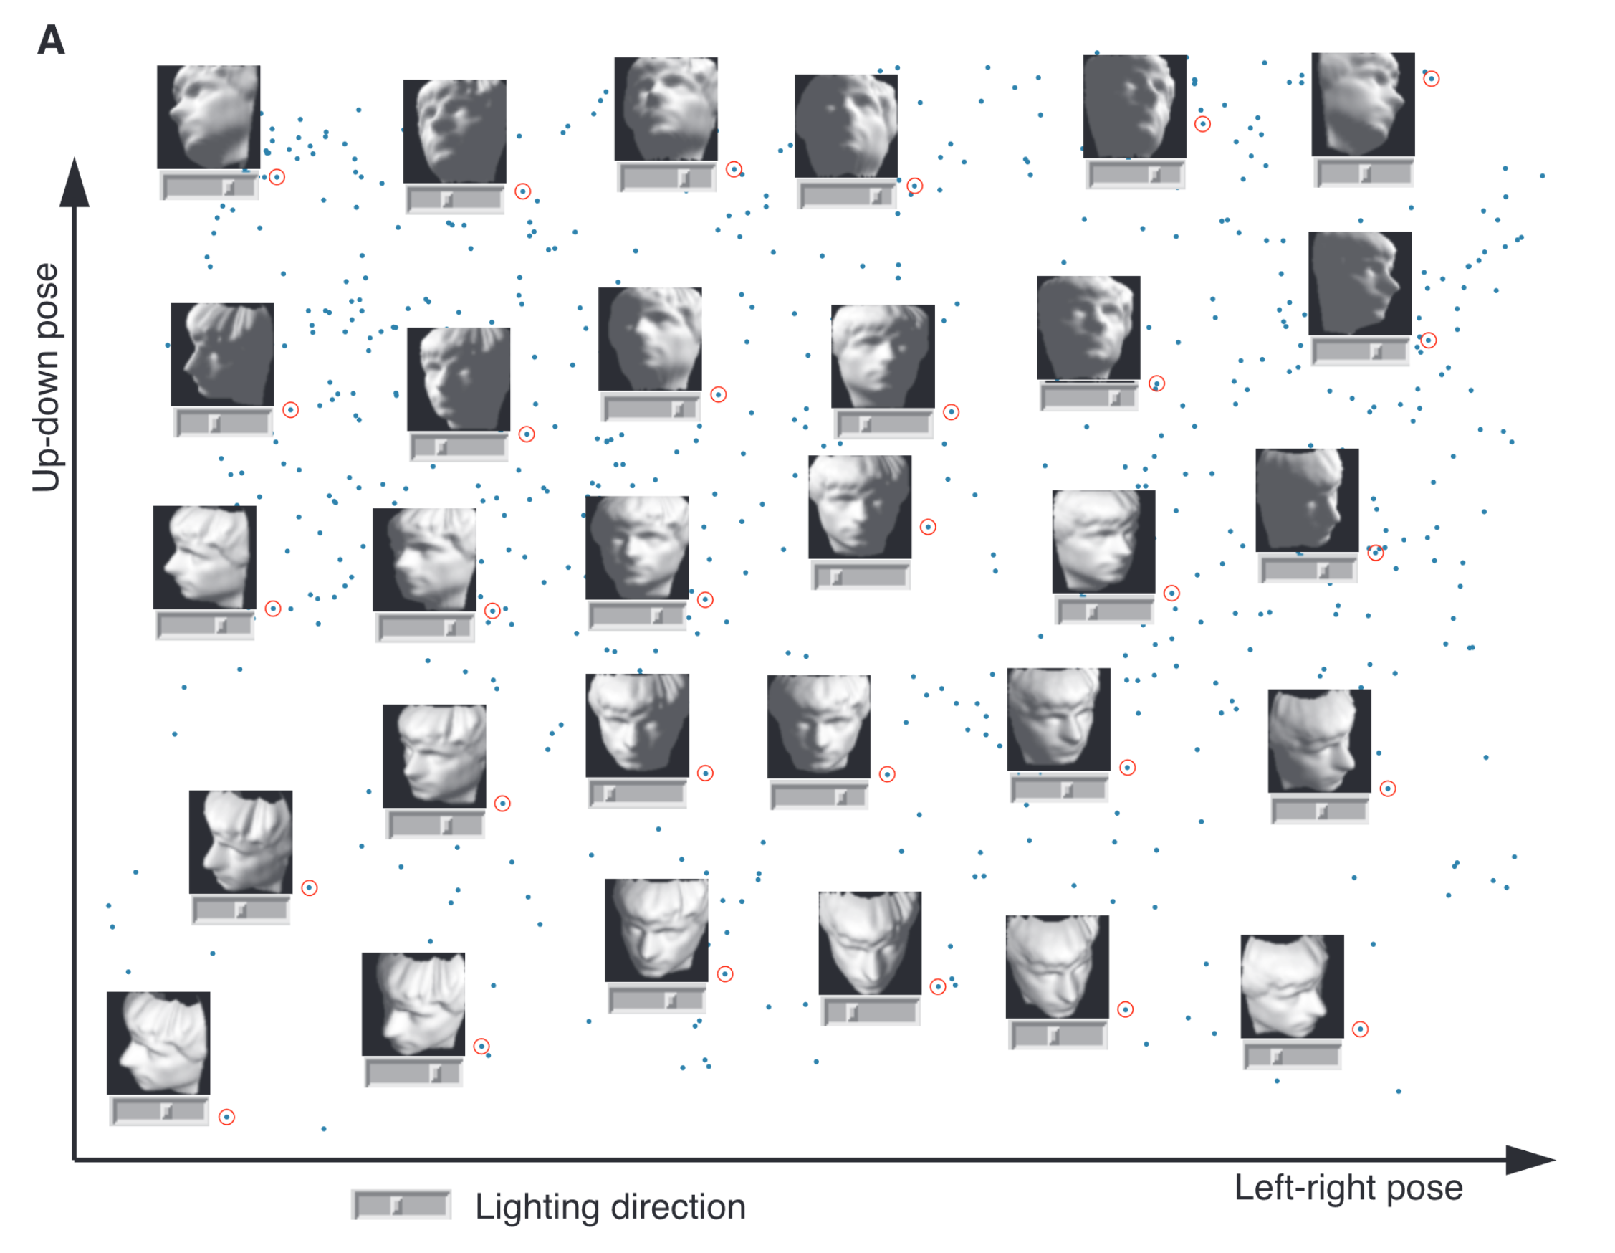
Manifold Learning
Tenenbaum, et al (2000)
Reveals
Two
Interesting
Modes Of
Variation

Slide 10
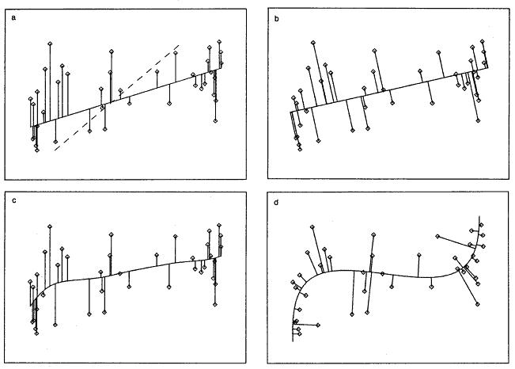
1st Principal Curve
Linear Reg’n
Proj’s Reg’n
Usual Smooth
Princ’l Curve

Slide 11
Manifold Learning
Key Component:
Principal Surfaces
LeBlanc & Tibshirani (1996)
Challenge:
Can have any dimensional surface,
But how to nest???
Proposal: Backwards Approach

Slide 12
An Interesting Observation
In non-Euclidean cases,
Backwards PCA seems easier?
Why is that?
E.g. PNS, NNCA

Slide 13
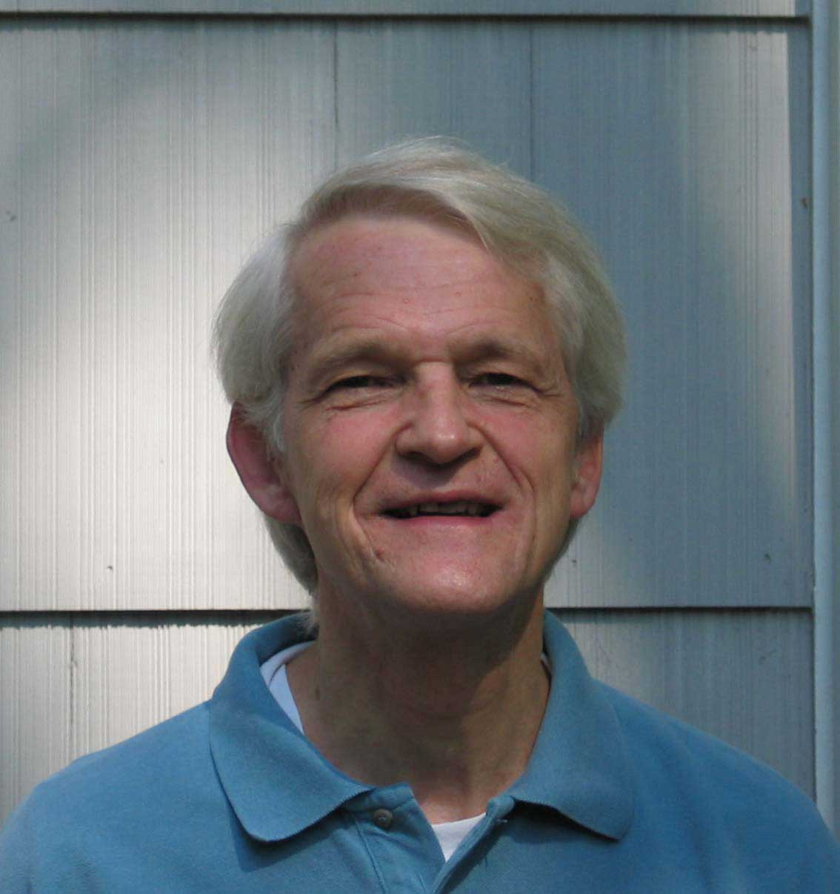
An Interesting Question
Why does backwards PC seem easier?
An Attractive Answer:
James Damon, UNC Mathematics
Geometry
Singularity
Theory

Slide 14
An Interesting Question
Why does backwards PC seem easier?
An Attractive Answer:
James Damon, UNC Mathematics
Damon and Marron (2014)

Slide 15
An Interesting Question
Why does backwards PC seem easier?
An Attractive Answer:
James Damon, UNC Mathematics
Key Idea: Express Backwards PCA as
Nested Series of Constraints

Slide 16
General View of Backwards PCA
Define Nested Spaces via Constraints
Satisfying More Constraints $⇒$
$⇒$ Smaller Subspaces

Slide 17
General View of Backwards PCA
Define Nested Spaces via Constraints
E.g. SVD
(Singular Value Decomposition =
= Not Mean Centered PCA)
(notationally very clean)

Slide 18
General View of Backwards PCA
Define Nested Spaces via Constraints
E.g. SVD
Have Nested Subspaces:
$$S_{1}⊆S_{2}⊆⋯⊆S_{d}$$

Slide 19
General View of Backwards PCA
Define Nested Spaces via Constraints
E.g. SVD $S_{k}=\left\{x :x=\sum_{j=1}^{k}{c_{j}u_{j}}\right\}$
$k$-th SVD Subspace
Scores
Loading Vectors (Basis Elements)

Slide 20
General View of Backwards PCA
Define Nested Spaces via Constraints
E.g. SVD $S_{k}=\left\{x :x=\sum_{j=1}^{k}{c_{j}u_{j}}\right\}$
Now Define:
$$S_{k−1}=\left\{x∈S_{k} :\left\langle x,u_{k}\right\rangle =0\right\}$$
Constraint Gives Nested Reduction of Dim’n

Slide 21
General View of Backwards PCA
Define Nested Spaces via Constraints
Backwards PCA
Reduce Using Affine Constraints

Slide 22
General View of Backwards PCA
Define Nested Spaces via Constraints
Backwards PCA
Principal Nested Spheres
Use Affine Constraints (Planar Slices)
In Ambient Space

Slide 23
General View of Backwards PCA
Define Nested Spaces via Constraints
Backwards PCA
Principal Nested Spheres
Principal Surfaces
Spline Constraint Within Previous?
{Been Done Already???}

Slide 24
General View of Backwards PCA
Define Nested Spaces via Constraints
Backwards PCA
Principal Nested Spheres
Principal Surfaces
Other Manifold Data Spaces
Sub-Manifold Constraints??
(Algebraic Geometry)

Slide 25
Covariance Matrices as Data Objects
Motivation: Diffusion Tensor Imaging (DTI)
Variation on Magnetic Resonance Imaging
Major Goal: Map Brain Connectivity
By Finding “Fibers”
Text: Sec 8.7
Basser et al. (1994)

Slide 26
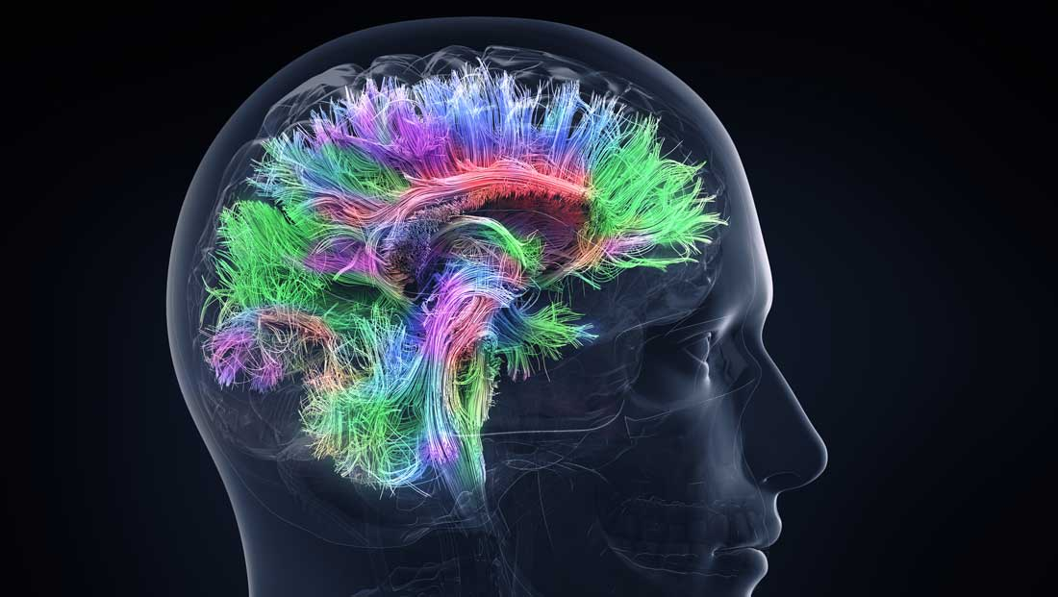
Covariance Matrices as Data Objects
Map Connectivity with Fiber Tracking
Thanks to DANA.ORG

Slide 27
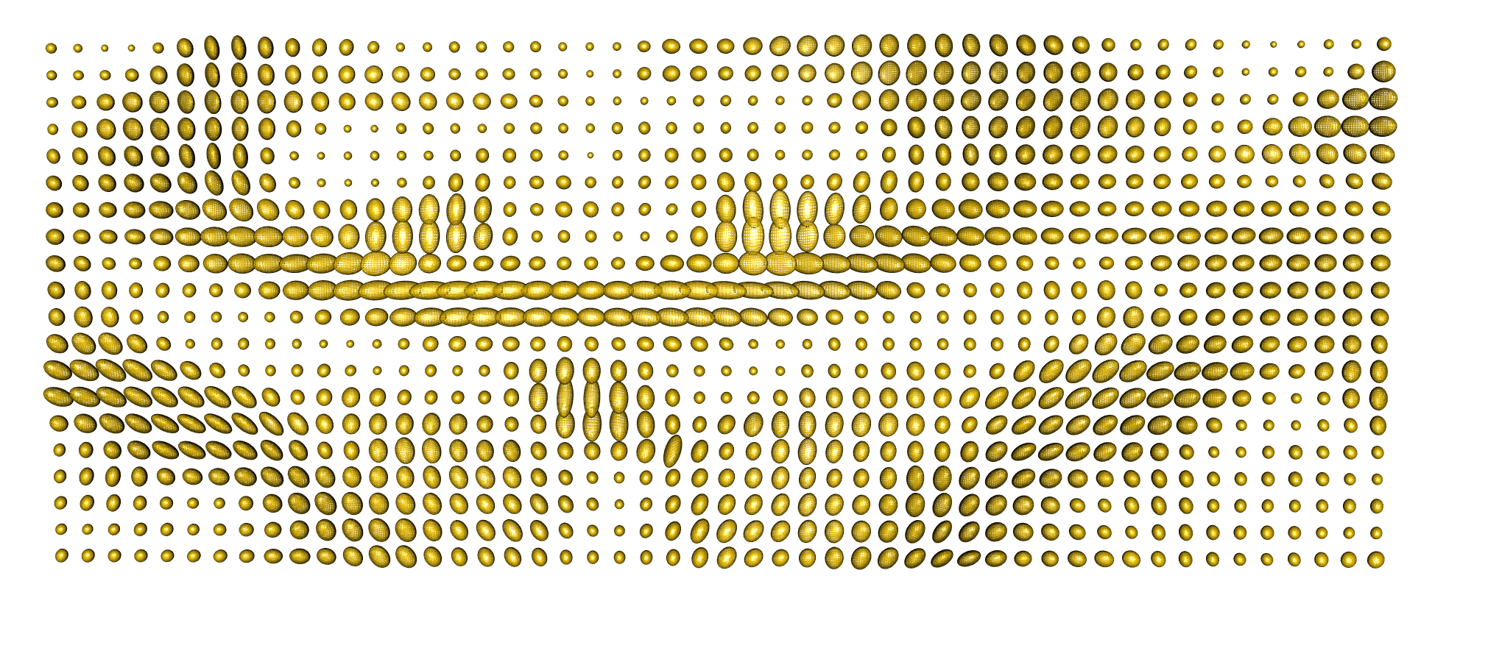
Covariance Matrices as Data Objects
DTI Approach: At 3-d “voxel grid”
Study Variation of Local Water Motion
Expressed as Covariance Matrices
One Slice, from One Person’s Brain

Slide 28
Covariance Matrices as Data Objects
Variation Expressed as Covariance Matrices
Low Variation $≈$ Solid Region
Spherical $≈$ Pure Fluid
Stretched $≈$ Fiber
One Slice, from One Person’s Brain

Slide 29
Covariance Matrices as Data Objects
Variation Expressed as Covariance Matrices
Key to Analysis: Eigen Analysis
Solid: $λ_{1}$, $λ_{2}, λ_{3}$ Small
Fiber: $λ_{1}≫$ $λ_{2}, λ_{3}$ (eigenvector → direct’n)
Pure Fluid (CSF): $λ_{1}≈$ $λ_{2}≈λ_{3}$ Large
Map Connectivity with Fiber Tracking

Slide 30
Covariance Matrices as Data Objects
Text: Sec 7.3.5
Important Point: Choice of Metric Matters
Geodesic from this fiber
To this fiber
For Interpolation of Fibers Want “Straight Line Path” (Geodesic)
Geodesic With Respect to Euclidean Distance = Frobenius Norm
Leaves Space of Fibers in a Strong Way
Clearly Need a
Better Metric

Slide 31
Covariance Matrices as Data Objects
Important Point: Choice of Metric Matters
Even Wildly Different Paths!

Slide 32
Covariance Matrices as Data Objects
Note on Metrics:
Each Induces a Manifold Structure
On the Set of Full Rank Covariance Matrices
Each Lower Rank also as a Manifold

Slide 33
Covariance Matrices as Data Objects
Full Set of Covariance Matrices is a
Manifold Stratified Space
A Union of Continuously Connected
Manifolds of Different Dimensions
(Called Strata)
Connections: Limit as $λ_{i}→0$

Slide 34
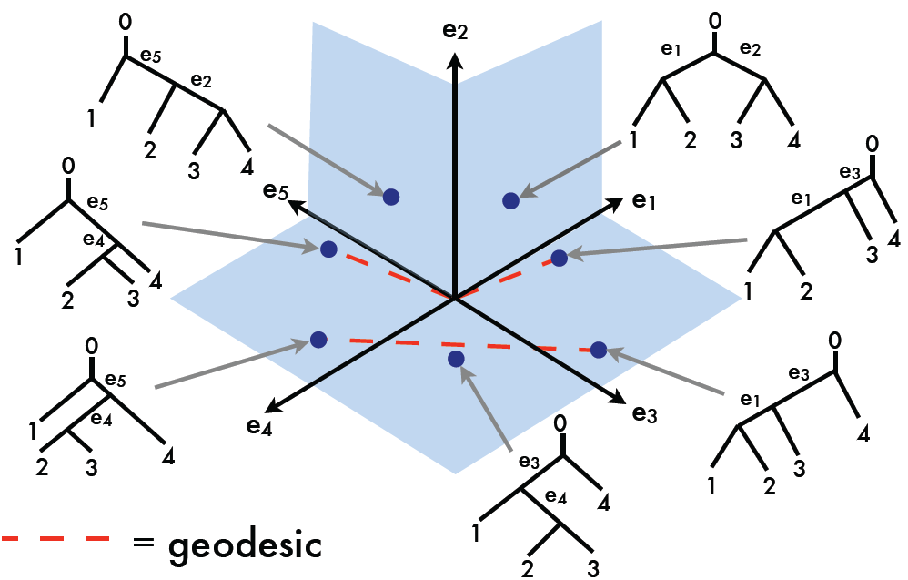
Manifold Stratified Spaces
Text: Sec 10.1.2
Another Important Example:
Phylogenetic Tree Space
Thanks to Megan Owen

Slide 35
Manifold Stratified Spaces
One More Example:
Projective Geometry
Important in Image Analysis
Good Source:
Patrangearu & Ellingson (2016)
Chapters 21 and 22

Slide 36
OODA Big Picture
Text: Chp. 9
New Topic:
Curve Registration
(Amplitude – Phase Variation)
Main Reference:
Srivastava et al (2011)
Interesting Aside: Never Published
Beyond ArXiv, yet 197 Google Citations

Slide 37
Collaborators
Anuj Srivastava (Florida State U.)
Wei Wu (Florida State U.)
Derek Tucker (Florida State U.)
Xiaosun Lu (U. N. C.)
Inge Koch (U. Adelaide)
Peter Hoffmann (U. Adelaide)
J. O. Ramsay (McGill U.)
Laura Sangalli (Milano Polytech.)

Slide 38
Motivating Example
Functional Data Analysis
i.e. Curves as Data Objects
Shifted Betas Example
How Amenable To
Classical PCA?

Slide 39
Motivating Example
Shifted Betas Example
Mean Not
Representative!
Centering Creates
Distortion?

Slide 40
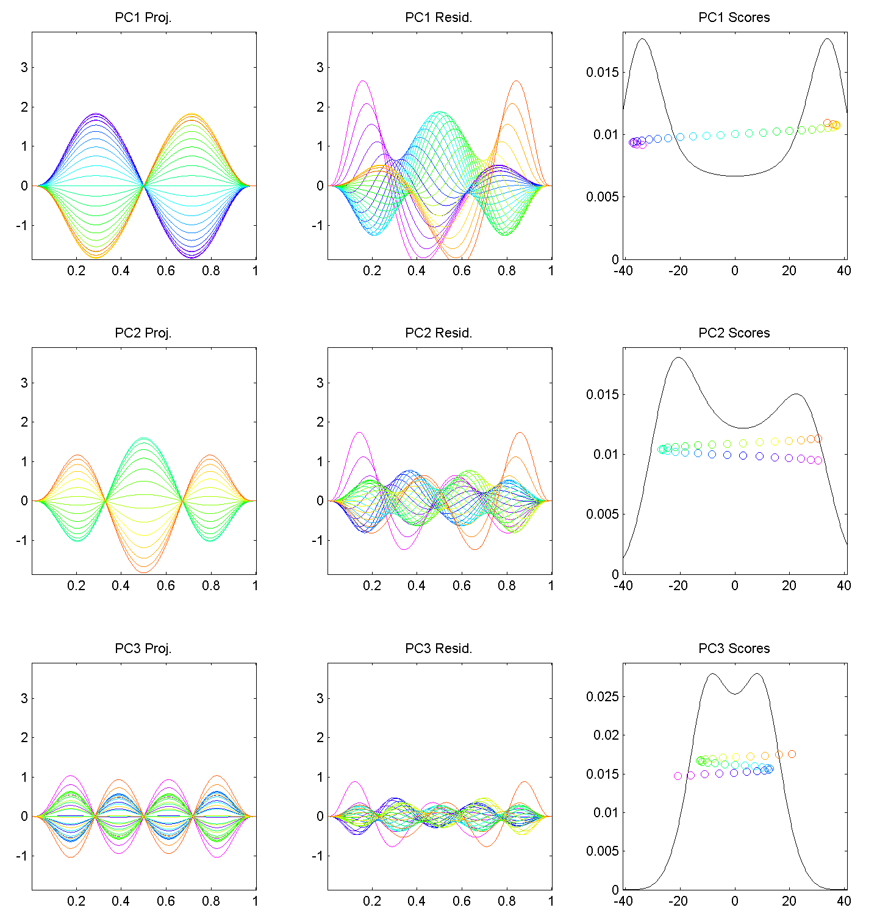
Motivating Example
Shifted Betas
Example PCA
Hard to Interpret 1st Mode
Yet Scores Seem Sensible
Conclusion: PCA
Modes of Variation
Yield Poor Insights
About Phase
Similar for Other Modes
Looks Like Harmonics
From Fourier Theory
Is There a Sturm-
Liouville Theory?

Slide 41
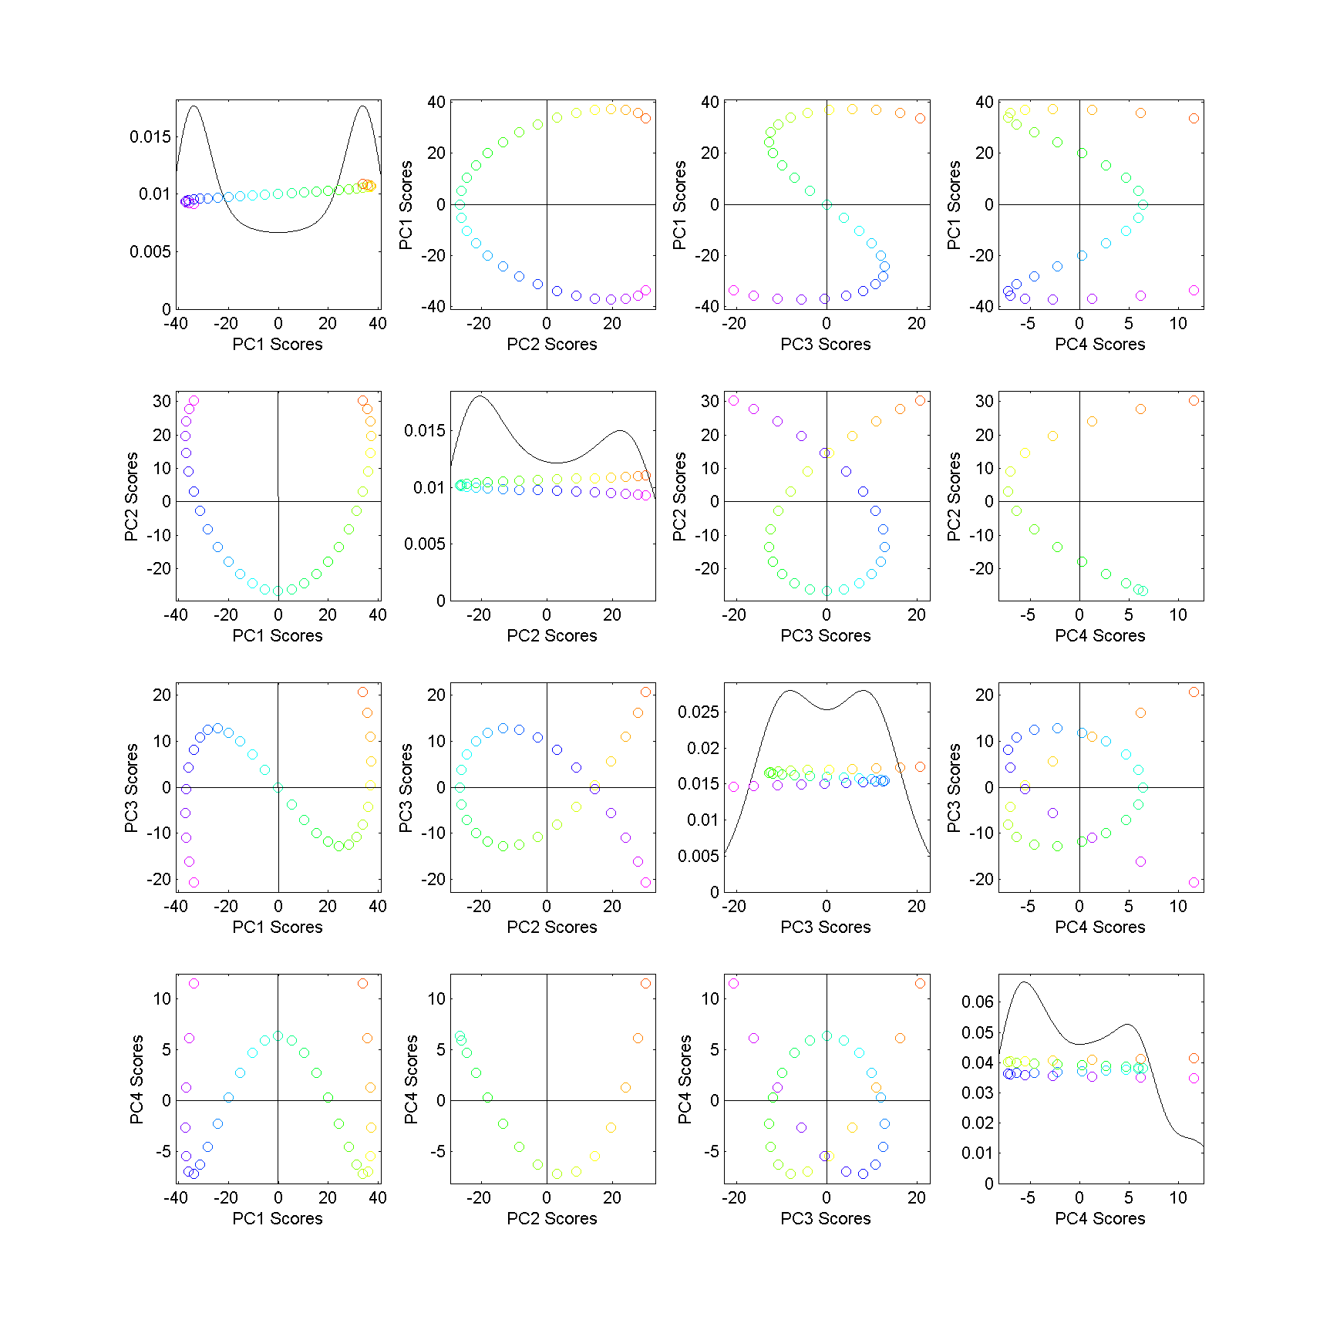
Motivating Example
Shifted
Betas
Example
PCA
Scores
Interesting
Patterns!
Variation
Follows
Single Curve
Bending
All Around
Very Poor Signal
Compression!

Slide 42
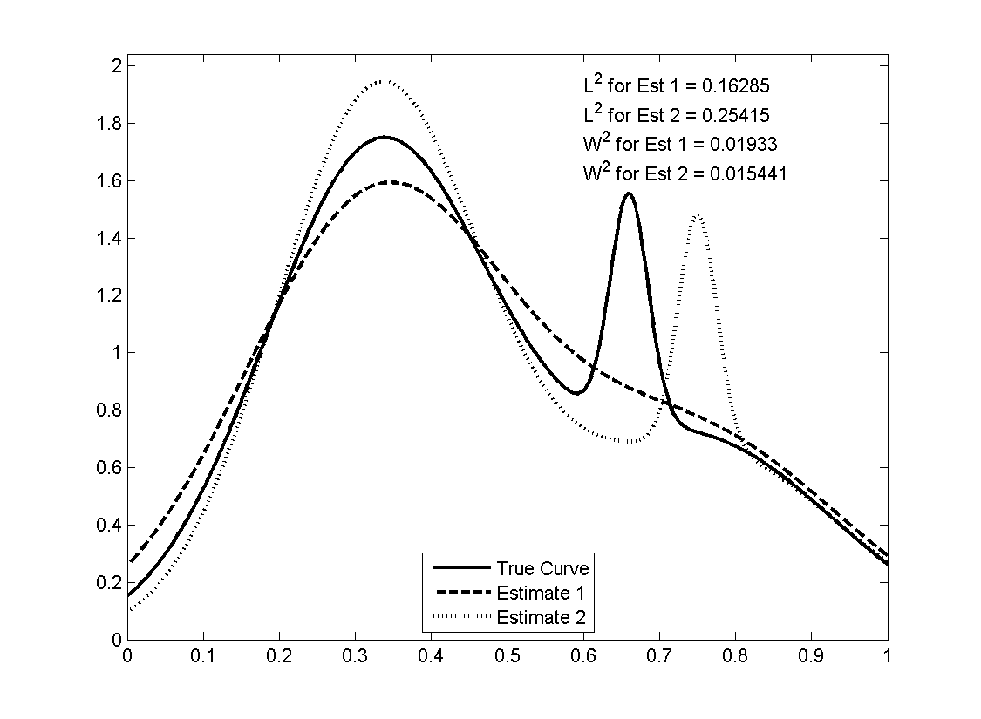
Motivating Example
Shifted Betas Example
Alternate
Approach:
Wasserstein
Distance
Based on
Optimal
Transport
Recall Earlier Example

Slide 43
Motivating Example
Shifted Betas Example
Alternate Analysis: Wasserstein MDS
Gives Much More
Interpretable Scores
Small Amplitude Variation
Large Phase Variation
Challenge: Only
Scores, No Modes

Slide 44
Motivating Example
Shifted Betas Example
Alternate Analysis: Wasserstein MDS
Log₁₀ Scree Plot
Gives Much Better
Signal Compression
Conventional PCA
Spreads Power
Across Spectrum
Log₁₀ Scaling Very Revealing

Slide 45
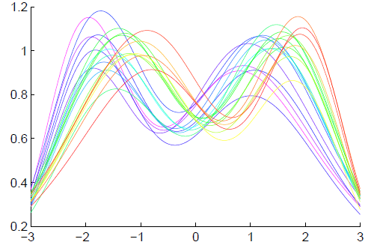
General Amp - Phase Context
Functional Data Analysis
Curves as Data Objects
Toy Example:

Slide 46
General Amp - Phase Context
Functional Data Analysis
Curves as Data Objects
Toy Example:
How Can We
Understand
Variation?

Slide 47
General Amp - Phase Context
Functional Data Analysis
Curves as Data Objects
Toy Example:
How Can We
Understand
Variation?

Slide 48
General Amp - Phase Context
Functional Data Analysis
Curves as Data Objects
Toy Example:
How Can We
Understand
Variation?

Slide 49
General Amp - Phase Context
Insightful
Decomposition

Slide 50
General Amp - Phase Context
Insightful
Decomposition
Horiz’l
Var’n

Slide 51
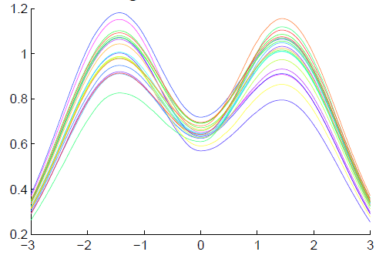
General Amp - Phase Context
Insightful
Decomposition
Vertical Variation
Horiz’l
Var’n

Slide 52
Challenge
Fairly Large Literature
Many (Diverse) Past Attempts
Limited Success (in General)
Surprisingly Slippery
(even mathematical formulation)

Slide 53
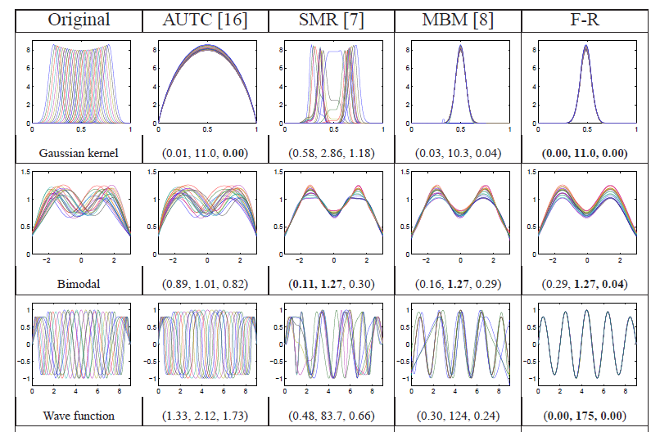
Challenge (Illustrated)
Thanks to Wei Wu

Slide 54
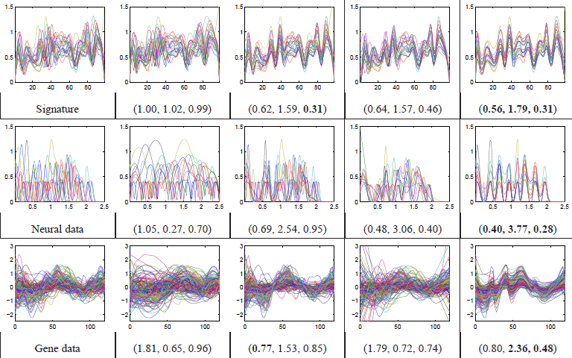
Challenge (Illustrated)
Thanks to Wei Wu

Slide 55
General Amp - Phase Context
Appropriate
Mathematical
Framework?
Vertical Variation
Horiz’l
Var’n

Slide 56
Time Warping
Foundational Concept for Curve Registration
Think Stretch & Compress Horizontal Axis
Mathematical Basis:
Diffeomorphisms

Slide 57
Time Warping
Let $Γ$ be the Set of All Strictly
Increasing Diffeomorphisms
Diffeomorphisms
$γ:\left[0,1\right] → [0,1]$
$γ$ is 1 to 1
$γ$ is onto
(thus $γ$ is invertible)
Differentiable
$γ^{−1}$ is Differentiable
Achieve by taking $γ$ strictly increasing

Slide 58
Time Warping Intuition
Elastically Stretch & Compress Axis

Slide 59
Time Warping Intuition
Elastically Stretch & Compress Axis
$γ\left(x\right)=x$
(identity)
(of group of
diffeomorphisms)

Slide 60
Time Warping Intuition
Elastically Stretch & Compress Axis
$γ\left(x\right)$

Slide 61
Time Warping Intuition
Elastically Stretch & Compress Axis
$γ\left(x\right)$

Slide 62
Time Warping Intuition
Elastically Stretch & Compress Axis
$γ\left(x\right)$

Slide 63
Time Warping Intuition
Say curves $f_{1}(x)$ and $f_{2}(x)$ are equivalent,
$$f_{1}≈f_{2}$$
When $∃γ$ so that
$$f_{1}\left(γ\left(x\right)\right)=f_{1}∘γ\left(x\right)=f_{2}(x)$$
Stretch & Compress Before Plugging In

Slide 64
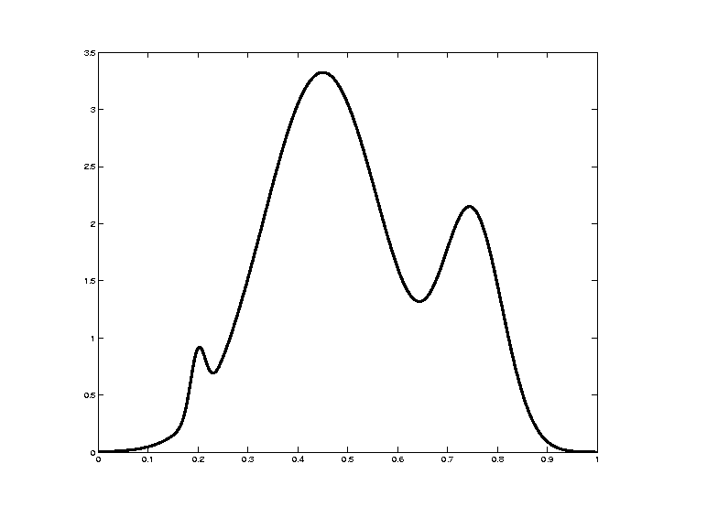
Time Warping Intuition
Toy Example: Starting Curve, $f\left(x\right)$

Slide 65
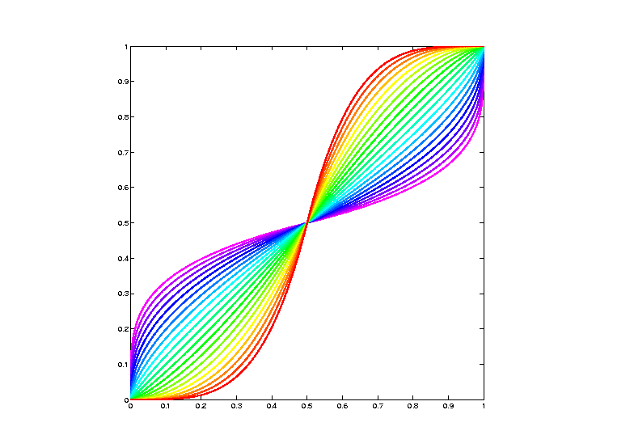
Time Warping Intuition
Toy Example: Warping Functions $γ_{i}(x)$

Slide 66
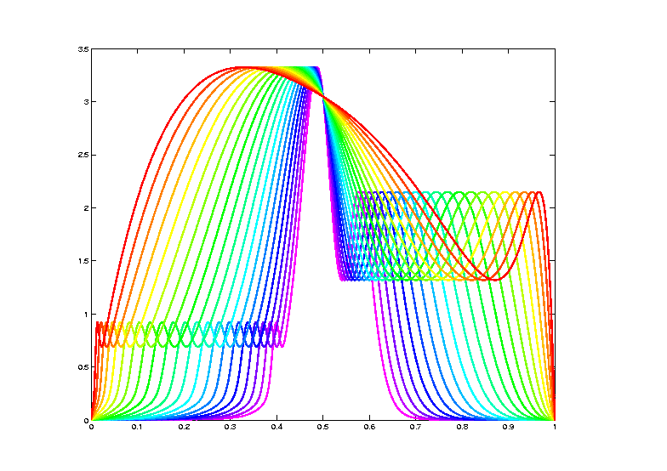
Time Warping Intuition
Toy Example: Time Warped Curves, $f\left(γ(x)\right)$

Slide 67
Curve Registration
What are the
Data Objects?
Vertical Variation
Horiz’l
Var’n

Slide 68
Recall Landmark Shape Analysis
Approach: Identify objects that are:
Translations
Rotations
Scalings
of each other
Mathematics: Equivalence Relation
Results in: Equivalence Classes
Which become the Data Objects

Slide 69
Recall Landmark Shape Analysis
Equivalence Classes become Data Objects
a.k.a. “Orbits”
Mathematics: Called “Quotient Space”
, , , , , ,

Slide 70
Curve Registration
What are the Data Objects?
Equivalence Classes from “Time Warpings”
$γ:\left[0,1\right] → [0,1]$ (smooth)
More Precisely: Diffeomorphisms

Slide 71
Data Objects I
Equivalence Classes as Data Objects
(Set of All
Warps of
Given Curve)
Notation: $\left[f\right]=\left\{f∘γ: γ∈Γ\right\}$
for a “representor” $f\left(x\right)$

Slide 72
Time Warping Intuition
Toy Example: Equivalent Curves, $\left[f\left(x\right)\right]$

Slide 73
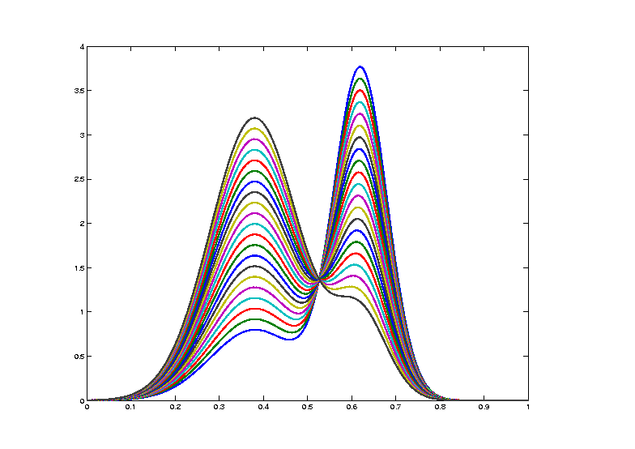
Curve Registration
Toy Example: Non-Equivalent Curves
Cannot
Warp
Into
Each
Other

Slide 74
Data Objects I
Equivalence Classes as Data Objects
(Set of All
Warps of
Given Curve)
Next Task:
Find Appropriate Metric

Slide 75
Metrics in Curve Space
Find Metric on Equivalence Classes
Start with Warp Invariant Metric on Curves
& Extend

Slide 76
Metrics in Curve Space
Traditional Approach to Curve Registration:
Align curves, say $f_{1}$ and $f_{2}$
By finding optimal time warp, $γ$, so:
$$\inf_{γ}\left\|f_{1}−\left(f_{2}∘γ\right)\right\|$$
Vertical var’n: PCA after alignment
Horizontal var’n: PCA on $γ$s

Slide 77
Metrics in Curve Space
Problem:
Don’t have proper metric
Since:
$$δ\left(f_{1},f_{2}\right)≠δ\left(f_{2},f_{1}\right)$$
Because:
$$\inf_{γ}\left\|f_{1}−\left(f_{2}∘γ\right)\right\|≠\inf_{γ}\left\|f_{2}−\left(f_{1}∘γ\right)\right\|$$

Slide 78
Metrics in Curve Space
$$\inf_{γ}\left\|f_{1}−\left(f_{2}∘γ\right)\right\|≠\inf_{γ}\left\|f_{2}−\left(f_{1}∘γ\right)\right\|$$
Thanks to
Xiaosun Lu
$$γ_{1}(x)$$
$$γ_{2}(x)$$
$$f_{2}(γ_{2}\left(x\right))$$
$$f_{1}(γ_{1}\left(x\right))$$

Slide 79
Metrics in Curve Space
$$\inf_{γ}\left\|f_{1}−\left(f_{2}∘γ\right)\right\|≠\inf_{γ}\left\|f_{2}−\left(f_{1}∘γ\right)\right\|$$
Note:
Very
Different
L² norms
Thanks to
Xiaosun Lu
But There is a
Good Answer,
Explained Later

Slide 80
Participant Presentation
12:10 Panos Andreou: Estimating the Transition Matrix of a Markov Chain

