Slide 1
Statistics – O. R. 881 Object Oriented Data Analysis
Start
Recording
Steve Marron
Dept. of Statistics and Operations Research
University of North Carolina

Slide 2
Current Sections in Textbook
Today:
Sections 9.1, 9.2
Next Class:
Sections 11.1, 11.2

Slide 3
An Interesting Question
Why does backwards PC seem easier?
An Attractive Answer:
James Damon, UNC Mathematics
Key Idea: Express Backwards PCA as
Nested Series of Constraints

Slide 4
General View of Backwards PCA
Define Nested Spaces via Constraints
Backwards PCA
Principal Nested Spheres
Principal Surfaces
Other Manifold Data Spaces
Sub-Manifold Constraints??
(Algebraic Geometry)

Slide 5
Covariance Matrices as Data Objects
Motivation: Diffusion Tensor Imaging (DTI)
Variation on Magnetic Resonance Imaging
Major Goal: Map Brain Connectivity
By Finding “Fibers”
Text: Sec 8.7
Basser et al. (1994)

Slide 6
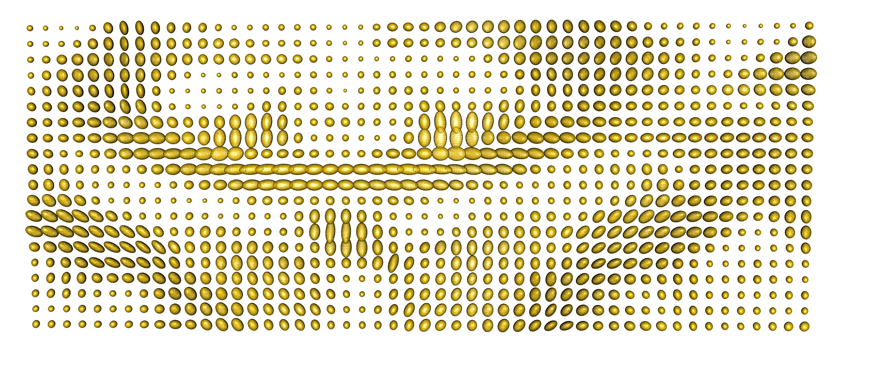
Covariance Matrices as Data Objects
Variation Expressed as Covariance Matrices
Low Variation $≈$ Solid Region
Spherical $≈$ Pure Fluid
Stretched $≈$ Fiber
One Slice, from One Person’s Brain

Slide 7
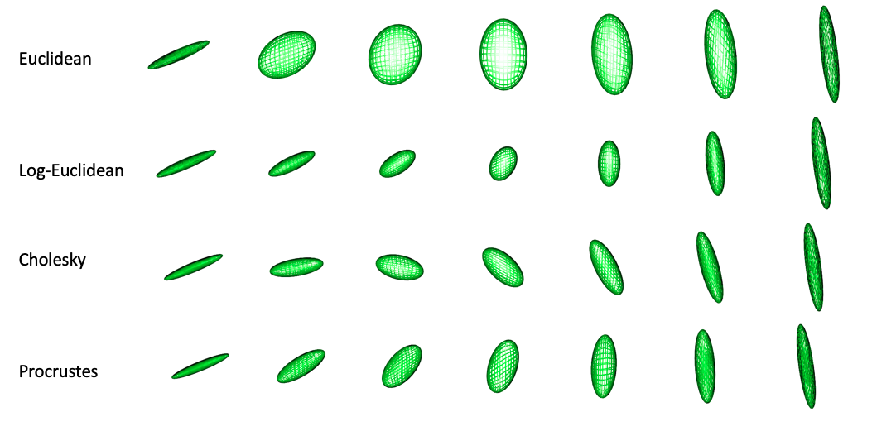
Covariance Matrices as Data Objects
Important Point: Choice of Metric Matters
Even Wildly Different Paths!

Slide 8
Covariance Matrices as Data Objects
Full Set of Covariance Matrices is a
Manifold Stratified Space
A Union of Continuously Connected
Manifolds of Different Dimensions
(Called Strata)
Connections: Limit as $λ_{i}→0$

Slide 9
OODA Big Picture
Text: Chp. 9
New Topic:
Curve Registration
(Amplitude – Phase Variation)
Main Reference:
Srivastava et al (2011)
Interesting Aside: Never Published
Beyond ArXiv, yet 197 Google Citations

Slide 10
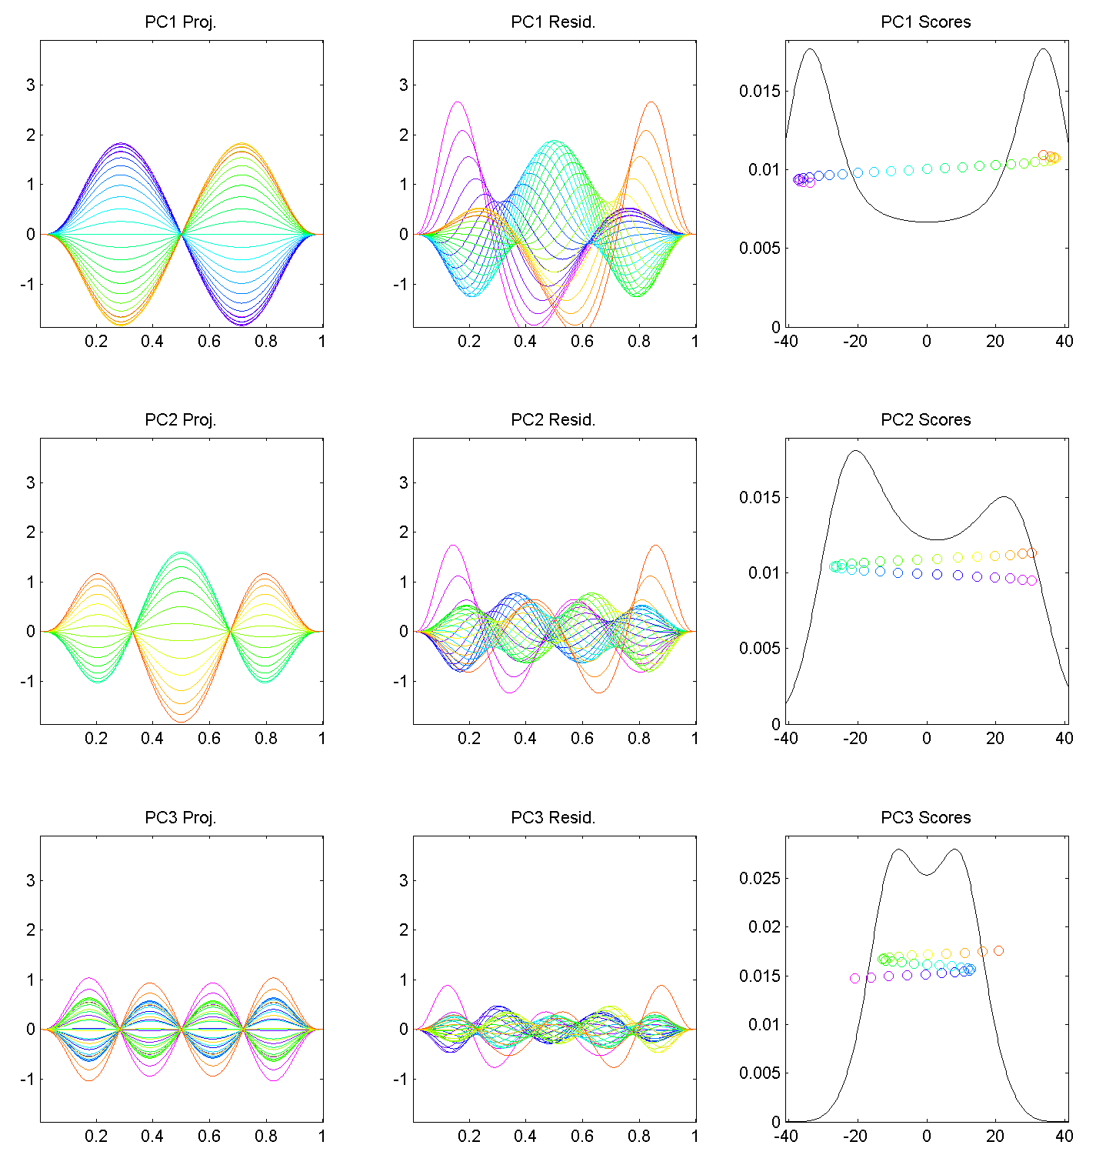
Motivating Example
Shifted Betas
Example PCA
Hard to Interpret 1st Mode
Yet Scores Seem Sensible
Conclusion: PCA
Modes of Variation
Yield Poor Insights
About Phase
Similar for Other Modes
Looks Like Harmonics
From Fourier Theory
Is There a Sturm-
Liouville Theory?

Slide 11
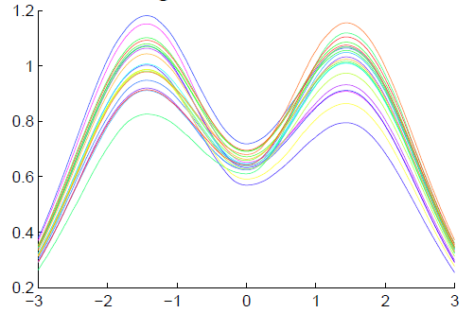
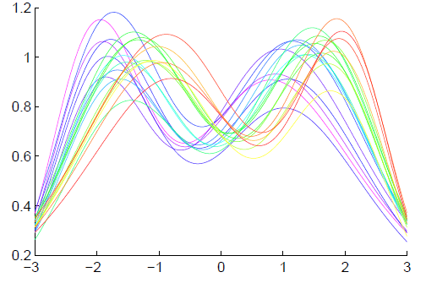
General Amp - Phase Context
Appropriate
Mathematical
Framework?
Vertical Variation
Horiz’l
Var’n

Slide 12
Time Warping
Foundational Concept for Curve Registration
Think Stretch & Compress Horizontal Axis
Mathematical Basis:
Diffeomorphisms

Slide 13
Time Warping Intuition
Elastically Stretch & Compress Axis
$γ\left(x\right)$

Slide 14
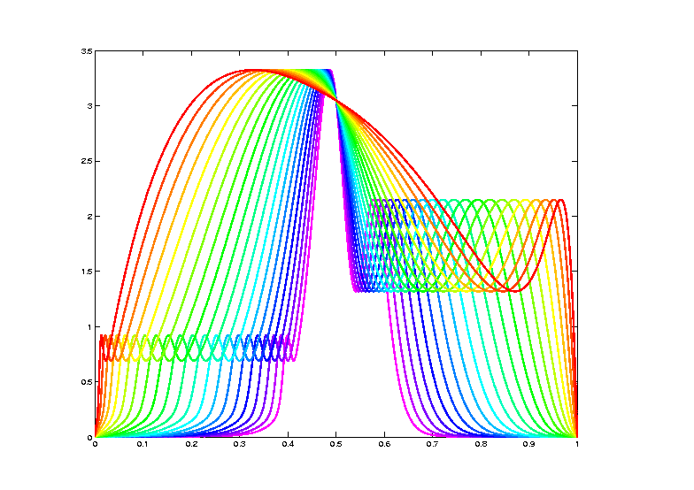
Data Objects I
Equivalence Classes as Data Objects
(Set of All
Warps of
Given Curve)
Notation: $\left[f\right]=\left\{f∘γ: γ∈Γ\right\}$
for a “representor” $f\left(x\right)$

Slide 15
Metrics in Curve Space
Find Metric on Equivalence Classes
Start with Warp Invariant Metric on Curves
& Extend

Slide 16
Metrics in Curve Space
$$\inf_{γ}\left\|f_{1}−\left(f_{2}∘γ\right)\right\|≠\inf_{γ}\left\|f_{2}−\left(f_{1}∘γ\right)\right\|$$
Note:
Very
Different
L² norms
Thanks to
Xiaosun Lu
But There is a
Good Answer,
Explained Later

Slide 17
Metrics in Curve Space
Solution:
Look for Warp Invariant Metric $δ$
Where:
$$δ\left(f_{1},f_{2}\right)=δ\left(f_{1}∘γ,f_{2}∘γ\right)$$

Slide 18
Metrics in Curve Space
$$δ\left(f_{1},f_{2}\right)=δ\left(f_{1}∘γ,f_{2}∘γ\right)$$
I.e. Have “Parallel”
Representatives
Of Equivalence
Classes

Slide 19
Metrics in Curve Space
Warp Invariant Metric $δ_{FR}$
Developed in context of:
Likelihood Geometry
Fisher – Rao Metric:
$$δ_{FR}\left(f_{1},f_{2}\right)=δ_{FR}\left(f_{1}∘γ,f_{2}∘γ\right)$$
Rao (1945)
Deeper Theory:
Amari (1985)

Slide 20
Metrics in Curve Space
Fisher – Rao Metric:
Computation Based on
Square Root Velocity Function (SRVF)
$$q_{f}\left(t\right)=\frac{\dot{f}\left(t\right)}{\sqrt{\left|\dot{f}\left(t\right)\right|}}$$
Where
$\dot{f}\left(t\right)=\frac{∂}{∂t}f(t)$
Signed Version
Of Square Root
Derivative

Slide 21
Metrics in Curve Space
Square Root Velocity Function (SRVF)
$$q_{f}\left(t\right)=\frac{\dot{f}\left(t\right)}{\sqrt{\left|\dot{f}\left(t\right)\right|}}$$
$$f\left(t\right)=f\left(0\right)+\int_{0}^{t}{q_{f}\left(s\right)\left|q_{f}\left(s\right)\right|ds}$$

Slide 22
Metrics in Curve Space
Fisher – Rao Metric:
Computation Based on SRVF:
$$δ_{FR}\left(f_{1},f_{2}\right)={\left\|q_{f_{1}}−q_{f_{2}}\right\|}_{2}$$
I.e. work with SRVF,
since much easier to compute.

Slide 23
Metrics in Curve Space
Note on SRVF representation:
$$δ_{FR}\left(f_{1},f_{2}\right)={\left\|q_{f_{1}}−q_{f_{2}}\right\|}_{2}$$
Warp Invariance
$$δ_{FR}\left(f_{1},f_{2}\right)=δ_{FR}\left(f_{1}∘γ,f_{2}∘γ\right)$$
Follows from Jacobean calculation

Slide 24
Homework 5
(a) Show the Warp Invariance of the
Fisher-Rao Metric, i.e.
$$δ_{FR}\left(f_{1},f_{2}\right)=δ_{FR}\left(f_{1}∘γ,f_{2}∘γ\right)$$
(Hints on Sakai Page)
Due: Mar. 10,
11:00AM

Slide 25
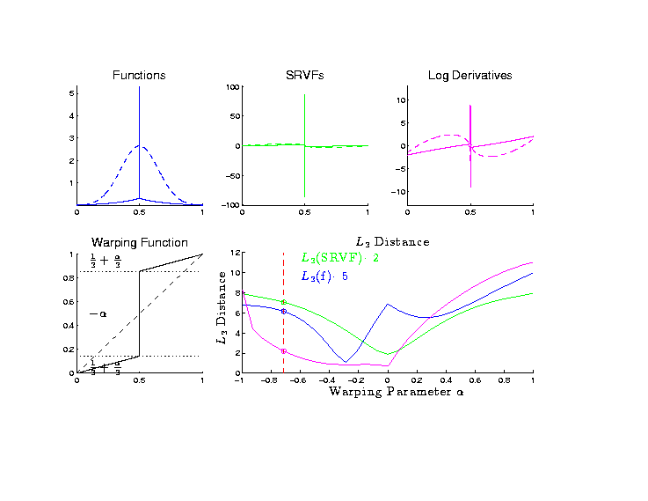
Metrics in Curve Space
Why
square
roots?
Thanks to
Xiaosun Lu

Slide 26
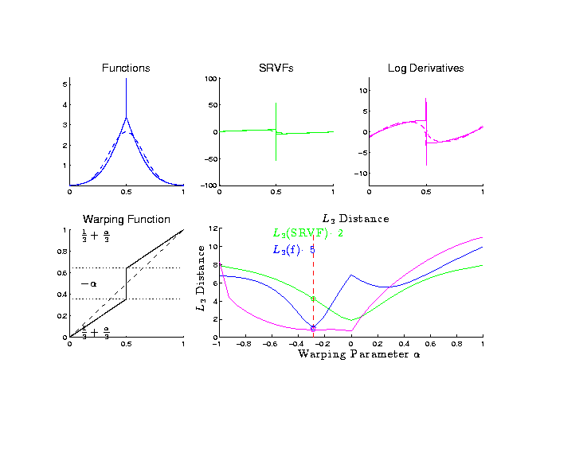
Metrics in Curve Space
Why
square
roots?

Slide 27
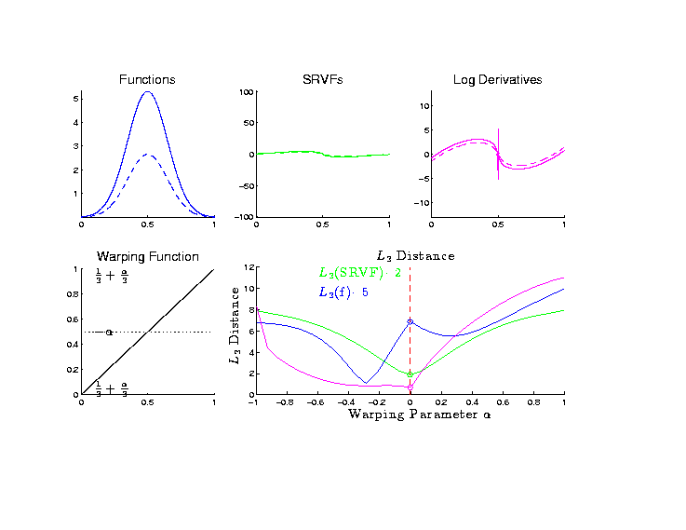
Metrics in Curve Space
Why
square
roots?

Slide 28
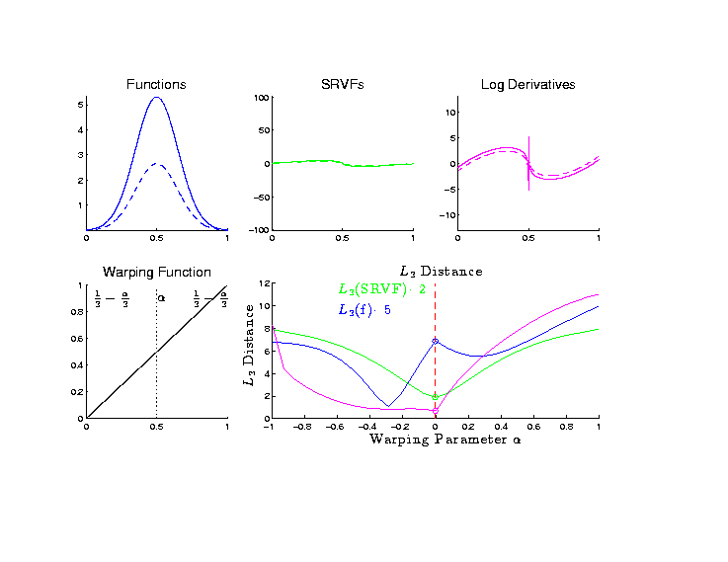
Metrics in Curve Space
Why
square
roots?

Slide 29
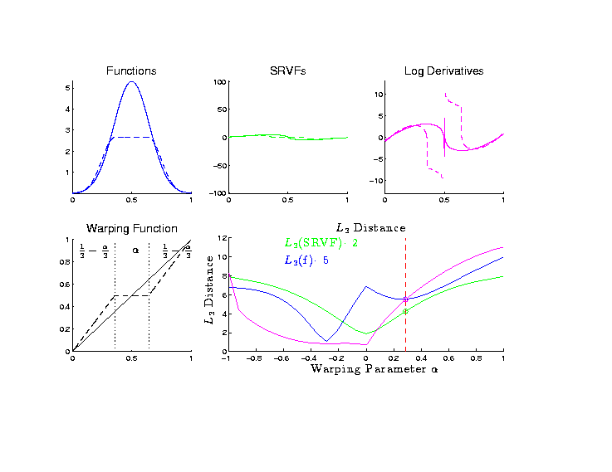
Metrics in Curve Space
Why
square
roots?

Slide 30
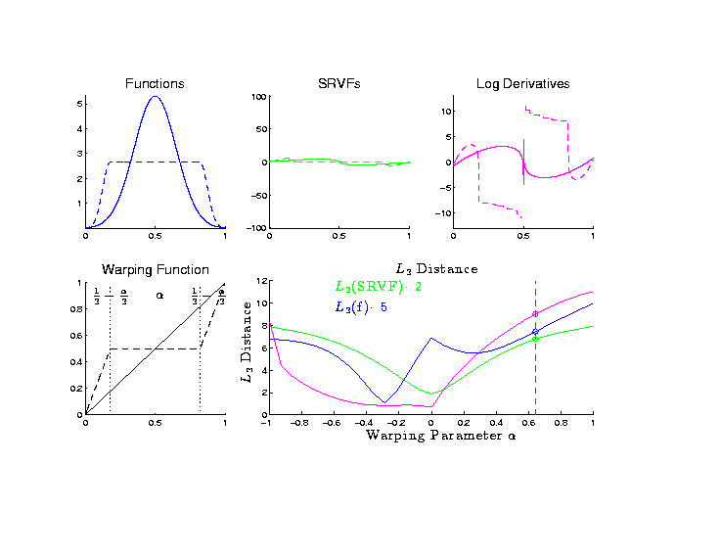
Metrics in Curve Space
Why
square
roots?

Slide 31
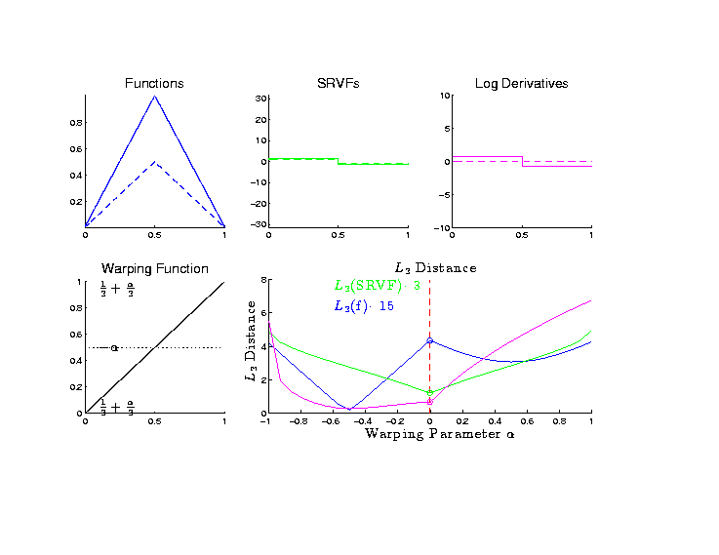
Metrics in Curve Space
Why
square
roots?

Slide 32
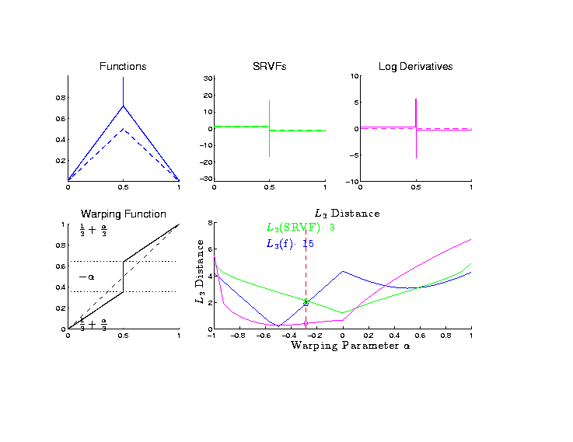
Metrics in Curve Space
Why
square
roots?

Slide 33
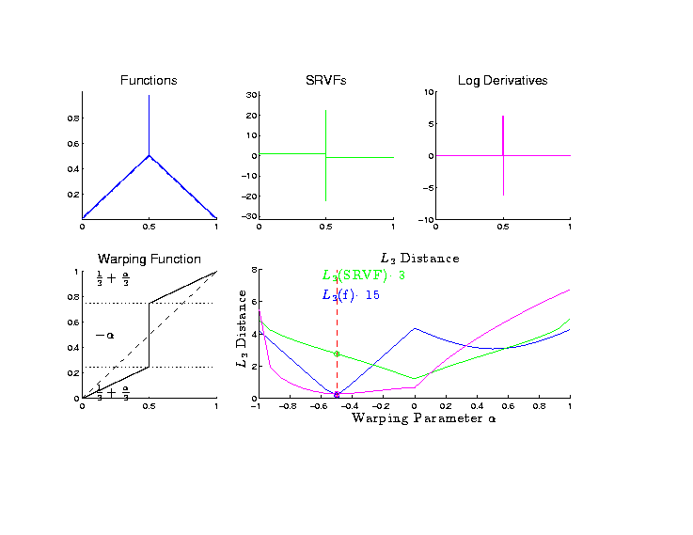
Metrics in Curve Space
Why
square
roots?

Slide 34
Metrics in Curve Space
Why
square
roots? Dislikes Pinching
Focusses Well On
Peaks of Unequal Height

Slide 35
Metrics in Curve Quotient Space
Above was Invariance for Individual Curves
Now extend to:
Equivalence Classes of Curves
I.e. Orbits as Data Objects
I.e. Define Metric on Quotient Space

Slide 36
Metrics in Curve Quotient Space
Define Amplitude Metric on Orbits:
For $\left[f_{1}\right]$ & $\left[f_{2}\right]$, i.e. $\left[q_{1}\right]$ & $\left[q_{2}\right]$
$$δ_{A}\left(\left[f_{1}\right],\left[f_{2}\right]\right)=\inf_{γ∈Γ}\left\|q_{f_{1}}−q_{f_{2}∘γ}\right\|$$
Independent of Choice of $f_{1}$ & $f_{2}$
By Warp Invariance

Slide 37
Homework 5
Show the Amplitude Metric
$$δ_{A}\left(\left[f_{1}\right],\left[f_{2}\right]\right)=\inf_{γ∈Γ}\left\|q_{f_{1}}−q_{f_{2}∘γ}\right\|$$
Is Independent of $f_{1}$ and $f_{2}$
(Hints on Sakai Page)
Due: Mar. 10,
11:00AM

Slide 38
Homework 5
(c) Show the Amplitude Metric
$$δ_{A}\left(\left[f_{1}\right],\left[f_{2}\right]\right)=\inf_{γ∈Γ}\left\|q_{f_{1}}−q_{f_{2}∘γ}\right\|$$
Satisfies the Metric Properties
(i.e. Really is a Distance Measure)
(Hints on Sakai Page)
Due: Mar. 10,
11:00AM

Slide 39
Mean in Curve Quotient Space
Benefit of a Metric:
Allows Definition of a “Mean”
Fréchet Mean
Geodesic Mean
Barycenter
Karcher Mean
Nomenclature
Objected to by
Karcher (2014)

Slide 40
Mean in Curve Quotient Space
Given Equivalence Class Data Objects:
$$\left[f_{1}\right], \left[f_{2}\right], ⋯,\left[f_{n}\right]$$
The Karcher Mean is:
$$\left[μ\right]={argmin}_{\left[f\right]}\sum_{i=1}^{n}{{δ_{A}\left(\left[f\right],\left[f_{i}\right]\right)}^{2}}$$

Slide 41
Mean in Curve Quotient Space
The Karcher Mean is:
$$\left[μ\right]={argmin}_{\left[f\right]}\sum_{i=1}^{n}{{δ\left(\left[f\right],\left[f_{i}\right]\right)}^{2}}$$
Intuition: Recall, for Euclidean Data
Minimizer = Conventional $\overline{X}$

Slide 42
Mean in Curve Quotient Space
Next Define “Most Representative”
Choice of $μ_{n}$
As Representer of$\left[μ\right]$
(e.g. Need a Curve for Graphical Displays)

Slide 43
Mean in Curve Quotient Space
“Most Representative” $μ_{n}$ in$\left[μ\right]$
Given a candidate $μ$
Consider warps to each $f_{i}$
Choose $μ_{n}$ to make
Karcher mean of warps = Identity
(under Fisher Rao metric)

Slide 44
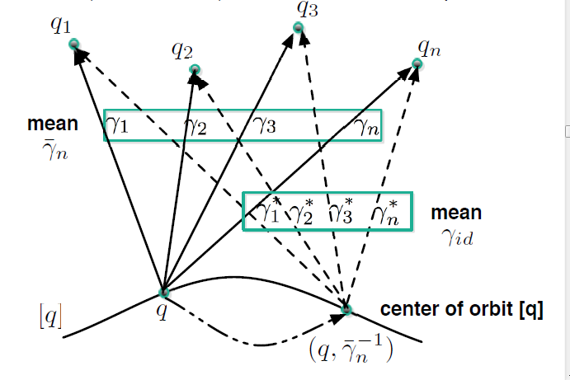
Mean in Curve Quotient Space
“Most Representative” $μ_{n}$ in$\left[μ\right]$
Thanks to Anuj Srivastava

Slide 45
Metrics in Curve Space
$$\inf_{γ}\left\|f_{1}−\left(f_{2}∘γ\right)\right\|≠\inf_{γ}\left\|f_{2}−\left(f_{1}∘γ\right)\right\|$$
Recall
Example
Illustrating
This Is Best
Representer
Of Karcher Mean

Slide 46
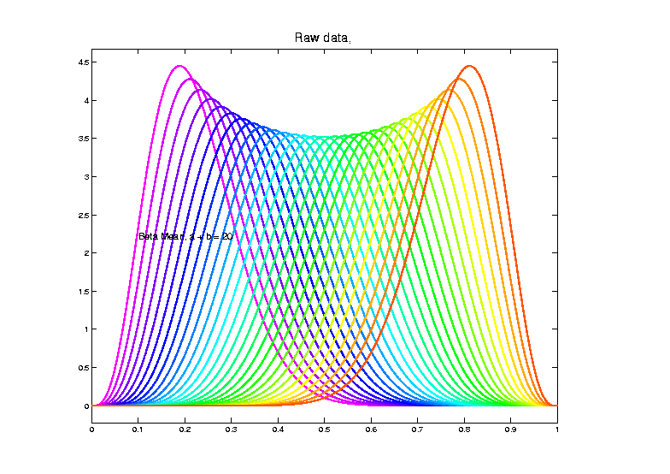
Shifted Betas Example
Recall
From
Above

Slide 47
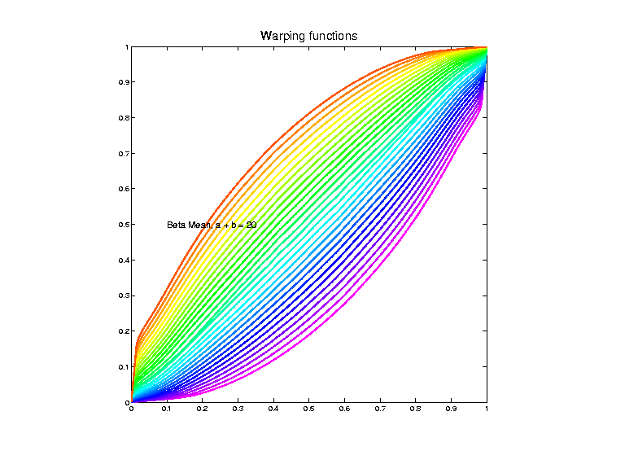
Shifted Betas Example
Estimated
Warps
(Note:
Represented
With Karcher
Mean At
Identity)

Slide 48
Mean in Curve Quotient Space
“Most Representative” $μ_{n}$ in$\left[μ\right]$
Terminology: The “Template Mean”

Slide 49
More Data Objects
Final Curve Warps:
Warp Each Data Curve, $f_{1}, ⋯,f_{n}$
To Template Mean, $μ_{n}$
Denote Warp Functions $γ_{1}, ⋯,γ_{n}$
Gives (Roughly Speaking):
Vertical Components $f_{1}∘γ_{1}, ⋯,f_{n}∘γ_{n}$
(Aligned Curves)
Horizontal Components $γ_{1}, ⋯,γ_{n}$
Data Objects I

Slide 50
More Data Objects
Data Objects II
Final Curve Warps:
Warp Each Data Curve, $f_{1}, ⋯,f_{n}$
To Template Mean, $μ_{n}$
Denote Warp Functions $γ_{1}, ⋯,γ_{n}$
Gives (Roughly Speaking):
Vertical Components $f_{1}∘γ_{1}, ⋯,f_{n}∘γ_{n}$
(Aligned Curves)
Horizontal Components $γ_{1}, ⋯,γ_{n}$
~ Kendall’s Shapes

Slide 51
More Data Objects
Final Curve Warps:
Warp Each Data Curve, $f_{1}, ⋯,f_{n}$
To Template Mean, $μ_{n}$
Denote Warp Functions $γ_{1}, ⋯,γ_{n}$
Gives (Roughly Speaking):
Vertical Components $f_{1}∘γ_{1}, ⋯,f_{n}∘γ_{n}$
(Aligned Curves)
Horizontal Components $γ_{1}, ⋯,γ_{n}$
Data Objects III
~ Chang’s Transfo’s

Slide 52
More Data Objects
Horizontal Components $γ_{1}, ⋯,γ_{n}$
Challenge: Visualization & Interpretation
Approach: Apply Warps to Karcher Mean:
I.e. Visualize ${μ_{n}°γ}_{1}, ⋯,μ_{n}°γ_{n}$

Slide 53
Functional Data Analysis
Insightful
Decomposition
Vertical Variation
Horiz’l
Var’n

Slide 54
Computation
Actual Mathematics is More Complicated
See Section 9.1.3 of Text For Full Details
Including Corresponding Phase Distance

Slide 55
Numeric Computation
Several Variations of
Dynamic Programming
Done by Eric Klassen, Wei Wu

Slide 56
Shifted Betas Example
Raw
Data
Both
Horizontal
And
Vertical
Variation

Slide 57
Visualization
Vertical Variation:
PCA on Aligned Curves, $f_{1}∘γ_{1}, ⋯,f_{n}∘γ_{n}$
Projected Curves

Slide 58
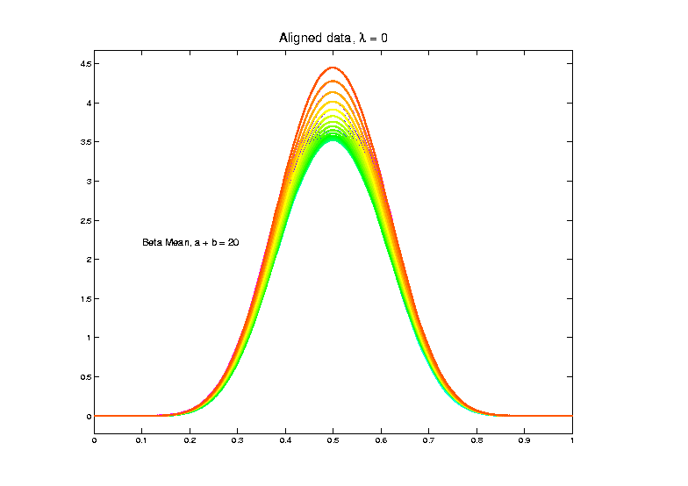
Shifted Betas Example
Aligned
Curves
(Clear
1-d
Vertical
Var’n)
Only Half of
Colors Due to
Exact Overlay

Slide 59
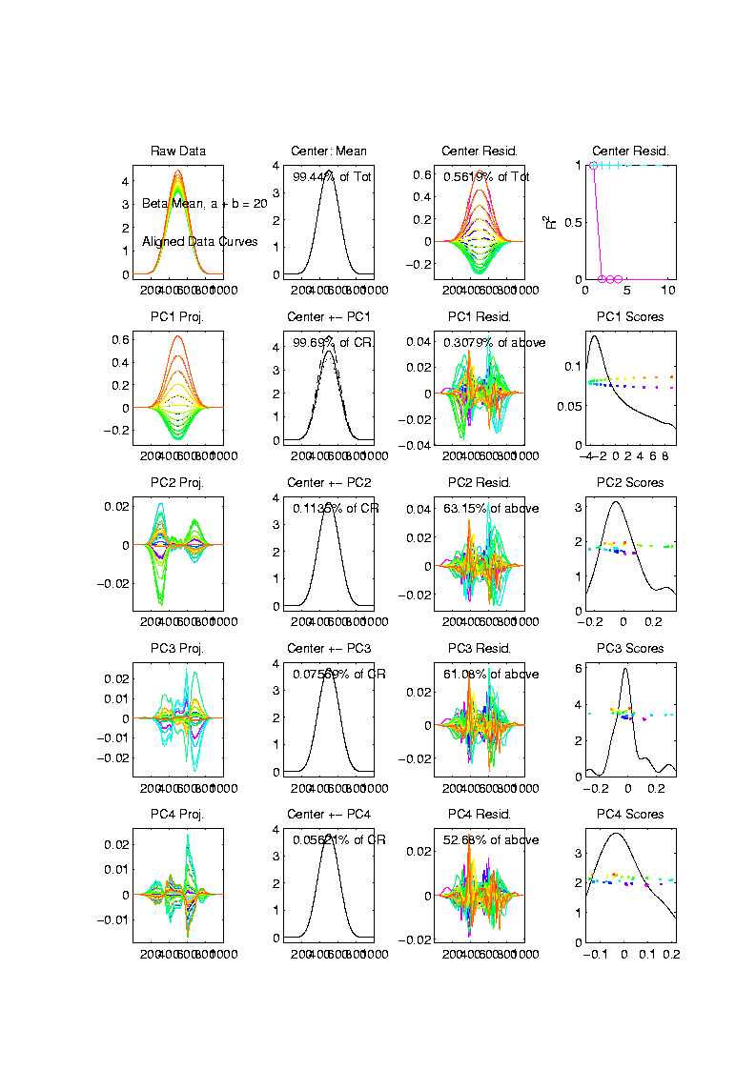
Shifted Betas Example
Aligned
Curve
PCA
Projections
All Var’n
In 1st
Component

Slide 60
Visualization
Horizontal Variation:
PCA on Warps, $γ_{1}, ⋯,γ_{n}$
Projected Curves

Slide 61
Shifted Betas Example
Raw
Data
Both
Horizontal
And
Vertical
Variation

Slide 62
Shifted Betas Example
Estimated
Warps

Slide 63
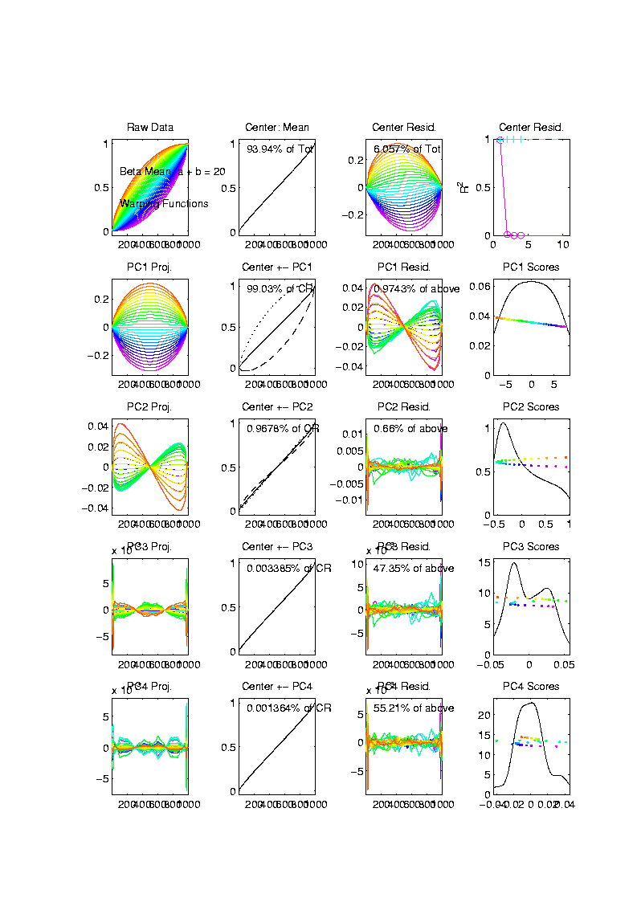
Shifted Betas Example
Warps,
PC
Projections

Slide 64
Shifted Betas Example
Warps,
PC
Projections
Mostly
1st PC

Slide 65
Shifted Betas Example
Warps,
PC
Projections
Mostly
1st PC,
But 2nd
Helps Some
Captures Varying Widths

Slide 66
Shifted Betas Example
Warps,
PC
Projections
Rest is
Not
Important

Slide 67
Shifted Betas Example
Horizontal Var’n Visualization Challenge:
(Complicated) Warps Hard to Interpret
Approach:
Apply Warps to Template Mean
(PCA components)

Slide 68
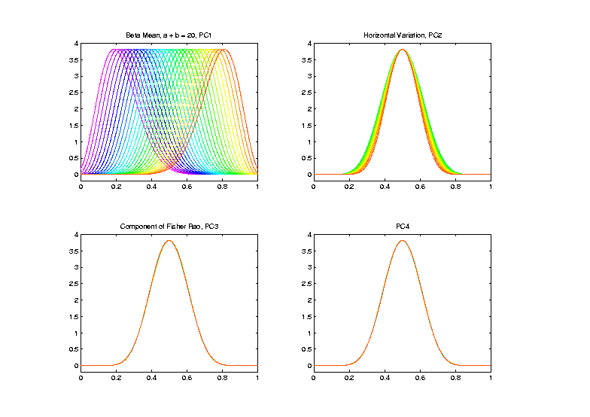
Shifted Betas Example
Warp
Compon’ts
(+ Mean)
Applied to
Template
Mean

Slide 69
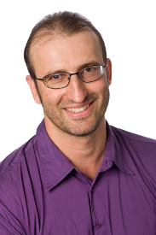
TIC testbed
Text: Sec 2.1
Serious Data Challenge:
TIC (Total Ion Count) Chromatograms
Modern type of “chemical spectra”
Thanks to Peter
Hoffmann

Slide 70
TIC testbed
Serious Data Challenge:
TIC (Total Ion Count) Chromatograms
Reference: Koch et al (2014)

Slide 71
TIC testbed
Raw Data: 15 TIC Curves (5 Colors)

Slide 72
TIC testbed
Special Feature: Answer Key of Known Peaks
Found by
Major
Time &
Labor
Investment

Slide 73
TIC testbed
Special Feature: Answer Key of Known Peaks
Goal:
Find
Warps
To Align
These

Slide 74
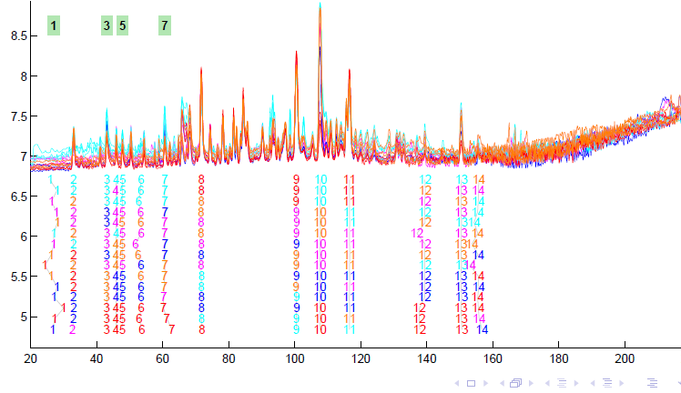
TIC testbed
Fisher – Rao Alignment

Slide 75
TIC testbed
Fisher – Rao Alignment
Spike-In
Peaks

Slide 76
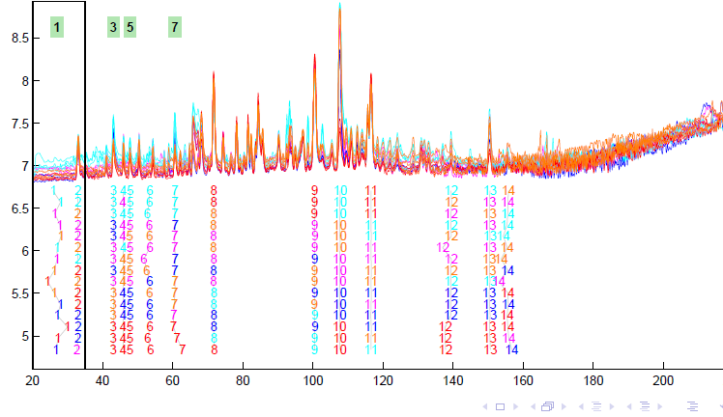
TIC testbed
Next Zoom in on This Region

Slide 77
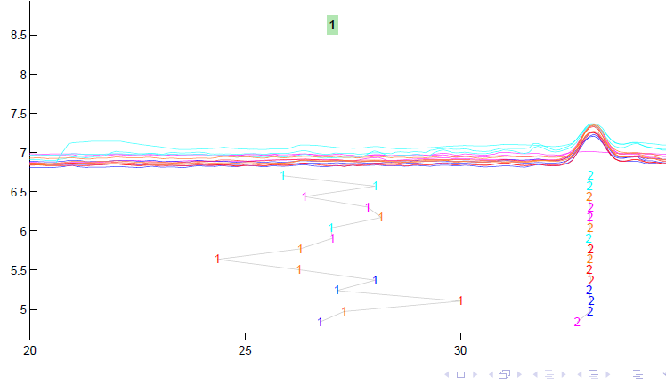
TIC testbed
Zoomed Fisher – Rao Alignment

Slide 78
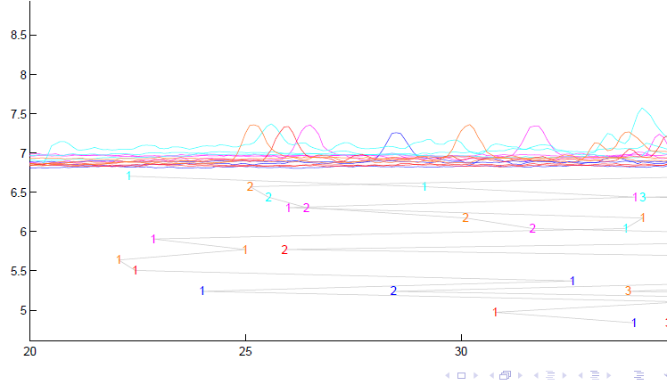
TIC testbed
Before Alignment

Slide 79
TIC testbed
Next Zoom in on This Region

Slide 80
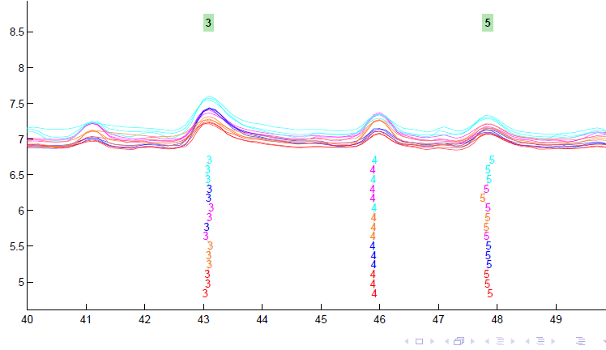
TIC testbed
Zoomed Fisher – Rao Alignment

Slide 81
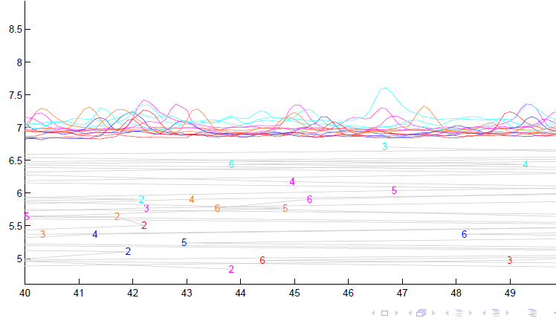
TIC testbed
Before Alignment

Slide 82
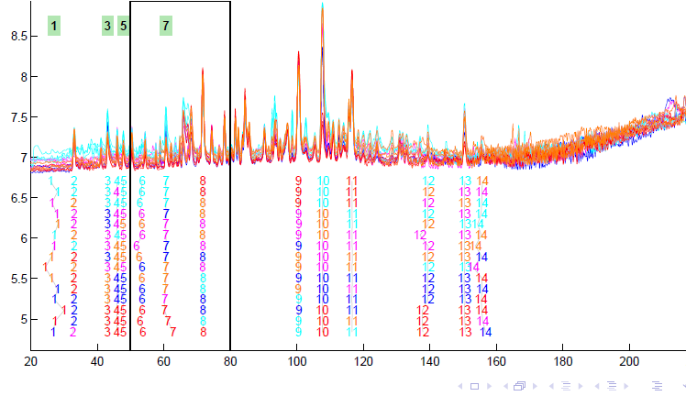
TIC testbed
Next Zoom in on This Region

Slide 83
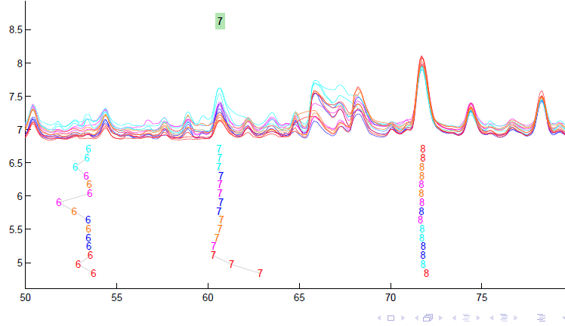
TIC testbed
Zoomed Fisher – Rao Alignment

Slide 84
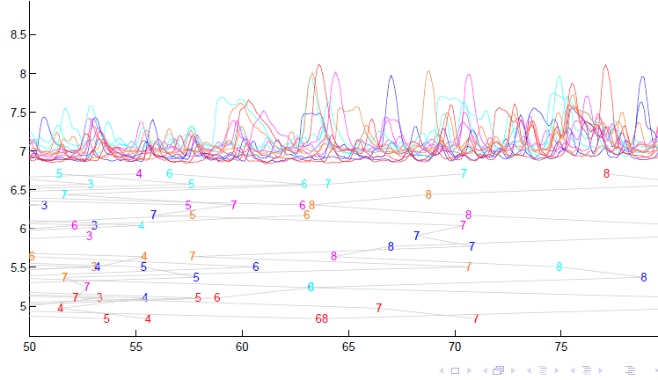
TIC testbed
Before Fisher-Rao Alignment

Slide 85
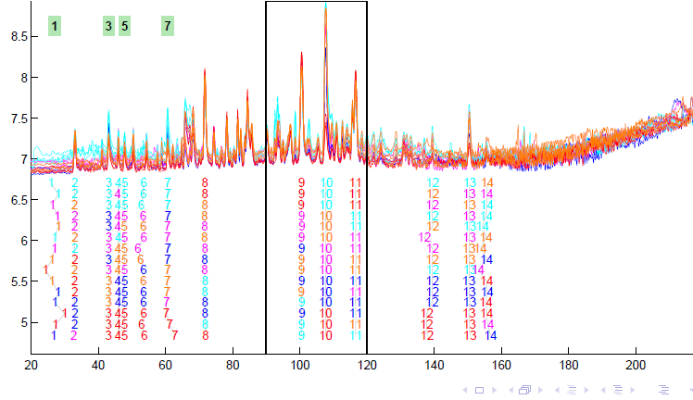
TIC testbed
Next Zoom in on This Region

Slide 86
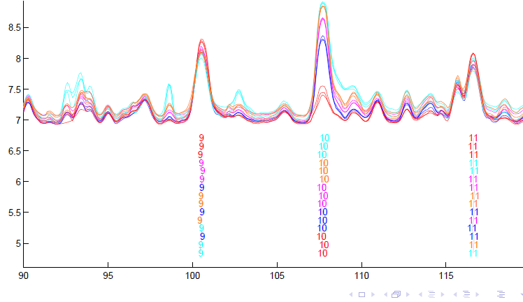
TIC testbed
Zoomed Fisher – Rao Alignment

Slide 87
TIC testbed
Zoomed Fisher – Rao Alignment
Note:
Very
Challenging

Slide 88
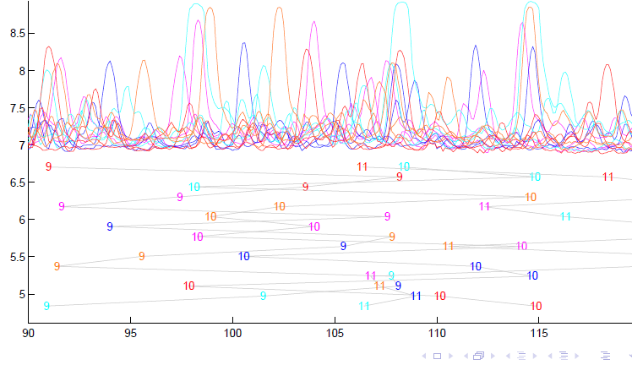
TIC testbed
Before Alignment

Slide 89
TIC testbed
Next Zoom in on This Region

Slide 90
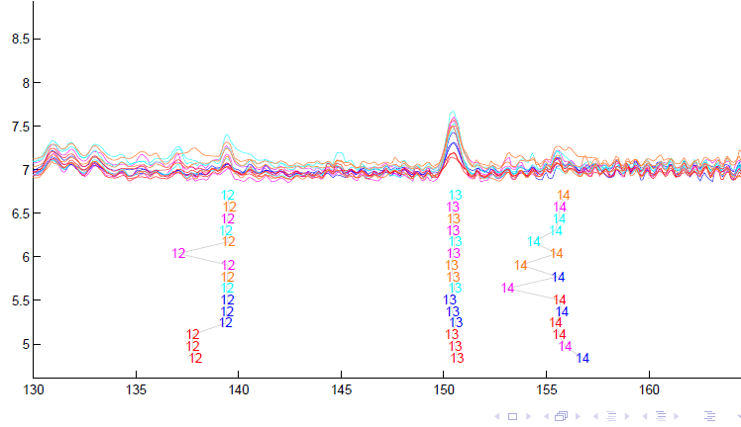
TIC testbed
Zoomed Fisher – Rao Alignment

Slide 91
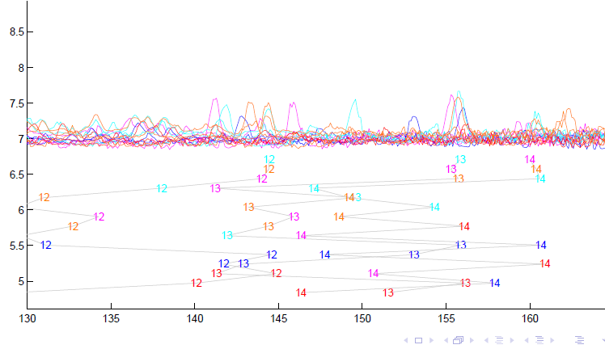
TIC testbed
Before Alignment

Slide 92
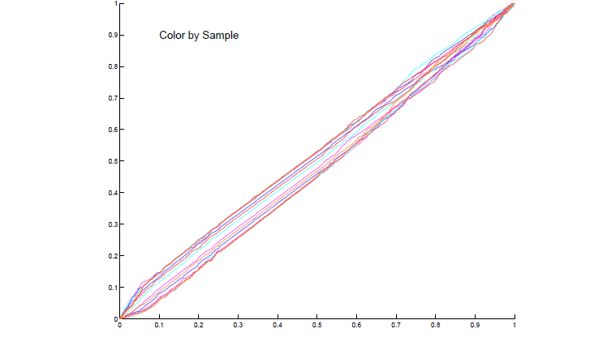
TIC testbed
Warping Functions

Slide 93
Refined Calculations
Text, Sec. 9.2
More Recent Development:
Better Exploit Manifold Data Space:
SRVF${(γ}_{i})∈S^{d}$
Principal Nested Spheres
Reference: Yu et al (2017)

Slide 94
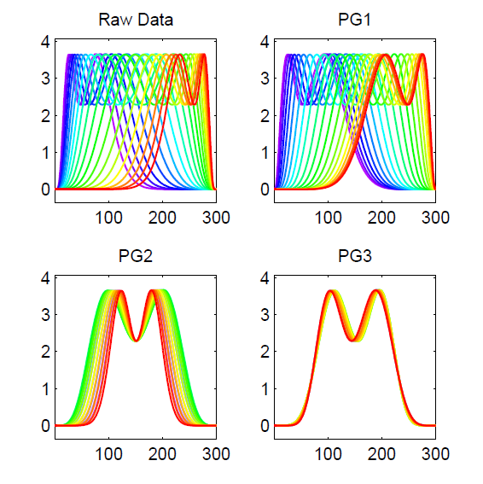
PNS on SRVF Sphere
Toy Example
Tangent Space PCA
(on Horiz. Var’n)
Thanks to Xiaosun Lu

Slide 95
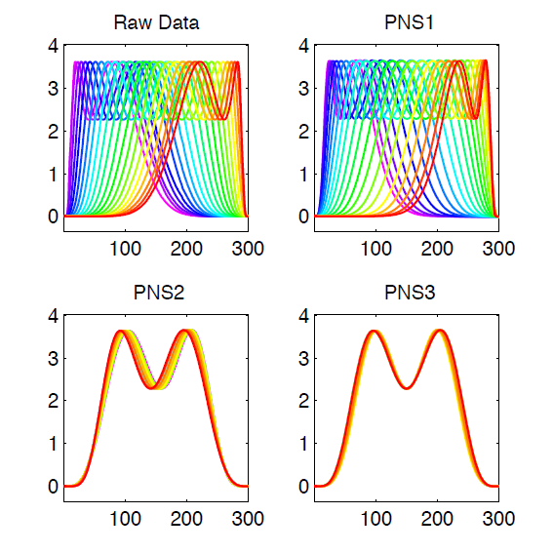
PNS on SRVF Sphere
Toy Example
PNS Projections
(Fewer Modes)

Slide 96
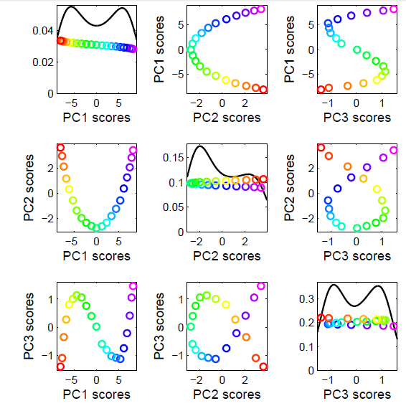
PNS on SRVF Sphere
Toy Example
Tangent Space PCA
Note: 3 Comp’s
Needed for This

Slide 97
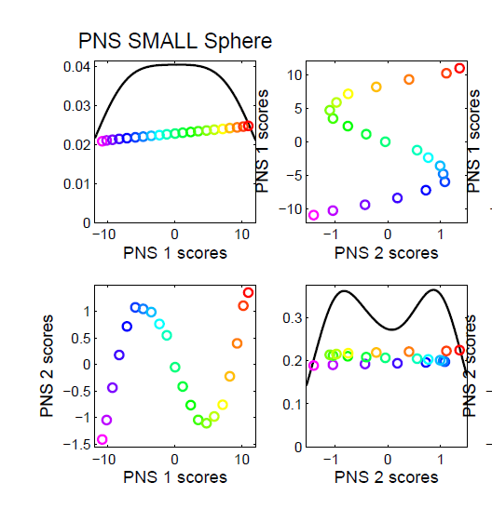
PNS on SRVF Sphere
Toy Example
PNS Projections
Only 2 for This

Slide 98
PNS on SRVF Sphere
Toy Example
Parametrized
By Values
At 1/3 And 2/3

Slide 99
PNS on SRVF Sphere
Toy Example
View As Points
Tangent Plane PC 1
PNS 1
Boundary of
Nonnegative
Orthant

Slide 100
PNS on SRVF Sphere
Toy Example
Curves from
Tangent Plane PC 1
Note: Some Are
No Longer Warps!

Slide 101
PNS on SRVF Sphere
Toy Example
View As Points
PNS 1
Good 1-d
Approx.

Slide 102
PNS on SRVF Sphere
Toy Example
Recall Original
Warps

Slide 103
PNS on SRVF Sphere
Toy Example
Another View
$∗$ Raw Warps
$⊡$Tangent PC1
$∘$ PNS 1

Slide 104
PNS on SRVF Sphere
Real Data Analysis: Blood Glucose Curves
Interpolation to Handle Missing Data

Slide 105
PNS on SRVF Sphere
Real Data Analysis: Blood Glucose Curves
Results of Fisher Rao Decomposition

Slide 106
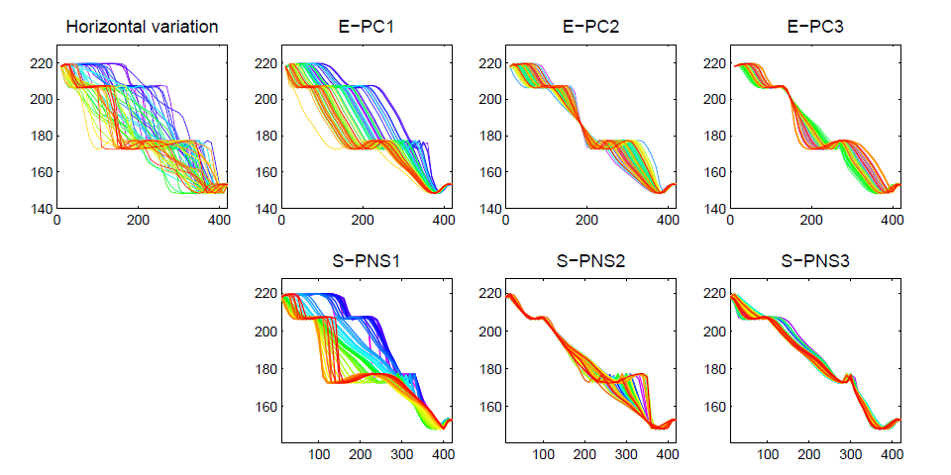
PNS on SRVF Sphere
Real Data Analysis: Blood Glucose Curves

Slide 107
PNS on SRVF Sphere
Real Data Analysis: Blood Glucose Curves
Understand PNS 1 Mode
Of Variation, Using
Equally Spaced Scores

Slide 108
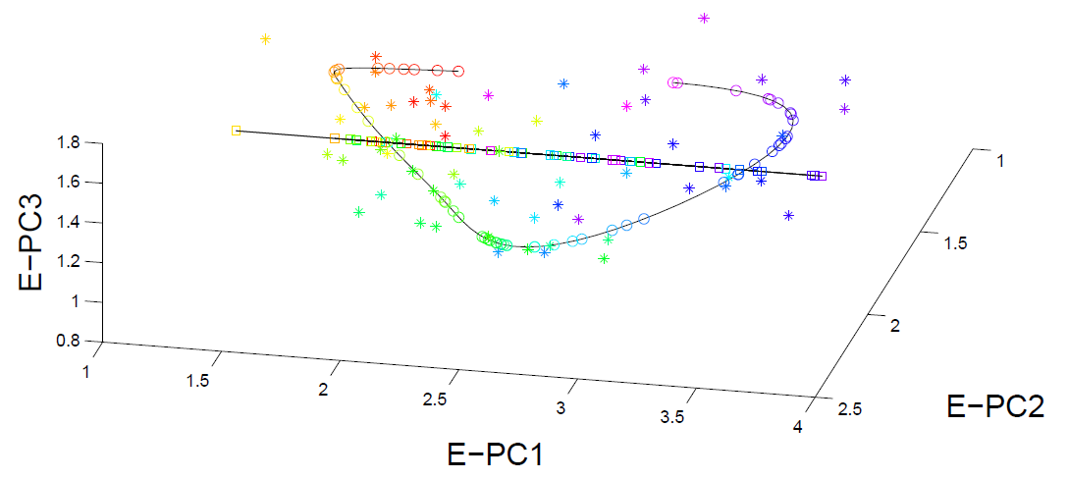
PNS on SRVF Sphere
Real Data Analysis: Blood Glucose Curves

Slide 109
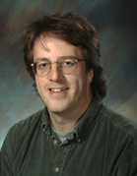
Juggling Data
Michael Newton – U. Wisconsin
Data from Ramsay et al (2014)
(Vertical Location vs. Time)
While Juggling
Thanks of Theravive.com

Slide 110
Juggling Data
Time
Traces
Cut Into
Time
Blocks:
(Data
Objects)

Slide 111
Juggling Data
Ampitude – Phase Variation Decomposition
(Analysis from Lu & Marron (2014))

Slide 112
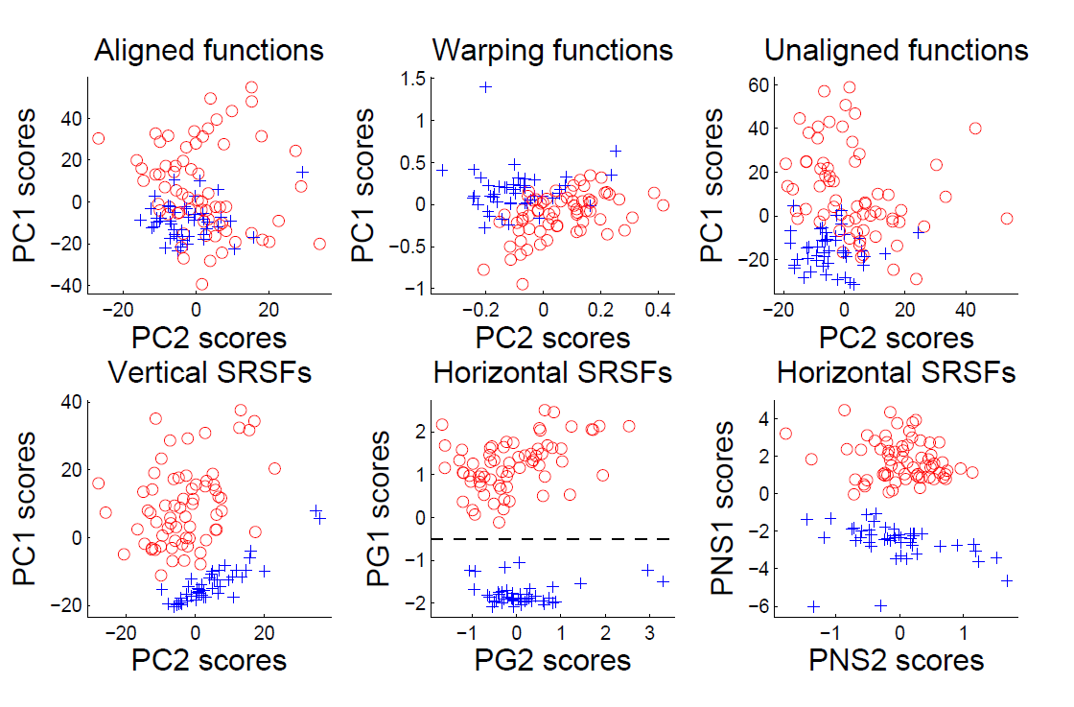
Juggling Data
Clustering In Phase Variation Space:

Slide 113
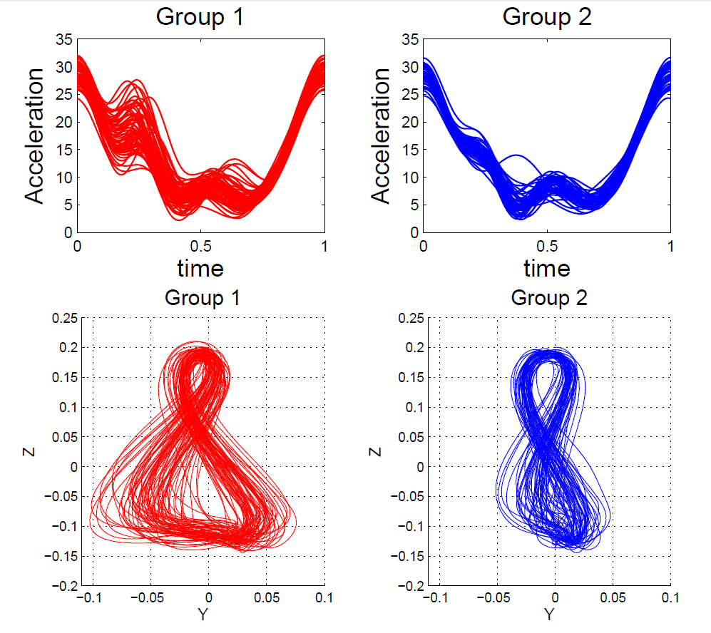
Juggling Data
Interpretation
of Clusters

Slide 114
References for Much More
Big Picture Survey:
Marron et al (2015)
Results of a Competition:
Marron et al (2014)

Slide 115
Overview
Curve Registration is Slippery
Thus, Careful Mathematics is Useful
Fisher-Rao Approach:
Gets the Math Right
Intuitively Sensible
Computable
Generalizable
Worth the Complication

Slide 116
Participant Presentations
12:05 Joseph Lavond: Fast Adversarial Training
12:10 Sam Ehrenstein: Non-Contrast Ultrasound Imaging of Blood Microvessels using SVD
Next Class:
Younghoon Kim, Hong Dang

