Slide 1
Statistics – O. R. 881
Object Oriented Data Analysis
Start
Recording
Steve Marron
Dept. of Statistics and Operations Research
University of North Carolina

Slide 2
Current Sections in Textbook
Today:
Sections 9.2, 11.1
Next Class:
Sections 11.2, 11.3

Slide 3
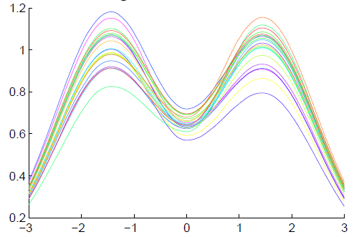
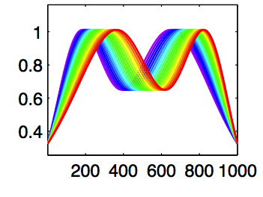
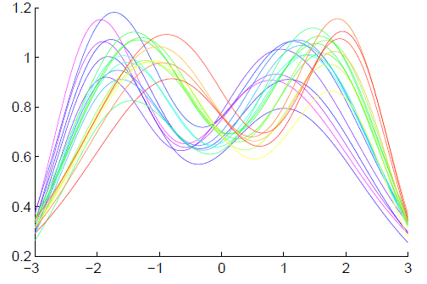
General Amp - Phase Context
Appropriate
Mathematical
Framework?
Vertical Variation
Horiz’l
Var’n

Slide 4
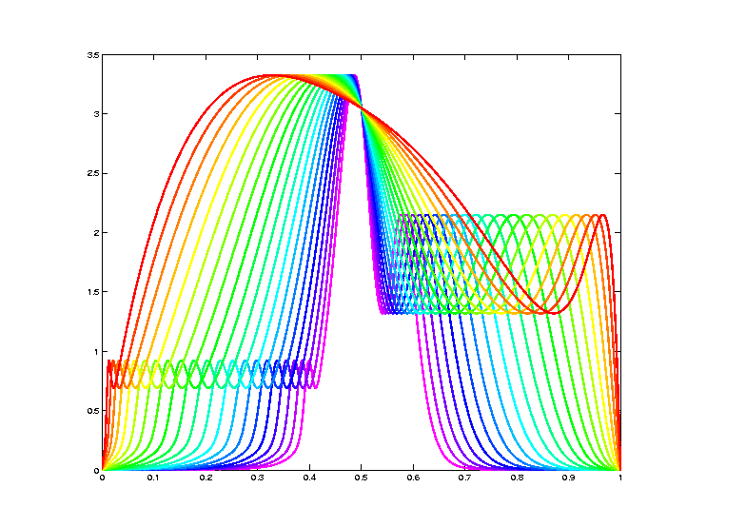
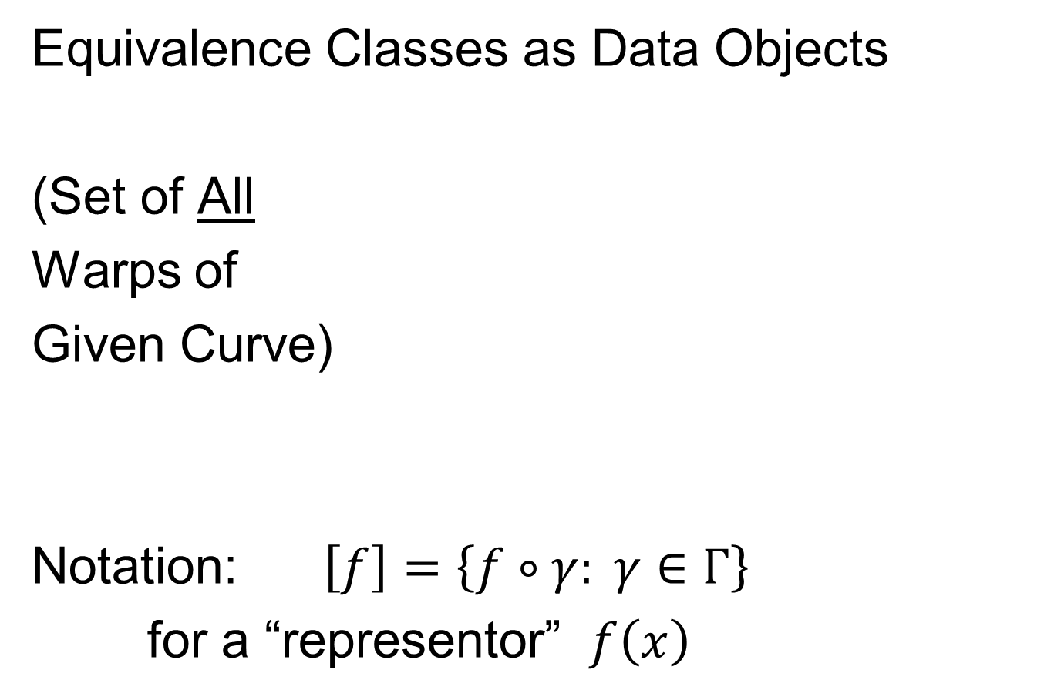
Data Objects I
Equivalence Classes as Data Objects
(Set of All
Warps of
Given Curve)
Notation: $\left[f\right]=\left\{f∘γ: γ∈Γ\right\}$
for a “representor” $f\left(x\right)$

Slide 5
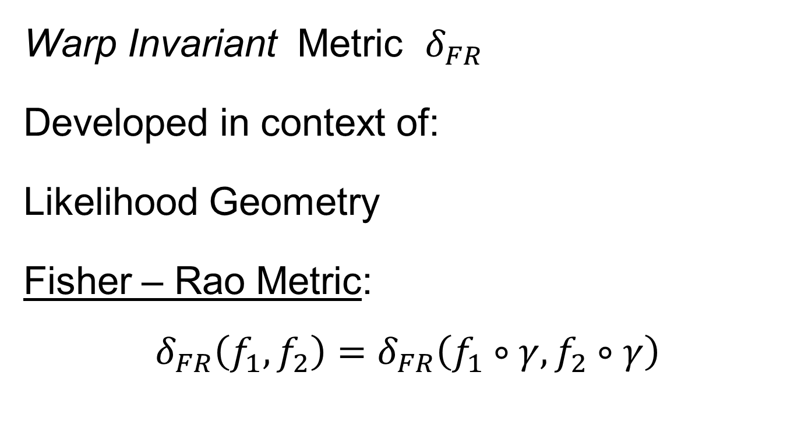
Metrics in Curve Space
Warp Invariant Metric $δ_{FR}$
Developed in context of:
Likelihood Geometry
Fisher – Rao Metric:
$$δ_{FR}\left(f_{1},f_{2}\right)=δ_{FR}\left(f_{1}∘γ,f_{2}∘γ\right)$$
Rao (1945)
Deeper Theory:
Amari (1985)

Slide 6
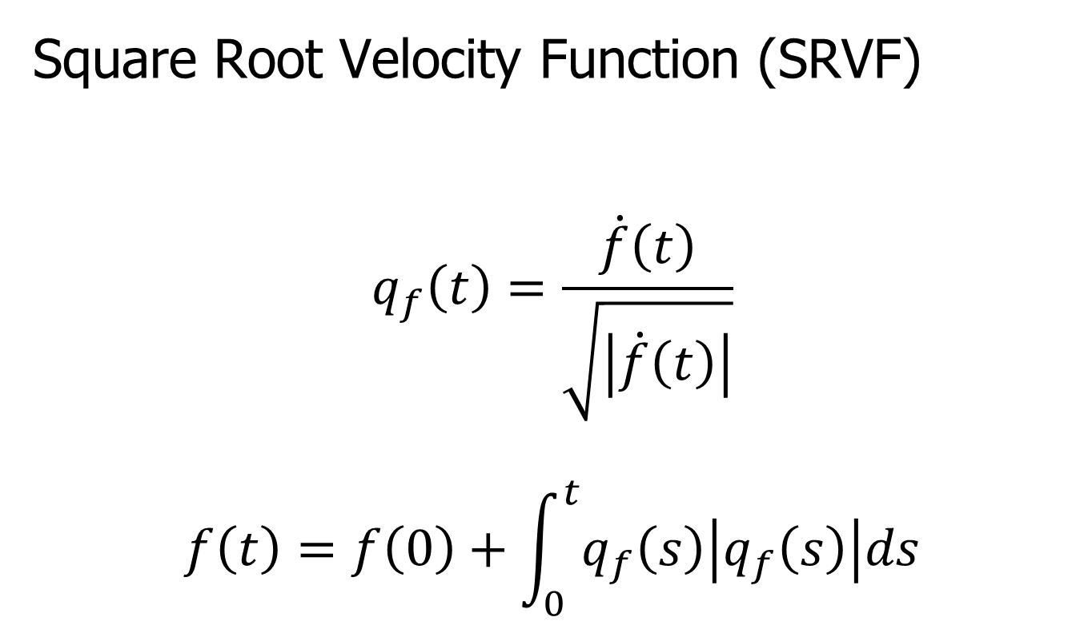
Metrics in Curve Space
Square Root Velocity Function (SRVF)
$$q_{f}\left(t\right)=\frac{\dot{f}\left(t\right)}{\sqrt{\left|\dot{f}\left(t\right)\right|}}$$
$$f\left(t\right)=f\left(0\right)+\int_{0}^{t}{q_{f}\left(s\right)\left|q_{f}\left(s\right)\right|ds}$$

Slide 7
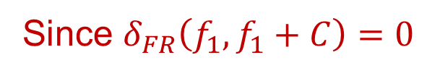
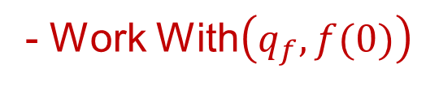
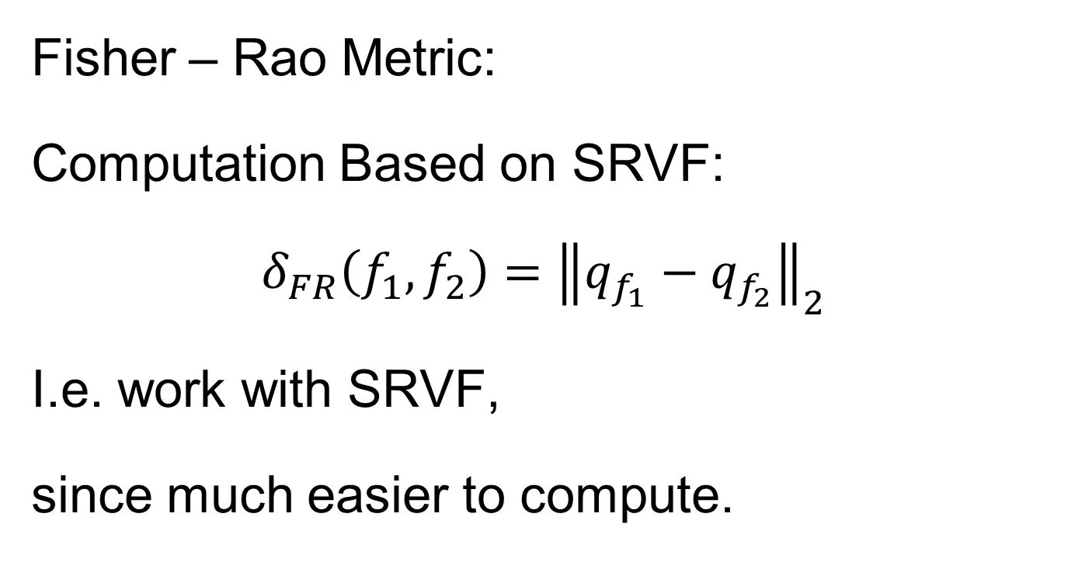
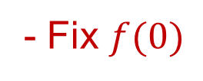
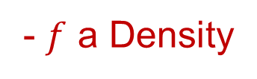
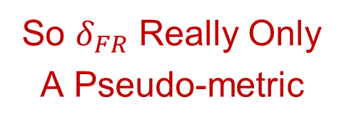
Metrics in Curve Space
Caution: This is Not True
Since $δ_{FR}\left(f_{1},f_{1}+C\right)=0$
Fisher – Rao Metric:
Computation Based on SRVF:
$$δ_{FR}\left(f_{1},f_{2}\right)={\left\|q_{f_{1}}−q_{f_{2}}\right\|}_{2}$$
I.e. work with SRVF,
since much easier to compute.
So $δ_{FR}$ Really Only
A Pseudo-metric
Could Add Assumptions:
- $f$ a Density
- Fix $f(0)$
- Work With$\left(q_{f},f(0)\right)$
Thanks to Bongsoo Yi

Slide 8

Homework 5
(c) Show the Amplitude Metric
$$δ_{A}\left(\left[f_{1}\right],\left[f_{2}\right]\right)=\inf_{γ∈Γ}\left\|q_{f_{1}}−q_{f_{2}∘γ}\right\|$$
Satisfies the Metric Properties
(i.e. Really is a Distance Measure)
(Hints on Sakai Page)
Due: Mar. 10,
11:00AM
Don’t Turn In, or Will Accept
Anything Already Turned In

Slide 9
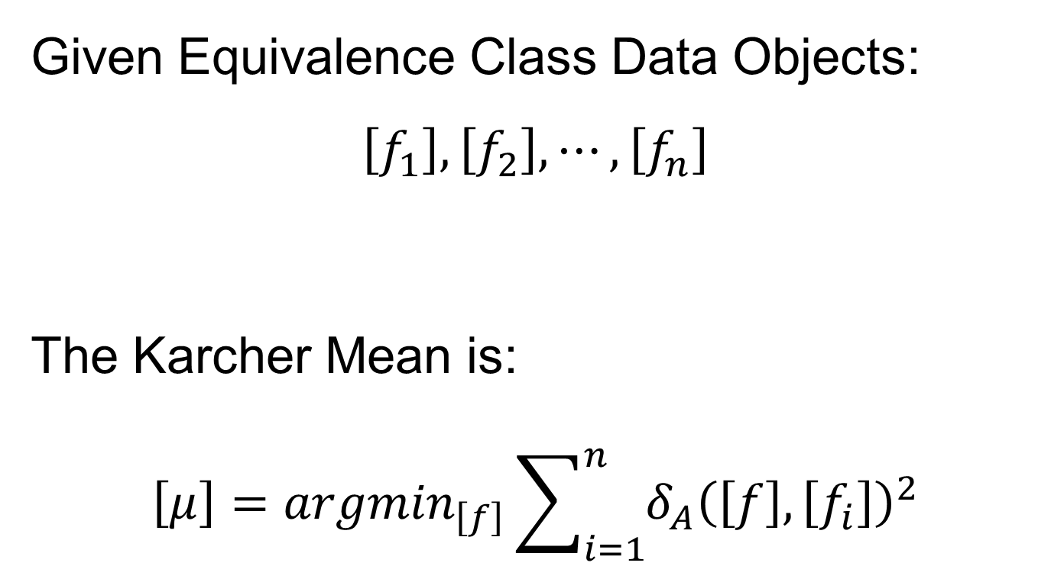
Mean in Curve Quotient Space
Given Equivalence Class Data Objects:
$$\left[f_{1}\right], \left[f_{2}\right], ⋯,\left[f_{n}\right]$$
The Karcher Mean is:
$$\left[μ\right]={argmin}_{\left[f\right]}\sum_{i=1}^{n}{{δ_{A}\left(\left[f\right],\left[f_{i}\right]\right)}^{2}}$$

Slide 10
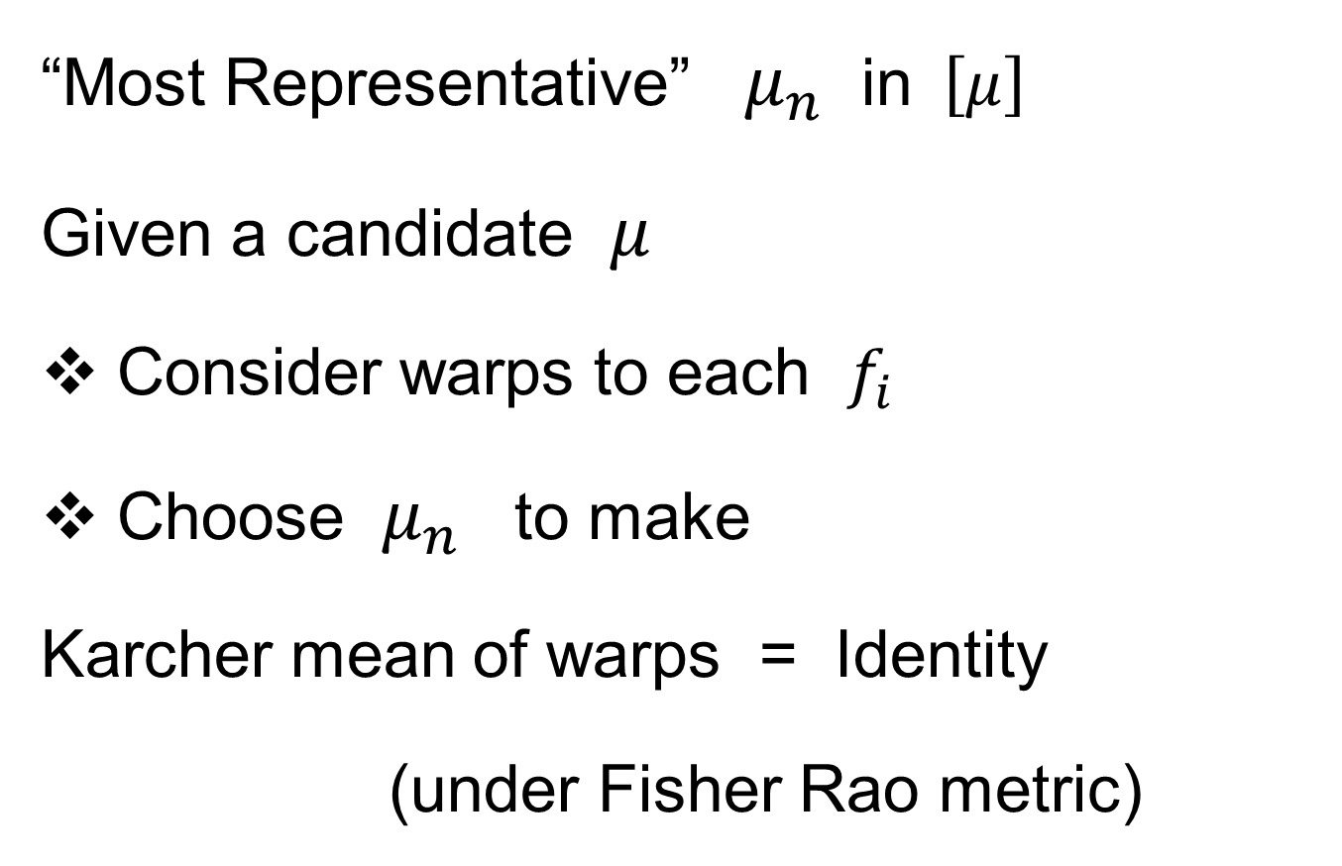
Mean in Curve Quotient Space
“Most Representative” $μ_{n}$ in$\left[μ\right]$
Given a candidate $μ$
Consider warps to each $f_{i}$
Choose $μ_{n}$ to make
Karcher mean of warps = Identity
(under Fisher Rao metric)

Slide 11
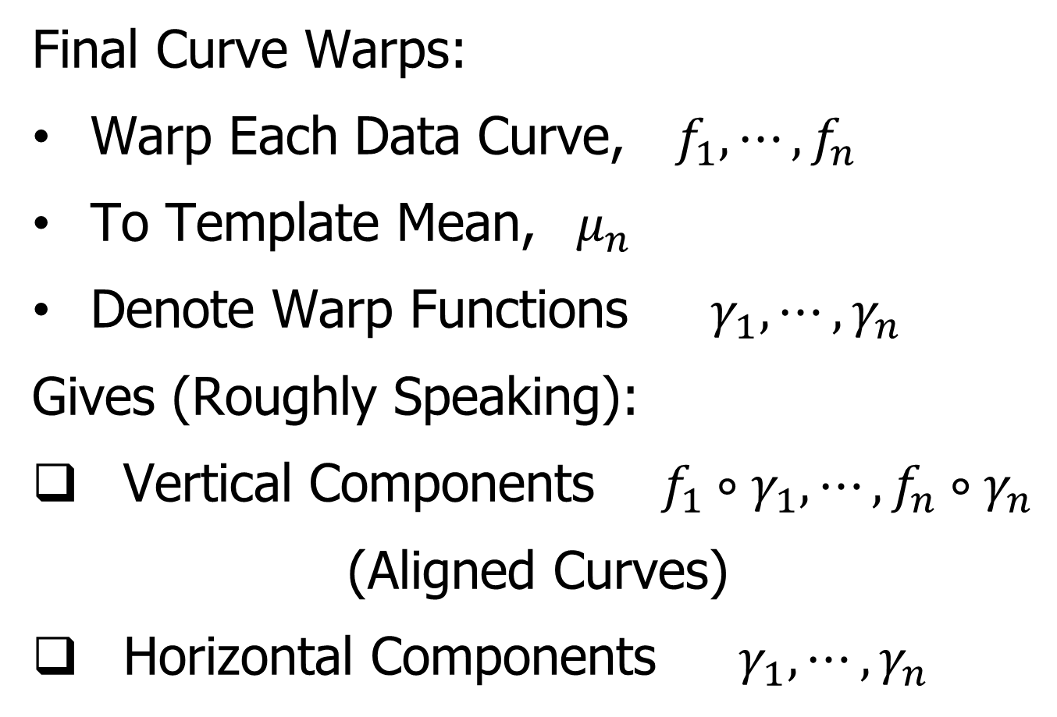
More Data Objects
Final Curve Warps:
Warp Each Data Curve, $f_{1}, ⋯,f_{n}$
To Template Mean, $μ_{n}$
Denote Warp Functions $γ_{1}, ⋯,γ_{n}$
Gives (Roughly Speaking):
Vertical Components $f_{1}∘γ_{1}, ⋯,f_{n}∘γ_{n}$
(Aligned Curves)
Horizontal Components $γ_{1}, ⋯,γ_{n}$
Data Objects I

Slide 12
More Data Objects
Data Objects II
Final Curve Warps:
Warp Each Data Curve, $f_{1}, ⋯,f_{n}$
To Template Mean, $μ_{n}$
Denote Warp Functions $γ_{1}, ⋯,γ_{n}$
Gives (Roughly Speaking):
Vertical Components $f_{1}∘γ_{1}, ⋯,f_{n}∘γ_{n}$
(Aligned Curves)
Horizontal Components $γ_{1}, ⋯,γ_{n}$
~ Kendall’s Shapes

Slide 13
More Data Objects
Final Curve Warps:
Warp Each Data Curve, $f_{1}, ⋯,f_{n}$
To Template Mean, $μ_{n}$
Denote Warp Functions $γ_{1}, ⋯,γ_{n}$
Gives (Roughly Speaking):
Vertical Components $f_{1}∘γ_{1}, ⋯,f_{n}∘γ_{n}$
(Aligned Curves)
Horizontal Components $γ_{1}, ⋯,γ_{n}$
Data Objects III
~ Chang’s Transfo’s

Slide 14
Functional Data Analysis
Insightful
Decomposition
Vertical Variation
Horiz’l
Var’n

Slide 15
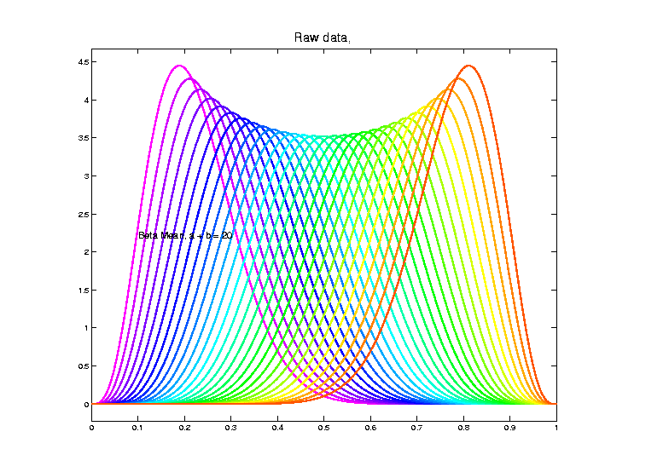
Shifted Betas Example
Raw
Data
Both
Horizontal
And
Vertical
Variation

Slide 16
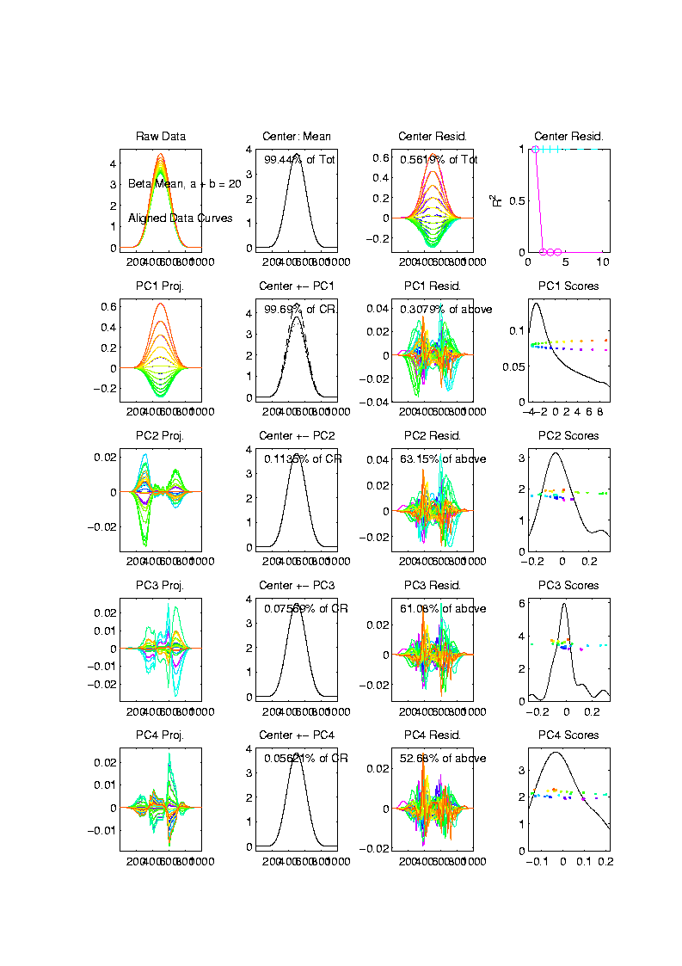
Shifted Betas Example
Aligned
Curve
PCA
Projections
All Var’n
In 1st
Component

Slide 17
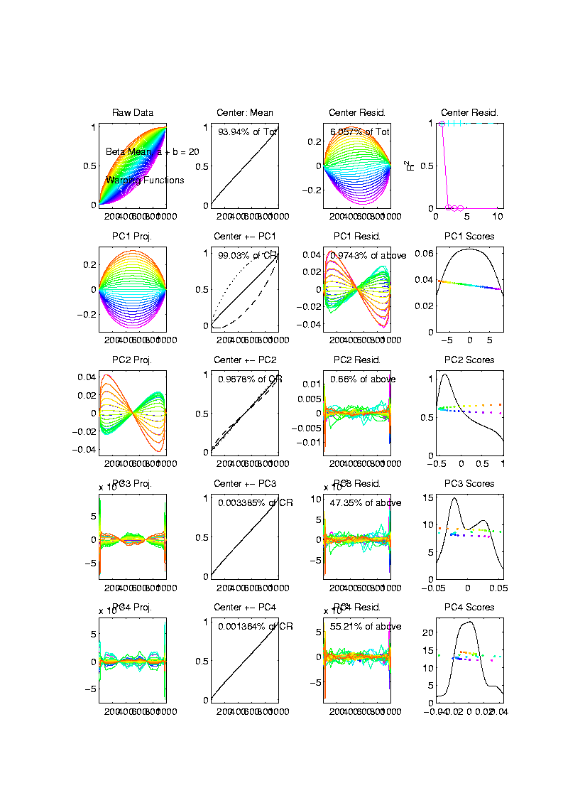
Shifted Betas Example
Warps,
PC
Projections

Slide 18
Shifted Betas Example
Warps,
PC
Projections
Rest is
Not
Important

Slide 19
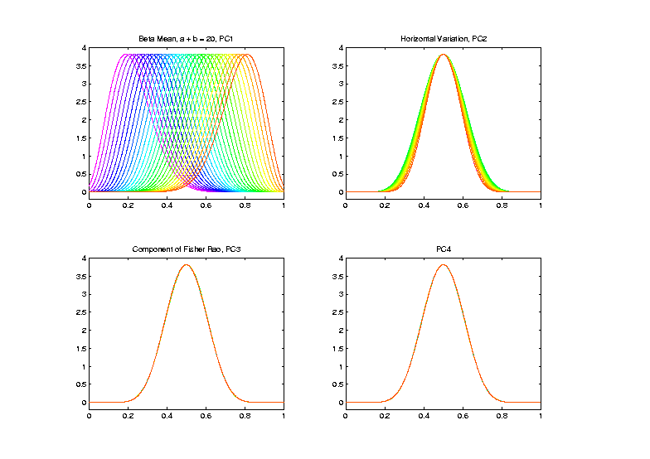
Shifted Betas Example
Warp
Compon’ts
(+ Mean)
Applied to
Template
Mean

Slide 20
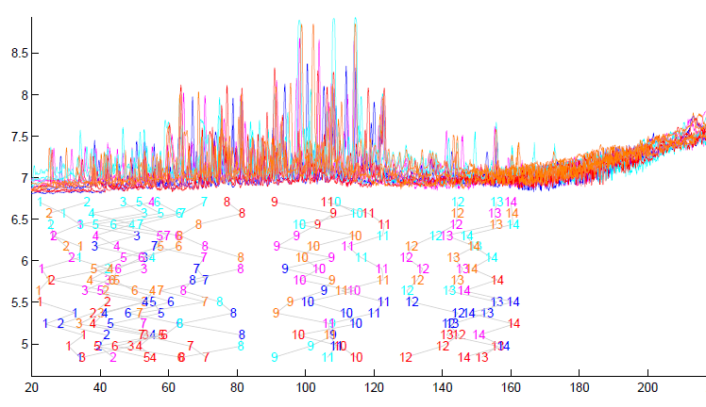
TIC testbed
Special Feature: Answer Key of Known Peaks
Goal:
Find
Warps
To Align
These

Slide 21
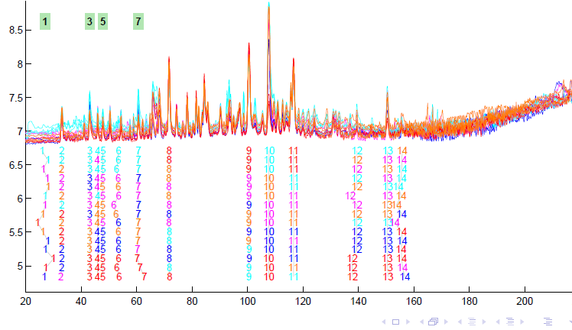
TIC testbed
Fisher – Rao Alignment

Slide 22
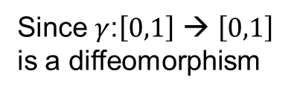
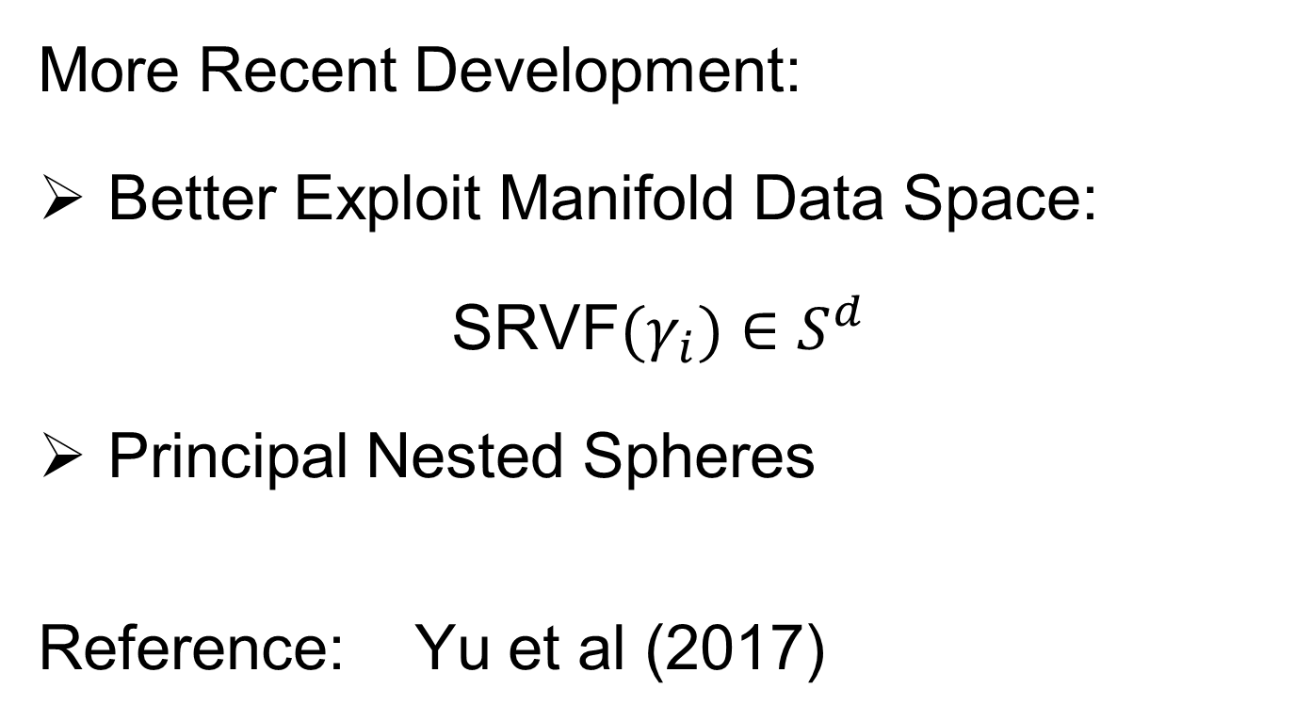
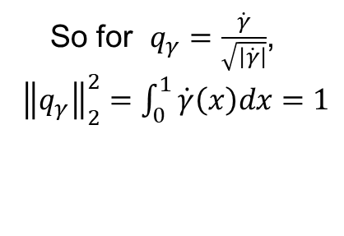
Refined Calculations
Text, Sec. 9.2
More Recent Development:
Better Exploit Manifold Data Space:
SRVF${(γ}_{i})∈S^{d}$
Principal Nested Spheres
Reference: Yu et al (2017)
Since $γ$:$\left[0,1\right]$ → $\left[0,1\right]$
is a diffeomorphism
So for $q_{γ}=\frac{\dot{γ}}{\sqrt{\left|\dot{γ}\right|}}$,
${\left\|q_{γ}\right\|}_{2}^{2}=\int_{0}^{1}{\dot{γ}\left(x\right)dx}=1$

Slide 23
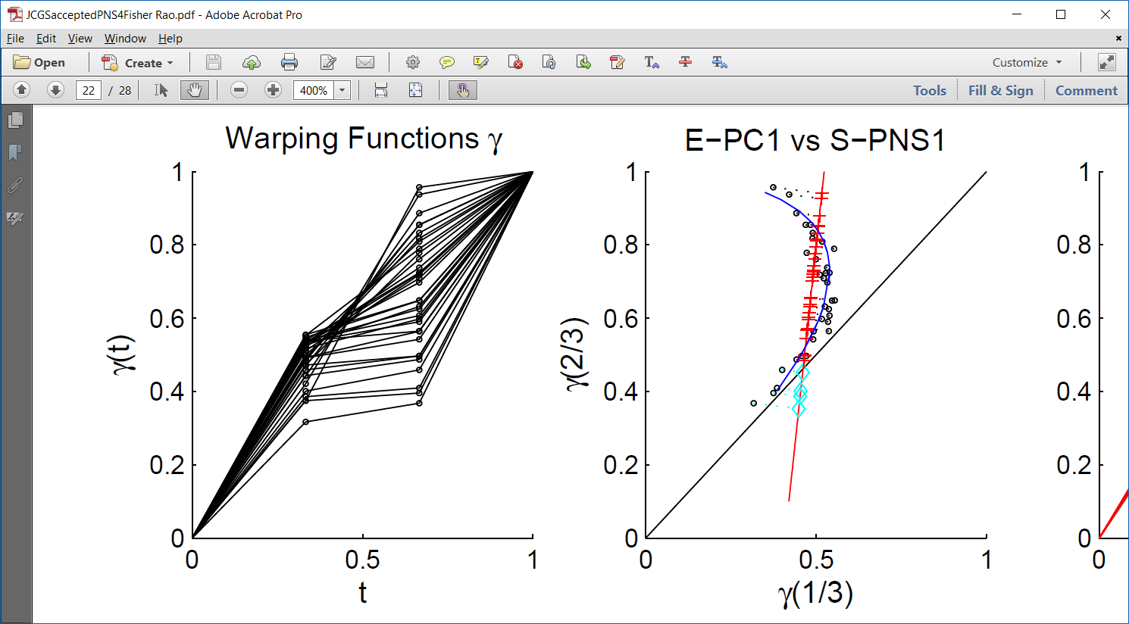
PNS on SRVF Sphere
Toy Example
Parametrized
By Values
At 1/3 And 2/3

Slide 24
PNS on SRVF Sphere
Toy Example
View As Points
Tangent Plane PC 1
PNS 1
Boundary of
Nonnegative
Orthant

Slide 25
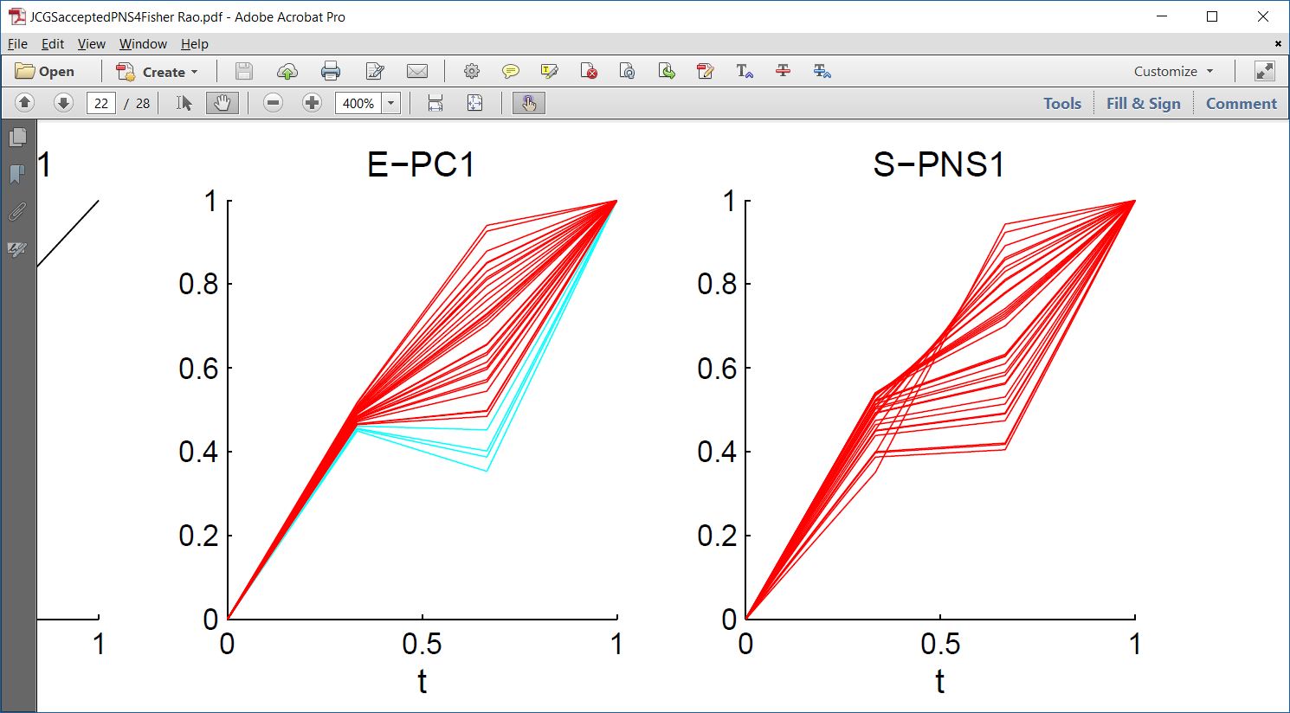
PNS on SRVF Sphere
Toy Example
Curves from
Tangent Plane PC 1
Note: Some Are
No Longer Warps!

Slide 26
PNS on SRVF Sphere
Toy Example
View As Points
PNS 1
Good 1-d
Approx.

Slide 27
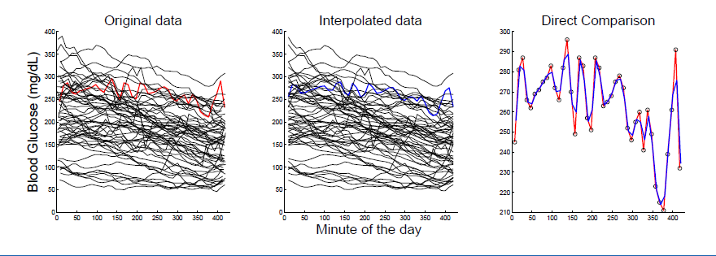
PNS on SRVF Sphere
Real Data Analysis: Blood Glucose Curves
Interpolation to Handle Missing Data

Slide 28
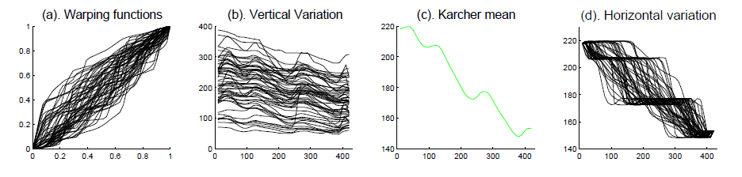
PNS on SRVF Sphere
Real Data Analysis: Blood Glucose Curves
Results of Fisher Rao Decomposition

Slide 29
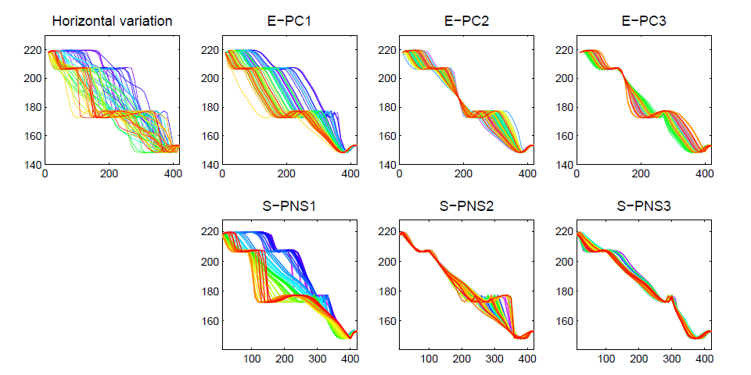
PNS on SRVF Sphere
Real Data Analysis: Blood Glucose Curves

Slide 30
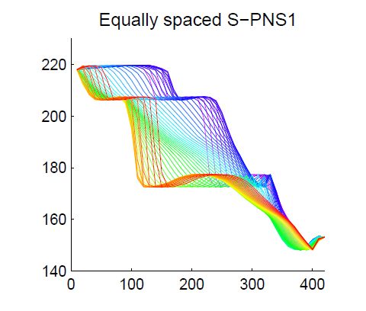
PNS on SRVF Sphere
Real Data Analysis: Blood Glucose Curves
Understand PNS 1 Mode
Of Variation, Using
Equally Spaced Scores

Slide 31
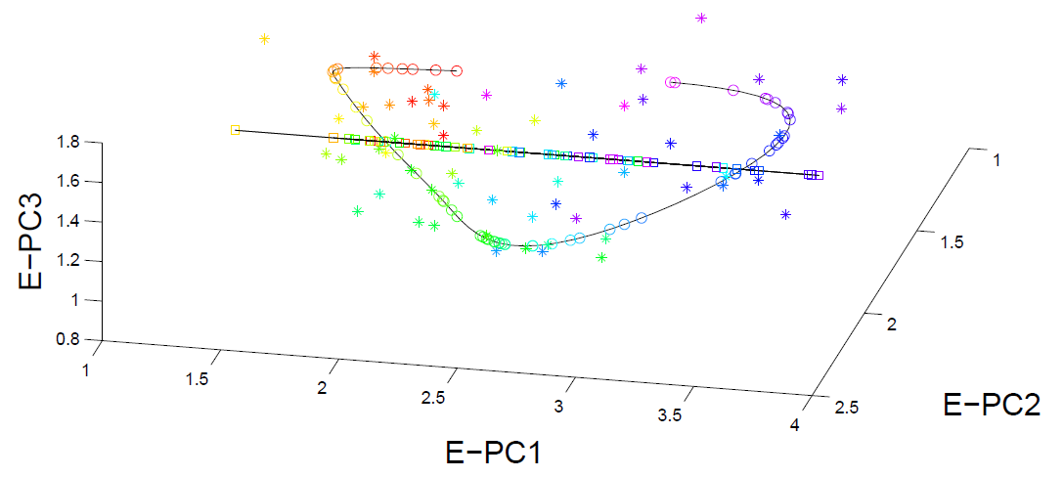
PNS on SRVF Sphere
Real Data Analysis: Blood Glucose Curves

Slide 32



Juggling Data
Michael Newton – U. Wisconsin
Data from Ramsay et al (2014)
(Vertical Location vs. Time)
While Juggling
Thanks of Theravive.com

Slide 33
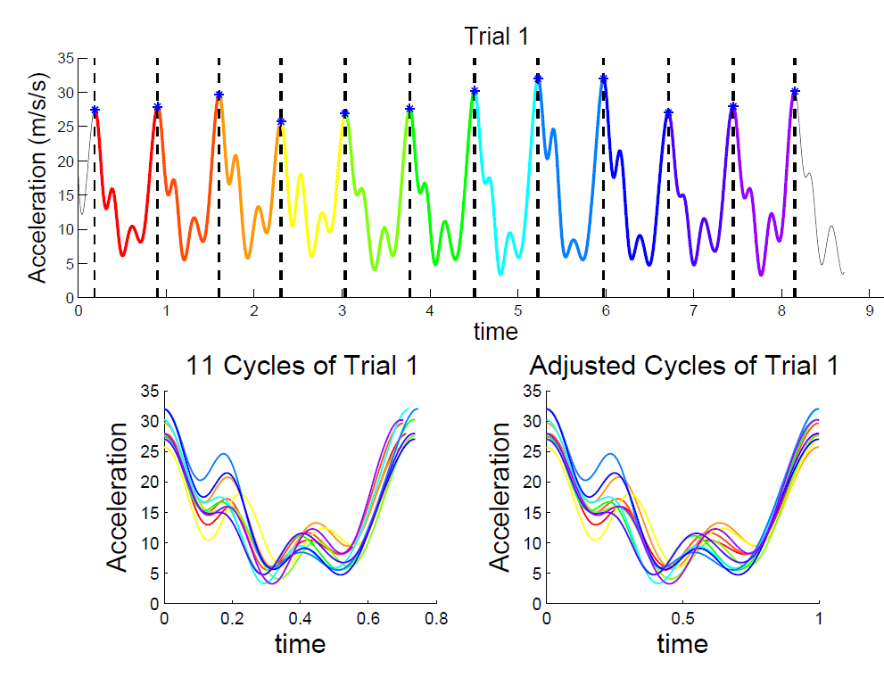
Juggling Data
Time
Traces
Cut Into
Time
Blocks:
(Data
Objects)

Slide 34
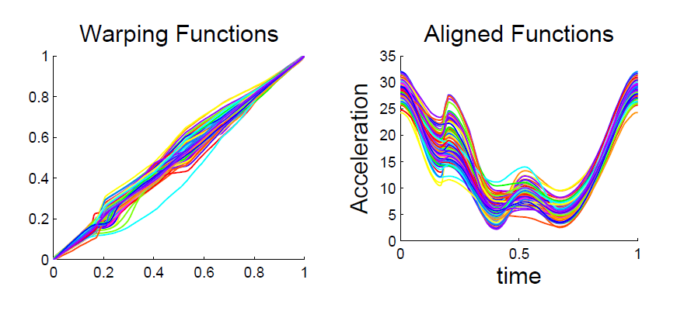
Juggling Data
Ampitude – Phase Variation Decomposition
(Analysis from Lu & Marron (2014))

Slide 35
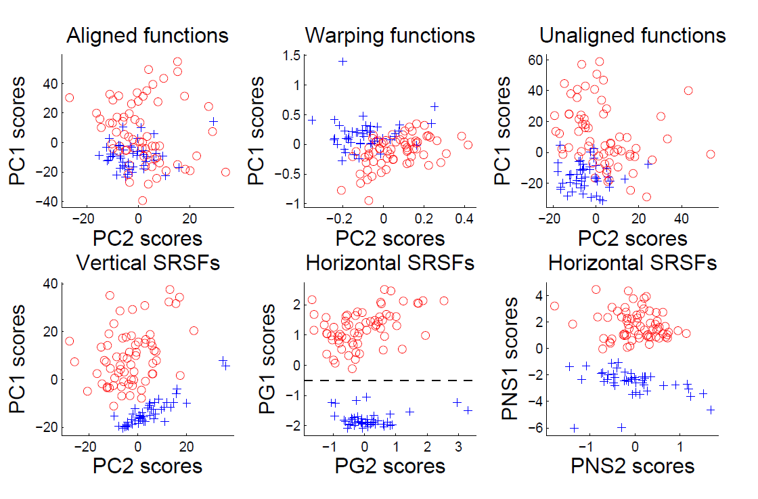
Juggling Data
Clustering In Phase Variation Space:

Slide 36
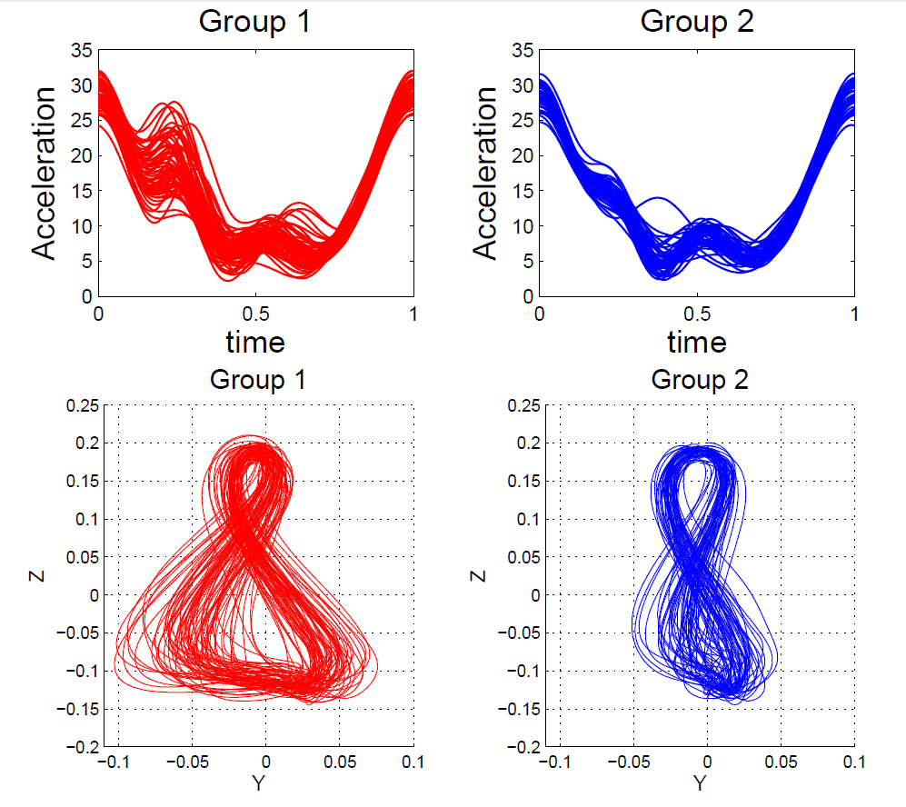
Juggling Data
Interpretation
of Clusters

Slide 37
References for Much More
Big Picture Survey:
Marron et al (2015)
Results of a Competition:
Marron et al (2014)

Slide 38
Overview
Curve Registration is Slippery
Thus, Careful Mathematics is Useful
Fisher-Rao Approach:
  Gets the Math Right
  Intuitively Sensible
  Computable
  Generalizable
  Worth the Complication

Slide 39
Return to Big Picture
Main statistical goals of OODA:
Understanding population structure
  Low dim’al Projections, PCA …
Classification (i. e. Discrimination)
  Understanding 2+ populations
Time Series of Data Objects
  Chemical Spectra, Mortality Data
“Vertical Integration” of Data Types

Slide 40
Classification - Discrimination
Background: Two Class (Binary) version:
Using “training data” from
Class +1 and Class -1
Develop a “rule” for
assigning new data to a Class
Canonical Example: Disease Diagnosis
New Patients are “Healthy” or “Ill”
Determine based on measurements
Text, Chp 11

Slide 41
Classification - Discrimination
Important Distinction:
Classification vs. Clustering
Classification:
Class labels are known,
Goal: understand differences
Clustering:
Goal: Find class labels (to be similar)
Both are about clumps of similar data,
but much different goals

Slide 42
Classification - Discrimination
Important Distinction:
Classification vs. Clustering
Useful terminology:
Classification: supervised learning
Clustering: unsupervised learning

Slide 43
Classification - Discrimination
Terminology:
For statisticians, these are synonyms

Slide 44
Classification - Discrimination
Terminology:
For statisticians, these are synonyms
For biologists, classification means:
Constructing taxonomies
And sorting organisms into them
(maybe this is why discrimination
was used, until politically incorrect…)
Kingdom
Phylum
Class
Order
Genus
Species

Slide 45
Classification (i.e. discrimination)
There are a number of:
Approaches
Philosophies
Schools of Thought
Too often cast as:
Statistics vs. EE - CS

Slide 46
Classification (i.e. discrimination)
EE – CS variations:
Pattern Recognition
Artificial Intelligence
Neural Networks (Deep Learning)
Data Mining
Machine Learning

Slide 47
Classification (i.e. discrimination)
Differing Viewpoints:
Statistics
Model Classes with Probability Distribut’ns
Use to study class diff’s & find rules
EE – CS
Data are just Sets of Numbers
Optimize Separation Rules
Current thought: combine these

Slide 48
Classification (i.e. discrimination)
Important Overview Reference:
Duda, Hart and Stork (2001)
Too much about neural nets???
Pizer disagrees…
Update of Duda & Hart (1973)

Slide 49

Classification (i.e. discrimination)
For a more classical statistical view:
McLachlan (2004).
Gaussian Likelihood theory, etc.
Not well tuned to HDLSS data
Notes:
49

Slide 50
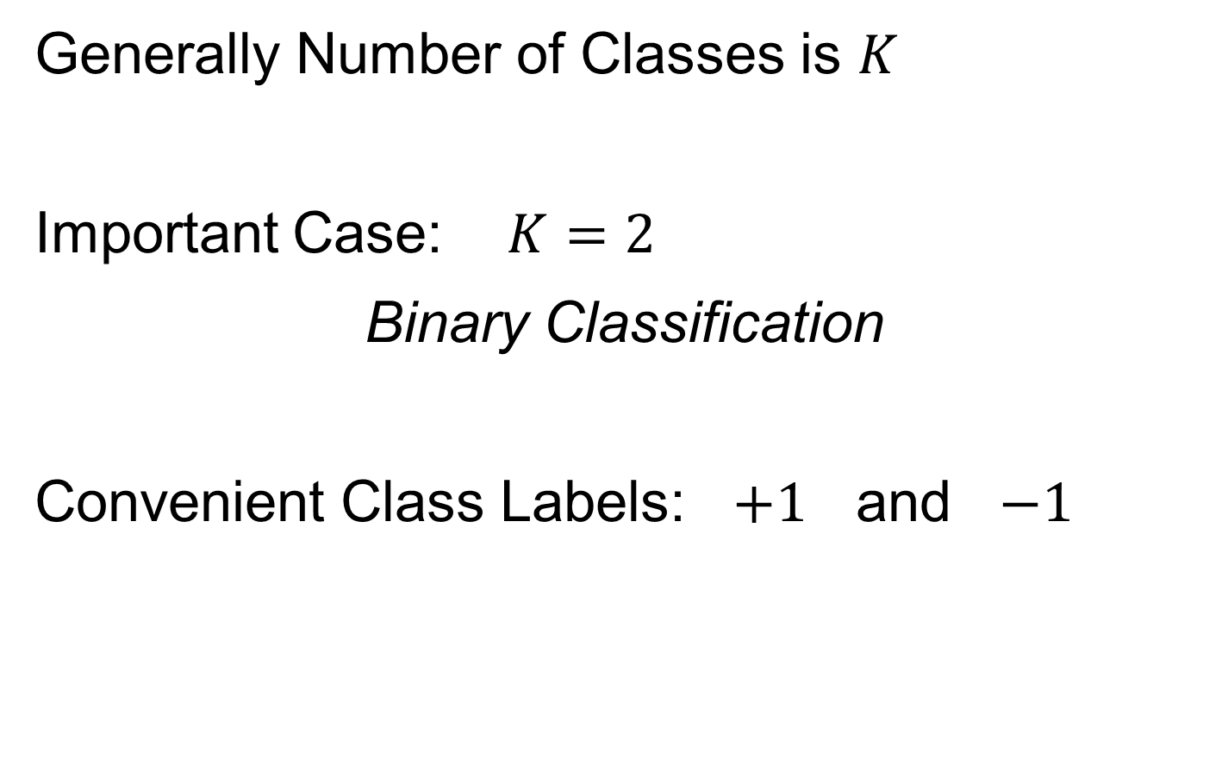
Classification Basics
Generally Number of Classes is $K$
Important Case: $K=2$
Binary Classification
Convenient Class Labels: $+1$ and $−1$
Notes:
HDLSStmbRaw.ps

Slide 51
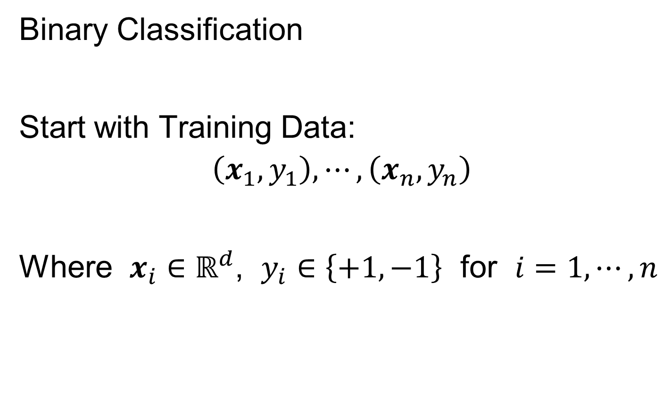
Classification Basics
Binary Classification
Start with Training Data:
$$\left(x_{1},y_{1}\right),⋯,\left(x_{n},y_{n}\right)$$
Where $x_{i}∈ℝ^{d}$, $y_{i}∈\left\{+1,−1\right\}$ for $i=1,⋯,n$
Notes:
HDLSStmbRaw.ps

Slide 52
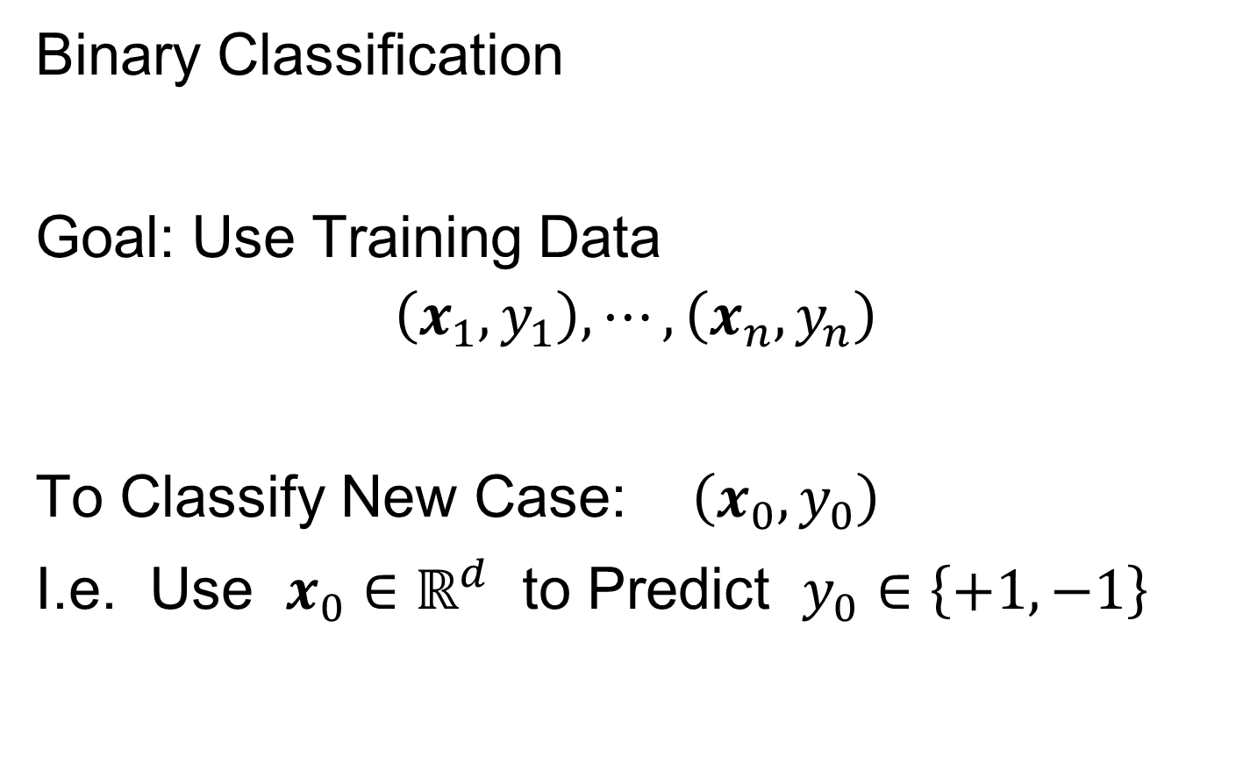
Classification Basics
Binary Classification
Goal: Use Training Data
$$\left(x_{1},y_{1}\right),⋯,\left(x_{n},y_{n}\right)$$
To Classify New Case: $\left(x_{0},y_{0}\right)$
I.e. Use $x_{0}∈ℝ^{d}$ to Predict $y_{0}∈\left\{+1,−1\right\}$
Notes:
HDLSStmbRaw.ps

Slide 53
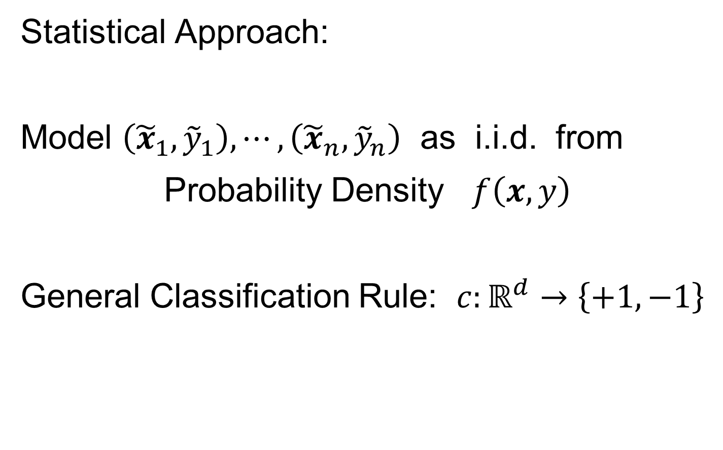
Classification Basics
Statistical Approach:
Model $\left({\tilde{x}}_{1},{\tilde{y}}_{1}\right),⋯,\left({\tilde{x}}_{n},{\tilde{y}}_{n}\right)$ as i.i.d. from
Probability Density $f\left(x,y\right)$
General Classification Rule: $c:ℝ^{d}→\left\{+1,−1\right\}$
Use tildes to denote
random variables
Notes:
HDLSStmbRaw.ps

Slide 54
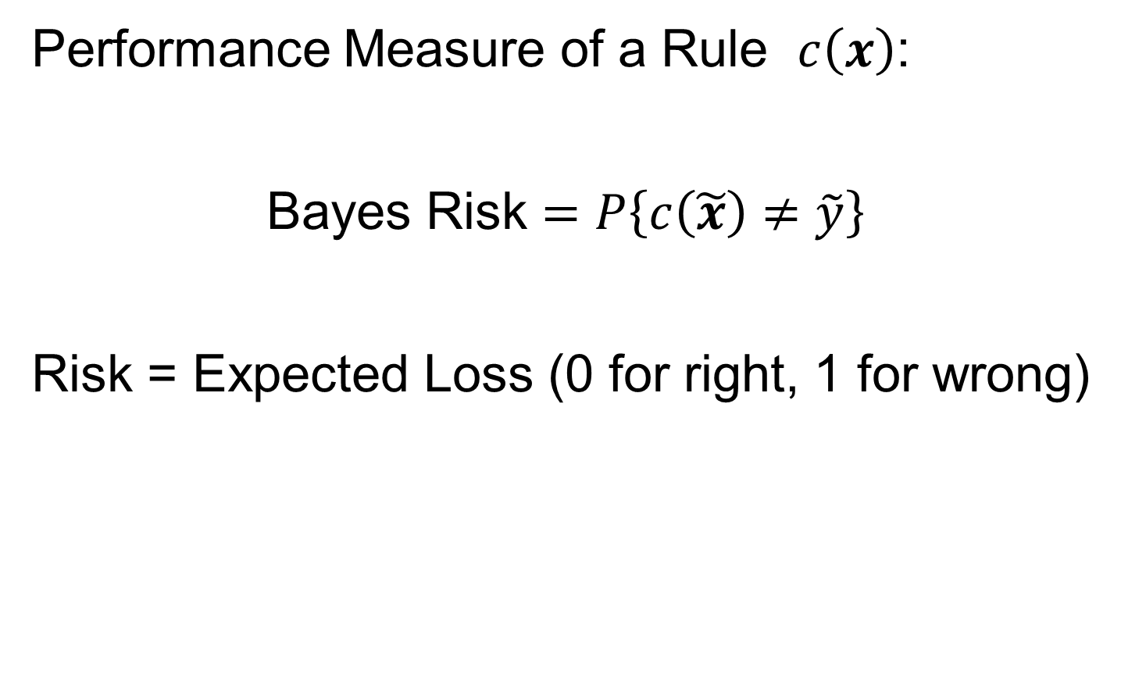
Classification Basics
Performance Measure of a Rule $c\left(x\right)$:
Bayes Risk $=P\left\{c\left(\tilde{x}\right)≠\tilde{y}\right\}$
Risk = Expected Loss (0 for right, 1 for wrong)
Notes:
HDLSStmbRaw.ps

Slide 55
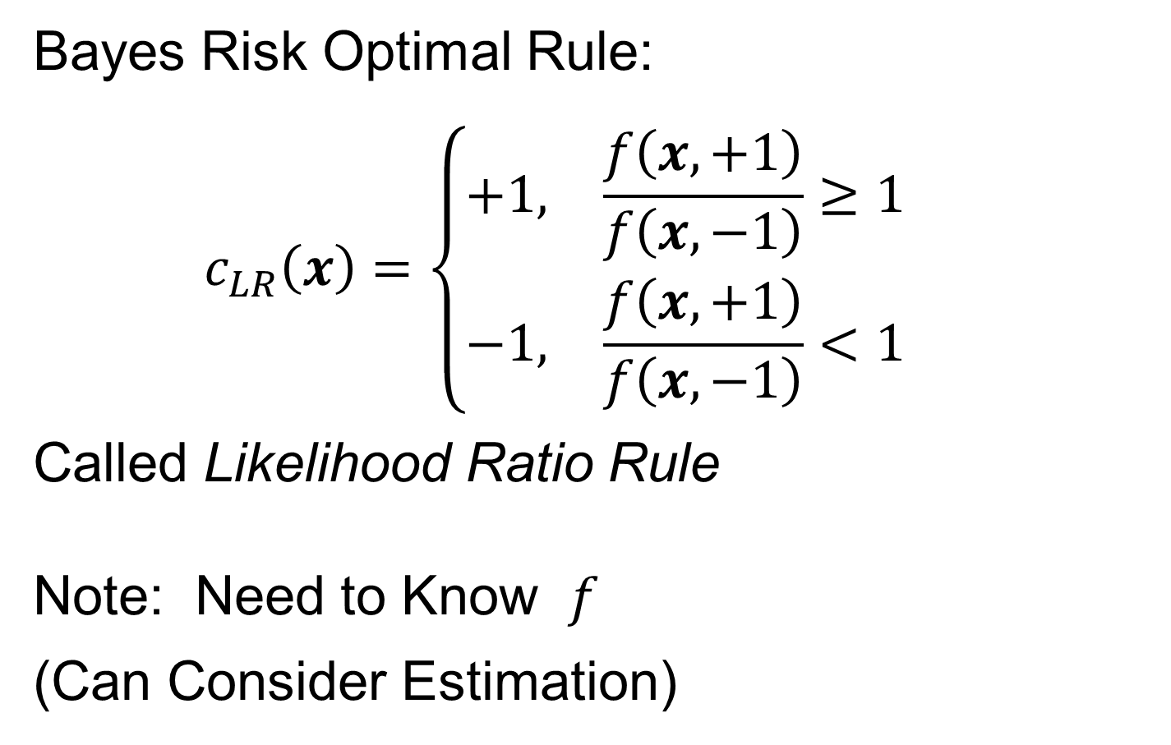
Classification Basics
Bayes Risk Optimal Rule:
$$c_{LR}\left(x\right)=\left\{\begin{matrix}+1, & \frac{f\left(x,+1\right)}{f\left(x,−1\right)}≥1 \\ −1, & \frac{f\left(x,+1\right)}{f\left(x,−1\right)}<1\end{matrix}\right.$$
Called Likelihood Ratio Rule
Note: Need to Know $f$
(Can Consider Estimation)
Provides an
Important
Upper Bound
Notes:
HDLSStmbRaw.ps

Slide 56
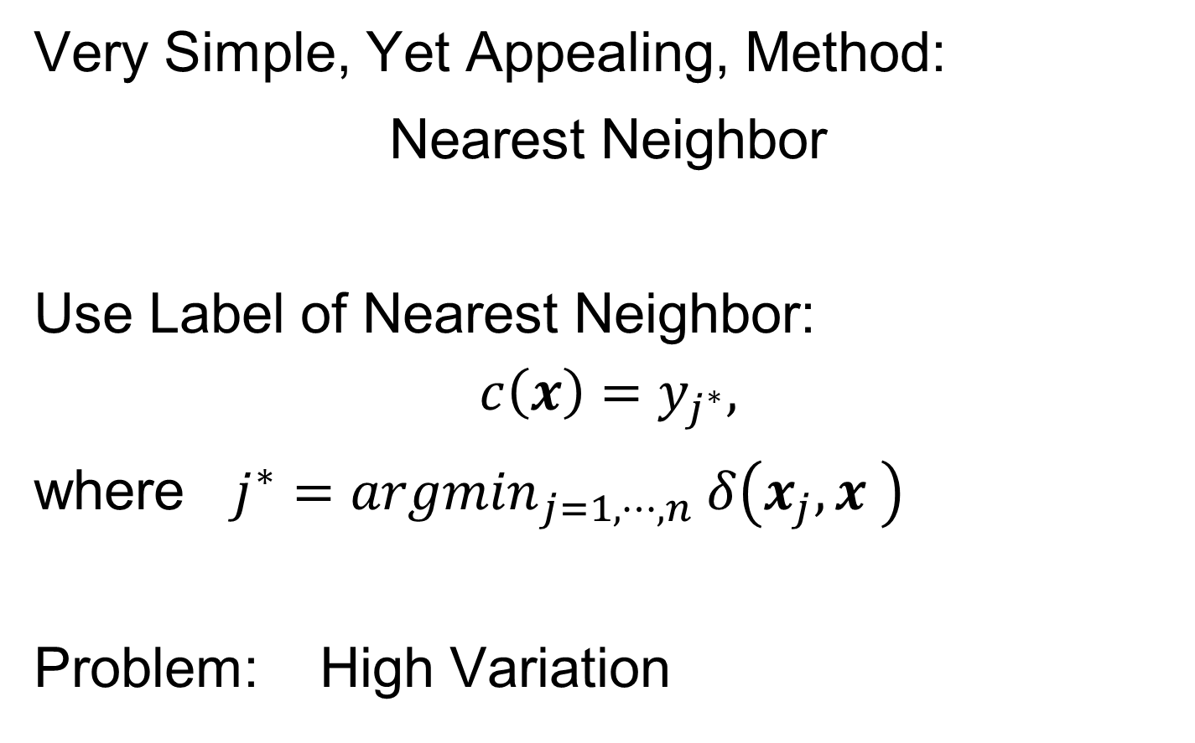
Classification Basics
Very Simple, Yet Appealing, Method:
Nearest Neighbor
Use Label of Nearest Neighbor:
$$c\left(x\right)=y_{j^{∗}},$$
where $j^{∗}={argmin}_{j=1,⋯,n} δ\left(x_{j},x \right)$
Problem: High Variation
Notes:
HDLSStmbRaw.ps

Slide 57
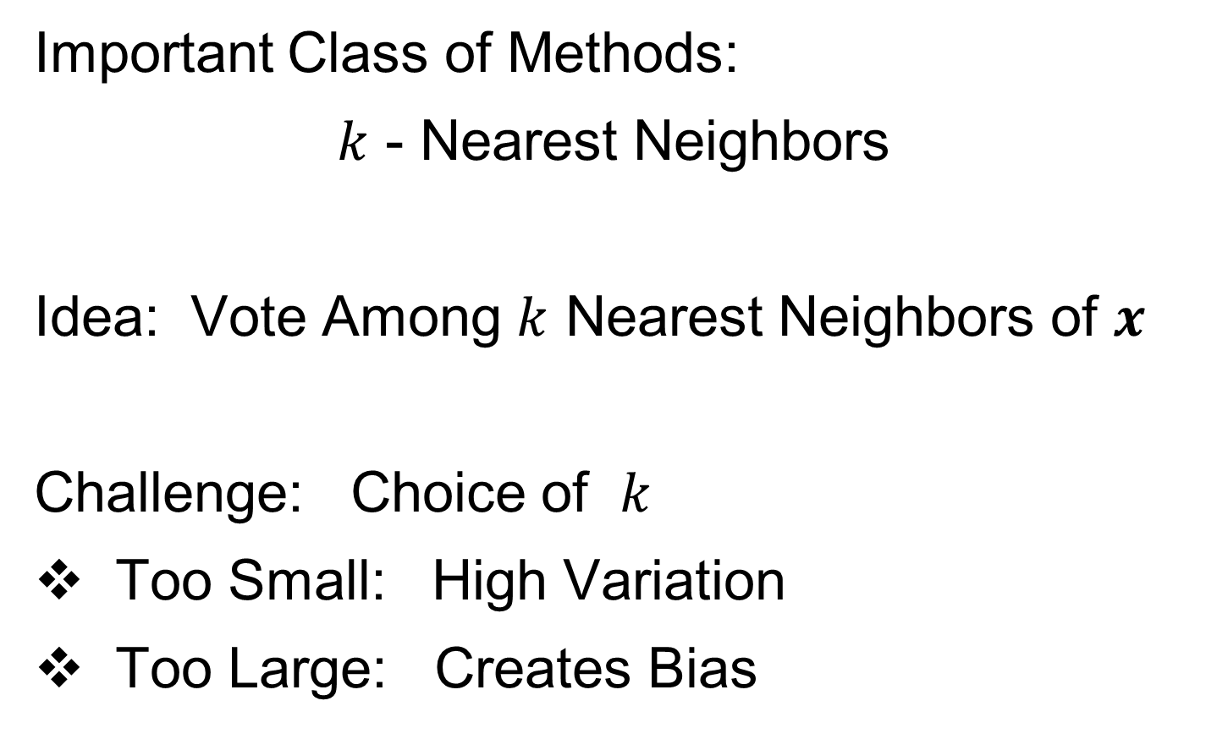
Classification Basics
Important Class of Methods:
$k$ - Nearest Neighbors
Idea: Vote Among $k$ Nearest Neighbors of $x$
Challenge: Choice of $k$
Too Small: High Variation
Too Large: Creates Bias
Notes:
HDLSStmbRaw.ps

Slide 58
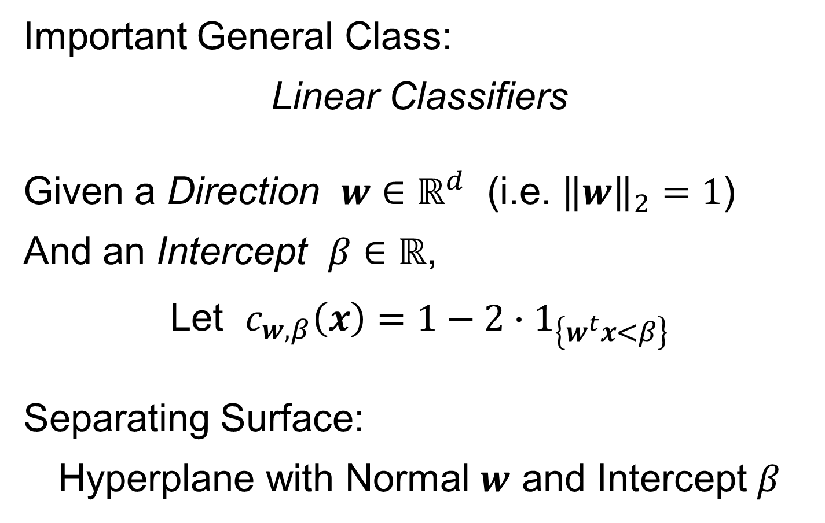
Classification Basics
Important General Class:
Linear Classifiers
Given a Direction $w∈ℝ^{d}$ (i.e. ${\left\|w\right\|}_{2}=1$)
And an Intercept $β∈ℝ$,
Let $c_{w,β}\left(x\right)=1−2∙1_{\left\{w^{t}x<β\right\}}$
Separating Surface:
Hyperplane with Normal $w$ and Intercept $β$
Indicator Function
Notes:
HDLSStmbRaw.ps

Slide 59
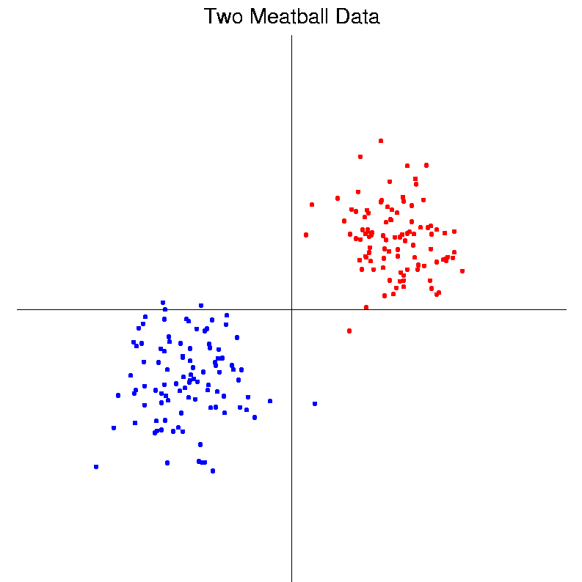
Classification Basics
Personal Viewpoint: Point Clouds
(In
Feature
Space)
Notes:
HDLSStmbRaw.ps

Slide 60
Classification Basics
Simple and Natural Linear Classifier:
Mean Difference
a.k.a.
Centroid Method
Find “skewer through two meatballs”

Slide 61
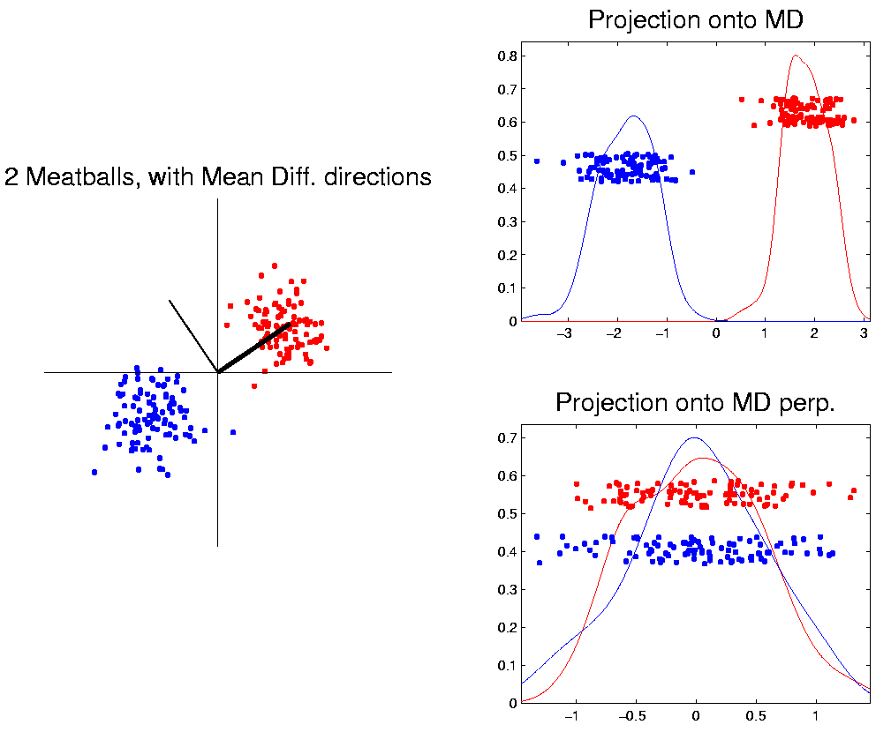
Classification Basics
For Simple Toy Example:
Project
On MD
& Split
at Center
(Assume Equal Numbers for Simplicity)
Notes:
HDLSStmbMdif.ps

Slide 62
Classification Basics
Note, for Shifts of the Standard Normal
MD is Bayes Risk Optimal
Since Likelihood Ratio Solution
(Either Theoretical or Estimated)

Slide 63
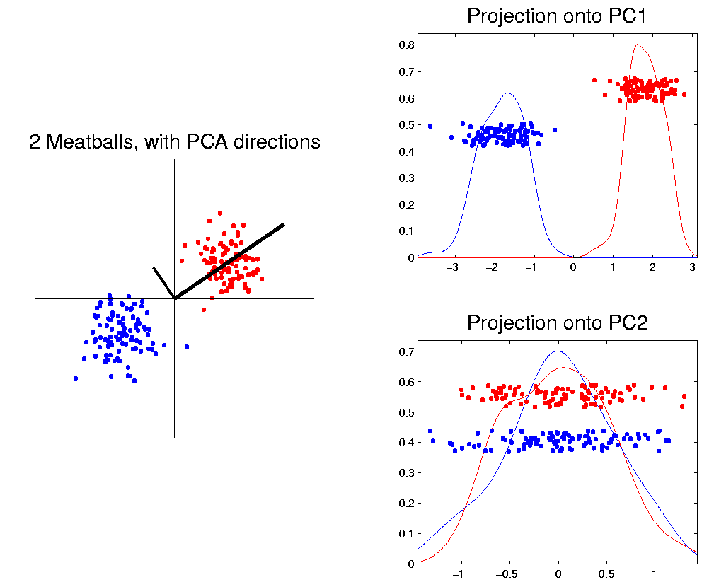
Classification Basics
Why not use PCA?
Reasonable
Result?
Doesn’t use
class labels…
Good?
Bad?
Notes:
HDLSStmbPCA.ps

Slide 64
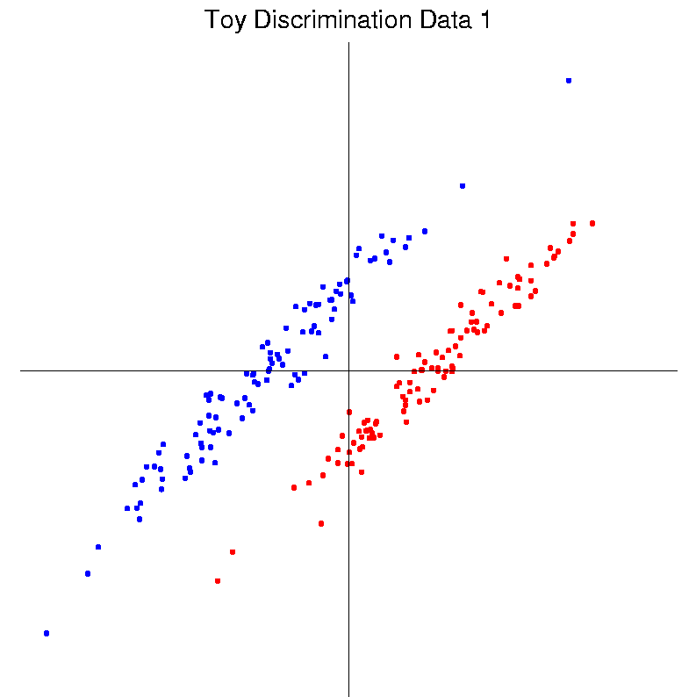
Classification Basics
Harder Example (slanted clouds):
Notes:
HDLSSod1Raw.ps

Slide 65

Classification Basics
PCA for slanted clouds:
PC1 terrible
PC2 better?
Still misses
right dir’n
Doesn’t use
Class Labels
Notes:
HDLSSod1PCA.ps

Slide 66

Classification Basics
Mean Difference for slanted clouds:
A little
better?
Still misses
right dir’n
Want to
account for
covariance
Notes:
HDLSSod1Mdif.ps

Slide 67

Classification Basics
Mean Difference & Covariance,
Simplest Approach:
Rescale (standardize) coordinate axes
i. e. replace (full) data matrix:
$$X=\left(\begin{matrix}x_{11} & ⋯ & x_{1n} \\ ⋮ & ⋱ & ⋮ \\ x_{d1} & ⋯ & x_{dn}\end{matrix}\right) → \left(\begin{matrix}\frac{1}{s_{1}} & ⋯ & 0 \\ ⋮ & ⋱ & ⋮ \\ 0 & ⋯ & \frac{1}{s_{d}}\end{matrix}\right)X=\left(\begin{matrix}\frac{x_{11}}{s_{1}} & ⋯ & \frac{x_{1n}}{s_{1}} \\ ⋮ & ⋱ & ⋮ \\ \frac{x_{d1}}{s_{d}} & ⋯ & \frac{x_{dn}}{s_{d}}\end{matrix}\right)$$
Then do Mean Difference
Called “Naïve Bayes Approach”
Name Seems to Be From Above MD Optimality

Slide 68
Classification Basics
Naïve Bayes Reference:
Domingos & Pazzani (1997)
Most sensible contexts:
Non-comparable data
E.g. different units

Slide 69
Classification Basics
Problem with Naïve Bayes:
Only adjusts
Variances
Not Covariances
Doesn’t solve
this problem
Notes:
HDLSSod1Raw.ps

Slide 70

Classification Basics
Better Solution: Linear Discriminant Analysis
Gets the
right dir’n
How does
it work?
Notes:
HDLSSod1FLD.ps

Slide 71

Linear Discriminant Analysis
Other common terminology (for LDA):
Fisher Linear Discrimination
Original Paper: Fisher (1936)
Published in Annals of Eugenics…
Founding Father of Both Statistics and Genetics, Now
Discredited Over Eugenics = Racist Pseudo-Science
(Also Tried to Disprove Evidence of Harm from Smoking)

Slide 72
Participant Presentations
12:05 Younghoon Kim: Simultaneous Component Analysis for Joint and Individual Models
12:10 Hong Dang: Single-cell RNA-seq from SARS-CoV-2 infected human airway epithelial cells
Next Class: Kenya Vazquez Martinez
,

