Slide 1
Statistics – O. R. 881 Object Oriented Data Analysis
Start
Recording
Steve Marron
Dept. of Statistics and Operations Research
University of North Carolina

Slide 2
Current Sections in Textbook
Today:
Sections 11.1
Next Class:
Sections 11.2

Slide 3
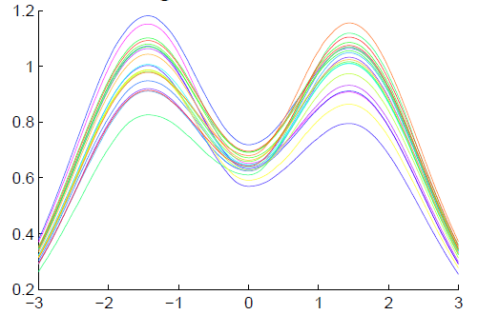
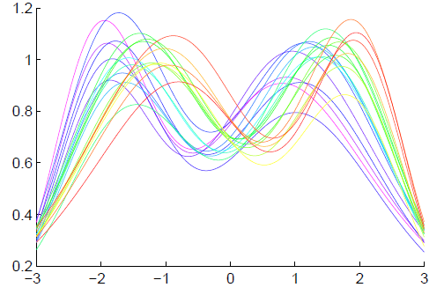
Functional Data Analysis
Insightful
Decomposition
Vertical Variation
Horiz’l
Var’n

Slide 4
Refined Calculations
Text, Sec. 9.2
More Recent Development:
Better Exploit Manifold Data Space:
SRVF${(γ}_{i})∈S^{d}$
Principal Nested Spheres
Reference: Yu et al (2017)
Since $γ$:$\left[0,1\right]$ → $\left[0,1\right]$
is a diffeomorphism
So for $q_{γ}=\frac{\dot{γ}}{\sqrt{\left|\dot{γ}\right|}}$,
${\left\|q_{γ}\right\|}_{2}^{2}=\int_{0}^{1}{\dot{γ}\left(x\right)dx}=1$

Slide 5
PNS on SRVF Sphere
Toy Example
View As Points
Tangent Plane PC 1
PNS 1
Boundary of
Nonnegative
Orthant

Slide 6
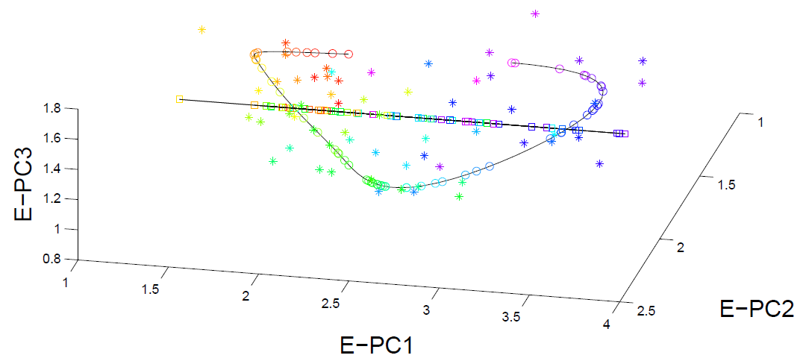
PNS on SRVF Sphere
Real Data Analysis: Blood Glucose Curves

Slide 7
Overview
Curve Registration is Slippery
Thus, Careful Mathematics is Useful
Fisher-Rao Approach:
Gets the Math Right
Intuitively Sensible
Computable
Generalizable
Worth the Complication

Slide 8
Return to Big Picture
Main statistical goals of OODA:
Understanding population structure
Low dim’al Projections, PCA …
Classification (i. e. Discrimination)
Understanding 2+ populations
Time Series of Data Objects
Chemical Spectra, Mortality Data
“Vertical Integration” of Data Types

Slide 9
Classification - Discrimination
Background: Two Class (Binary) version:
Using “training data” from
Class +1 and Class -1
Develop a “rule” for
assigning new data to a Class
Canonical Example: Disease Diagnosis
New Patients are “Healthy” or “Ill”
Determine based on measurements
Text, Chp 11

Slide 10
Classification - Discrimination
Important Distinction:
Classification vs. Clustering
Useful terminology:
Classification: supervised learning
Clustering: unsupervised learning

Slide 11
Classification Basics
Binary Classification
Goal: Use Training Data
$$\left(x_{1},y_{1}\right),⋯,\left(x_{n},y_{n}\right)$$
To Classify New Case: $\left(x_{0},y_{0}\right)$
I.e. Use $x_{0}∈ℝ^{d}$ to Predict $y_{0}∈\left\{+1,−1\right\}$
Notes:
HDLSStmbRaw.ps

Slide 12
Classification Basics
Statistical Approach:
Model $\left({\tilde{x}}_{1},{\tilde{y}}_{1}\right),⋯,\left({\tilde{x}}_{n},{\tilde{y}}_{n}\right)$ as i.i.d. from
Probability Density $f\left(x,y\right)$
General Classification Rule: $c:ℝ^{d}→\left\{+1,−1\right\}$
Use tildes to denote
random variables
Notes:
HDLSStmbRaw.ps

Slide 13
Classification Basics
Performance Measure of a Rule $c\left(x\right)$:
Bayes Risk $=P\left\{c\left(\tilde{x}\right)≠\tilde{y}\right\}$
Risk = Expected Loss (0 for right, 1 for wrong)
Notes:
HDLSStmbRaw.ps

Slide 14
Classification Basics
Bayes Risk Optimal Rule:
$$c_{LR}\left(x\right)=\left\{\begin{matrix}+1, & \frac{f\left(x,+1\right)}{f\left(x,−1\right)}≥1 \\ −1, & \frac{f\left(x,+1\right)}{f\left(x,−1\right)}<1\end{matrix}\right.$$
Called Likelihood Ratio Rule
Note: Need to Know $f$
(Can Consider Estimation)
Provides an
Important
Upper Bound
Notes:
HDLSStmbRaw.ps

Slide 15
Classification Basics
Important General Class:
Linear Classifiers
Given a Direction $w∈ℝ^{d}$ (i.e. ${\left\|w\right\|}_{2}=1$)
And an Intercept $β∈ℝ$,
Let $c_{w,β}\left(x\right)=1−2∙1_{\left\{w^{t}x<β\right\}}$
Separating Surface:
Hyperplane with Normal $w$ and Intercept $β$
Indicator Function
Notes:
HDLSStmbRaw.ps

Slide 16
Classification Basics
For Simple Toy Example:
Project
On MD
& Split
at Center
(Assume Equal Numbers for Simplicity)
Notes:
HDLSStmbMdif.ps

Slide 17
Classification Basics
Mean Difference for slanted clouds:
A little
better?
Still misses
right dir’n
Want to
account for
covariance
Notes:
HDLSSod1Mdif.ps

Slide 18
Classification Basics
Better Solution: Linear Discriminant Analysis
Gets the
right dir’n
How does
it work?
Notes:
HDLSSod1FLD.ps

Slide 19
Linear Discriminant Analysis
Careful development:
Useful notation (data vectors of length $d$):
Class +1: Class -1:
$x_{1}^{+},⋯,x_{n_{+}}^{+} x_{1}^{−},⋯,x_{n_{−}}^{−}$
Class Centerpoints:
${\overline{x}}^{+}=\frac{1}{n_{+}}\sum_{i=1}^{n_{+}}{x_{i}^{+}}$ and ${\overline{x}}^{−}=\frac{1}{n_{−}}\sum_{i=1}^{n_{−}}{x_{i}^{−}}$
Text, Sec. 11.1

Slide 20
Linear Discriminant Analysis
Covariances, ${\hat{Σ}}^{⨀}={\breve{X}}^{⨀}{{\breve{X}}^{⨀}}^{t}$ for $⨀$ = +,-
(outer products)
Based on centered, normalized data matrices:
$${\breve{X}}^{⨀}=\frac{1}{\sqrt{n_{⨀}}}\left(x_{1}^{⨀}−{\overline{x}}^{⨀},⋯,x_{n_{⨀}}^{⨀}−{\overline{x}}^{⨀}\right)$$
Note: use “MLE” version of estimated
covariance matrices, for simpler notation

Slide 21
Linear Discriminant Analysis
Good estimate of (common) within class cov?
Pooled (weighted average) within class cov:
$${\hat{Σ}}^{w}=\frac{n_{+}{\hat{Σ}}^{+}+n_{−}{\hat{Σ}}^{−}}{n_{+}+n_{−}}=\breve{\breve{X}}{\breve{\breve{X}}}^{t}$$
Outer Product of combined full data matrix:
$\breve{\breve{X}}$=$\frac{1}{\sqrt{n_{+}+n_{−}}}\left(\sqrt{n_{+}}{\breve{X}}^{+} \sqrt{n_{−}}{\breve{X}}^{−}\right)$
Note: Different Means

Slide 22
Linear Discriminant Analysis
Note: ${\hat{Σ}}^{w}$ is similar to $\hat{Σ}$ from before
I.e. covariance matrix ignoring class labels
Important Difference:
Class by Class Centering
Will be important later
Notes:
HDLSSod1Raw.ps

Slide 23
Linear Discriminant Analysis
Simple way to find “correct cov. adjustment”:
Individually transform subpopulations so
“spherical” about their means
For $⨀$ = +,- define $z_{i}^{⨀}={\left({\hat{Σ}}^{w}\right)}^{−1/2}x_{i}^{⨀}$
Notes:
HDLSSod1egFLD.ps

Slide 24
Linear Discriminant Analysis
For $⨀$ = +,- define $z_{i}^{⨀}={\left({\hat{Σ}}^{w}\right)}^{−1/2}x_{i}^{⨀}$
Note: This spheres the data, in the sense that
$$ZZ^{t}={\hat{Σ}}^{{−1}/2}\breve{X}{\left({\hat{Σ}}^{{−1}/2}\breve{X}\right)}^{t}=$$
$$={\hat{Σ}}^{{−1}/2}\breve{X}{\breve{X}}^{t}{\hat{Σ}}^{{−1}/2}=I$$
Notes:
HDLSSod1egFLD.ps

Slide 25
Linear Discriminant Analysis
Then:
In Transformed Space,
Best separating hyperplane
is
Perpendicular bisector of
line between means
Again Assuming Equal
Sample Sizes for Simplicity
Notes:
HDLSSod1egFLD.ps

Slide 26
Linear Discriminant Analysis
In Transformed Space,
Separating Hyperplane has:
Transformed Normal Vector:
$n_{TLDA}={\left({\hat{Σ}}^{w}\right)}^{−1/2}{\overline{x}}^{+}−{\left({\hat{Σ}}^{w}\right)}^{−1/2}{\overline{x}}^{−}$
$={\left({\hat{Σ}}^{w}\right)}^{−1/2}\left({\overline{x}}^{+}−{\overline{x}}^{−}\right)$
Notes:
HDLSSod1egFLD.ps

Slide 27
Linear Discriminant Analysis
In Transformed Space,
Separating Hyperplane has:
Transformed Normal Vector:
$n_{TLDA}={\left({\hat{Σ}}^{w}\right)}^{−1/2}{\overline{x}}^{+}−{\left({\hat{Σ}}^{w}\right)}^{−1/2}{\overline{x}}^{−}$
$={\left({\hat{Σ}}^{w}\right)}^{−1/2}\left({\overline{x}}^{+}−{\overline{x}}^{−}\right)$
Transformed Intercept:
$μ_{TLDA}={\frac{1}{2}\left({\hat{Σ}}^{w}\right)}^{−1/2}{\overline{x}}^{+}+\frac{1}{2}{\left({\hat{Σ}}^{w}\right)}^{−1/2}{\overline{x}}^{−}$
$={\left({\hat{Σ}}^{w}\right)}^{−1/2}\left(\frac{1}{2}{\overline{x}}^{+}+\frac{1}{2}{\overline{x}}^{−}\right)$
Notes:
HDLSSod1egFLD.ps

Slide 28
Linear Discriminant Analysis
In Transformed Space,
Separating Hyperplane has:
Transformed Normal Vector:
$n_{TLDA}={\left({\hat{Σ}}^{w}\right)}^{−1/2}{\overline{x}}^{+}−{\left({\hat{Σ}}^{w}\right)}^{−1/2}{\overline{x}}^{−}$
$={\left({\hat{Σ}}^{w}\right)}^{−1/2}\left({\overline{x}}^{+}−{\overline{x}}^{−}\right)$
Transformed Intercept:
$μ_{TLDA}={\frac{1}{2}\left({\hat{Σ}}^{w}\right)}^{−1/2}{\overline{x}}^{+}+\frac{1}{2}{\left({\hat{Σ}}^{w}\right)}^{−1/2}{\overline{x}}^{−}$
$={\left({\hat{Σ}}^{w}\right)}^{−1/2}\left(\frac{1}{2}{\overline{x}}^{+}+\frac{1}{2}{\overline{x}}^{−}\right)$
Separating Hyperplane Has Eqn.
$\left\{z:\left\langle z,n_{TLDA}\right\rangle =\left\langle μ_{TLDA},n_{TLDA}\right\rangle \right\}$
Notes:
HDLSSod1egFLD.ps

Slide 29
Linear Discriminant Analysis
Thus discrimination rule is:
Given a new data vector $x_{0}$,
Choose Class +1 when:
$$\left\langle {\left({\hat{Σ}}^{w}\right)}^{−1/2}x_{0},n_{TLDA}\right\rangle ≥\left\langle μ_{TLDA},n_{TLDA}\right\rangle$$
Using Boundary: $\left\{z:\left\langle z,n_{TLDA}\right\rangle =\left\langle μ_{TLDA},n_{TLDA}\right\rangle \right\}$

Slide 30
Linear Discriminant Analysis
Thus discrimination rule is:
Given a new data vector $x_{0}$,
Choose Class +1 when:
$$\left\langle {\left({\hat{Σ}}^{w}\right)}^{−1/2}x_{0},n_{TLDA}\right\rangle ≥\left\langle μ_{TLDA},n_{TLDA}\right\rangle$$
i.e. (transforming back to original space)
$$\left\langle x_{0},{\left({\hat{Σ}}^{w}\right)}^{−1/2}n_{TLDA}\right\rangle ≥\left\langle {\left({\hat{Σ}}^{w}\right)}^{1/2}μ_{TLDA},{\left({\hat{Σ}}^{w}\right)}^{−1/2}n_{TLDA}\right\rangle$$
$$\left\langle x_{0},n_{LDA}\right\rangle ≥\left\langle μ_{LDA},n_{LDA}\right\rangle$$
where:
$$n_{LDA}={\left({\hat{Σ}}^{w}\right)}^{−1/2}n_{TLDA}={\left({\hat{Σ}}^{w}\right)}^{−1}\left({\overline{x}}^{+}−{\overline{x}}^{−}\right)$$
$$μ_{LDA}={\left({\hat{Σ}}^{w}\right)}^{1/2}μ_{TLDA}=\left(\frac{1}{2}{\overline{x}}^{+}+\frac{1}{2}{\overline{x}}^{−}\right)$$

Slide 31
Linear Discriminant Analysis
Thus discrimination rule is:
Classify $x_{0}$ to Class +1 when:
$$\left\langle x_{0}, {\underline{n}}_{LDA}\right\rangle ≥\left\langle {\underline{μ}}_{LDA}, {\underline{n}}_{LDA}\right\rangle$$
where:
$n_{LDA}={\left({\hat{Σ}}^{w}\right)}^{−1/2}n_{TLDA}={\left({\hat{Σ}}^{w}\right)}^{−1}\left({\overline{x}}^{+}−{\overline{x}}^{−}\right)$
$μ_{LDA}={\left({\hat{Σ}}^{w}\right)}^{1/2}μ_{TLDA}=\left(\frac{1}{2}{\overline{x}}^{+}+\frac{1}{2}{\overline{x}}^{−}\right)$
i.e.
${x_{0}}^{t}{\left({\hat{Σ}}^{w}\right)}^{−1}\left({\overline{x}}^{+}−{\overline{x}}^{−}\right)≥$
$≥{\frac{1}{2}\left({\overline{x}}^{+}+{\overline{x}}^{−}\right)}^{t}{\left({\hat{Σ}}^{w}\right)}^{−1}$ $\left({\overline{x}}^{+}−{\overline{x}}^{−}\right)$
Same Inner Product
Of Center Point
Inner Product of New Data
Point & Transf’d Direction

Slide 32
Linear Discriminant Analysis
So (in orig’l space) have separ’ting hyperplane with:
Normal vector: $n_{LDA}$
Intercept:$μ_{LDA}$
Notes:
HDLSSod1egFLD.ps

Slide 33
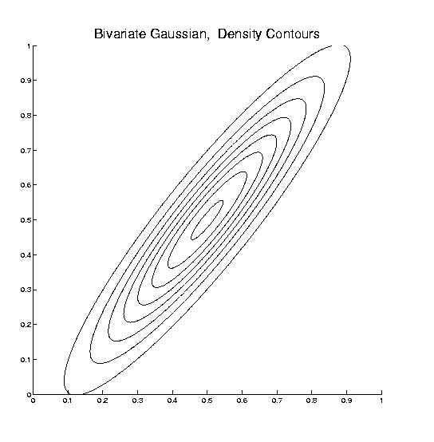
Linear Discriminant Analysis
Relationship to Mahalanobis distance
Idea: For $x_{1},x_{2}\sim N\left(μ,Σ\right)$, a natural distance
measure is: $d_{M}={\left[{\left(x_{1}−x_{2}\right)}^{t}Σ^{−1}\left(x_{1}−x_{2}\right)\right]}^{1/2}$
$$d_{1}=d_{2}$$

Slide 34
Linear Discriminant Analysis
Relationship to Mahalanobis distance
Idea: For $x_{1},x_{2}\sim N\left(μ,Σ\right)$, a natural distance
measure is: $d_{M}={\left[{\left(x_{1}−x_{2}\right)}^{t}Σ^{−1}\left(x_{1}−x_{2}\right)\right]}^{1/2}$
“unit free”, i.e. “standardized”
essentially mod out covariance structure
Euclidean dist. applied to $Σ^{−1/2}x_{1}$ & $Σ^{−1/2}x_{2}$
Same as key transformation for LDA
I.e. LDA is
mean difference in Mahalanobis space

Slide 35
Classical Discrimination
Above derivation of LDA was:
Nonstandard
Not in any other textbooks(?)
Nonparametric (don’t need Gaussian data)
I.e. Used no probability distributions
More Machine Learning than Statistics
(but careful about HDLSS case)

Slide 36
Classical Discrimination
LDA Likelihood View
Assume:
Class distributions are multivariate
$N\left(μ^{⨀},Σ^{w}\right)$ for $⨀$ = +,-
strong distributional assumption
+ common covariance (Within Class)

Slide 37
Classical Discrimination
LDA Likelihood View (cont.)
At a location $x_{0}$, the likelihood ratio, for
choosing between Class +1 and Class -1, is:
$$LR\left(x_{0},μ^{+},μ^{−},Σ^{w}\right)={φ_{Σ^{w}}\left(x_{0}−μ^{+}\right)}/{φ_{Σ^{w}}\left(x_{0}−μ^{−}\right)}$$
where $φ_{Σ^{w}}$ is the Gaussian density,
with covariance $Σ^{w}$

Slide 38
Classical Discrimination
LDA Likelihood View (cont.)
Simplifying, using the Gaussian density:
$$φ_{Σ^{w}}\left(x\right)=\frac{1}{{\left(2π\right)}^{d/2}\left|Σ^{w}\right|}e^{{−\left(x^{t}{Σ^{w}}^{−1}x\right)}/2}$$
Gives (critically using common covariances):
$LR\left(x_{0},μ^{+},μ^{−},Σ^{w}\right)$=
$$=e^{{−\left[{\left(x_{0}−μ^{+}\right)}^{t}{Σ^{w}}^{−1}\left(x_{0}−μ^{+}\right)−{\left(x_{0}−μ^{−}\right)}^{t}{Σ^{w}}^{−1}\left(x_{0}−μ^{−}\right)\right]}/2}$$
$−2\log{LR\left(x_{0},μ^{+},μ^{−},Σ^{w}\right)}=$
$$=\left[{\left(x_{0}−μ^{+}\right)}^{t}{Σ^{w}}^{−1}\left(x_{0}−μ^{+}\right)−{\left(x_{0}−μ^{−}\right)}^{t}{Σ^{w}}^{−1}\left(x_{0}−μ^{−}\right)\right]$$

Slide 39
Classical Discrimination
LDA Likelihood View (cont.)
But: ${\left(x_{0}−μ^{⨀}\right)}^{t}{Σ^{w}}^{−1}\left(x_{0}−μ^{⨀}\right)=$
$$={x_{0}}^{t}{Σ^{w}}^{−1}x_{0}−2{x_{0}}^{t}{Σ^{w}}^{−1}μ^{⨀}+{μ^{⨀}}^{t}{Σ^{w}}^{−1}μ^{⨀}$$
for $⨀=−1, +1$

Slide 40
Classical Discrimination
LDA Likelihood View (cont.)
But: ${\left(x_{0}−μ^{⨀}\right)}^{t}{Σ^{w}}^{−1}\left(x_{0}−μ^{⨀}\right)=$
$$={x_{0}}^{t}{Σ^{w}}^{−1}x_{0}−2{x_{0}}^{t}{Σ^{w}}^{−1}μ^{⨀}+{μ^{⨀}}^{t}{Σ^{w}}^{−1}μ^{⨀}$$
so: $−2\log{LR\left(x_{0},μ^{+},μ^{−},Σ^{w}\right)}=$
$$=−2{x_{0}}^{t}{Σ^{w}}^{−1}\left(μ^{+}−μ^{−}\right)+{\left(μ^{+}+μ^{−}\right)}^{t}{Σ^{w}}^{−1}\left(μ^{+}−μ^{−}\right)$$
Note: same terms subtract off

Slide 41
Classical Discrimination
LDA Likelihood View (cont.)
But: ${\left(x_{0}−μ^{⨀}\right)}^{t}{Σ^{w}}^{−1}\left(x_{0}−μ^{⨀}\right)=$
$$={x_{0}}^{t}{Σ^{w}}^{−1}x_{0}−2{x_{0}}^{t}{Σ^{w}}^{−1}μ^{⨀}+{μ^{⨀}}^{t}{Σ^{w}}^{−1}μ^{⨀}$$
so: $−2\log{LR\left(x_{0},{\underline{μ}}^{+},{\underline{μ}}^{−},Σ^{w}\right)}=$
$$=−2{x_{0}}^{t}{Σ^{w}}^{−1}\left(μ^{+}−μ^{−}\right)+{\left(μ^{+}+μ^{−}\right)}^{t}{Σ^{w}}^{−1}\left(μ^{+}−μ^{−}\right)$$
Note: cross terms have ± cancellation
Seen in Above
Nonparametric
Derivation
Similar To
Above Center

Slide 42
Classical Discrimination
LDA Likelihood View (cont.)
But: ${\left(x_{0}−μ^{⨀}\right)}^{t}{Σ^{w}}^{−1}\left(x_{0}−μ^{⨀}\right)=$
$$={x_{0}}^{t}{Σ^{w}}^{−1}x_{0}−2{x_{0}}^{t}{Σ^{w}}^{−1}μ^{⨀}+{μ^{⨀}}^{t}{Σ^{w}}^{−1}μ^{⨀}$$
so: $−2\log{LR\left(x_{0},μ^{+},{\underline{μ}}^{−},Σ^{w}\right)}=$
$$=−2{x_{0}}^{t}{Σ^{w}}^{−1}\left(μ^{+}−μ^{−}\right)+{\left(μ^{+}+μ^{−}\right)}^{t}{Σ^{w}}^{−1}\left(μ^{+}−μ^{−}\right)$$
Thus $LR\left(x_{0},μ^{+},μ^{−},Σ^{w}\right)≥1$ when
$$−2\log{LR\left(x_{0},μ^{+},μ^{−},Σ^{w}\right)}≤0$$
i.e. ${x_{0}}^{t}{Σ^{w}}^{−1}\left(μ^{+}−μ^{−}\right)≥\frac{1}{2}{\left(μ^{+}+μ^{−}\right)}^{t}{Σ^{w}}^{−1}\left(μ^{+}−μ^{−}\right)$

Slide 43
Classical Discrimination
LDA Likelihood View (cont.)
Replacing $μ^{+}$, $μ^{−}$ and $Σ^{w}$
by maximum likelihood estimates:
${\overline{x}}^{+}$, ${\overline{x}}^{−}$and ${\hat{Σ}}^{w}$
Gives the likelihood ratio discrimination rule:
Choose Class +1, when
$${x_{0}}^{t}{{\hat{Σ}}^{w}}^{−1}\left({\overline{x}}^{+}−{\overline{x}}^{−}\right)≥\frac{1}{2}{\left({\overline{x}}^{+}+{\overline{x}}^{−}\right)}^{t}{{\hat{Σ}}^{w}}^{−1}\left({\overline{x}}^{+}−{\overline{x}}^{−}\right)$$
Same as above, so: LDA can be viewed as
Likelihood Ratio Rule

Slide 44
Classical Discrimination
LDA Generalization I
Gaussian Likelihood Ratio Discrimination
(a. k. a. “Nonlinear Discriminant Analysis”)
Idea: Assume
class distributions are $N\left(μ^{⨀},Σ^{⨀}\right)$
Different covariances!
Likelihood Ratio rule is straightf’d num’l calc.
(thus can easily implement, and do discrim’n)

Slide 45
Classical Discrimination
Gaussian Likelihood Ratio Discrim’n (cont.)
No longer have separ’g hyperplane repr’n
(instead regions determined by quadratics)
(fairly complicated case-wise calculations)
Graphical display: for grid of test points,
color as:
Yellow if assigned to Class +1
Cyan if assigned to Class -1
(intensity is strength of assignment)

Slide 46
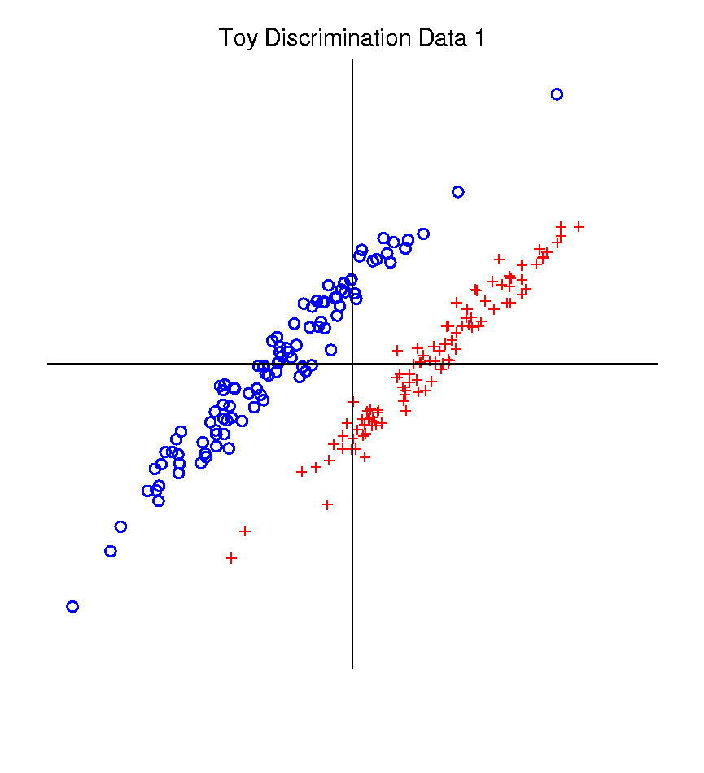
Classical Discrimination
Graphical Display of Classifiers
Use Yellow for Grid
Points Assigned
to Plus Class
Use Cyan for Grid
Points Assigned
to Minus Class
Notes:
PEod1FLDe1.ps

Slide 47
Classical Discrimination
LDA for Tilted Point Clouds – Works well
Notes:
PEod1FLDe1.ps

Slide 48
Classical Discrimination
GLR for Tilted Point Clouds – Works well
Notes:
PEod1GLRe1.ps

Slide 49
Classical Discrimination
LDA for Donut – Poor, no plane can work
Notes:
PEdonFLDe1.ps

Slide 50
Classical Discrimination
GLR for Donut – Works well (good quadratic)
(Even
though
data not
Gaussian)
Notes:
PEdonGLRe1.ps

Slide 51
Classical Discrimination
LDA for X – Poor, no plane can work
Notes:
PExd3FLDe1.ps

Slide 52
Classical Discrimination
GLR for X – Better, but not great
Notes:
PExd3GLRe1.ps

Slide 53
Classical Discrimination
Summary of LDA vs. GLR:
Tilted Point Clouds Data
LDA good
GLR good
Donut Data
LDA bad
GLR good
X Data
LDA bad
GLR OK, not great
Classical Conclusion: GLR generally better
(will see a different answer for HDLSS data)

Slide 54
Classical Discrimination
LDA Generalization II (Gen. I was GLR)
Different prior probabilities
Main idea:
Give different weights to 2 classes
I.e. assume not a priori equally likely
Canonical Example: Rare Disease Testing
(Often Train on Mostly Rare Cases)

Slide 55
Classical Discrimination
LDA Generalization II (Gen. I was GLR)
Different prior probabilities
Main idea:
Give different weights to 2 classes
I.e. assume not a priori equally likely
Development is “straightforward”
Modified likelihood
Change intercept in LDA
Won’t explore further here

Slide 56
Classical Discrimination
LDA Generalization III
Principal Discriminant Analysis
Also Called:
Multiple Discriminant Analysis
Duda, et al. (2001)
Canonical Variate Analysis
Mardia, et al. (1979)

Slide 57
Classical Discrimination
LDA Generalization III
Principal Discriminant Analysis
Idea: LDA-like approach to $K>2$ classes
Assumption: Class covariance matrices are the same (similar)
(but not Gaussian, same situation as for LDA)
Main idea:
Quantify “location of classes” by their means
$${\underline{μ}}^{(1)},{\underline{μ}}^{(2)},⋯,{\underline{μ}}^{(K)}$$
Analog of MD
For $K$ Classes

Slide 58
Classical Discrimination
Principal Discriminant Analysis (cont.)
Simple way to find “interesting directions” among the means:
PCA on set of means
(Think Analog of Mean Difference)

Slide 59
Classical Discrimination
Principal Discriminant Analysis (cont.)
Simple way to find “interesting directions” among the means:
PCA on set of means
i.e. Eigen-analysis of “between class covariance matrix” ${\hat{Σ}}^{B}=MM^{t}$
Where
$$M=\frac{1}{\sqrt{K}}\left(μ^{(1)}−\overline{μ} ⋯μ^{(K)}−\overline{μ}\right)$$
Aside: can show: overall $n\hat{Σ}=K{\hat{Σ}}^{B}+n{\hat{Σ}}^{w}$
Mean of Means

Slide 60
Classical Discrimination
Principal Discriminant Analysis (cont.)
But PCA only works like Mean Difference,
Expect can improve by
taking covariance into account.
(Recall Improvement of LDA over MD)

Slide 61
Classical Discrimination
Principal Discriminant Analysis (cont.)
But PCA only works like Mean Difference,
Expect can improve by
taking covariance into account.
Blind application of above ideas suggests eigen-analysis of: ${Σ^{w}}^{−1}Σ^{B}$

Slide 62
Classical Discrimination
Principal Discriminant Analysis (cont.)
There are:
smarter ways to compute
(“generalized eigenvalue”)
other representations
(this solves optimization prob’s)
Special case: 2 classes,
reduces to standard LDA
Good reference for more: Section 3.8 of:
Duda et al. (2001)

Slide 63
Classical Discrimination
Summary of Classical Ideas:
Among “Simple Methods”
MD and LDA sometimes similar
Sometimes LDA better
So LDA is preferred
Among Complicated Methods
GLR is best
So always use that?
Caution:
Story changes for HDLSS settings
High Dimension
Low Sample Size

Slide 64
HDLSS Discrimination
Main HDLSS issues:
Sample Size, $n$ < Dimension, $d$
Singular sample covariance matrix, $\hat{Σ}$
So can’t use matrix inverse
I.e. can’t standardize (sphere) the data
(requires root inverse covariance)
Can’t do classical multivariate analysis

Slide 65
HDLSS Discrimination
Main HDLSS issues:
Can’t do classical multivariate analysis
Key Idea: Standardize
Subtract Sample Mean
Sphere the Data (i.e. Multiply by ${\hat{Σ}}^{−1/2}$)
And use $N(0,I)$ dist’n for statistical inference

Slide 66
HDLSS Discrimination
An approach to non-invertible covariances:
Replace by generalized inverses
Sometimes called pseudo inverses
Note: there are several
Here use Moore Penrose inverse
As used by Matlab (pinv.m)
Often provides useful results
(but not always)

Slide 67
Moore Penrose Generalized Inverse
Based on Eigen-Analysis of $d×d$ Symmetric
Matrix $Σ$
$$Σ=UΛU^{t}$$
Where:
$U$ is an orthonormal basis matrix of $ℝ^{d}$
$Λ$ is a diagonal matrix of eigen-values:
$$λ_{1}≥⋯≥λ_{r}>0=⋯=0$$
$d−r$ is number
of $0$ eigen-values
Rank of $Σ$ is $r$

Slide 68
Moore Penrose Generalized Inverse
Let $Σ^{−}=UΛ^{−}U^{t}$
Where $Λ^{−}$ is the diagonal matrix with entries:
$$\frac{1}{λ_{1}},⋯,\frac{1}{λ_{r}},0,⋯,0$$
$Σ^{−}$ is a generalized inverse in the sense
$Σ^{−}=Σ^{−}ΣΣ^{−}$ and $Σ=ΣΣ^{−}Σ$

Slide 69
HDLSS Discrimination
Application of Generalized Inverse to LDA:
Direction (Normal) Vector:
$$n_{LDA}={\left({\hat{Σ}}^{w}\right)}^{−}\left({\overline{x}}^{+}−{\overline{x}}^{−}\right)$$
Intercept:
$$μ_{LDA}=\left(\frac{1}{2}{\overline{x}}^{+}+\frac{1}{2}{\overline{x}}^{−}\right)$$

Slide 70
HDLSS Discrimination
Application of Generalized Inverse to LDA:
Direction (Normal) Vector:
$$n_{LDA}={\left({\hat{Σ}}^{w}\right)}^{−}\left({\overline{x}}^{+}−{\overline{x}}^{−}\right)$$
Intercept:
$$μ_{LDA}=\left(\frac{1}{2}{\overline{x}}^{+}+\frac{1}{2}{\overline{x}}^{−}\right)$$
Have replaced ${\left({\hat{Σ}}^{w}\right)}^{−1}$ by ${\left({\hat{Σ}}^{w}\right)}^{−}$

Slide 71
HDLSS Discrimination
Toy Example: Increasing Dimension
$n_{+}=n_{−}=20$ data vectors:
Entry 1:
Class +1: $N\left(+2.2,1\right)$ Class –1: $N\left(−2.2,1\right)$
Other Entries: $N\left(0,1\right)$
All Entries Independent
Look through dimensions, $d=1, 2, ⋯, 1000$

Slide 72
HDLSS Discrimination
Increasing Dimension Example
Project on
Optimal
Direction
Project on
LDA Direction
Project on
Both

Slide 73
HDLSS Discrimination
Add a 2nd Dimension ($N\left(0,1\right)$ noise)
Same Projections on
Optimal Direction
Axes Here
Are Same As
Directions Here
Now See 2
Dimensions

Slide 74
HDLSS Discrimination
Add a 3rd Dimension ($N\left(0,1\right)$ noise)
Project on
2-d subspace
generated
by optimal
dir’n & by
LDA dir’n

Slide 75
HDLSS Discrimination
Movie Through Increasing Dimensions

Slide 76
HDLSS Discrimination
FLD in Increasing Dimensions:
Low dimensions (d = 2-9):
Visually good separation
Small angle between LDA and Optimal
Good generalizability
Medium Dimensions (d = 10-26):
Visual separation too good?!?
Larger angle between LDA and Optimal
Worse generalizability
Feel effect of sampling noise

Slide 77
HDLSS Discrimination
LDA in Increasing Dimensions:
High Dimensions (d=27-37):
Much worse angle
Very poor generalizability
But very small within class variation
Poor separation between classes
Large separation / variation ratio

Slide 78
HDLSS Discrimination
LDA in Increasing Dimensions:
At HDLSS Boundary (d=38):
38 = degrees of freedom
(need to estimate 2 class means)
Within class variation = 0 ?!?
Data pile up, on just two points
Perfect separation / variation ratio?
But only feels microscopic noise aspects
So likely not generalizable
Angle to optimal very large

Slide 79
HDLSS Discrimination
LDA in Increasing Dimensions:
Just beyond HDLSS boundary (d=39-70):
Improves with higher dimension?!?
Angle gets better
Improving generalizability?
More noise helps classification?!?

Slide 80
HDLSS Discrimination
LDA in Increasing Dimensions:
Far beyond HDLSS boun’ry (d=70-1000):
Quality degrades
Projections look terrible
(populations overlap)
And Generalizability falls apart, as well
Asymptotics worked out by Bickel & Levina (2004)
Problem is estimation of $d×d$ covariance matrix

Slide 81
HDLSS Discrimination
Simple Solution:
Mean Difference (Centroid) Method
Recall not classically recommended
Usually no better than LDA
Sometimes worse
But avoids estimation of covariance
Means are very stable
Expect less HDLSS problem

Slide 82
Participant Presentations
12:10 Kenya Vazquez Martinez:
Kippenhahn curves of some tridiagonal matrices
Next Class: Rui Liu, Nick Tapp-Hughes

