Slide 1
Statistics – O. R. 881 Object Oriented Data Analysis
Start
Recording
Steve Marron
Dept. of Statistics and Operations Research
University of North Carolina

Slide 2
Current Sections in Textbook
Today:
Sections 11.1, 11.2
Next Class:
Sections 11.2, 11.3

Slide 3
Return to Big Picture
Main statistical goals of OODA:
Understanding population structure
Low dim’al Projections, PCA …
Classification (i. e. Discrimination)
Understanding 2+ populations
Time Series of Data Objects
Chemical Spectra, Mortality Data
“Vertical Integration” of Data Types

Slide 4
Classification Basics
For Simple Toy Example:
Project
On MD
& Split
at Center
(Assume Equal Numbers for Simplicity)
Notes:
HDLSStmbMdif.ps

Slide 5
Classification Basics
Better Solution: Linear Discriminant Analysis
Gets the
right dir’n
How does
it work?
Notes:
HDLSSod1FLD.ps

Slide 6
Linear Discriminant Analysis
Simple way to find “correct cov. adjustment”:
Individually transform subpopulations so
“spherical” about their means
For $⨀$ = +,- define $z_{i}^{⨀}={\left({\hat{Σ}}^{w}\right)}^{−1/2}x_{i}^{⨀}$
Notes:
HDLSSod1egFLD.ps

Slide 7
Linear Discriminant Analysis
In Transformed Space,
Separating Hyperplane has:
Transformed Normal Vector:
$n_{TLDA}={\left({\hat{Σ}}^{w}\right)}^{−1/2}{\overline{x}}^{+}−{\left({\hat{Σ}}^{w}\right)}^{−1/2}{\overline{x}}^{−}$
$={\left({\hat{Σ}}^{w}\right)}^{−1/2}\left({\overline{x}}^{+}−{\overline{x}}^{−}\right)$
Transformed Intercept:
$μ_{TLDA}={\frac{1}{2}\left({\hat{Σ}}^{w}\right)}^{−1/2}{\overline{x}}^{+}+\frac{1}{2}{\left({\hat{Σ}}^{w}\right)}^{−1/2}{\overline{x}}^{−}$
$={\left({\hat{Σ}}^{w}\right)}^{−1/2}\left(\frac{1}{2}{\overline{x}}^{+}+\frac{1}{2}{\overline{x}}^{−}\right)$
Separating Hyperplane Has Eqn.
$\left\{z:\left\langle z,n_{TLDA}\right\rangle =\left\langle μ_{TLDA},n_{TLDA}\right\rangle \right\}$
Notes:
HDLSSod1egFLD.ps

Slide 8
Linear Discriminant Analysis
Thus discrimination rule is:
Classify $x_{0}$ to Class +1 when:
$$\left\langle x_{0}, {\underline{n}}_{LDA}\right\rangle ≥\left\langle {\underline{μ}}_{LDA}, {\underline{n}}_{LDA}\right\rangle$$
where:
$n_{LDA}={\left({\hat{Σ}}^{w}\right)}^{−1/2}n_{TLDA}={\left({\hat{Σ}}^{w}\right)}^{−1}\left({\overline{x}}^{+}−{\overline{x}}^{−}\right)$
$μ_{LDA}={\left({\hat{Σ}}^{w}\right)}^{1/2}μ_{TLDA}=\left(\frac{1}{2}{\overline{x}}^{+}+\frac{1}{2}{\overline{x}}^{−}\right)$
i.e.
${x_{0}}^{t}{\left({\hat{Σ}}^{w}\right)}^{−1}\left({\overline{x}}^{+}−{\overline{x}}^{−}\right)≥$
$≥{\frac{1}{2}\left({\overline{x}}^{+}+{\overline{x}}^{−}\right)}^{t}{\left({\hat{Σ}}^{w}\right)}^{−1}$ $\left({\overline{x}}^{+}−{\overline{x}}^{−}\right)$
Same Inner Product
Of Center Point
Inner Product of New Data
Point & Transf’d Direction

Slide 9
Classical Discrimination
LDA Likelihood View
Assume:
Class distributions are multivariate
$N\left(μ^{⨀},Σ^{w}\right)$ for $⨀$ = +,-
strong distributional assumption
+ common covariance (Within Class)

Slide 10
Classical Discrimination
LDA Likelihood View (cont.)
Replacing $μ^{+}$, $μ^{−}$ and $Σ^{w}$
by maximum likelihood estimates:
${\overline{x}}^{+}$, ${\overline{x}}^{−}$and ${\hat{Σ}}^{w}$
Gives the likelihood ratio discrimination rule:
Choose Class +1, when
$${x_{0}}^{t}{{\hat{Σ}}^{w}}^{−1}\left({\overline{x}}^{+}−{\overline{x}}^{−}\right)≥\frac{1}{2}{\left({\overline{x}}^{+}+{\overline{x}}^{−}\right)}^{t}{{\hat{Σ}}^{w}}^{−1}\left({\overline{x}}^{+}−{\overline{x}}^{−}\right)$$
Same as above, so: LDA can be viewed as
Likelihood Ratio Rule

Slide 11
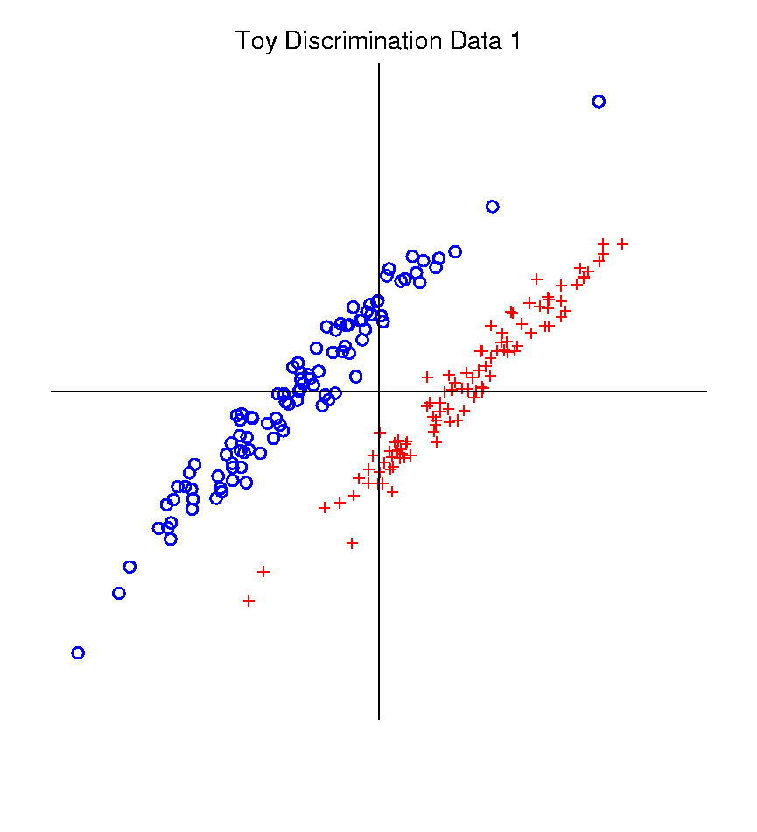
Classical Discrimination
Graphical Display of Classifiers
Use Yellow for Grid
Points Assigned
to Plus Class
Use Cyan for Grid
Points Assigned
to Minus Class
Notes:
PEod1FLDe1.ps

Slide 12
Classical Discrimination
LDA for Donut – Poor, no plane can work
Notes:
PEdonFLDe1.ps

Slide 13
Classical Discrimination
GLR for Donut – Works well (good quadratic)
(Even
though
data not
Gaussian)
Notes:
PEdonGLRe1.ps

Slide 14
Classical Discrimination
Summary of Classical Ideas:
Among “Simple Methods”
MD and LDA sometimes similar
Sometimes LDA better
So LDA is preferred
Among Complicated Methods
GLR is best
So always use that?
Caution:
Story changes for HDLSS settings
High Dimension
Low Sample Size

Slide 15
HDLSS Discrimination
Main HDLSS issues:
Sample Size, $n$ < Dimension, $d$
Singular sample covariance matrix, $\hat{Σ}$
So can’t use matrix inverse
I.e. can’t standardize (sphere) the data
(requires root inverse covariance)
Can’t do classical multivariate analysis

Slide 16
HDLSS Discrimination
An approach to non-invertible covariances:
Replace by generalized inverses
Sometimes called pseudo inverses
Note: there are several
Here use Moore Penrose inverse
As used by Matlab (pinv.m)
Often provides useful results
(but not always)

Slide 17
HDLSS Discrimination
Application of Generalized Inverse to LDA:
Direction (Normal) Vector:
$$n_{LDA}={\left({\hat{Σ}}^{w}\right)}^{−}\left({\overline{x}}^{+}−{\overline{x}}^{−}\right)$$
Intercept:
$$μ_{LDA}=\left(\frac{1}{2}{\overline{x}}^{+}+\frac{1}{2}{\overline{x}}^{−}\right)$$
Have replaced ${\left({\hat{Σ}}^{w}\right)}^{−1}$ by ${\left({\hat{Σ}}^{w}\right)}^{−}$

Slide 18
HDLSS Discrimination
Toy Example: Increasing Dimension
$n_{+}=n_{−}=20$ data vectors:
Entry 1:
Class +1: $N\left(+2.2,1\right)$ Class –1: $N\left(−2.2,1\right)$
Other Entries: $N\left(0,1\right)$
All Entries Independent
Look through dimensions, $d=1, 2, ⋯, 1000$

Slide 19
HDLSS Discrimination
Movie Through Increasing Dimensions

Slide 20
HDLSS Discrimination
LDA in Increasing Dimensions:
Low dimensions (d = 2-9):
Visually good separation
Small angle between LDA and Optimal
Good generalizability
Medium Dimensions (d = 10-26):
Visual separation too good?!?
Larger angle between LDA and Optimal
Worse generalizability
Feel effect of sampling noise

Slide 21
HDLSS Discrimination
LDA in Increasing Dimensions:
High Dimensions (d=27-37):
Much worse angle
Very poor generalizability
But very small within class variation
Poor separation between classes
Large separation / variation ratio

Slide 22
HDLSS Discrimination
LDA in Increasing Dimensions:
At HDLSS Boundary (d=38):
38 = degrees of freedom
(need to estimate 2 class means)
Within class variation = 0 ?!?
Data pile up, on just two points
Perfect separation / variation ratio?
But only feels microscopic noise aspects
So likely not generalizable
Angle to optimal very large

Slide 23
HDLSS Discrimination
LDA in Increasing Dimensions:
Just beyond HDLSS boundary (d=39-70):
Improves with higher dimension?!?
Angle gets better
Improving generalizability?
More noise helps classification?!?

Slide 24
HDLSS Discrimination
LDA in Increasing Dimensions:
Far beyond HDLSS boun’ry (d=70-1000):
Quality degrades
Projections look terrible
(populations overlap)
And Generalizability falls apart, as well
Asymptotics worked out by Bickel & Levina (2004)
Problem is estimation of $d×d$ covariance matrix

Slide 25
HDLSS Discrimination
Simple Solution:
Mean Difference (Centroid) Method
Recall not classically recommended
Usually no better than LDA
Sometimes worse
But avoids estimation of covariance
Means are very stable
Expect less HDLSS problem

Slide 26
HDLSS Discrimination
Mean Difference (Centroid) Method
Same
Data,
Movie
over
dim’s

Slide 27
HDLSS Discrimination
Mean Difference (Centroid) Method
Far more stable over dimensions
Because is likelihood ratio solution
(for known variance - Gaussians)
Doesn’t feel HDLSS boundary
Eventually becomes too good?!?
Widening gap between clusters?!?
Careful: angle to optimal grows
So lose generalizability (since noise inc’s)
HDLSS data present some odd effects…

Slide 28
Maximal Data Piling
Text, Sec. 11.1
Strange LDA effect at HDLSS boundary:
Data Piling:
For each class,
all data
project to
single
value

Slide 29
Maximal Data Piling
What is happening?
Hard to imagine
Since our intuition is 3-dim’al
Came from our ancestors…
Try to understand data piling with
some simple examples

Slide 30
Maximal Data Piling
Simple example (Ahn & Marron 2010):
$n_{+}=n_{−}=2$ in $ℝ^{3}$
Let ${ \tilde{H}}_{+}$ be the hyperplane:
Generated by Class +1
Which has dimension = 1
I.e. line containing the 2 points
Similarly, let ${\tilde{H}}_{−}$ be the hyperplane
Generated by Class -1

Slide 31
Maximal Data Piling
Simple example: $n_{+}=n_{−}=2$ in $ℝ^{3}$
Let $H_{+}$, $H_{−}$ be
Parallel shifts of ${\tilde{H}}_{+}$, ${\tilde{H}}_{−}$
So that they pass through the origin
Still have dimension 1
But now are subspaces

Slide 32
Maximal Data Piling
Simple example: $n_{+}=n_{−}=2$ in $ℝ^{3}$
Notes:
C:\Documents and Settings\J S Marron\My Documents\Research\ComplexPopn\MaxDataPiling\dppic2_2.pdf

Slide 33
Maximal Data Piling
Simple example: $n_{+}=n_{−}=2$ in $ℝ^{3}$
Construction 1:
Let $H_{+}+H_{−}$ be
Subspace generated by $H_{+}$ & $H_{−}$
Two dimensional
Shown as cyan plane

Slide 34
Maximal Data Piling
Simple example: $n_{+}=n_{−}=2$ in $ℝ^{3}$
Construction 1 (cont.):
Let $v_{MDP}$ be
Direction orthogonal to $H_{+} \& H_{−}$
One dimensional
Makes Class +1 Data project to one point
And Class -1 Data project to one point
Called Maximal Data Piling Direction

Slide 35
Maximal Data Piling
Simple example: $n_{+}=n_{−}=2$ in $ℝ^{3}$
Notes:
C:\Documents and Settings\J S Marron\My Documents\Research\ComplexPopn\MaxDataPiling\dppic2_2.pdf

Slide 36
Maximal Data Piling
Simple example: $n_{+}=n_{−}=2$ in $ℝ^{3}$
Construction 2:
Let ${H_{+}}^{⊥}$ & ${H_{−}}^{⊥}$ be
Subspaces orthogonal to $H_{+}$ & $H_{−}$
(respectively)
${H_{+}}^{⊥}$ Projection collapses Class +1
${H_{−}}^{⊥}$ Projection collapses Class -1
Both are 2-d (planes)

Slide 37
Maximal Data Piling
Simple example: $n_{+}=n_{−}=2$ in $ℝ^{3}$
Construction 2 (cont.):
Let intersection of ${H_{+}}^{⊥}$ & ${H_{−}}^{⊥}$ be $v_{MDP}$
Same Maximal Data Piling Direction
Projection collapses both
Class +1 and Class -1
Intersection of 2-d (planes) is 1-d dir’n

Slide 38
Maximal Data Piling
General Case: $n_{+}$,$n_{−}$ in $ℝ^{d}$ with $d≥n_{+}+n_{−}$
Let ${\tilde{H}}_{+}$ & ${\tilde{H}}_{−}$ be
Hyperplanes generated by Classes
Of Dimensions $n_{+}−1$, $n_{−}−1$ (resp.)
Let $H_{+}$ & $H_{−}$ be
Parallel subspaces
I.e. shifts to origin
Of Dimensions $n_{+}−1$, $n_{−}−1$ (resp.)

Slide 39
Maximal Data Piling
General Case: $n_{+}$,$n_{−}$ in $ℝ^{d}$ with $d≥n_{+}+n_{−}$
Let ${H_{+}}^{⊥}$ & ${H_{−}}^{⊥}$ be
Orthogonal Subspaces
Of Dim’ns $d−n_{+}+1$, $d−n_{−}+$1 (resp.)
Where
Proj’n in ${H_{+}}^{⊥}$ Dir’ns Collapse Class +1
Proj’n in ${H_{−}}^{⊥}$ Dir’ns Collapse Class -1
Expect $d−n_{+}−n_{−}+2$ intersection

Slide 40
Maximal Data Piling
General Case: $n_{+}$,$n_{−}$ in $ℝ^{d}$ with $d≥n_{+}+n_{−}$
Can show (Ahn & Marron 2010):
Most dir’ns in intersection collapse all to 0
But there is a great circle of directions
(within subspace generated by data)

Slide 41
Maximal Data Piling
General Case: $n_{+}$,$n_{−}$ in $ℝ^{d}$ with $d≥n_{+}+n_{−}$
Can show (Ahn & Marron 2010):
Most dir’ns in intersection collapse all to 0
But there is a great circle of directions,
Where Classes collapse to different points
(Gap changes along great circle,
including sign flips)

Slide 42
Maximal Data Piling
General Case: $n_{+}$,$n_{−}$ in $ℝ^{d}$ with $d≥n_{+}+n_{−}$
Can show (Ahn & Marron 2010):
Most dir’ns in intersection collapse all to 0
But there is a great circle of directions,
Where Classes collapse to different points
Distance is max’ed in 2 direct’ns: $±v_{MDP}$
Called Maximal Data Piling direction(s)
Unique (up to $±$) in subspace of data

Slide 43
Maximal Data Piling
Movie Through Increasing Dimensions

Slide 44
Maximal Data Piling
MDP in Increasing Dimensions:
Sub HDLSS dimensions (d = 1-37):
Looks similar to FLD?!?
Reason for this?
At HDLSS Boundary (d = 38):
Again similar to FLD…

Slide 45
Maximal Data Piling
FLD in Increasing Dimensions:
For HDLSS dimensions (d = 39-1000):
Always have data piling
Gap between grows for larger n
Even though noise increases?
Angle (gen’bility) first improves, d = 39–180
Then worsens, d = 200-1000
Eventually noise dominates
Trade-off is where gap near optimal diff’nce

Slide 46
Maximal Data Piling
How to compute $v_{MDP}$?
Can show (Ahn & Marron 2010):
$$v_{MDP}={\hat{Σ}}^{−}\left({\overline{x}}^{+}−{\overline{x}}^{−}\right)$$
Recall FLD formula:
$$v_{LDA}={\left({\hat{Σ}}^{w}\right)}^{−}\left({\overline{x}}^{+}−{\overline{x}}^{−}\right)$$
Only difference is global vs. within class
Covariance Estimates!

Slide 47
Maximal Data Piling
Historical Note:
Discovery of MDP
Came from a programming error
Forgetting to use within class covariance
In LDA…

Slide 48
Maximal Data Piling
Visual similarity of ${\underline{v}}_{MDP}$ & ${\underline{v}}_{LDA}$?
Can show (Ahn & Marron 2010),
for $d≤n−2$:
$${{\underline{v}}_{MDP}}/{\left\|{\underline{v}}_{MDP}\right\|}={{\underline{v}}_{LDA}}/{\left\|{\underline{v}}_{LDA}\right\|}$$
I.e. directions are the same!
How can this be?
Note lengths are different…
Study from transformation viewpoint

Slide 49
Maximal Data Piling
Recall
Transfo’
view of
LDA:

Slide 50
Maximal Data Piling
Include
Corres-
ponding
MDP
Transfo’:
Both give
Same
Result!

Slide 51
Maximal Data Piling
Details:
LDA & MDP:
Separating Plane
Normal Vector
Computed in Each
Transformed Space,
Shown in Original
Space

Slide 52
Maximal Data Piling
Details:
LDA & MDP:
Separating Plane
Normal Vector
Within Class:
PC1
PC2
Computed for Each
Class Separately

Slide 53
Maximal Data Piling
Details:
LDA & MDP:
Separating Plane
Normal Vector
Within Class:
PC1
PC2
Global:
PC1
PC2
Computed
Globally

Slide 54
Maximal Data Piling
Acknowledgement:
This viewpoint
I.e. insight into why LDA = MDP
(for low dim’al data)
Suggested by Daniel Peña

Slide 55
Maximal Data Piling
Another Viewpoint on:
$${{\underline{v}}_{MDP}}/{\left\|{\underline{v}}_{MDP}\right\|}={{\underline{v}}_{LDA}}/{\left\|{\underline{v}}_{LDA}\right\|}$$
for $d<n$
I.e. directions are the same
Study from optimization viewpoint

Slide 56
Maximal Data Piling
Alternate approach: Optimization Viewpoint
For a direction vector, $v$ ($\left\|v\right\|=1$),
and for $⨀$ = +,- define
$\overline{P_{v}X^{⨀}}=Avg\left(v^{t}x^{⨀}\right)$ = Average Proj’n
$V_{v}^{⨀}=var(vx^{⨀})$ = Variance of Proj’ns
Consider:
$\max_{\underline{v}}{\frac{{\left(\overline{P_{\underline{v}}X^{+}}−\overline{P_{\underline{v}}X^{−}}\right)}^{2}}{V_{\underline{v}}^{+}+V_{\underline{v}}^{−}}}$
Between Class
Variation
Within Class
Variation

Slide 57
Maximal Data Piling
Consider Optimization:
$$\max_{\underline{v}}{\frac{{\left(\overline{P_{\underline{v}}X^{+}}−\overline{P_{\underline{v}}X^{−}}\right)}^{2}}{V_{\underline{v}}^{+}+V_{\underline{v}}^{−}}}$$
Seems Sensible and Useful?
“MD² / Variation” is Basis of F-Test?
Study in Context of Visualizations
(HDLSS Contexts Require Caution)

Slide 58
Maximal Data Piling
Now Relate Visualizations to Optimization:
$\max_{\underline{v}}{\frac{{\left(\overline{P_{\underline{v}}X^{+}}−\overline{P_{\underline{v}}X^{−}}\right)}^{2}}{V_{\underline{v}}^{+}+V_{\underline{v}}^{−}}}$
Yet Lower $d$
Is More
Generalizable
This is Better
For Higher $d$

Slide 59
Maximal Data Piling
Alternate approach: Optimization Viewpoint
Find a direction vector, $\underline{v}$ ($\left\|\underline{v}\right\|=1$), to
$\max_{\underline{v}}{\frac{{\left(\overline{P_{\underline{v}}X^{+}}−\overline{P_{\underline{v}}X^{−}}\right)}^{2}}{V_{\underline{v}}^{+}+V_{\underline{v}}^{−}}}$
Case 1: $d≤n−2$
Solutions are:
${\underline{v}}_{LDA}∝{\left({\hat{Σ}}^{w}\right)}^{−}\left({\underline{\overline{X}}}^{+}−{\underline{\overline{X}}}^{−}\right)$
${\underline{v}}_{MDP}∝{\hat{Σ}}^{−}\left({\underline{\overline{X}}}^{+}−{\underline{\overline{X}}}^{−}\right)$
E.g. Sec. 3.8.2 of
Duda et al (2001)
Common
Practice In
Literature:
Assume
This, But
Not Make It
Very Clear

Slide 60
Maximal Data Piling
$\max_{\underline{v}}{\frac{{\left(\overline{P_{\underline{v}}X^{+}}−\overline{P_{\underline{v}}X^{−}}\right)}^{2}}{V_{\underline{v}}^{+}+V_{\underline{v}}^{−}}}$
Case 2: $d≥n−1$
Solution is:
${\underline{v}}_{MDP}={\hat{Σ}}^{−}\left({\underline{\overline{X}}}^{+}−{\underline{\overline{X}}}^{−}\right)$
But not:
${\underline{v}}_{LDA}={\left({\hat{Σ}}^{w}\right)}^{−}\left({\underline{\overline{X}}}^{+}−{\underline{\overline{X}}}^{−}\right)$
Point
Not Made
Anywhere
Else???

Slide 61
Maximal Data Piling
A point of terminology (Ahn & Marron 2010):
MDP is “maximal” in 2 senses:
# of data piled
Size of gap
(within subspace
gen’d by data)

Slide 62
Maximal Data Piling
Fun e.g:
rotate
from PCA
to MDP
dir’ns

Slide 63
Maximal Data Piling
MDP for other class labellings:
Always exists
Separation bigger for natural clusters
Could be used for clustering
Consider all directions
Find one that makes largest gap
Very hard optimization problem
Over 2^{n-2} possible directions
Ahn, et al. (2012)
Major Challenge:
Fast Computation?

Slide 64
Maximal Data Piling
Usefulness for Classification?
First Glance: Terrible, not generalizable
HDLSS View: Maybe OK?
Simulation Result:
Good Performance for
Autocorrelated Errors
Every Dog
Has His Day
Reason: Induces Stretch in Data - Miao (2015)

Slide 65
Maximal Data Piling
Recurring, over-arching, issue:
HDLSS space is a weird place

Slide 66
Kernel Embedding
Aizerman, Braverman and Rozoner (1964)
Motivating idea:
Extend scope of linear discrimination,
By adding nonlinear components to data
(embedding in a higher dim’al space)
Better use of name:
nonlinear discrimination?
Text: Sec. 11.2

Slide 67
Kernel Embedding
Toy Examples:
In 1d, linear separation splits the domain
$\left\{x:x∈ℝ\right\}$ into only 2 parts

Slide 68
Kernel Embedding
But in the “quadratic
embedded domain”,
$\left\{{\left(x,x^{2}\right)}^{t}:x∈ℝ\right\}⊂ℝ^{2}$
linear separation
can give 3 parts

Slide 69
Kernel Embedding
But in the quadratic embedded domain
$\left\{{\left(x,x^{2}\right)}^{t}:x∈ℝ\right\}⊂ℝ^{2}$
Linear separation can give 3 parts
original data space lies in 1d manifold
very sparse region of $ℝ^{2}$
curvature of manifold gives:
better linear separation
can have any 2 break points
(2 points $⟹$ line)

Slide 70
Kernel Embedding
Stronger effects for
higher order
polynomial embedding:
E.g. for cubic,
$\left\{{\left(x,x^{2},x^{3}\right)}^{t}:x∈ℝ\right\}⊂ℝ^{3}$
linear separation
can give 4 parts
(or fewer)

Slide 71
Kernel Embedding
Stronger effects - high. ord. poly. embedding:
original space lies in 1-d manifold,
even sparser in $ℝ^{3}$
higher $d$ curvature gives:
improved linear separation
can have any 3 break points
(3 points $⟹$ plane)?
Note: relatively few
“interesting separating planes”

Slide 72
Kernel Embedding
General View: for original data matrix:
$$\left(\begin{matrix}x_{11} & ⋯ & x_{1n} \\ ⋮ & ⋱ & ⋮ \\ x_{d1} & ⋯ & x_{dn}\end{matrix}\right)$$
add rows:
i.e. embed in
Higher
Dimensional
space
$$\left(\begin{matrix}\begin{matrix}x_{11} \\ ⋮ \\ x_{d1}\end{matrix} & & \begin{matrix}x_{1n} \\ ⋮ \\ x_{dn}\end{matrix} \\ \begin{matrix}x_{11}^{2} \\ ⋮ \\ x_{d1}^{2}\end{matrix} & ⋯ & \begin{matrix}x_{1n}^{2} \\ ⋮ \\ x_{dn}^{2}\end{matrix} \\ \begin{matrix}x_{11}x_{21} \\ ⋮\end{matrix} & & \begin{matrix}x_{1d}x_{2d} \\ ⋮\end{matrix}\end{matrix}\right)$$

Slide 73
Kernel Embedding
Embedded Linear Discriminant Analysis:
Choose Class +1, for any ${\underline{x}}^{0}∈ℝ^{d}$ when:
$${x^{0}}^{t}{{\hat{Σ}}^{w}}^{−1}\left({\overline{x}}^{+}−{\overline{x}}^{−}\right)≥\frac{1}{2}{{{\left({\overline{x}}^{+}+{\overline{x}}^{−}\right)}^{t}\hat{Σ}}^{w}}^{−1}\left({\overline{x}}^{+}−{\overline{x}}^{−}\right)$$
in embedded space.
Image of class boundaries in original space is nonlinear
Allows more complicated class regions
Can also do Gaussian Lik. Rat. (or others)
Compute image by classifying points from original space

Slide 74
Kernel Embedding
Visualization for Toy Examples:
Have Linear Disc. In Embedded Space
Study Effect in Original Data Space
Via Implied Nonlinear Regions
Challenge: Hard to Explicitly Compute

Slide 75
Kernel Embedding
Visualization for Toy Examples:
Have Linear Disc. In Embedded Space
Study Effect in Original Data Space
Via Implied Nonlinear Regions
Approach:
Use Test Set in Original Space
(dense equally spaced grid)
Apply embedded discrimination Rule
Color Using the Result

Slide 76
Kernel Embedding
Recall Classifier Display Device:
Parallel Clouds
Use Yellow for Grid
Points Assigned
to Plus Class
Use Cyan for Grid
Points Assigned
to Minus Class
Notes:
PEod1Raw.ps

Slide 77
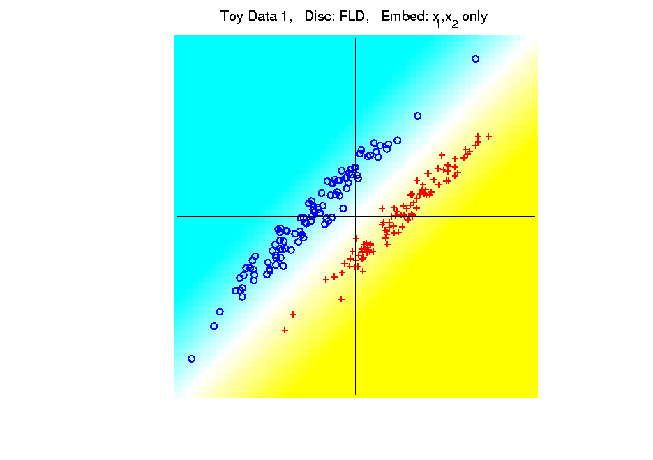
Kernel Embedding
Polynomial Embedding, Toy Example 1:
Parallel Clouds
LDA
Original
Data
Notes:
PEod1Raw.ps

Slide 78
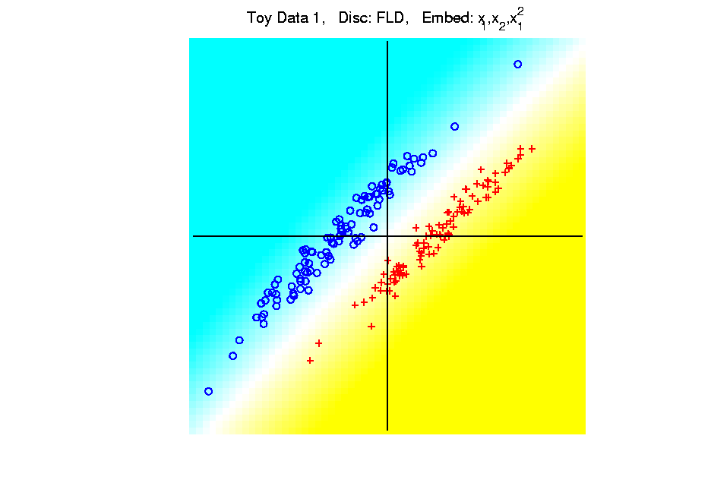
Kernel Embedding
Polynomial Embedding, Toy Example 1:
Parallel Clouds
LDA
Notes:
PEod1Raw.ps

Slide 79
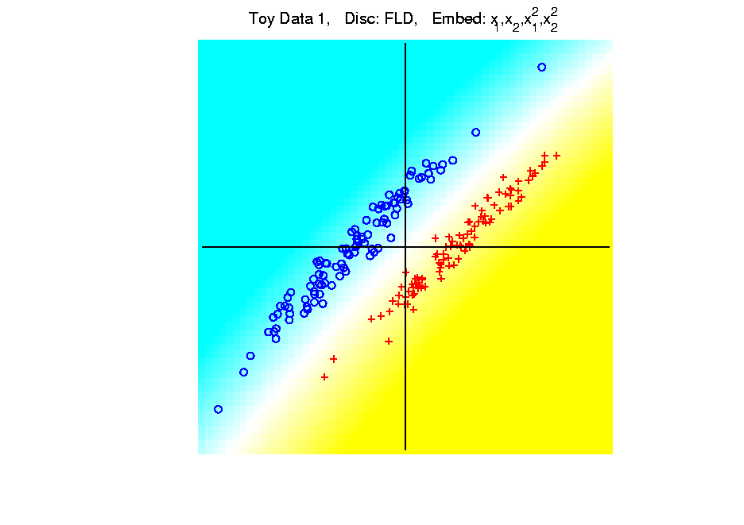
Kernel Embedding
Polynomial Embedding, Toy Example 1:
Parallel Clouds
LDA
Notes:
PEod1Raw.ps

Slide 80
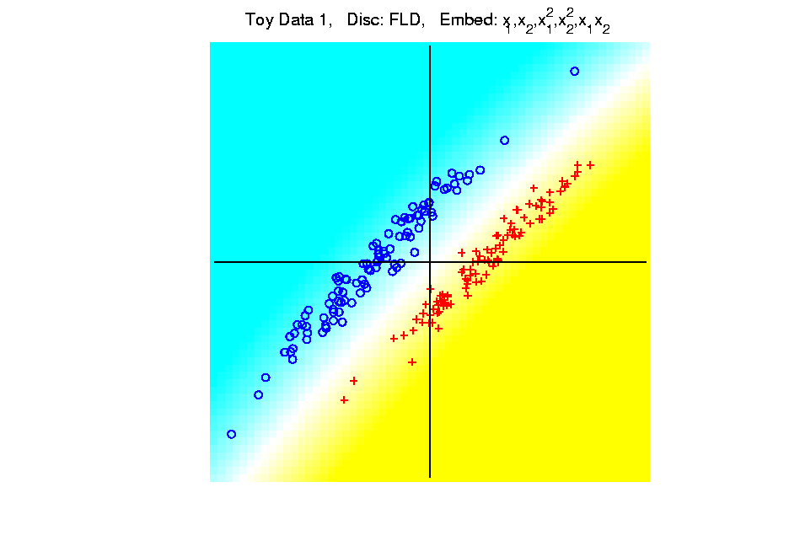
Kernel Embedding
Polynomial Embedding, Toy Example 1:
Parallel Clouds
LDA
Notes:
PEod1Raw.ps

Slide 81
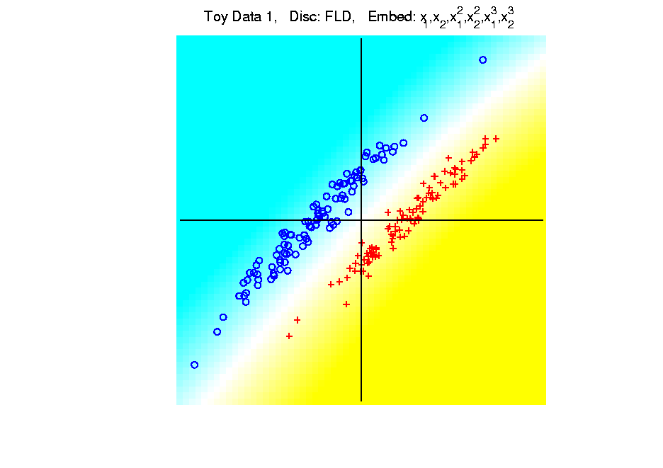
Kernel Embedding
Polynomial Embedding, Toy Example 1:
Parallel Clouds
LDA
All Stable
& Very Good
Since No Better
Separation in
Embedded Space
Notes:
PEod1Raw.ps

Slide 82
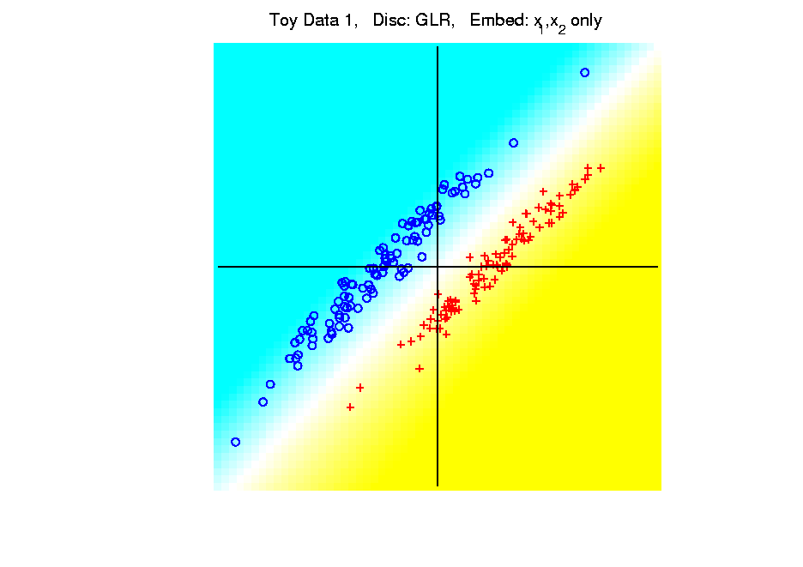
Kernel Embedding
Polynomial Embedding, Toy Example 1:
Parallel Clouds
GLR
Original
Data
Notes:
PEod1Raw.ps

Slide 83
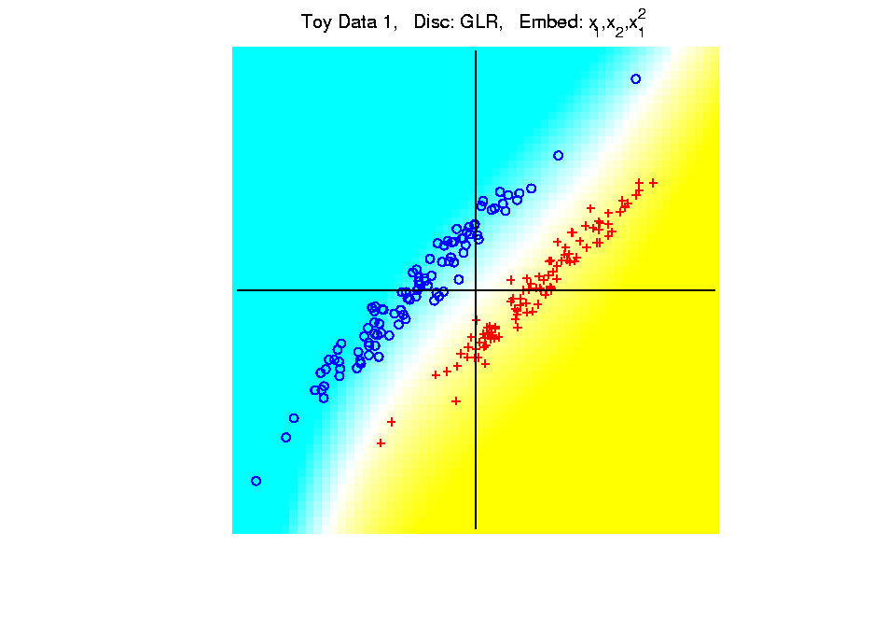
Kernel Embedding
Polynomial Embedding, Toy Example 1:
Parallel Clouds
GLR
Notes:
PEod1Raw.ps

Slide 84
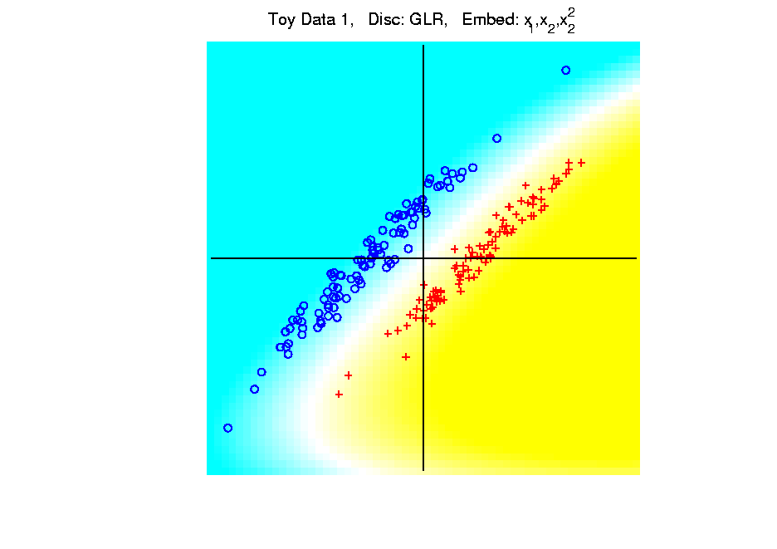
Kernel Embedding
Polynomial Embedding, Toy Example 1:
Parallel Clouds
GLR
Notes:
PEod1Raw.ps

Slide 85
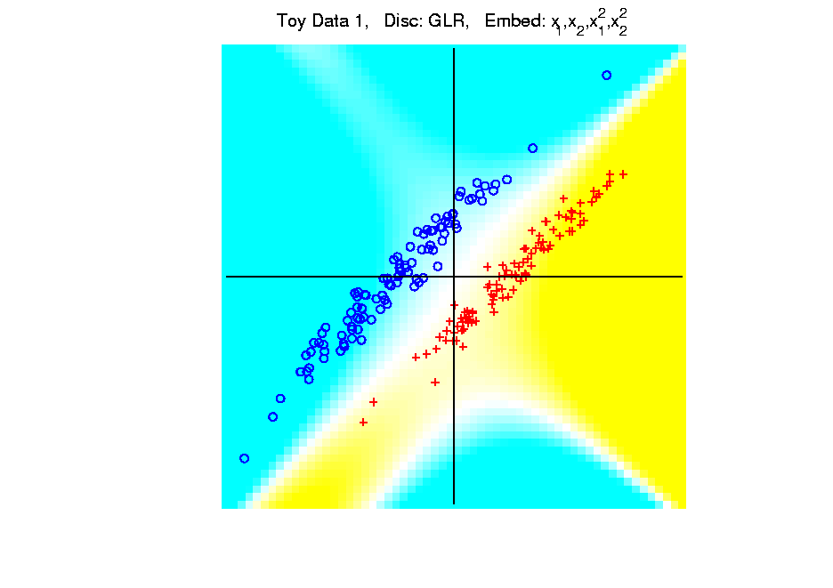
Kernel Embedding
Polynomial Embedding, Toy Example 1:
Parallel Clouds
GLR
Notes:
PEod1Raw.ps

Slide 86
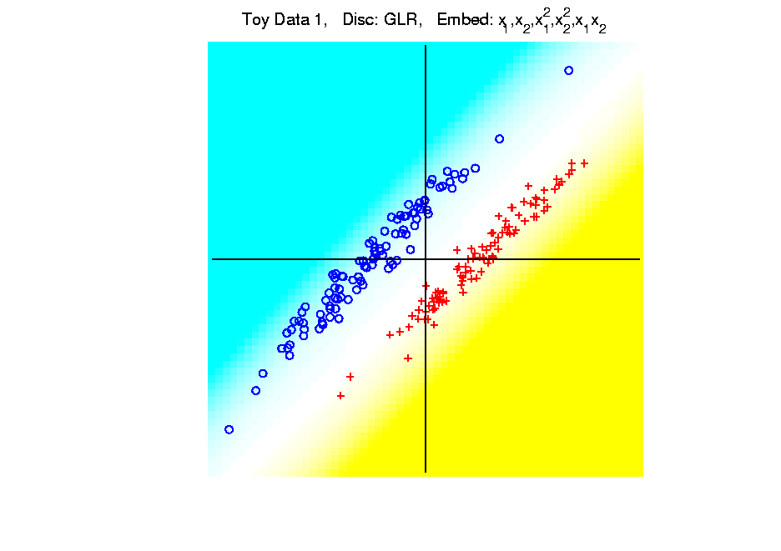
Kernel Embedding
Polynomial Embedding, Toy Example 1:
Parallel Clouds
GLR
Notes:
PEod1Raw.ps

Slide 87
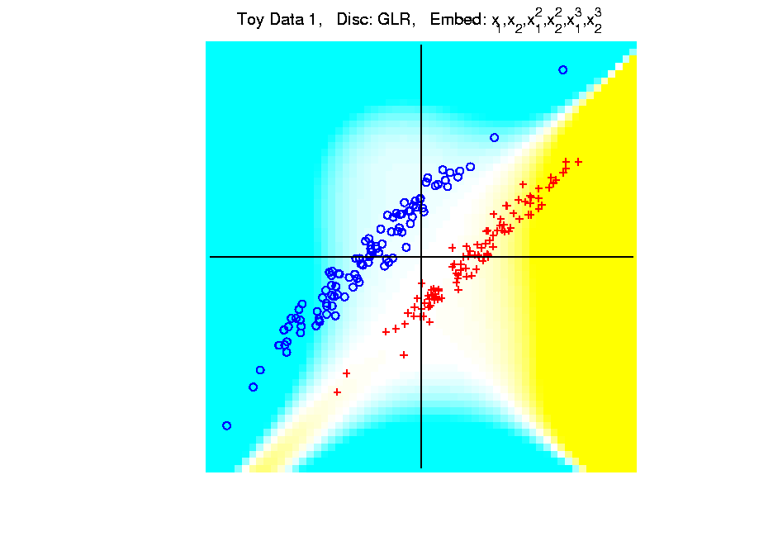
Kernel Embedding
Polynomial Embedding, Toy Example 1:
Parallel Clouds
GLR
Unstable
Subject to
Overfitting
Too Much Flexibility
In Embedded Space
Notes:
PEod1Raw.ps

Slide 88
Participant Presentations
12:05 Rui Liu:
Hi-C Data Analysis
12:10 Nick Tapp-Hughes:
Introduction to Skeletal Representations
Next Class: Brian White, John Lin

