Slide 1
Statistics – O. R. 881 Object Oriented Data Analysis
Start
Recording
Steve Marron
Dept. of Statistics and Operations Research
University of North Carolina

Slide 2
Current Sections in Textbook
Today:
Section 11.3
Next Class:
Sections 11.3, 11.4

Slide 3
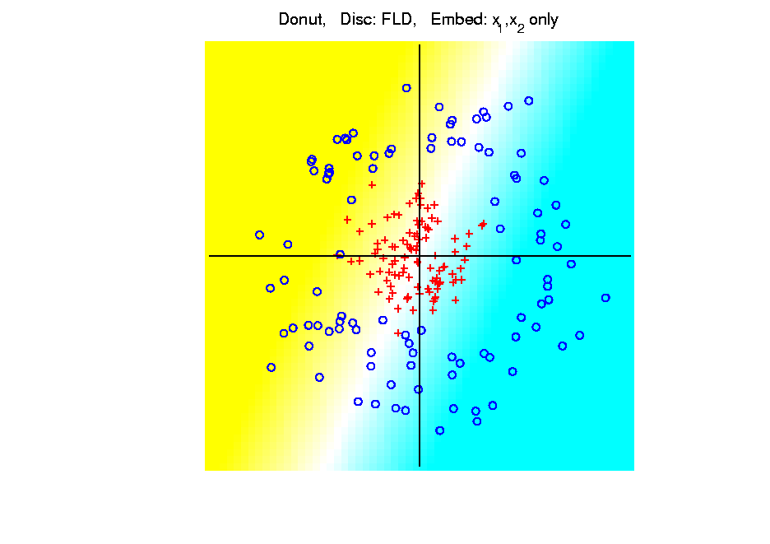
Kernel Embedding
Polynomial Embedding, Toy Example 3:
Donut
LDA
Original
Data
Very
Bad
Notes:
PEod1Raw.ps

Slide 4
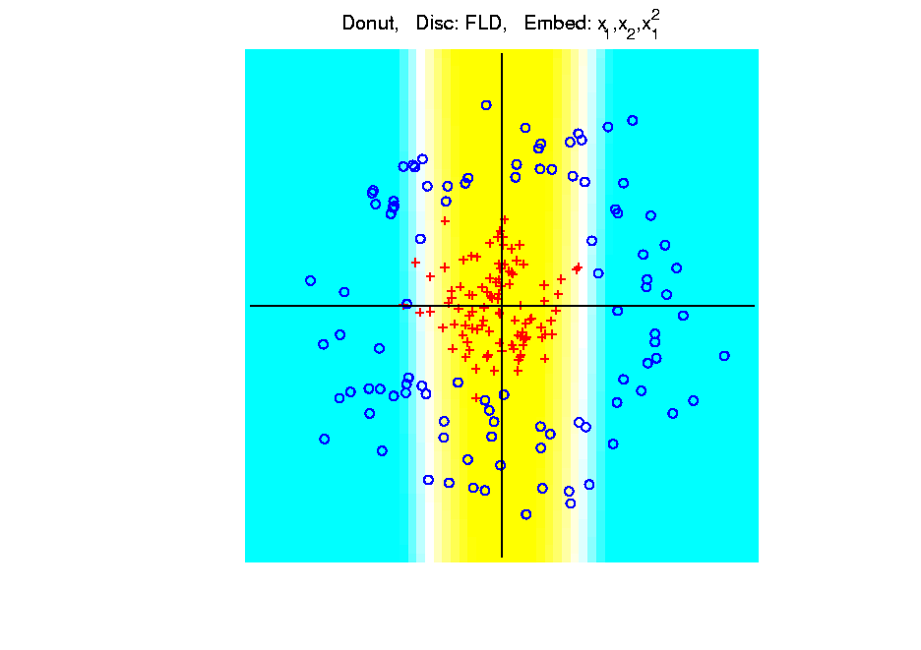
Kernel Embedding
Polynomial Embedding, Toy Example 3:
Donut
LDA
Somewhat
Better
(Parabolic Fold)
Notes:
PEod1Raw.ps

Slide 5
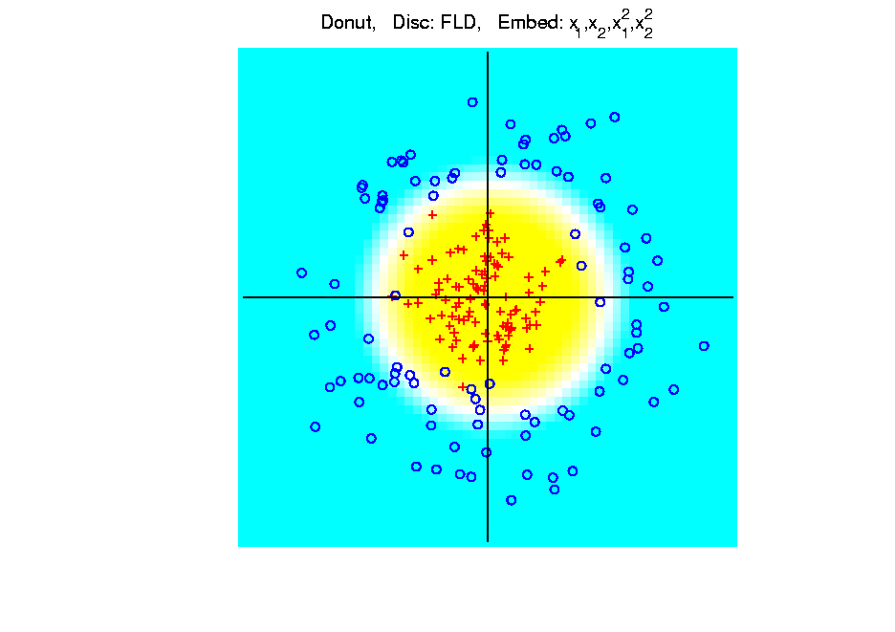
Kernel Embedding
Polynomial Embedding, Toy Example 3:
Donut
LDA
Good
Performance
(Slice of
Paraboloid)
Notes:
PEod1Raw.ps

Slide 6
Kernel Embedding
Naïve Embedding, Radial basis functions:
At some “grid points” $g_{1}⋯,g_{k}$,
For a “bandwidth” (i.e. standard dev’n) $σ$,
Consider ($d$ dim’al) functions:
$$φ_{σ}\left(x−g_{1}\right),⋯,φ_{σ}\left(x−g_{k}\right)$$
Replace data matrix with:
$$\left(\begin{matrix}φ_{σ}\left(x_{1}−g_{1}\right) & ⋯ & φ_{σ}\left(x_{n}−g_{1}\right) \\ ⋮ & ⋱ & ⋮ \\ φ_{σ}\left(x_{1}−g_{k}\right) & ⋯ & φ_{σ}\left(x_{n}−g_{k}\right)\end{matrix}\right)$$

Slide 7
Kernel Embedding
Toy Example 4: Checkerboard
Radial
Basis
Embedding
+ LDA
Is
Excellent!
Notes:
PEod1Raw.ps

Slide 8
t-SNE Visualization
Main Idea:
Data
Kernel Space
MDS Type Representers
Induces Kernel
PCA Type Locality
Gaussian Kernel
Transformation
Cauchy Kernel
Transformation
Pushes Away
Farther Points
Optimization: Make
Close As Possible
Recall Multi Dimensional
Scaling = Auto-Encoder

Slide 9
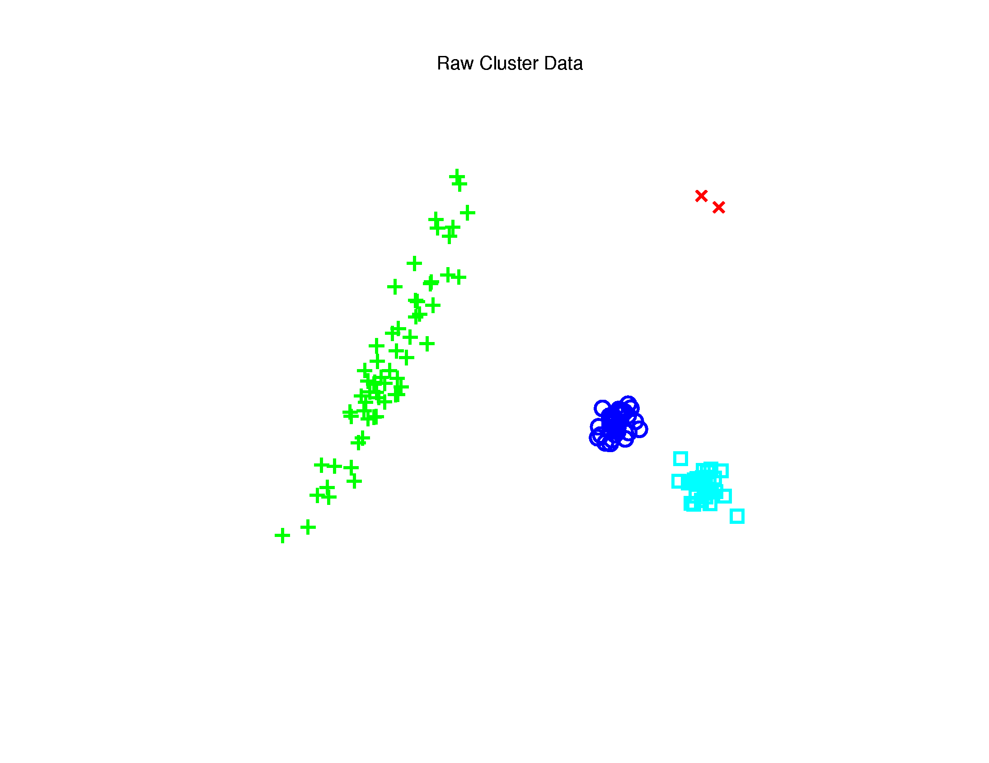
t-SNE Visualization
Same Toy $ℝ^{2}$ Example
4(?) Quite
Diverse
Clusters

Slide 10
t-SNE Visualization
Perplexity = 30 (Default)
Keeps Local
Structure
But Global
Rearangement
And Outlier
Cluster is Split

Slide 11
Support Vector Machines
Motivation:
Find a linear method that “works well”
for embedded data
Note: Embedded data are
very non-Gaussian
Suggests value of
really new approach

Slide 12
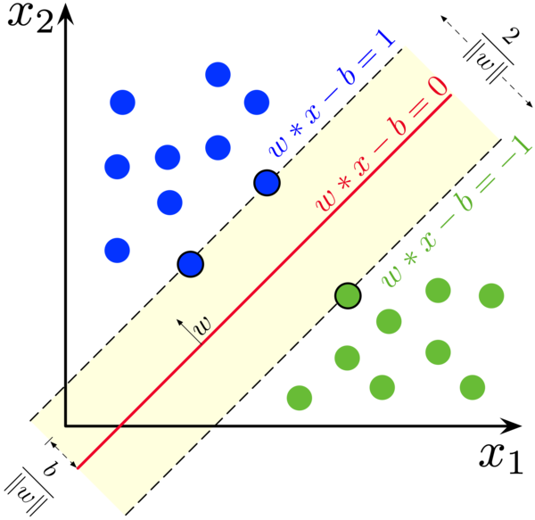
SVMs, Optimization Viewpoint
Alternate Approach (than that of Last Class):
Reparametrize Optimization Problem:
Alternate Goal: Minimize $\left\|w\right\|$ (i.e. max $\frac{1}{\left\|w\right\|}$)
Note: $w$ is no
longer just a
direction, but
now captures
gap between
classes
(Thanks to
Wikipedia)

Slide 13
SVMs, Optimization Viewpoint
Alternate Approach (than that of Last Class)
Nonseparable Version:
Minimize, over $w$ and $b$,
$${\left\|w\right\|}^{2}+C\sum_{i=1}^{n}{{\left(1−y_{i}\left(w^{t}x_{i}−b\right)\right)}_{+}}$$
for a Tuning Parameter $C>0$
C Large → Minimize Violations of Margin
C Small → Weak Enforcement of Violations

Slide 14
SVMs, Tuning Parameter
Study Regularization Parameter $C$:
Controls penalty for violation
I.e. lying on wrong side of plane
Appears in slack variables
Affects performance of SVM
Study Toy Example:
$d=50$, Spherical Gaussian data

Slide 15
SVMs, Tuning Parameter
Toy Example: $d=50$, Sph’l Gaussian data

Slide 16
SVMs, Tuning Parameter
Toy Example: $d=50$, Sph’l Gaussian data
For Large Values of C
Lots of Data Piling
Large Angle to Optimal
Thus Less Generalizable
(For This Data Set)
But Big
Margin
Called Hard Margin SVM

Slide 17
SVMs, Tuning Parameter
Toy Example: $d=50$, Sph’l Gaussian data

Slide 18
SVMs, Tuning Parameter
Toy Example: $d=50$, Sph’l Gaussian data
For Small Values of C
No Apparent Data Piling
Smaller Angle to Optimal
So More Generalizable
Yet Smaller
Margin $\frac{1}{\left\|w\right\|}$
Connection to MD?
Add MD Axis to Plot

Slide 19
SVMs, Tuning Parameter
Toy Example: $d=50$, Sph’l Gaussian data
Put MD on horizontal axis
Note:
For C Small
SVM Dir’n =
= MD Dir’n

Slide 20
SVMs, Tuning Parameter
Toy Example: $d=50$, Sph’l Gaussian data
Put MD on horizontal axis
For Large Values of C
SVM not MD
Hard Margin SVM
Clearly Different
Yet Same for Small C!
(For This Data Set)

Slide 21
SVMs, Tuning Parameter
Toy Example: $d=50$, Sph’l Gaussian data
Mathematics Behind This:
Carmichael & Marron (2021)
Small C in General: Trimmed Mean
Small Range Between That & Hard Margin
Established Useful Bounds on Ends
Very Useful for Coding Cross-Validation

Slide 22
Support Vector Machines
Important Extension:
Multi-Class SVMs
Hsu & Lin (2002)
Lee, Lin, & Wahba (2002)
Defined for “implicit” version
“Direction Based” variation???

Slide 23
Support Vector Machines
SVM Tuning Parameter Selection:
Joachims (2000)
Wahba et al. (1999, 2003)

Slide 24
Distance Weighted Discrim’n
Improvement of SVM for HDLSS Data
Toy e.g.
$d=50$
indep. $N\left(0,1\right)$
$μ_{1}=±2$
$n_{+}=n_{−}=20$
(similar to
earlier movies)
Text, Sec. 11.4

Slide 25
Distance Weighted Discrim’n
Toy e.g.: Maximal Data Piling Direction
- Perfect
Separation
- Gross
Overfitting
- Large Angle
- Poor
Gen’ability
MDP
Feels Small Scale
Noise Artifacts

Slide 26
Distance Weighted Discrim’n
Toy e.g.: Hard Margin SVM Direction
- Bigger Gap
- Smaller Angle
- Better
Gen’ability
- Feels support
vectors too
strongly???
- Ugly subpops?
- Improvement?
Similarly Feels Small
Scale Noise Artifacts

Slide 27
Distance Weighted Discrim’n
Toy e.g.: Distance Weighted Discrimination
- Addresses
these issues
- Smaller Angle
- Better
Gen’ability
- Nice subpops
- Replaces
min dist. by
avg. dist.

Slide 28
Distance Weighted Discrim’n
Based on Optimization Problem:
For “Residuals”:

Slide 29
Distance Weighted Discrim’n
Based on Optimization Problem:
Uses “poles” to push plane away from data

Slide 30
Distance Weighted Discrim’n
Based on Optimization Problem:
More precisely:
Work in appropriate penalty for violations
Optimization Method:
Second Order Cone Programming
“Still convex” gen’n of quad’c program’g
Allows fast greedy solution
Can use available fast software
(SDP3, Michael Todd, et al)

Slide 31
Distance Weighted Discrim’n
References for more on DWD:
Main paper:
Marron, Todd and Ahn (2007)
Links to more papers:
Ahn (2006)
R Implementation of DWD:
CRAN (2014)
SDPT3 Software:
Toh et al (1999)
Sparse DWD: Wang & Zou (2016)
Notes:
31

Slide 32
Distance Weighted Discrim’n
References for more on DWD:
Faster Version:
Lam et al. (2018)
Robust (Against Heterogeneity) Version:
Wang & Zou (2016)
Approach: three-block
semiproximal alternating
direction method of
multipliers
Will Discuss
More Later
Notes:
32

Slide 33
Distance Weighted Discrim’n
2-d Visualization:
Pushes Plane
Away From
Data
All Points
Have Some
Influence
(not just support vectors)

Slide 34
Distance Weighted Discrim’n
Caution:
Early DWD Versions Assumed $n_{+}=n_{−}$
(Balanced Sampling)
Improved Version:
Qiao et al. (2010)
Also Includes Arbitrary Class Priors
If Not, Cutoff $β$ Is Wrong,
Can Give Poor Results
Notes:
34

Slide 35
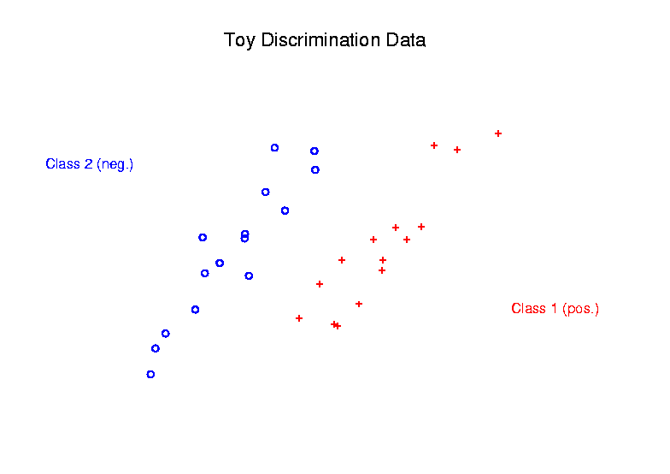
Support Vector Machines
Graphical View, using Toy Example:

Slide 36
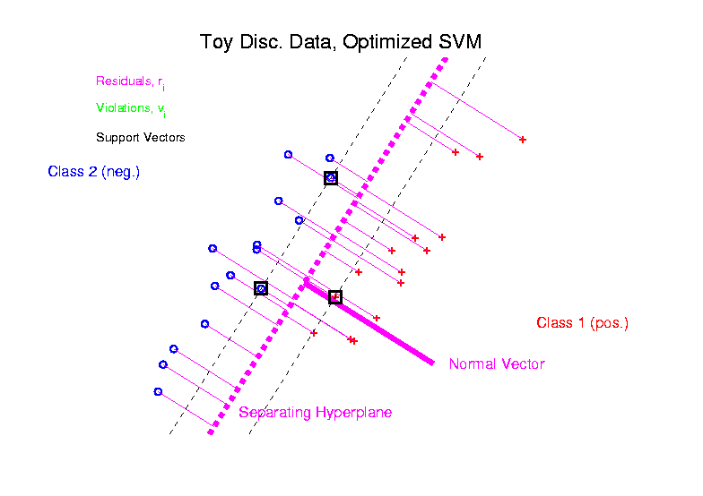
Support Vector Machines
Graphical View, using Toy Example:

Slide 37
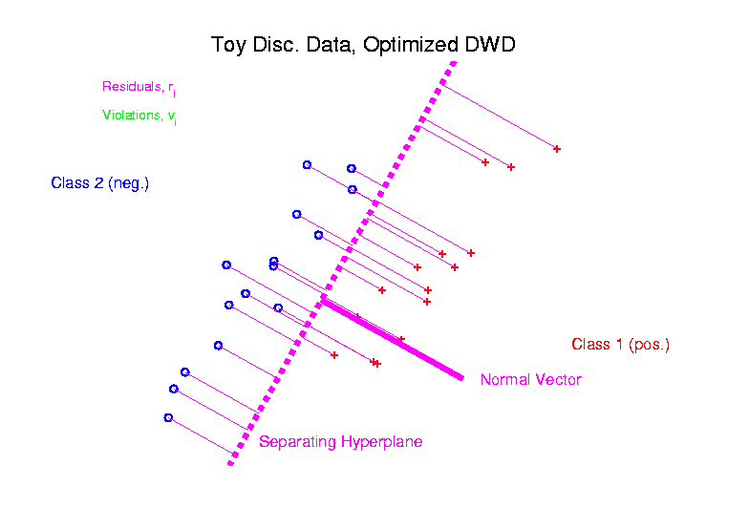
Distance Weighted Discrim’n
Graphical View, using Toy Example:

Slide 38
Distance Weighted Discrim’n
Current Choice of Tuning Parameter $C$:
“Large Value Works Well”
“Hard Margin” Analog Handles Variation Well
Don’t Need Cross-Validation as with SVM
(So DWD much more efficient)

Slide 39
Distance Weighted Discrim’n
Interesting Open Problem:
Analyze DWD from Viewpoint of:
Carmichael and Marron (2021)

Slide 40
HDLSS Discrim’n Simulations
Main idea:
Comparison of
SVM (Hard Margin Version)
DWD (Distance Weighted Discrimination)
MD (Mean Difference, a.k.a. Centroid)
Linear versions, across dimensions
Notes:
40

Slide 41
HDLSS Discrim’n Simulations
Overall Approach:
Study different known phenomena
Spherical Gaussians
Outliers
Polynomial Embedding
Common Sample Sizes
$$n_{+}=n_{−}=25$$
But wide range of dimensions
$$d=10, 40, 100, 400, 1600$$

Slide 42
HDLSS Discrim’n Simulations
Criterion for Comparison:
Based on 100 Simulated Experiments
Each had $n_{+}=n_{−}=25$ Training Data
Assessed with $200$ Test Data Points
Recorded Misclassification Proportion

Slide 43
HDLSS Discrim’n Simulations
Spherical Gaussians:
Notes:
DWD1figEBig.ps

Slide 44
HDLSS Discrim’n Simulations
Spherical Gaussians:
Same setup as before
Means shifted in dim 1 only, $μ_{1}=±2.2$
All methods pretty good
Harder problem for higher dimension
SVM noticeably worse
MD best (Likelihood method)
DWD very close to MD
Methods converge for higher dimension??

Slide 45
HDLSS Discrim’n Simulations
Outlier Mixture:
Notes:
DWD1figFBig.ps

Slide 46
HDLSS Discrim’n Simulations
Outlier Mixture:
80% dim. 1 $μ_{1}=±2.2$, other dims 0
20% dim. 1 ±100, dim. 2 ±500, others 0
MD is a disaster, driven by outliers
SVM & DWD are both very robust
SVM is best
DWD very close to SVM (insig’t difference)
Methods converge for higher dimension??
Ignore RLR (a mistake)

Slide 47
HDLSS Discrim’n Simulations
Wobble Mixture:
Notes:
DWD1figGBig.ps

Slide 48
HDLSS Discrim’n Simulations
Wobble Mixture:
80% dim. 1 $μ_{1}=±2.2$, other dims 0
20% dim. 1 ±0.1, rand dim ±100, others 0
MD still very bad, driven by outliers
SVM & DWD are both very robust
SVM loses (affected by margin push)
DWD slightly better (by w’ted influence)
Methods converge for higher dimension??
Ignore RLR (a mistake)

Slide 49
HDLSS Discrim’n Simulations
Nested Spheres:
Notes:
DWD1figHBig.ps

Slide 50
HDLSS Discrim’n Simulations
Nested Spheres:
1st d/2 dim’s, Gaussian with var 1 or C
2nd d/2 dim’s, the squares of the 1st dim’s
(as for 2nd degree polynomial embedding)
Each method best somewhere
MD best in highest d (data non-Gaussian)
Methods not comparable (realistic)
Methods converge for higher dimension??
HDLSS space is a strange place
Ignore RLR (a mistake)

Slide 51
HDLSS Discrim’n Simulations
Conclusions:
Everything (sensible) is best sometimes
DWD often very near best
MD weak beyond Gaussian
Caution about simulations (and examples):
Very easy to cherry pick best ones
Good practice in Machine Learning
“Ignore method proposed, but read
paper for useful comparison of others”
Every Dog Has his Day

Slide 52
HDLSS Discrim’n Simulations
Caution: There are additional players
E.g. Regularized Logistic Regression
looks also very competitive
Interesting Phenomenon:
All methods come together
in very high dimensions???

Slide 53
HDLSS Discrim’n Simulations
Can we say more about:
All methods come together
in very high dimensions???
Mathematical Statistical Question:
Mathematics behind this???
Will Investigate Later
Notes:
53

Slide 54
DWD in DiProPerm Testing
Recall Permutation Based 2-Class
Hypothesis Test
(Reflecting Visual Impression)
Recall Application: Pan Cancer Data
Studied Data Scaling in Context of
Comparing Ovarian (o) & Uterine (+)

Slide 55
DWD in DiProPerm Testing
Recall Comparison of Scalings
Original
Scale
Zoomed
In
Log
Scale

Slide 56
DWD in DiProPerm Testing
Compare DWD & MD
DiProPerm Performance
Using Log Scale Data Comparing
Ovarian (o) vs. Uterine (+)

Slide 57
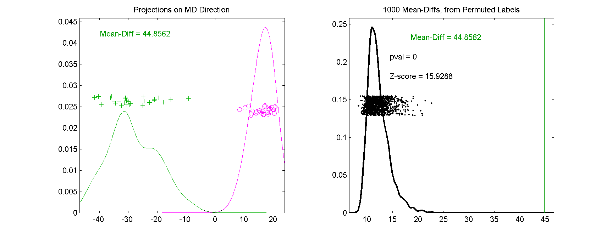
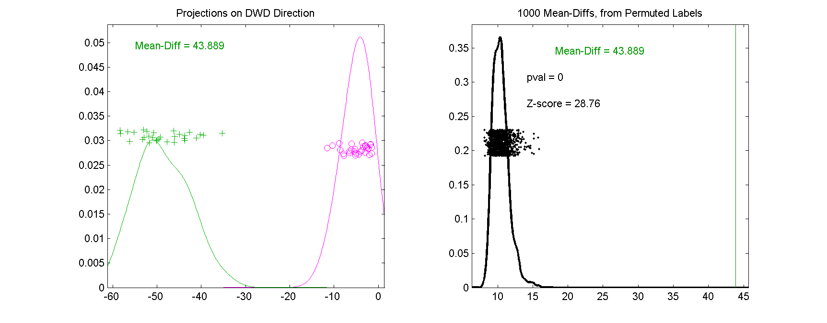
DWD in DiProPerm Testing
Compare DWD & MD
DWD Gives
Stronger
Inference

Slide 58
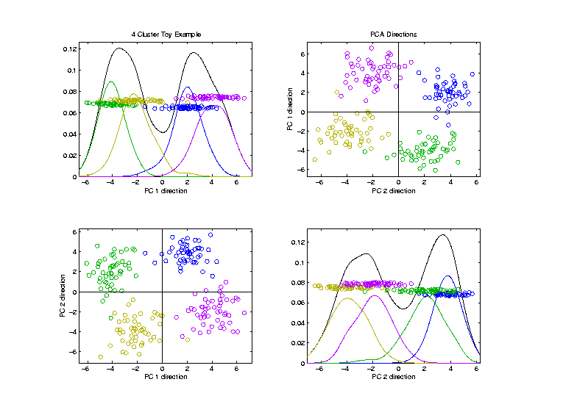
Visualization by DWD, SVM, MD
Toy Example:
4 Clusters,
Symmetric
Gaussians,
$d=200$

Slide 59
Visualization by DWD, SVM, MD
Toy Example:
Train DWD
On These
2 Classes

Slide 60
Visualization by DWD, SVM, MD
Toy Example:
Train SVM & MD
On These
2 Classes

Slide 61
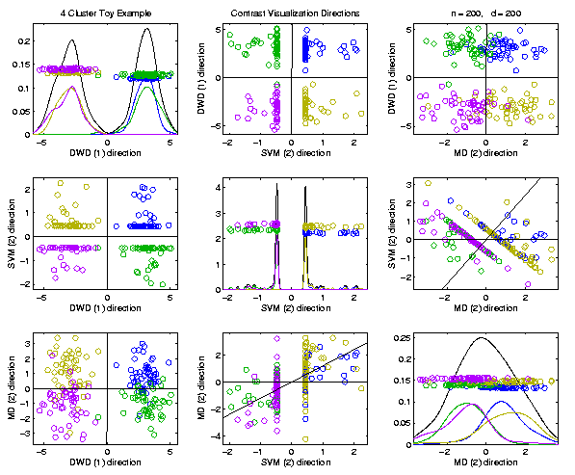
Visualization by DWD, SVM, MD
Toy Example:
Use Those
Directions
In Scatterplot
Matrix View
SVM Data Piling Leaves Lines in Plots

Slide 62
Visualization by DWD, SVM, MD
Toy Example:
MD Has
Strong
Overlap
DWD Gives Superior Visualization

Slide 63
Batch and Source Adjustment
Important Application
of
Distance Weighted Discrimination

Slide 64
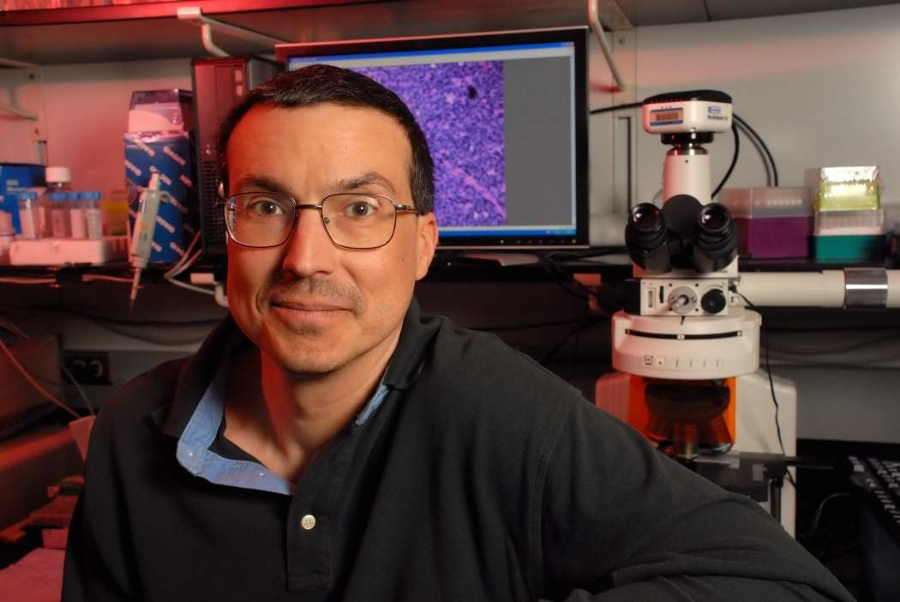
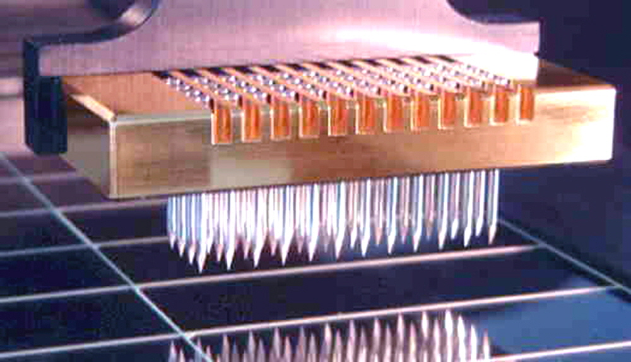
Batch and Source Adjustment
For Stanford Breast Cancer Data
From Perou et al (2000)
Microarray for Measuring Gene Expression
Old Style: Arrays Printed in Lab

Slide 65
Batch and Source Adjustment
For Stanford Breast Cancer Data
From Perou et al (2000)
Analysis in Benito et al (2004)
Adjust for Source Effects
Different sources of mRNA
Adjust for Batch Effects
Arrays fabricated at different times

Slide 66
Idea Behind Adjustment
Early Approach: Alter et al (2000)
Squash Out PC1 direction
Eliminates variation in that direction

Slide 67
DWD: Why not PC1?
PC 1 Direction feels variation, not classes
Also eliminates (important?) within class variation

Slide 68
DWD: Why not PC1?
Direction driven by classes
“Sliding” maintains (important?) within class variation

Slide 69
E. g. even worse for PCA
PC1 direction is worst possible

Slide 70
But easy for DWD
Since DWD uses class label information

Slide 71
Batch and Source Adjustment
Try Out Real Data:
Stanford Breast Cancer Data
From Perou et al (2000)
$d=1753$ “Intrinsic” Genes
$n=107$ Breast Cancer Patients
Discovered With Clustering: Subtypes

Slide 72
Source Batch Adj: Raw Breast Cancer data
See Some
Clusters?

Slide 73
Source Batch Adj: Source Colors
Color By Ink Used
to Print Chips
Bad News, Since
This Dominates PC1
Squishing PC1
Not So Good
Since PC2
Also Involved
Yet Want to Find
Cancer Subtypes

Slide 74
Source Batch Adj: Batch Colors
Color By
Fabrication
Batch
This
Dominates
PC4
Is There
Any Biology
In This Data?

Slide 75
Source Batch Adj: Biological Class Colors
Color By
Cancer
Subtypes
Important Biology
Appears in PCs 2 & 3
Strongly Motivates
Adjustment of Data

Slide 76
Source Batch Adj: Biological Class Col. & Symbols
Follow Subtypes
Using Symbols

Slide 77
Source Batch Adj: Biological Class Symbols
Switch Off
Subtype
Colors

Slide 78
Source Batch Adj: Source Colors
Return to
Source
Colors

Slide 79
Participant Presentations
12:10 Alice Peng:
Studying Epstein-Barr with qPCR and PCA
Next Class: Jordan Valone, Darius Bost

