Slide 1
Statistics – O. R. 881 Object Oriented Data Analysis
Start
Recording
Steve Marron
Dept. of Statistics and Operations Research
University of North Carolina

Slide 2
Current Sections in Textbook
Today:
Sections 11.4, 17.2
Next Class:
Section 17.2

Slide 3
SVMs, Tuning Parameter
Toy Example: $d=50$, Sph’l Gaussian data
For Large Values of C
Lots of Data Piling
Large Angle to Optimal
Thus Less Generalizable
(For This Data Set)
But Big
Margin
Called Hard Margin SVM

Slide 4
SVMs, Tuning Parameter
Toy Example: $d=50$, Sph’l Gaussian data
For Small Values of C
No Apparent Data Piling
Smaller Angle to Optimal
So More Generalizable
Yet Smaller
Margin $\frac{1}{\left\|w\right\|}$
Connection to MD?
Add MD Axis to Plot

Slide 5
Distance Weighted Discrim’n
Toy e.g.: Hard Margin SVM Direction
- Bigger Gap
- Smaller Angle
- Better
Gen’ability
- Feels support
vectors too
strongly???
- Ugly subpops?
- Improvement?
Similarly Feels Small
Scale Noise Artifacts

Slide 6
Distance Weighted Discrim’n
Toy e.g.: Distance Weighted Discrimination
- Addresses
these issues
- Smaller Angle
- Better
Gen’ability
- Nice subpops
- Replaces
min dist. by
avg. dist.

Slide 7
Distance Weighted Discrim’n
Based on Optimization Problem:
For “Residuals”:

Slide 8
HDLSS Discrim’n Simulations
Conclusions:
Everything (sensible) is best sometimes
DWD often very near best
MD weak beyond Gaussian
Caution about simulations (and examples):
Very easy to cherry pick best ones
Good practice in Machine Learning
“Ignore method proposed, but read
paper for useful comparison of others”
Every Dog Has his Day

Slide 9
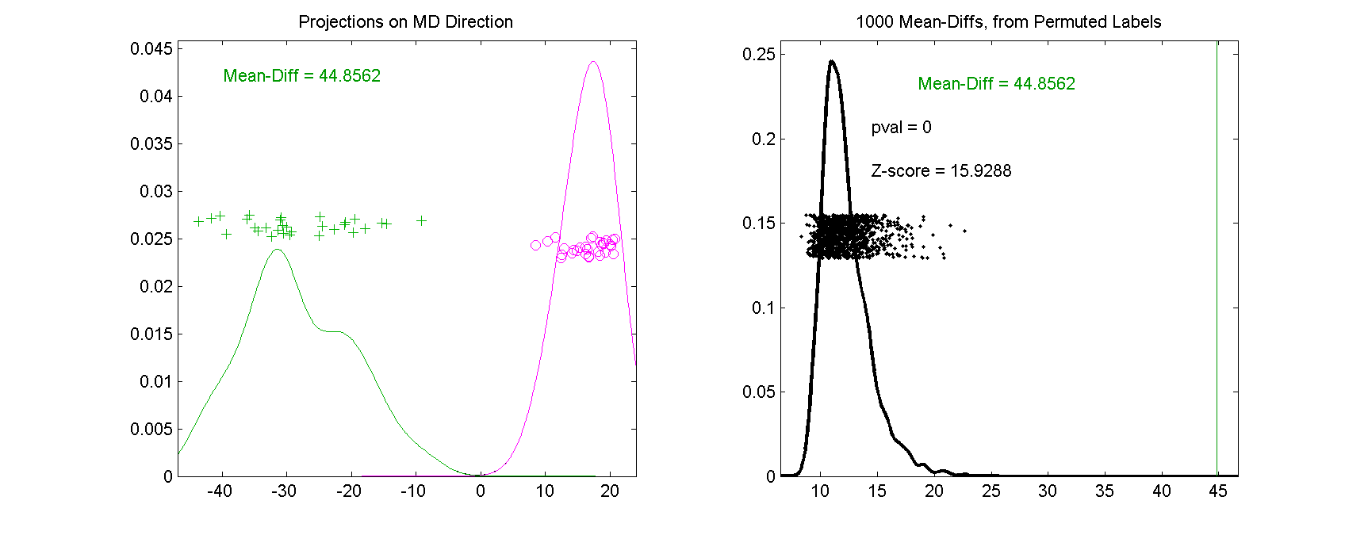
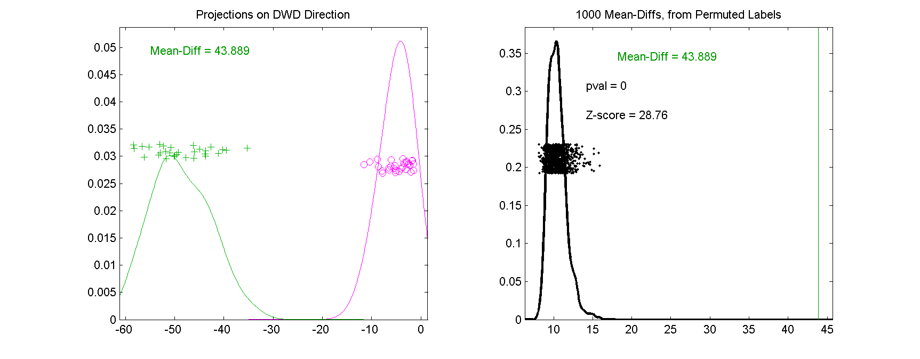
DWD in DiProPerm Testing
Compare DWD & MD
DWD Gives
Stronger
Inference

Slide 10
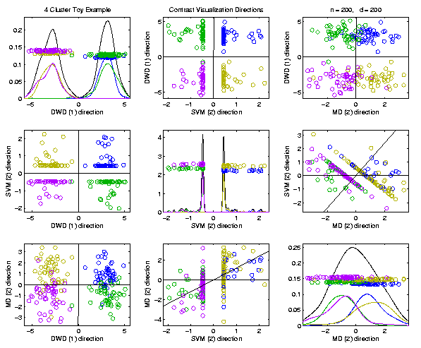
Visualization by DWD, SVM, MD
Toy Example:
MD Has
Strong
Overlap
DWD Gives Superior Visualization

Slide 11
Batch and Source Adjustment
Important Application
of
Distance Weighted Discrimination

Slide 12
Batch and Source Adjustment
Try Out Real Data:
Stanford Breast Cancer Data
From Perou et al (2000)
$d=1753$ “Intrinsic” Genes
$n=107$ Breast Cancer Patients
Discovered With Clustering: Subtypes

Slide 13
Source Batch Adj: Raw Breast Cancer data
See Some
Clusters?

Slide 14
Source Batch Adj: Source Colors
Color By Ink Used
to Print Chips
Bad News, Since
This Dominates PC1
Squishing PC1
Not So Good
Since PC2
Also Involved
Yet Want to Find
Cancer Subtypes

Slide 15
Source Batch Adj: Batch Colors
Color By
Fabrication
Batch
This
Dominates
PC4
Is There
Any Biology
In This Data?

Slide 16
Source Batch Adj: Biological Class Colors
Color By
Cancer
Subtypes
Important Biology
Appears in PCs 2 & 3
Strongly Motivates
Adjustment of Data

Slide 17
Source Batch Adj: Biological Class Col. & Symbols
Follow Subtypes
Using Symbols

Slide 18
Source Batch Adj: Biological Class Symbols
Switch Off
Subtype
Colors

Slide 19
Source Batch Adj: Source Colors
Return to
Source
Colors

Slide 20
Source Batch Adj: PC 1-3 & DWD direction
Replace PC4
By DWD
Direction
Note Much Farther
Apart Than in PC1

Slide 21
Source Batch Adj: DWD Source Adjustment
Slide Data
In DWD
Direction
Note How Subtypes
Come Together
Until Means
Are the Same

Slide 22
Source Batch Adj: Source Adj’d, PCA view
Return PC4

Slide 23
Source Batch Adj: Source Adj’d, Class Colored
Subtype Colors
Shows Very
Successful
Adjustment

Slide 24
Source Batch Adj: Source Adj’d, Batch Colored
Next Consider
Batch Colors

Slide 25
Source Batch Adj: Source Adj’d, 5 PCs
Don’t Want to Replace PC4
With DWD, Since Will Miss
Effect of Adjustment,
So Add PC5 (to Replace)

Slide 26
Source Batch Adj: S. Adj’d, Batch 1,2 vs. 3 DWD
Replace PC5 With DWD Trained
on Blue vs. (Green & Red)

Slide 27
Source Batch Adj: S. & B1,2 vs. 3 Adjusted
Slide Data
In DWD
Direction
Good Impact
On PC4

Slide 28
Source Batch Adj: S. & B1,2 vs. 3 Adj’d, 5 PCs
Return to PC5

Slide 29
Source Batch Adj: S. & B Adj’d, B1 vs. 2 DWD
DWD Trained on
(Green & Blue) vs. Red

Slide 30
Source Batch Adj: S. & B Adj’d, B1 vs. 2 Adj’d
Slide Data
In DWD
Direction

Slide 31
Source Batch Adj: S. & B Adj’d, 5 PC view
Return
To PC5

Slide 32
Source Batch Adj: S. & B Adj’d, 4 PC view
Go Back To
4 PCs View

Slide 33
Source Batch Adj: S. & B Adj’d, Class Colors
Return Subtype Colors
Note Subtypes Distinguished,
i.e. Successful Adjustment
After adjusting, These Are
No Longer PC Directions

Slide 34
Source Batch Adj: S. & B Adj’d, Adj’d PCA
Recompute PC Axes
PC1 & 2 Now About Biology

Slide 35
DWD does not solve all problems
Only handles means, not differing variation
Alternative: Shabalin et al (2008)

Slide 36
Interesting Benchmark Data Set
NCI 60 Cell Lines
Interesting benchmark, since same cells
Data Web available:
http://discover.nci.nih.gov/datasetsNature2000.jsp
Both cDNA and Affymetrix Platforms
Different from Breast Cancer Data
Which had no common samples
See Liu et al. (2009)

Slide 37
Interesting Benchmark Data Set
NCI 60 Cell Lines
Interesting benchmark, since same cells
Previously Studied, (8/27/2019)
Illustrating Limitations of PCA Views
Used DWD Dir’ns to Focus on Types

Slide 38
NCI 60: Can we find classes Using PCA view?
Notes:
38

Slide 39
NCI 60: Views using DWD Dir’ns (focus on biology)
Now
Study
Where
This
Data
Came
From
Notes:
39

Slide 40
Recall DWD Appl’n: Visualization
Recall PCA limitations
DWD uses class info
Hence can “better separate known classes”
Did this for pairs of classes
(DWD just on those, ignore others)
Carefully choose pairs in NCI 60 data
Shows Effectiveness of Adjustment

Slide 41
NCI 60: Raw Data, Platform Colored
Common Samples
Connected by
Dashed Lines
Huge Platform
Differences
Fortunately
Systematic

Slide 42
NCI 60: Raw Data
Use Common Colors

Slide 43
NCI 60: Raw Data, Before DWD Adjustment
Slide Points Down
Along Diagonal
(to make space)
Color Blue
For “Before”

Slide 44
NCI 60: Before & After DWD adjustment
Add On Red
Points for
“After” DWD
Show Blue → Red
Difference as
Black Lines

Slide 45
NCI 60: Before & After, new scales
Rescale Axes to
Focus on Red Only

Slide 46
NCI 60: After DWD
Turn Off
All But Red

Slide 47
NCI 60: DWD adjusted data
Slide Down to Middle

Slide 48
NCI 60: Before Column Mean Adjustment
Slide Further Down
To Become “Before”
For Next Step

Slide 49
NCI 60: Before & After Column Mean Adjustment
Impacts Variation
In PC1 Direction
Subtract Trait Means
(i.e. Means of Columns)

Slide 50
NCI 60: Before & After Col. Mean Adj., Rescaled
Rescale Axes to
Focus on Red Only

Slide 51
NCI 60: After DWD & Column Mean Adj.
Turn Off
All But Red

Slide 52
NCI 60: DWD & Column Mean Adjusted
Slide Down to Middle

Slide 53
NCI 60: Before Column Stand. Dev. Adjustment
Slide Further Down
To Become “Before”
For Next Step

Slide 54
NCI 60: Before and After Column S.D. Adjustment
Standardize Columns
(Divide Columns by SD)
Reduces Blue Variation Everywhere

Slide 55
NCI 60: Before and After Col. S.D. Adj., Rescaled
Rescale Axes to
Focus on Red Only

Slide 56
NCI 60: After Column Stand. Dev. adjustment
Turn Off
All But Red

Slide 57
NCI 60: Fully Adjusted Data
Slide Down to Middle

Slide 58
NCI 60: Fully Adjusted Data, Platform Colored
Return Original Colors
Next Study Clusters
Using “Brushing”

Slide 59
NCI 60: Fully Adjusted Data, Melanoma Cluster
BREAST.MDAMB435
BREAST.MDN
MELAN.MALME3M
MELAN.SKMEL2
MELAN.SKMEL5
MELAN.SKMEL28
MELAN.M14
MELAN.UACC62
MELAN.UACC257
Known Mislabellings

Slide 60
NCI 60: Fully Adjusted Data, Leukemia Cluster
LEUK.CCRFCEM
LEUK.K562
LEUK.MOLT4
LEUK.HL60
LEUK.RPMI8266
LEUK.SR

Slide 61
Why not adjust using SVM?
Major Problem: Proj’d Distrib’al Shape
Triangular Dist’ns (opposite skewed)
Does not allow sensible rigid shift

Slide 62
Why not adjust using SVM?
Nicely Fixed by DWD
Projected Dist’ns near Gaussian
Sensible to shift

Slide 63
Why not adjust by means?
DWD is complicated: value added?
Because it is “cool”
Recall Improves SVM for HDLSS
Good Empirical Success
Routinely Used in Perou Lab
Many Comparisons Done
Similar Lessons from Wistar
Proven Statistical Power

Slide 64
Why not adjust by means?
But Why Not PAM (~Mean Difference)?
Simpler is Better
Why not means, i.e. point cloud centerpoints?
Elegant Answer: Liu et al (2009)

Slide 65
Why not adjust by means?
But Why Not PAM (~Mean Difference)?
Simpler is Better
Why not means, i.e. point cloud centerpoints?
Drawback to PAM:
Poor Handling of Unbalanced Biological Subtypes
DWD more Resistant to Unbalance

Slide 66
Why not adjust by means?
Toy Example:
Gaussian Clusters
Two batches (denoted: + o)
Two subtypes (red and blue)
Goal: bring together
+ ←→ o and also + ←→ o
Challenge: unequal biological ratios within batches

Slide 67
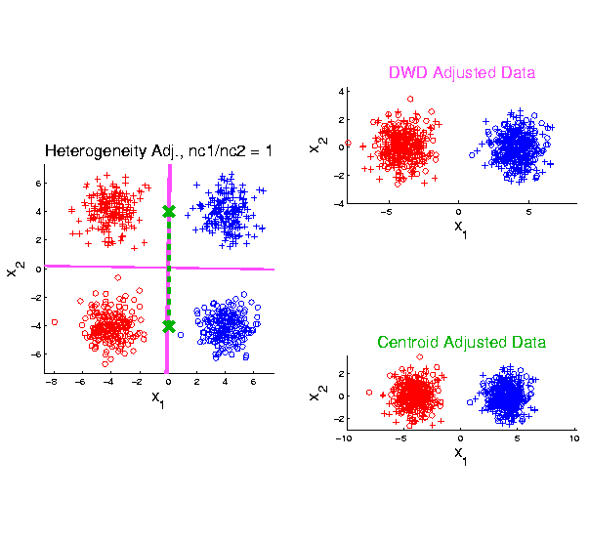
Twiddle ratios of subtypes
2-d Toy
Example
Balanced
Mixture
Adjusted Along
DWD Direction
Adjusted Along
MD Direction

Slide 68
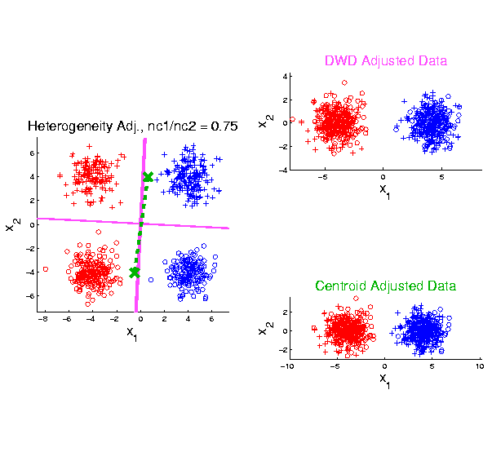
Twiddle ratios of subtypes
2-d Toy
Example
Unbalanced
Mixture
(Through
“decimation”)

Slide 69
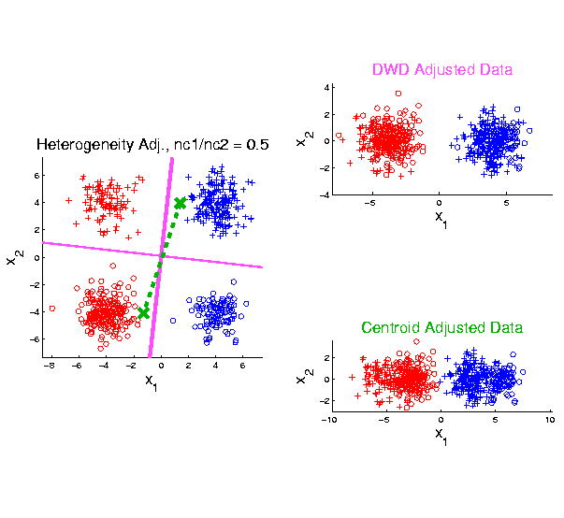
Twiddle ratios of subtypes
2-d Toy
Example
Unbalanced
Mixture
(Diminishing
Discriminatory
Power)

Slide 70
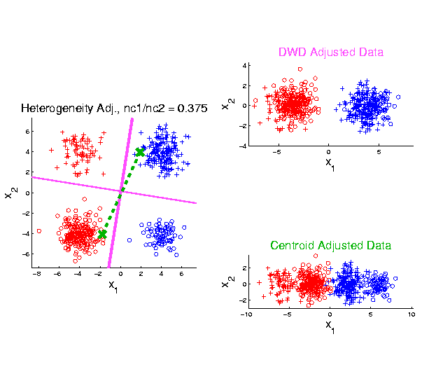
Twiddle ratios of subtypes
2-d Toy
Example
Unbalanced
Mixture

Slide 71
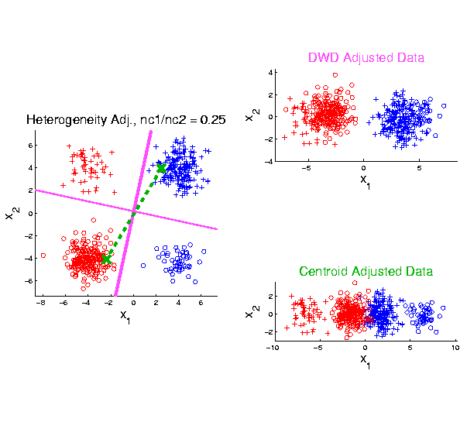
Twiddle ratios of subtypes
2-d Toy
Example
Unbalanced
Mixture

Slide 72
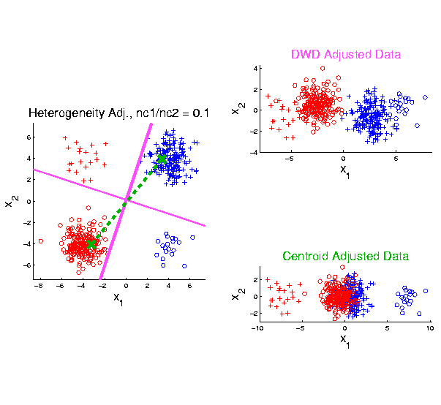
Twiddle ratios of subtypes
2-d Toy
Example
Unbalanced
Mixture
Note: Losing
Distinction
To Be Studied

Slide 73
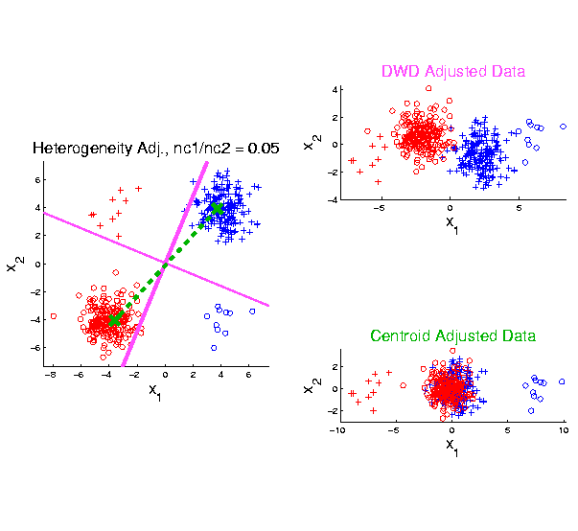
Twiddle ratios of subtypes
2-d Toy
Example
Unbalanced
Mixture

Slide 74
Why not adjust by means?
DWD robust against non-proportional subtypes…
Mathematical Statistical Question:
Are there mathematics behind this?
Will Investigate Later
Notes:
74

Slide 75
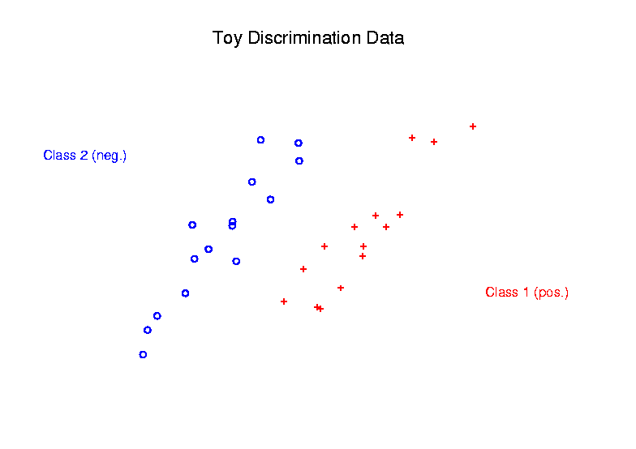
Radial DWD
Main Idea:
Linear Classifiers Good When Each Class Lives in a Distinct Region
Notes:
75

Slide 76
Radial DWD
Main Idea:
Linear Classifiers Good When Each Class Lives in a Distinct Region
Hard When All Members Of One Class Are Outliers in a Random Direction
Notes:
76

Slide 77
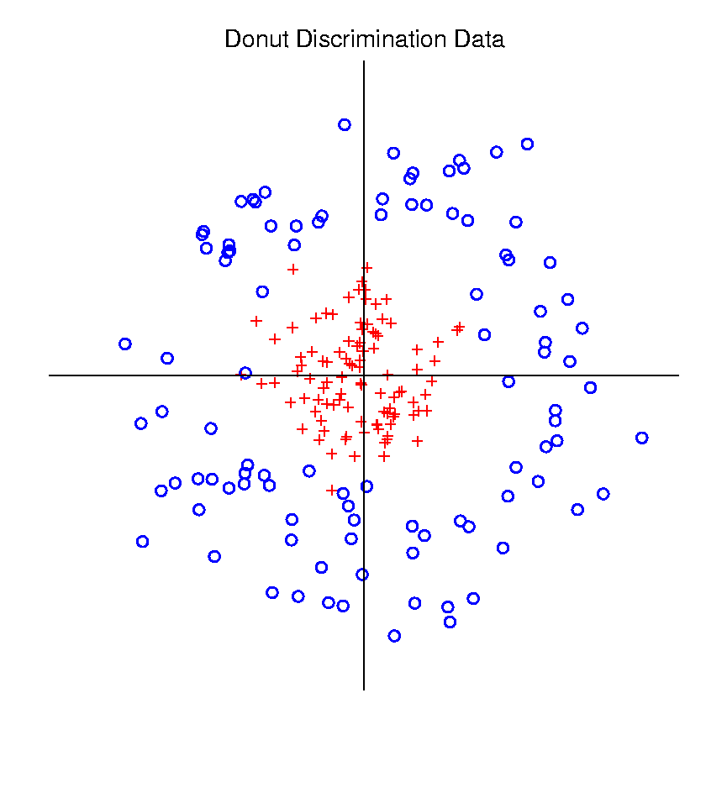
Radial DWD
Hard When All Members Of One Class Are Outliers in a Random Direction
Think HDLSS
Version of
Notes:
77

Slide 78
Radial DWD
Hard When All Members Of One Class Are Outliers in a Random Direction
E.g. Normal Cases
& Randomly Degraded
Notes:
78

Slide 79
Radial DWD
Reference:
Xiong, Dittmer & Marron (2016)
Notes:
79

Slide 80
Radial DWD
Motivating Example: Virus Hunting
Based on DNA
DNA in Sample is Amplified & Cut Up
Matched to Known Virus Genome
Data Objects: Counts $x=\left(\begin{matrix}x_{1} \\ ⋮ \\ x_{d}\end{matrix}\right)$
Notes:
80

Slide 81
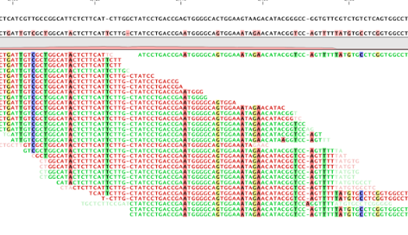
Virus Hunting
“Reads” Matched to Virus Genome & Counted to give $x_{1},⋯,x_{d}$
Notes:
81

Slide 82
Virus Hunting
Challenge 1:
Highly Variable DNA Amplification
Solution:
Standardize by Dividing by Total
Notes:
82

Slide 83
Virus Hunting
Standardize by Dividing by Total
Consequence:
Data Objects lie on Unit Simplex
$$\left\{x=\left(\begin{matrix}x_{1} \\ ⋮ \\ x_{d}\end{matrix}\right):x_{1},⋯x_{d}≥0,\sum_{j=1}^{d}{x_{j}}=1\right\}$$
Called Compositional Data
Notes:
83

Slide 84
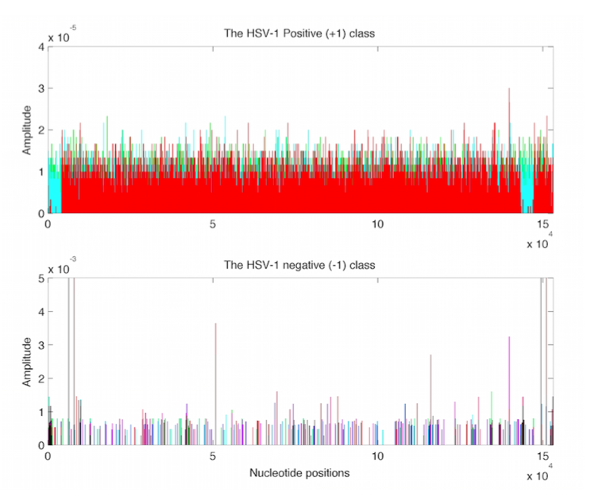
Virus Hunting
Look at
Data:
Mostly
Non-0
Near Simplex Center
Almost
All 0
Near Simplex Corners
Notes:
84

Slide 85
Virus Hunting
Look at
Data:
Note:
Heights
Orders of
Magnitude
-5 << -3
Different
Notes:
85

Slide 86
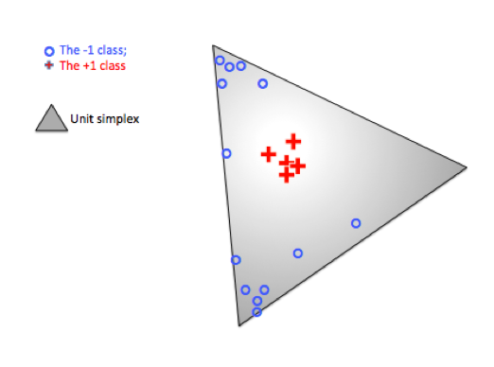
Radial DWD
Thought
Model:
+ Class
Near Center
- Class At
Random
Corners
Note: $∃$ Many ($d$) Corners
Notes:
86

Slide 87
Radial DWD
Consider Training Data
+ Class in Center
- Class Really in
Multiple Corners
Notes:
87

Slide 88
Radial DWD
Consider Training Data
Classify Using
Separating Plane
Notes:
88

Slide 89
Radial DWD
Consider Training Data
But What About
Test Point In A
Different Corner
???
Notes:
89

Slide 90
Radial DWD
Approach:
Replace Separating Plane
With Separating Sphere
Find Parameters
Via DWD-like
Optimization
Enables Finding Corners
With No Training Data
Notes:
90

Slide 91
Virus Hunting
Real Data Result:
Train + (+)
Train – (o)
Test + (*)
Related (*)
Test - (x)
Notes:
91

Slide 92
Virus Hunting
Compare With Other Classifiers
Includes Above Radial DWD
Notes:
92

Slide 93
Virus Hunting
Compare With Other Classifiers
Linear Methods All Poor
Notes:
93

Slide 94
Virus Hunting
Compare With Other Classifiers
Even Kernel SVM Fails!!!
Reason:
Test Data
Lies In
Corners
With No
Training
Data
Notes:
94

Slide 95
Radial DWD
Verify With Simulation Study
Note: Very Similar Behavior!
Notes:
95

Slide 96
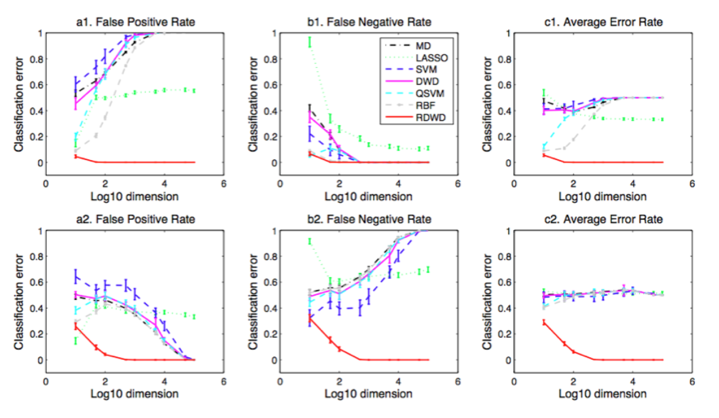
Radial DWD
Verify With Simulation Study
Stunning Test Classificat’n Rates as $d$ grows!
Notes:
96

Slide 97
Return to Big Picture
Main statistical goals of OODA:
Understanding population structure
Low dim’al Projections, PCA …
Classification (i. e. Discrimination)
Understanding 2+ populations
Time Series of Data Objects
Chemical Spectra, Mortality Data
“Vertical Integration” of Data Types

Slide 98
Data Integration
Text, Sec. 17.2
Modern Data Collections Often Involve
Multiple Data Types
Important Analytical Task:
Understand How These Work Together
(And Work Separately)

Slide 99
Data Integration
Important Example: Cancer Research
Late 1990s – early 2000s
Microarrays for gene expression
Hype: “Will Cure Cancer”
Hmm, afraid not…
Response:
Have $$$, so measure much more…

Slide 100
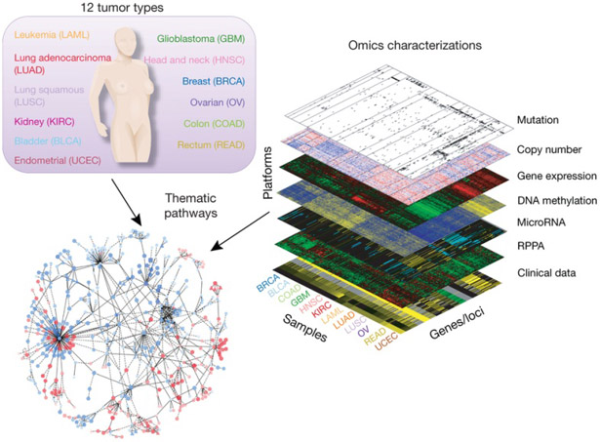
Data Integration
Deep Example:
The
Cancer
Genome
Atlas
(TCGA)
Figure : The Cancer Genome Atlas Research Network, Weinstein, J.N., Collisson, E.A., Mills, G.B., Shaw, K.M., Ozenberger, B.A., Ellrott, K., Shmulevich, I., Sander, C., and Stuart, J.M. (2013)
The Cancer Genome Atlas Pan-Cancer analysis project.

Slide 101
Data Integration
The Cancer Genome Atlas (TCGA)
Additional Statistical Challenge:
Data Heterogeneity
$∵$ Massive Cross-Lab Collaboration
Needed Because of Diversity of Cancer
(not 1 Disease, But 100s or 1000s?)

Slide 102
Data Integration
Common Data Structure:
Multi-Block Analysis
Synomyns:
Data Fusion
Multi-View (Machine Learning)
Functional Factor Models

Slide 103
Data Integration
Multi-Block Data Structure
Blocks are $\left(B\right)$ Data Matrices
Convention:
Columns as Data Objects
I.e. Common Patients,
Experimental Units…

Slide 104
Data Integration
$B=2$ Block Notation
(Can Be Different)
$d_{1},d_{2}=$number of variables
(i.e. features)
$$d_{1}$$
$$n$$
$n =$number of cases
(i.e. subjects or samples)
$$d_{2}$$
$$n$$
(Must Be Same)

Slide 105
Data Integration
Insightful Goal:
Modes of Variation
As in PCA
(Recall Spanish Mortality Data)

Slide 106
A Taste of OODA Examples
Spanish Male Mortality Curves
Enhancement: Color by Year
1908
1931
1964
1987
2002

Slide 107
A Taste of OODA Examples
Spanish Male Mortality Curves
1918 Flu Pandemic
Spanish Civil War
1st Mode of
Variation

Slide 108
A Taste of OODA Examples
Spanish Male Mortality Curves
Flu Pandemic, Civil War
2nd Mode of
Variation
Intro of Automobile,
Improved Safety

Slide 109
Data Integration
Insightful Goal:
Modes of Variation
As in PCA
But Replace Maximal Variation
With Maximal Commonality
(& Maybe Maximal Difference)

Slide 110
Participant Presentations
12:05 Jordan Valone:
Context specific effects of genetic variation in response to Wnt pathway activation
12:10 Darius Bost:
Meta-analysis of Predicted Expression on Addiction Traits
Next Class: Minji Kim, Parvathi Meyyappan

