Slide 1
Statistics – O. R. 881
Object Oriented Data Analysis
Start
Recording
Steve Marron
Dept. of Statistics and Operations Research
University of North Carolina

Slide 2
Current Sections in Textbook
Today:
Section 17.2
Next Class:
Sections 17.2, 14.2

Slide 3
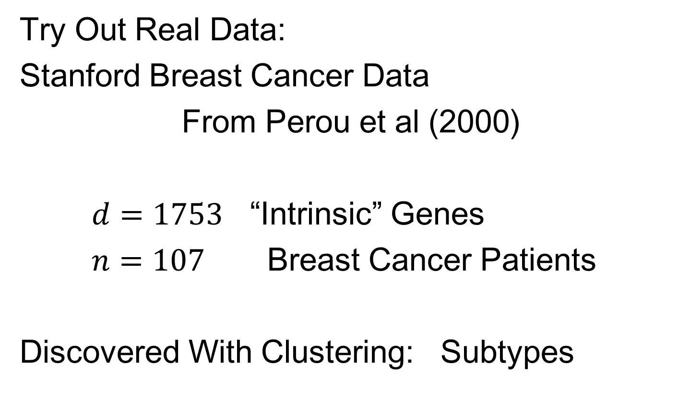
Batch and Source Adjustment
Try Out Real Data:
Stanford Breast Cancer Data
From Perou et al (2000)
$d=1753$ “Intrinsic” Genes
$n=107$ Breast Cancer Patients
Discovered With Clustering: Subtypes

Slide 4
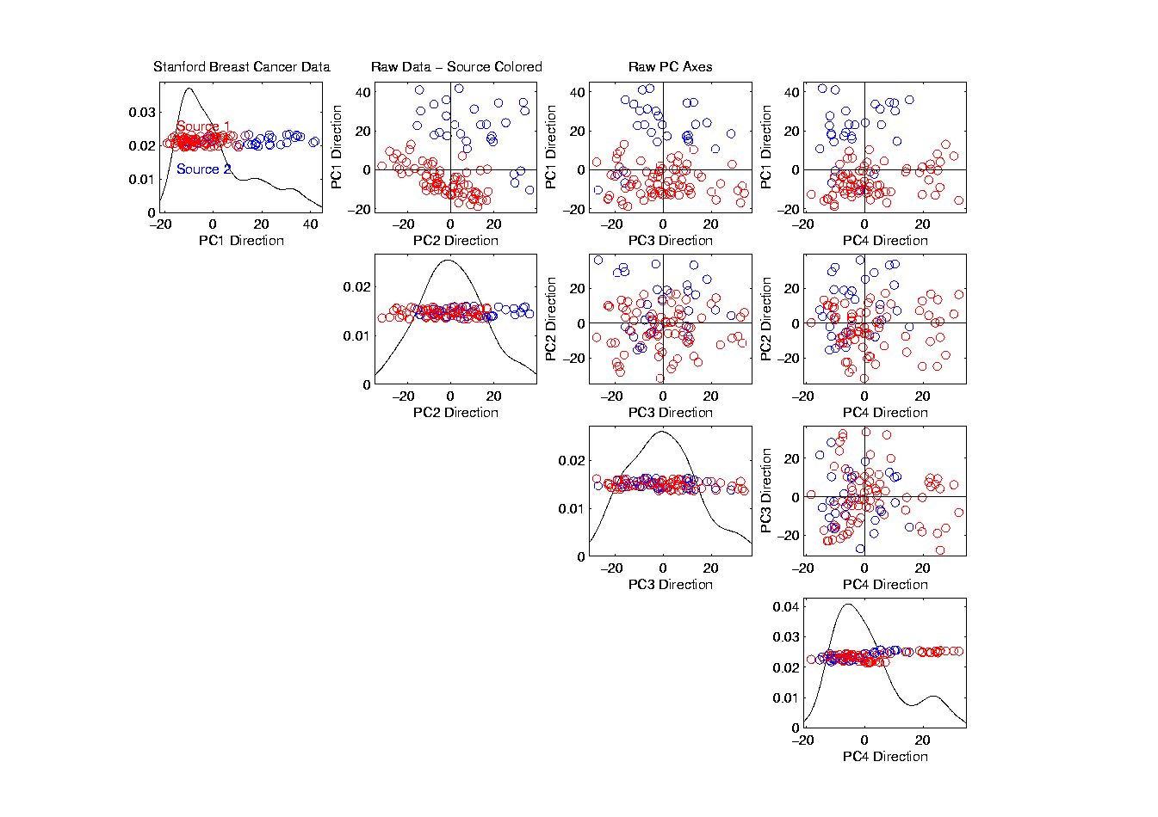
Source Batch Adj: Source Colors
Color By Ink Used
to Print Chips
Bad News, Since
This Dominates PC1
Squishing PC1
Not So Good
Since PC2
Also Involved
Yet Want to Find
Cancer Subtypes

Slide 5
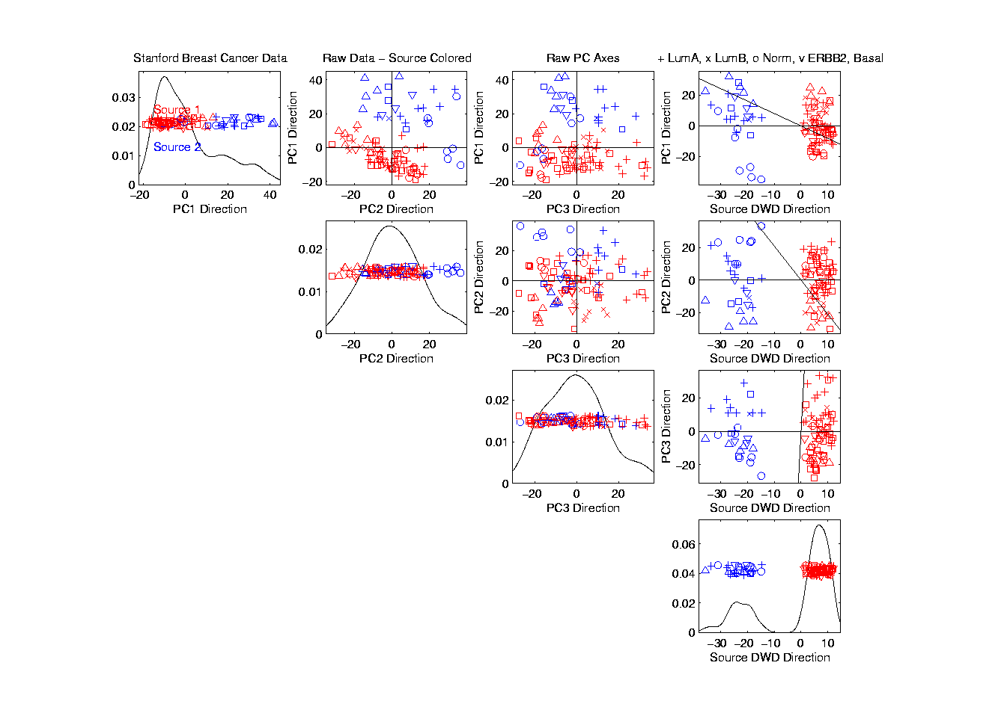
Source Batch Adj: PC 1-3 & DWD direction
Replace PC4
By DWD
Direction
Note Much Farther
Apart Than in PC1

Slide 6
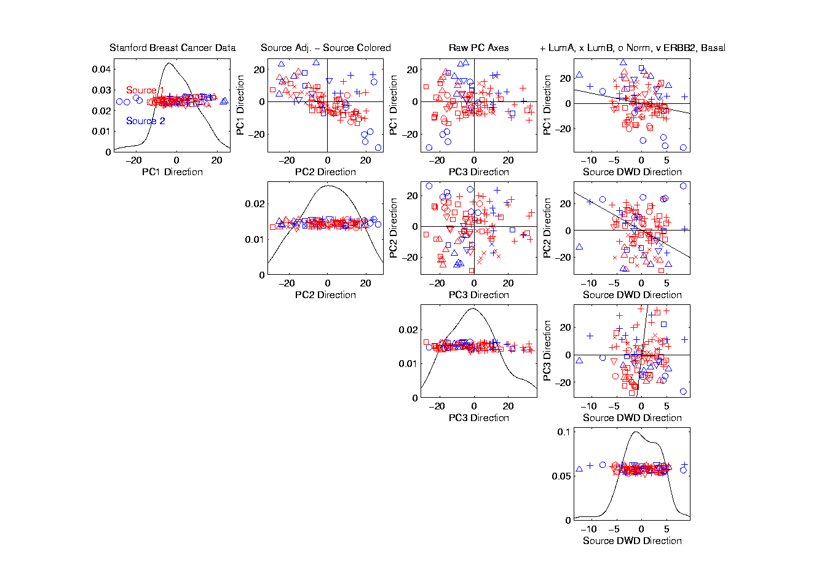
Source Batch Adj: DWD Source Adjustment
Slide Data
In DWD
Direction
Note How Subtypes
Come Together
Until Means
Are the Same

Slide 7
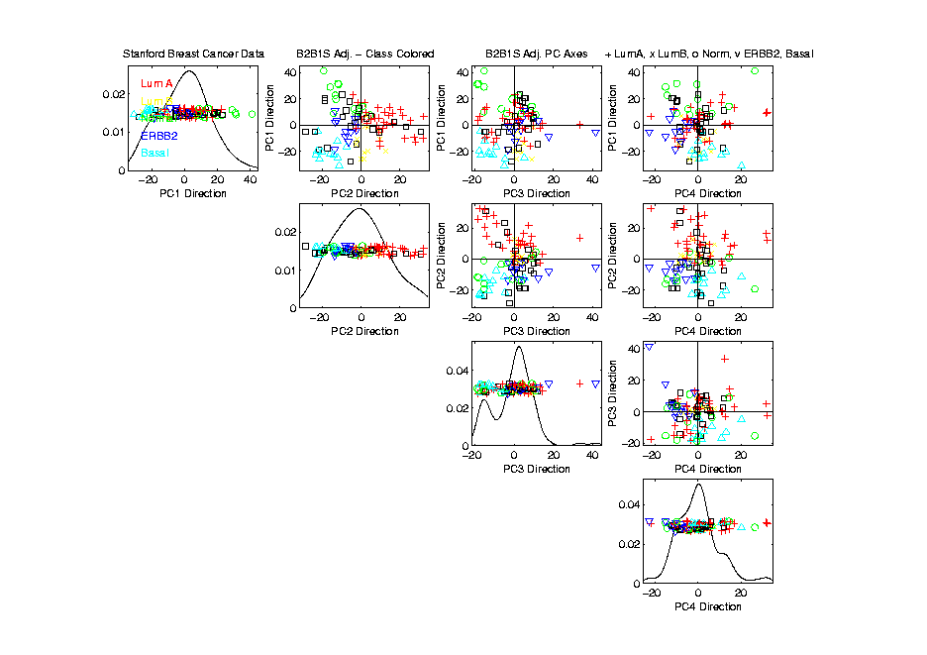
Source Batch Adj: S. & B Adj’d, Adj’d PCA
Recompute PC Axes
PC1 & 2 Now About Biology

Slide 8
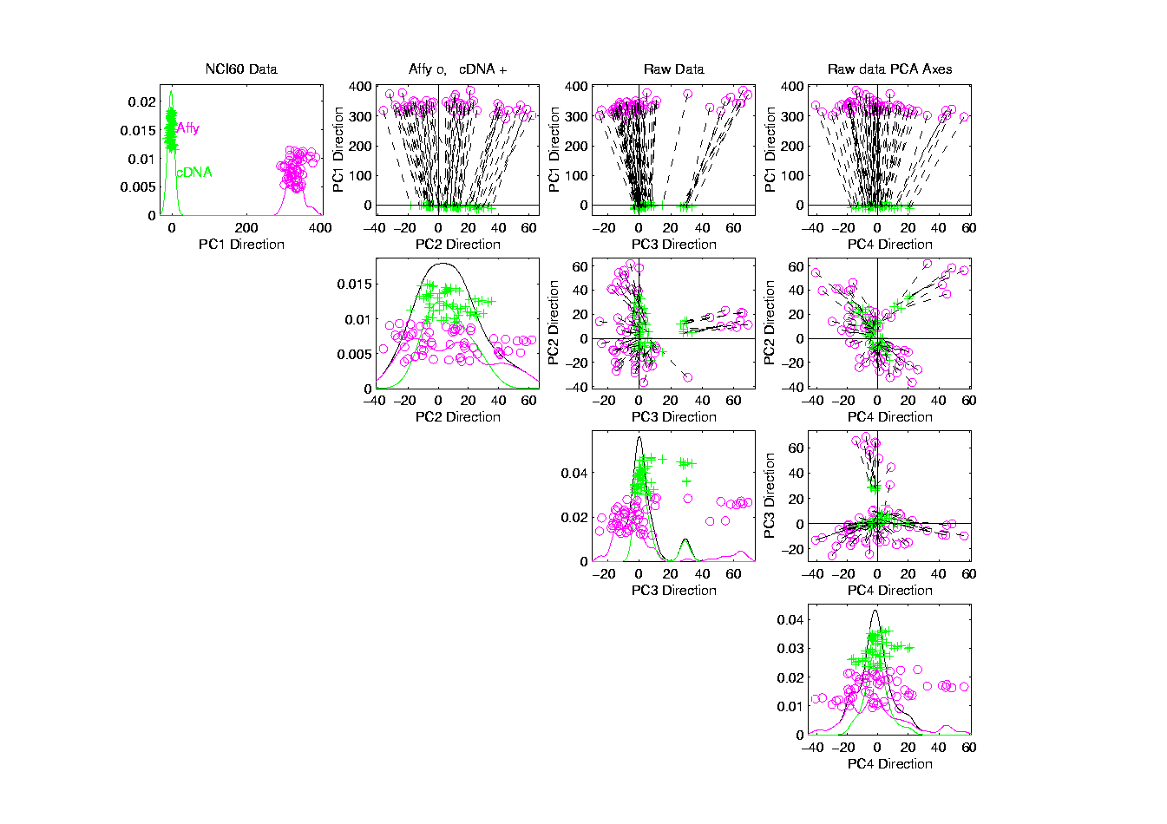
NCI 60: Raw Data, Platform Colored
Common Samples
Connected by
Dashed Lines
Huge Platform
Differences
Fortunately
Systematic

Slide 9
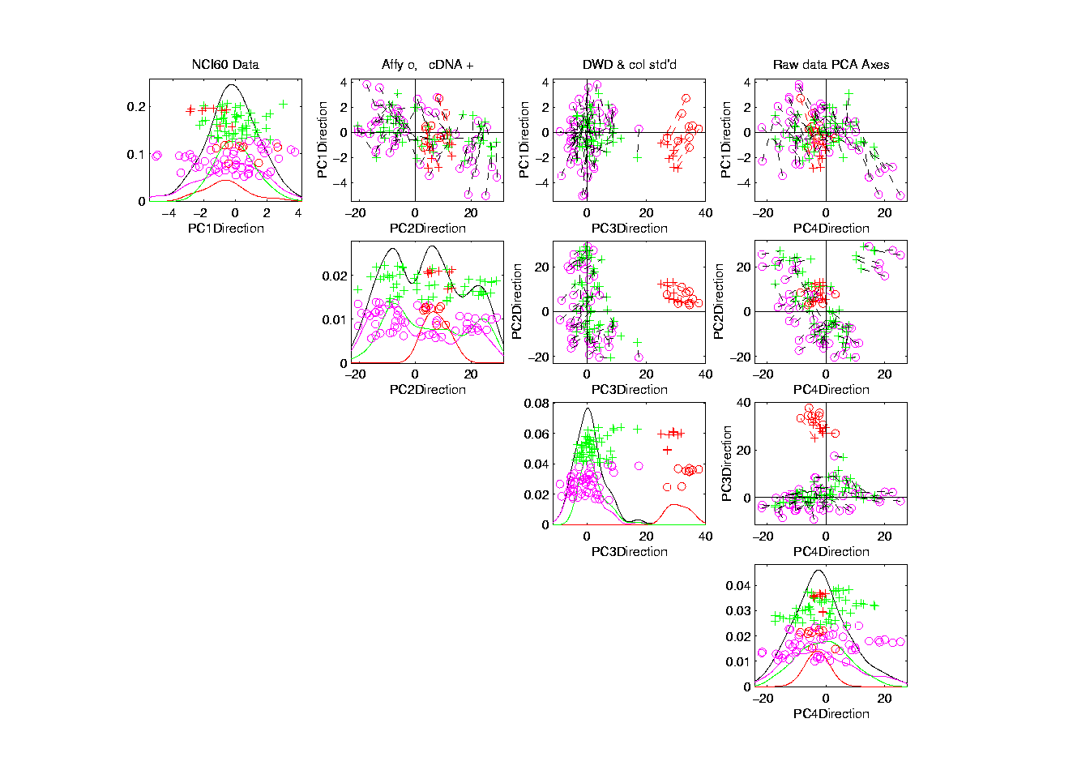
NCI 60: Fully Adjusted Data, Melanoma Cluster
BREAST.MDAMB435
BREAST.MDN
MELAN.MALME3M
MELAN.SKMEL2
MELAN.SKMEL5
MELAN.SKMEL28
MELAN.M14
MELAN.UACC62
MELAN.UACC257
Known Mislabellings

Slide 10
Why not adjust by means?
But Why Not PAM (~Mean Difference)?
Simpler is Better
Why not means, i.e. point cloud centerpoints?
Elegant Answer: Liu et al (2009)

Slide 11
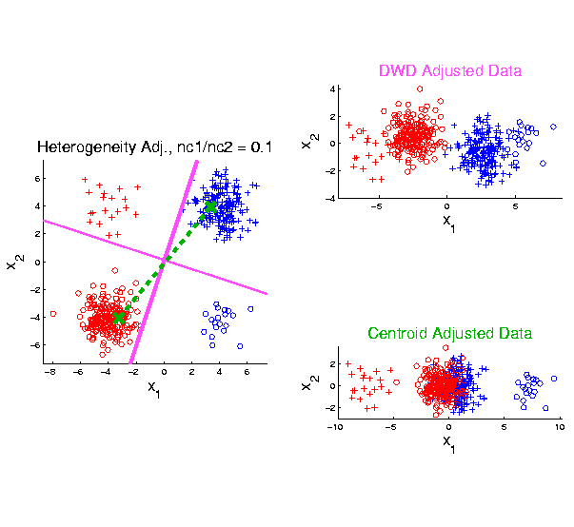
Twiddle ratios of subtypes
2-d Toy
Example
Unbalanced
Mixture
Note: Losing
Distinction
To Be Studied

Slide 12
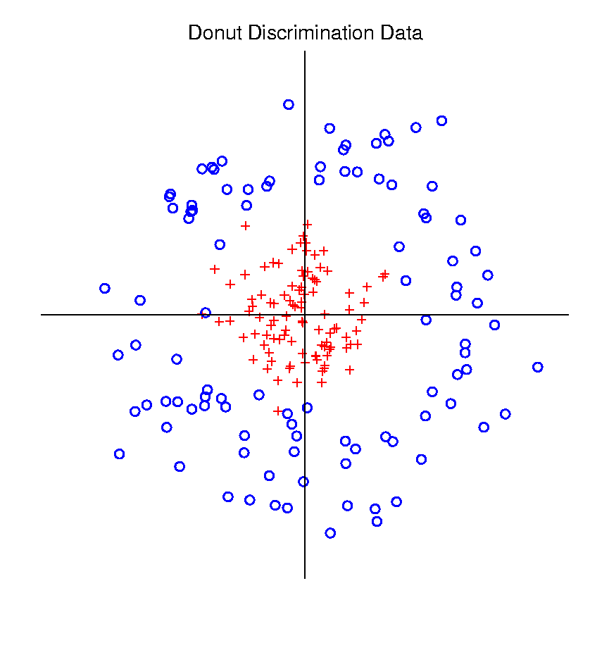
Radial DWD
Hard When All Members Of One Class Are Outliers in a Random Direction
Think HDLSS
Version of
Notes:
12

Slide 13
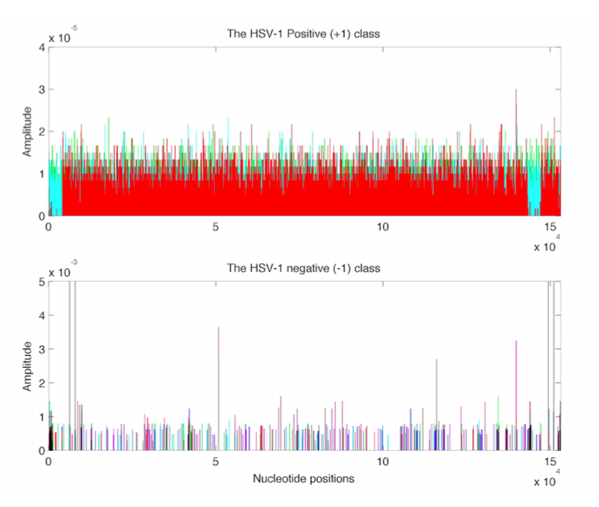
Virus Hunting
Look at
Data:
Mostly
Non-0
Near Simplex Center
Almost
All 0
Near Simplex Corners
Notes:
13

Slide 14
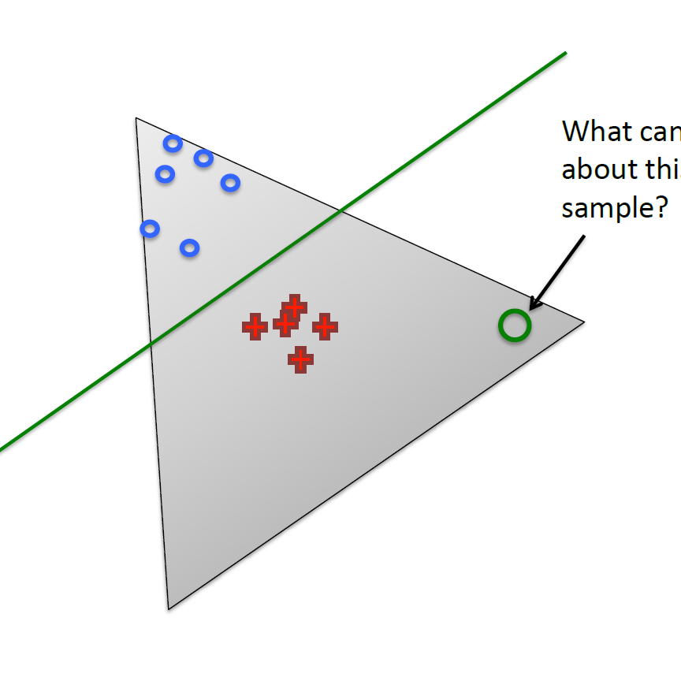
Radial DWD
Consider Training Data
But What About
Test Point In A
Different Corner
???
Notes:
14

Slide 15
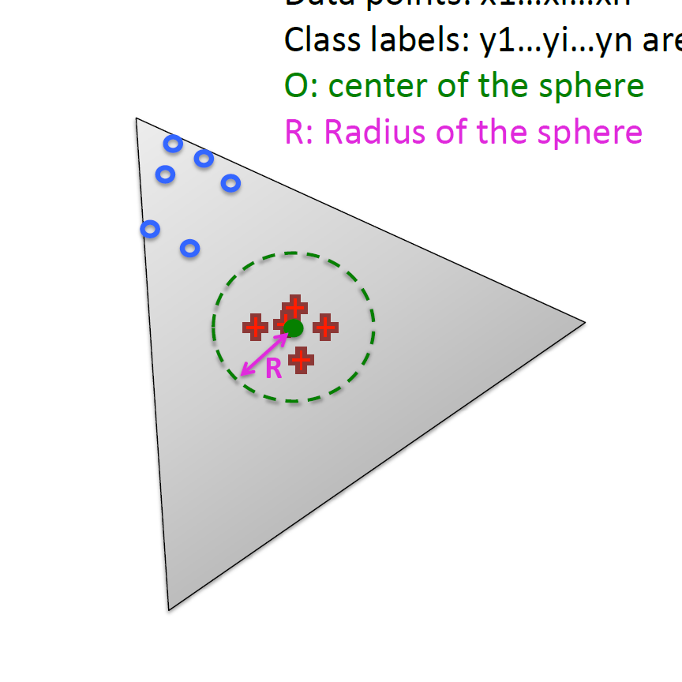
Radial DWD
Approach:
Replace Separating Plane
With Separating Sphere
Find Parameters
Via DWD-like
Optimization
Enables Finding Corners
With No Training Data
Notes:
15

Slide 16
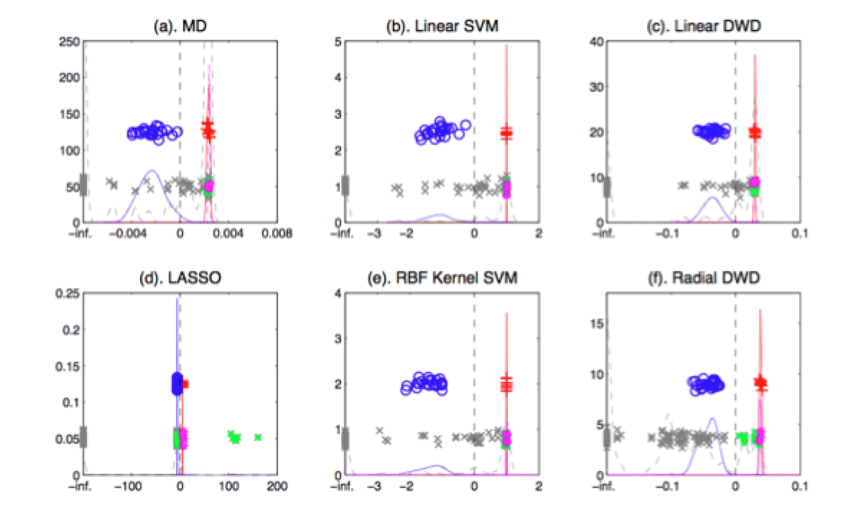
Virus Hunting
Compare With Other Classifiers
Even Kernel SVM Fails!!!
Reason:
Test Data
Lies In
Corners
With No
Training
Data
Notes:
16

Slide 17
Return to Big Picture
Main statistical goals of OODA:
Understanding population structure
  Low dim’al Projections, PCA …
Classification (i. e. Discrimination)
  Understanding 2+ populations
Time Series of Data Objects
  Chemical Spectra, Mortality Data
“Vertical Integration” of Data Types

Slide 18
Data Integration
Text, Sec. 17.2
Modern Data Collections Often Involve
Multiple Data Types
Important Analytical Task:
Understand How These Work Together
(And Work Separately)

Slide 19
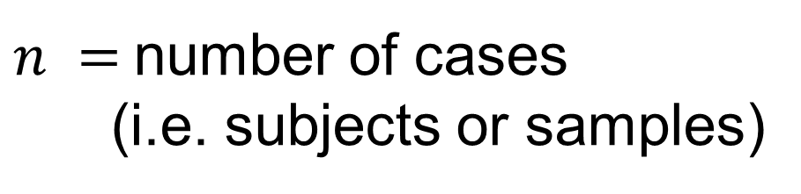




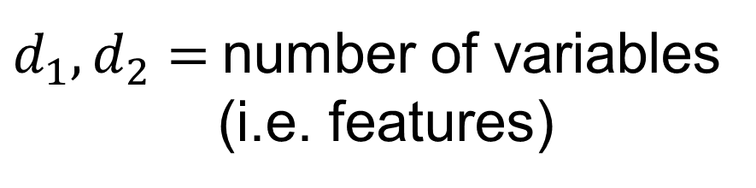

Data Integration
$B=2$ Block Notation
(Can Be Different)
$d_{1},d_{2}=$number of variables
(i.e. features)
$$d_{1}$$
$$n$$
$n =$number of cases
(i.e. subjects or samples)
$$d_{2}$$
$$n$$
(Must Be Same)

Slide 20
Data Integration
Insightful Goal:
Modes of Variation
As in PCA
But Replace Maximal Variation
With Maximal Commonality
(& Maybe Maximal Difference)

Slide 21
Data Integration
Insightful Goal:
Modes of Variation
Important Tool:
Singular Value Decomposition (SVD)
(Recall From Before)

Slide 22
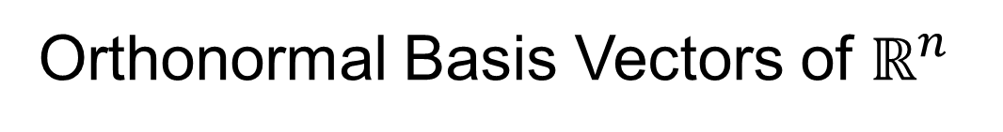
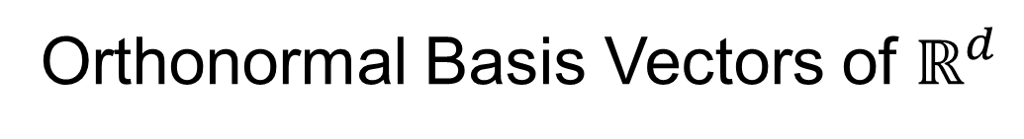




Review of Linear Algebra (Cont.)
SVD Full Representation:
=
$$V_{n×n}^{t}$$
$$X_{d×n}$$
$$U_{d×d}$$
$$S_{d×n}$$
Orthonormal Basis Vectors of $ℝ^{d}$
Diagonal Matrix of Singular Values
Orthonormal Basis Vectors of $ℝ^{n}$

Slide 23

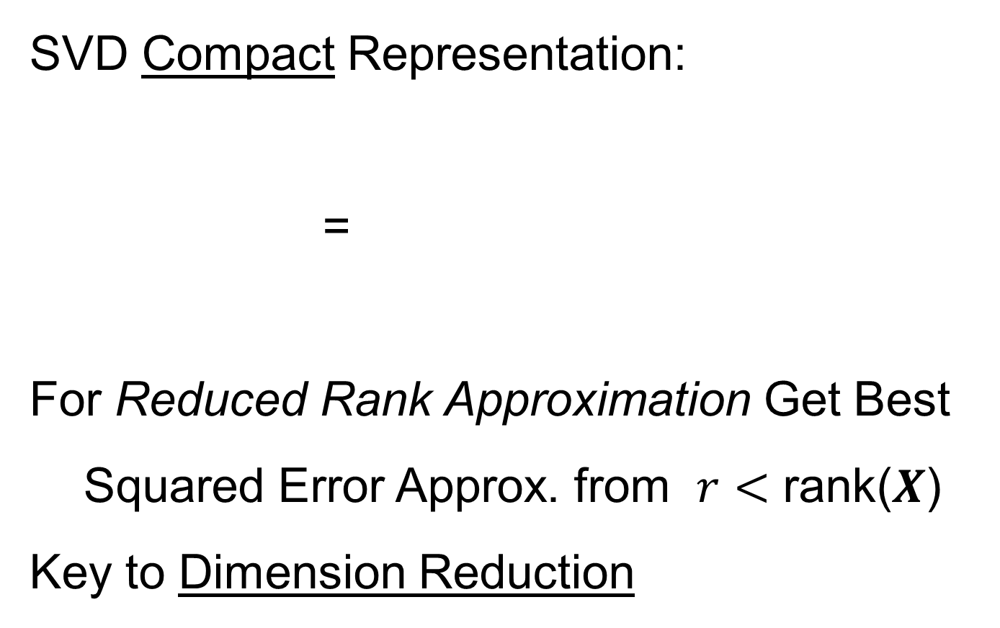


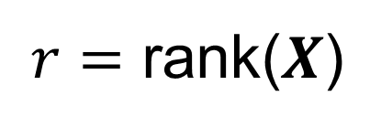
Review of Linear Algebra (Cont.)
SVD Compact Representation:
=
For Reduced Rank Approximation Get Best Squared Error Approx. from $r<$ rank($X$)
Key to Dimension Reduction
$$S_{r×r}$$
$$V_{r×n}^{t}$$
$$X_{d×n}$$
$$U_{d×r}$$
$r=$ rank($X$)

Slide 24
Data Integration
Centering: Common Assumption is
Column Object Mean Centered
(Subtract Column Mean Vectors)
Alternate View:
For Each Row,
Subtract Scalar Mean

Slide 25
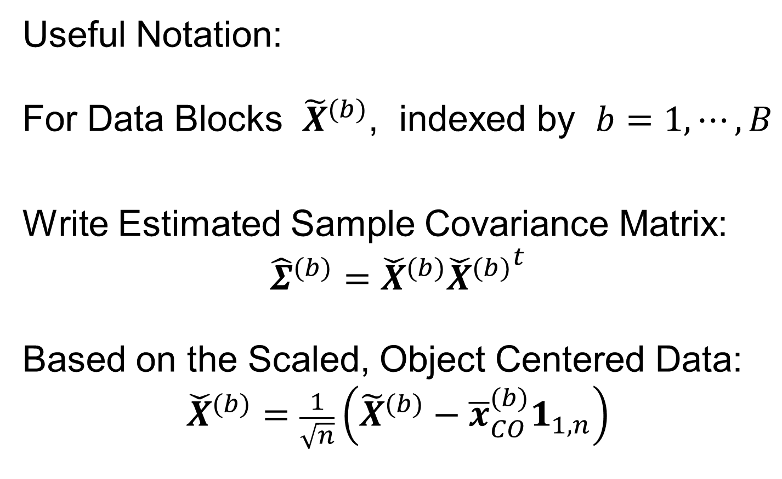



Data Integration
Recall Tilde Denotes Random Quantities
Useful Notation:
For Data Blocks ${\tilde{X}}^{(b)}$, indexed by $b=1,⋯,B$
Write Estimated Sample Covariance Matrix:
$${\hat{Σ}}^{(b)}={\check{X}}^{(b)}{{\check{X}}^{(b)}}^{t}$$
Based on the Scaled, Object Centered Data:
$${\check{X}}^{(b)}=\frac{1}{\sqrt{n}}\left({\tilde{X}}^{(b)}−{\overline{x}}_{CO}^{(b)}1_{1,n}\right)$$
Matrix of $n$ data objects of dim $d_{b}$
Recall $d_{b}×d_{b}$ Matrix
Recall $d_{b}×n$ Matrix

Slide 26
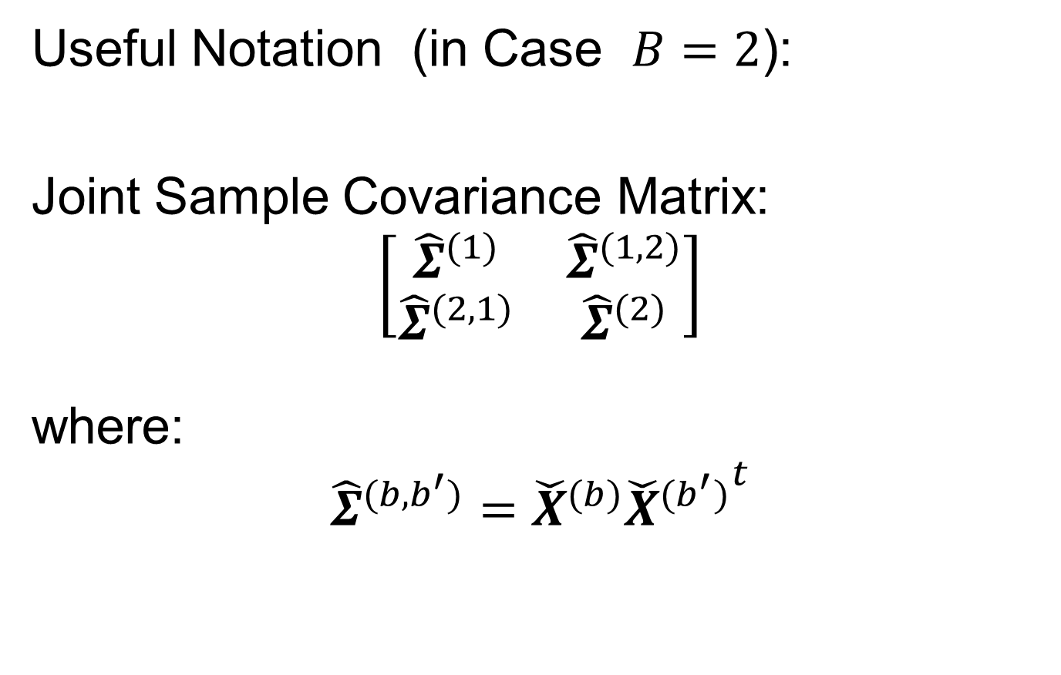

Data Integration
Useful Notation (in Case $B=2$):
Joint Sample Covariance Matrix:
$$\left[\begin{matrix}{\hat{Σ}}^{(1)} & {\hat{Σ}}^{(1,2)} \\ {\hat{Σ}}^{(2,1)} & {\hat{Σ}}^{(2)}\end{matrix}\right]$$
where:
$${\hat{Σ}}^{(b,b^{′})}={\check{X}}^{(b)}{{\check{X}}^{(b^{′})}}^{t}$$
$d_{b}×d_{b^{′}}$ Matrix
Called Cross-Covariance

Slide 27
Data Integration
Major Approaches (to Modes of Variation):
Partial Least Squares
Canonical Correlations
JIVE

Slide 28
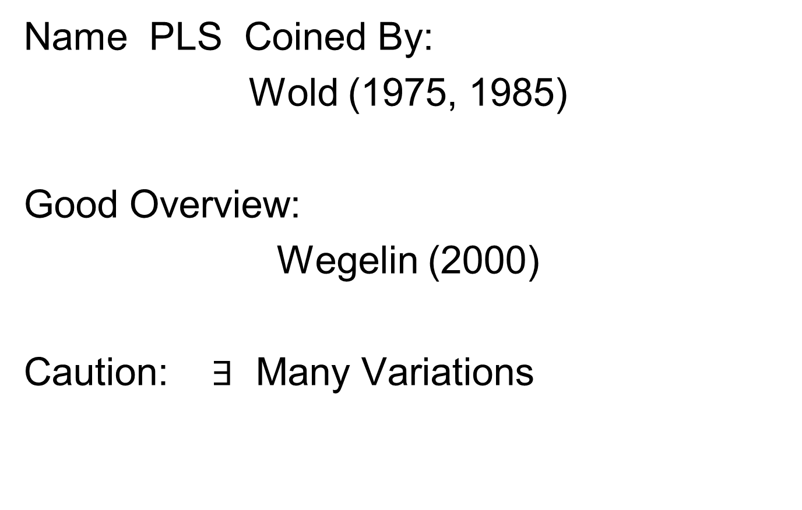
Partial Least Squares
Text: Sec, 17.2.1
Name PLS Coined By:
Wold (1975, 1985)
Good Overview:
Wegelin (2000)
Caution: $∃$ Many Variations

Slide 29
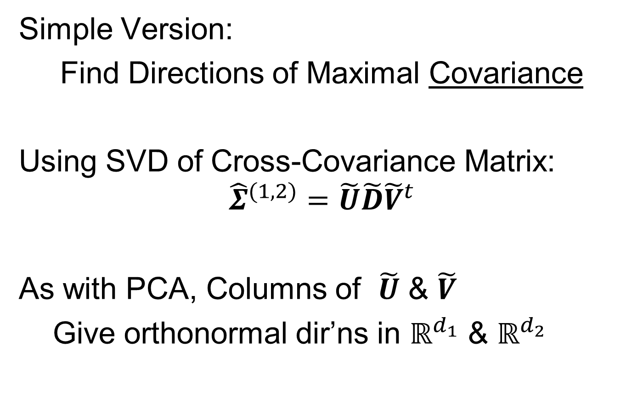
Partial Least Squares
Simple Version:
Find Directions of Maximal Covariance
Using SVD of Cross-Covariance Matrix:
$${\hat{Σ}}^{(1,2)}=\tilde{U}\tilde{D}{\tilde{V}}^{t}$$
As with PCA, Columns of $\tilde{U}$ & $\tilde{V}$
Give orthonormal dir’ns in $ℝ^{d_{1}}$ & $ℝ^{d_{2}}$
Hence are Loadings Vectors

Slide 30
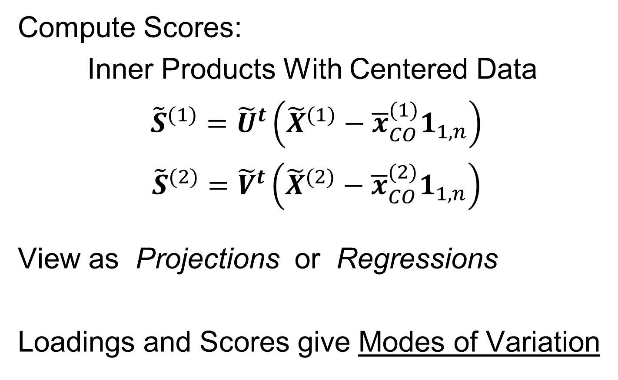
Partial Least Squares
Compute Scores:
Inner Products With Centered Data
${\tilde{S}}^{(1)}={\tilde{U}}^{t}\left({\tilde{X}}^{(1)}−{\overline{x}}_{CO}^{(1)}1_{1,n}\right)$
${\tilde{S}}^{(2)}={\tilde{V}}^{t}\left({\tilde{X}}^{(2)}−{\overline{x}}_{CO}^{(2)}1_{1,n}\right)$
View as Projections or Regressions
Loadings and Scores give Modes of Variation

Slide 31
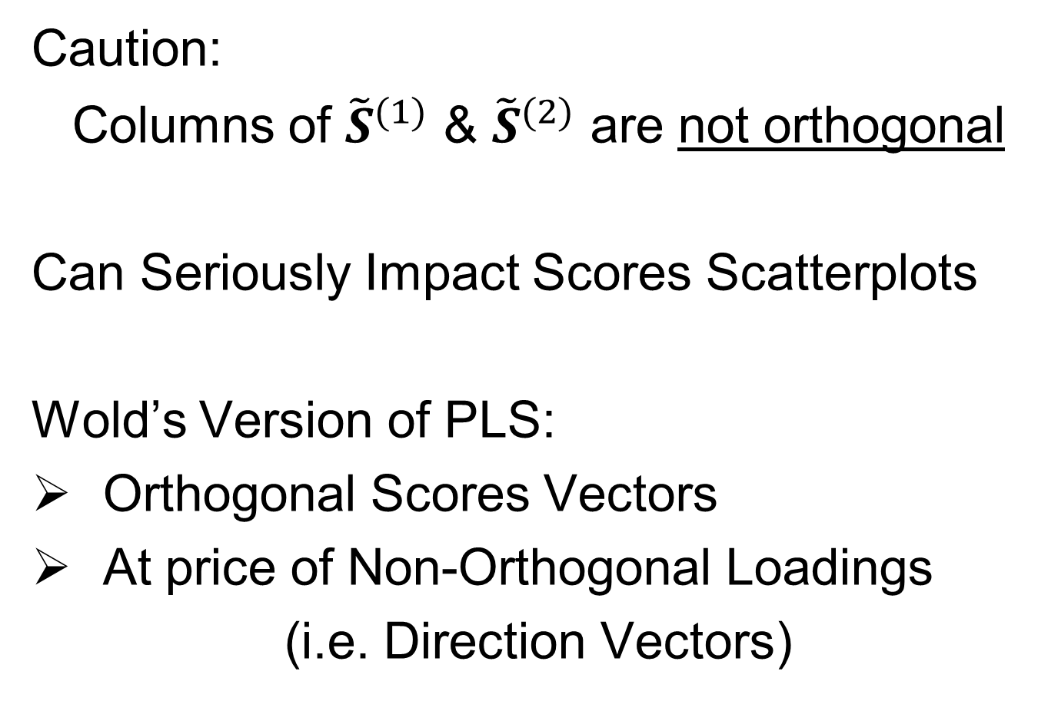
Partial Least Squares
Caution:
Columns of ${\tilde{S}}^{(1)}$ & ${\tilde{S}}^{(2)}$ are not orthogonal
Can Seriously Impact Scores Scatterplots
Wold’s Version of PLS:
Orthogonal Scores Vectors
At price of Non-Orthogonal Loadings
(i.e. Direction Vectors)

Slide 32
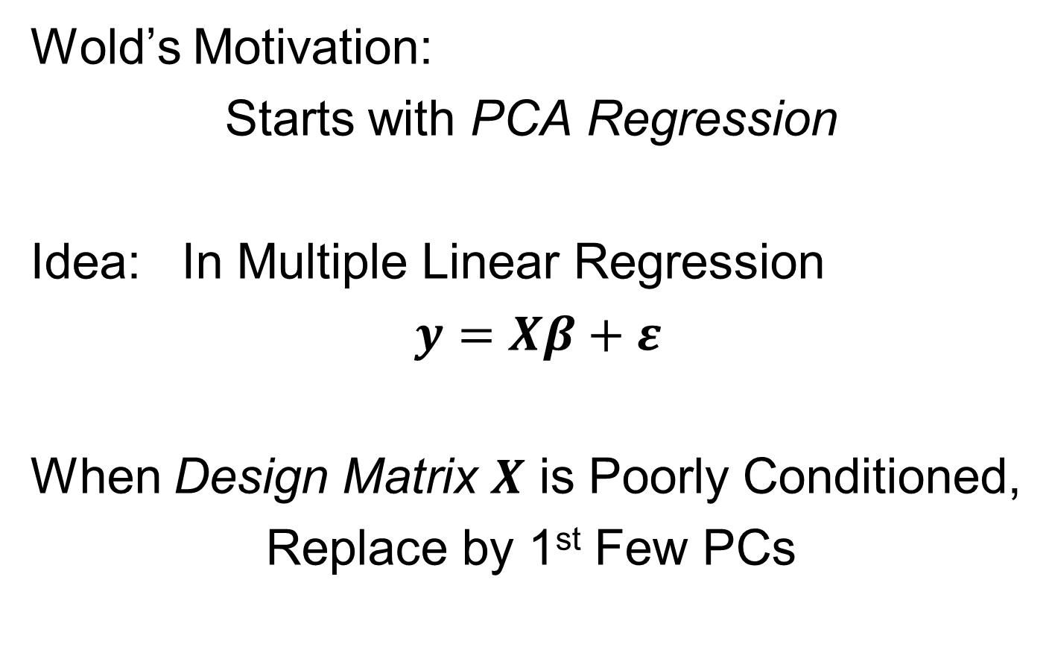
Partial Least Squares
Wold’s Motivation:
Starts with PCA Regression
Idea: In Multiple Linear Regression
$y=Xβ+ε$
When Design Matrix $X$ is Poorly Conditioned,
Replace by 1st Few PCs
E. g. Has
Co-Linearities
Often Called Latent Variables
Provides Stable Least Squares

Slide 33
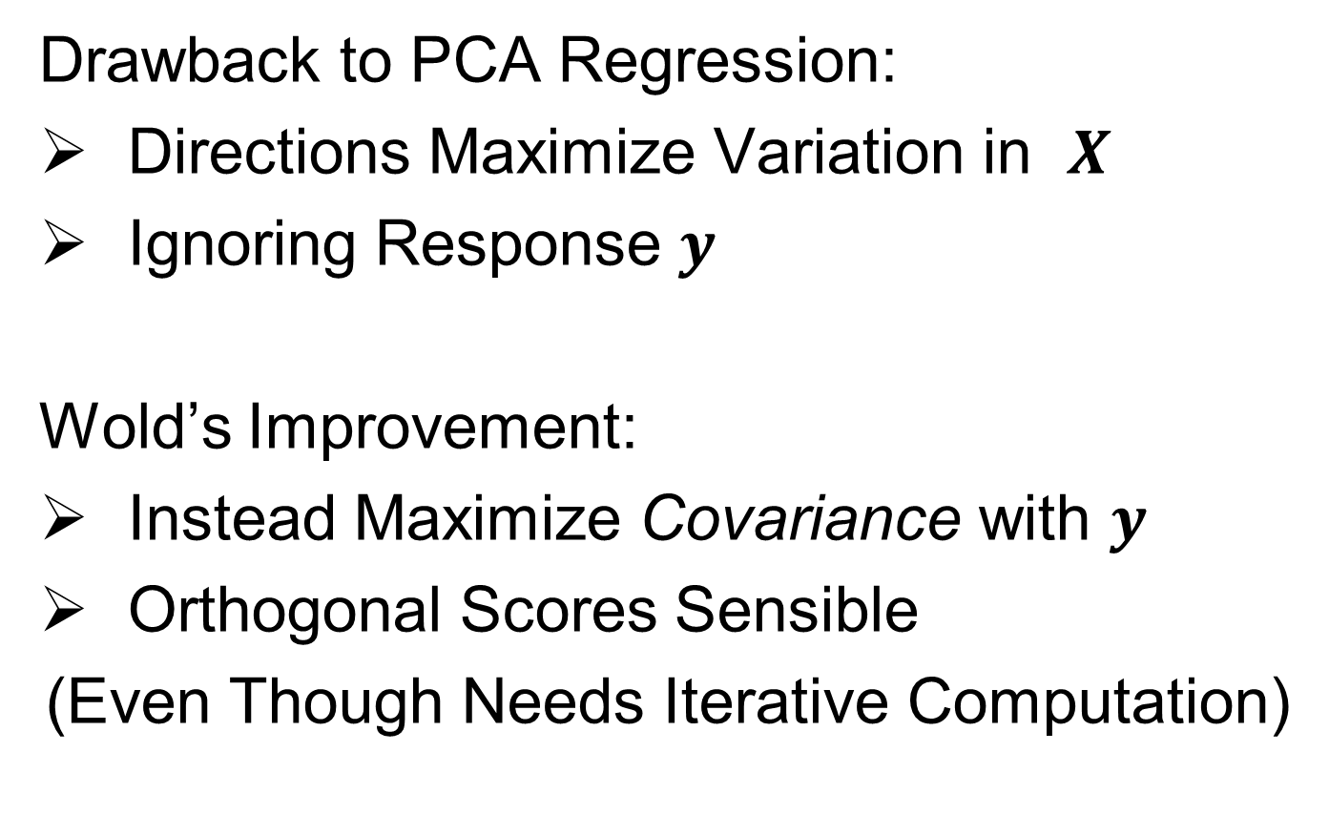
Partial Least Squares
Drawback to PCA Regression:
Directions Maximize Variation in $X$
Ignoring Response $y$
Wold’s Improvement:
Instead Maximize Covariance with $y$
Orthogonal Scores Sensible
(Even Though Needs Iterative Computation)
Parallel to Visualization Idea:
PCA Ignores Class Labels

Slide 34
Partial Least Squares
Aside: “PLS Regression” Seems to Dominate Searches for:
“Partial Least Squares”
Despite Value for Calculating
Modes of Variation

Slide 35
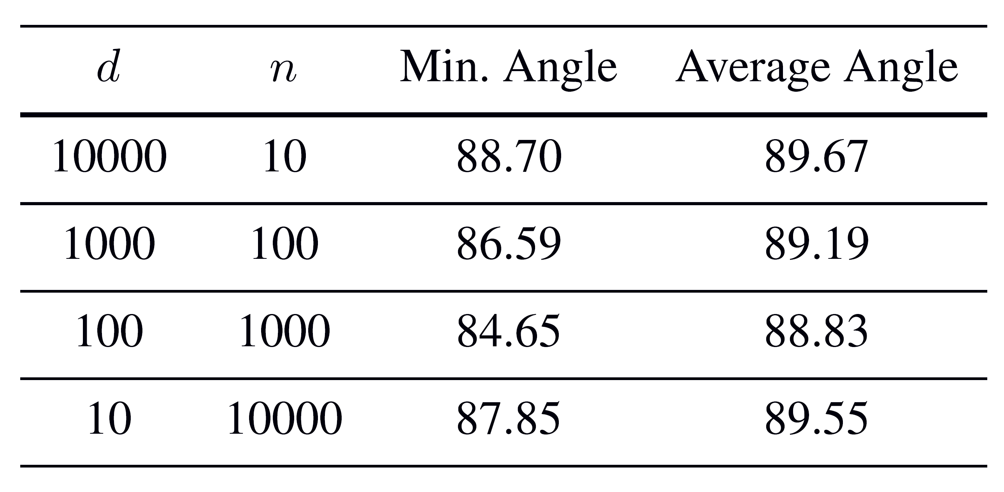
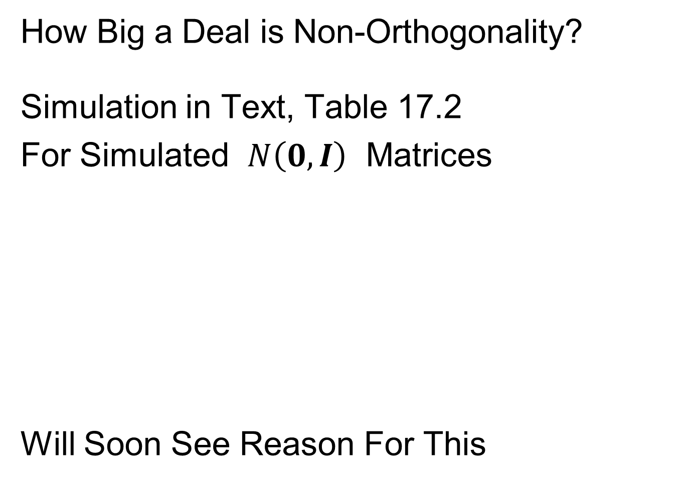
Partial Least Squares
How Big a Deal is Non-Orthogonality?
Simulation in Text, Table 17.2
For Simulated $N\left(0,I\right)$ Matrices
Will Soon See Reason For This

Slide 36
Data Integration
Major Approaches (to Modes of Variation):
Partial Least Squares
Canonical Correlations
JIVE

Slide 37
Canonical Correlations
Text: Sec, 17.2.2
Hotelling (1936):
Canonical Correlation Analysis (CCA)
Main Idea: Dir’ns to Maximize Correlation
(versus Covariance for PLS)
Founder of UNC STOR

Slide 38
Canonical Correlations
CCA Computation:
Change of Variable & SVD
Details in Section 17.2.2 of Text
Gives Orthogonal Scores, but Not Loadings

Slide 39
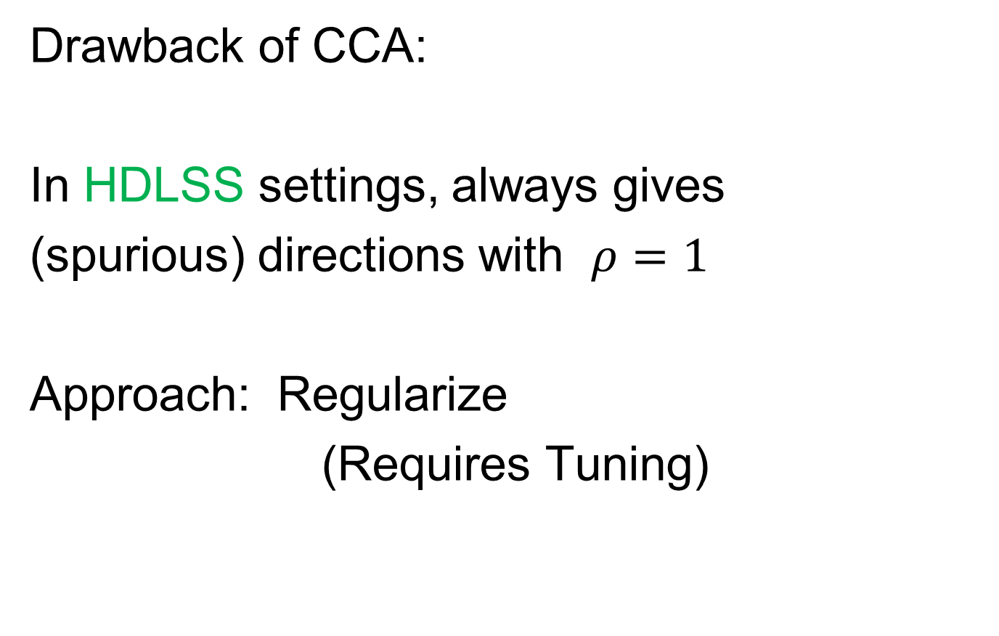
Canonical Correlations
Drawback of CCA:
In HDLSS settings, always gives
(spurious) directions with $ρ=1$
Approach: Regularize
(Requires Tuning)

Slide 40
Data Integration
Major Approaches (to Modes of Variation):
Partial Least Squares
Canonical Correlations
JIVE

Slide 41
JIVE
Text: Sec, 17.2.2
Joint and Individual Variation Explained
Lock, Hoadley, Marron & Nobel (2013)
Joint Variation ~ CCA
Key Contribution: Individual Modes
Angle Based JIVE (AJIVE)
Feng, Jiang, Hannig & Marron (2018)
Non-Iterative Linear Algebra Calculation
Uses Intuitive Principal Angle Analysis
(But No Spurious Directions)

Slide 42
AJIVE Analytical Goals
Explore & Quantify Variation
Through Joint Variation
via Common Scores
(Signatures Among Cases)
Focus Away from Directions in PCA
Now On Scores, Not Loadings
(As in PLS & CCA)
Since Commonality is Among Cases

Slide 43
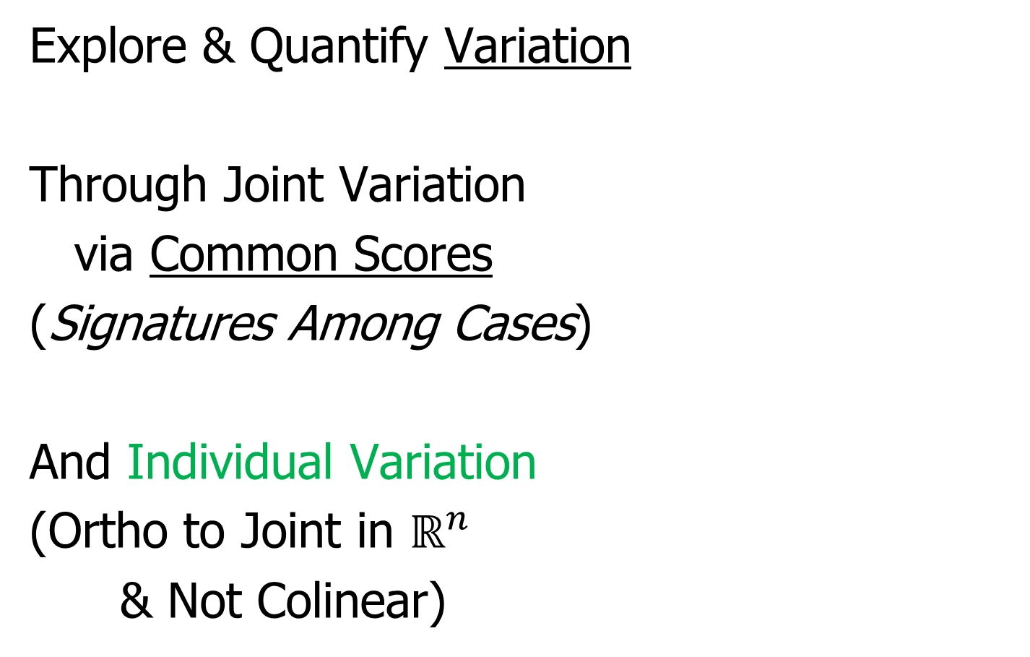
AJIVE Analytical Goals
Explore & Quantify Variation
Through Joint Variation
via Common Scores
(Signatures Among Cases)
And Individual Variation
(Ortho to Joint in $ℝ^{n}$
& Not Colinear)

Slide 44
AJIVE Analytical Goals
Then Understand Drivers
Of Variation Using:
Joint Loadings
Recall Modes of Variation
Are Rank 1 Matrices
= Loadings x Scores

Slide 45
AJIVE Analytical Goals
Then Understand Drivers
Of Variation Using:
Joint Loadings
Individual Loadings
Both Computed as
Projections Onto Scores

Slide 46
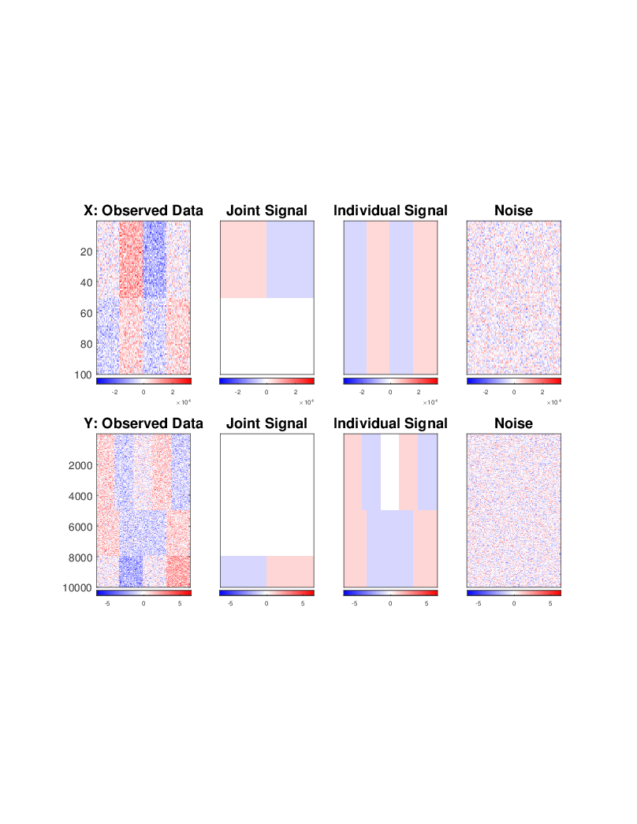
AJIVE Toy Example
“Heat Map” View
Based on Color Bar
Red for > 0
White for = 0
Blue for < 0
Intensity shows magnitude

Slide 47
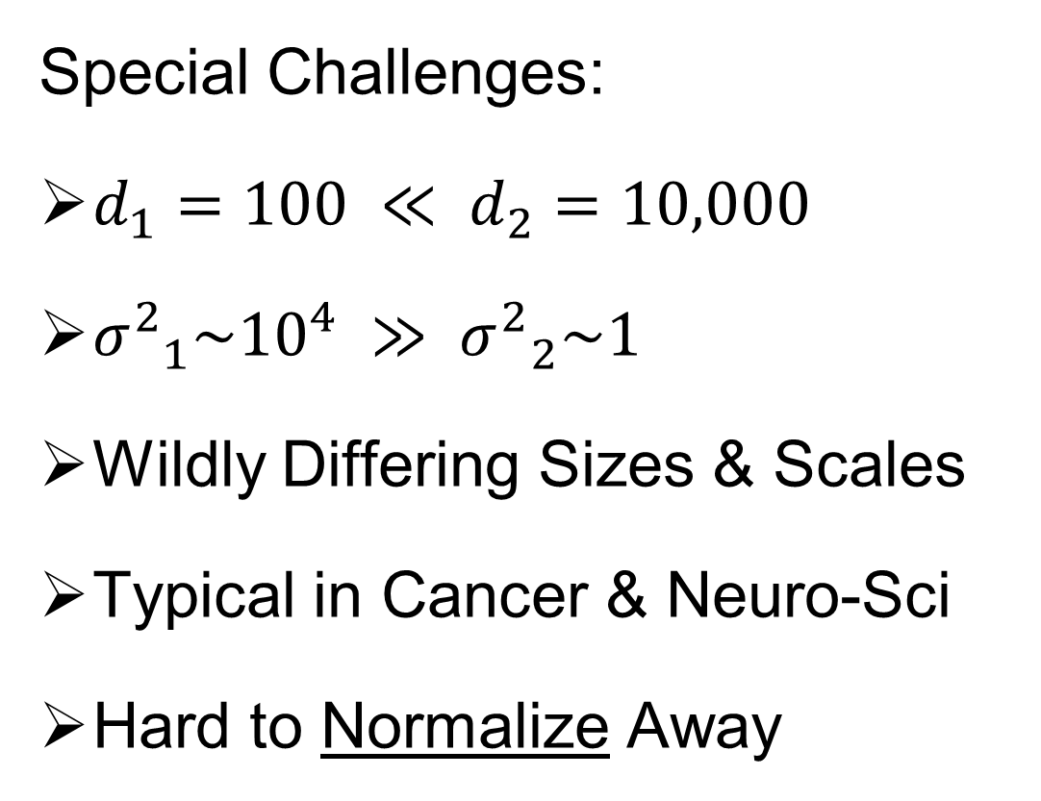
AJIVE Toy Example
Special Challenges:
$d_{1}=100 ≪ d_{2}=10,000$
${σ^{2}}_{1}\sim {10}^{4} ≫ {σ^{2}}_{2}\sim 1$
Wildly Differing Sizes & Scales
Typical in Cancer & Neuro-Sci
Hard to Normalize Away

Slide 48
AJIVE Toy Example
Underlying Components
(Additive
Signals +
+ Noise)
=
+
+
=
+
+

Slide 49
AJIVE Toy Example
Underlying Components:
Joint – Rank 1
Same
“Subject
Signal”
(linear combo)
=
+
+
=
+
+

Slide 50
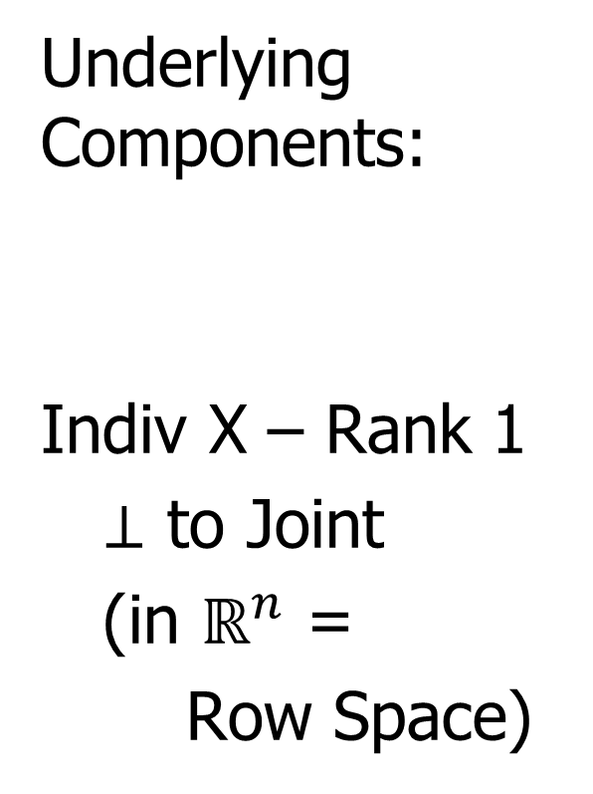
AJIVE Toy Example
Underlying Components:
Indiv X – Rank 1
$⊥$ to Joint
(in $ℝ^{n}$ =
Row Space)
=
+
+
=
+
+

Slide 51
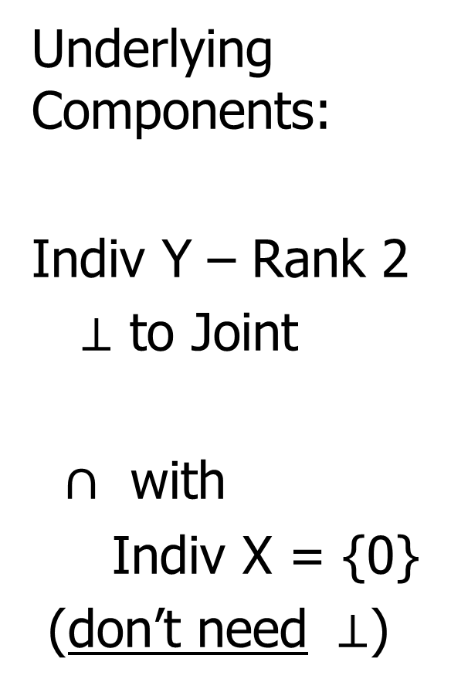
AJIVE Toy Example
Underlying Components:
Indiv Y – Rank 2
$⊥$ to Joint
$∩$ with
Indiv X = {0}
(don’t need $⊥$)
=
+
+
=
+
+

Slide 52
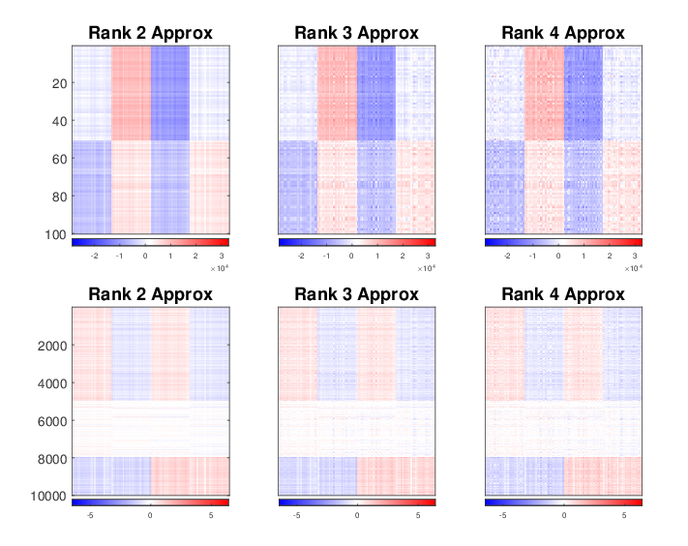

AJIVE Toy Example
Concatenate & SVD:
Only (Joint $∪$ X – Indiv), Lose Sep. & Y – Indiv

Slide 53
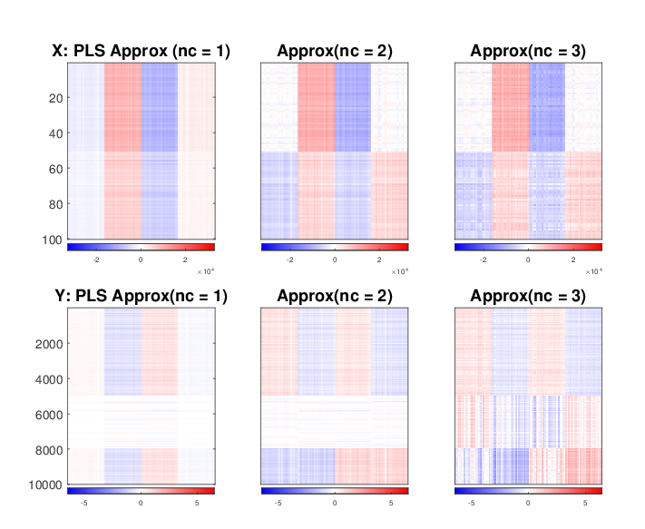
AJIVE Toy Example
Partial Least Squares:
Decent Rank 2 Approx., but no Indiv. Comp.

Slide 54
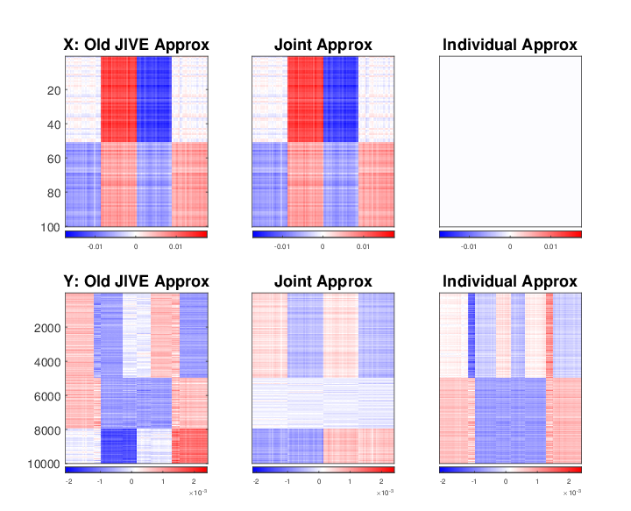
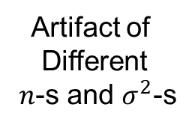
AJIVE Toy Example
Artifact of
Different
$n$-s and $σ^{2}$-s
Early JIVE (Lock et al, 2013):
Good 2-d Approx. – Missed Joint-Ind Decomp.

Slide 55
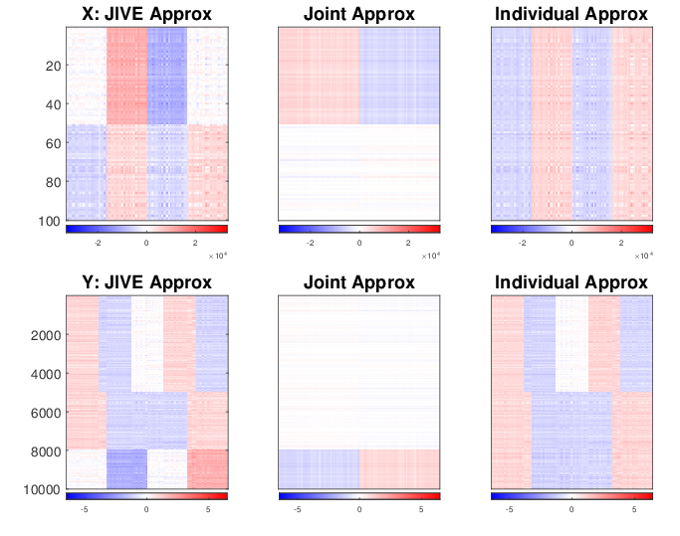
AJIVE Toy Example
Current AJIVE: Excellent Decomposition (Both Joint and Individual)

Slide 56
AJIVE Analysis of FMRI Data
Functional Magnetic Resonance Imaging
Approach:
Measure “Brain Activity”
Over Both Location & Time
Via Blood Flow
Data Objects???

Slide 57



AJIVE Analysis of FMRI Data
Functional Magnetic Resonance Imaging
2015 SAMSI Program
On Neuroscience
Qunqun Yu Benjamin Risk

Slide 58
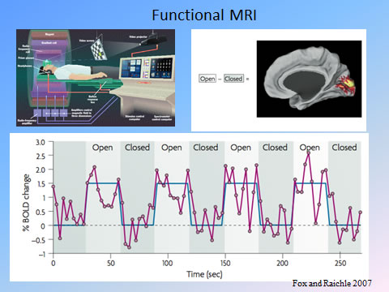
AJIVE Analysis of FMRI Data
Data
Objects?
3d- Movie?
Time Series
At Voxels?
Thanks to fmri.ucsd.edu

Slide 59

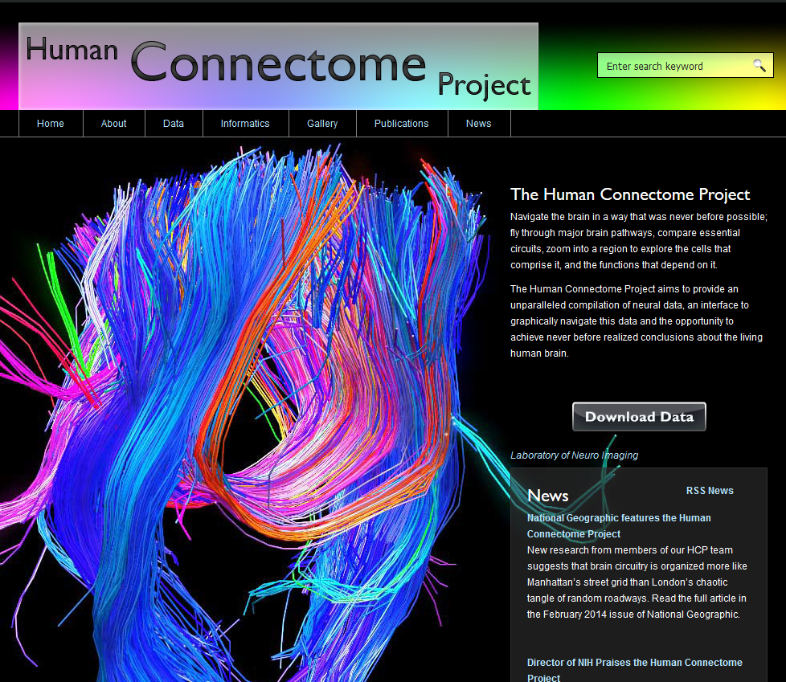
AJIVE Analysis of FMRI Data
Study Data From:
Posted Data With Huge
Amount of Pre-Processing
E.g. Registration

Slide 60
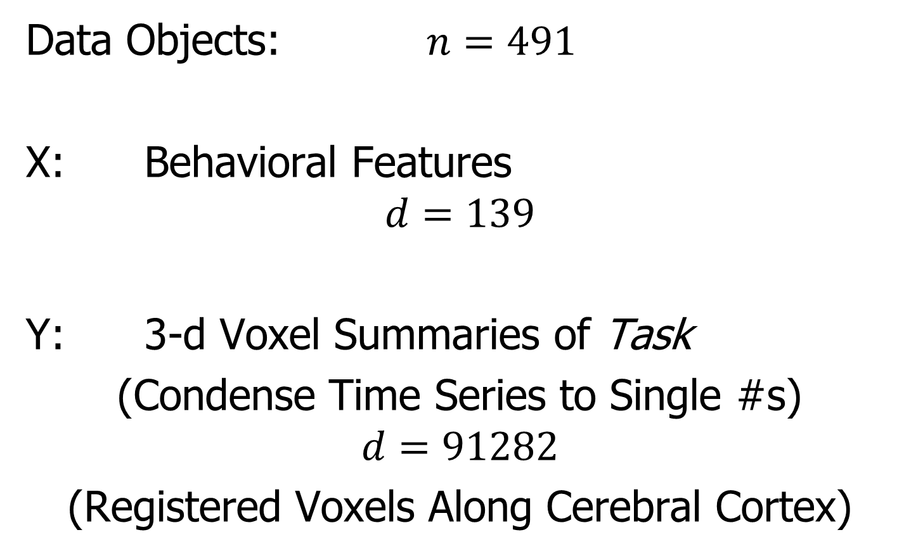
AJIVE Analysis of FMRI Data
Data Objects: $n=491$
X: Behavioral Features
$$d=139$$
Y: 3-d Voxel Summaries of Task
(Condense Time Series to Single #s)
$$d=91282$$
(Registered Voxels Along Cerebral Cortex)

Slide 61
AJIVE Analysis of FMRI Data
Focus of Analysis:
Loadings (Drivers)
  Behavioral Features
  Lit Up Brain Regions
Since Scores All Gaussian
(Normal Population)
Which Work
Together?
Which Work
Separately?

Slide 62
AJIVE Analysis of FMRI Data
View Entries of Eigenvectors
Separate
PC1 of
Behavior
Feature
Loadings
Important
Groups

Slide 63
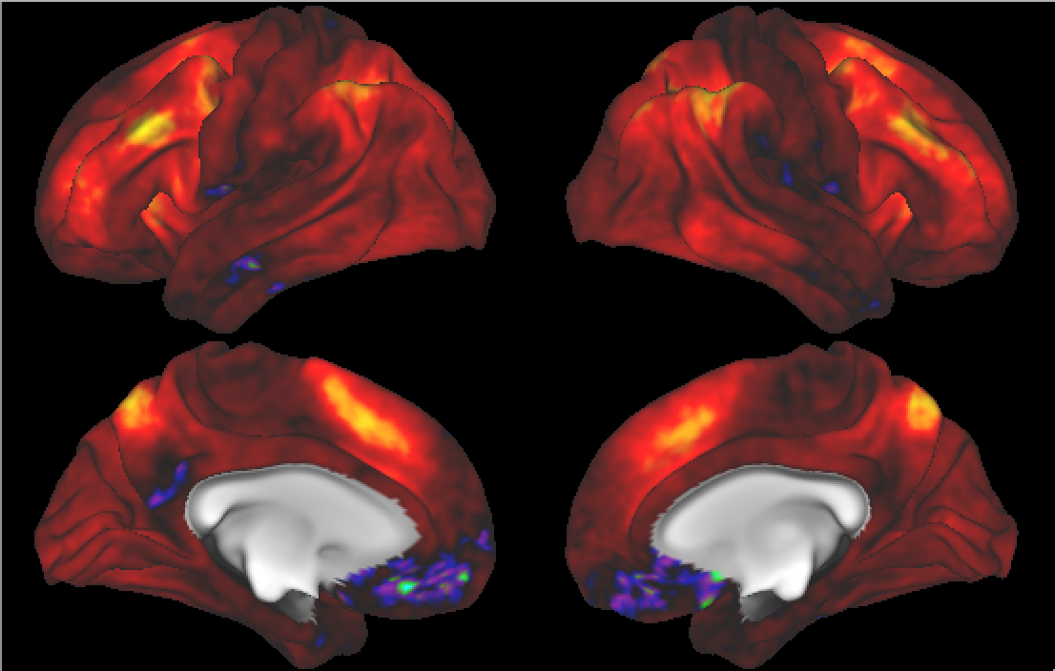

AJIVE Analysis of FMRI Data
Separate PC1 of Image Loadings
All Up
& Down
Together
View Entries of Eigenvectors
Also Some
Hot Spots?
Mostly Uses Only Hot Colors

Slide 64
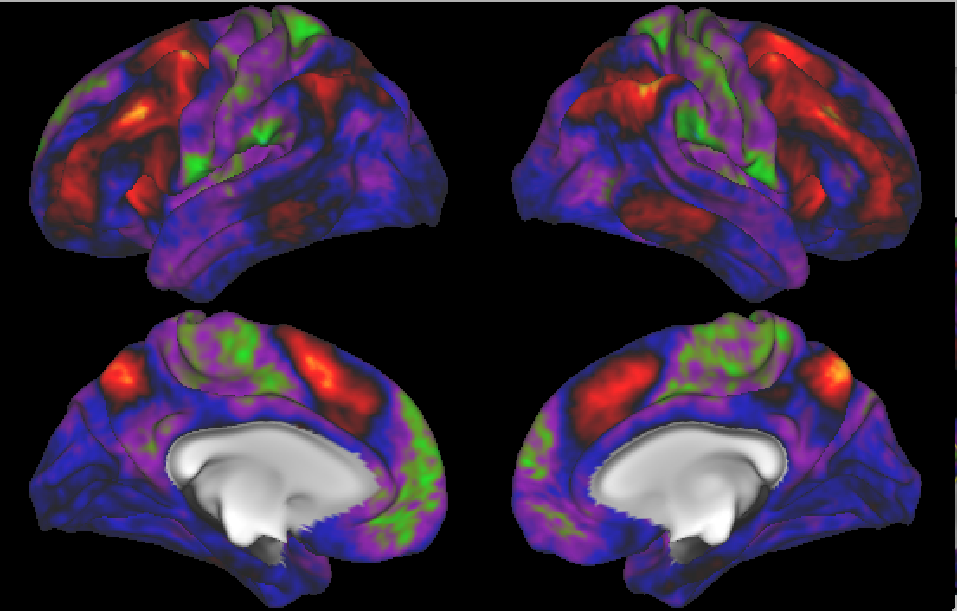
AJIVE Analysis of FMRI Data
Separate PC2 of Image Loadings
Interesting
Structure
???
And Same
Hot Spots?

Slide 65
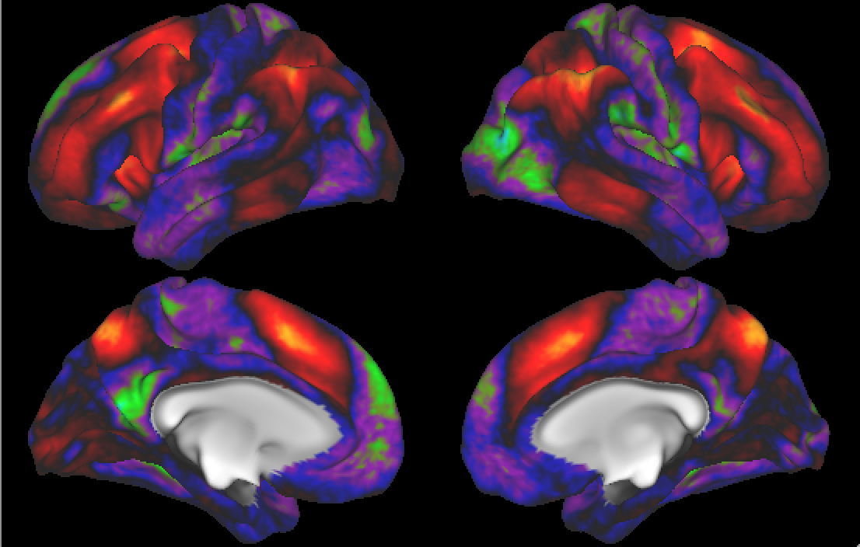
AJIVE Analysis of FMRI Data
Previous Mapping of Regions of Interest
Hot Spots
Are
Working
Memory
Related

Slide 66
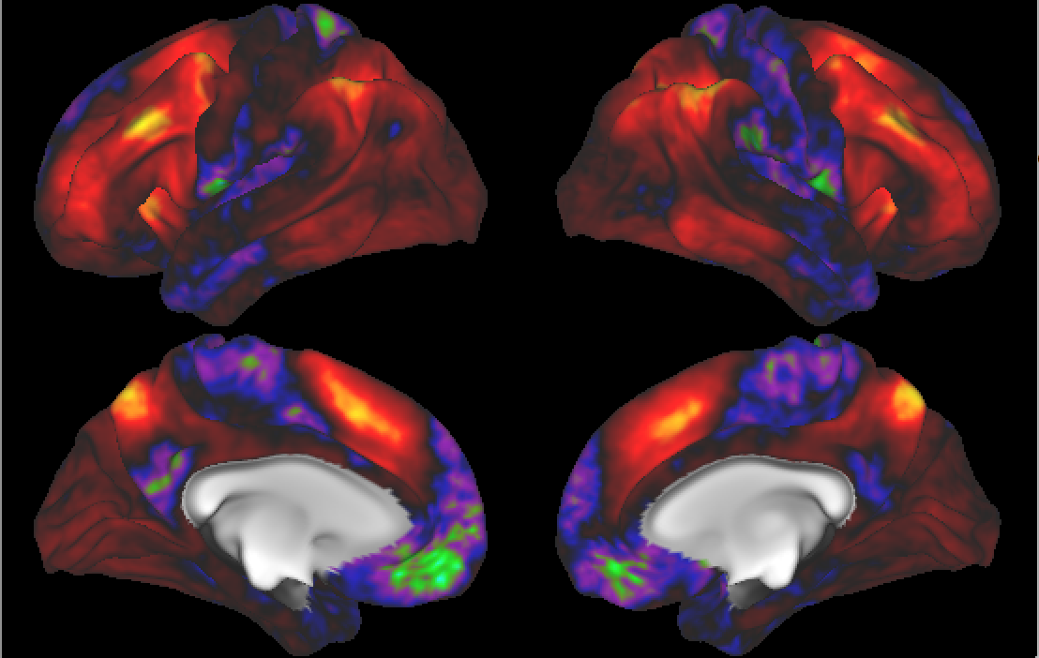
AJIVE Analysis of FMRI Data
Joint PC1 of Image Loadings
Using
Behavior
Combines
Hot Spots
From
Separate
PC1 & 2

Slide 67
Participant Presentations
12:05 Minji Kim:
Step Data Clustering via Thick Pen Transform
12:10 Parvathi Meyyappan:
Classifying Fuel Type from Chemical Compounds in Wildfire Smoke Samples
Next Class: Xianwen He, Andy Ackerman

