Slide 1
Statistics – O. R. 881
Object Oriented Data Analysis
Start
Recording
Steve Marron
Dept. of Statistics and Operations Research
University of North Carolina

Slide 2
Current Sections in Textbook
Today:
Section 14.2
Next Class:
Section 17.2

Slide 3
Data Integration
Text, Sec. 17.2
Modern Data Collections Often Involve
Multiple Data Types
Important Analytical Task:
Understand How These Work Together
(And Work Separately)

Slide 4
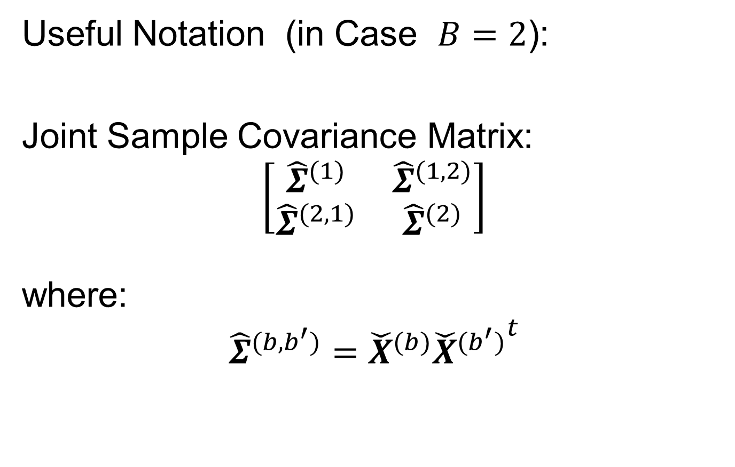

Data Integration
Useful Notation (in Case $B=2$):
Joint Sample Covariance Matrix:
$$\left[\begin{matrix}{\hat{Σ}}^{(1)} & {\hat{Σ}}^{(1,2)} \\ {\hat{Σ}}^{(2,1)} & {\hat{Σ}}^{(2)}\end{matrix}\right]$$
where:
$${\hat{Σ}}^{(b,b^{′})}={\check{X}}^{(b)}{{\check{X}}^{(b^{′})}}^{t}$$
$d_{b}×d_{b^{′}}$ Matrix
Called Cross-Covariance

Slide 5
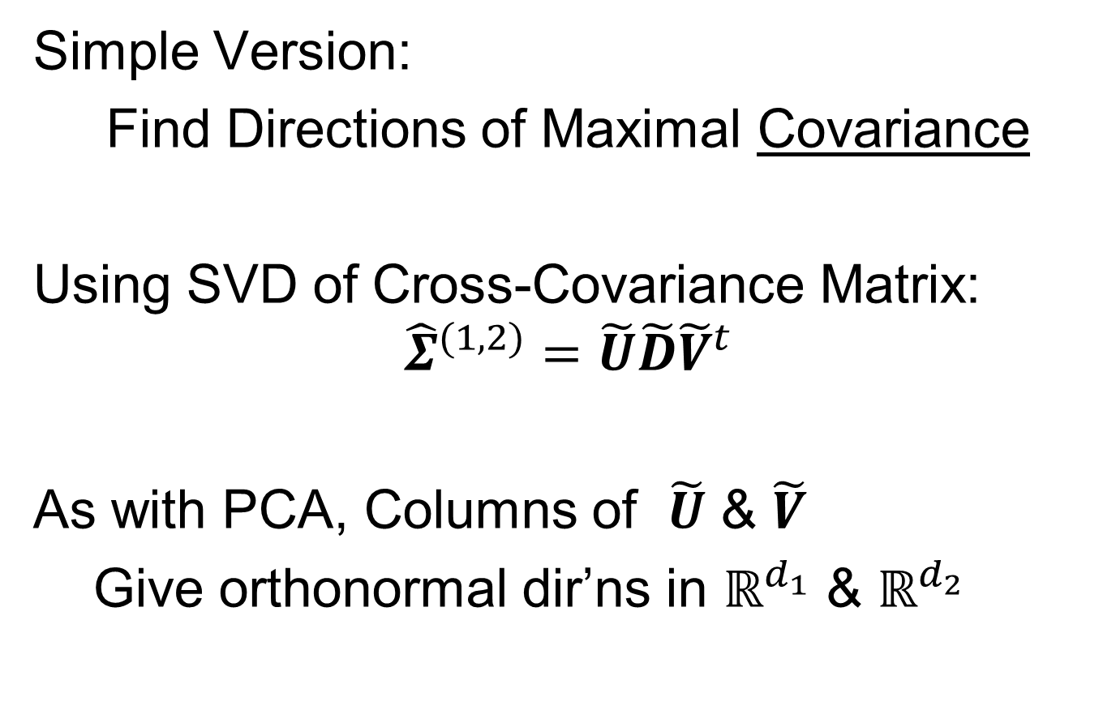
Partial Least Squares
Simple Version:
Find Directions of Maximal Covariance
Using SVD of Cross-Covariance Matrix:
$${\hat{Σ}}^{(1,2)}=\tilde{U}\tilde{D}{\tilde{V}}^{t}$$
As with PCA, Columns of $\tilde{U}$ & $\tilde{V}$
Give orthonormal dir’ns in $ℝ^{d_{1}}$ & $ℝ^{d_{2}}$
Hence are Loadings Vectors

Slide 6
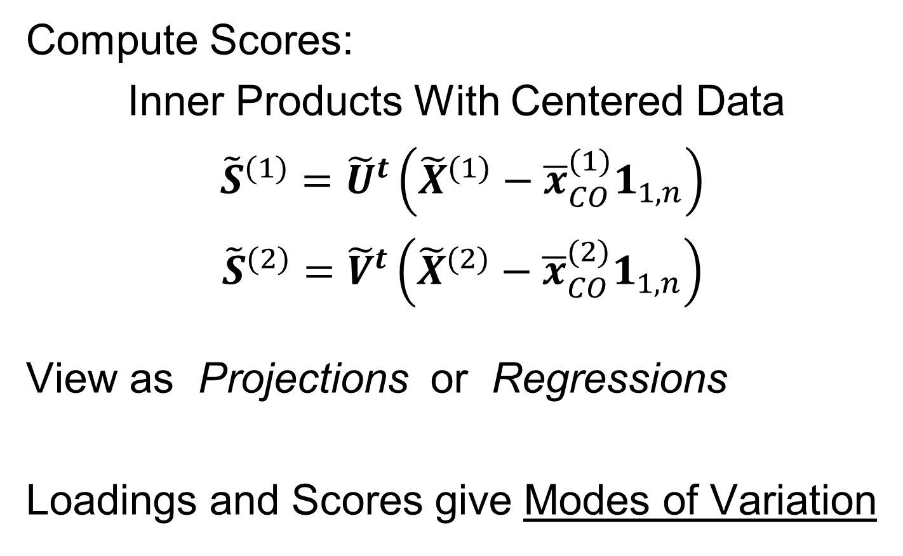
Partial Least Squares
Compute Scores:
Inner Products With Centered Data
${\tilde{S}}^{(1)}={\tilde{U}}^{t}\left({\tilde{X}}^{(1)}−{\overline{x}}_{CO}^{(1)}1_{1,n}\right)$
${\tilde{S}}^{(2)}={\tilde{V}}^{t}\left({\tilde{X}}^{(2)}−{\overline{x}}_{CO}^{(2)}1_{1,n}\right)$
View as Projections or Regressions
Loadings and Scores give Modes of Variation

Slide 7
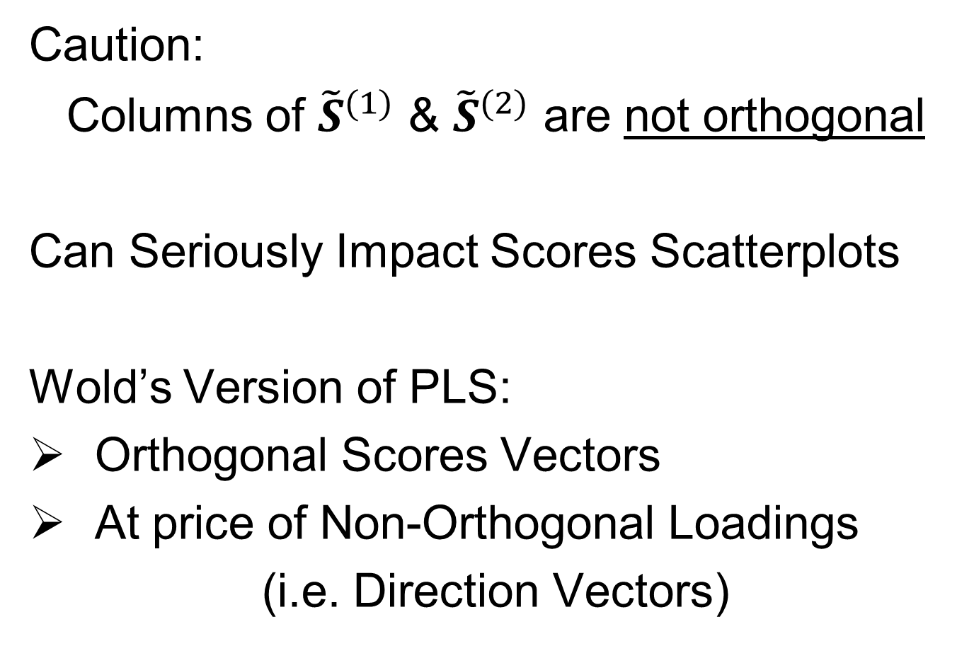
Partial Least Squares
Caution:
Columns of ${\tilde{S}}^{(1)}$ & ${\tilde{S}}^{(2)}$ are not orthogonal
Can Seriously Impact Scores Scatterplots
Wold’s Version of PLS:
Orthogonal Scores Vectors
At price of Non-Orthogonal Loadings
(i.e. Direction Vectors)

Slide 8
Canonical Correlations
Text: Sec, 17.2.2
Hotelling (1936):
Canonical Correlation Analysis (CCA)
Main Idea: Dir’ns to Maximize Correlation
(versus Covariance for PLS)
Founder of UNC STOR

Slide 9
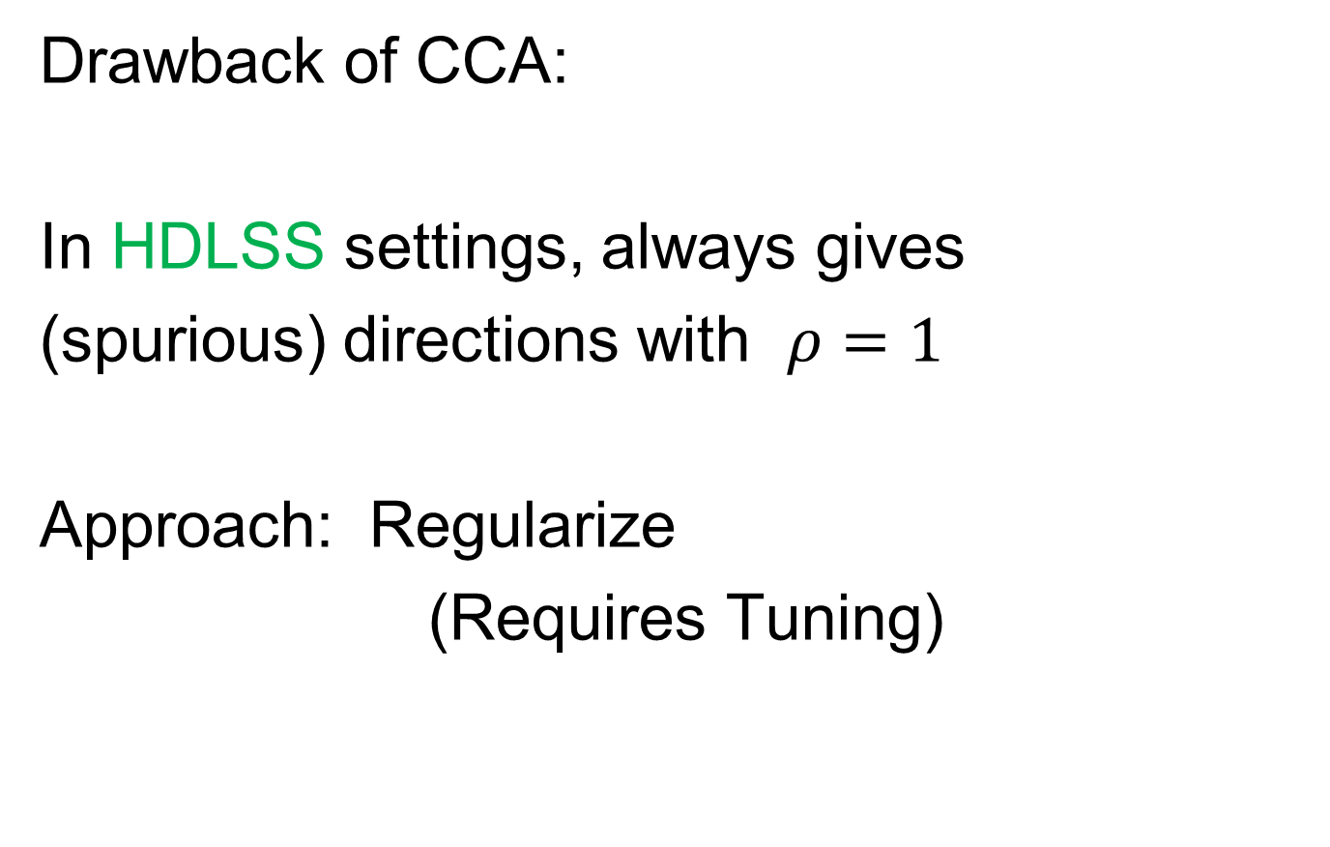
Canonical Correlations
Drawback of CCA:
In HDLSS settings, always gives
(spurious) directions with $ρ=1$
Approach: Regularize
(Requires Tuning)

Slide 10
JIVE
But Only Briefly Mentioned
Text: Sec, 17.2.3
Joint and Individual Variation Explained
Lock, Hoadley, Marron & Nobel (2013)
Joint Variation ~ CCA
Key Contribution: Individual Modes
Angle Based JIVE (AJIVE)
Feng, Jiang, Hannig & Marron (2018)
Non-Iterative Linear Algebra Calculation
Uses Intuitive Principal Angle Analysis

Slide 11
AJIVE Analytical Goals
Explore & Quantify Variation
Through Joint Variation
via Common Scores
(Signatures Among Cases)
Focus Away from Directions in PCA
Now On Scores, Not Loadings
(As in PLS & CCA)
Since Commonality is Among Cases

Slide 12
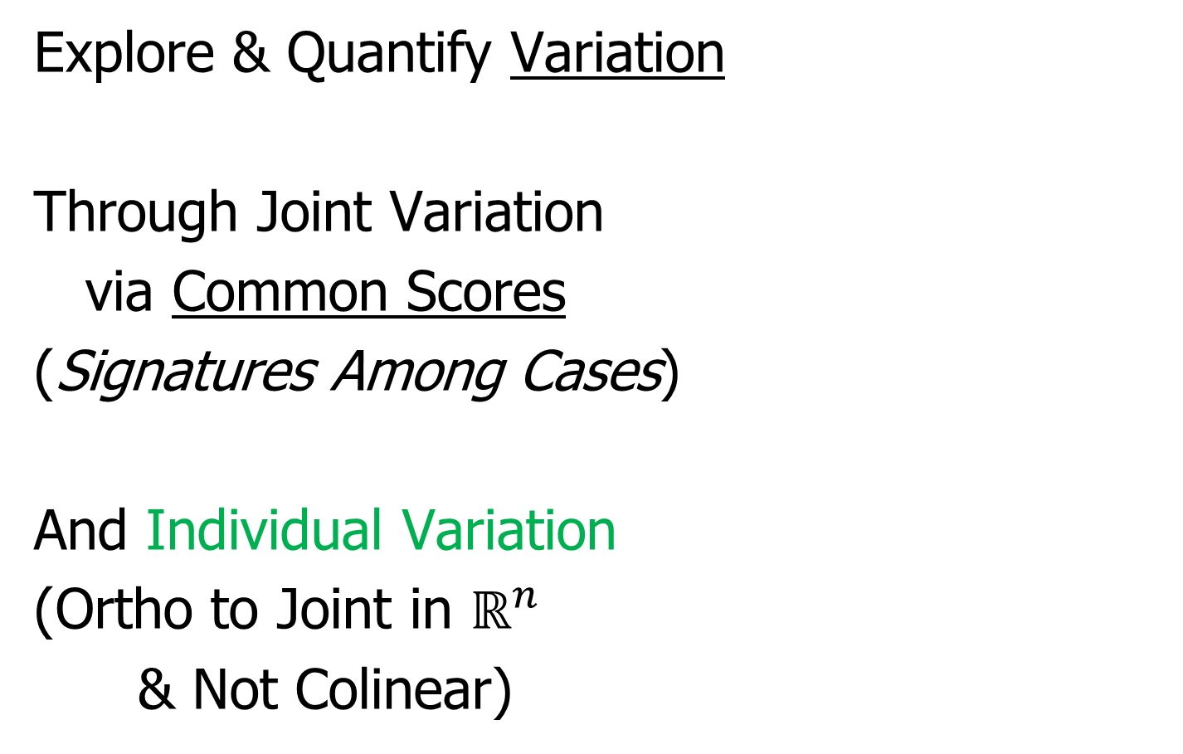
AJIVE Analytical Goals
Explore & Quantify Variation
Through Joint Variation
via Common Scores
(Signatures Among Cases)
And Individual Variation
(Ortho to Joint in $ℝ^{n}$
& Not Colinear)

Slide 13
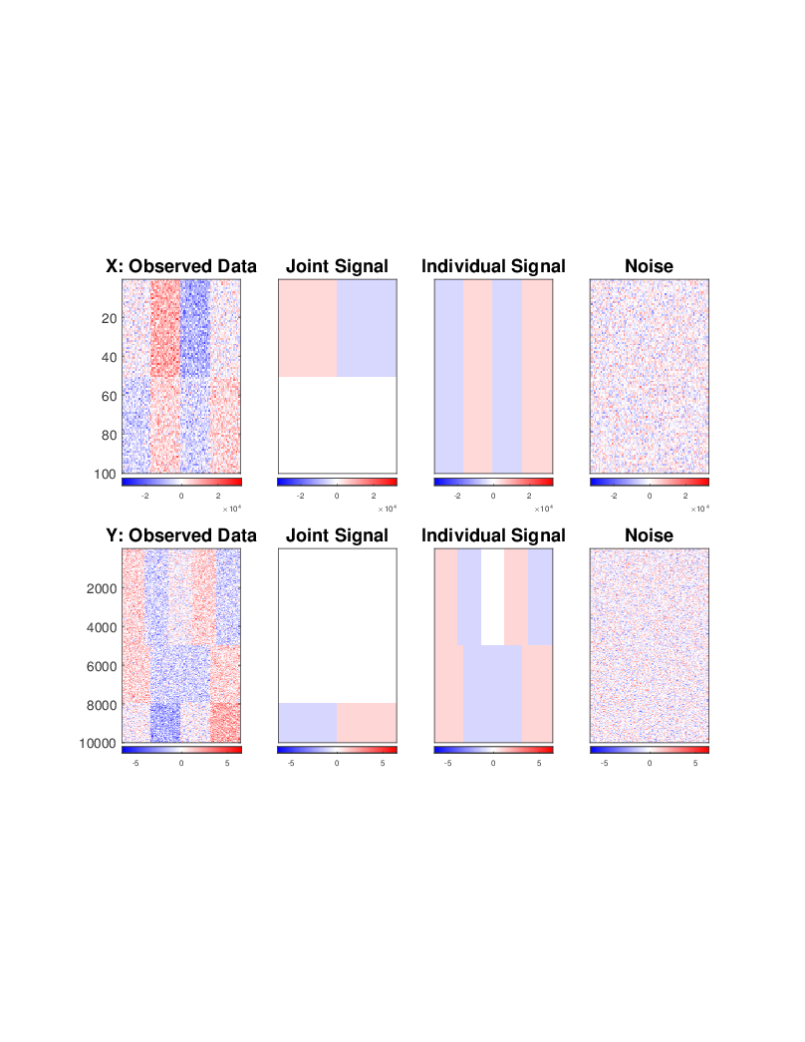
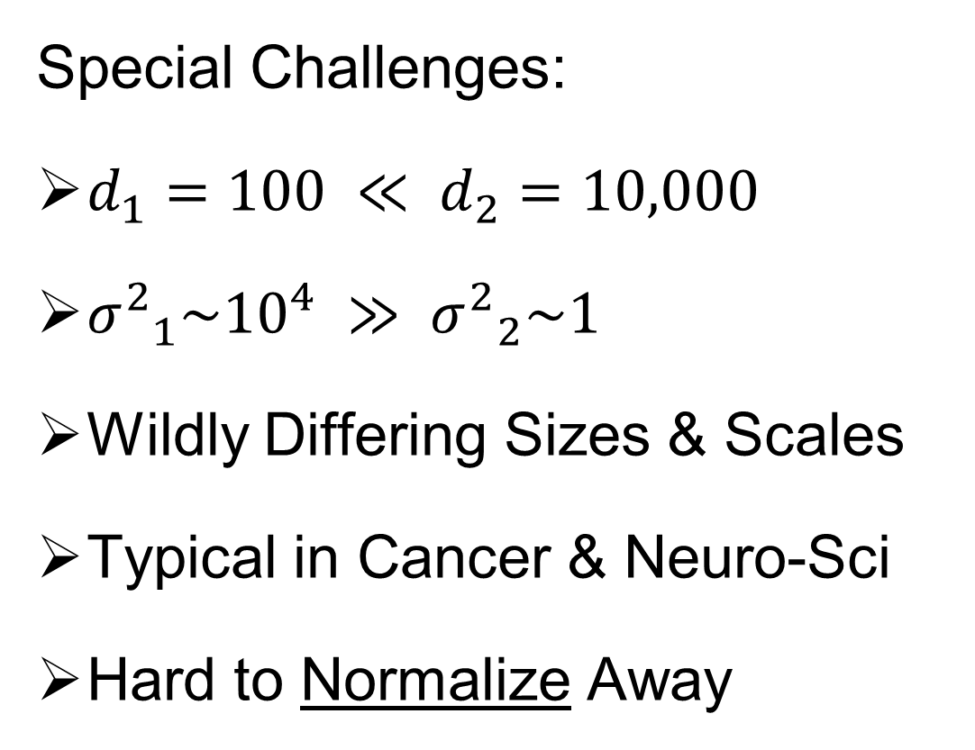
AJIVE Toy Example
Special Challenges:
$d_{1}=100 ≪ d_{2}=10,000$
${σ^{2}}_{1}\sim {10}^{4} ≫ {σ^{2}}_{2}\sim 1$
Wildly Differing Sizes & Scales
Typical in Cancer & Neuro-Sci
Hard to Normalize Away

Slide 14
AJIVE Toy Example
Underlying Components
(Additive
Signals +
+ Noise)
=
+
+
=
+
+

Slide 15
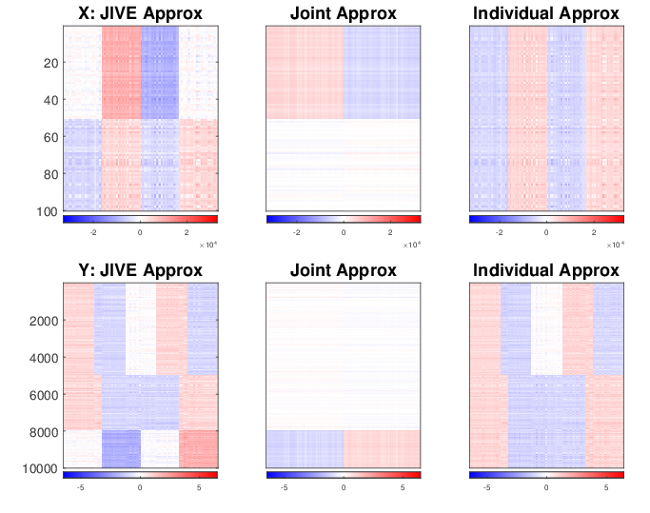
AJIVE Toy Example
Current AJIVE: Excellent Decomposition (Both Joint and Individual)

Slide 16
AJIVE Analysis of FMRI Data
Functional Magnetic Resonance Imaging
Approach:
Measure “Brain Activity”
Over Both Location & Time
Via Blood Flow
Data Objects???

Slide 17
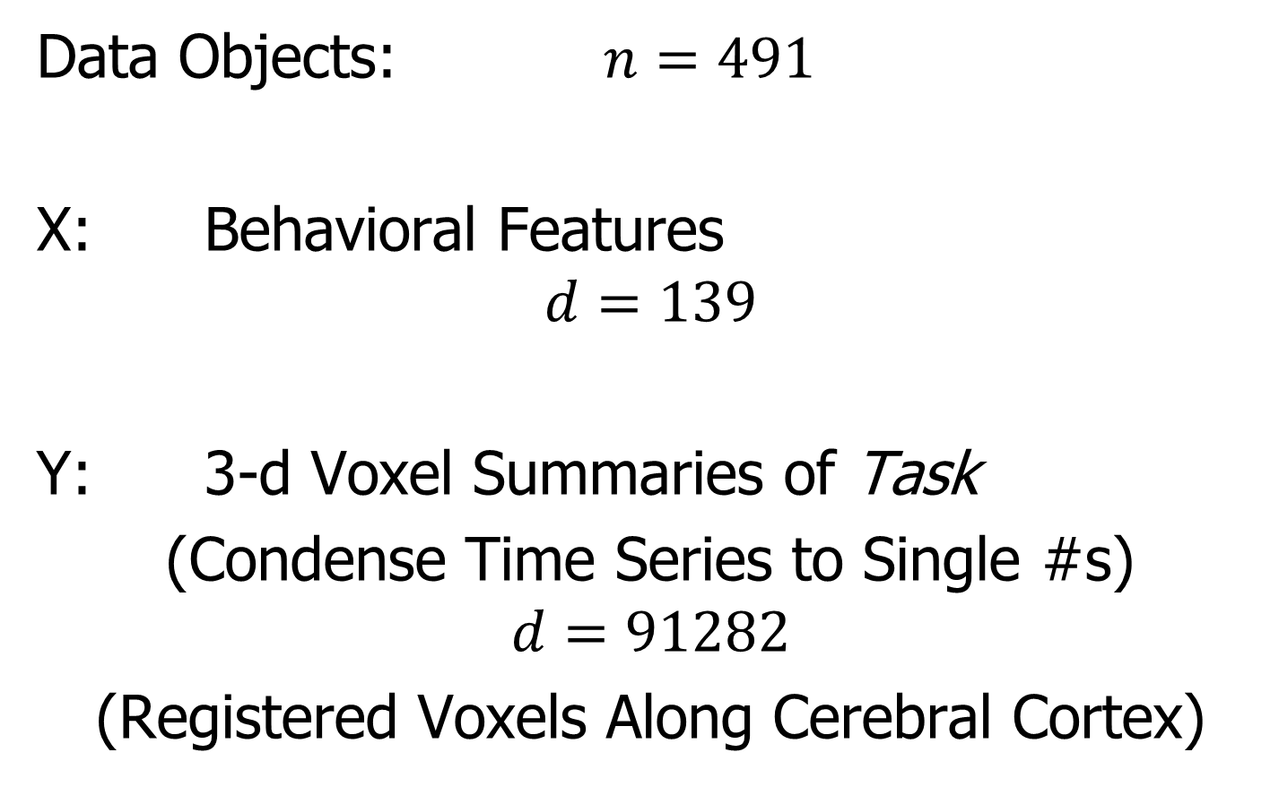
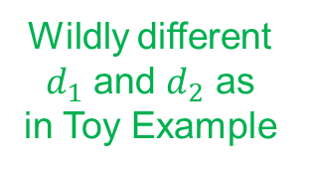
AJIVE Analysis of FMRI Data
Data Objects: $n=491$
X: Behavioral Features
$$d=139$$
Y: 3-d Voxel Summaries of Task
(Condense Time Series to Single #s)
$$d=91282$$
(Registered Voxels Along Cerebral Cortex)
Wildly different
$d_{1}$ and $d_{2}$ as
in Toy Example

Slide 18
AJIVE Analysis of FMRI Data
Focus of Analysis:
Loadings (Drivers)
  Behavioral Features
  Lit Up Brain Regions
Since Scores All Gaussian
(Normal Population)
Which Work
Together?
Which Work
Separately?

Slide 19
AJIVE Analysis of FMRI Data
View Entries of Eigenvectors
Separate
PC1 of
Behavior
Feature
Loadings
Important
Groups

Slide 20
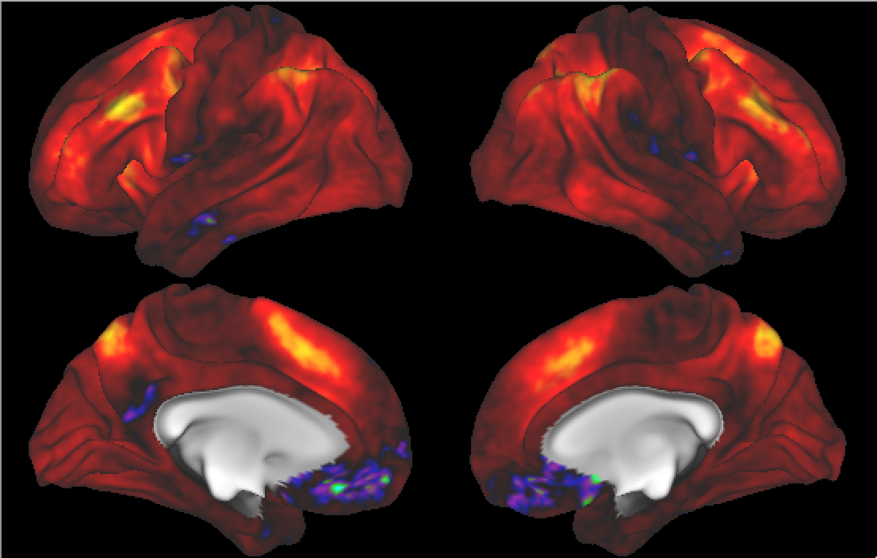

AJIVE Analysis of FMRI Data
Separate PC1 of Image Loadings
All Up
& Down
Together
View Entries of Eigenvectors
Also Some
Hot Spots?
Mostly Uses Only Hot Colors

Slide 21
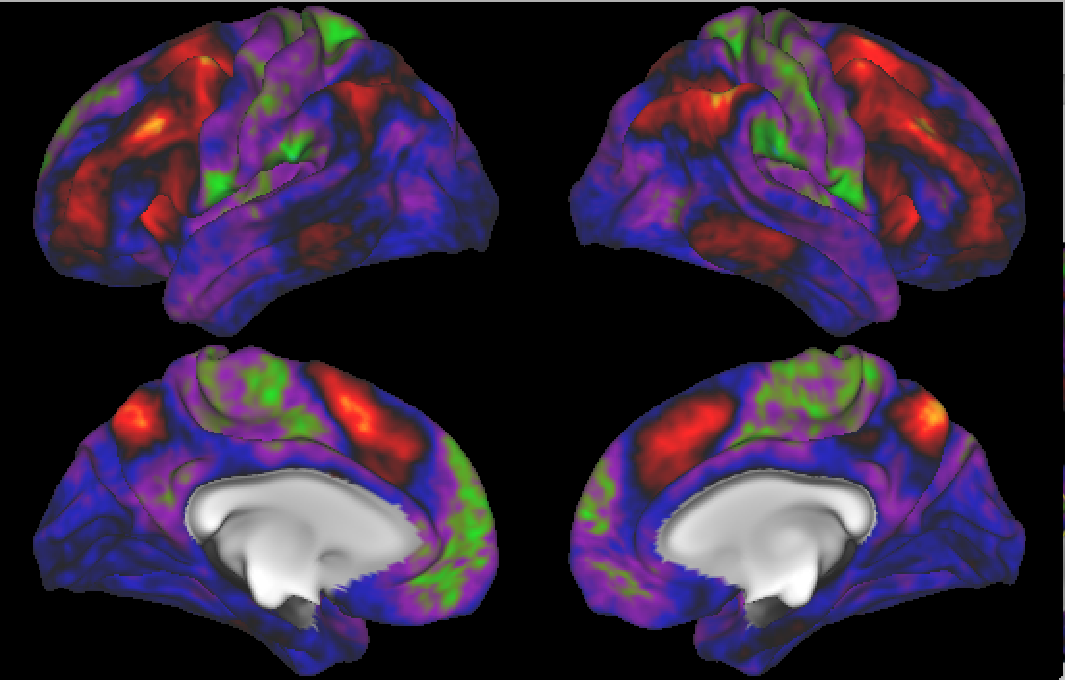
AJIVE Analysis of FMRI Data
Separate PC2 of Image Loadings
Interesting
Structure
???
And Same
Hot Spots?

Slide 22
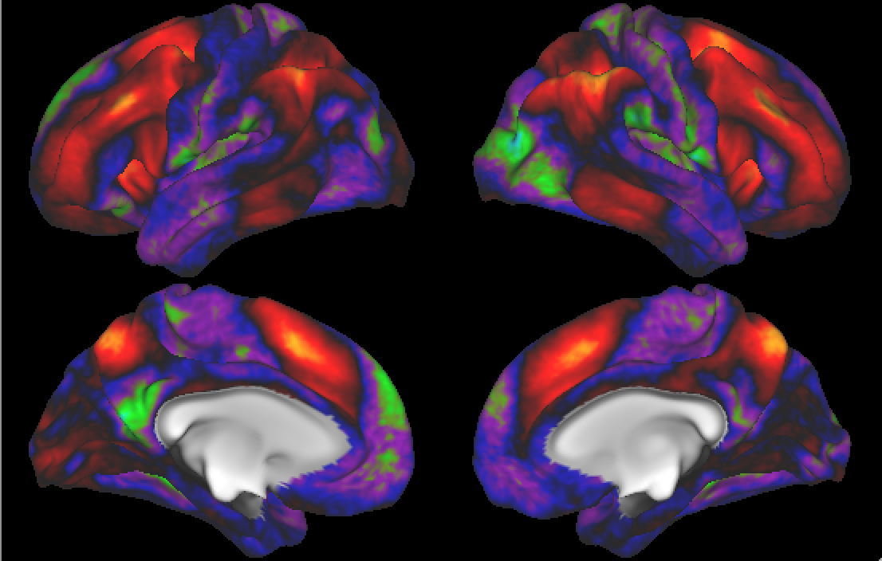
AJIVE Analysis of FMRI Data
Previous Mapping of Regions of Interest
Hot Spots
Are
Working
Memory
Related

Slide 23
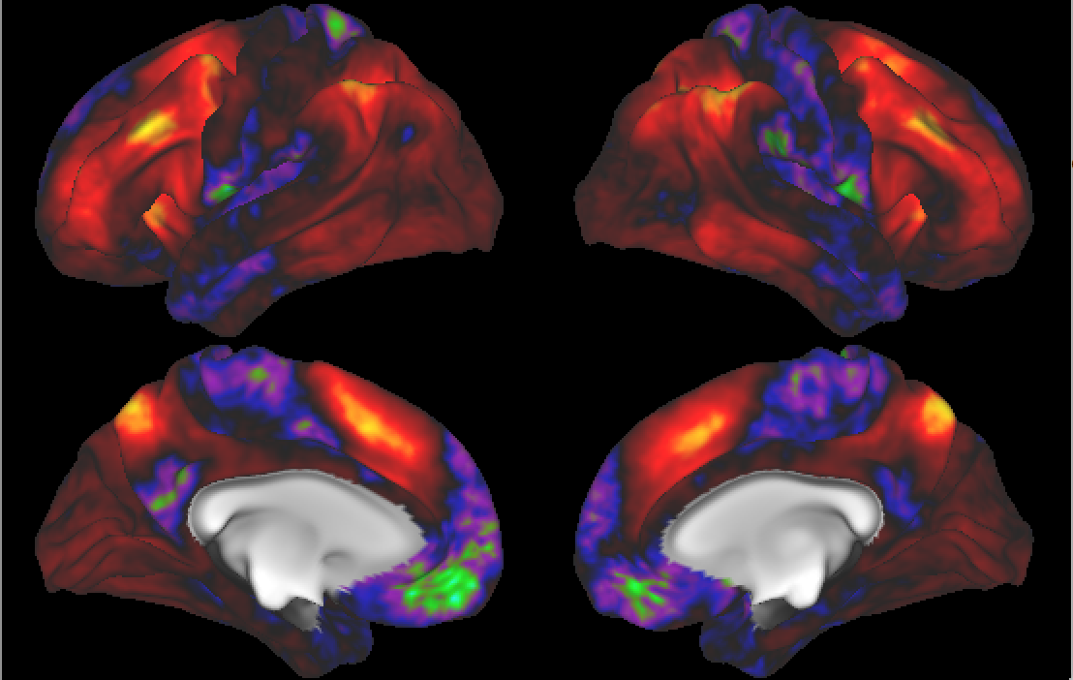
AJIVE Analysis of FMRI Data
Joint PC1 of Image Loadings
Using
Behavior
Combines
Hot Spots
From
Separate
PC1 & 2

Slide 24
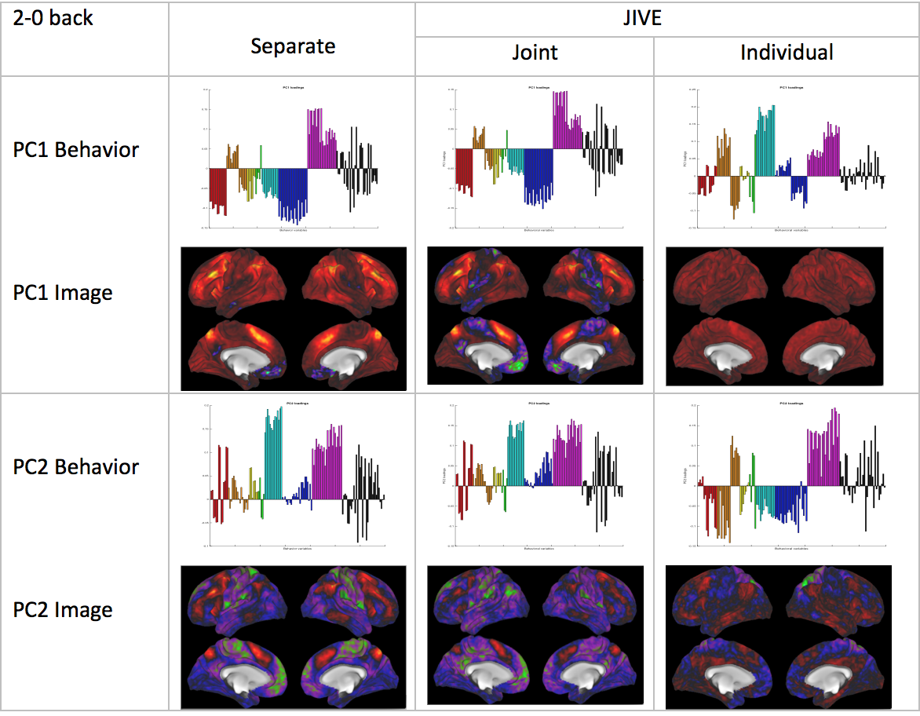
AJIVE Analysis of FMRI Data
Overall
Comparison

Slide 25
AJIVE Analysis of FMRI Data
Overall
Comparison
Earlier Showed
And Also

Slide 26
AJIVE Analysis of FMRI Data
Overall
Comparison
Sep. Beh. PC1
Assoc. w. Image
Joint Im. PC1
Concentrates
Relevant Parts
Of Sep.
PC1 & PC2

Slide 27
AJIVE Analysis of FMRI Data
Overall
Comparison
Overall Heat
Var’n not
Assoc. w/
Behavior
New 2nd Mode
Of Joint Var’n
Behavior
~ Sep. PC2

Slide 28
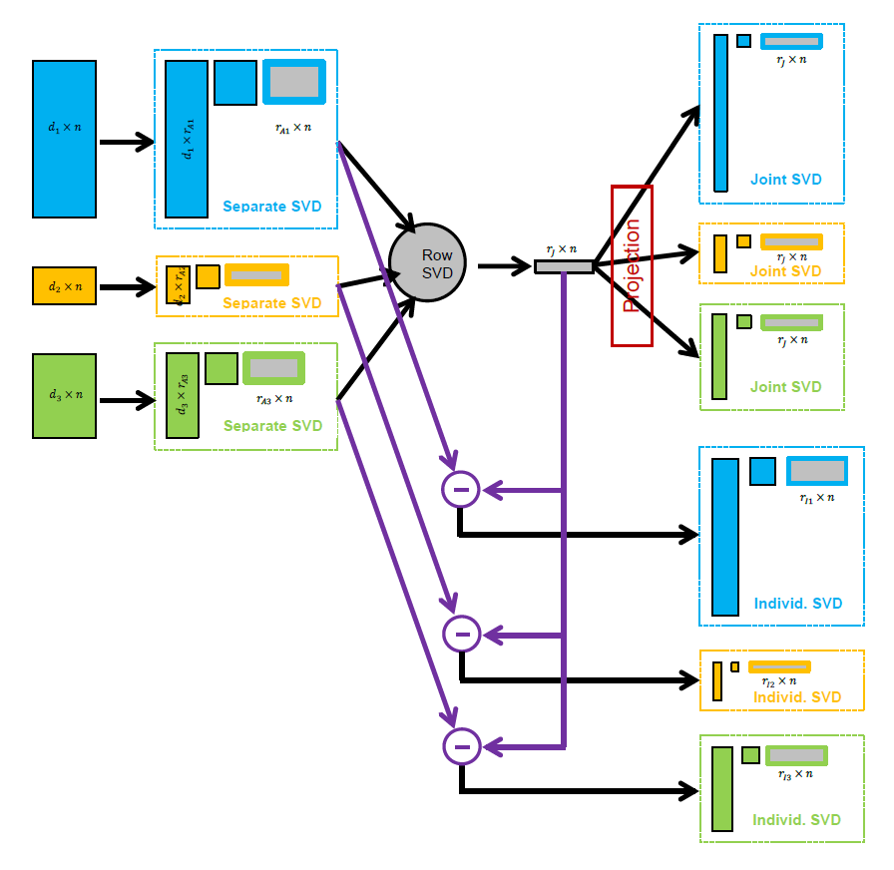
AJIVE Algorithm
Overview
Step 1

Slide 29
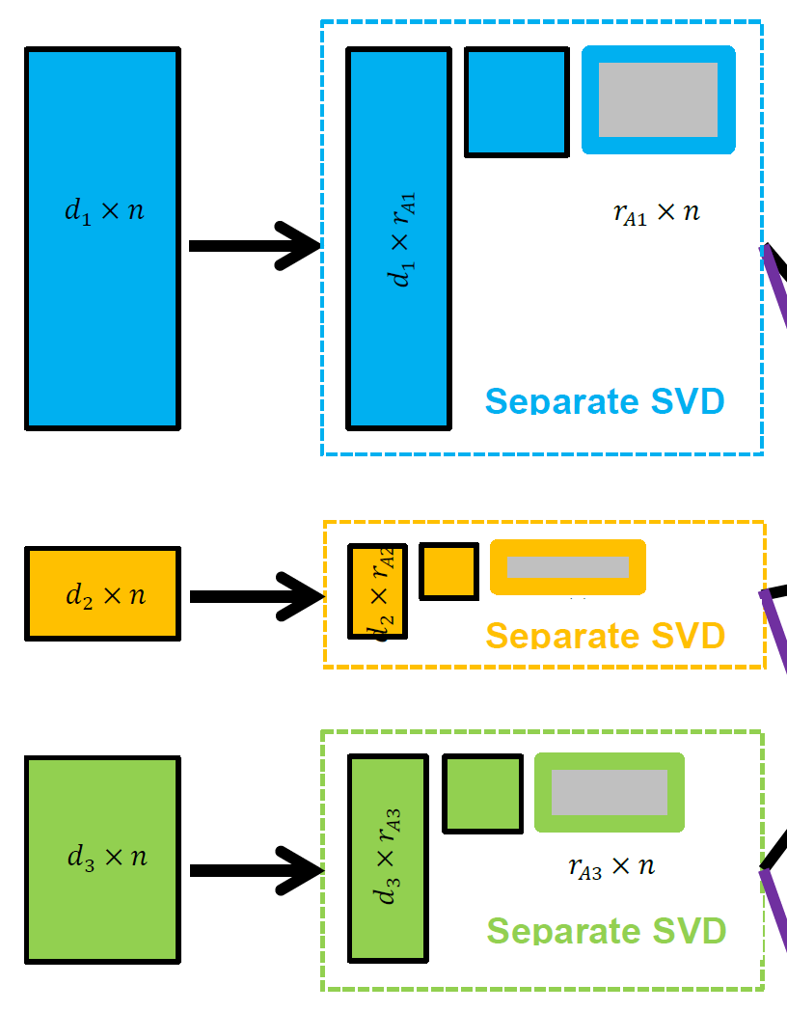

AJIVE Algorithm
Step 1:
Initial Low Rank
Approximations
Separate SVDs
Ranks: $r_{A1},r_{A2},$ $r_{A3}$
Motivation 1: Avoid Noise
Impacting Analysis
Motivation 2: Go Forward
With Scale Free Scores

Slide 30

AJIVE Algorithm
Step 1:
Initial Low Rank
Approximations
Separate SVDs
Ranks: $r_{A1},r_{A2},$ $r_{A3}$
Illustrate with Previous Toy Example

Slide 31
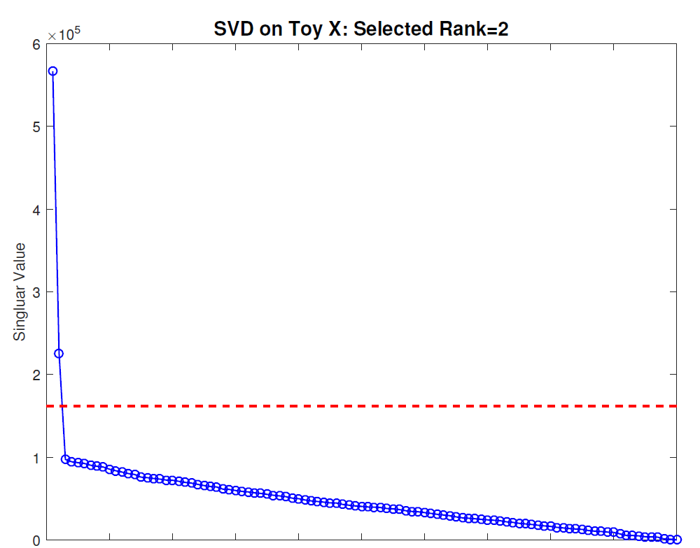
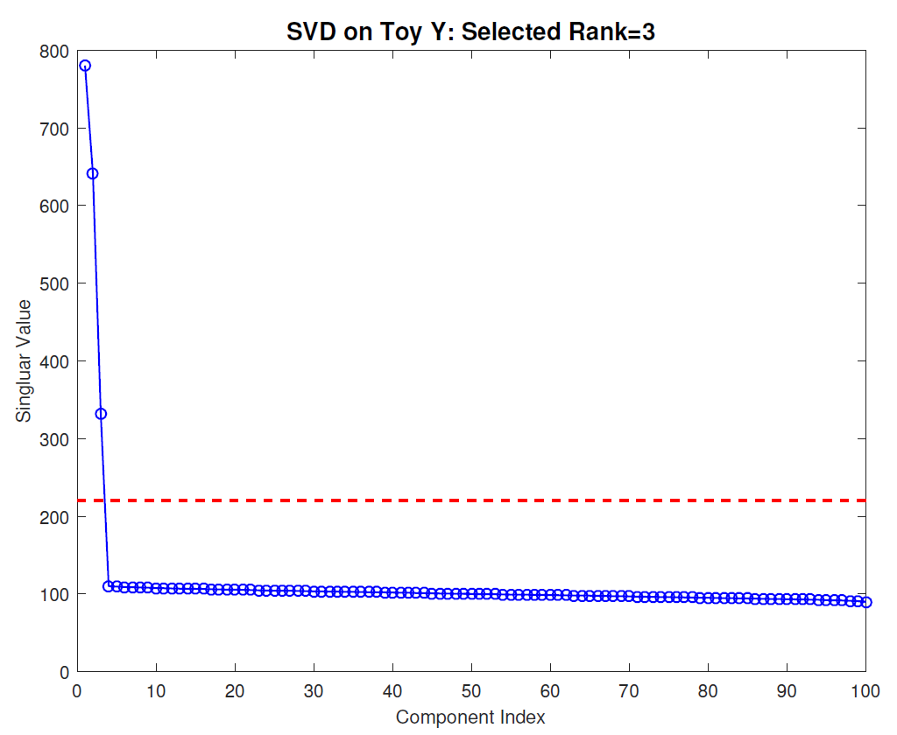
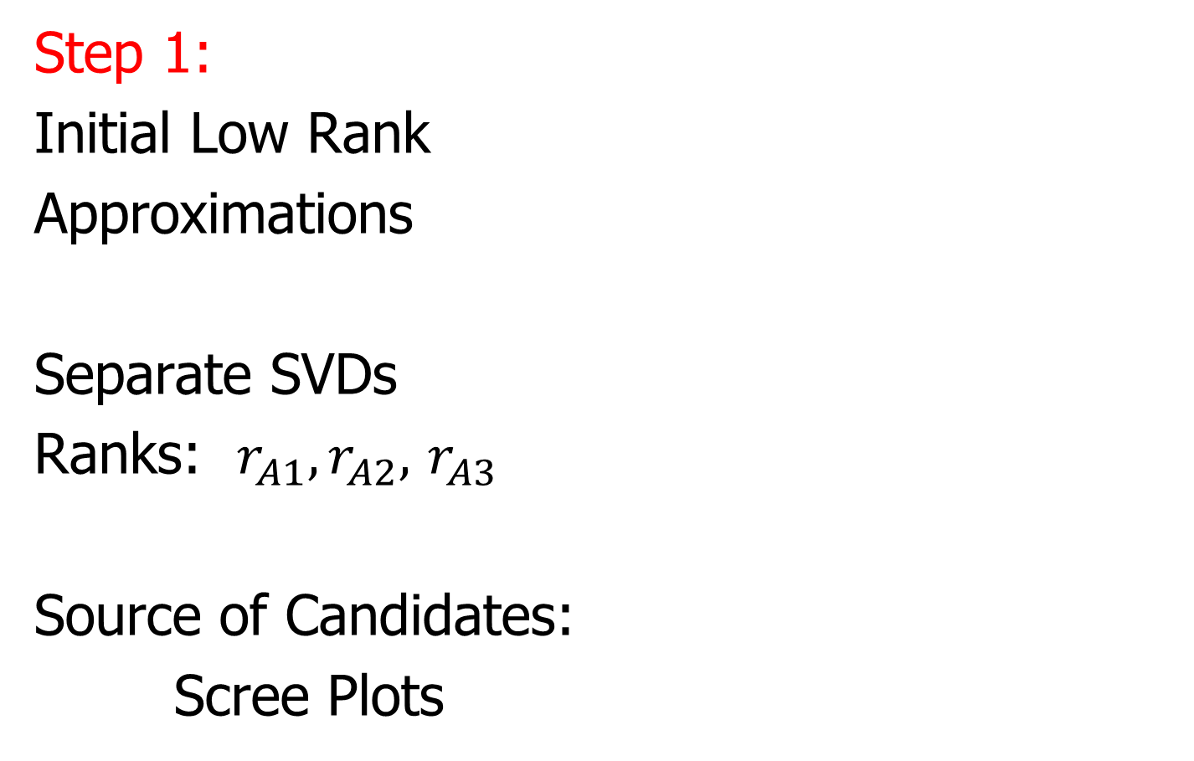
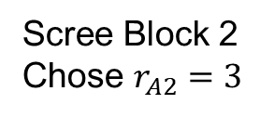
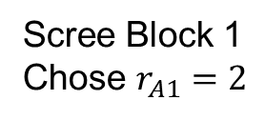
AJIVE Algorithm
Scree Block 1
Chose $r_{A1}=2$
Step 1:
Initial Low Rank
Approximations
Separate SVDs
Ranks: $r_{A1},r_{A2},$ $r_{A3}$
Source of Candidates:
Scree Plots
Scree Block 2
Chose $r_{A2}=3$

Slide 32
AJIVE Algorithm
Step 1:
Initial Low Rank
Approximations
Separate SVDs
Ranks: $r_{A1},r_{A2},$ $r_{A3}$
Source of Candidates:
Scree Plots
Assessment of Ranks:
Wedin Bounds
Random Subspaces
Diagnostic Plots
Directional Bounds
Active Research

Slide 33
AJIVE Algorithm
Overview
Step 2

Slide 34
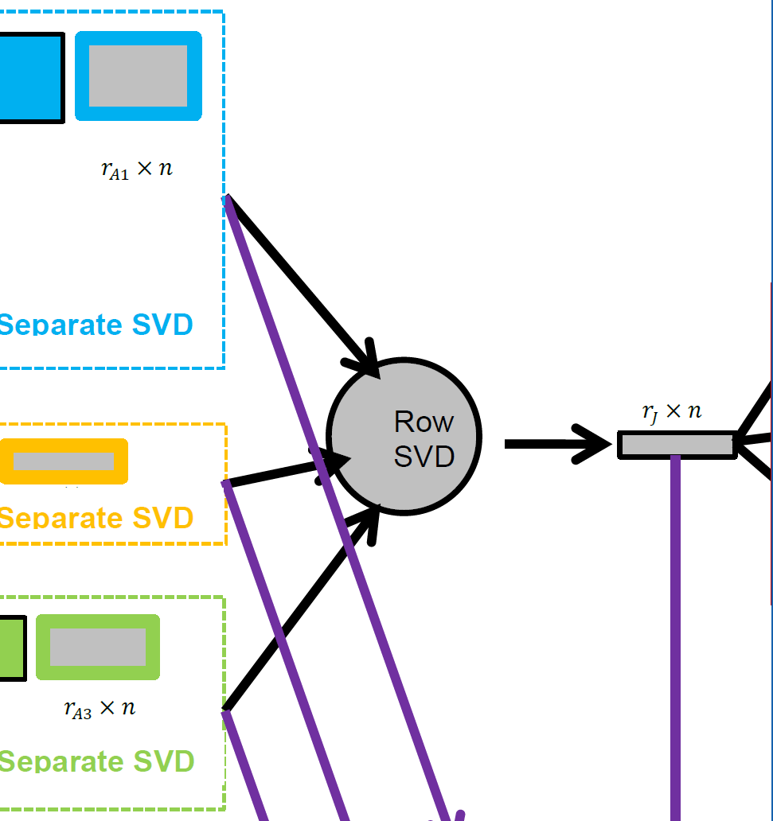
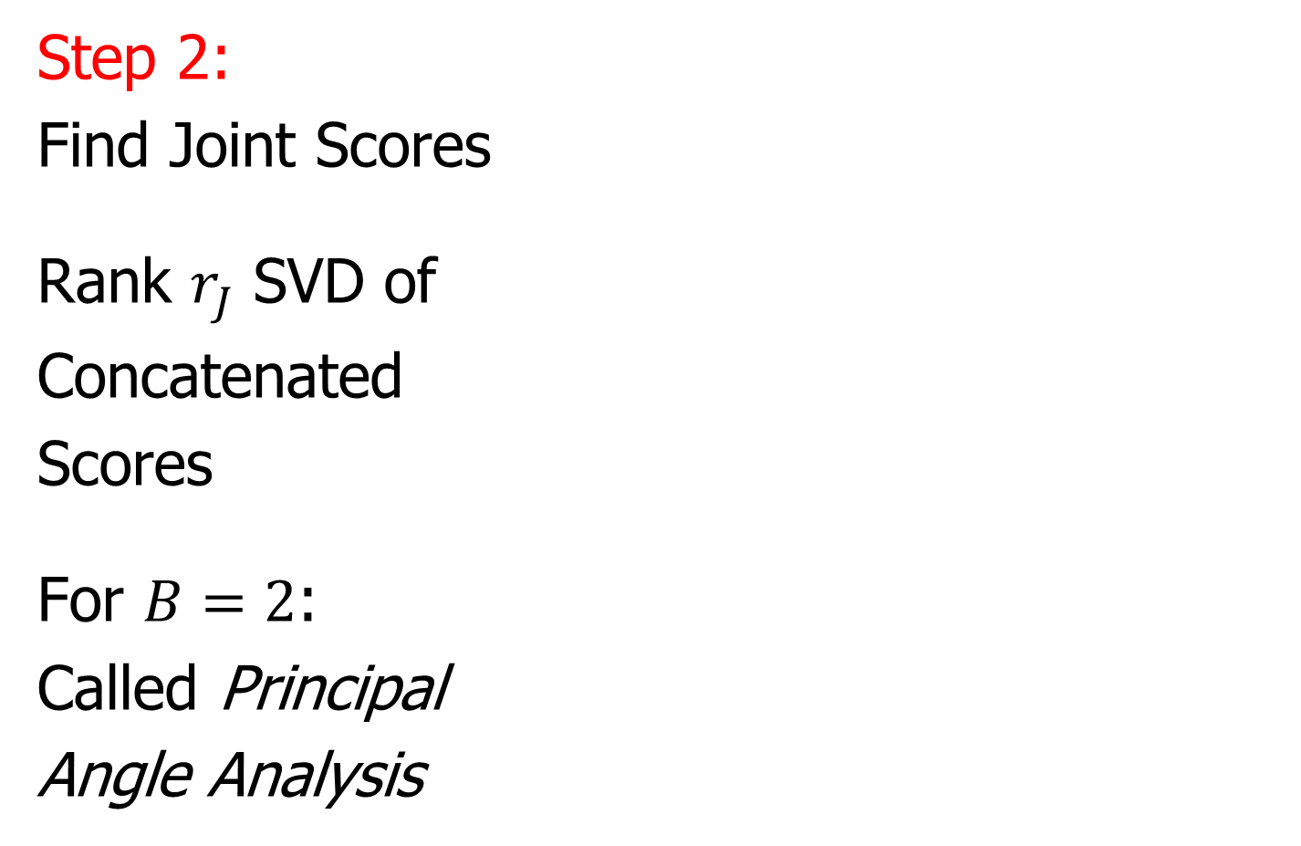
AJIVE Algorithm
Step 2:
Find Joint Scores
Rank $r_{J}$ SVD of
Concatenated
Scores
For $B=2$:
Called Principal
Angle Analysis

Slide 35

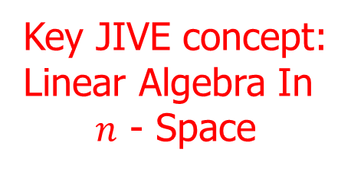


Aside: Principal Angle Analysis
Idea: Relate Subspaces $S_{1}$, $S_{2}$ of $ℝ^{n}$
Using Minimal Angles
$$θ_{1}=0$$
$$θ_{2}$$
Key JIVE concept:
Linear Algebra In
$n$ - Space
And Iterate Orthogonally
PAA Computation: ~Concatenate & SVD

Slide 36
AJIVE Algorithm
Overview
Step 3

Slide 37
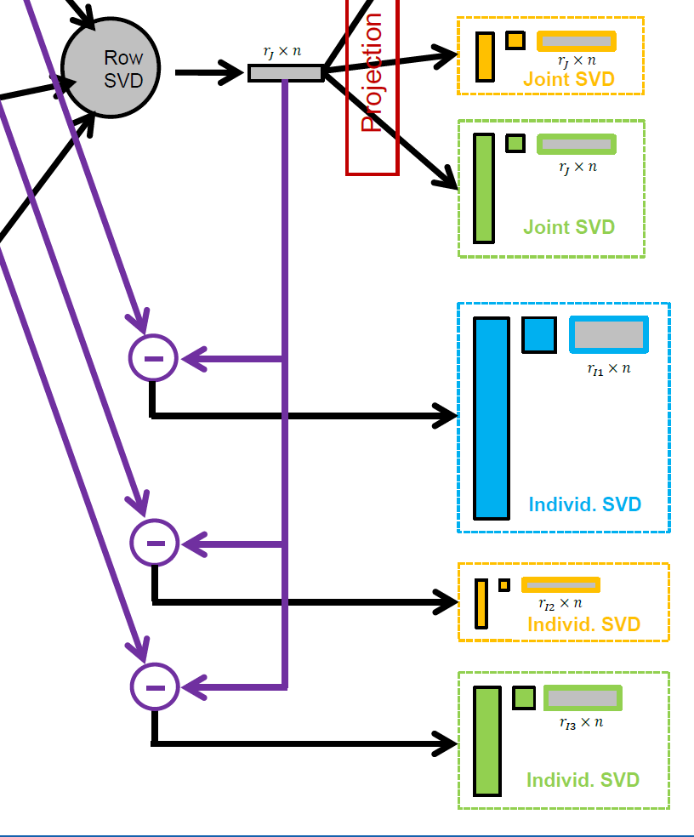

AJIVE Algorithm
Step 3:
Find Individual
Scores
By Orthogonal
Basis Subtraction
Guarantees
Joint $⊥$ Individual

Slide 38
AJIVE Algorithm
Overview
Step 4

Slide 39
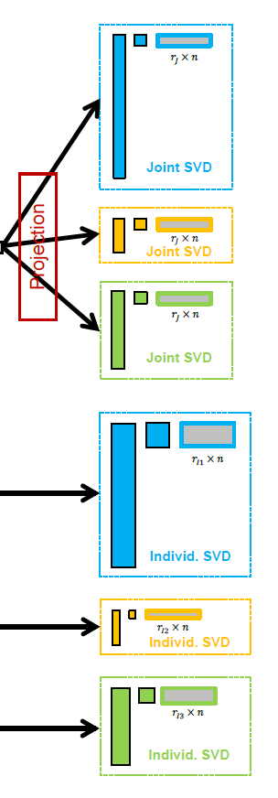
AJIVE Algorithm
Step 4:
Reproject Data
To Get Both
Joint and
Individual
Decompositions

Slide 40
AJIVE Algorithm
Output Options (for Differing Purposes):
Common Normalized Scores
Block Specific Scores (Joint & Indiv.)
Full Matrices

Slide 41
AJIVE Algorithm
Output Options (for Differing Purposes):
Common Normalized Scores
Block Specific Scores (Joint & Indiv.)
Full Matrices

Slide 42
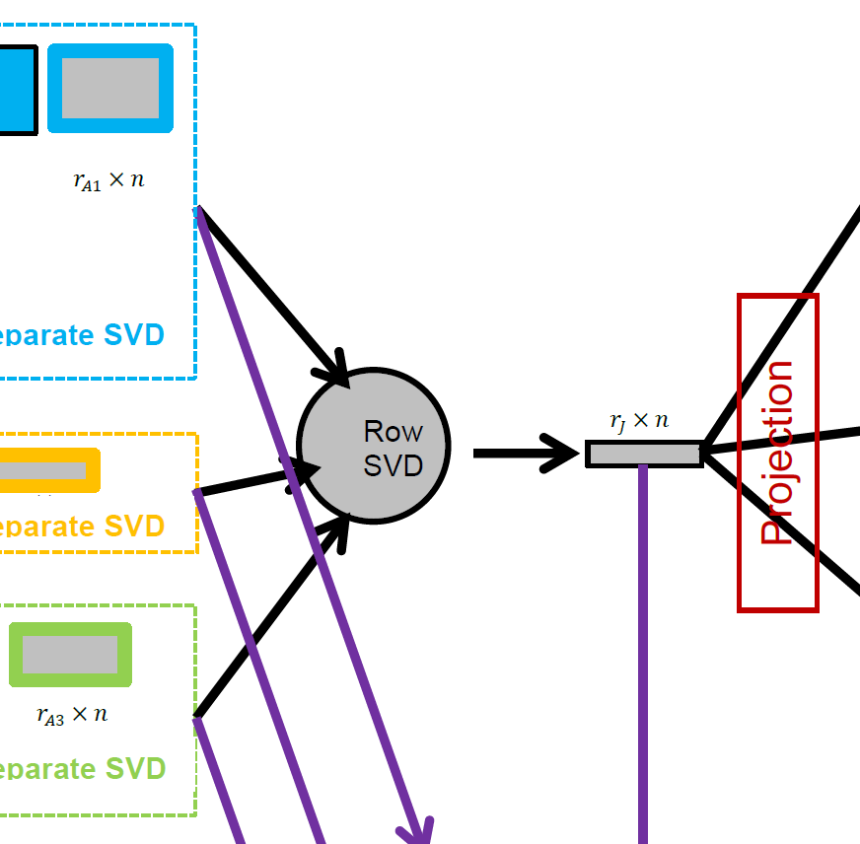
AJIVE Algorithm
Caution: Common
Normalized Loadings
Need Not Be Orthogonal
Common Normalized Scores
  Same for Each Block
  Finds Joint Behavior
  Useful: Scatterplots
  Can Have Common
  Loadings By Projecting
  Gives Interpretation
  of Driving Features
E.g. FMRI Neuro Science Data

Slide 43
AJIVE Algorithm
Output Options (for Differing Purposes):
Common Normalized Scores
Block Specific Scores (Joint & Indiv.)
Full Matrices

Slide 44

AJIVE Algorithm
Block Specific Scores
(Joint & Indiv.)
  SVD Re-Ordered Basis
  Loadings Now Orthogonal
  Includes Magnitudes (SVs)
  Compact $r_{∗}×n$ Representation
  E.g. Input for Classification
  Interpretation via Loadings

Slide 45
AJIVE Algorithm
Output Options (for Differing Purposes):
Common Normalized Scores
Block Specific Scores (Joint & Indiv.)
Full Matrices

Slide 46
AJIVE Algorithm
Full Matrices
  Size of Original Data
  Allows Heat Map View
  And Network Analysis

Slide 47
Revisit Toy Example
Joint Signal has Rank 1
Underlying Components
(Additive
Signals +
+ Noise)
=
+
+
1st Individual Signal
has Rank 1
=
+
+
2nd Individual Signal
has Rank 2

Slide 48


Revisit Toy Example
Recall Scree Plots
Easy in this Simple Case
Scree Block X
Chose $r_{A1}=2$
Scree Block Y
Chose $r_{A2}=3$

Slide 49
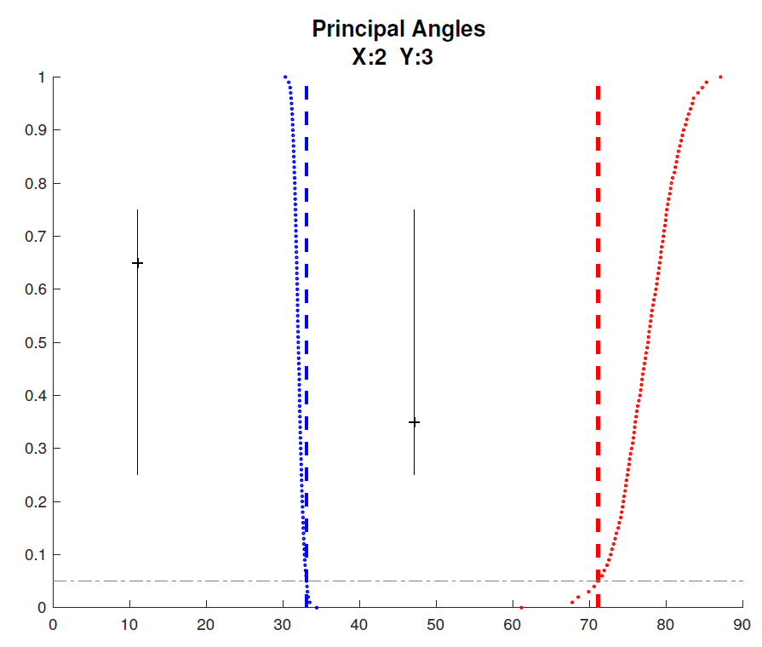

Revisit Toy Example
Well Chosen Initial Ranks, $r_{A1}=2$, $r_{A2}=3$
Diagnostic Plot:
1st Principal Angle
(Joint + noise)
Conclude
Neither Is
Random
Conclude
Larger
Not Joint
2nd Principal Angle
(Small Indiv. + )
Random Subspaces
Distribution & Quantile
Wedin Bound Estimates
Distribution & Quantile

Slide 50
Revisit Toy Example
=
+
+
Relatively Small
Angle Between
Row Spaces
=
+
+

Slide 51
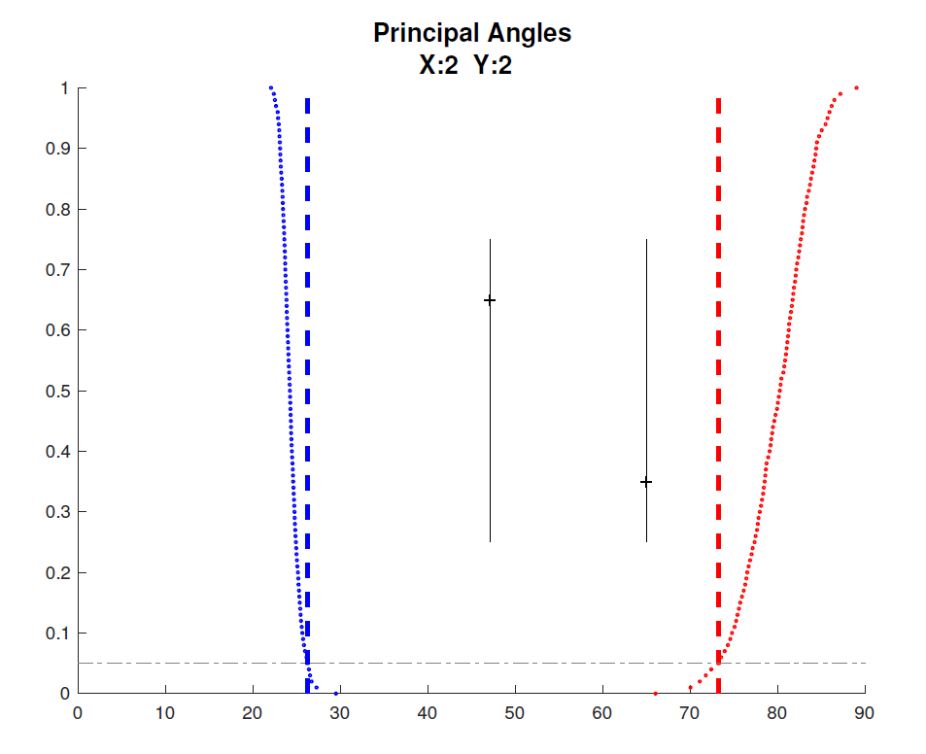

Revisit Toy Example
Choose $r_{A2}=2$, Too Small (Lose Info)
Diagnostic Plot:
Both Principal Angles
Larger (Lost Info)
Neither is Random
Neither is Joint
Since Joint Signal in Y
Relatively Small

Slide 52
Revisit Toy Example
=
+
+
Relatively
Less Signal
In Y Joint
Component
=
+
+

Slide 53
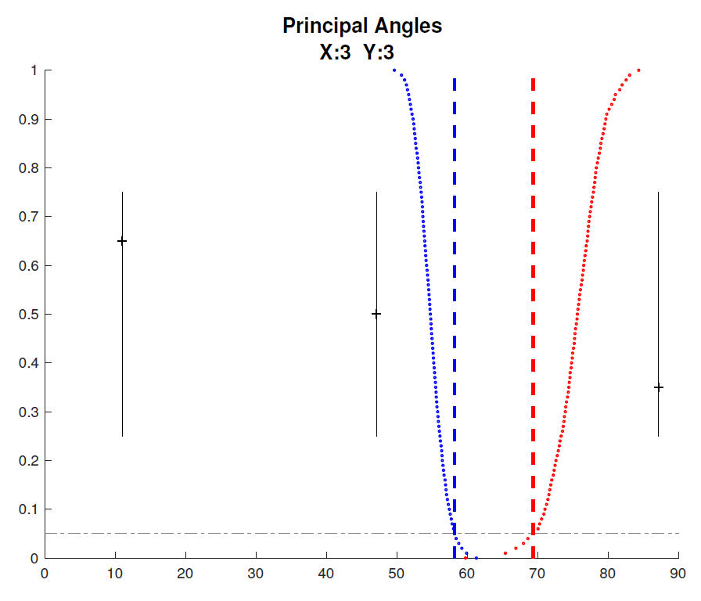


Revisit Toy Example
Choose $r_{A1}=3$, Too Big (Feels Noise)
Diagnostic Plot:
Now 3 Principal Angles
3rd Could be Random
(OK, Since True $r_{A1}=2$)
2nd Could be Joint
(Consequence of Poor
Wedin Approximation)

Slide 54
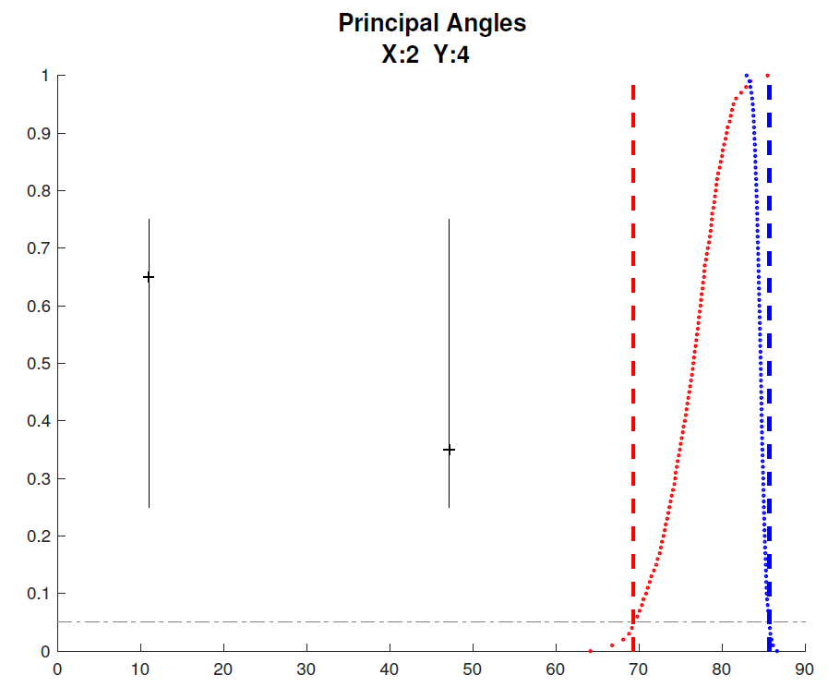


Revisit Toy Example
Choose $r_{A2}=4$, Too Big (Feels Noise)
Diagnostic Plot:
Wedin Bound Useless
$>$Random Subspace Bound
Due to High Noise
Neither Angle Random
Both Could Be Joint
Not Much Info Here

Slide 55


AJIVE Analysis of Cancer Data
Carolina Breast Cancer Study (CBCS)
Thanks to: Iain Carmichael (Deep Learning, AJIVE)
Melissa Troester (Head, CBCS)
Joseph Geradts, Benjamin Calhoun (Pathology)
Katie Hoadley, Chuck Perou (Genomics)

Slide 56
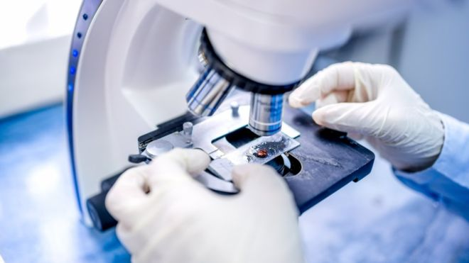
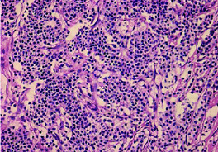
AJIVE Analysis of Cancer Data
Clinical Diagnosis of Cancer:
Pathologist Views Tissue Under Microscope,
Tissue Stained with Hematoxylin & Eosin (H&E)
Thanks to BBC.CO.UK
and Reseachgate.net

Slide 57
AJIVE Analysis of Cancer Data
Analysis Goal:
Understand How Images & Genomics
Work Together
Work Separately
Approach: AJIVE
Clinical Diagnostic Standard
Deep Insight &
New Treatments
As of Jan. 2020: ~70
Drugs Approved for
Breast Cancer Therapy

Slide 58
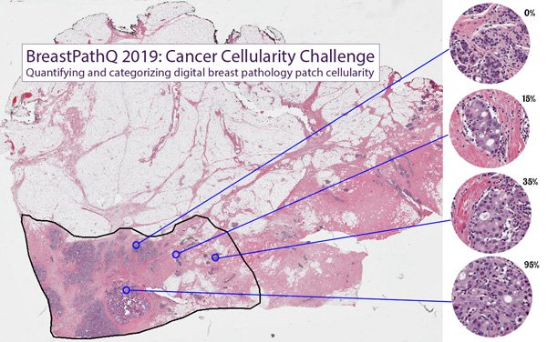
AJIVE Analysis of Cancer Data
Tissue Micro Array Data:
Extract Small
(1mm diam.)
“Cores”
Thanks to SPIE.ORG

Slide 59
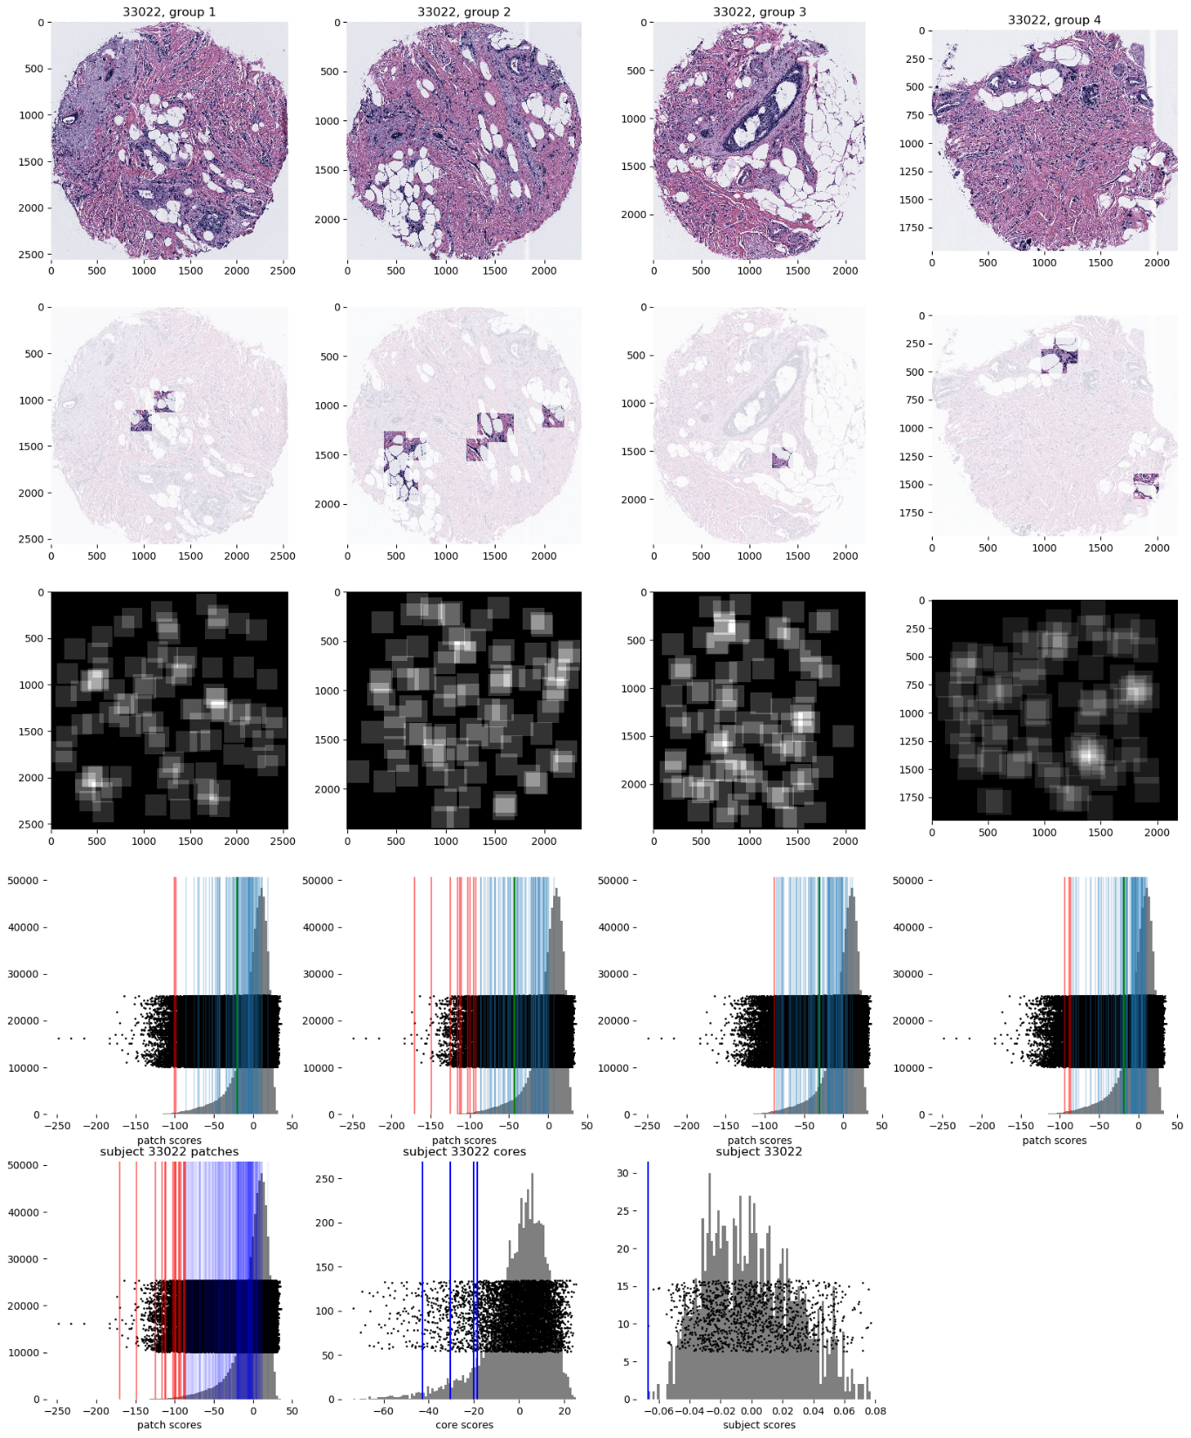
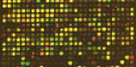

AJIVE Analysis of Cancer Data
Experimental Design: $n=1191$ people
For Each:
1 – 4 TMA Cores
PAM 50 Gene Expression:

Slide 60

AJIVE Analysis of Cancer Data
PAM 50 Gene Expression:
Set of 50 Genes
Measured mRNA Expression Level
Good at Separating SubTypes
  Basal
  Her2
  Luminal A
  Luminal B
Early Technology, More Recent
RNAseq → 10,000s Genes
Perou Discovery:
No Benefit From
Chemo-Therapy

Slide 61

AJIVE Analysis of Cancer Data
Deep Learning Image Representation
Each Core:
Randomly
Select 100
$224×224$
Patches

Slide 62
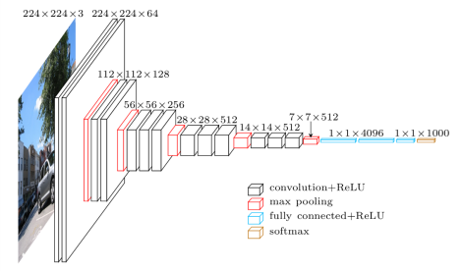
AJIVE Analysis of Cancer Data
Deep Learning Image Representation
Reduce Each Patch to 512 Features
Using Transfer Learning From VGG16:
(Trained on Many
Natural Images)
Thanks to pyimagesearch.com

Slide 63
AJIVE Analysis of Cancer Data
Deep Learning Image Representation
For Each Core:
Aggregate Patches by Averaging
(Damps Out “Location” Information)
Then Average Cores For Each Person

Slide 64

AJIVE Analysis of Cancer Data
JIVE: Common Normalized Scores 1
Look at Extremes
Negative End
Top Person
Top 16 Patches
Fat Cells & Stroma

Slide 65

AJIVE Analysis of Cancer Data
JIVE: Common Normalized Scores 1
Look at Extremes
Positive End
Top Person
Top 16 Patches
Highly “Cellular”
Markedly Atypical Cells

Slide 66

AJIVE Analysis of Cancer Data
JIVE: Gene Expression
Common Normalized
Loadings 1
Very Consistent w/ Image
“High Proliferation” Genes
“Low Prolif.” – Lum A Genes

Slide 67

AJIVE Analysis of Cancer Data
JIVE: Common Normalized Scores 2
Look at Extremes
Negative, Top
Top 16 Patches
High Nuclear Grade
Atypical Cells

Slide 68

AJIVE Analysis of Cancer Data
JIVE: Common Normalized Scores 1
Look at Extremes
Positive, Top
Top 16 Patches
Lower Nuclear Grade
Stroma, Sclerosis

Slide 69

AJIVE Analysis of Cancer Data
JIVE: Gene Expression
Common Normalized
Loadings 2
Very Consistent w/ Image
Luminal Subtype Genes
Basal Subtype Genes

Slide 70

AJIVE Analysis of Cancer Data
JIVE, Genes, Individual 1
Overall Up & Down
Together

Slide 71

AJIVE Analysis of Cancer Data
JIVE, Genes, Individual 1
Overall Up & Down
Together
Recall “Flat Mode of Variation”
From Shifted Parabolas Example
Caused by Varying
RNA Amplification
Purely A
Laboratory
Effect

Slide 72
AJIVE Analysis of Cancer Data
JIVE, Genes, Individual 1
Overall Up & Down
Together
Not Subtype Related!

Slide 73
Participant Presentations
12:05 Xianwen He :
County-level GDP estimation around Chinese Mainland via CNN from remote sensing data
12:10 Andy Ackerman :
Data Integration for MRI
Next Class: Ben Brown, Adrian Allen

