Slide 1
Statistics – O. R. 881 Object Oriented Data Analysis
Start
Recording
Steve Marron
Dept. of Statistics and Operations Research
University of North Carolina

Slide 2
Current Sections in Textbook
Today:
Section 17.2, 14.2
Next Class:
Sections 14.2, 14.1

Slide 3
From Course Web Page:
Please Send Titles
(Save Me Time Sending Emails)

Slide 4
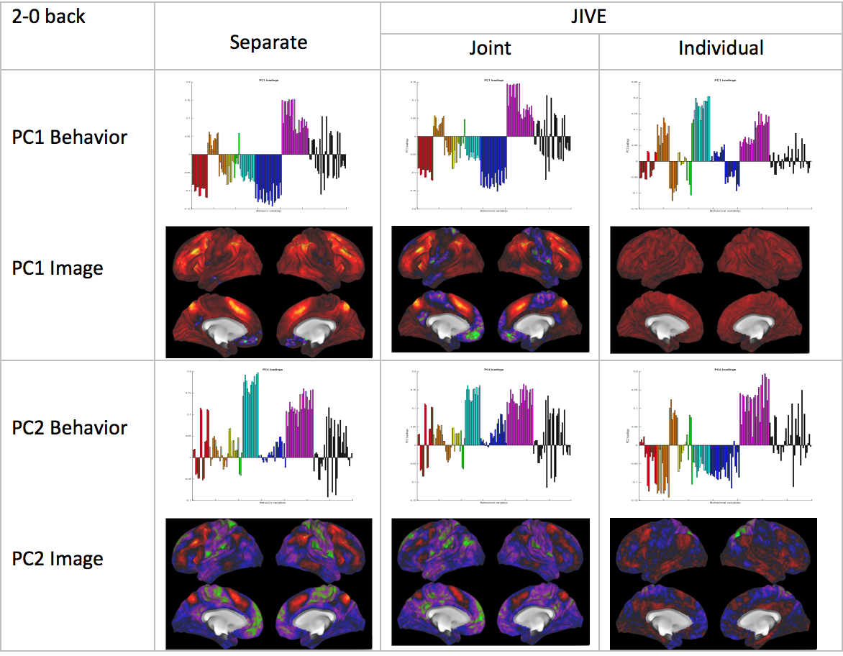
AJIVE Analysis of FMRI Data
Overall
Comparison
Sep. Beh. PC1
Assoc. w. Image
Joint Im. PC1
Concentrates
Relevant Parts
Of Sep.
PC1 & PC2

Slide 5
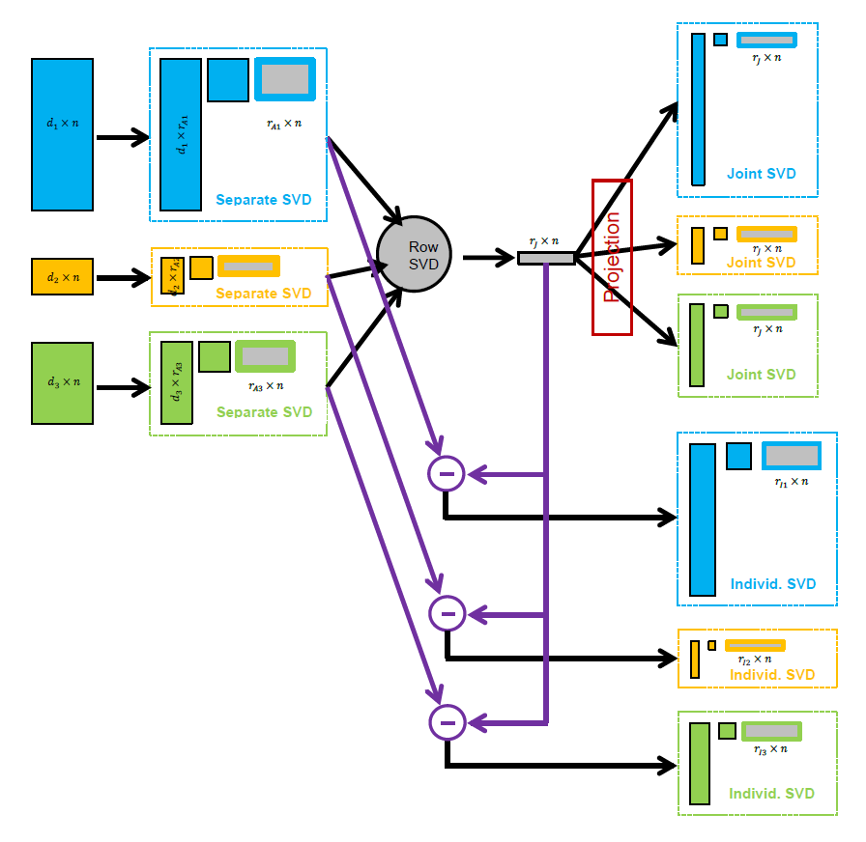
AJIVE Algorithm
Overview

Slide 6
Aside: Principal Angle Analysis
Idea: Relate Subspaces $S_{1}$, $S_{2}$ of $ℝ^{n}$
Using Minimal Angles
$$θ_{1}=0$$
$$θ_{2}$$
Key JIVE concept:
Linear Algebra In
$n$ - Space
And Iterate Orthogonally
PAA Computation: ~Concatenate & SVD

Slide 7
AJIVE Algorithm
Output Options (for Differing Purposes):
Common Normalized Scores
Block Specific Scores (Joint & Indiv.)
Full Matrices

Slide 8
Revisit Toy Example
Well Chosen Initial Ranks, $r_{A1}=2$, $r_{A2}=3$
Diagnostic Plot:
1st Principal Angle
(Joint + noise)
Conclude
Neither Is
Random
Conclude
Larger
Not Joint
2nd Principal Angle
(Small Indiv. + )
Random Subspaces
Distribution & Quantile
Wedin Bound Estimates
Distribution & Quantile

Slide 9
AJIVE Analysis of Cancer Data
Carolina Breast Cancer Study (CBCS)
Thanks to: Iain Carmichael (Deep Learning, AJIVE)
Melissa Troester (Head, CBCS)
Joseph Geradts, Benjamin Calhoun (Pathology)
Katie Hoadley, Chuck Perou (Genomics)

Slide 10
AJIVE Analysis of Cancer Data
Analysis Goal:
Understand How Images & Genomics
Work Together
Work Separately
Approach: AJIVE
Clinical Diagnostic Standard
Deep Insight &
New Treatments
As of Jan. 2020: ~70
Drugs Approved for
Breast Cancer Therapy

Slide 11
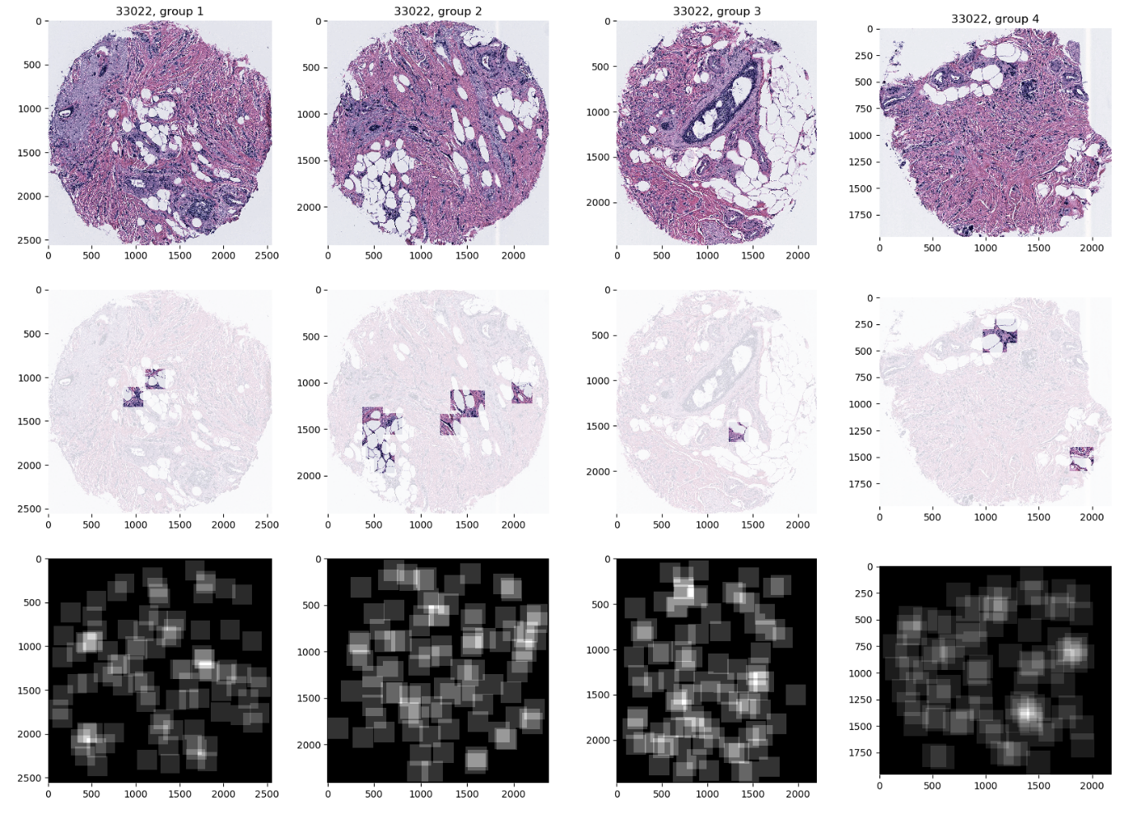
AJIVE Analysis of Cancer Data
Deep Learning Image Representation
Each Core:
Randomly
Select 100
$224×224$
Patches

Slide 12
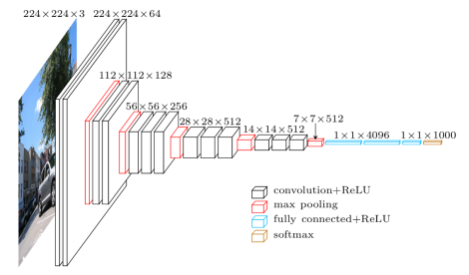
AJIVE Analysis of Cancer Data
Deep Learning Image Representation
Reduce Each Patch to 512 Features
Using Transfer Learning From VGG16:
(Trained on Many
Natural Images)
Thanks to pyimagesearch.com

Slide 13
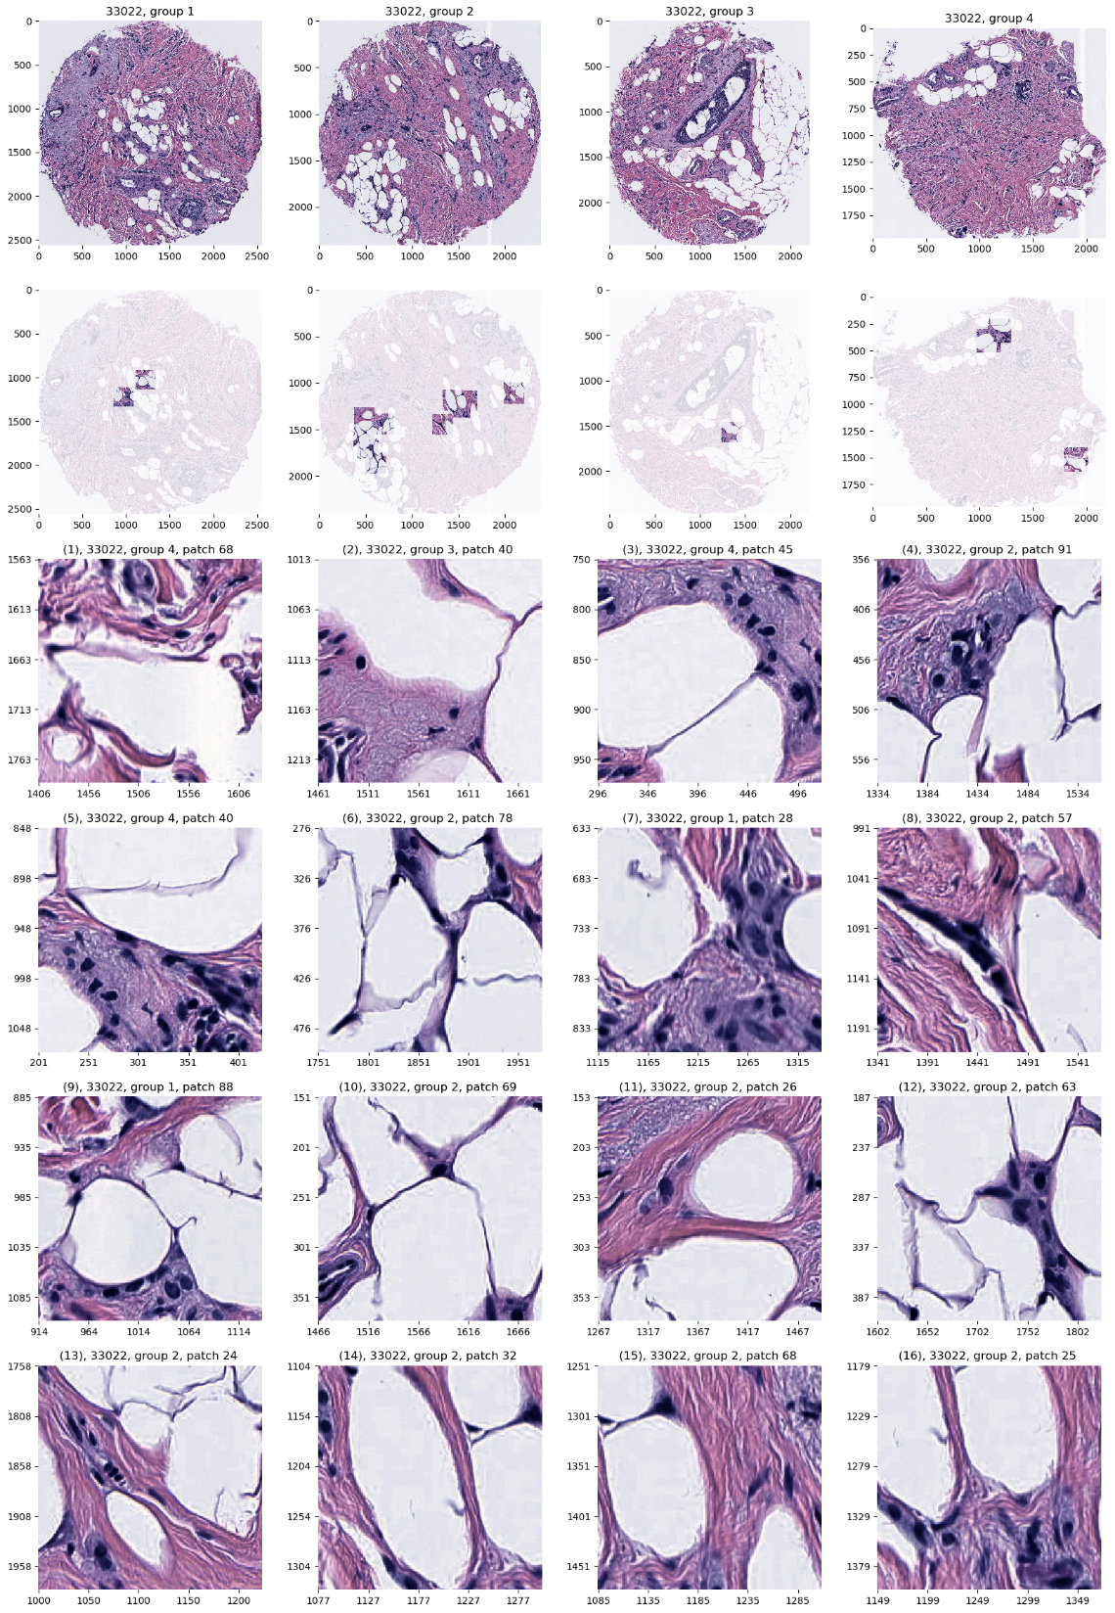
AJIVE Analysis of Cancer Data
JIVE: Common Normalized Scores 1
Look at Extremes
Negative End
Top Person
Top 16 Patches
Fat Cells & Stroma

Slide 14
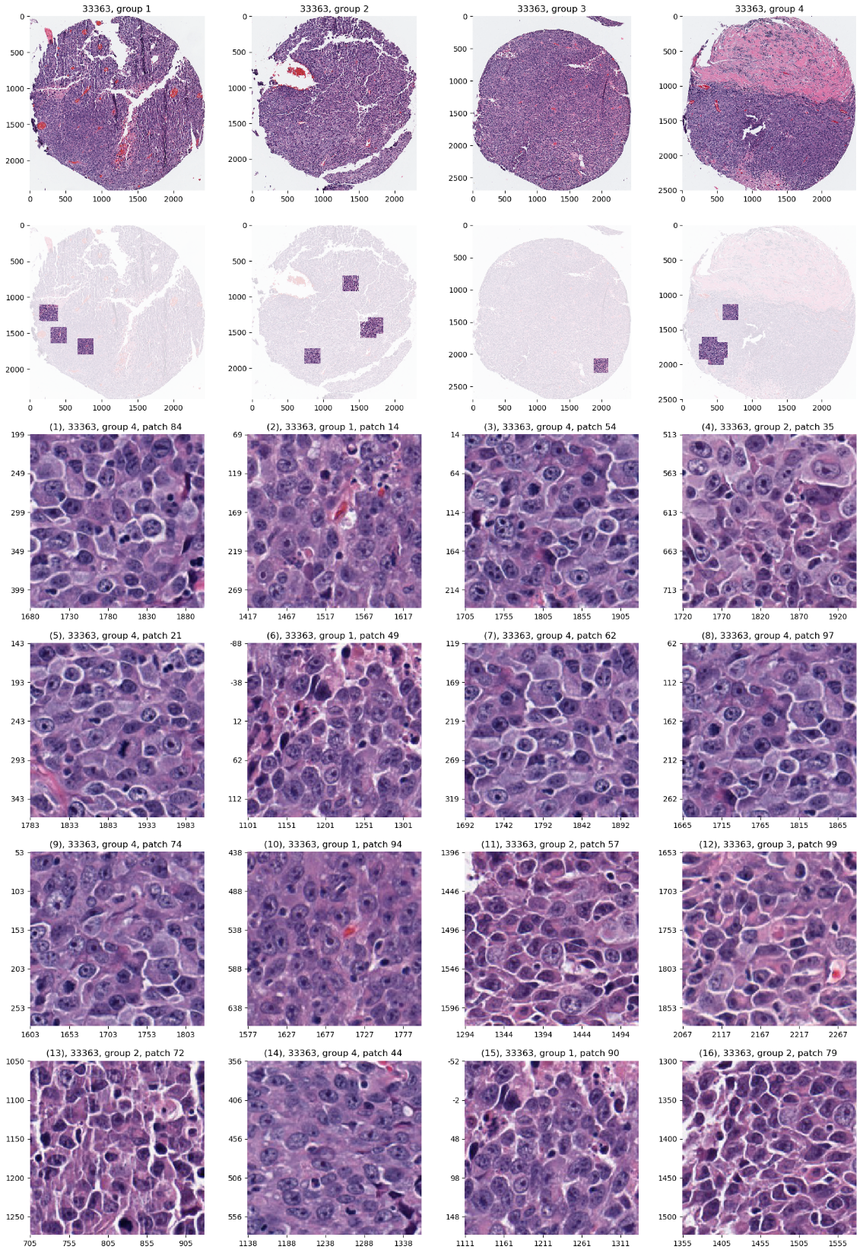
AJIVE Analysis of Cancer Data
JIVE: Common Normalized Scores 1
Look at Extremes
Positive End
Top Person
Top 16 Patches
Highly “Cellular”
Markedly Atypical Cells

Slide 15
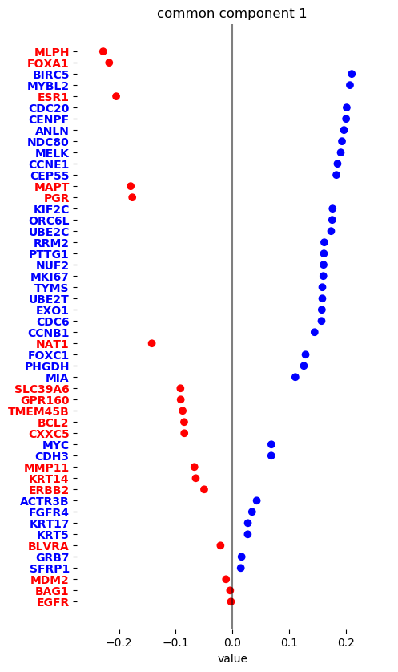
AJIVE Analysis of Cancer Data
JIVE: Gene Expression
Common Normalized
Loadings 1
Very Consistent w/ Image
“High Proliferation” Genes
“Low Prolif.” – Lum A Genes

Slide 16
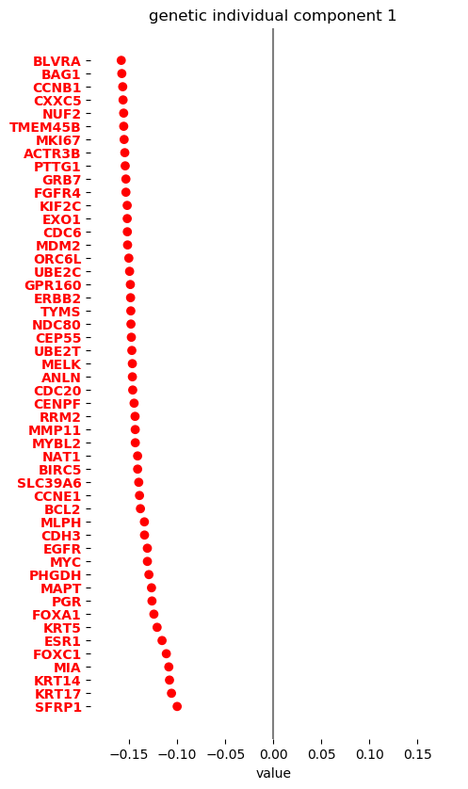
AJIVE Analysis of Cancer Data
JIVE, Genes, Individual 1
Overall Up & Down
Together
Not Subtype Related!

Slide 17
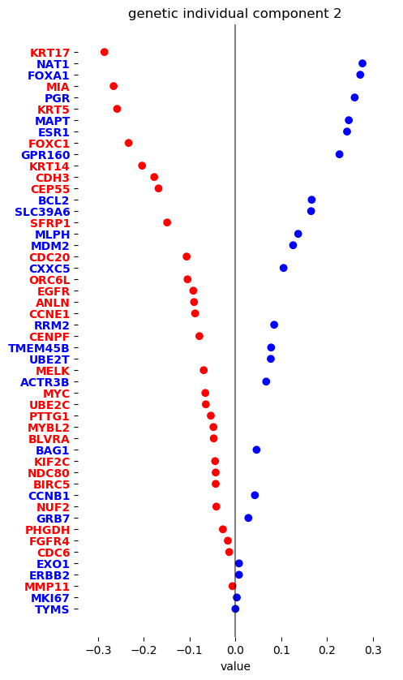
AJIVE Analysis of Cancer Data
JIVE, Genes, Individual 2
Luminal vs. Basal
“Contrast”?
“Unbalanced Types”?

Slide 18
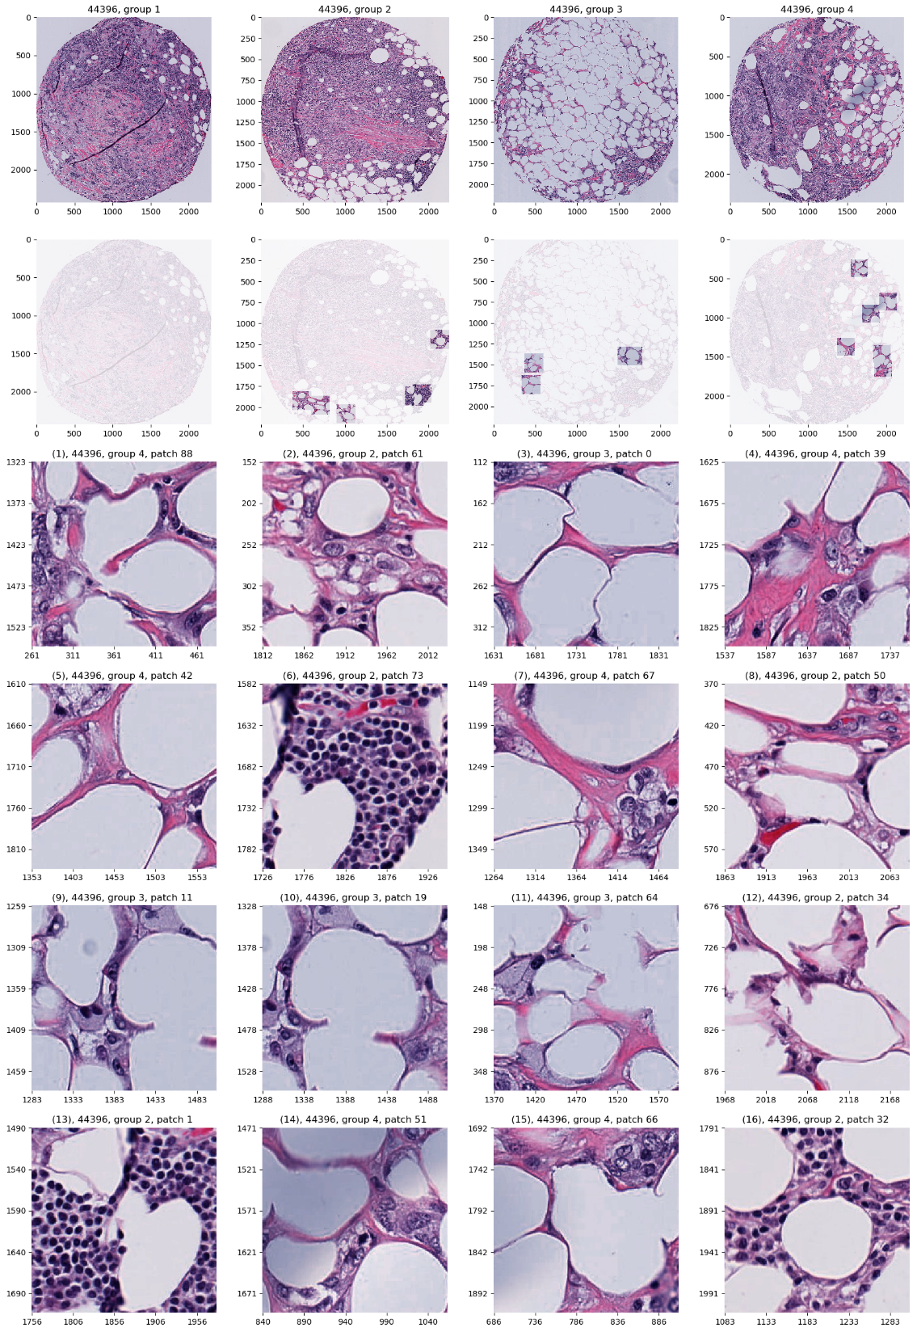
AJIVE Analysis of Cancer Data
JIVE, Images, Individual 1
Negative
Mostly Fat Cells
Few Nuclei

Slide 19
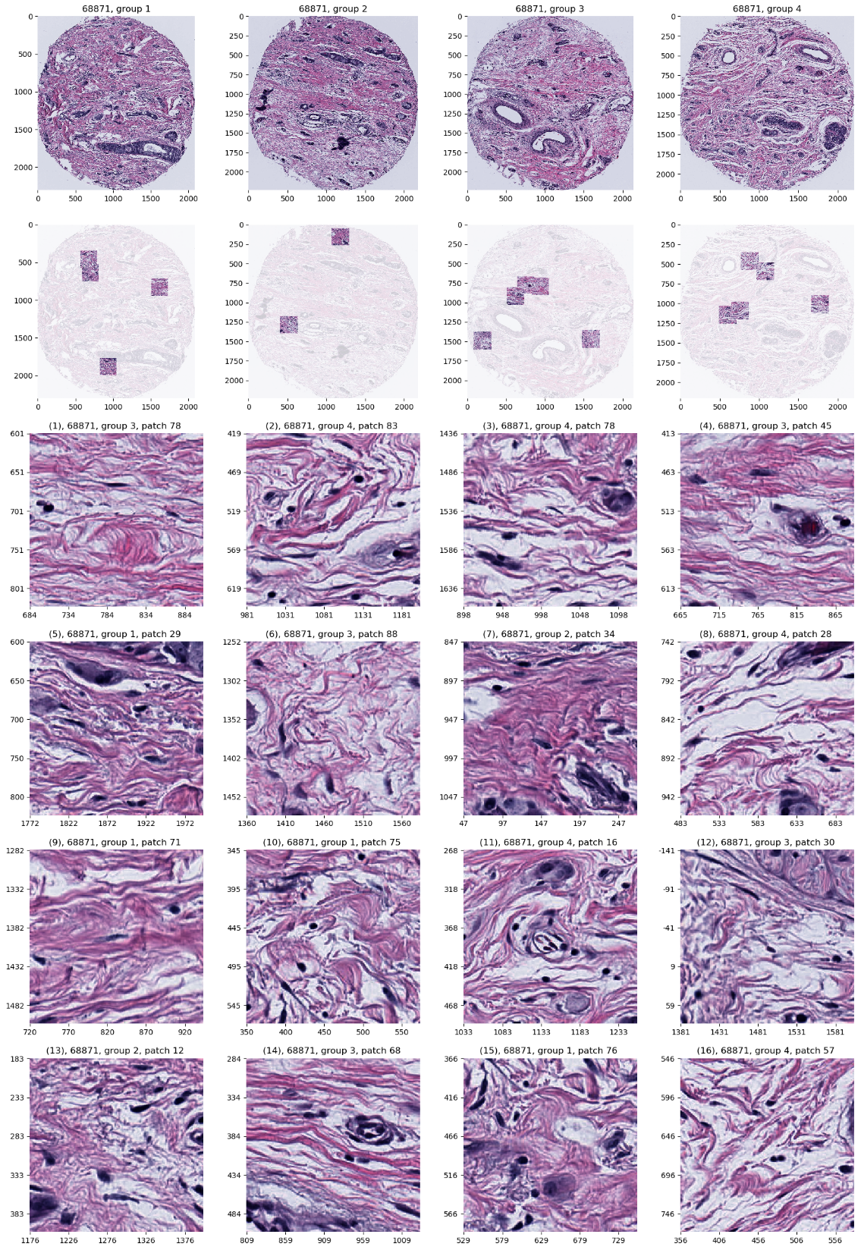
AJIVE Analysis of Cancer Data
JIVE, Images, Individual 1
Positive
Reactive Stroma,
Few Nuclei
Little Gene Connected

Slide 20
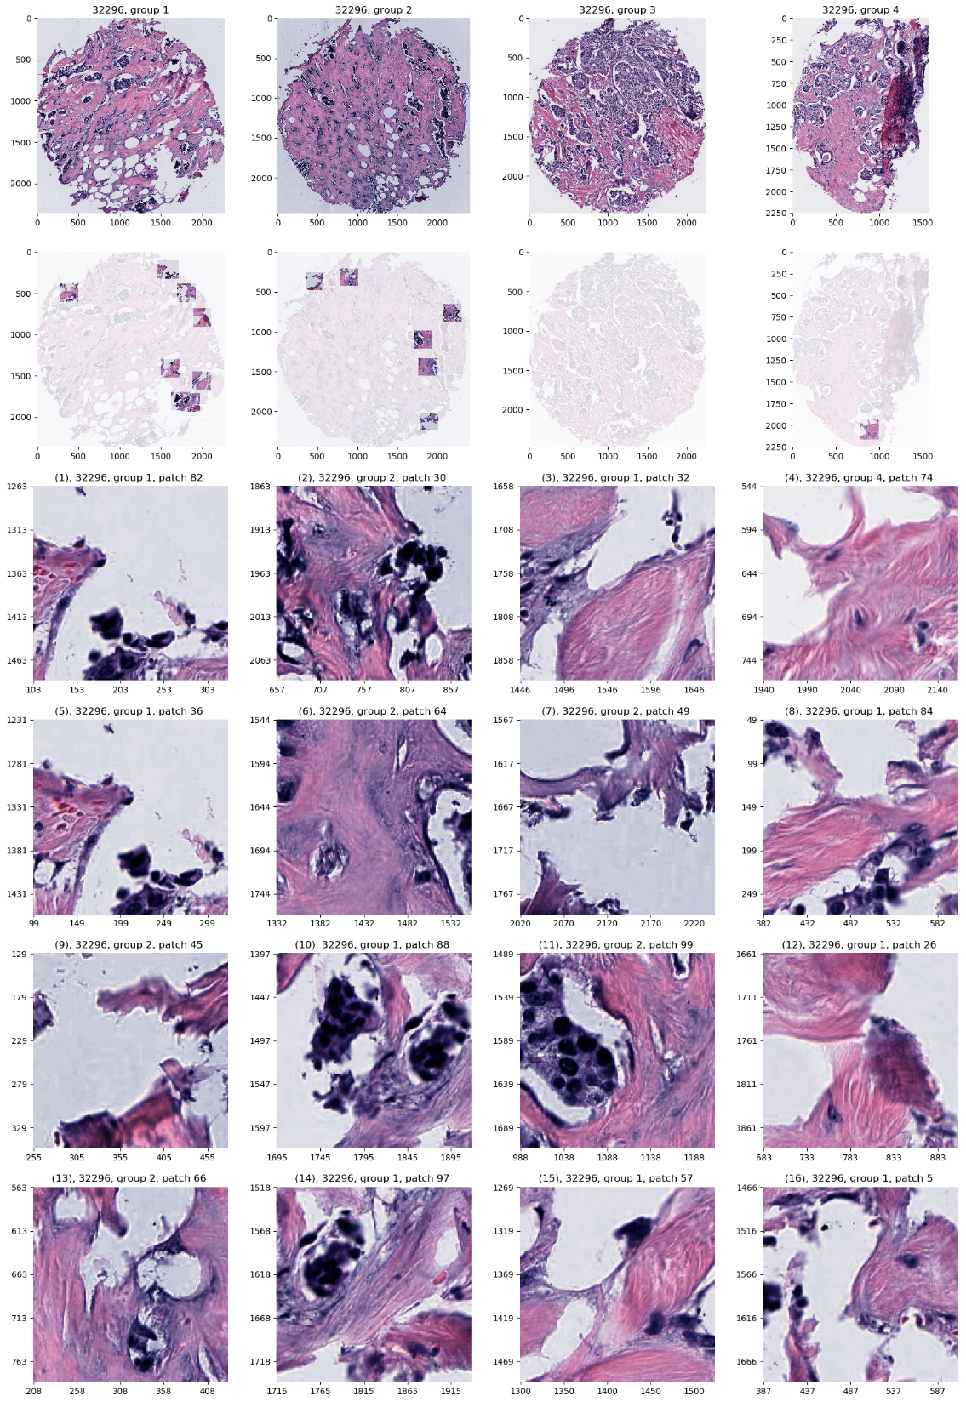
AJIVE Analysis of Cancer Data
JIVE, Images, Individual 2
Negative
Mucinous & Micro-
Papillary Carcinoma
Not PAM50 Related

Slide 21
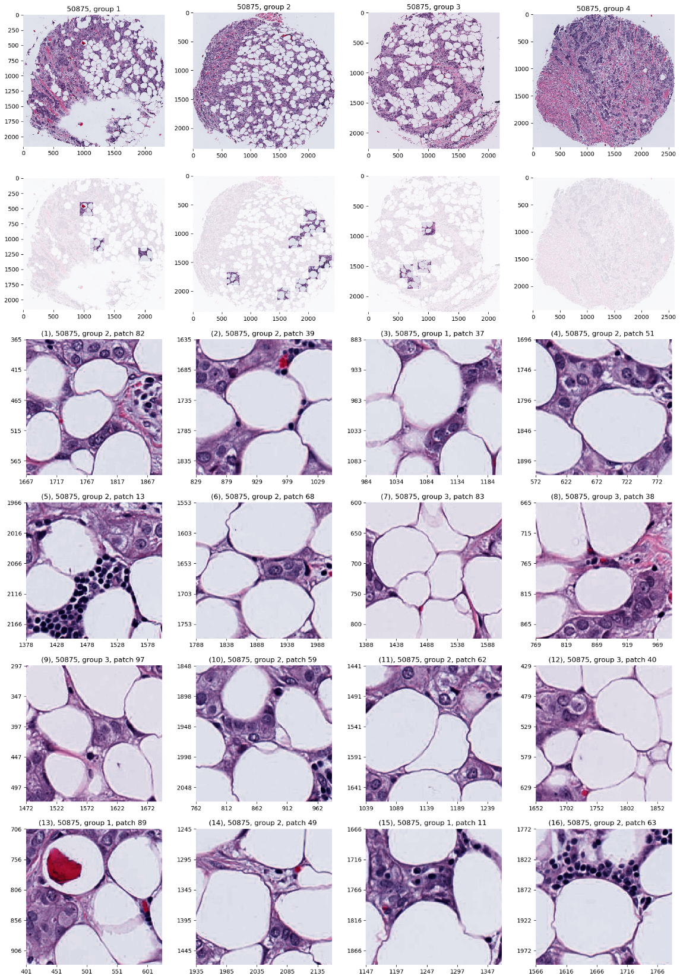
AJIVE Analysis of Cancer Data
JIVE, Images, Individual 2
Positive
Fat Cells
Common Endpoint?
“Center”?

Slide 22
AJIVE Analysis of Cancer Data
Carolina Breast Cancer Study (CBCS)
Better Analysis (Centering and More):
Carmichael, et al. (2021)

Slide 23
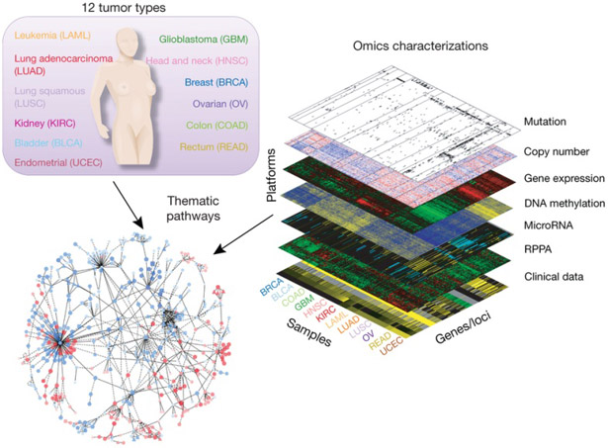
Cancer Genomics by AJIVE
Recall:
The Cancer
Genome Atlas
Subset Here:
Breast Cancer
Figure : The Cancer Genome Atlas Research Network, Weinstein, J.N., Collisson, E.A., Mills, G.B., Shaw, K.M., Ozenberger, B.A., Ellrott, K., Shmulevich, I., Sander, C., and Stuart, J.M. (2013)
The Cancer Genome Atlas Pan-Cancer analysis project.

Slide 24
Cancer Genomics by AJIVE
TCGA Breast Cancer Data:
Data Blocks ($∩$s & Carefully Cleaned)
mRNA (GE): 16615×616
Copy Number (CN): 24174×616
Rev. Phase Protein Array (RPPA): 187×616
Gene mutation (Mutation): 18256×616
Tumor Subtypes
Basal-like: ⊲
HER2-like: ∗
Luminal A: +
Luminal B: ×
Once Again
Wildly different
$d_{b}$ -s as
in Toy Example

Slide 25
Cancer Genomics by AJIVE
Separate PCA on Gene Expression (GE)
Clear
Subtype
Effects
(Not
Surprising)

Slide 26
Cancer Genomics by AJIVE
Separate PCA on Gene Expression (GE)
PC1 Flags
Basals
PC2 Flags
LumAs

Slide 27
Cancer Genomics by AJIVE
Separate PCA on Copy Number (CN)
Other
Effects
+Subtypes

Slide 28
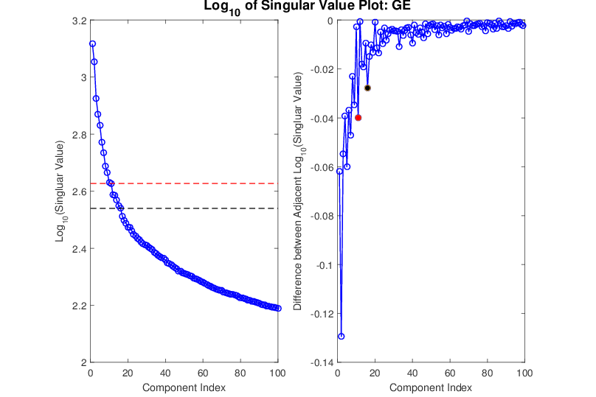
Cancer Genomics by AJIVE
Gene Expression (GE) 1st SVD Threshold
Suggested Ranks： 11 / 16
Log(Consecutive Differences)

Slide 29
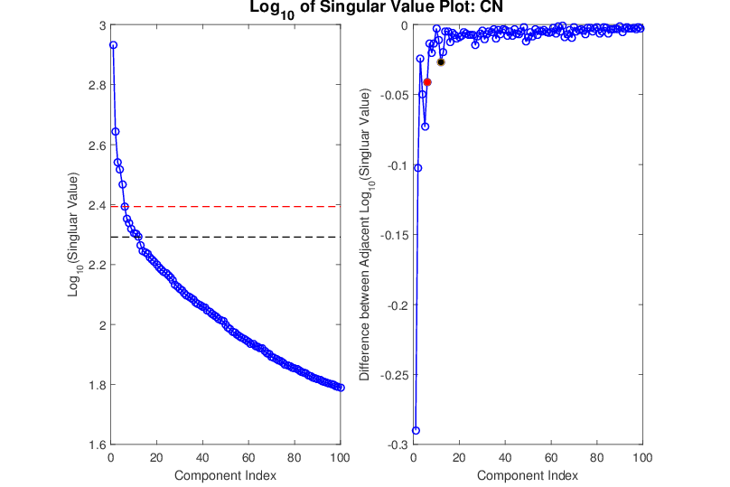
Cancer Genomics by AJIVE
Copy Number (CN) 1st SVD Threshold
Suggested Ranks： 6 / 12

Slide 30
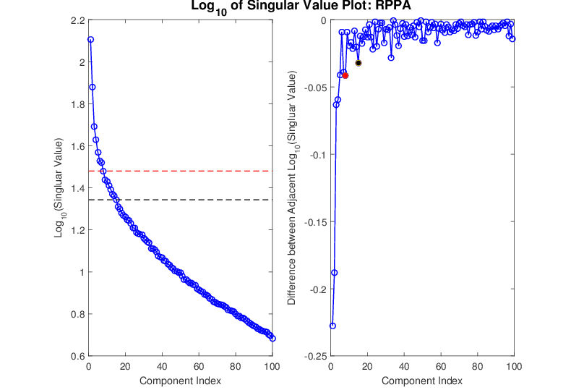
Cancer Genomics by AJIVE
Proteins (RPPA) 1st SVD Threshold
Suggested Ranks： 8 / 15

Slide 31
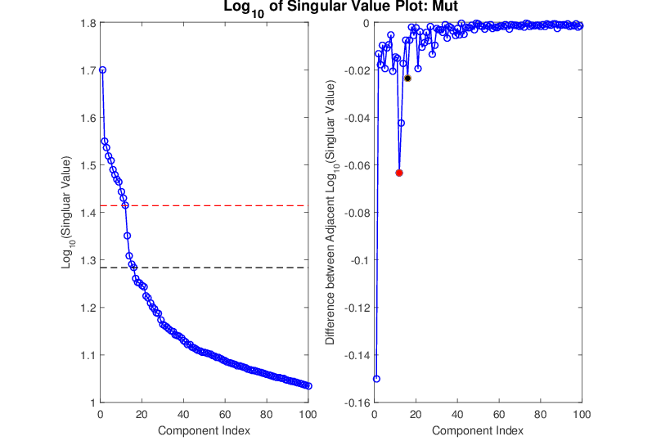
Cancer Genomics by AJIVE
Mutations (Mut) 1st SVD Threshold
Suggested Ranks： 12 / 16

Slide 32
Cancer Genomics by AJIVE
4-way Joint Threshold
After Step 3:
Only 1 Remaining Joint Component
(2nd Strong in all but Mut.)
(Fits w/ Biologist’s Impression of Mut. Data)

Slide 33
Cancer Genomics by AJIVE
4-way Joint Scores (CNS)
Flags LumAs
Effect Driven
By All 4
Factors
Together
Interesting Point: Mutation Plays Role Here

Slide 34
Cancer Genomics by AJIVE
Next Issue: 3-way JIVE for GE-CN-RPPA
Approach: Use 3 Indiv. Blocks from above,
GE, CN, RPPA as inputs
Perform JIVE, Study Joint PC1

Slide 35
Cancer Genomics by AJIVE
Joint JIVE PC1 for GE-CN-RPPA (CNS)
Great Separation
of Basals
Some Separation
of Her2s
LumAs & LumBs
Combined
All More Distinct
Than Raw Data

Slide 36
Cancer Genomics by AJIVE
Now Focus on Pair-Wise Comparisons:
JIVE on GE – CN only
Hypothesis Test of Basals vs. Others
(DiProPerm Z-scores Allow Quantitation)

Slide 37
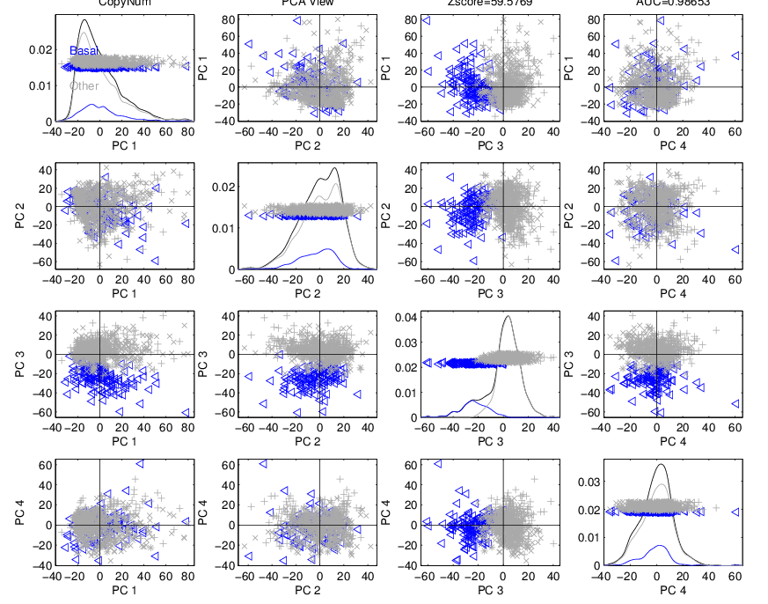
Cancer Genomics by AJIVE
JIVE on GE – CN, Test of Basals vs. Others
(SEPARATE!)
CN - PCA
View
Group
Coloring

Slide 38
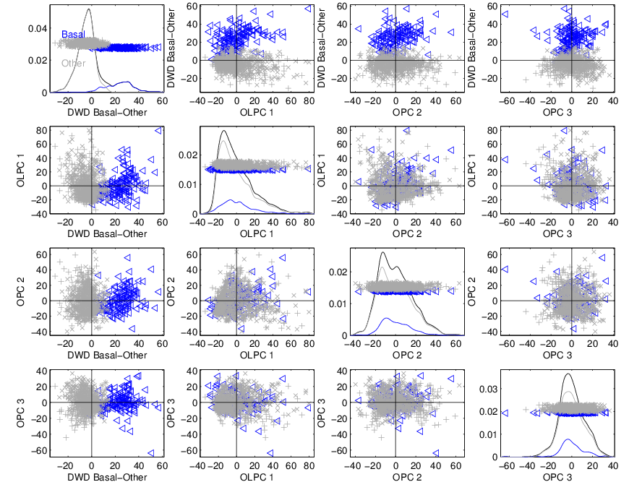
Cancer Genomics by AJIVE
JIVE on GE – CN, Test of Basals vs. Others
Better
Separation
From DWD
& Ortho PC
Directions
How Separated???

Slide 39
Cancer Genomics by AJIVE
JIVE on GE – CN, Test of Basals vs. Others
DiProPerm Hypothesis Test
Stat. Sig. ~ Z-score

Slide 40
Cancer Genomics by AJIVE
JIVE on GE – CN, Test of Basals vs. Others
Summarize Z-scores
Separate PCA:
GE >> CN
(Not
Surprising)

Slide 41
Cancer Genomics by AJIVE
JIVE on GE – CN, Test of Basals vs. Others
Summarize Z-scores
Joint JIVE
>> Separate
JIVE Data
Combo Helps!

Slide 42
Cancer Genomics by AJIVE
JIVE on GE – CN, Test of Basals vs. Others
Summarize Z-scores
GE has info
Not in CN
But not CN

Slide 43
Early Single Cell RNAseq
Powerful Expression Technology
RNAseq for Separate Cells
Original Data: Grun et al (2014)
Challenge: Random RNA Amplification
Control: Spike In Measurements
scPLS Approach: Chen and Zhou (2016)

Slide 44
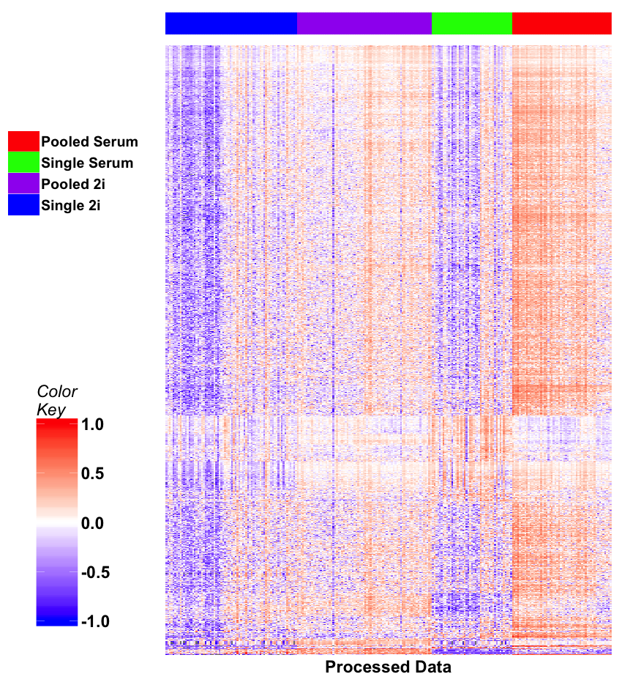
Early Single Cell RNAseq
Input Data
Clear Artifacts
Desired Groups

Slide 45
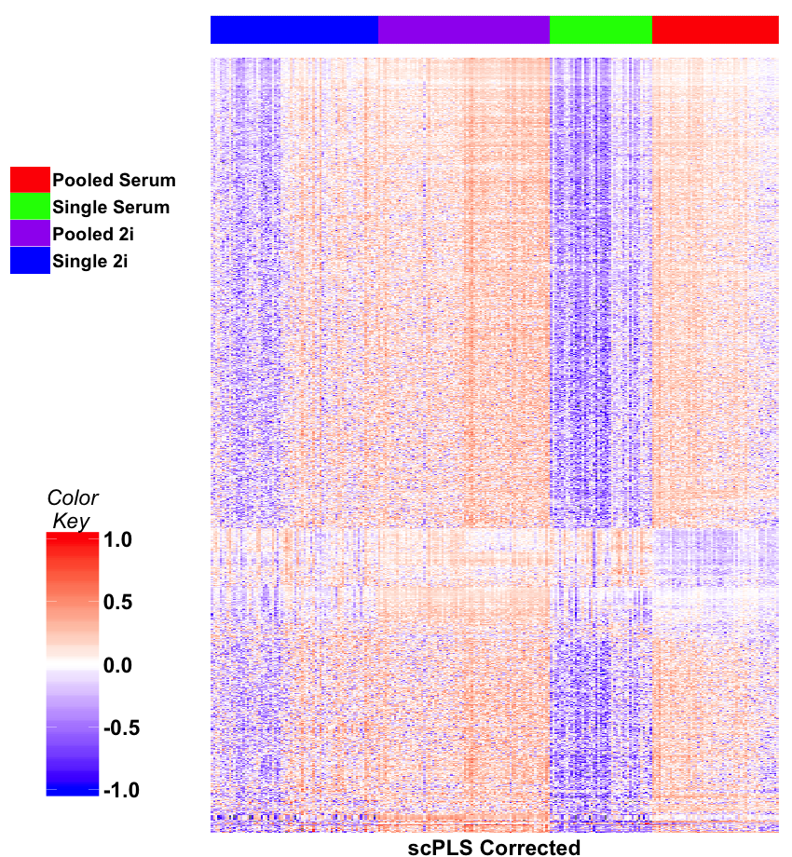
Early Single Cell RNAseq
scPLS
Some
Improvement
Desired Groups

Slide 46
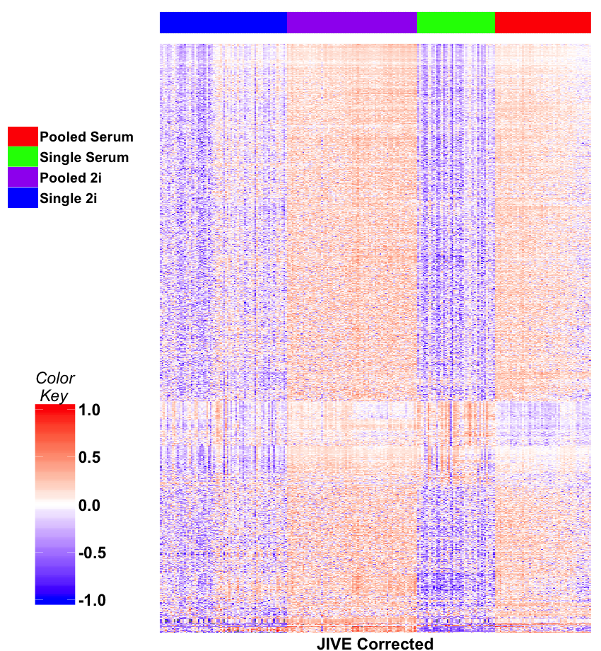
Early Single Cell RNAseq
JIVE Individual
Much Better
Desired Groups

Slide 47
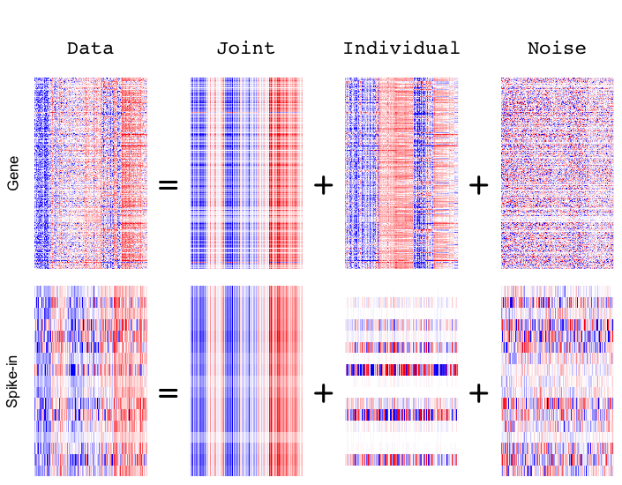
Early Single Cell RNAseq
Detail
View
of
JIVE
Analysis
Final Result
Ignore as Nuisance Variation

Slide 48
DIVAS
Data Integration Via Analysis of Subspaces (DIVAS)
With Hannig, Prothero, Jiang, Quoc

Slide 49
DIVAS
Improvements Over AJIVE:
3 Block JIVE Analysis
≈ +

Slide 50
DIVAS
Improvements Over AJIVE:
Partially Shared Blocks in DIVAS Analysis
≈ + + + +

Slide 51
DIVAS
Improvements Over AJIVE:
Partially Shared Blocks
Improved Initial Rank Choice
Inference Via Random Direction Bounds
Iterative Search Algorithm
Give Better and More Precise Inference

Slide 52
DIVAS
Mathematical Set Up:
Blocks $X_{b}=A_{b}+E_{b}∈ℝ^{d_{b}×n}$, $b=1,⋯,B$
Where:
$A_{b}$ Is Low Rank
$E_{b}$ Entries i.i.d. mean $0$, var $σ^{2}$, 4th Mom.
$A_{b}$ & $E_{b}$ “relatively isotropous”
Invariant with
Respect to
Direction
(Weaker than Gaussian)

Slide 53
DIVAS
Improved (over AJIVE) Initial Rank Choice
Conventional Scree Plot
(square root scale)
Underlying
Low Rank
Signal, $A_{b}$
Signal plus Gaussian
Noise, $d=1000$
$N\left(0,1\right)$ Noise
Impossible
To Recover

Slide 54
DIVAS
Improved (over AJIVE) Initial Rank Choice
Does Not Look Additive,
Since on Singular Value
(Not Energy) Scale
Conventional Scree Plot
(square root scale)
Signal plus Gaussian
Noise, $d=1000$
Bigger than $σ=1$, Since First $100$ In Sort

Slide 55
DIVAS
Improved (over AJIVE) Initial Rank Choice
Estimate Singular Values of Signal $A_{b}$
Appropriately
Shrinks Big Ones
Shabalin
Nobel (2013)
Shrinkage
Zeroes Out
Small Values
${\hat{σ}}^{2}$ Based on Median
Of Marcenko-Pasteur
Will Cover Soon

Slide 56
DIVAS
Shabalin Nobel Shrinkage (For Denoising)
Optimized
For
Marcenko
Pasteur
Optimal
Cutoff
Gives
Initial
Rank,
${\hat{r}}_{b}$

Slide 57
DIVAS
Inference I: Random Direction Bound
For Random Direction $u^{∗}∈ℝ^{n}$,
And ${\hat{r}}_{b}$-dim’al Random Subspace $S^{∗}⊆ℝ^{n}.$
5th %-tile of dist’n of:
$$Angle\left(u^{∗},S^{∗}\right)=\min_{v∈S^{∗}}Angle\left(u^{∗},v\right)$$
Idea: Smaller Angles “Have Signal”,
Larger Angles Could Be “Pure Noise”

Slide 58
DIVAS
Inference II: Bootstrap Principal Angles
Goal: Relationship Between Subspaces
Signal $row\left(A_{b}\right)$ & Estimated $row\left({\tilde{A}}_{b}\right)$
Useful Summary:
Principal Angle Analysis
Bootstrap Unknown $A_{k}$

Slide 59
DIVAS
Inference II: Bootstrap Principal Angles
Based on rank ${\hat{r}}_{b}$ SVD: $X_{b}=UDV^{t}$
And Shabalin-Nobel Shrunken s.v.s $D_{s}$
Estimate Residual Matrix, ${\hat{E}}_{b}=X_{b}−UD_{s}V^{t}$
Simulate Bootstrap Signal: $A_{b}^{∗}=U^{∗}D_{s}V^{∗t}$
Where $U^{∗}$, $V^{∗}$ are ${\hat{r}}_{b}$ bases of $ℝ^{d}$, $ℝ^{n}$ (resp.)
Think Random Rotations

Slide 60
DIVAS
Inference II: Bootstrap Principal Angles
PAA measures of Subspace Approximations
Real World: $row\left(A_{b}\right)$ Est’d by $row\left({\tilde{A}}_{b}\right)$
Bootstrap World: $row\left(A_{b}^{∗}\right)$ Est’d by$row\left({\tilde{A}}_{b}^{∗}\right)$
“Relative Isotropy” Makes This Work
≈

Slide 61
DIVAS
Inference II: Bootstrap Principal Angles
Generate Bootstrap Data: $X_{b}^{∗}=A_{b}^{∗}+{\hat{E}}_{b}$
Get Bootstrap Estimates: ${\tilde{V}}_{b}^{∗}$
For $l=1,⋯,{\hat{r}}_{b}$,
Study Largest Principal Angles
Between 1st $l$ Cols of $V_{b}^{∗}$ and ${\tilde{V}}_{b}^{∗}$

Slide 62
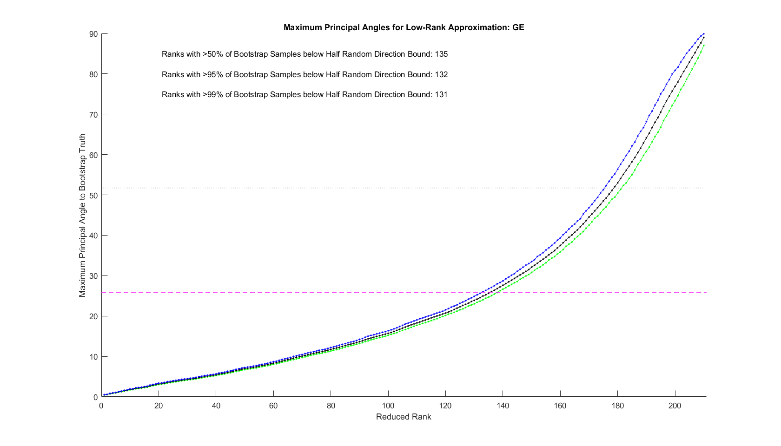
DIVAS
Initial Rank Selection (Bootstrap Inference):
Random Direction Bound
Scaled by $β=\frac{1}{2}$
$β$ gives comparable
control for $b=1,⋯,B$
Determines ${\tilde{r}}_{b}$
Gene Exp. Block, $d=16,615$

Slide 63
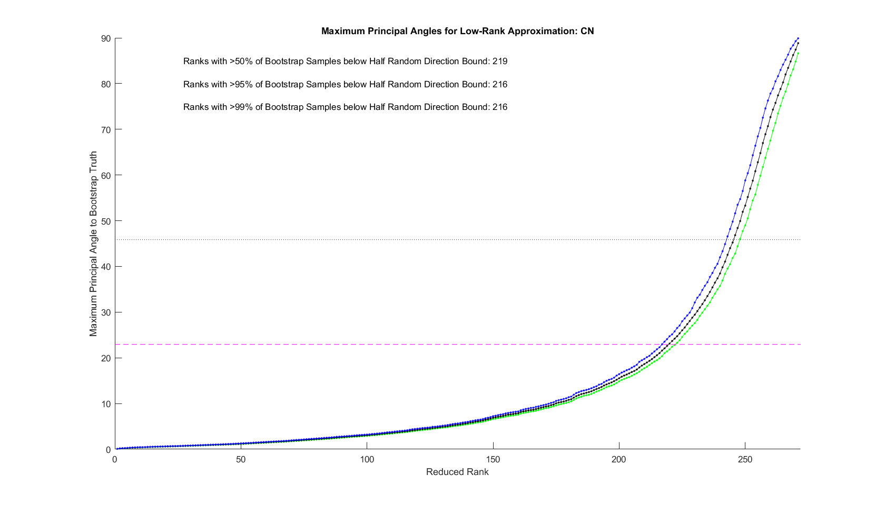
DIVAS
Initial Rank Selection (Bootstrap Inference):
Copy Num. Block, $d=24,174$

Slide 64
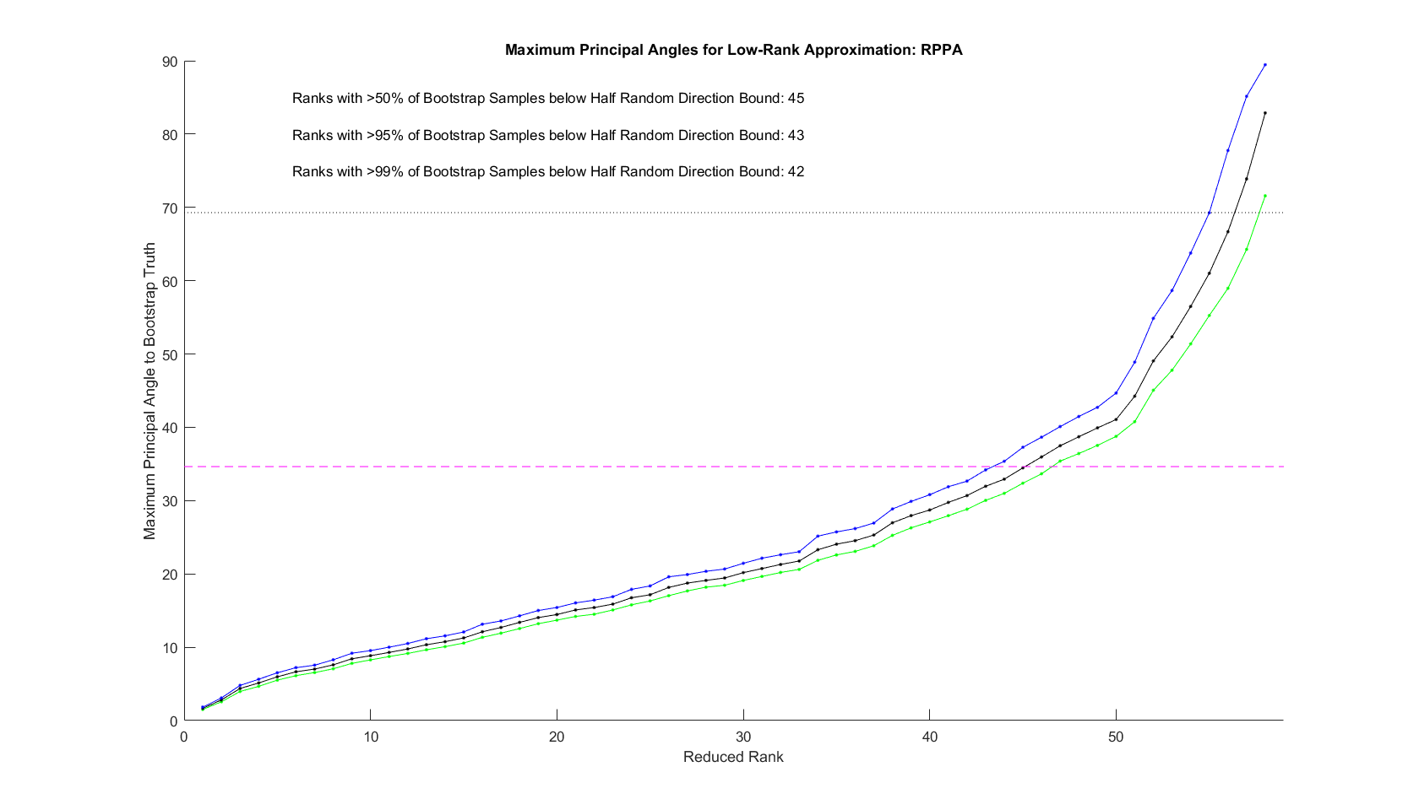
DIVAS
Initial Rank Selection (Bootstrap Inference):
Proteins Block, $d=187$

Slide 65
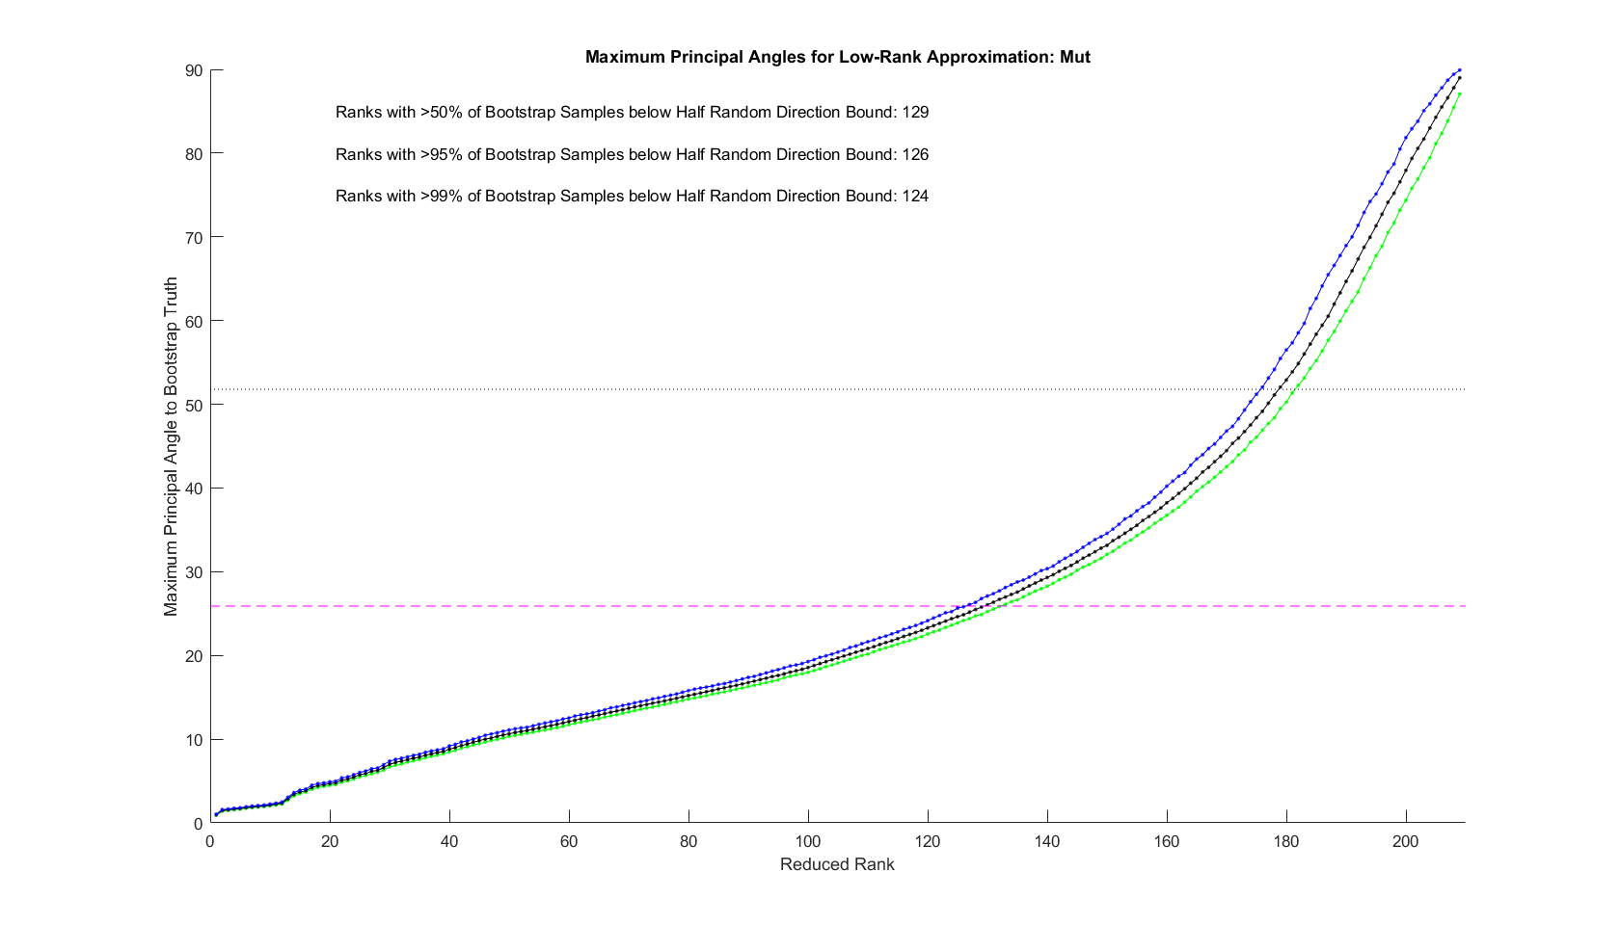
DIVAS
Initial Rank Selection (Bootstrap Inference):
Mutation Block, $d=18,256$

Slide 66
DIVAS
Iteratively Find Orthogonal Directions $v∈ℝ^{n}$
To Minimize Angles to $V_{b}$, $b=1,⋯.B$
Until One > Random Direction Bound
Then Work With Subsets of Blocks,
Indexed by $I⊆2^{B}$
Finally Remainders are Individual Directions

Slide 67
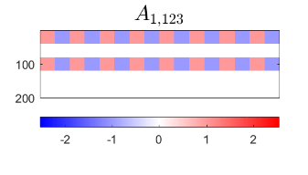
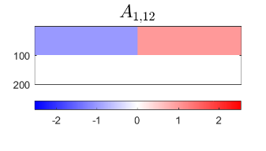
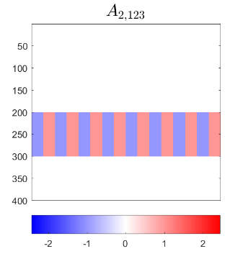
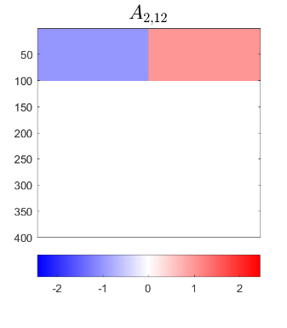
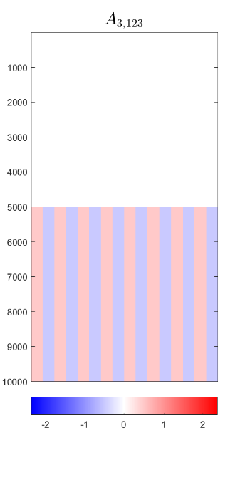
DIVAS – 3 Block Toy Example
1-2 Joint Comp, Rank 1
1-2 Scores
Orthogonal to
1-2-3 Scores
1-2-3 Joint Component, Rank 1

Slide 68
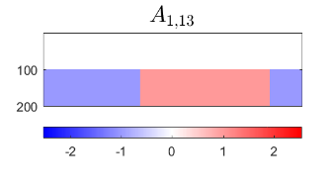
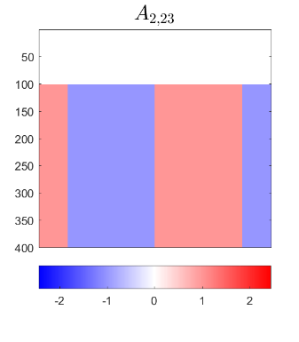
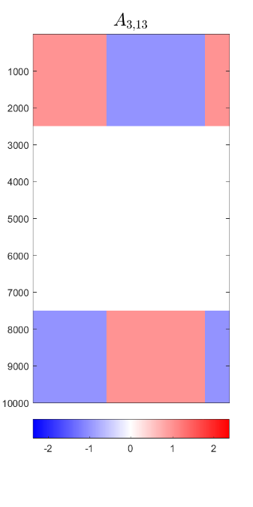
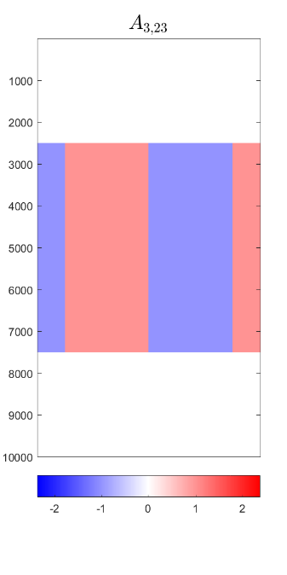
DIVAS – 3 Block Toy Example
1-3 Comps.
2-3 Comps.
Both $⊥$ to Joint
And All three ${60}^{°}$ Apart

Slide 69
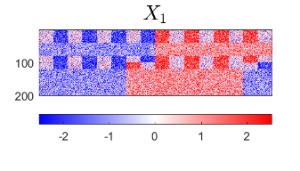
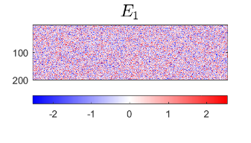
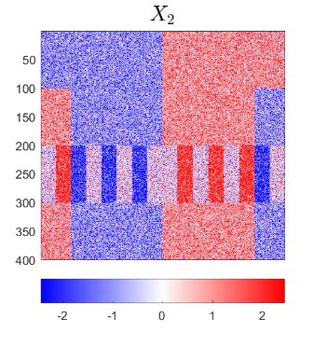
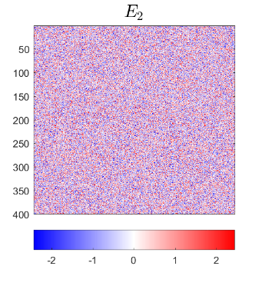
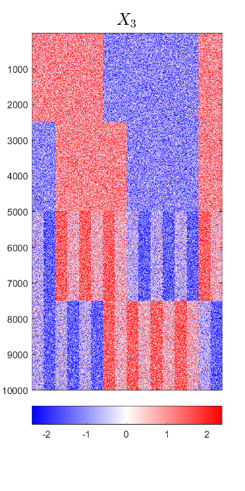
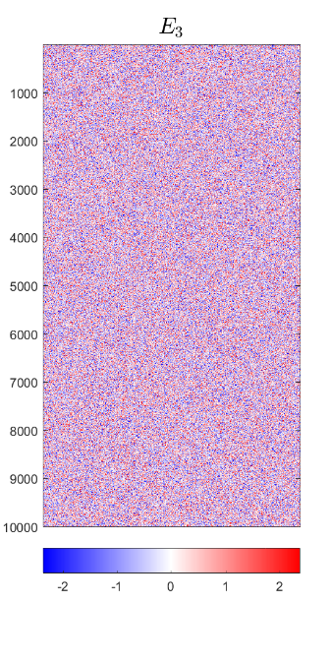
DIVAS – 3 Block Toy Example
Input to DIVAS: Sum of ALL
IID Gaussian Noise

Slide 70
DIVAS – 3 Block Toy Example
$$X_{1}$$
$$A_{1}$$
$$E_{1}$$
$$X_{2}$$
$$A_{2}$$
$$E_{2}$$
$$X_{3}$$
$$A_{3}$$
$$E_{3}$$

Slide 71
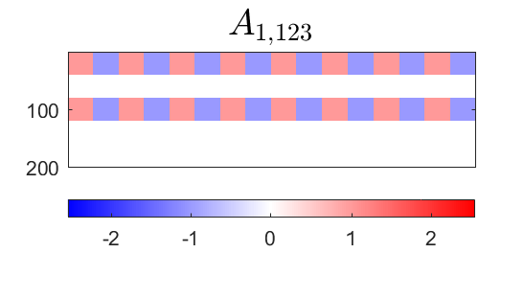
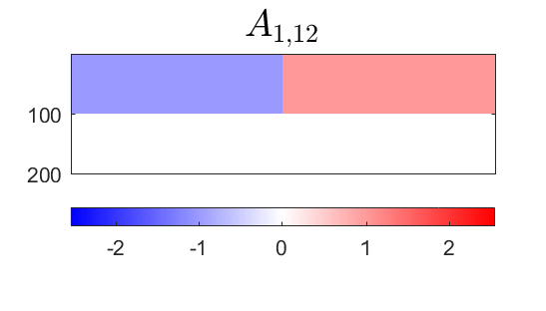
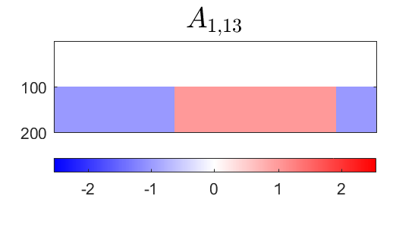
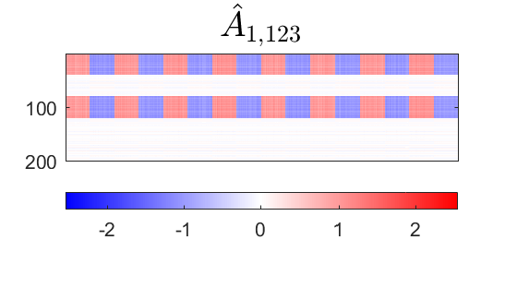
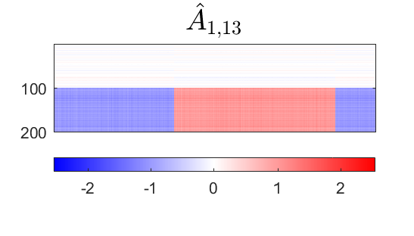
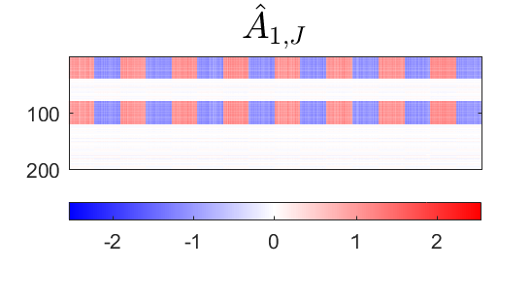
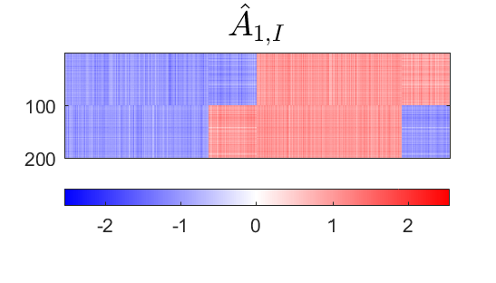
DIVAS – 3 Block Toy Example
Deeper Look at Estimation of 1st Block, i.e. $A_{1}$
Target
DIVAS
AJIVE
Large Angles $≈$ Worse Estimation
2.76°
5.01°
1.71°
4.23°
7.89°
7.14°

Slide 72
DIVAS – 3 Block Toy Example
Deeper Look at Estimation of 2nd Block
Target
DIVAS
AJIVE
DIVAS
Again
Gives
Better
Estimation
2.76°
5.00°
2.11°
4.23°
5.79°
3.76°

Slide 73
DIVAS – 3 Block Toy Example
Deeper 3rd Block - Target

Slide 74
DIVAS – 3 Block Toy Example
Deeper 3rd Block - DIVAS
2.76°
1.71°
2.11°

Slide 75
DIVAS – 3 Block Toy Example
Deeper 3rd Block - AJIVE
4.23°
1.43°
2.47°

Slide 76
Participant Presentations
12:00 Ben Brown:
Binary Expansion Testing
12:05 Adrian Allen:
A Tree-based Method for Parcellating the Brain Based on Its Structural and Functional Connectivity
12:10 Izzy Wiesenthal:
Eliminating Acoustic Feedback in Hearing Aids
Next Class: Jeff Ayers, Hank Flury

