Slide 1
Statistics – O. R. 881
Object Oriented Data Analysis
Start
Recording
Steve Marron
Dept. of Statistics and Operations Research
University of North Carolina

Slide 2
Current Sections in Textbook
Today:
Section 17.2, 14.2
Next Class:
Sections 14.2, 14.1

Slide 3
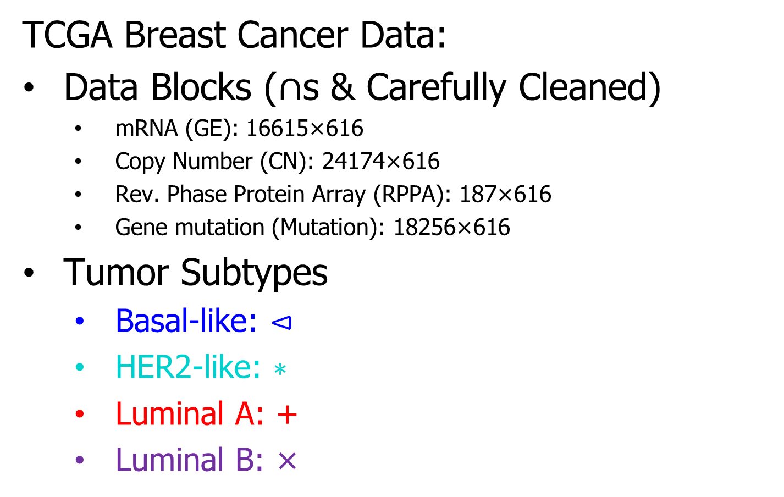
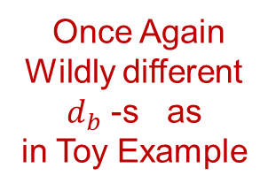
Cancer Genomics by AJIVE
TCGA Breast Cancer Data:
Data Blocks ($∩$s & Carefully Cleaned)
  mRNA (GE): 16615×616
  Copy Number (CN): 24174×616
  Rev. Phase Protein Array (RPPA): 187×616
  Gene mutation (Mutation): 18256×616
Tumor Subtypes
  Basal-like: ⊲
  HER2-like: ∗
  Luminal A: +
  Luminal B: ×
Once Again
Wildly different
$d_{b}$ -s as
in Toy Example

Slide 4
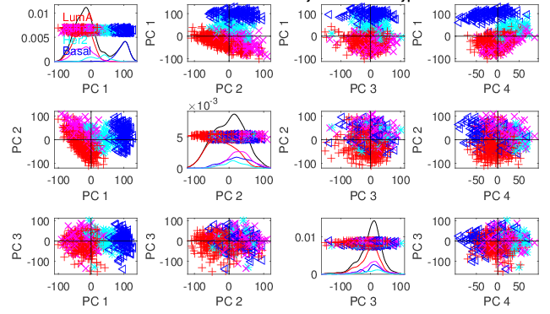
Cancer Genomics by AJIVE
Separate PCA on Gene Expression (GE)
PC1 Flags
Basals
PC2 Flags
LumAs

Slide 5
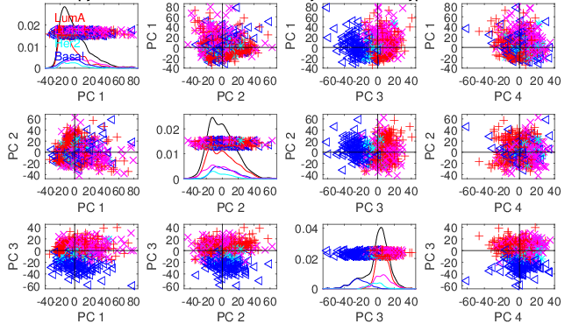
Cancer Genomics by AJIVE
Separate PCA on Copy Number (CN)
Other
Effects
+Subtypes

Slide 6
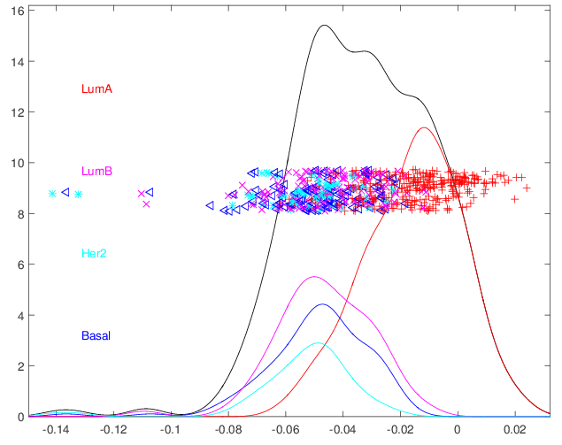
Cancer Genomics by AJIVE
4-way Joint Scores (CNS)
Flags LumAs
Effect Driven
By All 4
Factors
Together
Interesting Point: Mutation Plays Role Here

Slide 7
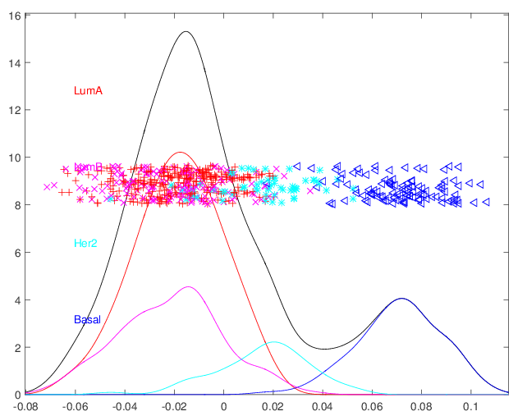
Cancer Genomics by AJIVE
Joint JIVE PC1 for GE-CN-RPPA (CNS)
Great Separation
of Basals
Some Separation
of Her2s
LumAs & LumBs
Combined
All More Distinct
Than Raw Data

Slide 8
Cancer Genomics by AJIVE
JIVE on GE – CN, Test of Basals vs. Others
Summarize Z-scores
Joint JIVE
>> Separate
JIVE Data
Combo Helps!

Slide 9
Cancer Genomics by AJIVE
JIVE on GE – CN, Test of Basals vs. Others
Summarize Z-scores
GE has info
Not in CN
But not CN

Slide 10
DIVAS
Improvements Over AJIVE:
3 Block JIVE Analysis
≈ +

Slide 11
DIVAS
Improvements Over AJIVE:
Partially Shared Blocks in DIVAS Analysis
≈ + + + +

Slide 12
DIVAS
Improvements Over AJIVE:
Partially Shared Blocks
Improved Initial Rank Choice
Inference Via Random Direction Bounds
Iterative Search Algorithm
Give Better and More Precise Inference

Slide 13
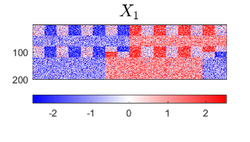
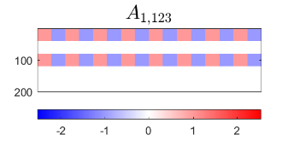
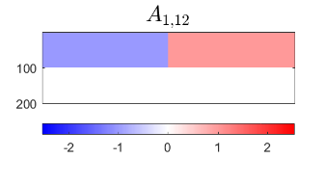
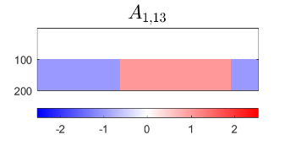
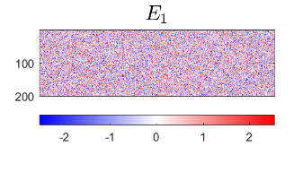
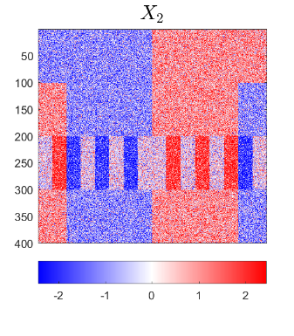
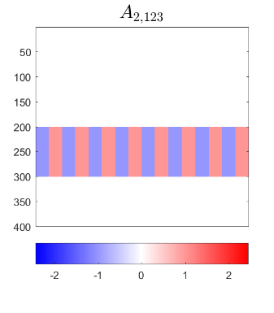
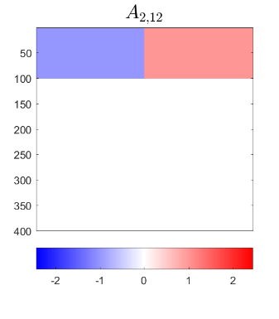
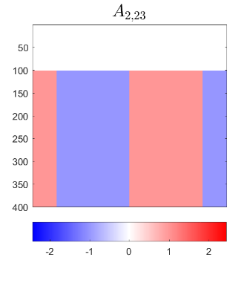
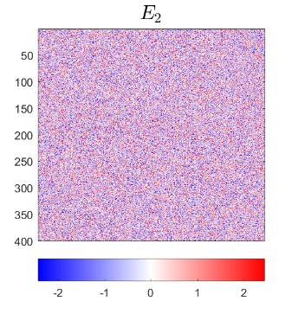
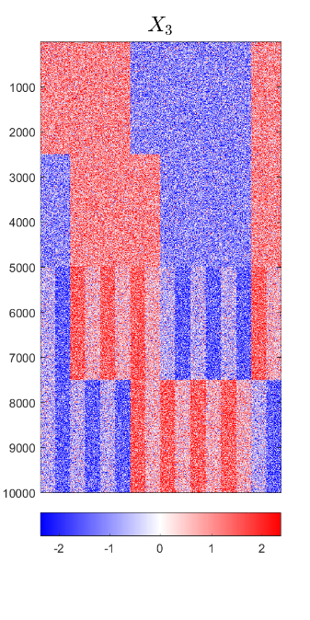
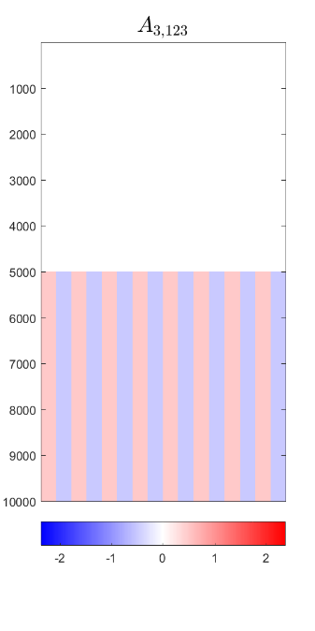
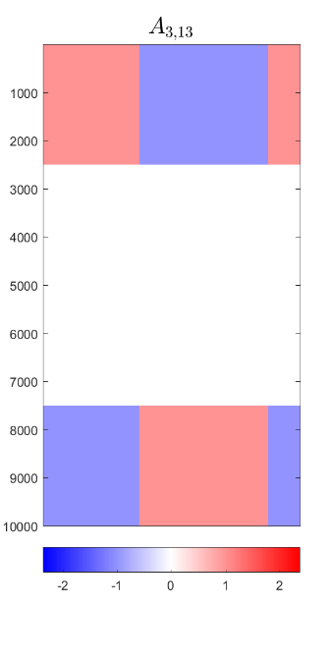
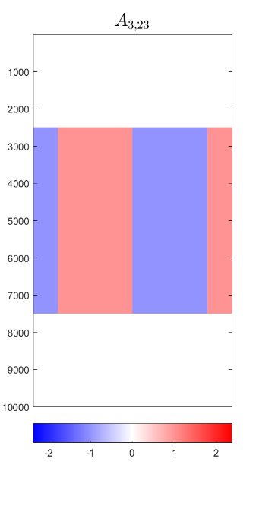
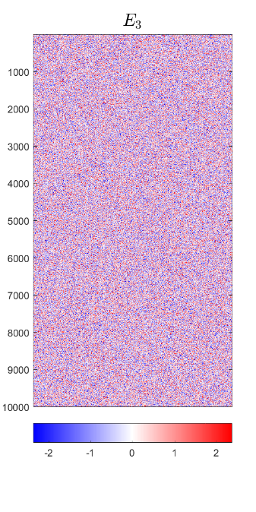
DIVAS – 3 Block Toy Example
Input to DIVAS: Sum of ALL
IID Gaussian Noise

Slide 14
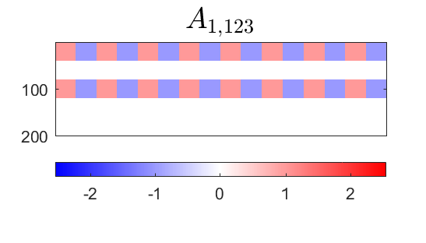
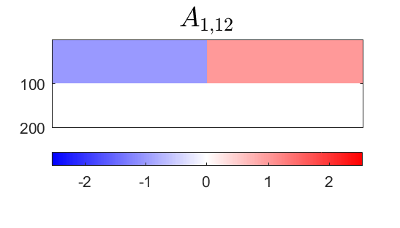
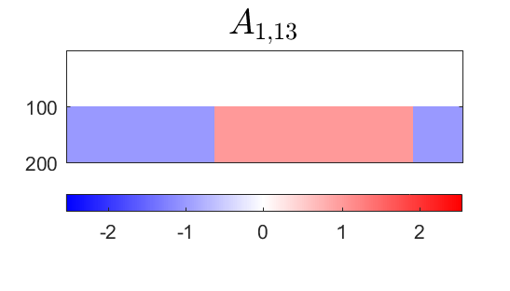
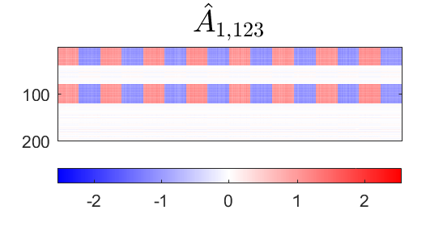

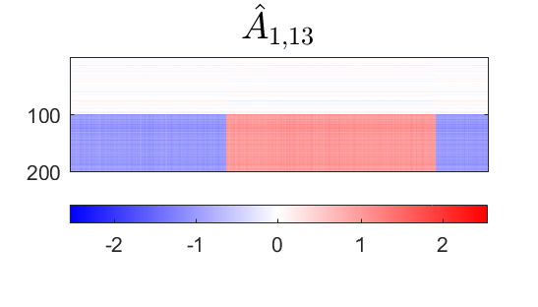
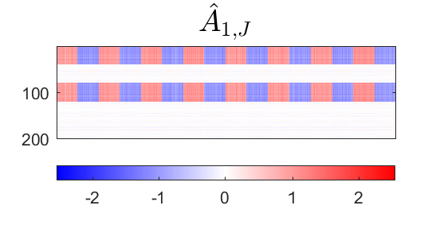
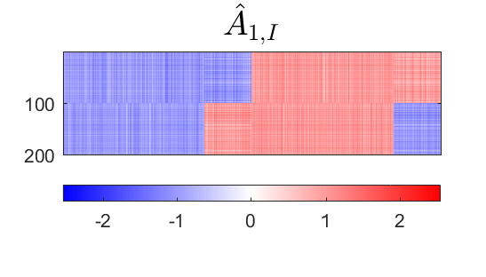


DIVAS – 3 Block Toy Example
Deeper Look at Estimation of 1st Block, i.e. $A_{1}$
Target
DIVAS
AJIVE
Large Angles $≈$ Worse Estimation
2.76°
5.01°
1.71°
4.23°
7.89°
7.14°

Slide 15
DIVAS on TCGA Data
Breast Cancer
Gene Expression (GE) [16615 x 616]
Copy Number (CN) [24174 x 616]
Protein Exp. (RPPA) [187 x 616]
Mutation Status (MU) [18256 x 616]

Slide 16
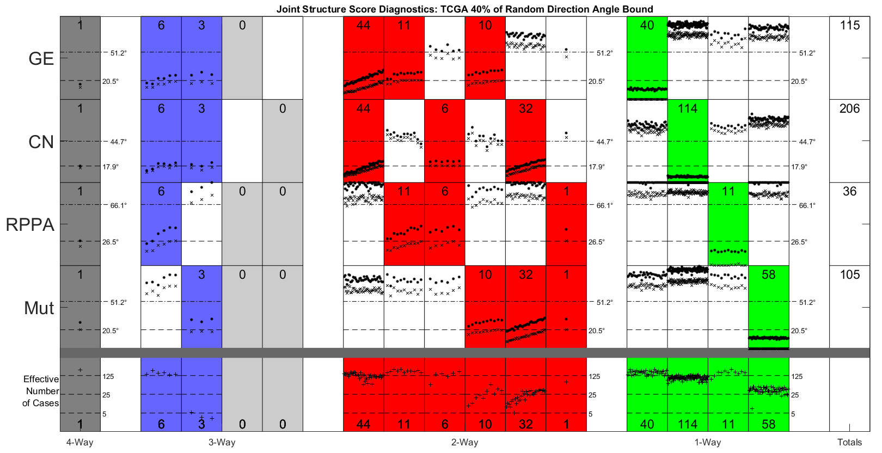
DIVAS on TCGA Data
Color Coded Share Types
Counts of
Directions
in Each
Statistical Significance Summary

Slide 17

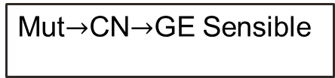
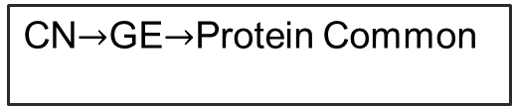
DIVAS on TCGA Data
CN$→$GE$→$Protein Common
Statistical Significance Summary
Single 4-way mode, as in AJIVE Analysis
Mut$→$CN$→$GE Sensible
No Mut$→$Protein
Without CN&GE

Slide 18
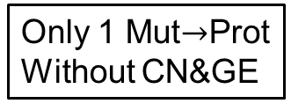


DIVAS on TCGA Data
GE or CN$→$ Proteins
Statistical Significance Summary
Lots of Mut&CN Variation
Major CN$→$GE Variation
Only 1 Mut$→$Prot
Without CN&GE
Only Barely
Significant

Slide 19
DIVAS on TCGA Data
Statistical Significance Summary
Number of Cases Involved
in Direction

Slide 20
DIVAS on TCGA Data
Statistical Significance Summary

Slide 21
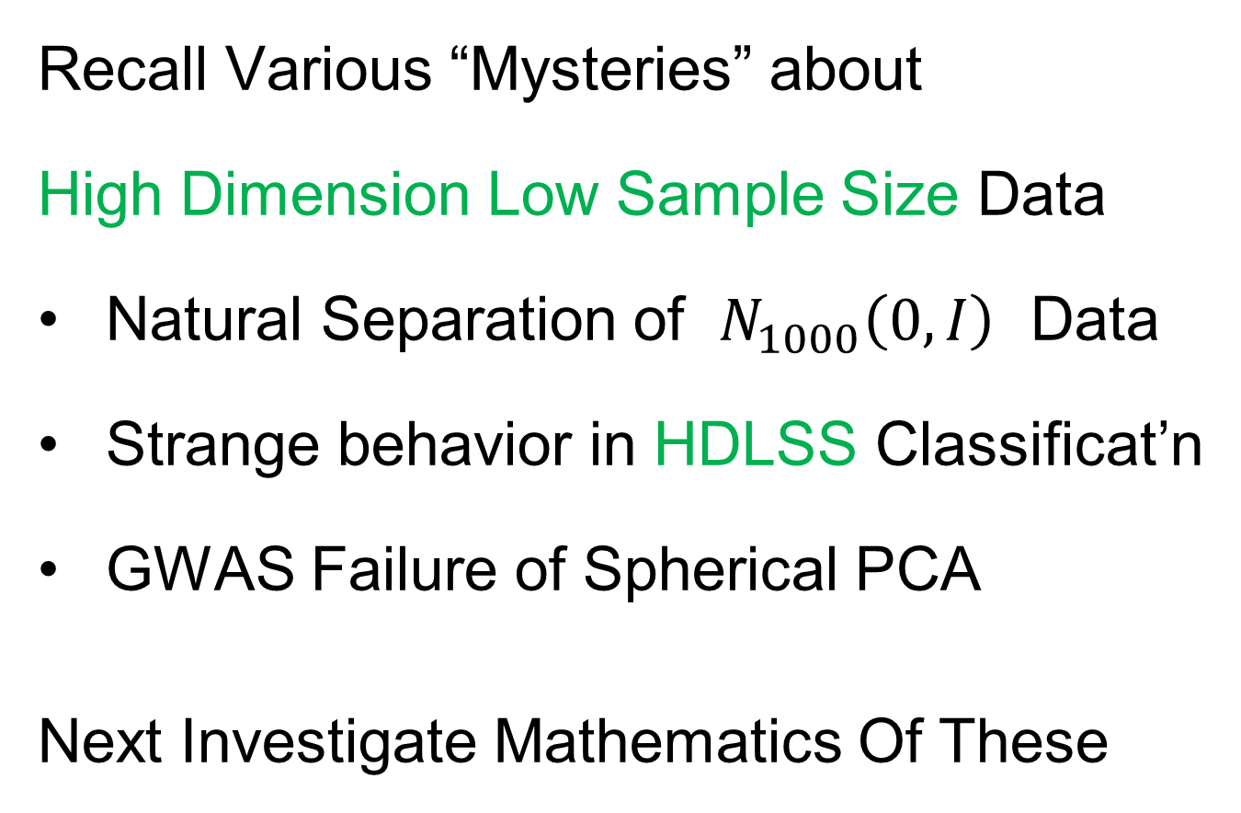
HDLSS Asymptotics
Text: Sec. 14.2
Recall Various “Mysteries” about
High Dimension Low Sample Size Data
Natural Separation of $N_{1000}\left(0,I\right)$ Data
Strange behavior in HDLSS Classificat’n
GWAS Failure of Spherical PCA
Next Investigate Mathematics Of These
Notes:
21

Slide 22

HDLSS Asymptotics
Modern Mathematical Statistics:
Based on asymptotic analysis
Notes:
22

Slide 23
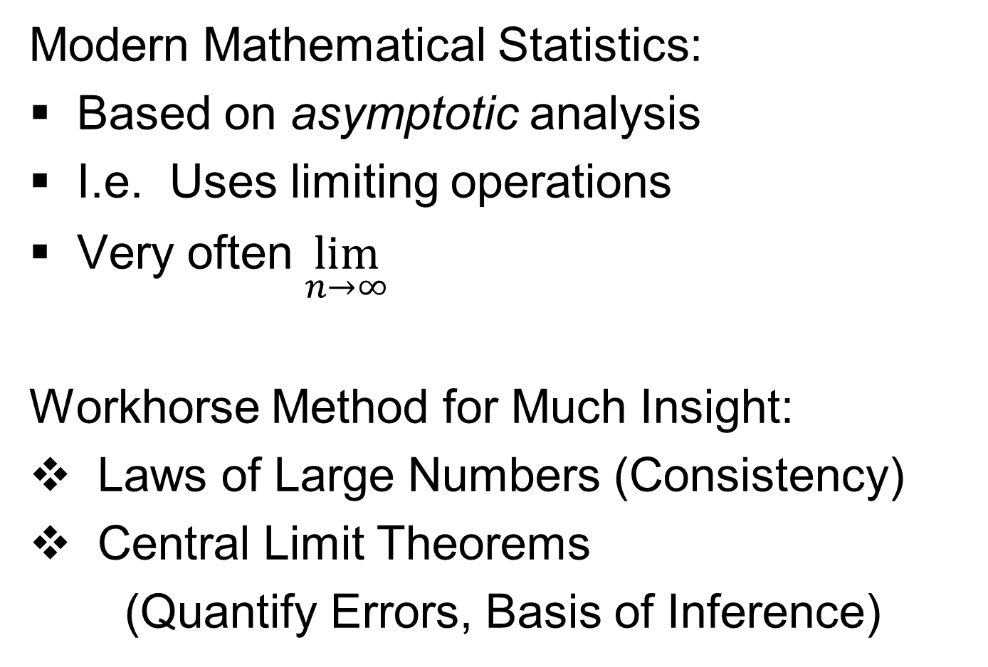
HDLSS Asymptotics
Modern Mathematical Statistics:
Based on asymptotic analysis
I.e. Uses limiting operations
Very often $\lim_{n→∞}{}$
Workhorse Method for Much Insight:
Laws of Large Numbers (Consistency)
Central Limit Theorems
(Quantify Errors, Basis of Inference)
Notes:
23

Slide 24
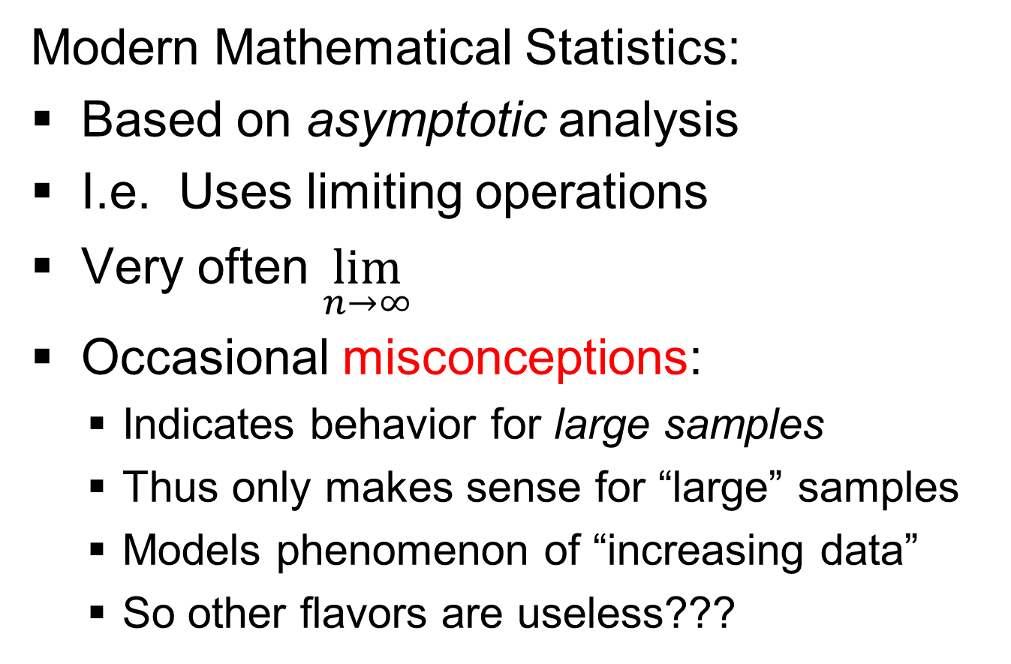
HDLSS Asymptotics
Modern Mathematical Statistics:
Based on asymptotic analysis
I.e. Uses limiting operations
Very often $\lim_{n→∞}{}$
Occasional misconceptions:
  Indicates behavior for large samples
  Thus only makes sense for “large” samples
  Models phenomenon of “increasing data”
  So other flavors are useless???
Sometimes Ask
Junior Researchers
Why They Do
Asymptotics
Notes:
24

Slide 25
HDLSS Asymptotics
Modern Mathematical Statistics:
Based on asymptotic analysis
Real Reasons:
  Approximation provides insights
  Can find simple underlying structure
  In complex situations
Thus various flavors are fine:
$$\lim_{n→∞}{} \lim_{d→∞}{} \lim_{n,d→∞}{} \lim_{σ→0}{}$$
Even desirable! (find additional insights)
Notes:
25

Slide 26
HDLSS Asymptotics
Personal Observations:
HDLSS world is…
Surprising (many times!)
[Think I’ve got it, and then …]
Mathematically Beautiful (?)
Doing Mathematics Is Essential
Practically Relevant
Only Way To Understand
When Intuition Fails!

Slide 27
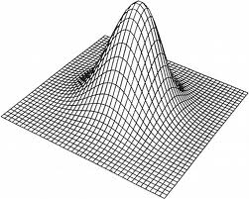
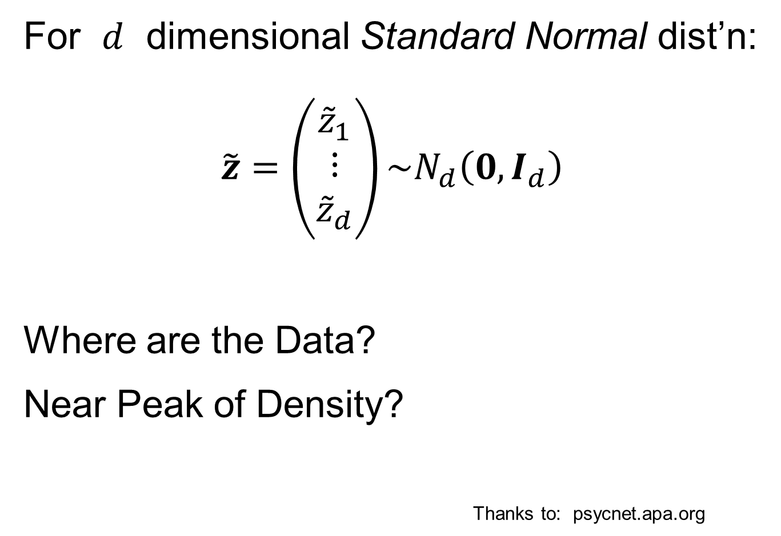
HDLSS Asymptotics: Simple Paradoxes
For $d$ dimensional Standard Normal dist’n:
$$\tilde{z}=\left(\begin{matrix}{\tilde{z}}_{1} \\ ⋮ \\ {\tilde{z}}_{d}\end{matrix}\right)\sim N_{d}\left(0,I_{d}\right)$$
Where are the Data?
Near Peak of Density?
Thanks to: psycnet.apa.org
Recall tilde for random,
Bold for vectors & matrices

Slide 28
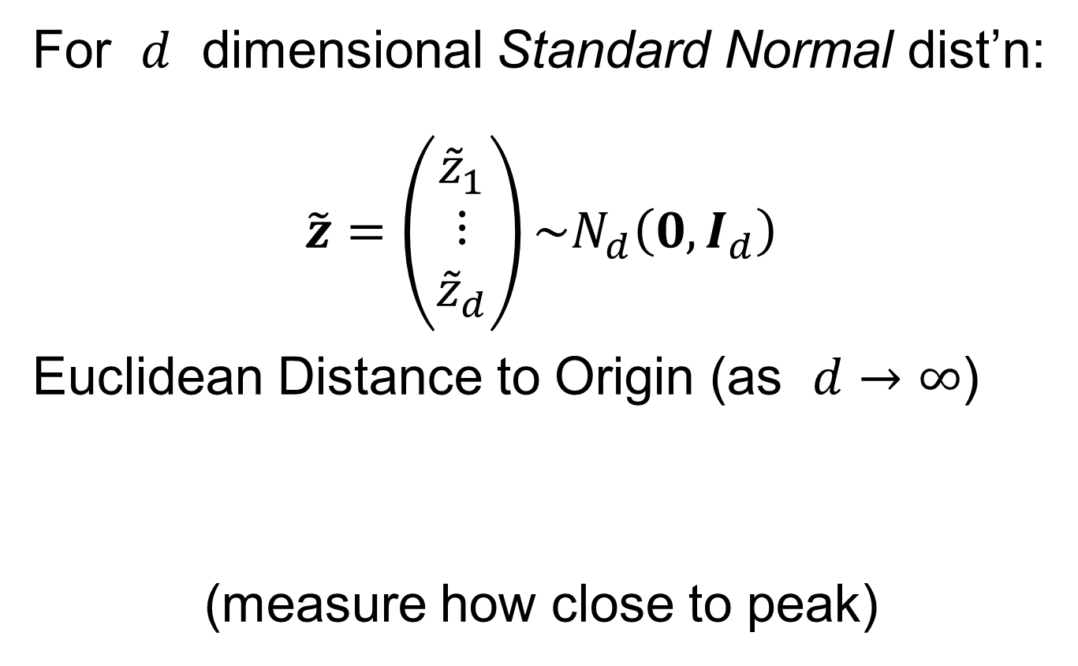
HDLSS Asymptotics: Simple Paradoxes
For $d$ dimensional Standard Normal dist’n:
$$\tilde{z}=\left(\begin{matrix}{\tilde{z}}_{1} \\ ⋮ \\ {\tilde{z}}_{d}\end{matrix}\right)\sim N_{d}\left(0,I_{d}\right)$$
Euclidean Distance to Origin (as $d→∞$)
(measure how close to peak)

Slide 29
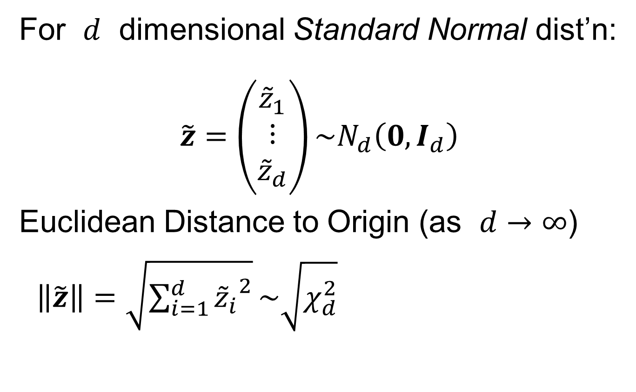

HDLSS Asymptotics: Simple Paradoxes
For $d$ dimensional Standard Normal dist’n:
$$\tilde{z}=\left(\begin{matrix}{\tilde{z}}_{1} \\ ⋮ \\ {\tilde{z}}_{d}\end{matrix}\right)\sim N_{d}\left(0,I_{d}\right)$$
Euclidean Distance to Origin (as $d→∞$)
$\left\|\tilde{z}\right\|=\sqrt{\sum_{i=1}^{d}{{{\tilde{z}}_{i}}^{2}}}\sim \sqrt{χ_{d}^{2}}$
Recall $Eχ_{d}^{2}=d$,
$var\left(χ_{d}^{2}\right)=2d$

Slide 30
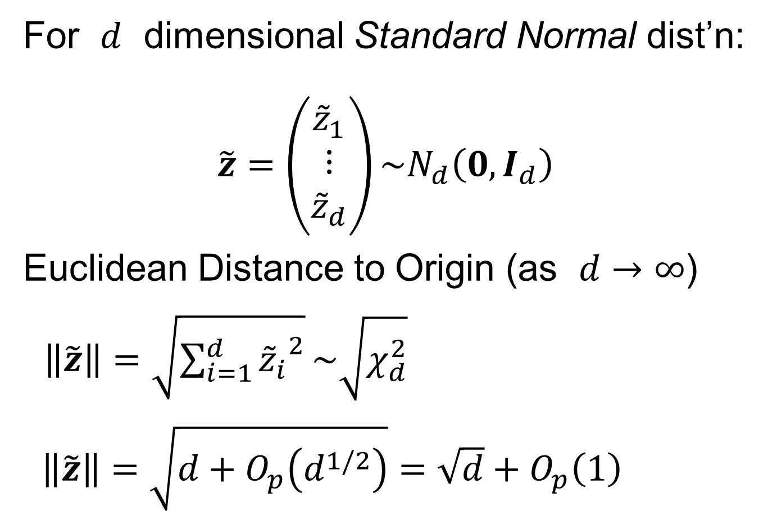
HDLSS Asymptotics: Simple Paradoxes
For $d$ dimensional Standard Normal dist’n:
$$\tilde{z}=\left(\begin{matrix}{\tilde{z}}_{1} \\ ⋮ \\ {\tilde{z}}_{d}\end{matrix}\right)\sim N_{d}\left(0,I_{d}\right)$$
Euclidean Distance to Origin (as $d→∞$)
$\left\|\tilde{z}\right\|=\sqrt{\sum_{i=1}^{d}{{{\tilde{z}}_{i}}^{2}}}\sim \sqrt{χ_{d}^{2}}$
$\left\|\tilde{z}\right\|=\sqrt{d+O_{p}\left(d^{1/2}\right)}=\sqrt{d}+O_{p}\left(1\right)$
Taylor Expansion,
i.e. “Delta Method”

Slide 31
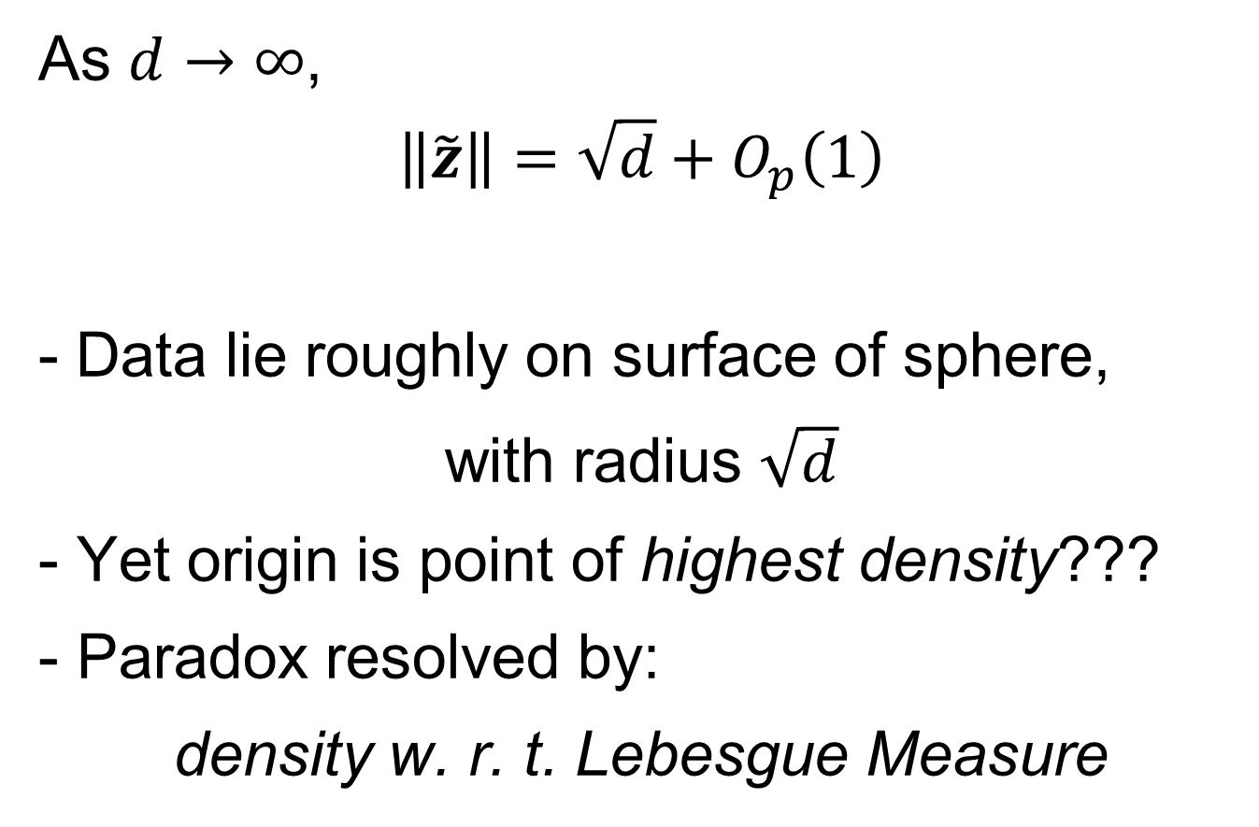
HDLSS Asymptotics: Simple Paradoxes
As $d→∞$,
$$\left\|\tilde{z}\right\|=\sqrt{d}+O_{p}\left(1\right)$$
Data lie roughly on surface of sphere,
with radius $\sqrt{d}$
- Yet origin is point of highest density???
- Paradox resolved by:
density w. r. t. Lebesgue Measure
Notes:
31

Slide 32
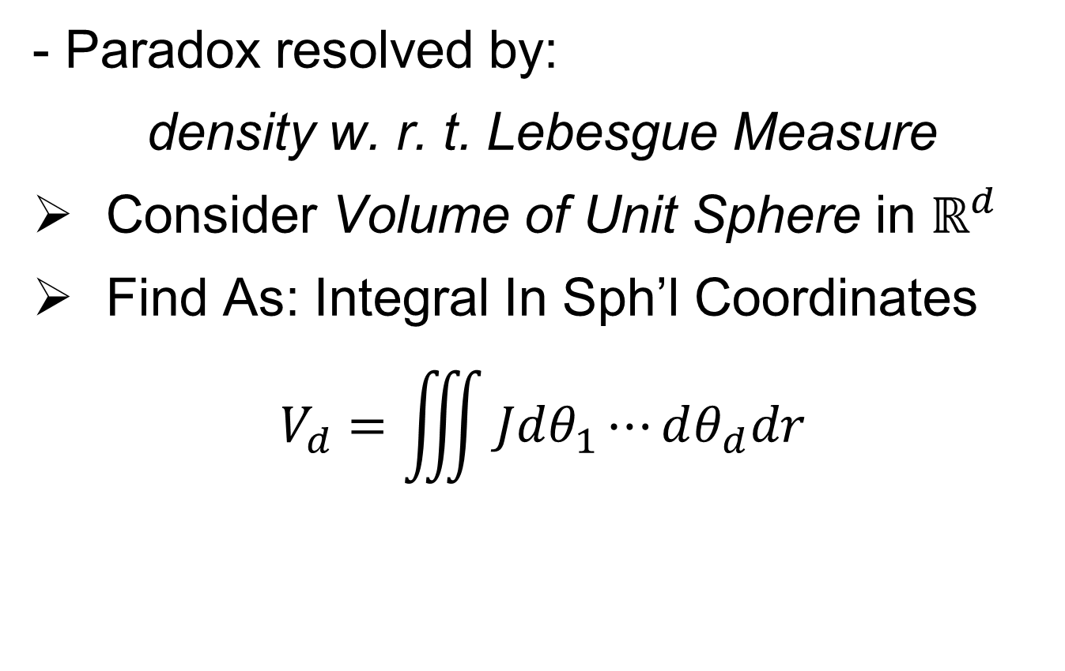
HDLSS Asymptotics: Simple Paradoxes
- Paradox resolved by:
density w. r. t. Lebesgue Measure
Consider Volume of Unit Sphere in $ℝ^{d}$
Find As: Integral In Sph’l Coordinates
$$V_{d}=\iiint{Jdθ_{1}⋯dθ_{d}dr}$$
Notes:
32

Slide 33
HDLSS Asymptotics: Simple Paradoxes
- Paradox resolved by:
density w. r. t. Lebesgue Measure
Consider Volume of Unit Sphere in $ℝ^{d}$
Find As: Integral In Sph’l Coordinates
$$V_{d}=\iiint{Jdθ_{1}⋯dθ_{d}dr}$$
Look At Integrand w.r.t. $r$
Can Show: Puts ~ All Weight Near $r=1$
Notes:
33

Slide 34
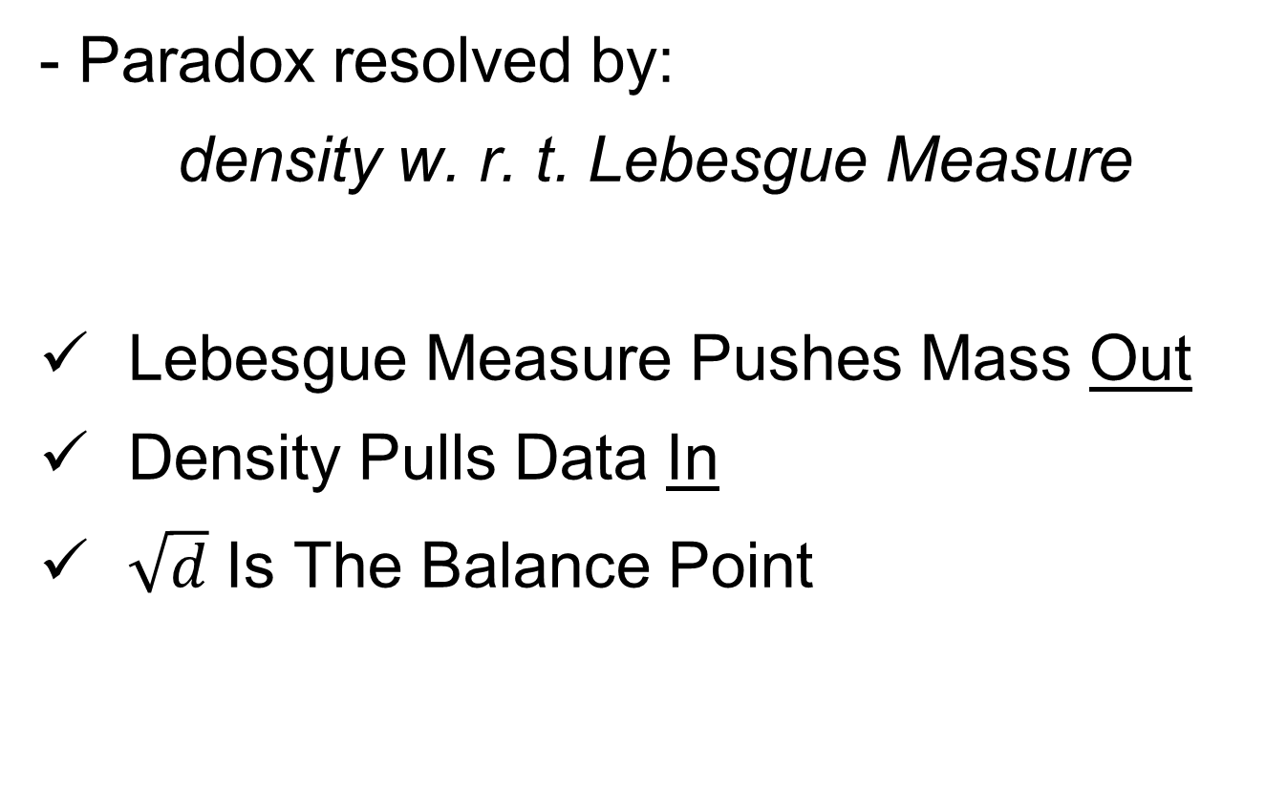
HDLSS Asymptotics: Simple Paradoxes
- Paradox resolved by:
density w. r. t. Lebesgue Measure
Lebesgue Measure Pushes Mass Out
Density Pulls Data In
$\sqrt{d}$ Is The Balance Point
Notes:
34

Slide 35
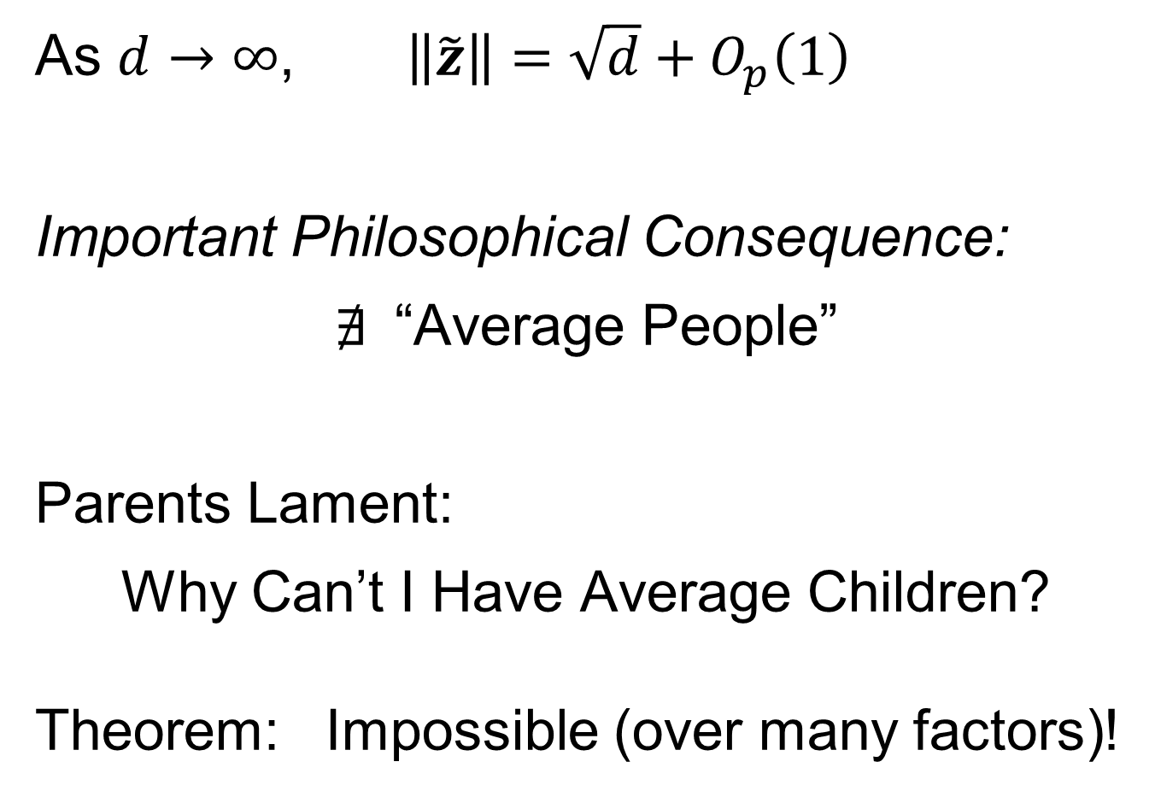
HDLSS Asymptotics: Simple Paradoxes
As $d→∞$, $\left\|\tilde{z}\right\|=\sqrt{d}+O_{p}\left(1\right)$
Important Philosophical Consequence:
$∄$“Average People”
Parents Lament:
Why Can’t I Have Average Children?
Theorem: Impossible (over many factors)!
Notes:
35

Slide 36
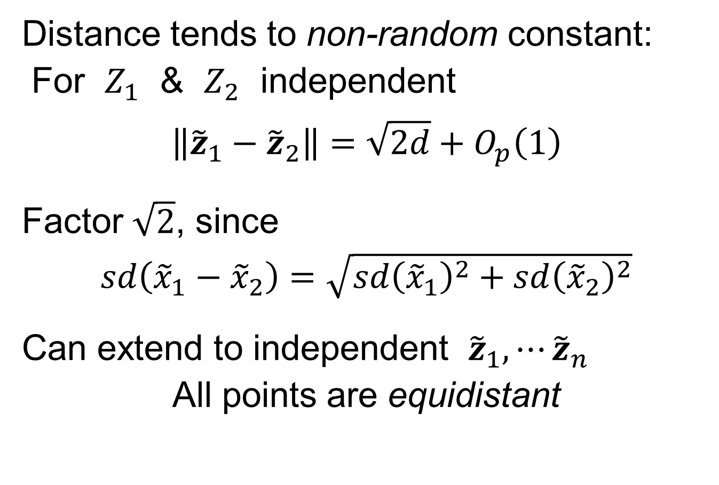
HDLSS Asymptotics: Simple Paradoxes
Distance tends to non-random constant:
For $Z_{1}$ & $Z_{2}$ independent
$$\left\|{\tilde{z}}_{1}−{\tilde{z}}_{2}\right\|=\sqrt{2d}+O_{p}\left(1\right)$$
Factor $\sqrt{2}$, since
$sd\left({\tilde{x}}_{1}−{\tilde{x}}_{2}\right)=\sqrt{{sd\left({\tilde{x}}_{1}\right)}^{2}+{sd\left({\tilde{x}}_{2}\right)}^{2}}$
Can extend to independent ${\tilde{z}}_{1},⋯{\tilde{z}}_{n}$
All points are equidistant
(We can only perceive 3 dimensions)
Notes:
36

Slide 37
HDLSS Asymptotics: Simple Paradoxes
Recall Reason Why
Perceptual System from Ancestors
They Needed to Find Food
Food Exists in 3-d World
(We can only perceive 3 dimensions)
Notes:
37

Slide 38
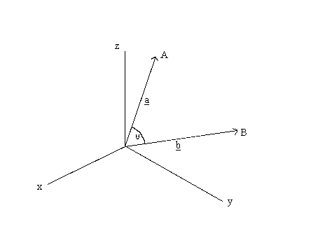
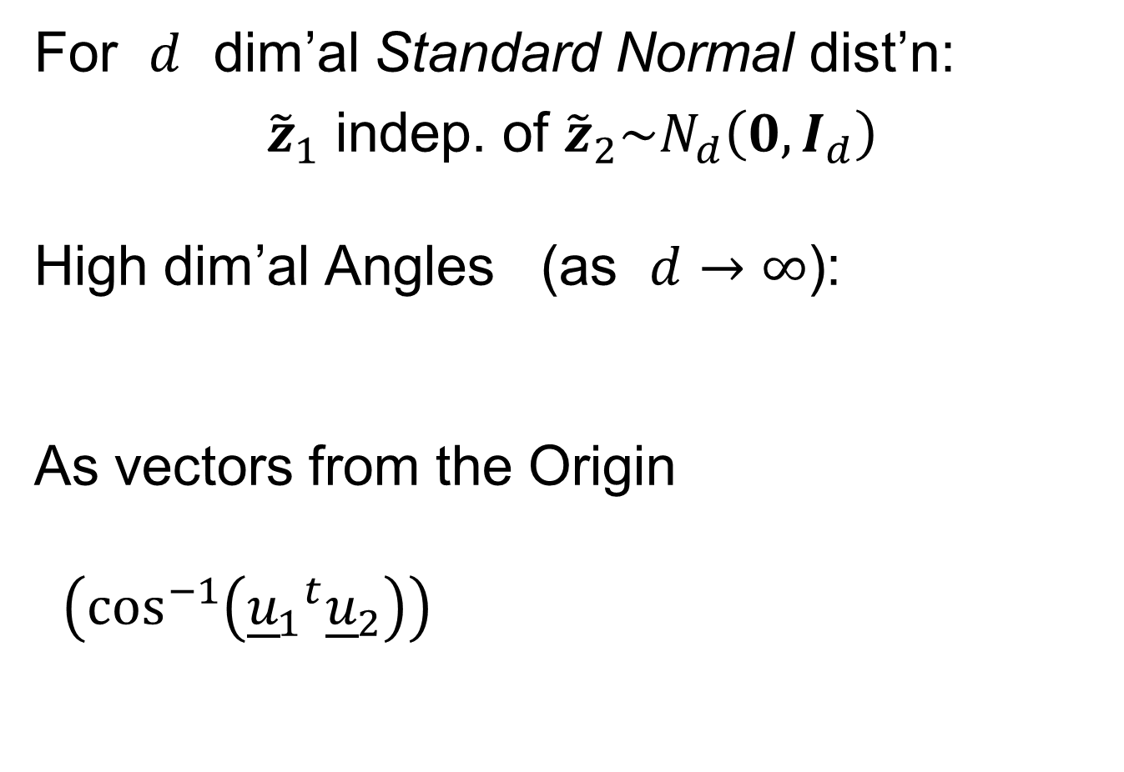
HDLSS Asymptotics: Simple Paradoxes
For $d$ dim’al Standard Normal dist’n:
${\tilde{z}}_{1}$ indep. of ${\tilde{z}}_{2}\sim N_{d}\left(0,I_{d}\right)$
High dim’al Angles (as $d→∞$):
As vectors from the Origin
$\left(\cos^{−1}\left({{\underline{u}}_{1}}^{t}{\underline{u}}_{2}\right)\right)$
Thanks to: members.tripod.com

Slide 39
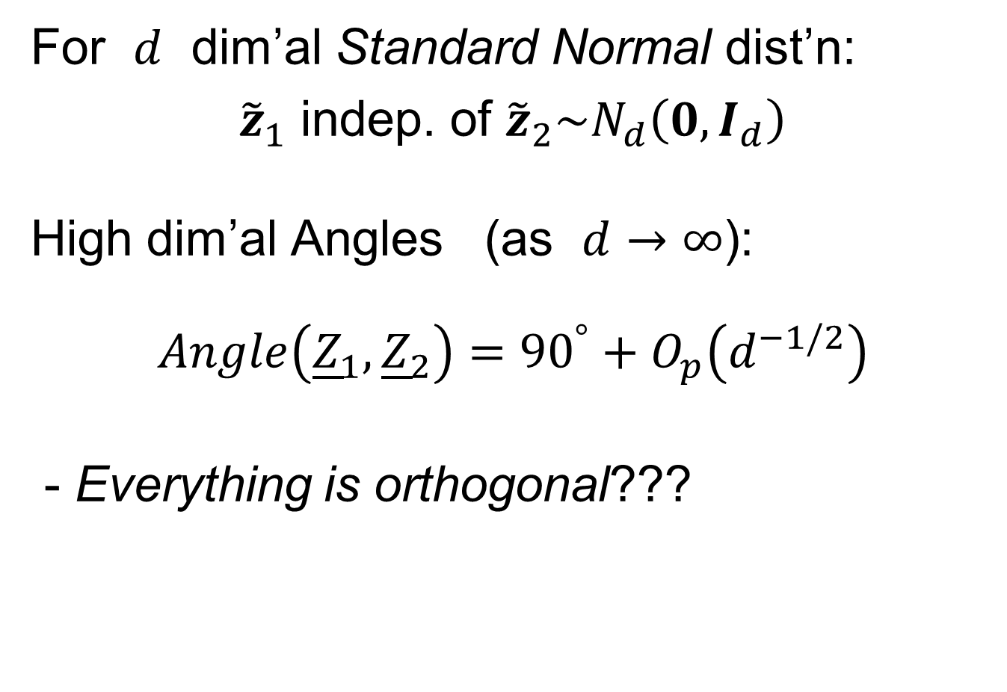




HDLSS Asymptotics: Simple Paradoxes
For $d$ dim’al Standard Normal dist’n:
${\tilde{z}}_{1}$ indep. of ${\tilde{z}}_{2}\sim N_{d}\left(0,I_{d}\right)$
High dim’al Angles (as $d→∞$):
$$Angle\left({\underline{Z}}_{1},{\underline{Z}}_{2}\right)={90}^{°}+O_{p}\left(d^{−1/2}\right)$$
- Everything is orthogonal???
$\sqrt{2d}$
Note Pythagorean Theorem:
$\sqrt{d}$
${90}^{°}$
$\sqrt{d}$

Slide 40

HDLSS Asy’s: Geometrical Represent’n
Assume ${\tilde{z}}_{1},⋯{\tilde{z}}_{n}\sim N_{d}\left(0,I_{d}\right)$, let $d→∞$
Study Subspace Generated by Data
Hall, Marron & Neeman (2005)

Slide 41

HDLSS Asy’s: Geometrical Represent’n
Assume ${\tilde{z}}_{1},⋯{\tilde{z}}_{n}\sim N_{d}\left(0,I_{d}\right)$, let $d→∞$
Study Subspace Generated by Data
Hyperplane through $0$,
of dimension $n$
Hall, Marron & Neeman (2005)

Slide 42

HDLSS Asy’s: Geometrical Represent’n
Assume ${\tilde{z}}_{1},⋯{\tilde{z}}_{n}\sim N_{d}\left(0,I_{d}\right)$, let $d→∞$
Study Subspace Generated by Data
Hyperplane through $0$,
of dimension $n$
Points are “nearly equidistant to $0$”,
& dist $\sqrt{d}$
Hall, Marron & Neeman (2005)

Slide 43

HDLSS Asy’s: Geometrical Represent’n
Assume ${\tilde{z}}_{1},⋯{\tilde{z}}_{n}\sim N_{d}\left(0,I_{d}\right)$, let $d→∞$
Study Subspace Generated by Data
Hyperplane through $0$,
of dimension $n$
Points are “nearly equidistant to $0$”,
& dist $\sqrt{d}$
Within plane, can
“rotate towards $\sqrt{d} ×$ Unit Simplex”
Hall, Marron & Neeman (2005)

Slide 44


Unit Simplex in $ℝ^{d}$
Convex Combinations of Unit Vectors
$\left(\begin{matrix}\begin{matrix}0 \\ 1 \\ 0\end{matrix} \\ ⋮ \\ 0\end{matrix}\right)$
$\left(\begin{matrix}\begin{matrix}1 \\ 0\end{matrix} \\ \begin{matrix}⋮ \\ 0\end{matrix}\end{matrix}\right)$
Simplex = $\left\{\left(\begin{matrix}x_{1} \\ ⋮ \\ x_{n_{1}}\end{matrix}\right):\sum_{i=1}^{d}{x_{i}=1,x_{i}≥0}\right\}$

Slide 45

HDLSS Asy’s: Geometrical Represent’n
Assume ${\tilde{z}}_{1},⋯{\tilde{z}}_{n}\sim N_{d}\left(0,I_{d}\right)$, let $d→∞$
Study Subspace Generated by Data
Hyperplane through $0$,
of dimension $n$
Points are “nearly equidistant to $0$”,
& dist $\sqrt{d}$
Within plane, can
“rotate towards $\sqrt{d} ×$ Unit Simplex”
All Gaussian data sets are:
“near Unit Simplex Vertices”!!!
(modulo rotation)
Hall, Marron & Neeman (2005)

Slide 46

HDLSS Asy’s: Geometrical Represent’n
Assume ${\tilde{z}}_{1},⋯{\tilde{z}}_{n}\sim N_{d}\left(0,I_{d}\right)$, let $d→∞$
Study Subspace Generated by Data
Hyperplane through $0$,
of dimension $n$
Points are “nearly equidistant to $0$”,
& dist $\sqrt{d}$
Within plane, can
“rotate towards $\sqrt{d} ×$ Unit Simplex”
All Gaussian data sets are:
“near Unit Simplex Vertices”!!!
“Randomness” appears
only in rotation of simplex
Hall, Marron & Neeman (2005)

Slide 47


HDLSS Asy’s: Geometrical Represent’n
Assume ${\tilde{z}}_{1},⋯{\tilde{z}}_{n}\sim N_{d}\left(0,I_{d}\right)$, let $d→∞$
Study Hyperplane Generated by Data
$n−1$ dimensional hyperplane
Points are pairwise equidistant, dist $\sim \sqrt{2d}$
Points lie at vertices of:
$\sqrt{2d}×$“regular $n−$ hedron”
Again “randomness in data” is only in rotation
Surprisingly rigid structure in
random data?

Slide 48

HDLSS Asy’s: Geometrical Represen’tion
Simulation View: study “rigidity after rotation”
Simple 3 point $N(0,I)$ data sets
In dimensions d = 2, 20, 200, 20000
Generate hyperplane of dimension 2
Rotate that to plane of screen
Rotate within plane, to make “comparable”
Repeat 7 times, use different colors

Slide 49

HDLSS Asy’s: Geometrical Represen’tion
Simulation View: Shows “Rigidity after Rotation”

Slide 50
HDLSS Asy’s: Geometrical Represen’tion
View from Probability Theory:
These phenomena named
Concentration of Measure
Key References:
Talagrand (1991, 1995)
Ledoux (2005)

Slide 51


An Interesting HDLSS Explanation
Recall Two
Class $N\left(0,I\right)$
Example
Strong DWD
Separation
Was Called
“Natural
Variation”

Slide 52

An Interesting HDLSS Explanation
“Natural Variation” for $n_{1}=n_{2}=50$
From $N_{1000}\left(0,I_{1000}\right)$:
All Points Equidistant From 0
All Points in Orthogonal Directions
Consider Red Group, ~ a Simplex
And Also Blue Group, ~ another Simplex
DWD Direction ~ Goes Through Centers
DWD Projection Well Separated

Slide 53

An Interesting HDLSS Explanation
Study simplex of $n_{1}$ red points in $ℝ^{d}$
$\left(\begin{matrix}\begin{matrix}0 \\ \sqrt{d} \\ 0\end{matrix} \\ ⋮ \\ 0\end{matrix}\right)$
$\left(\begin{matrix}\begin{matrix}\sqrt{d} \\ 0\end{matrix} \\ \begin{matrix}⋮ \\ 0\end{matrix}\end{matrix}\right)$
Simplex = $\left\{\left(\begin{matrix}\begin{matrix}x_{1} \\ ⋮ \\ x_{n_{1}}\end{matrix} \\ \begin{matrix}0 \\ ⋮ \\ 0\end{matrix}\end{matrix}\right):\sum_{i=1}^{n_{1}}{x_{i}=\sqrt{d},x_{i}≥0}\right\}$

Slide 54

An Interesting HDLSS Explanation
Study simplex of $n_{1}$ red points in $ℝ^{d}$
so $\overline{x_{1}}=\left(\begin{matrix}\begin{matrix}{\sqrt{d}}/{n_{1}} \\ ⋮ \\ {\sqrt{d}}/{n_{1}}\end{matrix} \\ \begin{matrix}0 \\ ⋮ \\ 0\end{matrix}\end{matrix}\right)$
Mean $\overline{x_{1}}$ Points in Direction:
$\left(\begin{matrix}\begin{matrix}c \\ ⋮ \\ c\end{matrix} \\ \begin{matrix}0 \\ ⋮ \\ 0\end{matrix}\end{matrix}\right)$
and satisfies $n_{1}×c=\sqrt{d}$
Thus $c={\sqrt{d}}/{n_{1}}$

Slide 55

An Interesting HDLSS Explanation
Study simplex of $n_{1}$ red points in $ℝ^{d}$
so $\overline{x_{1}}=\left(\begin{matrix}\begin{matrix}{\sqrt{d}}/{n_{1}} \\ ⋮ \\ {\sqrt{d}}/{n_{1}}\end{matrix} \\ \begin{matrix}0 \\ ⋮ \\ 0\end{matrix}\end{matrix}\right)$
So Distance from
Origin to $\overline{x_{1}}$ is:
$\left\|\overline{x_{1}}\right\|=\sqrt{n_{1}×{\left(\frac{\sqrt{d}}{n_{1}}\right)}^{2}}$
$=\sqrt{\frac{d}{n_{1}}}$
Familiar “$1/{\sqrt{n}}$” rule from CLT

Slide 56

An Interesting HDLSS Explanation
Similar Analysis for $n_{2}$ blue points in $ℝ^{d}$:
$\left\|\overline{x_{2}}\right\|=\sqrt{\frac{d}{n_{2}}}$
Also note: $\overline{x_{1}}⊥\overline{x_{2}}$
(since in ortho subspaces)
So $\left\|\overline{x_{1}}−\overline{x_{2}}\right\|=\sqrt{\frac{d}{n_{1}}+\frac{d}{n_{2}}}$

Slide 57

An Interesting HDLSS Explanation
Recall Two
Class $N\left(0,I\right)$
Example
Plug In
These
Numbers

Slide 58

An Interesting HDLSS Explanation
Evaluate $\left\|\overline{x_{1}}−\overline{x_{2}}\right\|=\sqrt{\frac{d}{n_{1}}+\frac{d}{n_{2}}}$
$=\sqrt{\frac{1000}{50}+\frac{1000}{50}}$
$≈6.3$

Slide 59

An Interesting HDLSS Explanation
Recall Two
Class $N\left(0,I\right)$
Example
$\left\|\overline{x_{1}}−\overline{x_{2}}\right\|$
$≈6.3$

Slide 60

HDLSS Asy’s: Geometrical Represen’tion
Straightforward Generalizations:
non-Gaussian data: only need moments?
non-independent: use “mixing conditions”
Mild Eigenvalue condition on Theoretical Cov.
(Ahn, Marron, Muller & Chi, 2007)
$⋮$
All based on simple “Laws of Large Numbers”

Slide 61
2nd Paper on HDLSS Asymptotics
Ahn, Marron, Muller & Chi (2007)
  Assume 2nd Moments
  Assume no eigenvalues too large

Slide 62

2nd Paper on HDLSS Asymptotics
Ahn, Marron, Muller & Chi (2007)
  Assume 2nd Moments
  Assume no eigenvalues too large in sense:
For $ε=\frac{{\left(\sum_{j=1}^{d}{λ_{j}}\right)}^{2}}{d\sum_{j=1}^{d}{λ_{j}^{2}}}$ assume $ε^{−1}=o(d)$ i.e. $≫d^{−1}$

Slide 63

2nd Paper on HDLSS Asymptotics
Background:
In classical multivariate analysis, the statistic
$ε=\frac{{\left(\sum_{j=1}^{d}{λ_{j}}\right)}^{2}}{d\sum_{j=1}^{d}{λ_{j}^{2}}}$
Is called the “epsilon statistic”, John (1976)
And is used to test “sphericity” of dist’n,
i.e. “are all cov’nce eigenvalues the same?”
Likelihood
Ratio Stat.

Slide 64

2nd Paper on HDLSS Asymptotics
Can show: epsilon statistic: $ε=\frac{{\left(\sum_{j=1}^{d}{λ_{j}}\right)}^{2}}{d\sum_{j=1}^{d}{λ_{j}^{2}}}$
Satisfies: $ε∈\left(\frac{1}{d},\right.\left. 1\right]$
For spherical Normal, $ε=1$
Single extreme eigenvalue gives $ε≈\frac{1}{d}$
So assumption $ε≫d^{−1}$ is very mild

Slide 65

2nd Paper on HDLSS Asymptotics
Ahn, Marron, Muller & Chi (2007)
  Assume 2nd Moments
  Assume no eigenvalues too large, $ε≫d^{−1}$:
Then $\left\|{\tilde{x}}_{i}−{\tilde{x}}_{j}\right\|=O_{p}\left(1\right)×\sqrt{d}$
Not so strong as before:
$$\left\|{\tilde{z}}_{i}−{\tilde{z}}_{j}\right\|=\sqrt{2d}+O_{p}\left(1\right)$$

Slide 66


3rd Paper on HDLSS Asymptotics
Get Geometrical Representation using
4th Moment Assumption
Stronger Covariance Matrix (only) Assum’n
Yata & Aoshima (2012)

Slide 67
0 Covariance is not independence
Key to Why Eigenvalues Alone Are Not Enough for Geometric Representation

Slide 68

0 Covariance is not independence
Simple Example:
Random Variables $X$ and $Y$
Make both Gaussian $X, Y \sim N\left(0,1\right)$
(Note: Not Using Multivariate Gaussian)

Slide 69


0 Covariance is not independence
Simple Example:
Random Variables $X$ and $Y$
Make both Gaussian $X, Y \sim N\left(0,1\right)$
With strong dependence
Yet $0$ covariance
Given $c>0$, define $Y=\left\{\begin{matrix}X & \left|X\right|>c \\ −X & \left|X\right|≤c\end{matrix}\right.$
Find $c$ to make
this happen

Slide 70


0 Covariance is not independence
Simple Example:
Can Lower This
By Increasing $c$

Slide 71

0 Covariance is not independence
Simple Example:
Have Overshot So
Search Between

Slide 72

0 Covariance is not independence
Simple Example, c to make cov(X,Y) = 0
Yet Strongly Dependent!

Slide 73

0 Covariance is not independence
Simple Example:
Distribution is degenerate
Supported on diagonal lines
Not abs. cont. w.r.t. 2-d Lebesgue meas.
For small $c$, have $cov\left(X,Y\right)>0$
For large $c$, have $cov\left(X,Y\right)<0$
By continuity, $∃ c$ with $cov\left(X,Y\right)=0$

Slide 74

0 Covariance is not independence
Result:
Joint distribution of $X$ and $Y$:
  Has Gaussian marginals
  Has $cov\left(X,Y\right)=0$
  Yet strong dependence of $X$ and $Y$
  Thus not multivariate Gaussian
Shows Multivariate Gaussian means more
than Gaussian Marginals

Slide 75


2nd Paper on HDLSS Asymptotics
Recall Weaker Moment Assumptions
(Than Mixing Conditions)
Can we improve on:
$\left\|{\tilde{x}}_{i}−{\tilde{x}}_{j}\right\|=O_{p}\left(1\right)×\sqrt{d}$ ?
John Kent example: Normal scale mixture
${\tilde{x}}_{i}\sim 0.5N_{d}\left(\underline{0},I_{d}\right)+0.5N_{d}\left(\underline{0},{100∗I}_{d}\right)$
Won’t get: $\left\|{\tilde{x}}_{i}−{\tilde{x}}_{j}\right\|=C×\sqrt{d}+O_{p}\left(1\right)$

Slide 76

HDLSS Math. Stat. of PCA
Conditions for Geo. Rep’n & PCA Consist.:
John Kent example:
$$\underline{X}\sim 0.5N_{d}\left(\underline{0},I_{d}\right)+0.5N_{d}\left(\underline{0},{100∗I}_{d}\right)$$
Can only say: $\left\|\underline{X}\right\|=O_{p}\left(d^{1/2}\right)$ $\left(=\left\{\begin{matrix}d^{1/2} & w.p.\frac{1}{2} \\ 10d^{1/2} & w.p.\frac{1}{2}\end{matrix}\right. \right)$
not deterministic
Conclude: For Geo. Rep’n need Additional Condition
Reasonable Approach: Mixing Conditions

Slide 77

Mixing Conditions
Idea From Probability Theory:
Recall Standard Asymptotic Results, as $n→∞:$
Law of Large Numbers,
$$\overline{X}→μ$$
(“Weak” = in prob., “Strong” = a.s.)

Slide 78

Mixing Conditions
Idea From Probability Theory:
Recall Standard Asymptotic Results, as $n→∞:$
Law of Large Numbers,
$$\overline{X}→μ$$
Central Limit Theorem,
$$\overline{X}≈μ+\frac{σ}{\sqrt{n}}N\left(0,1\right)$$

Slide 79
Mixing Conditions
Idea From Probability Theory:
Law of Large Numbers,
Central Limit Theorem,
Both have Technical Assumptions
(Usually Ignore ???)

Slide 80

Mixing Conditions
Idea From Probability Theory:
Law of Large Numbers,
Central Limit Theorem,
Both have Technical Assumptions
E.g. $X_{1},⋯,X_{n}$ Independent and Ident. Dist’d

Slide 81
Mixing Conditions
Idea From Probability Theory:
Mixing Conditions:
Explore Weaker Assumptions, to Still Get
Law of Large Numbers,
Central Limit Theorem

Slide 82


Mixing Conditions
Mixing Conditions:
A Whole Area in Probability Theory
$∃$ a Large Literature
A Comprehensive Reference
Bradley (2005, update of 1986 version)
Newer Reference: White (2014)

Slide 83

Mixing Conditions
Mixing Condition Used Here:
Rho – Mixing
For Random Variables ${\left\{Z_{j}\right\}}_{−∞}^{+∞}$, Define
$$ρ\left(m\right)=\sup_{j,f,g}\left|corr(f,g)\right|,$$
Where $f∈ℑ_{−∞}^{j}$, $g∈ℑ_{m+j}^{+∞}$

Slide 84

Mixing Conditions
Mixing Condition Used Here:
Rho – Mixing
For Random Variables ${\left\{Z_{j}\right\}}_{−∞}^{+∞}$, Define
$$ρ\left(m\right)=\sup_{j,f,g}\left|corr(f,g)\right|,$$
Where $f∈ℑ_{−∞}^{j}$, $g∈ℑ_{m+j}^{+∞}$
For Sigma-Fields Generated by:
$Z_{−∞},⋯,Z_{j}$

Slide 85

Mixing Conditions
Mixing Condition Used Here:
Rho – Mixing
For Random Variables ${\left\{Z_{j}\right\}}_{−∞}^{+∞}$, Define
$$ρ\left(m\right)=\sup_{j,f,g}\left|corr(f,g)\right|,$$
Where $f∈ℑ_{−∞}^{j}$, $g∈ℑ_{m+j}^{+∞}$
For Sigma-Fields Generated by:
$Z_{−∞},⋯,Z_{j}$
$Z_{m+j},⋯,Z_{∞}$

Slide 86

Mixing Conditions
Mixing Condition Used Here:
Rho – Mixing
For Random Variables ${\left\{Z_{j}\right\}}_{−∞}^{+∞}$, Define
$$ρ\left(m\right)=\sup_{j,f,g}\left|corr(f,g)\right|,$$
Where $f∈ℑ_{−∞}^{j}$, $g∈ℑ_{m+j}^{+∞}$
For Sigma-Fields Generated by:
$Z_{−∞},⋯,Z_{j}$
$Z_{m+j},⋯,Z_{∞}$
Note: Gap of Lag $m$

Slide 87

Mixing Conditions
Mixing Condition Used Here:
Rho – Mixing
For Random Variables ${\left\{Z_{j}\right\}}_{−∞}^{+∞}$, Define
$$ρ\left(m\right)=\sup_{j,f,g}\left|corr(f,g)\right|,$$
Where $f∈ℑ_{−∞}^{j}$, $g∈ℑ_{m+j}^{+∞}$
Assume: $\lim_{m→∞}{ρ\left(m\right)=0}$
Idea: Uncorrelated at Far Lags

Slide 88
Participant Presentations
12:05 Jeff Ayers :
Solutions of the Quantum Differential Equation
12:10 Hank Flury:
Bivariate Estimation for Spatial Processes
Next Class: Yang Luo, Madison Lindsay

