Slide 1
Statistics – O. R. 881
Object Oriented Data Analysis
Start
Recording
Steve Marron
Dept. of Statistics and Operations Research
University of North Carolina

Slide 2
Current Sections in Textbook
Today:
Section 14.2, 14.1
Next Class:
Sections 14.1, 12.1

Slide 3
DIVAS on TCGA Data
Breast Cancer
Gene Expression (GE) [16615 x 616]
Copy Number (CN) [24174 x 616]
Protein Exp. (RPPA) [187 x 616]
Mutation Status (MU) [18256 x 616]

Slide 4
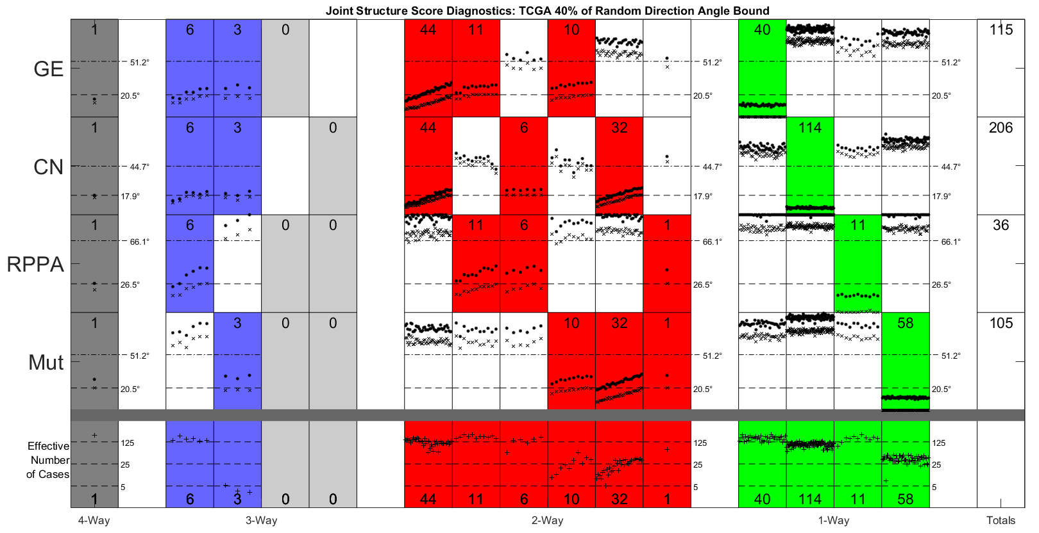
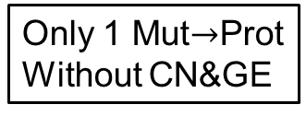


DIVAS on TCGA Data
GE or CN$→$ Proteins
Statistical Significance Summary
Lots of Mut&CN Variation
Major CN$→$GE Variation
Only 1 Mut$→$Prot
Without CN&GE
Only Barely
Significant

Slide 5
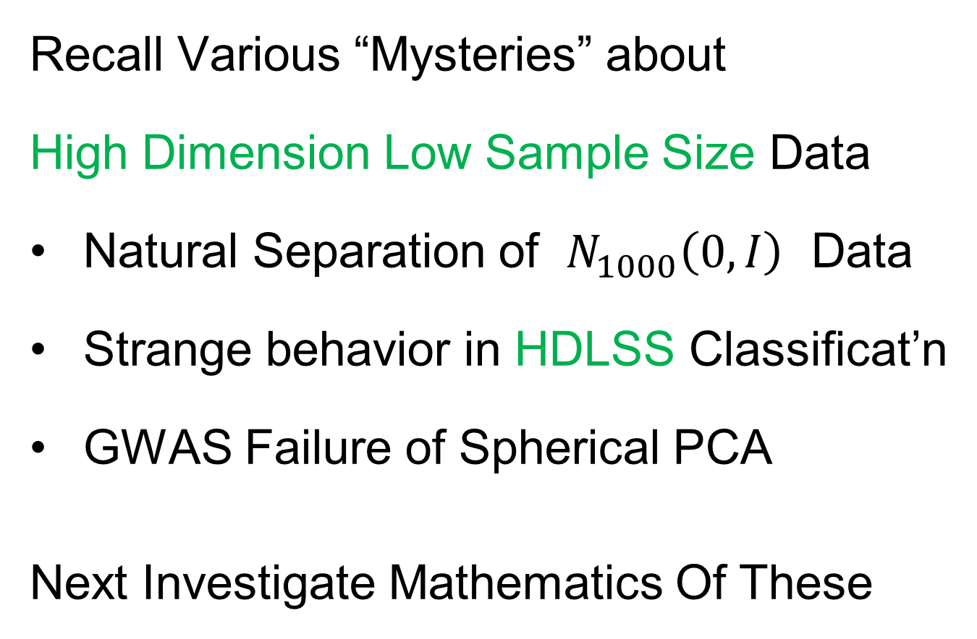
HDLSS Asymptotics
Text: Sec. 14.2
Recall Various “Mysteries” about
High Dimension Low Sample Size Data
Natural Separation of $N_{1000}\left(0,I\right)$ Data
Strange behavior in HDLSS Classificat’n
GWAS Failure of Spherical PCA
Next Investigate Mathematics Of These
Notes:
5

Slide 6
HDLSS Asymptotics
Modern Mathematical Statistics:
Based on asymptotic analysis
Real Reasons:
  Approximation provides insights
  Can find simple underlying structure
  In complex situations
Thus various flavors are fine:
$$\lim_{n→∞}{} \lim_{d→∞}{} \lim_{n,d→∞}{} \lim_{σ→0}{}$$
Even desirable! (find additional insights)
Notes:
6

Slide 7
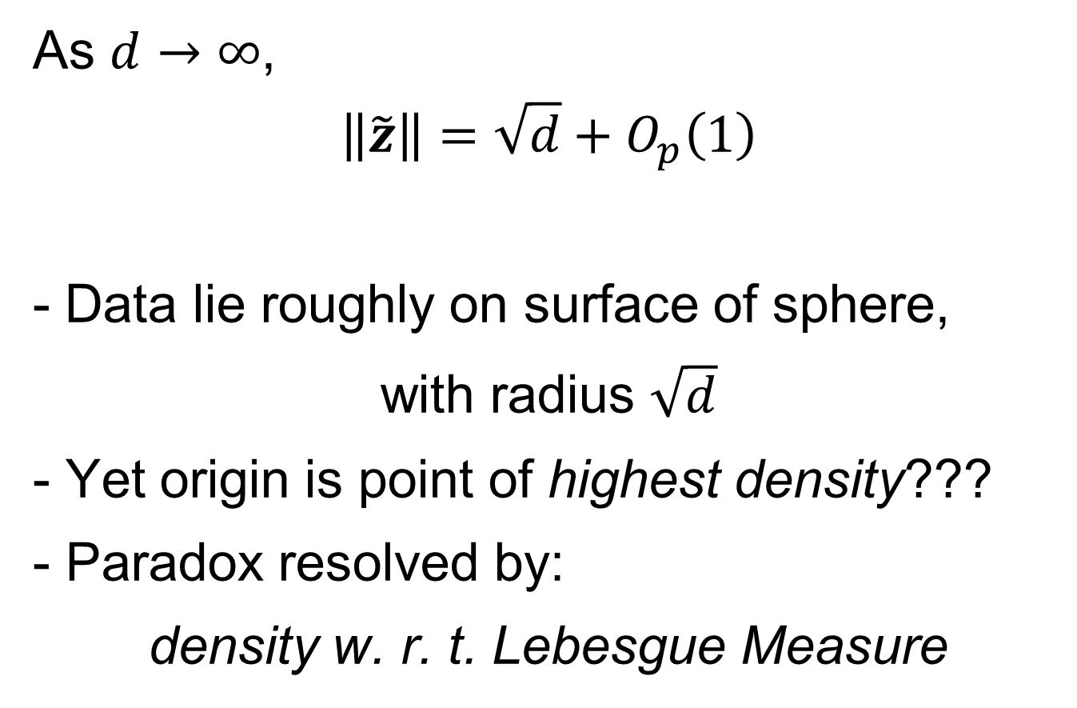
HDLSS Asymptotics: Simple Paradoxes
As $d→∞$,
$$\left\|\tilde{z}\right\|=\sqrt{d}+O_{p}\left(1\right)$$
Data lie roughly on surface of sphere,
with radius $\sqrt{d}$
- Yet origin is point of highest density???
- Paradox resolved by:
density w. r. t. Lebesgue Measure
Notes:
7

Slide 8
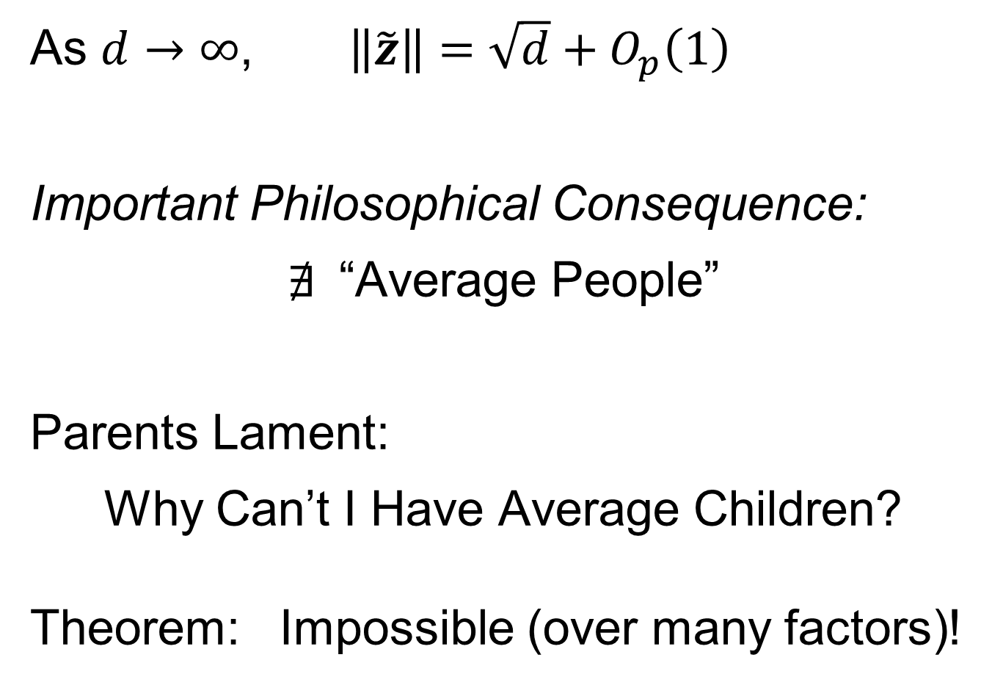
HDLSS Asymptotics: Simple Paradoxes
As $d→∞$, $\left\|\tilde{z}\right\|=\sqrt{d}+O_{p}\left(1\right)$
Important Philosophical Consequence:
$∄$“Average People”
Parents Lament:
Why Can’t I Have Average Children?
Theorem: Impossible (over many factors)!
Notes:
8

Slide 9
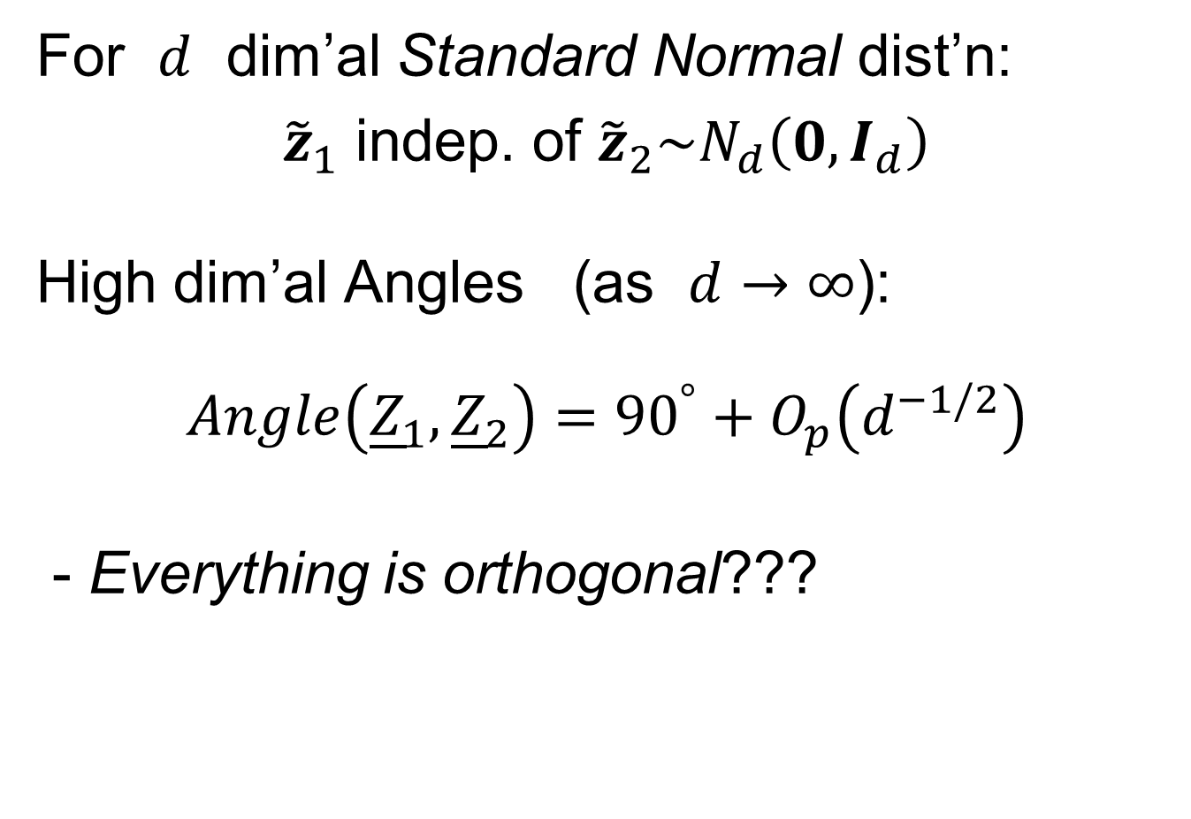




HDLSS Asymptotics: Simple Paradoxes
For $d$ dim’al Standard Normal dist’n:
${\tilde{z}}_{1}$ indep. of ${\tilde{z}}_{2}\sim N_{d}\left(0,I_{d}\right)$
High dim’al Angles (as $d→∞$):
$$Angle\left({\underline{Z}}_{1},{\underline{Z}}_{2}\right)={90}^{°}+O_{p}\left(d^{−1/2}\right)$$
- Everything is orthogonal???
$\sqrt{2d}$
Note Pythagorean Theorem:
$\sqrt{d}$
${90}^{°}$
$\sqrt{d}$

Slide 10
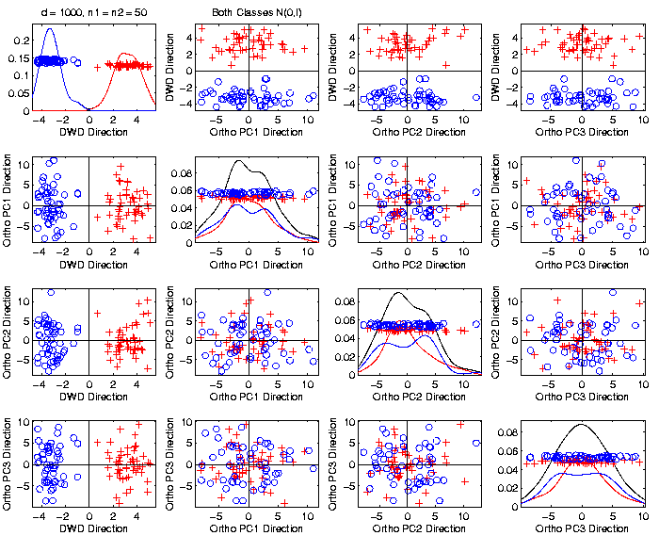
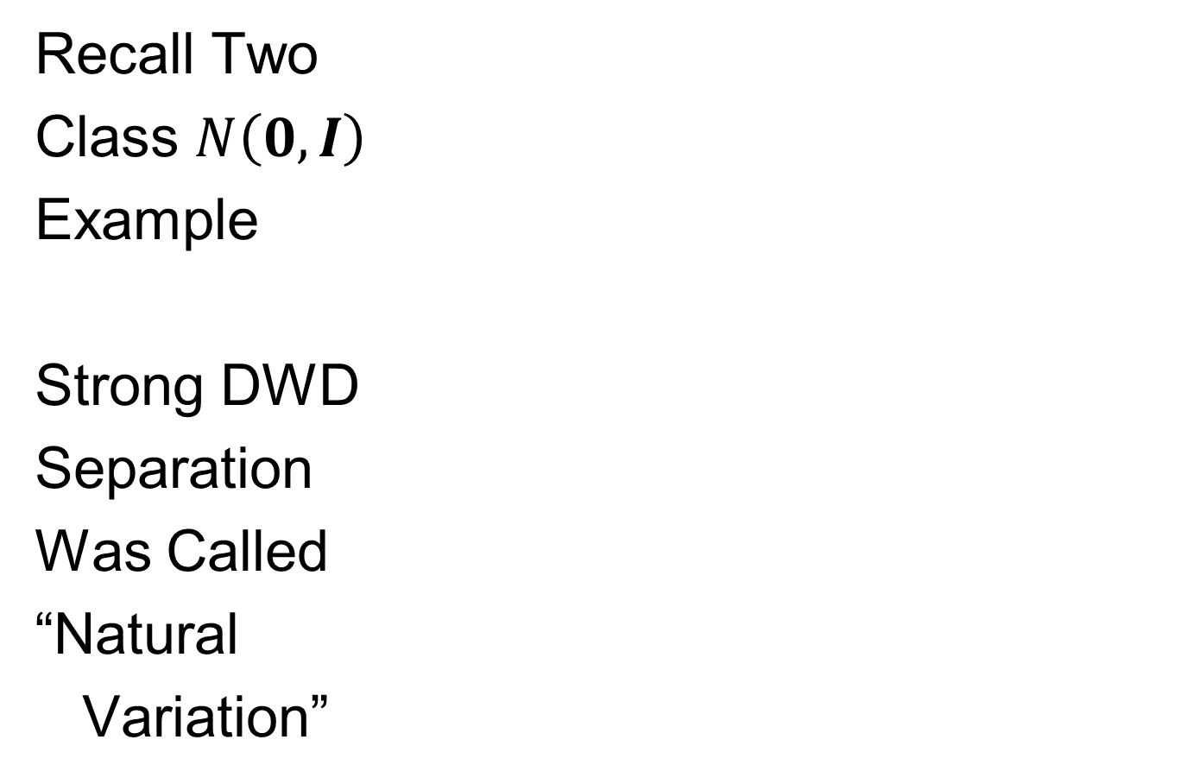
An Interesting HDLSS Explanation
Recall Two
Class $N\left(0,I\right)$
Example
Strong DWD
Separation
Was Called
“Natural
Variation”

Slide 11
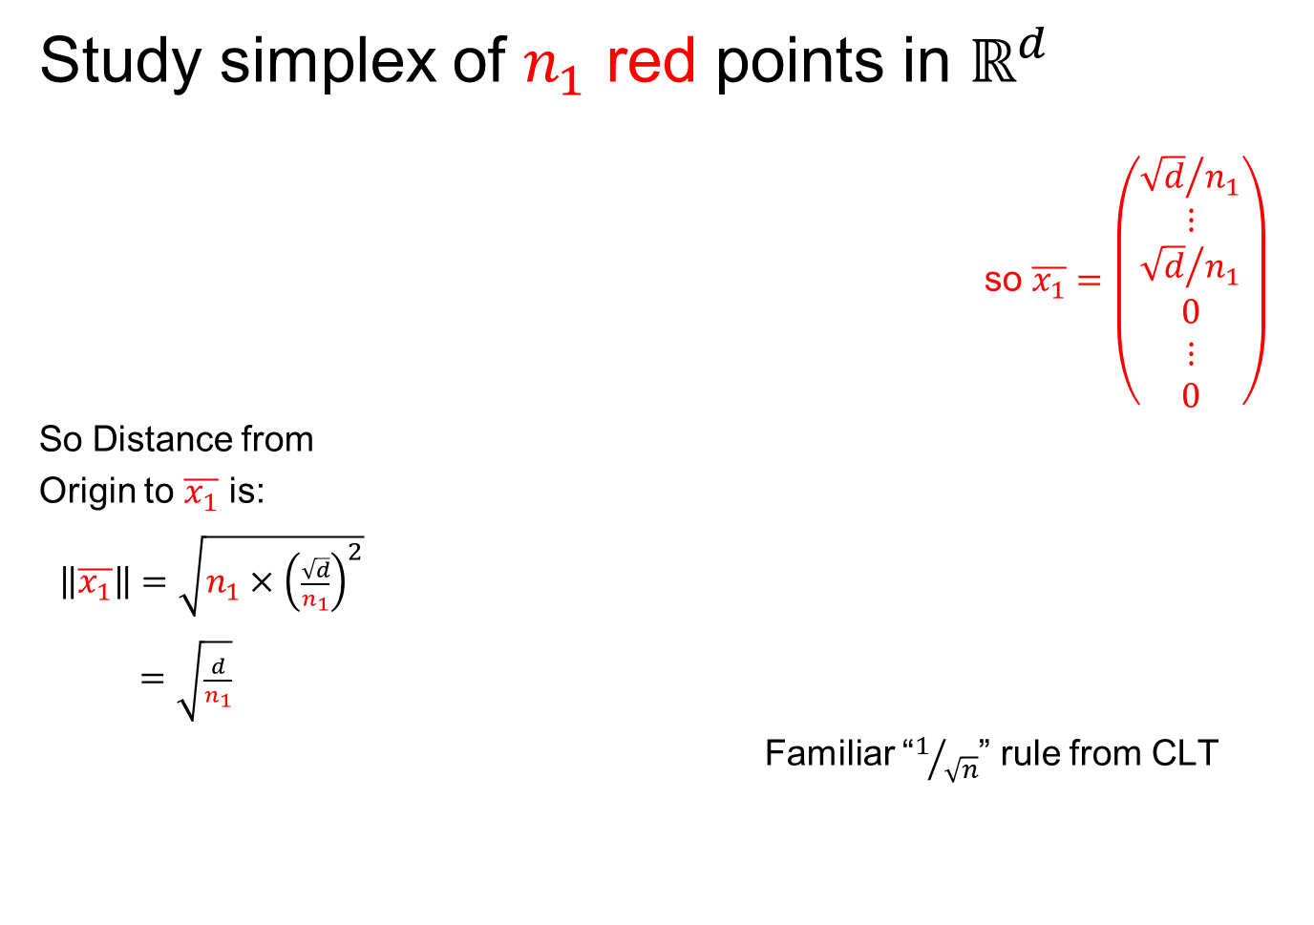
An Interesting HDLSS Explanation
Study simplex of $n_{1}$ red points in $ℝ^{d}$
so $\overline{x_{1}}=\left(\begin{matrix}\begin{matrix}{\sqrt{d}}/{n_{1}} \\ ⋮ \\ {\sqrt{d}}/{n_{1}}\end{matrix} \\ \begin{matrix}0 \\ ⋮ \\ 0\end{matrix}\end{matrix}\right)$
So Distance from
Origin to $\overline{x_{1}}$ is:
$\left\|\overline{x_{1}}\right\|=\sqrt{n_{1}×{\left(\frac{\sqrt{d}}{n_{1}}\right)}^{2}}$
$=\sqrt{\frac{d}{n_{1}}}$
Familiar “$1/{\sqrt{n}}$” rule from CLT

Slide 12

An Interesting HDLSS Explanation
Recall Two
Class $N\left(0,I\right)$
Example
$\left\|\overline{x_{1}}−\overline{x_{2}}\right\|$
$≈6.3$

Slide 13
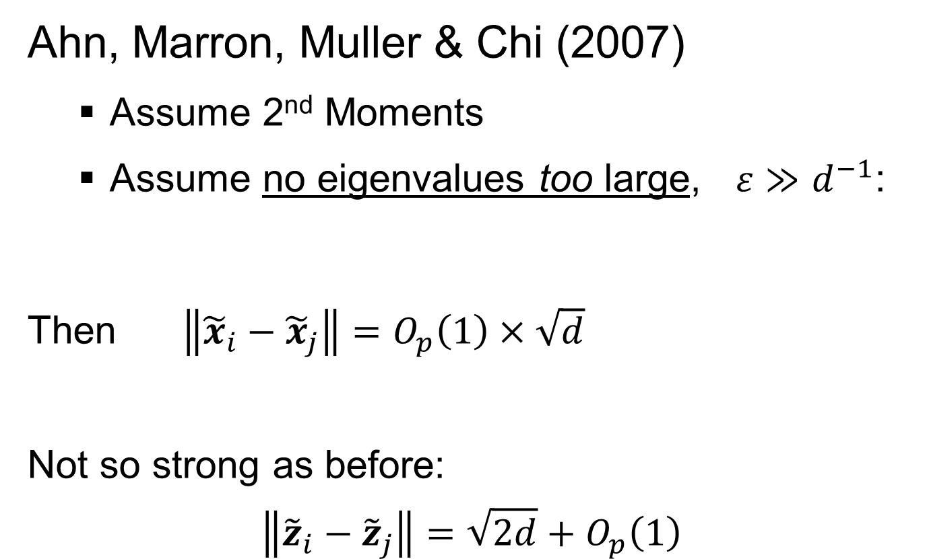
2nd Paper on HDLSS Asymptotics
Ahn, Marron, Muller & Chi (2007)
  Assume 2nd Moments
  Assume no eigenvalues too large, $ε≫d^{−1}$:
Then $\left\|{\tilde{x}}_{i}−{\tilde{x}}_{j}\right\|=O_{p}\left(1\right)×\sqrt{d}$
Not so strong as before:
$$\left\|{\tilde{z}}_{i}−{\tilde{z}}_{j}\right\|=\sqrt{2d}+O_{p}\left(1\right)$$

Slide 14

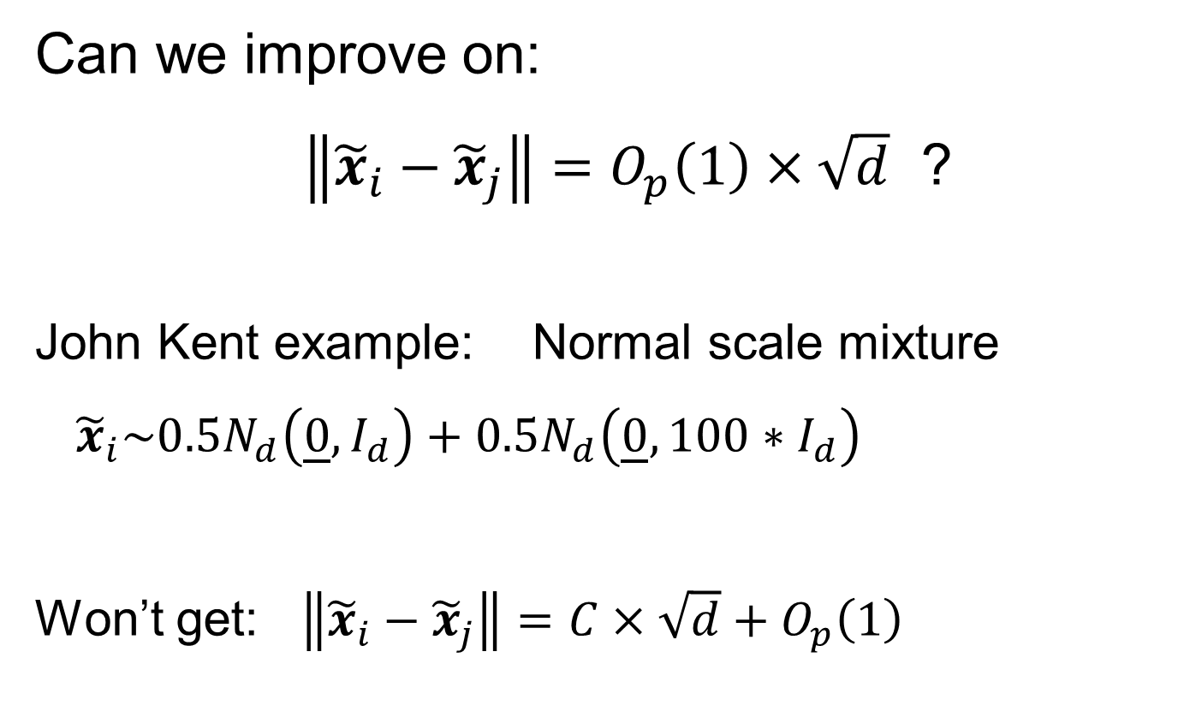
2nd Paper on HDLSS Asymptotics
Recall Weaker Moment Assumptions
(Than Mixing Conditions)
Can we improve on:
$\left\|{\tilde{x}}_{i}−{\tilde{x}}_{j}\right\|=O_{p}\left(1\right)×\sqrt{d}$ ?
John Kent example: Normal scale mixture
${\tilde{x}}_{i}\sim 0.5N_{d}\left(\underline{0},I_{d}\right)+0.5N_{d}\left(\underline{0},{100∗I}_{d}\right)$
Won’t get: $\left\|{\tilde{x}}_{i}−{\tilde{x}}_{j}\right\|=C×\sqrt{d}+O_{p}\left(1\right)$

Slide 15
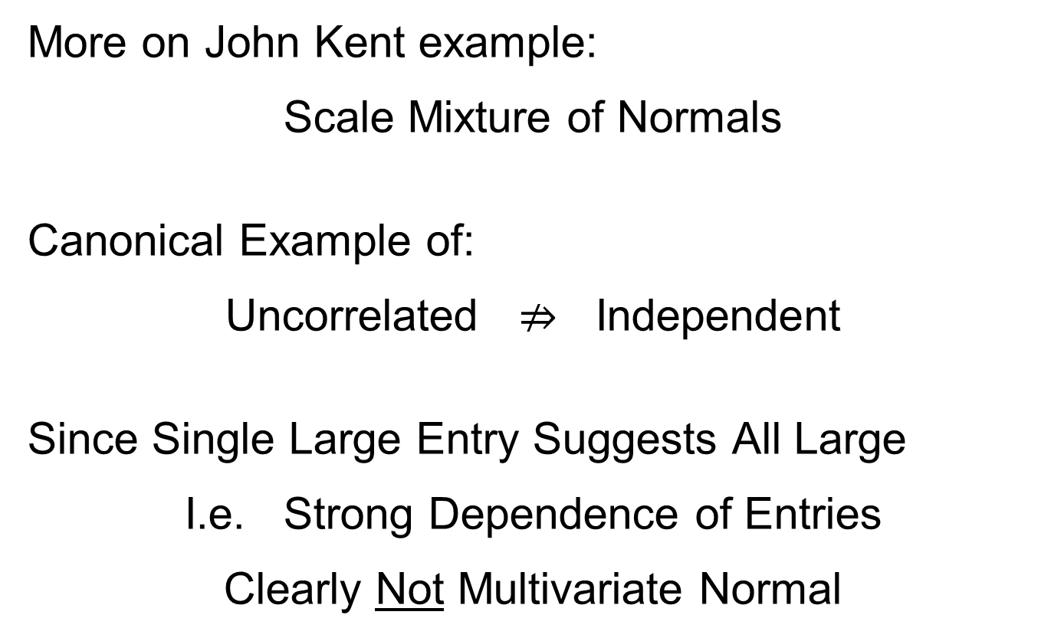
2nd Paper on HDLSS Asymptotics
More on John Kent example:
Scale Mixture of Normals
Canonical Example of:
Uncorrelated $⇏$ Independent
Since Single Large Entry Suggests All Large
I.e. Strong Dependence of Entries
Clearly Not Multivariate Normal
Should Check This

Slide 16
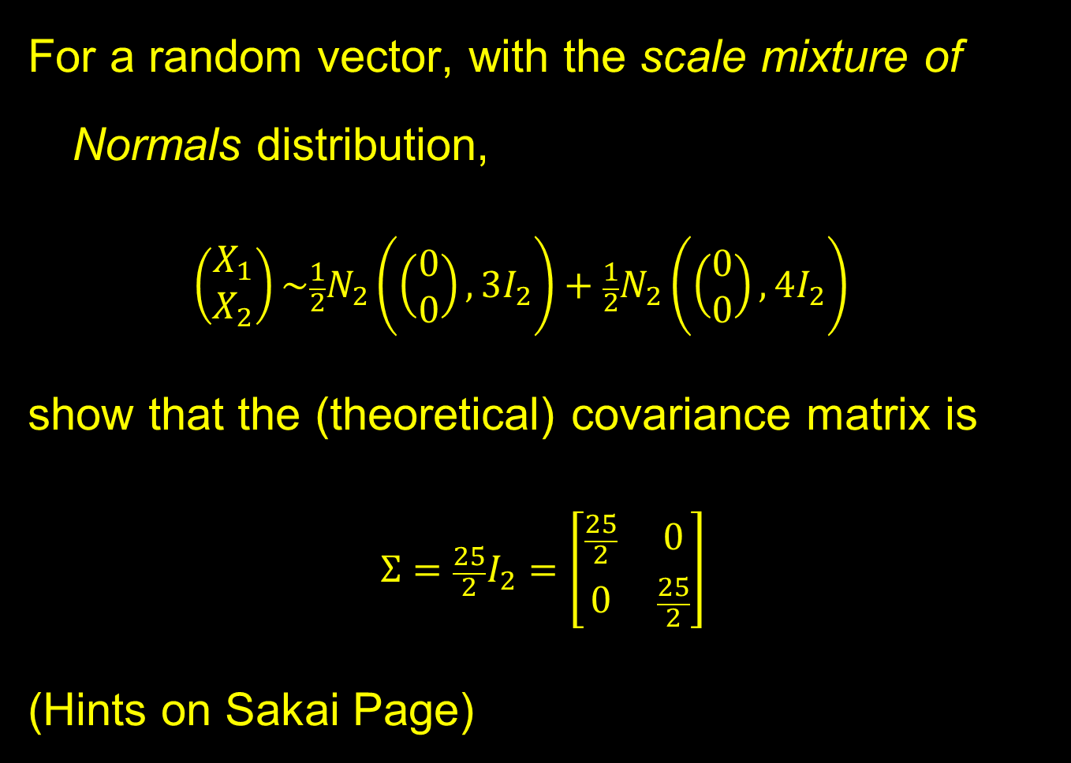
Homework 6
For a random vector, with the scale mixture of Normals distribution,
$$\left(\begin{matrix}X_{1} \\ X_{2}\end{matrix}\right)\sim \frac{1}{2}N_{2}\left(\left(\begin{matrix}0 \\ 0\end{matrix}\right),3I_{2}\right)+\frac{1}{2}N_{2}\left(\left(\begin{matrix}0 \\ 0\end{matrix}\right),4I_{2}\right)$$
show that the (theoretical) covariance matrix is
$$Σ=\frac{25}{2}I_{2}=\left[\begin{matrix}\frac{25}{2} & 0 \\ 0 & \frac{25}{2}\end{matrix}\right]$$
(Hints on Sakai Page)
Due: Apr. 26,
11:00AM

Slide 17
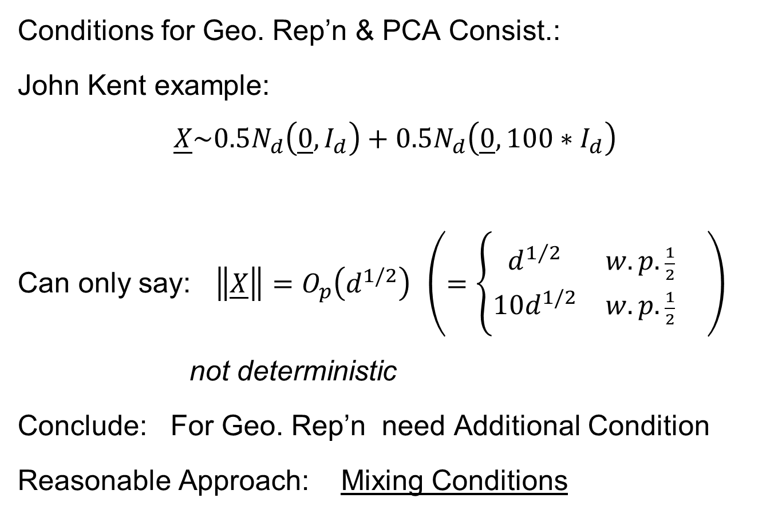
HDLSS Math. Stat. of PCA
Conditions for Geo. Rep’n & PCA Consist.:
John Kent example:
$$\underline{X}\sim 0.5N_{d}\left(\underline{0},I_{d}\right)+0.5N_{d}\left(\underline{0},{100∗I}_{d}\right)$$
Can only say: $\left\|\underline{X}\right\|=O_{p}\left(d^{1/2}\right)$ $\left(=\left\{\begin{matrix}d^{1/2} & w.p.\frac{1}{2} \\ 10d^{1/2} & w.p.\frac{1}{2}\end{matrix}\right. \right)$
not deterministic
Conclude: For Geo. Rep’n need Additional Condition
Reasonable Approach: Mixing Conditions

Slide 18


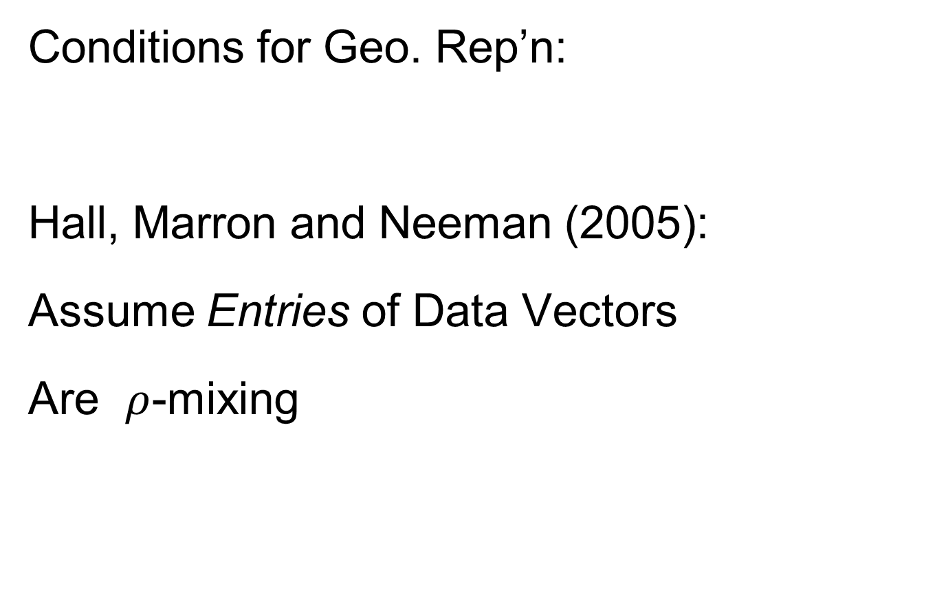
HDLSS Geometric Representation
Conditions for Geo. Rep’n:
Hall, Marron and Neeman (2005):
Assume Entries of Data Vectors
Are $ρ$-mixing

Slide 19
HDLSS Geometric Representation
Conditions for Geo. Rep’n:
Hall, Marron and Neeman (2005):
Drawback: Strong Assumption
(???)
In JRSS-B, since Biometrika Rejected

Slide 20
HDLSS Geometric Representation
Conditions for Geo. Rep’n:
Hall, Marron and Neeman (2005):
Later Realization:
This Mixing is Very Natural in
Genome Wide Association Studies
1st such: Klein et al (2005)

Slide 21
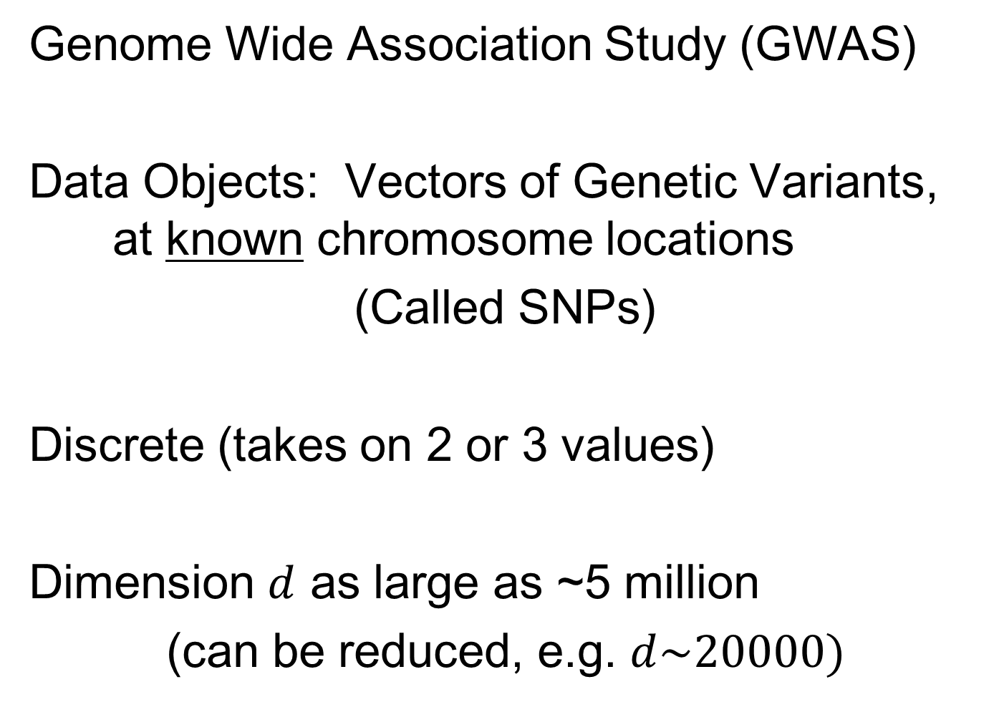
Recall GWAS Data Analysis
Genome Wide Association Study (GWAS)
Data Objects: Vectors of Genetic Variants, at known chromosome locations
(Called SNPs)
Discrete (takes on 2 or 3 values)
Dimension $d$ as large as ~5 million
(can be reduced, e.g. $d\sim 20000)$

Slide 22
HDLSS Geometric Representation
Conditions for Geo. Rep’n:
Series of Technical Improvements:
Ahn, Marron, Muller & Chi (2007)
Yata & Aoshima (2009, 2010a, 2010b, 2012, 2013)
(Fully Covariance Based,
No Mixing)

Slide 23
HDLSS Geometric Representation
Conditions for Geo. Rep’n:
Tricky Point: Classical Mixing Conditions
Require Notion of Time Ordering
Not Always Clear, e.g. Gene Expression

Slide 24

HDLSS Geometric Representation
Conditions for Geo. Rep’n:
Condition from Jung & Marron (2009):
where
Note: Not Gaussian (Allows Discrete)

Slide 25

HDLSS Geometric Representation
Conditions for Geo. Rep’n:
Condition from Jung & Marron (2009):
where
Define:
Standardized Version
Only Mean $0$, Covariance $I$

Slide 26
HDLSS Geometric Representation
Conditions for Geo. Rep’n:
Condition from Jung & Marron (2009):
where
Define:
Assume: Ǝ a permutation,
So that is ρ-mixing

Slide 27
HDLSS Math. Stat. of PCA
HDLSS Analysis of PCA
from Jung & Marron (2009)

Slide 28
HDLSS Math. Stat. of PCA
Consistency & Strong Inconsistency
(Study Properties of PCA,
In Estimating Eigen-Directions & -Values)
[Assume Data are Mean Centered]

Slide 29

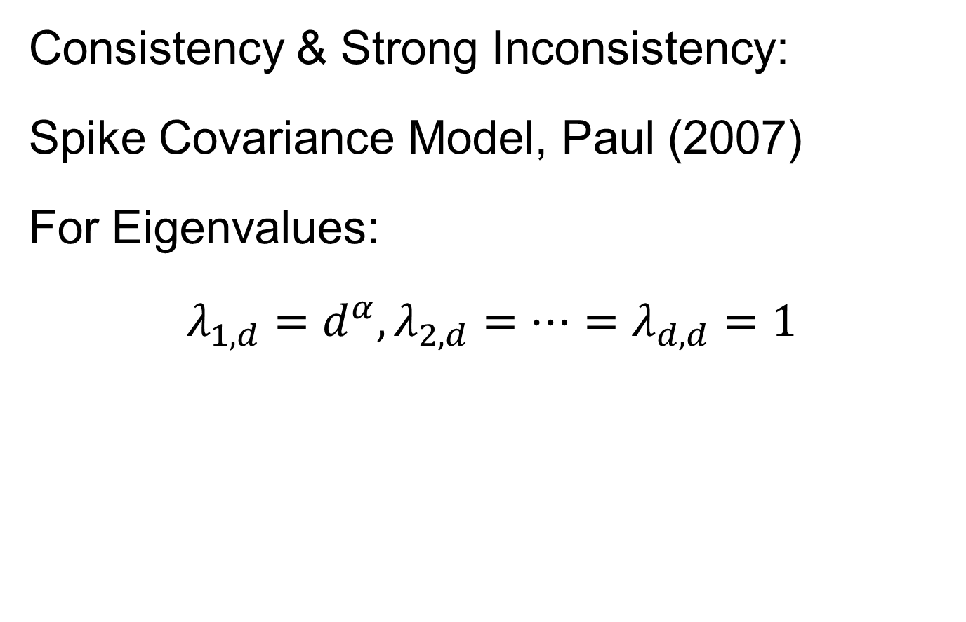
HDLSS Math. Stat. of PCA
Consistency & Strong Inconsistency:
Spike Covariance Model, Paul (2007)
For Eigenvalues:
$λ_{1,d}=d^{α},λ_{2,d}=⋯=λ_{d,d}=1$

Slide 30
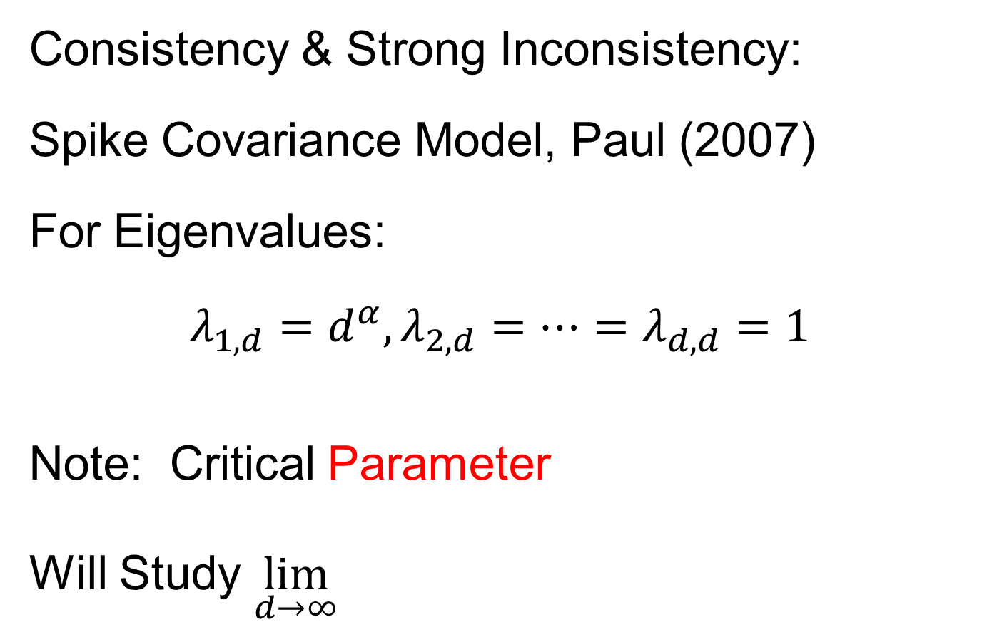
HDLSS Math. Stat. of PCA
Consistency & Strong Inconsistency:
Spike Covariance Model, Paul (2007)
For Eigenvalues:
$λ_{1,d}=d^{α},λ_{2,d}=⋯=λ_{d,d}=1$
Note: Critical Parameter
Will Study $\lim_{d→∞}{}$

Slide 31
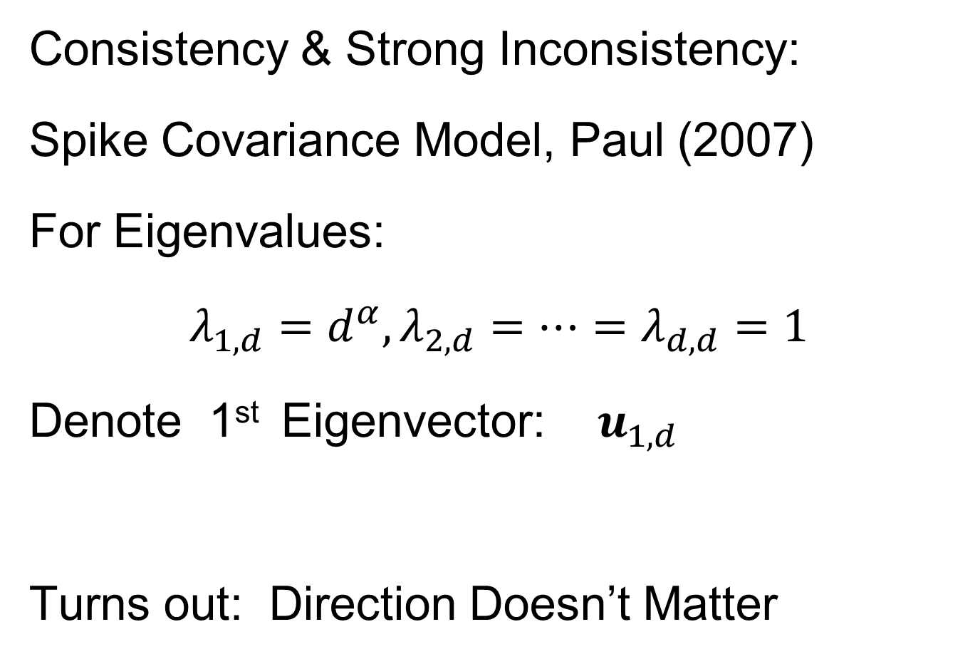
HDLSS Math. Stat. of PCA
Consistency & Strong Inconsistency:
Spike Covariance Model, Paul (2007)
For Eigenvalues:
$λ_{1,d}=d^{α},λ_{2,d}=⋯=λ_{d,d}=1$
Denote 1st Eigenvector: $u_{1,d}$
Turns out: Direction Doesn’t Matter

Slide 32
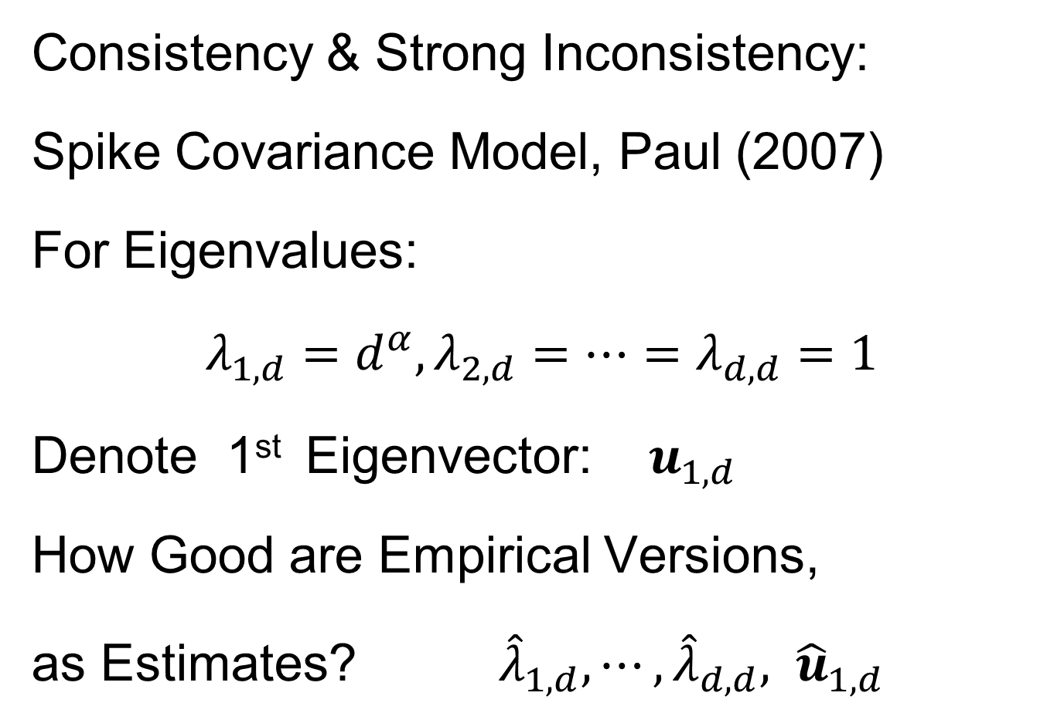
HDLSS Math. Stat. of PCA
Consistency & Strong Inconsistency:
Spike Covariance Model, Paul (2007)
For Eigenvalues:
$λ_{1,d}=d^{α},λ_{2,d}=⋯=λ_{d,d}=1$
Denote 1st Eigenvector: $u_{1,d}$
How Good are Empirical Versions,
as Estimates? ${\hat{λ}}_{1,d},⋯,{\hat{λ}}_{d,d}, {\hat{u}}_{1,d}$

Slide 33
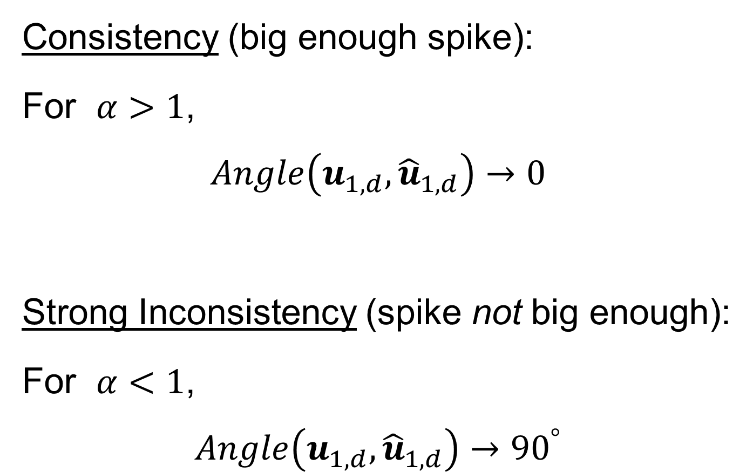
HDLSS Math. Stat. of PCA
Consistency (big enough spike):
For $α>1$,
$$Angle\left(u_{1,d},{\hat{u}}_{1,d}\right)→0$$
Strong Inconsistency (spike not big enough):
For $α<1$,
$$Angle\left(u_{1,d},{\hat{u}}_{1,d}\right)→{90}^{°}$$

Slide 34
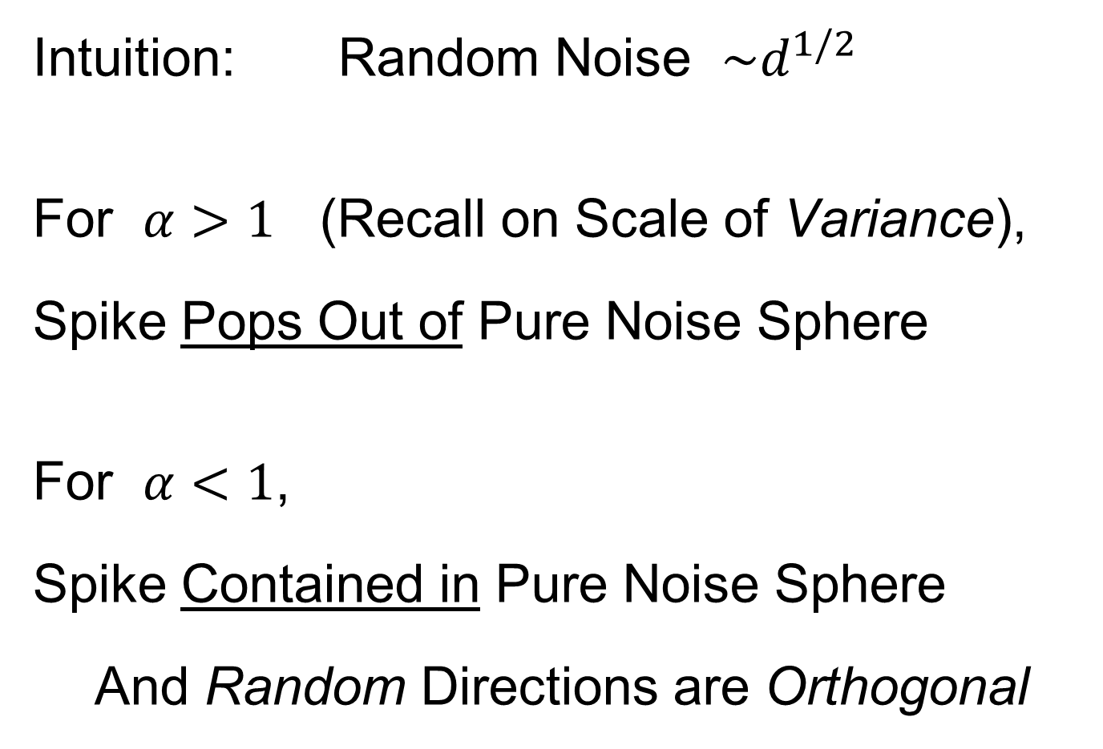
HDLSS Math. Stat. of PCA
Intuition: Random Noise $\sim d^{1/2}$
For $α>1$ (Recall on Scale of Variance),
Spike Pops Out of Pure Noise Sphere
For $α<1$,
Spike Contained in Pure Noise Sphere
And Random Directions are Orthogonal

Slide 35
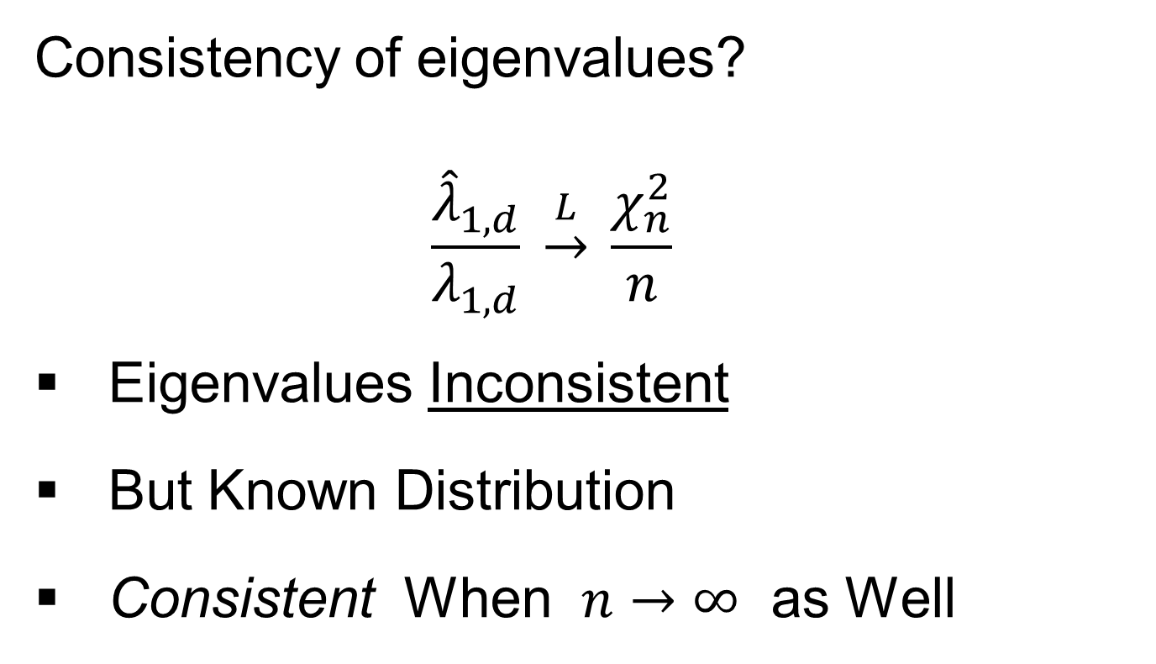
HDLSS Math. Stat. of PCA
Consistency of eigenvalues?
$$\frac{{\hat{λ}}_{1,d}}{λ_{1,d}} \underset{→}{L} \frac{χ_{n}^{2}}{n}$$
Eigenvalues Inconsistent
But Known Distribution
Consistent When $n→∞$ as Well
Consistency
Needs = 1

Slide 36

HDLSS Math. Stat. of PCA
Careful look at:
PCA Consistency - $α>1$ spike
(Reality Check, Suggested by Reviewer)

Slide 37
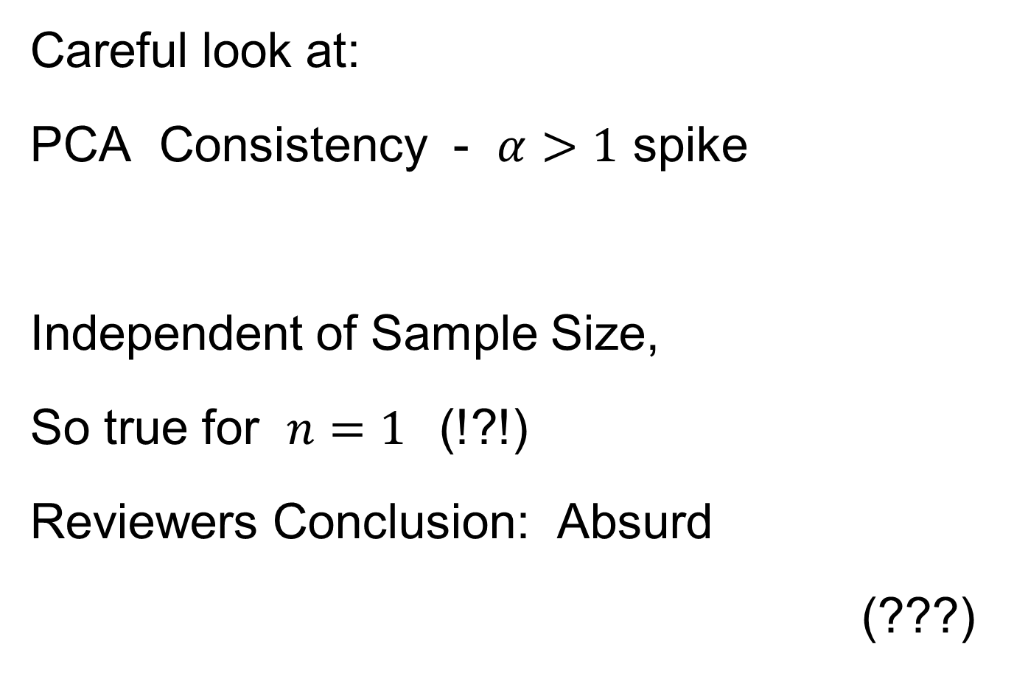
HDLSS Math. Stat. of PCA
Careful look at:
PCA Consistency - $α>1$ spike
Independent of Sample Size,
So true for $n=1$(!?!)
Reviewers Conclusion: Absurd
(???)
Shows assumption too strong for practice

Slide 38
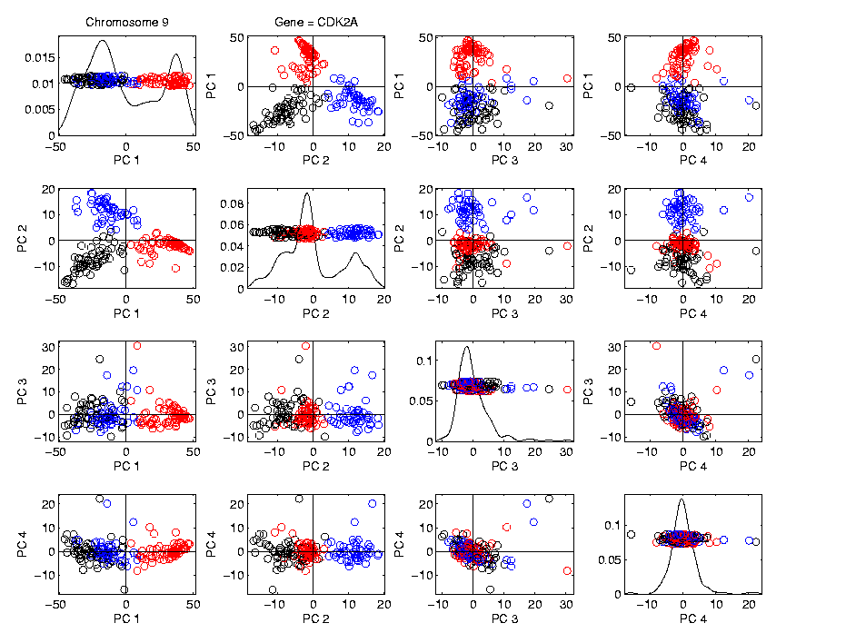
HDLSS Math. Stat. of PCA
HDLSS
PCA
Often
Finds
Signal,
Not Pure
Noise

Slide 39

HDLSS Math. Stat. of PCA
Recall
RNAseq
Example
$d\sim 1700$
$n=180$

Slide 40
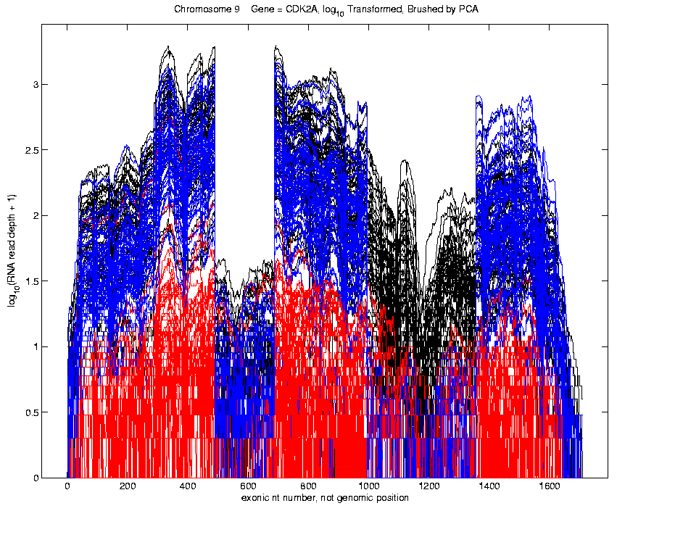
Functional Data Analysis
Manually
Brushed
Clusters
Clear
Alternate
Splicing
Not
Noise!

Slide 41
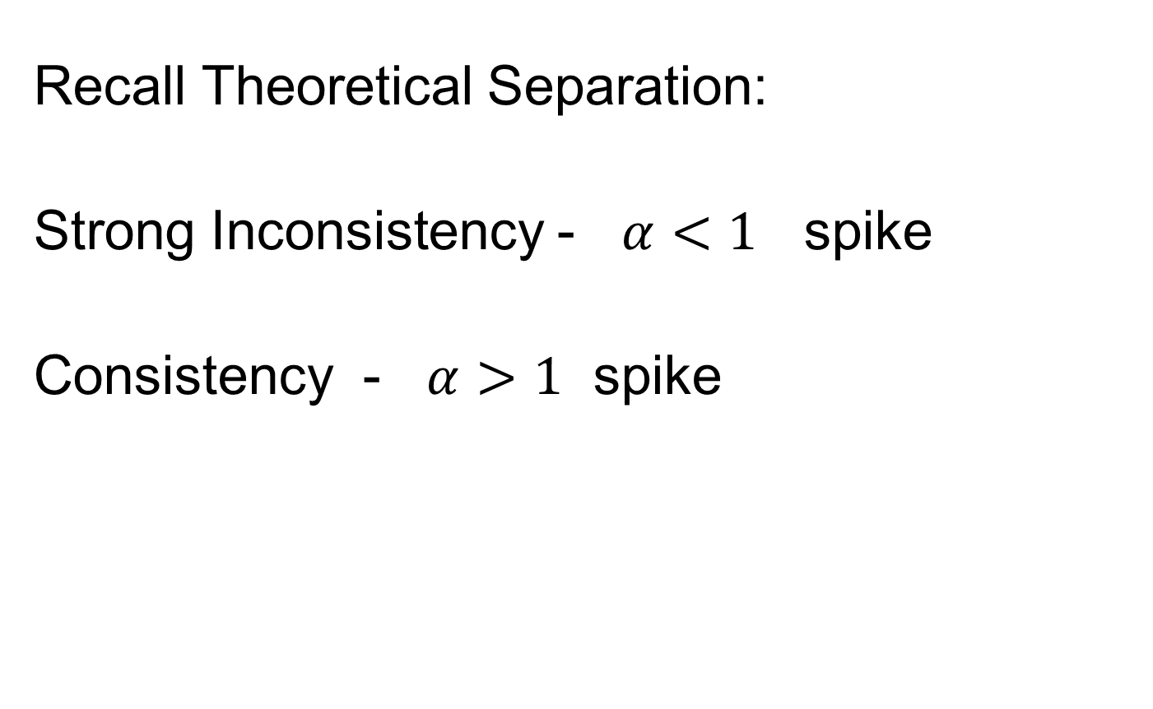
HDLSS Math. Stat. of PCA
Recall Theoretical Separation:
Strong Inconsistency - $α<1$ spike
Consistency - $α>1$ spike

Slide 42
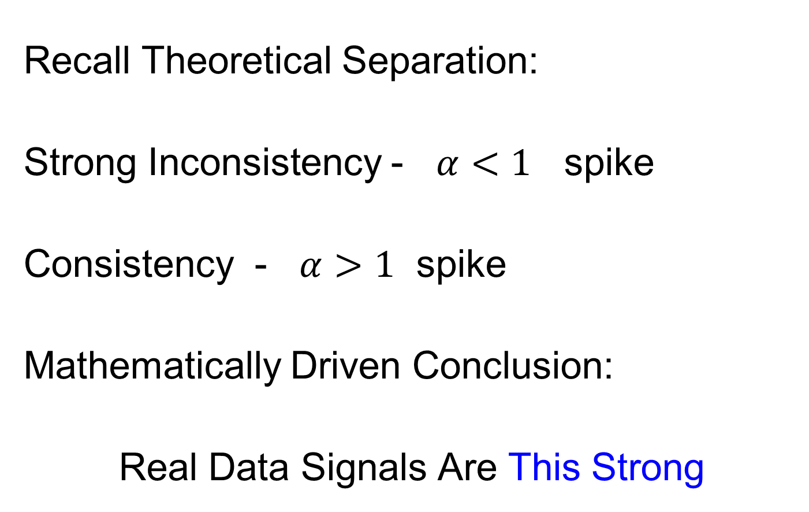
HDLSS Math. Stat. of PCA
Recall Theoretical Separation:
Strong Inconsistency - $α<1$ spike
Consistency - $α>1$ spike
Mathematically Driven Conclusion:
Real Data Signals Are This Strong

Slide 43
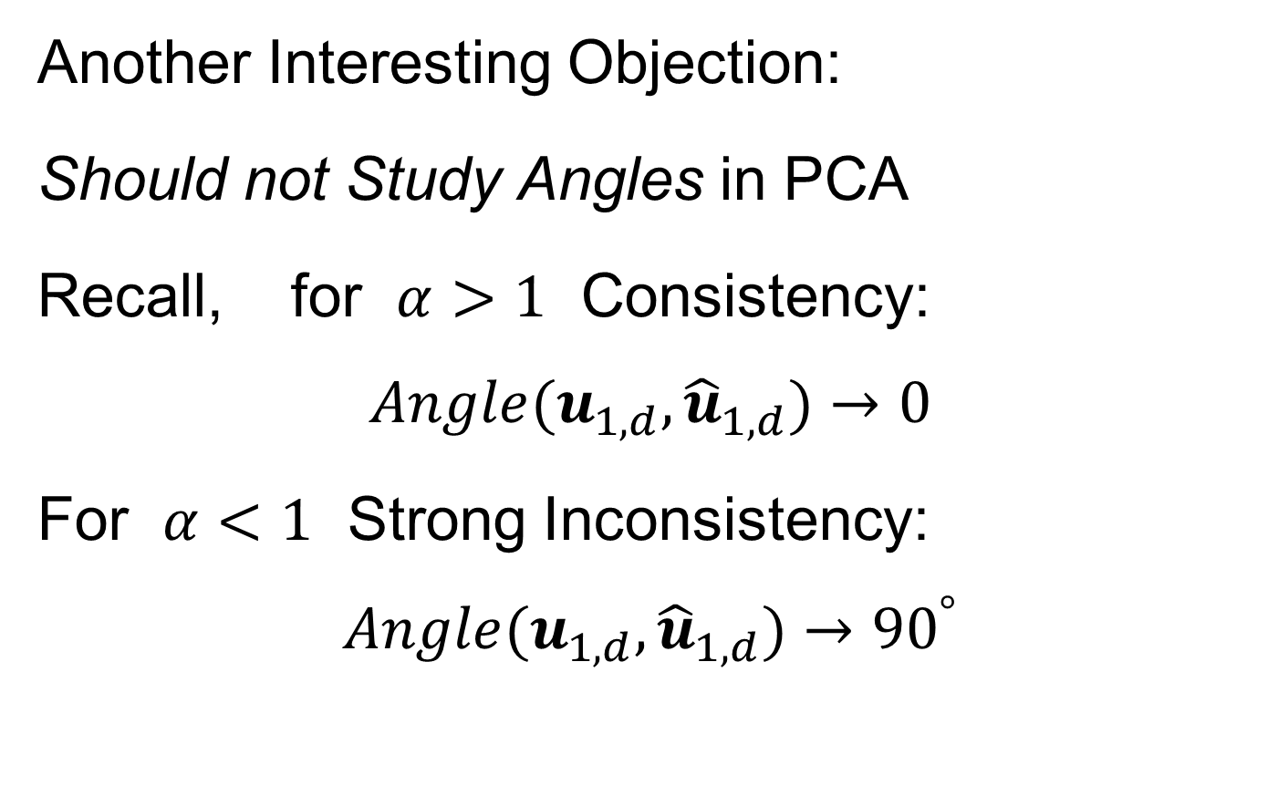
HDLSS Math. Stat. of PCA
Another Interesting Objection:
Should not Study Angles in PCA
Recall, for $α>1$ Consistency:
$$Angle(u_{1,d},{\hat{u}}_{1,d})→0$$
For $α<1$ Strong Inconsistency:
$$Angle(u_{1,d},{\hat{u}}_{1,d})→{90}^{°}$$

Slide 44
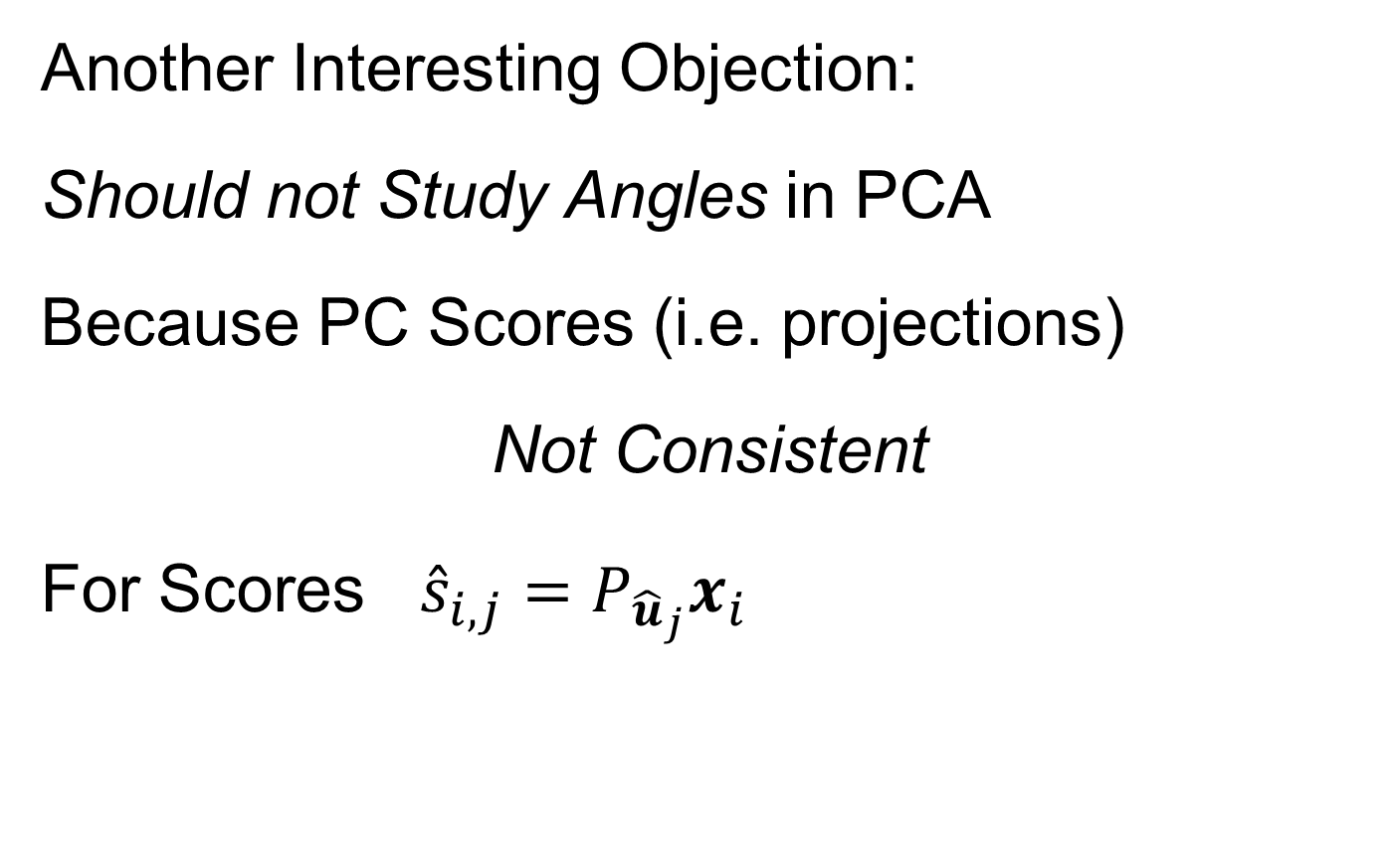
HDLSS Math. Stat. of PCA
Another Interesting Objection:
Should not Study Angles in PCA
Because PC Scores (i.e. projections)
Not Consistent
For Scores ${\hat{s}}_{i,j}=P_{{\hat{u}}_{j}}x_{i}$
What we study in PCA scatterplots

Slide 45

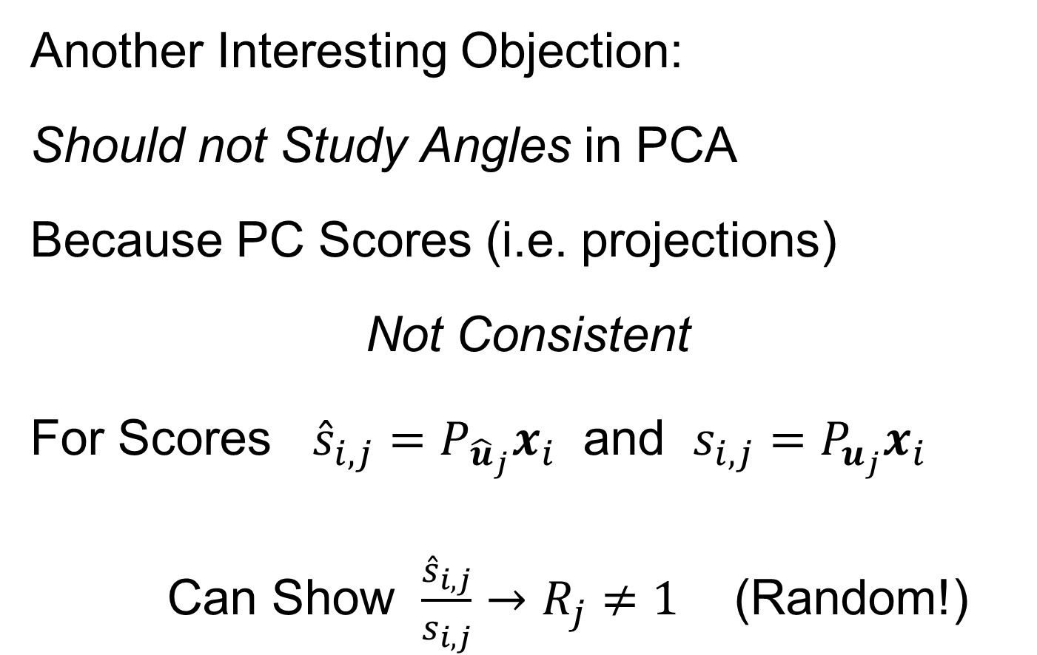
HDLSS Math. Stat. of PCA
Another Interesting Objection:
Should not Study Angles in PCA
Because PC Scores (i.e. projections)
Not Consistent
For Scores ${\hat{s}}_{i,j}=P_{{\hat{u}}_{j}}x_{i}$ and $s_{i,j}=P_{u_{j}}x_{i}$
Can Show $\frac{{\hat{s}}_{i,j}}{s_{i,j}}→R_{j}≠1$ (Random!)
Due to Dan Shen

Slide 46
HDLSS Math. Stat. of PCA
PC Scores (i.e. projections)
Not Consistent
So how can PCA find Useful Signals in Data?

Slide 47
HDLSS Math. Stat. of PCA
HDLSS
PCA
Often
Finds
Signal,
Not Pure
Noise

Slide 48
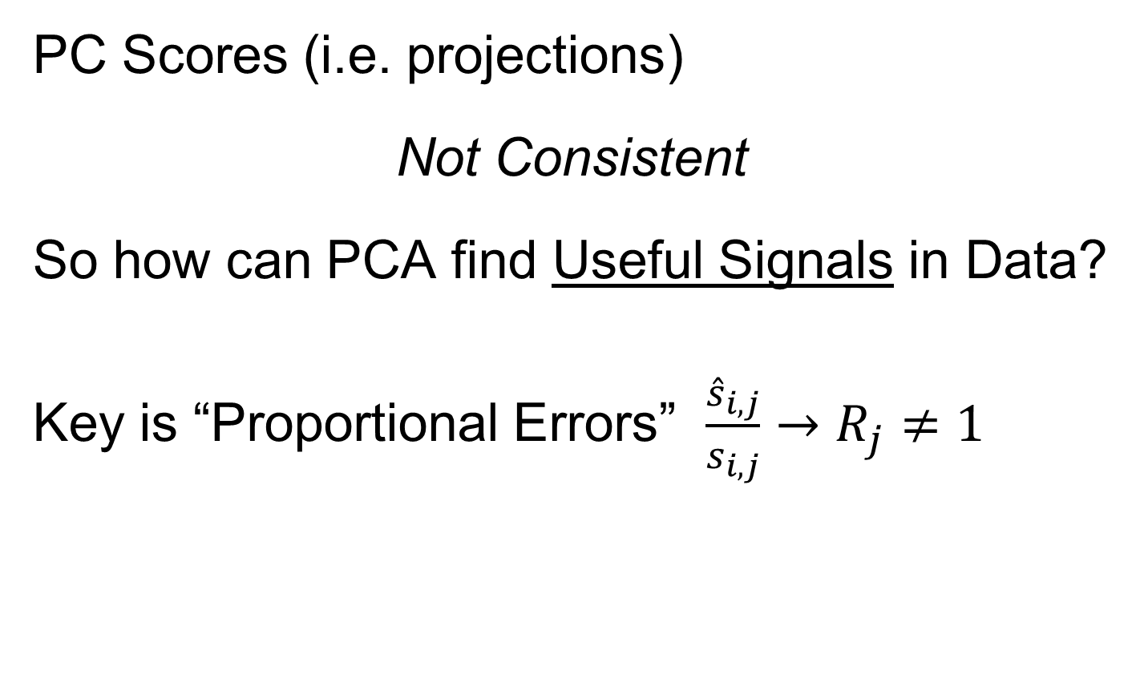
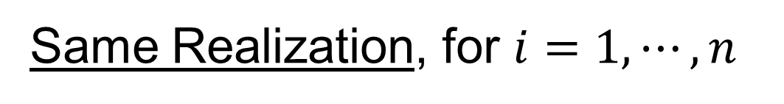
HDLSS Math. Stat. of PCA
PC Scores (i.e. projections)
Not Consistent
So how can PCA find Useful Signals in Data?
Key is “Proportional Errors” $\frac{{\hat{s}}_{i,j}}{s_{i,j}}→R_{j}≠1$
Same Realization, for $i=1,⋯,n$

Slide 49
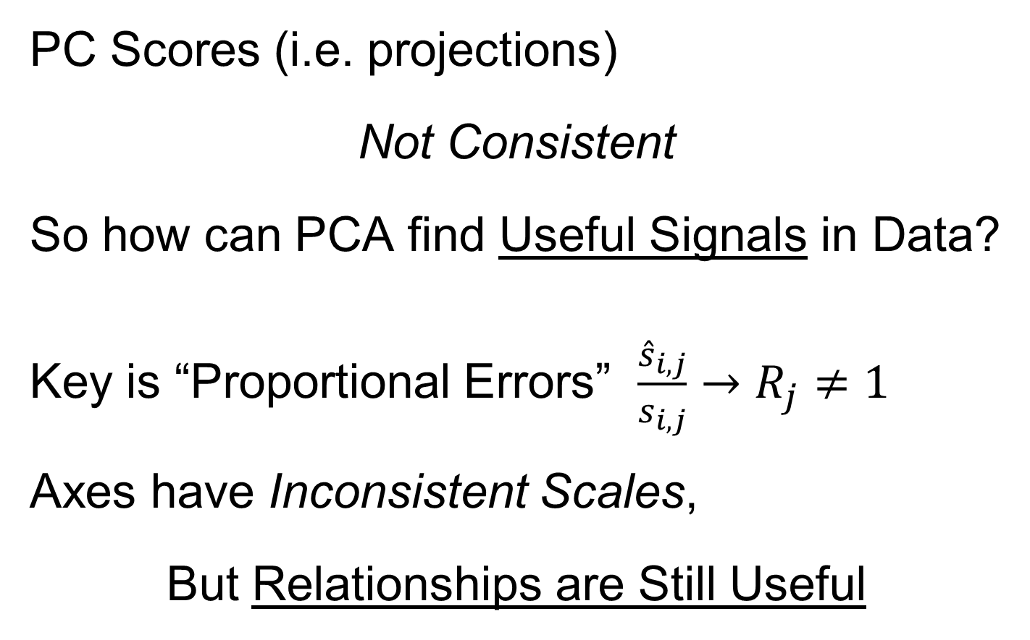
HDLSS Math. Stat. of PCA
PC Scores (i.e. projections)
Not Consistent
So how can PCA find Useful Signals in Data?
Key is “Proportional Errors” $\frac{{\hat{s}}_{i,j}}{s_{i,j}}→R_{j}≠1$
Axes have Inconsistent Scales,
But Relationships are Still Useful

Slide 50
HDLSS Math. Stat. of PCA
Numbers
On Axes
Are Wrong
But
Relationships
Are Right

Slide 51
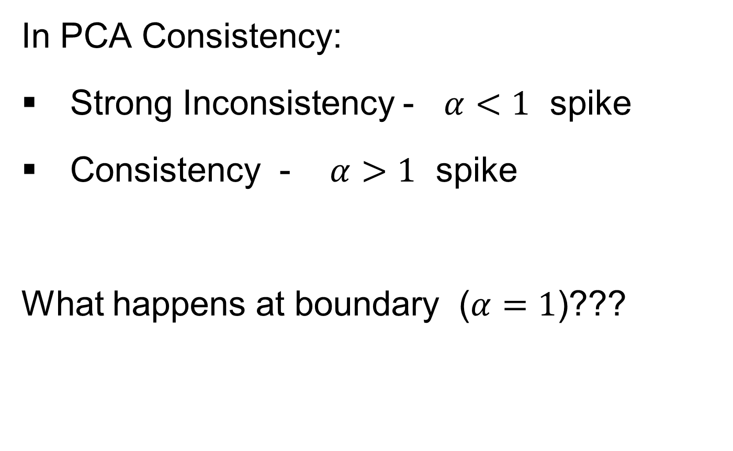
HDLSS Deep Open Problem
In PCA Consistency:
Strong Inconsistency - $α<1$ spike
Consistency - $α>1$ spike
What happens at boundary ($α=1$)???

Slide 52
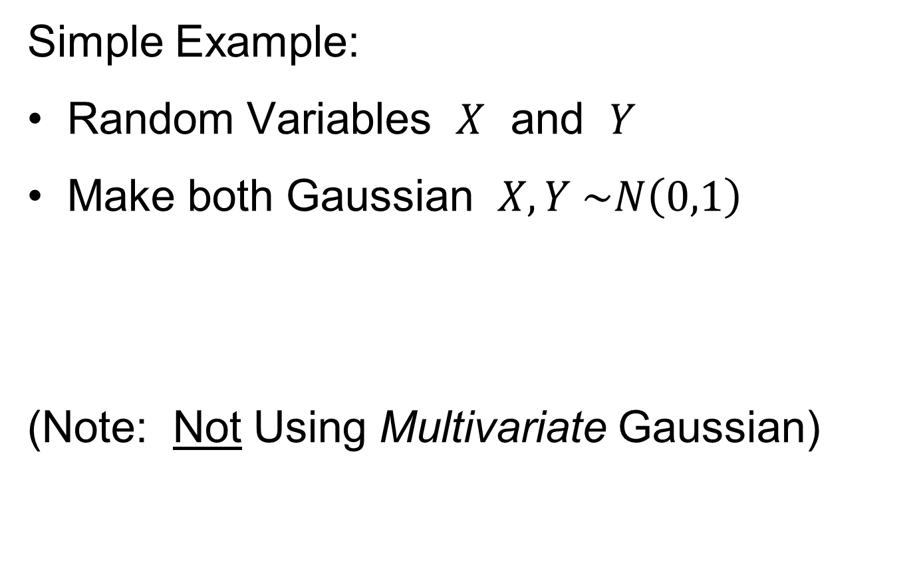
HDLSS Deep Open Problem
Result
In PCA Consistency:
Strong Inconsistency - $α<1$ spike
Consistency - $α>1$ spike
What happens at boundary ($α=1$)???
Ǝ interesting Limit Distn’s
Jung, Sen & Marron (2012)

Slide 53
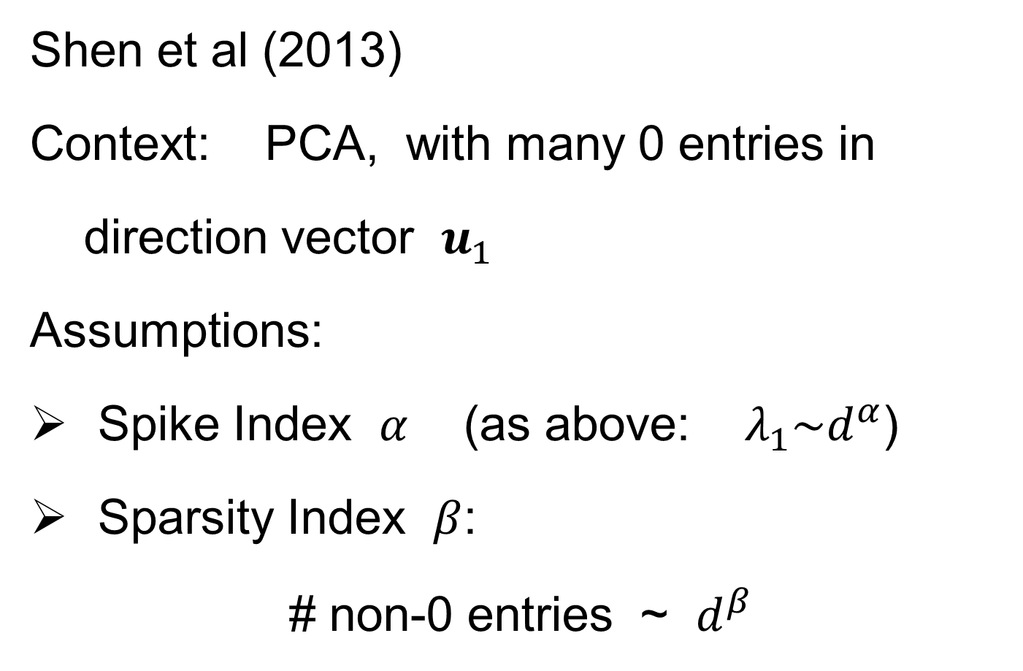
HDLSS & Sparsity
Shen et al (2013)
Context: PCA, with many 0 entries in
direction vector $u_{1}$
Assumptions:
Spike Index $α$ (as above: $λ_{1}\sim d^{α}$)
Sparsity Index $β$:
# non-0 entries ~ $d^{β}$

Slide 54
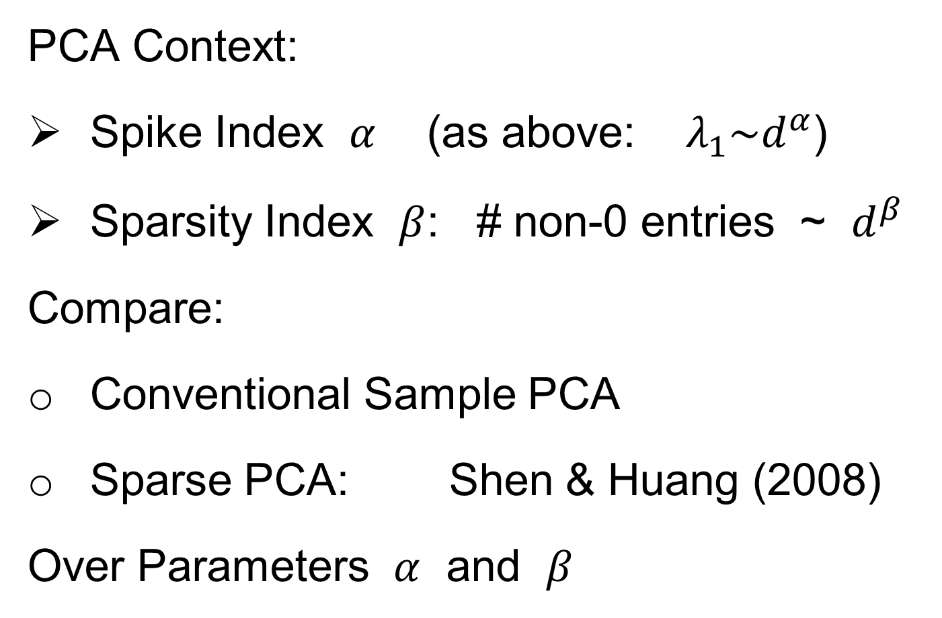
HDLSS & Sparsity
PCA Context:
Spike Index $α$ (as above: $λ_{1}\sim d^{α}$)
Sparsity Index $β$: # non-0 entries ~ $d^{β}$
Compare:
Conventional Sample PCA
Sparse PCA: Shen & Huang (2008)
Over Parameters $α$ and $β$

Slide 55
1
0≤ α < β ≤1
0.7
β
0≤ α = β ≤1
Sparsity Index
α>1
0 ≤ β ≤1
0.5
0.3
0≤β<α≤1
0.1
0
0
0.2
0.4
0.6
0.8
1
Jung and Marron
α
Spike Index
Regular PCA: Inconsistent & Consistent

Slide 56
1
0≤ α < β ≤1
0.7
β
0≤ α = β ≤1
Sparsity Index
α>1
0 ≤ β ≤1
0.5
0.3
0≤β<α≤1
0.1
0
0
0.2
0.4
0.6
0.8
1
Jung and Marron
α
Spike Index
Sparse PCA: Inconsistent & New Consistency Region

Slide 57
HDLSS & Sparsity
Sparse PCA Opens Up Whole New
Region of Consistency

Slide 58
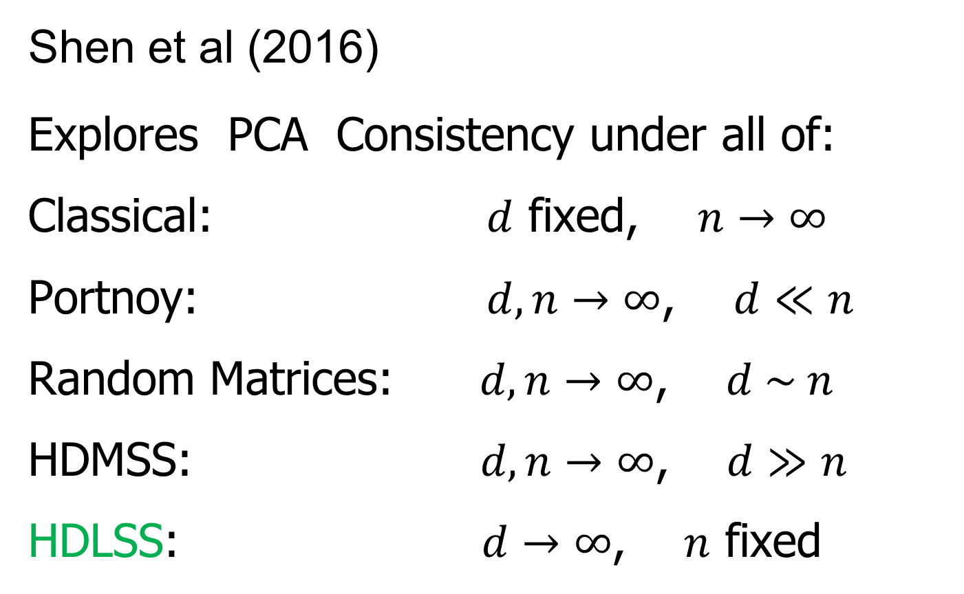
HDLSS & Other Asymptotics
Shen et al (2016)
Explores PCA Consistency under all of:
Classical: $d$ fixed, $n→∞$
Portnoy: $d, n→∞$, $d≪n$
Random Matrices: $d, n→∞$, $d \sim n$
HDMSS: $d, n→∞$, $d≫n$
HDLSS: $d→∞$, $n$ fixed

Slide 59
(A) Single Spike - Example 1.1
(B) Multi Spike - Example 1.2
Consistency
1
1
Sample Index
α + γ >1
γ
α + γ >1, γ >0
Sample Index (Johnstone and Lu (2009))
γ
Strong Inconsistency
0≤ α + γ <1
0≤ α + γ <1
(0,0)
Strong Inconsistency
1
Consistency
(0,0)
Strong Inconsistency
1
α
α
Subspace Consistency
Spike Index (Jung and Marron (2009))
Spike Index (Jung and Marron (2009))

Slide 60
(A) Single Spike - Example 1.1
(B) Multi Spike - Example 1.2
Consistency
1
1
Sample Index
α + γ >1
γ
α + γ >1, γ >0
Sample Index (Johnstone and Lu (2009))
γ
Strong Inconsistency
0≤ α + γ <1
0≤ α + γ <1
(0,0)
Strong Inconsistency
1
Consistency
(0,0)
Strong Inconsistency
1
α
α
Subspace Consistency
Spike Index (Jung and Marron (2009))
Spike Index (Jung and Marron (2009))

Slide 61
More HDLSS Asymptotics
Yata & Aoshima (2009,…,2012)
Natural Covariance Matrix Assumptions
(non-Gaussian)
Improvements on PCA
(Milder Consistency Cond.)
Using Clever Dual Space Calculations

Slide 62

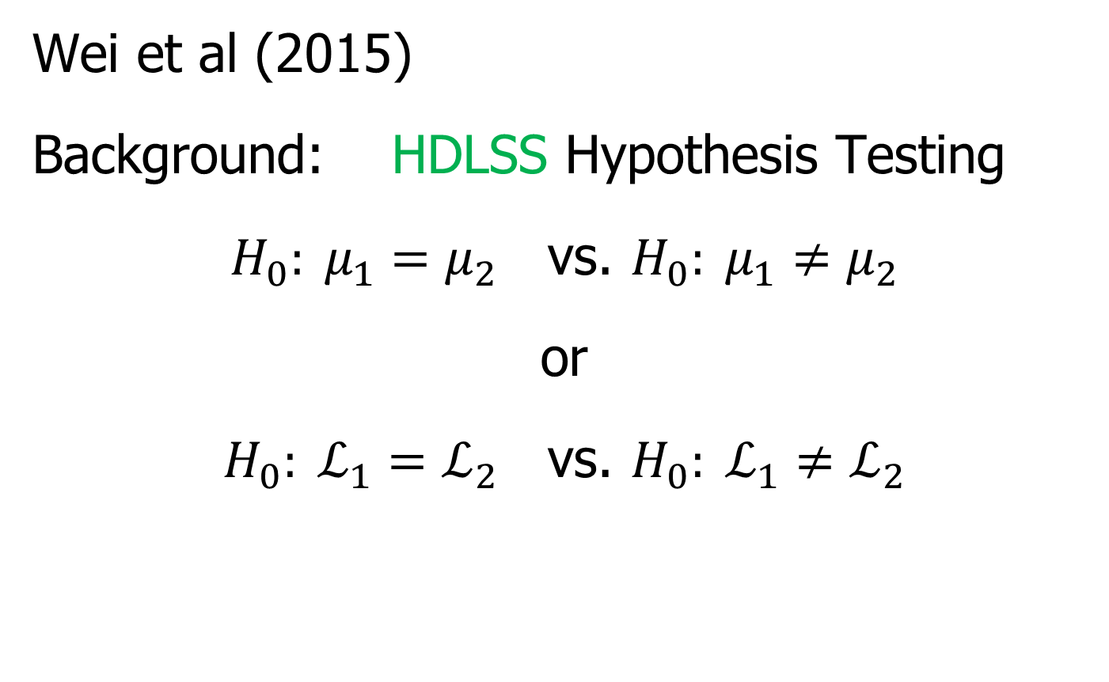
HDLSS Analysis of DiProPerm
Wei et al (2015)
Background: HDLSS Hypothesis Testing
$H_{0}: μ_{1}=μ_{2}$ vs. $H_{0}: μ_{1}≠μ_{2}$
or
$H_{0}: ℒ_{1}=ℒ_{2}$ vs. $H_{0}: ℒ_{1}≠ℒ_{2}$
Most Generally, But Test is Designed
for Maximal Power in Direction of Mean

Slide 63
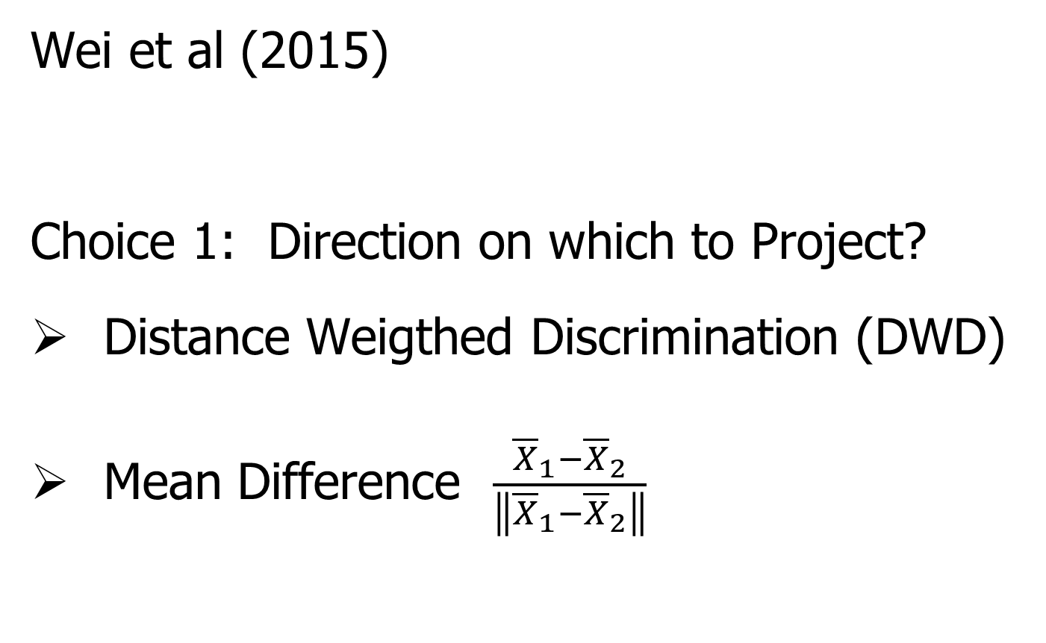
HDLSS Analysis of DiProPerm
Wei et al (2015)
Choice 1: Direction on which to Project?
Distance Weigthed Discrimination (DWD)
Mean Difference $\frac{{\overline{X}}_{1}−{\overline{X}}_{2}}{\left\|{\overline{X}}_{1}−{\overline{X}}_{2}\right\|}$

Slide 64
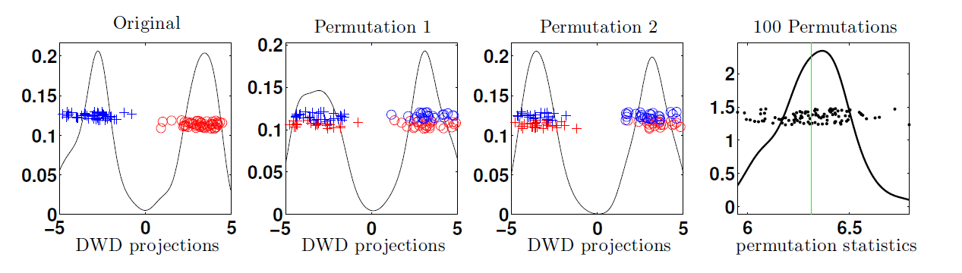
HDLSS Analysis of DiProPerm
Wei et al (2015)
Recall: N(0,1) data (both classes)

Slide 65
HDLSS Analysis of DiProPerm
Choice 2:
Which Statistic to Summarize Projections?
2 – Sample t statistic
Mean Difference

Slide 66


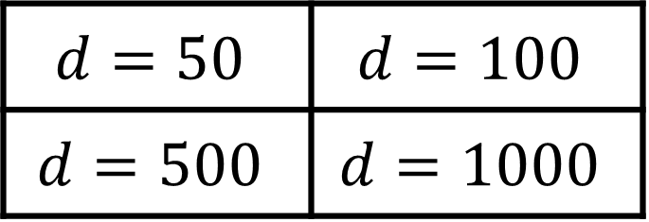

HDLSS Analysis of DiProPerm
Jack Prothero Simulations
$g=0$, $g=$1, $g=5$, $g=10$
$$N_{d}\left(\left(\begin{matrix}±g \\ ±g \\ \begin{matrix}0 \\ ⋮ \\ 0\end{matrix}\end{matrix}\right), I_{d}\right)$$
$$d=50$$ | $$d=100$$
$$d=500$$ | $$d=1000$$

Slide 67
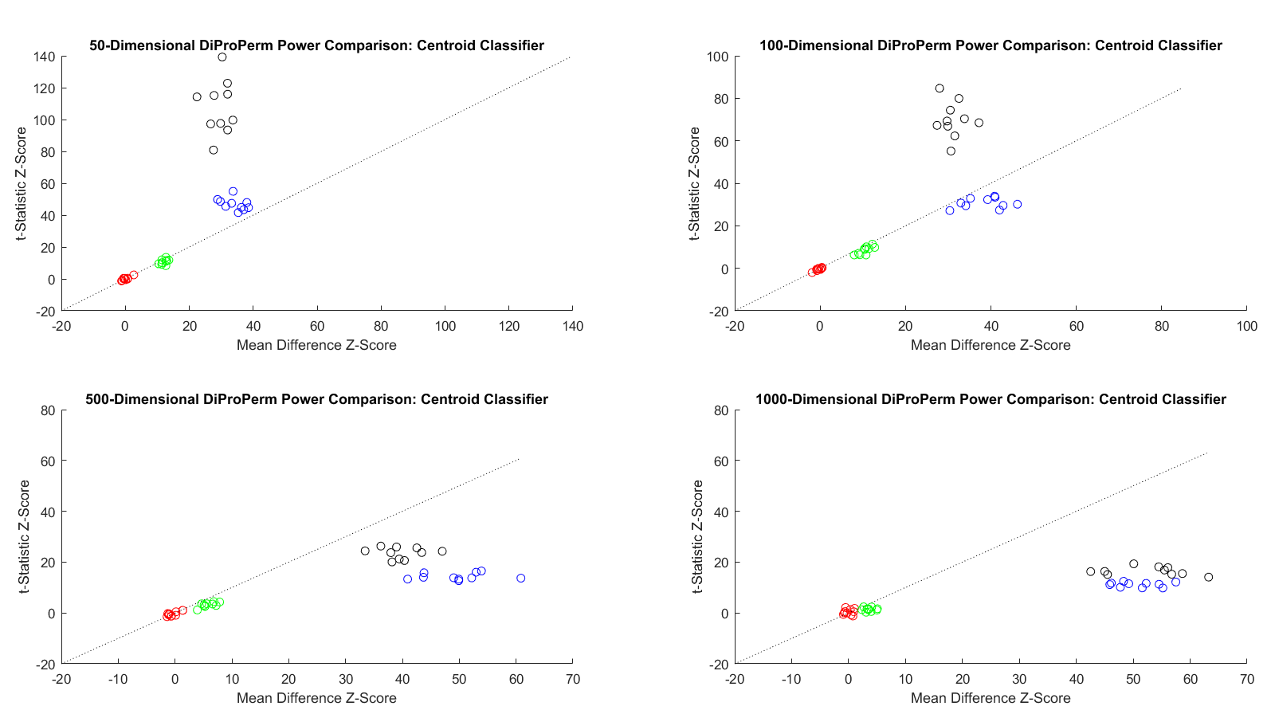
HDLSS Analysis of DiProPerm
Jack Prothero Simulations
Each Panel Compares
t-Statistic
With Mean Difference

Slide 68
HDLSS Analysis of DiProPerm
Jack Prothero Simulations
Over
Over Different Dimensions
All For The Centroid Direction

Slide 69


HDLSS Analysis of DiProPerm
Jack Prothero Simulations
T-Statistic Better for Lower $d$
Mean Difference Better for Higher $d$

Slide 70
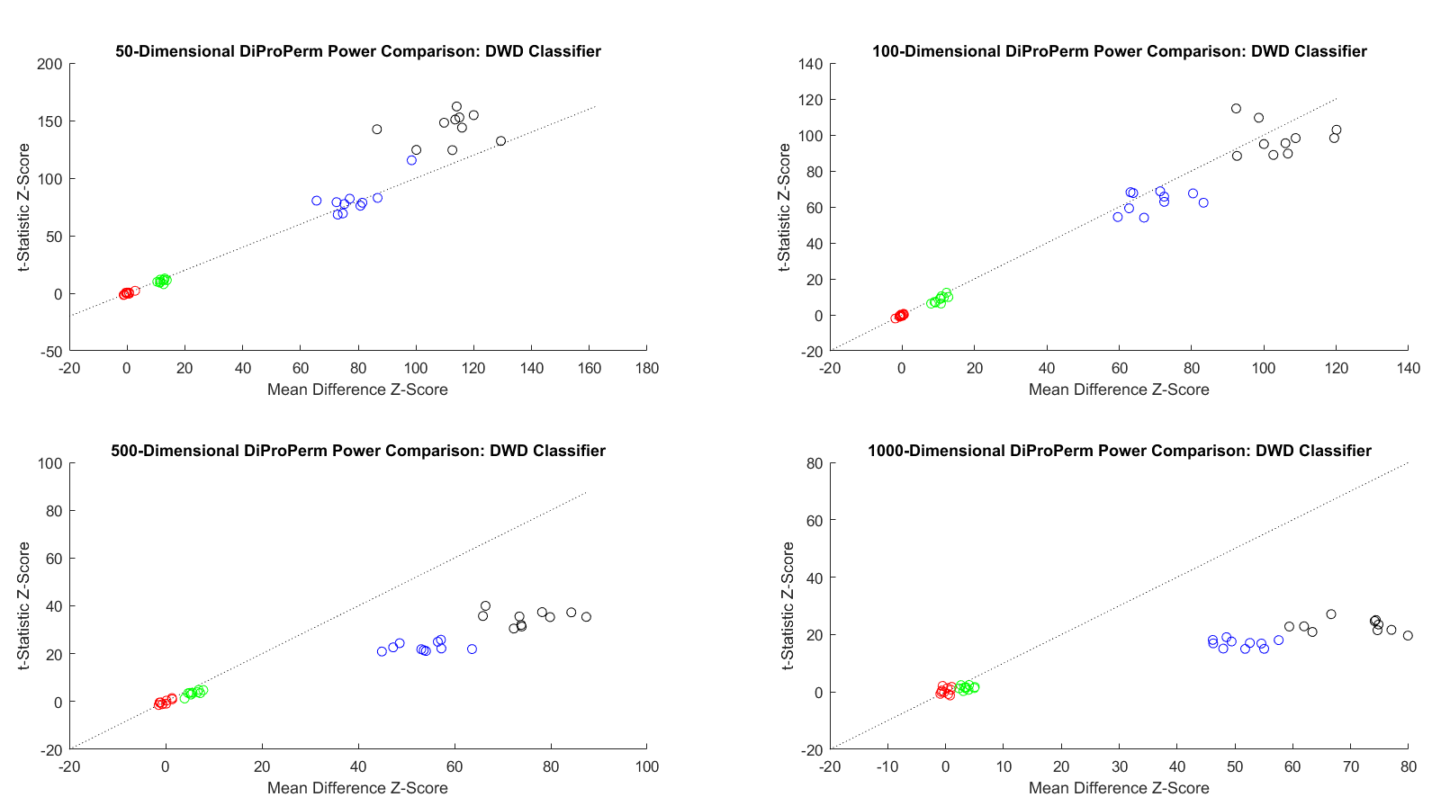


HDLSS Analysis of DiProPerm
Jack Prothero Simulations
Change to DWD Direction
Both Similar for Lower $d$
Mean Difference Better for Higher $d$

Slide 71

HDLSS Analysis of DiProPerm
Jack Prothero Simulations
For Large $d$ MD-Stat Better than t-Stat
Opposite for Low $d$, MD-Dir’n
DWD-Dir’n & MD-Stat Overall Best
Every Dog Has His Day

Slide 72


HDLSS Asymptotics in Classification
Recall in Simulations,
Methods Came Together, for High $d$

Slide 73
HDLSS Asymptotics in Classification
Explanation of Observed (Simulation) Behavior:
“everything similar for very high d ”
2 popn’s are 2 simplices (i.e. regular n-hedrons)
All are same distance from the other class
i.e. everything is a support vector
i.e. all sensible directions show “data piling”
so “sensible methods are all nearly the same”

Slide 74
HDLSS Asymptotics in Classification
Further Consequences of Geometric Represen’tion
1. DWD more stable than SVM
(based on deeper limiting distributions)
(reflects intuitive idea feeling sampling variation)
(something like mean vs. median)
Hall, Marron, Neeman (2005)
2. 1-NN rule inefficiency is quantified.
Hall, Marron, Neeman (2005)
3. Inefficiency of DWD for uneven sample size
(motivates weighted version)
Qiao, et al (2010)

Slide 75

Twiddle ratios of subtypes
2-d Toy
Example
Unbalanced
Mixture

Slide 76
Why not adjust by means?
DWD robust against non-proportional subtypes…
Mathematical Statistical Question:
Are there mathematics behind this?
Notes:
76

Slide 77

HDLSS Data Combo Mathematics
Liu (2007) Dissertation Results:
Simple Unbalanced Cluster Model
Growing at rate $d^{α}$ as $d→∞$
Answers depend on $α$
Visualization of setting….

Slide 78

HDLSS Data Combo Mathematics

Slide 79

HDLSS Data Combo Mathematics

Slide 80

HDLSS Data Combo Mathematics
Asymptotic Results (as $d→∞$)
Let $r$ denote ratio between subgroup sizes
Let $α$ quantify class difference:
$$\left\|X−Y\right\|\sim d^{α}$$

Slide 81

HDLSS Data Combo Mathematics
Asymptotic Results (as $d→∞$):
For $α>\frac{1}{2}$, PAM Inconsistent
Angle(PAM,Truth) $→ C_{r}≥0$
For $α<\frac{1}{2}$, PAM Strongly Inconsistent
Angle(PAM,Truth) $→ {90}^{°}$

Slide 82

HDLSS Data Combo Mathematics
Asymptotic Results (as $d→∞$):
For $α>\frac{1}{2}$, DWD Inconsistent
Angle(DWD,Truth) $→ C_{r}^{∗}≥0$
For $α<\frac{1}{2}$, DWD Strongly Inconsistent
Angle(DWD,Truth) $→ {90}^{°}$

Slide 83



HDLSS Data Combo Mathematics
Value of $C_{r}$ and $C_{r}^{∗}$, for sample size ratio $r$:
$C_{r}^{∗}=C_{r}=0$, only when $r=1$
Otherwise for $r≠1$, both are Inconsistent
$$C_{r}=\cos^{−1}\left(\frac{r+1}{\sqrt{2r^{2}+2}}\right)$$
$$C_{r}^{∗}=\cos^{−1}\left(\frac{\sqrt[3]{r}+1}{\sqrt{2r^{2/3}+2}}\right)$$

Slide 84

HDLSS Data Combo Mathematics
Comparison between PAM and DWD?
I.e. between $C_{r}$ and $C_{r}^{∗}$?

Slide 85

HDLSS Data Combo Mathematics
Comparison between PAM and DWD?

Slide 86

HDLSS Data Combo Mathematics
Comparison between PAM and DWD?
I.e. between $C_{r}$ and $C_{r}^{∗}$?
Shows Strong Difference
Explains Above Empirical Observation

Slide 87

Recall Radial DWD
Motivating Example: Virus Hunting
Based on DNA
DNA in Sample is Amplified & Cut Up
Matched to Known Virus Genome
Data Objects: Counts $x=\left(\begin{matrix}x_{1} \\ ⋮ \\ x_{d}\end{matrix}\right)$
Notes:
87

Slide 88


Virus Hunting
“Reads” Matched to Virus Genome & Counted to give $x_{1},⋯,x_{d}$
Notes:
88

Slide 89

Virus Hunting
Standardize by Dividing by Total
Consequence:
Data Objects lie on Unit Simplex
$$\left\{x=\left(\begin{matrix}x_{1} \\ ⋮ \\ x_{d}\end{matrix}\right):x_{1},⋯x_{d}≥0,\sum_{j=1}^{d}{x_{j}}=1\right\}$$
Notes:
89

Slide 90

Virus Hunting
Look at
Data:
Mostly
Non-0
Near Simplex Center
Almost
All 0
Near Simplex Corners
Notes:
90

Slide 91
Virus Hunting
Look at
Data:
Note:
Heights
Orders of
Magnitude
-5 << -3
Different
Notes:
91

Slide 92


Radial DWD
Thought
Model:
+ Class
Near Center
- Class At
Random
Corners
Note: $∃$ Many ($d$) Corners
Notes:
92

Slide 93

Virus Hunting
Note: HDLSS situation: $d\sim 10,000s n\sim 100s$
Have usual asymptotics?
Recall:
$\left\|x_{i}\right\| \sim \sqrt{d}$
$\left\|x_{i}−x_{j}\right\| \sim \sqrt{2d}$
Notes:
93

Slide 94



Virus Hunting
Check
HDLSS
Dist’s
Negative Cases
$\sim \sqrt{2d}$ From Positive
Positive Cases
Near Center
Negative Cases
$\sim \sqrt{d}$ From Center
Notes:
94

Slide 95
HDLSS Asymptotics
Survey & Introductory Paper:
Aoshima, Shen, Shen, Yata, Zhou & Marron (2018) Australian & New Zealand Journal of Statistics, 60, 4-19.
Memorial to Peter G. Hall

Slide 96
HDLSS Asymptotics
Personal Observations:
HDLSS world is…
Surprising (many times!)
[Think I’ve got it, and then …]
Mathematically Beautiful (?)
Practically Relevant

Slide 97
The Future of HDLSS Asymptotics
“Contiguity” in Hypo Testing?
Rates of Convergence?
Improvements of DWD?
(e.g. other functions of distance than inverse)
Many Others?
It is still early days …

Slide 98

State of HDLSS Research?
Development
Of Methods
Mathematical
Assessment
…
(thanks to:
defiant.corban.edu/gtipton/net-fun/iceberg.html)

Slide 99
Participant Presentations
12:05 Yang Luo:
Halpern-Type Accelerated Algorithms For Monotone Inclusions
12:10 Madison Lindsay:
Analysis of a State-Dependent Markovian Queuing System
Next Class: Bongsoo Yi, Fengyu Yang, Wan Zhang

