Slide 1
Statistics – O. R. 881 Object Oriented Data Analysis
Start
Recording
Steve Marron
Dept. of Statistics and Operations Research
University of North Carolina

Slide 2
Current Sections in Textbook
Today:
Section 14.1, 12.1
Next Class:
Sections 12.1, 12.2

Slide 3
HDLSS Math. Stat. of PCA
Consistency & Strong Inconsistency:
Spike Covariance Model, Paul (2007)
For Eigenvalues:
$λ_{1,d}=d^{α},λ_{2,d}=⋯=λ_{d,d}=1$
Denote 1st Eigenvector: $u_{1,d}$
How Good are Empirical Versions,
as Estimates? ${\hat{λ}}_{1,d},⋯,{\hat{λ}}_{d,d}, {\hat{u}}_{1,d}$

Slide 4
HDLSS Math. Stat. of PCA
Consistency (big enough spike):
For $α>1$,
$$Angle\left(u_{1,d},{\hat{u}}_{1,d}\right)→0$$
Strong Inconsistency (spike not big enough):
For $α<1$,
$$Angle\left(u_{1,d},{\hat{u}}_{1,d}\right)→{90}^{°}$$

Slide 5
HDLSS Math. Stat. of PCA
Intuition: Random Noise $\sim d^{1/2}$
For $α>1$ (Recall on Scale of Variance),
Spike Pops Out of Pure Noise Sphere
For $α<1$,
Spike Contained in Pure Noise Sphere
And Random Directions are Orthogonal

Slide 6
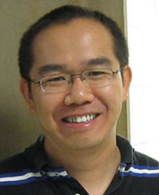
HDLSS Math. Stat. of PCA
Another Interesting Objection:
Should not Study Angles in PCA
Because PC Scores (i.e. projections)
Not Consistent
For Scores ${\hat{s}}_{i,j}=P_{{\hat{u}}_{j}}x_{i}$ and $s_{i,j}=P_{u_{j}}x_{i}$
Can Show $\frac{{\hat{s}}_{i,j}}{s_{i,j}}→R_{j}≠1$ (Random!)
Due to Dan Shen

Slide 7
HDLSS Math. Stat. of PCA
PC Scores (i.e. projections)
Not Consistent
So how can PCA find Useful Signals in Data?
Key is “Proportional Errors” $\frac{{\hat{s}}_{i,j}}{s_{i,j}}→R_{j}≠1$
Axes have Inconsistent Scales,
But Relationships are Still Useful

Slide 8
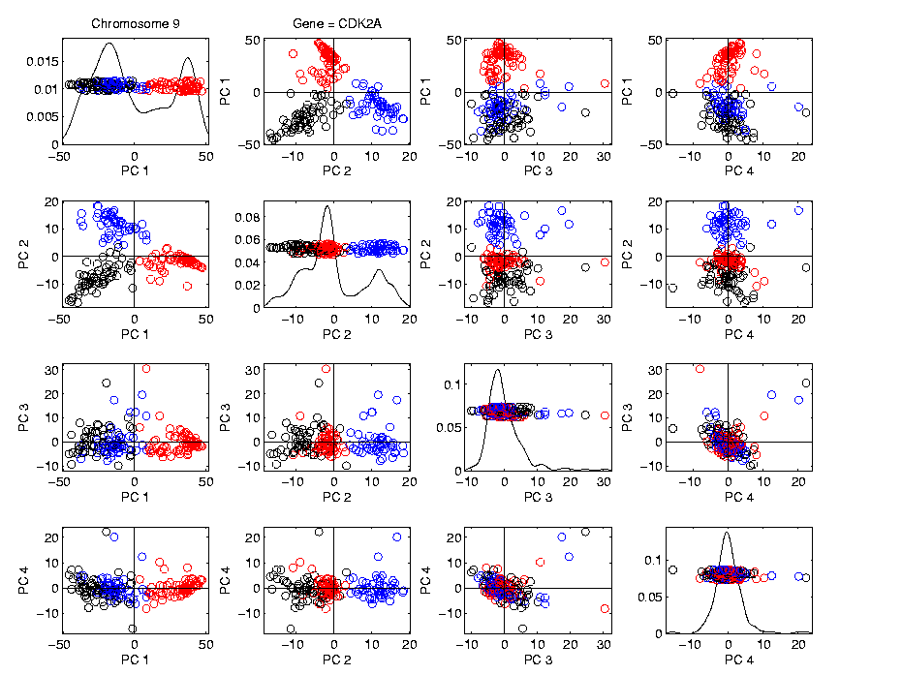
HDLSS Math. Stat. of PCA
Numbers
On Axes
Are Wrong
But
Relationships
Are Right

Slide 9
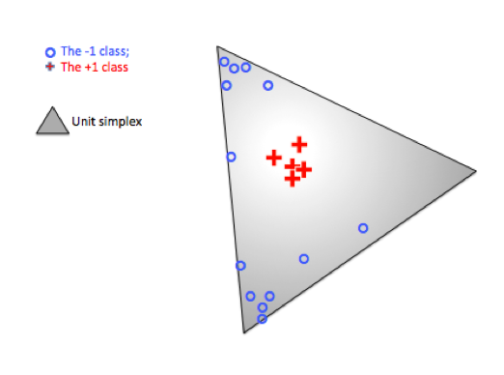
Radial DWD
Thought
Model:
+ Class
Near Center
- Class At
Random
Corners
Note: $∃$ Many ($d$) Corners
Notes:
9

Slide 10
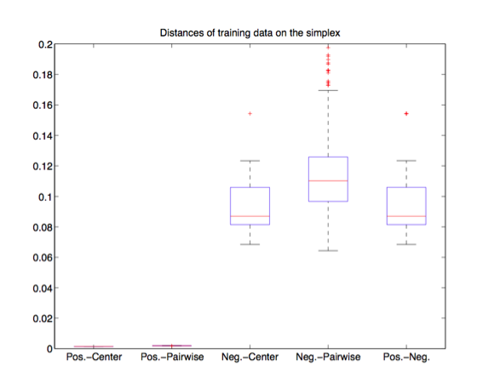
Virus Hunting
Check
HDLSS
Dist’s
Negative Cases
$\sim \sqrt{2d}$ From Positive
Positive Cases
Near Center
Negative Cases
$\sim \sqrt{d}$ From Center
Notes:
10

Slide 11
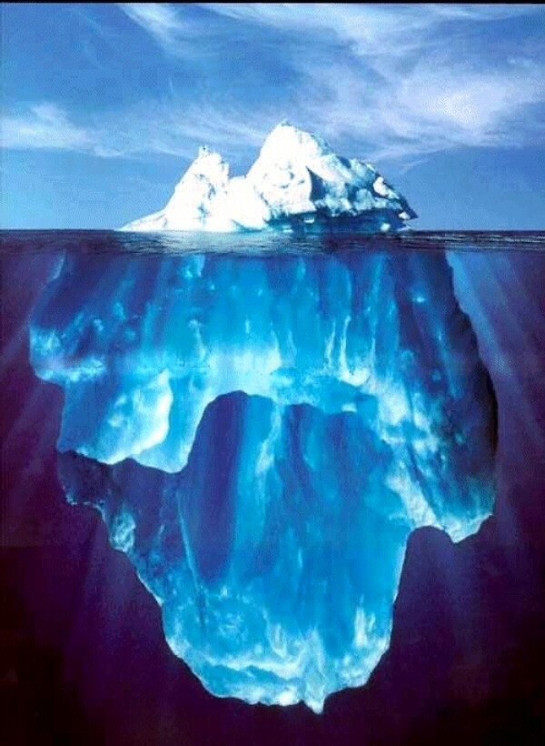
State of HDLSS Research?
Development
Of Methods
Mathematical
Assessment
…
(thanks to:
defiant.corban.edu/gtipton/net-fun/iceberg.html)

Slide 12
Random Matrix Theory
Text: Sec. 14.1
Main Ideas:
1. Asymptotics as $n,d→∞$
2. Pure Noise Distribution of PCA Eigenvalues
Usefulness:
Interpretation of Scree Plots
For Eigenvalues $λ_{j}$ of Sample Covariance $\hat{Σ}$
Plot $λ_{j}$ vs. $j$

Slide 13
PCA Redist’n of Energy (Cont.)
Note, have already considered some of these Useful Plots:
Power Spectrum (as %s)
Cumulative Power Spectrum (%)
Common Terminology:
Power Spectrum is Called
“Scree Plot”
Kruskal (1964) Cattell (1966)
(all but name “scree”) (1st Appearance of name???)
Notes:
13

Slide 14
PCA Redist’n of Energy (Cont.)
Note, have already considered some of these Useful Plots:
Power Spectrum (as %s)
Cumulative Power Spectrum (%)
Large Values Reflect
Important Structure
Notes:
14

Slide 15
PCA Redist’n of Energy (Cont.)
Note, have already considered some of these Useful Plots:
Power Spectrum (as %s)
Cumulative Power Spectrum (%)
Zoom In & Characterize Noise
Notes:
15

Slide 16
Random Matrix Theory
Text, Sec. 14.1
Pure Noise Data Matrix:
$X=$
Defined as: Entries i.i.d. $N(0,1)$
$$d$$
Thinking of
Columns As
Data Objects
$$n$$

Slide 17
Random Matrix Theory
Clean Notation Version of Covariance Matrix:
$$\tilde{Σ}=\frac{1}{n}XX^{t}$$
Simplified by:
No Mean Centering (using $N(0,1)$)
Roughly OK, By Usual Mean Centering
Also Standardize by $\frac{1}{n}$ not $\frac{1}{n−1}$
Easy & Sensible for No Mean Centering
Size = $d×d$

Slide 18
Random Matrix Theory
Eigenvalues are $\tilde{λ_{j}}$, diagonal entries of $Λ$ in
$$\tilde{Σ}=UΛU^{t}$$
(Eigen-analysis)
Distribution of $\tilde{λ_{j}}$?

Slide 19
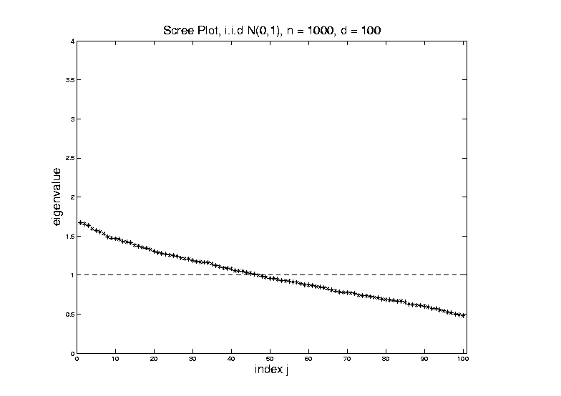
Random Matrix Theory
For $d=100$, $n=1000$, Eigenvalues $≈1$
But There Is (Chance) Variation

Slide 20
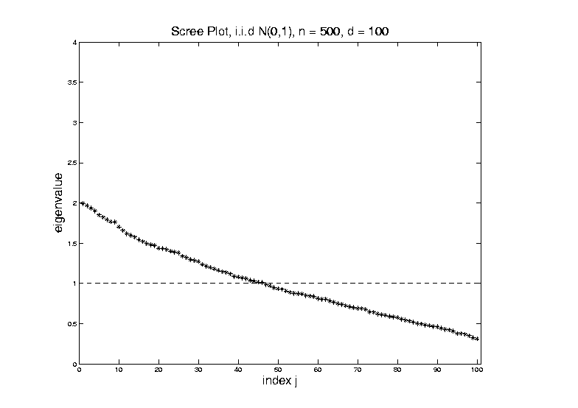
Random Matrix Theory
Smaller $n=500$ Boosts Variation
(More Uncertainty)

Slide 21
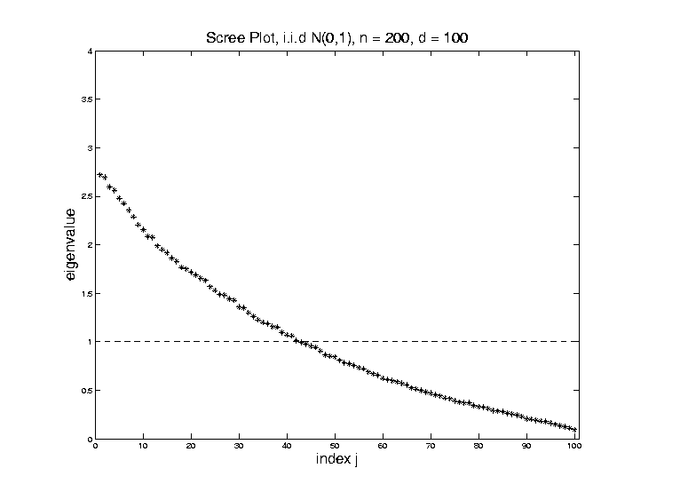
Random Matrix Theory
Smaller $n=200$ Boosts Variation
(More Uncertainty)

Slide 22
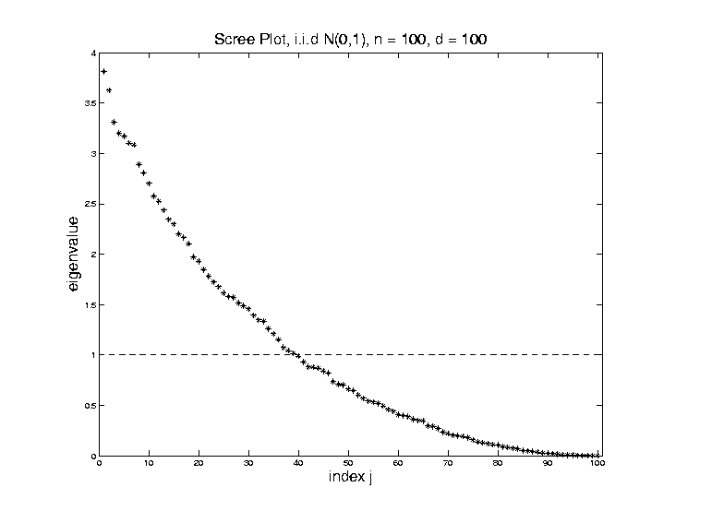
Random Matrix Theory
Smaller $n=100$ Boosts Variation
But Can’t Go Negative
Although
Can Get
Large

Slide 23
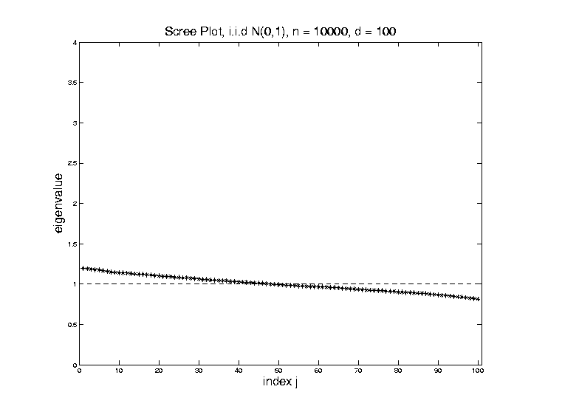
Random Matrix Theory
Larger $n=10,000$ Reduces Variation

Slide 24
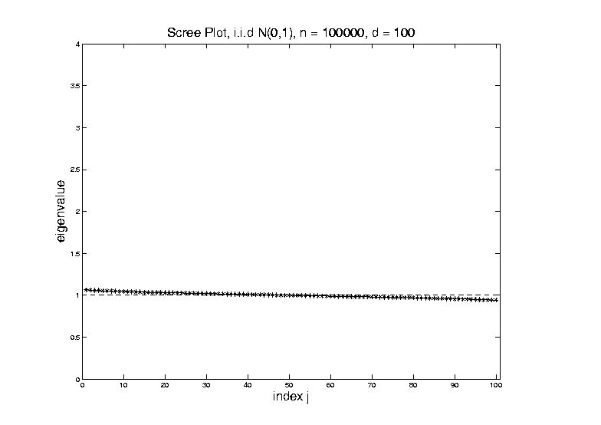
Random Matrix Theory
Larger $n=100,000$ Reduces Variation

Slide 25
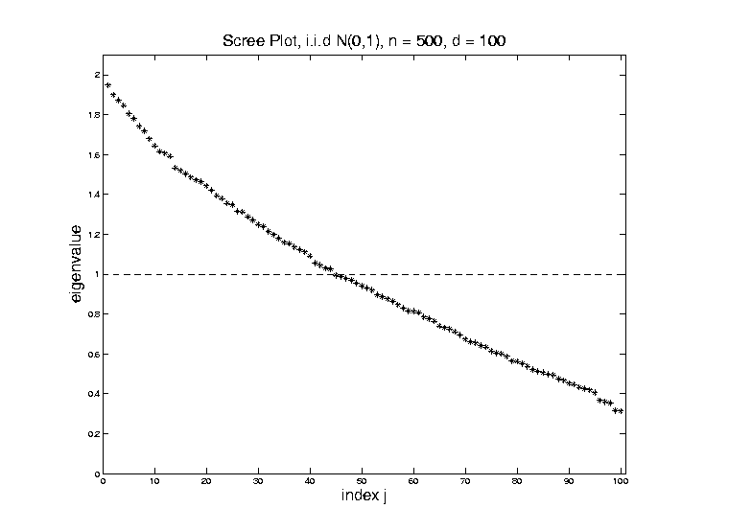
Random Matrix Theory
Fix $y=\frac{d}{n}=\frac{1}{5}$, and let $d$, $n$ grow ($→∞$).
Essentially
Same
Shape

Slide 26
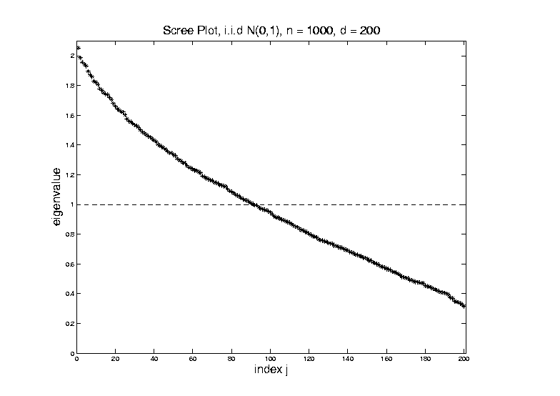
Random Matrix Theory
Fix $y=\frac{d}{n}=\frac{1}{5}$, and let $d$, $n$ grow ($→∞$).
Essentially
Same
Shape

Slide 27
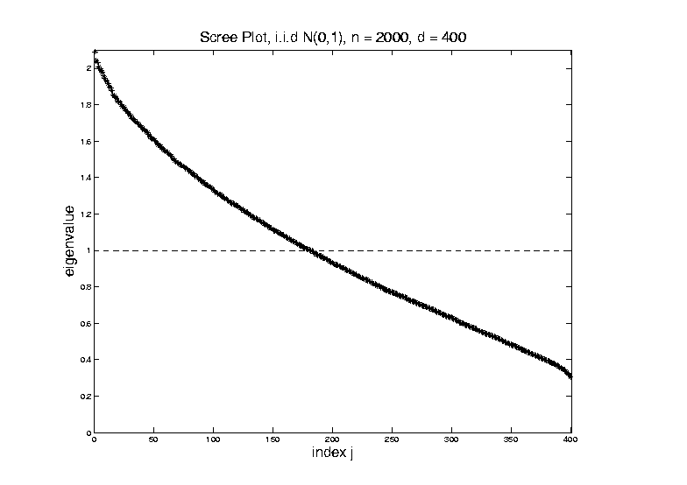
Random Matrix Theory
Fix $y=\frac{d}{n}=\frac{1}{5}$, and let $d$, $n$ grow ($→∞$).
But Less
Sampling
Noise

Slide 28
Random Matrix Theory
Fix $y=\frac{d}{n}=\frac{1}{5}$, and let $d$, $n$ grow ($→∞$).
But Less
Sampling
Noise

Slide 29
Random Matrix Theory
Fix $y=\frac{d}{n}=\frac{1}{5}$, and let $d$, $n$ grow ($→∞$).
What Is
That Shape?

Slide 30
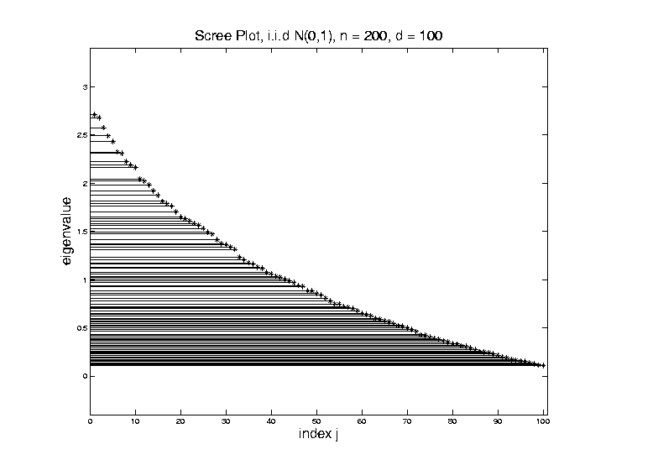
Random Matrix Theory
Shape is Captured by
Empirical Spectral Density
“Density”
Of These
Eigenvalues

Slide 31
Random Matrix Theory
Limiting Spectral Density
(in limit as $n, d→∞$, with $y=\frac{d}{n}$)
References:
Marčenko Pastur (1967)
Yao et al (2015)
Dobriban (2015)

Slide 32
Random Matrix Theory
Limiting Spectral Density
(in limit as $n, d→∞$, with $y=\frac{d}{n}$)
Limit Exists
No Closed Form
But Can Implicitly Define
(Using Integral Equations)
And Numerically Approximate

Slide 33
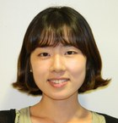
Random Matrix Theory
Limiting Spectral Density, for given $y=\frac{d}{n}$
Convenient Visualization Interface
By Hyo Young Choi

Slide 34
Random Matrix Theory
LSD:
Above
Case
$n=200,$
$d=100$

Slide 35
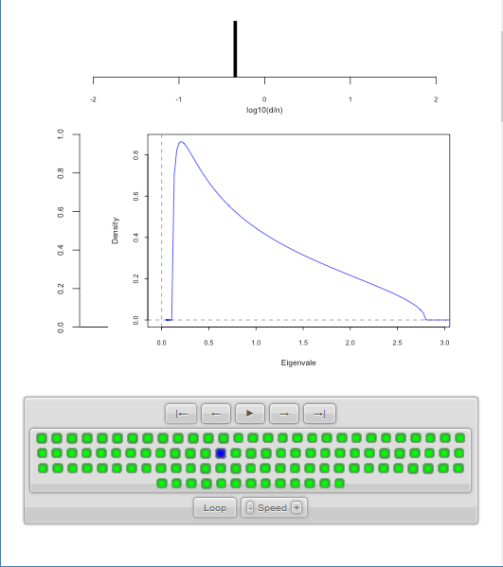
Random Matrix Theory
LSD:
Above
Case
$n=200,$
$d=100,$
$y=0.5$
$\log_{10}{y}=−0.301$

Slide 36
Random Matrix Theory
LSD
Note: These
Have Finite
Support
$⊂(0,∞)$

Slide 37
Random Matrix Theory
LSD
In Particular:
$$σ^{2}{\left(1−\sqrt{y}\right)}^{2}$$
$$σ^{2}{\left(1+\sqrt{y}\right)}^{2}$$

Slide 38
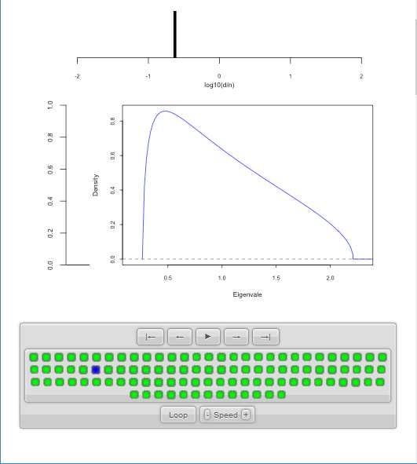
Random Matrix Theory
LSD:
Now Try Smaller
(More Negative log)
Values of $y=\frac{d}{n}$

Slide 39
Random Matrix Theory
LSD:
Now Try Smaller
(More Negative log)
Values of $y=\frac{d}{n}$

Slide 40
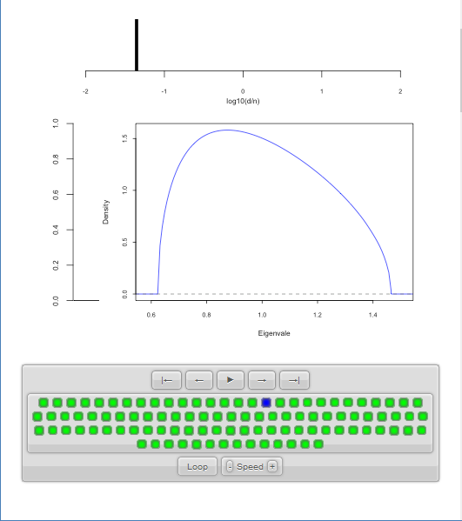
Random Matrix Theory
LSD:
Now Try Smaller
(More Negative log)
Values of $y=\frac{d}{n}$
Note: Support
Points $→1$

Slide 41
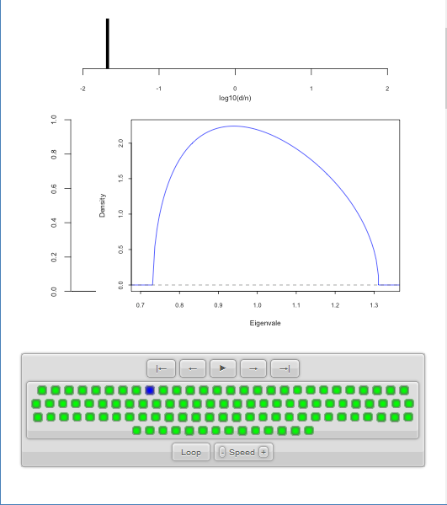
Random Matrix Theory
LSD:
Now Try Smaller
(More Negative log)
Values of $y=\frac{d}{n}$

Slide 42
Random Matrix Theory
LSD:
Now Try Smaller
(More Negative log)
Values of $y=\frac{d}{n}$
Note: Increasing
Symmetry
Endpoints $σ^{2}{\left(1±\sqrt{y}\right)}^{2}$
Are Converging To 1

Slide 43
Random Matrix Theory
Larger $n=100,000$ Reduces Variation
Recall
Previous
Large $n$
Case,
LSD is
Zooming
In On This

Slide 44
Random Matrix Theory
Limiting Case:
$$\lim_{d→∞}{\lim_{n→∞}{}}$$
Called Medium Dimension High Sample Size
Resulting Density is “Semi-Circle”
$$f\left(x\right)=\frac{2}{πR^{2}}\sqrt{R^{2}−x^{2}}1_{\left[−R,R\right]}(x)$$
Called “Wigner Semi-Circle Distribution”

Slide 45
Random Matrix Theory
Summary:
Have Studied Data Matrix Shapes
Observed:
Convergence to 1
Increasing Symmetry
What About Other Direction (Larger $d$)?

Slide 46
Random Matrix Theory
Consider Growing $d$
Challenge:
Only $n$ Columns in $X$ (so rank $=n$)
Yet $\tilde{Σ}=\frac{1}{n}XX^{t}$ is $d×d$
So Have $d−n$ Eigenvalues $=0$

Slide 47
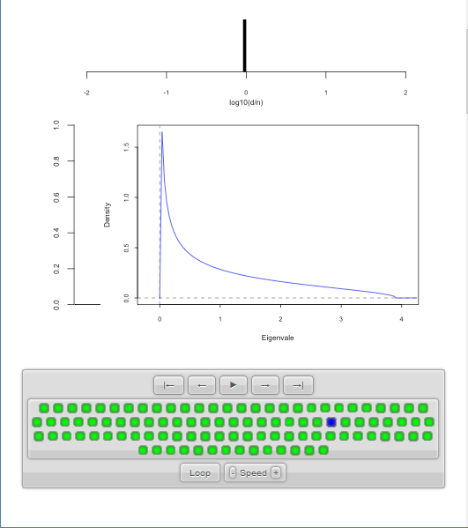
Random Matrix Theory
LSD:
Start With
$y=\frac{d}{n}≈1$
Case

Slide 48
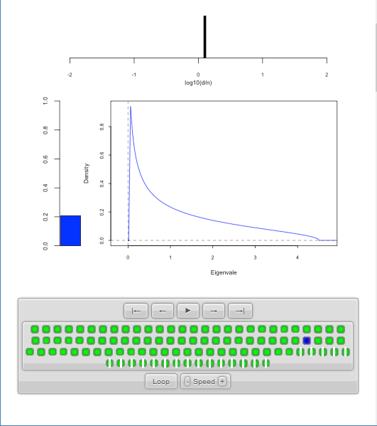
Random Matrix Theory
LSD:
Now Try Larger
Values of $y=\frac{d}{n}$
Proportion of
0 Eigenvalues

Slide 49
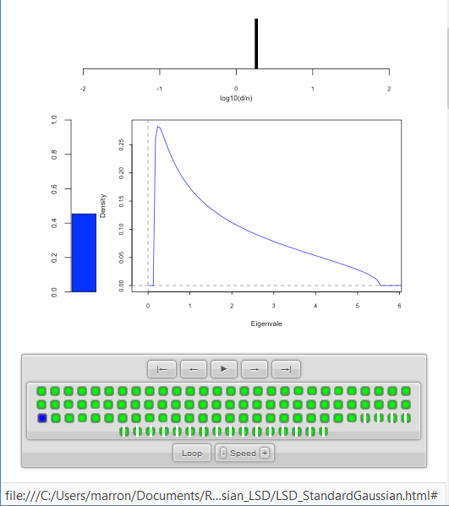
Random Matrix Theory
LSD:
Now Try Larger
Values of $y=\frac{d}{n}$
Spectral Density of
Non-0 Eigenvalues

Slide 50
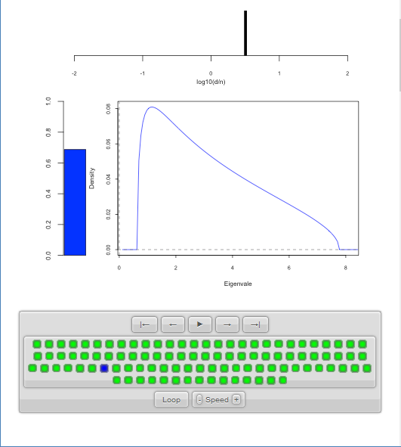
Random Matrix Theory
LSD:
Now Try Larger
Values of $y=\frac{d}{n}$

Slide 51
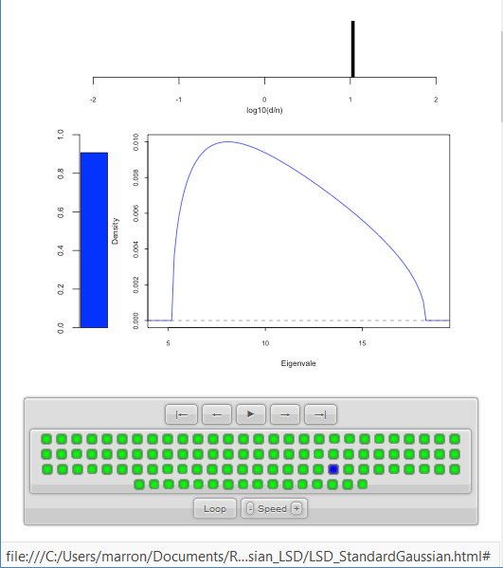
Random Matrix Theory
LSD:
Now Try Larger
Values of $y=\frac{d}{n}$

Slide 52
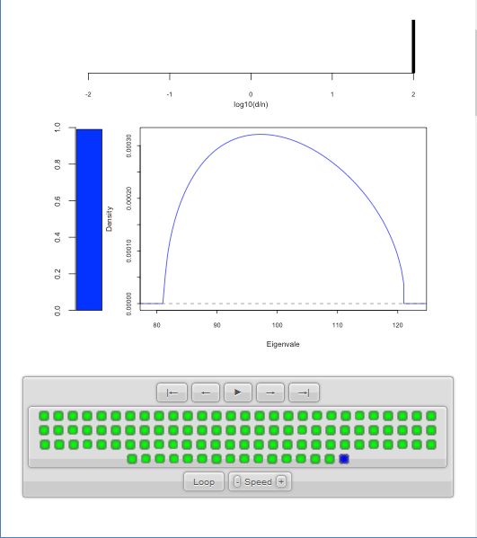
Random Matrix Theory
LSD:
Now Try Larger
Values of $y=\frac{d}{n}$
Again Heads
Towards Semi-Circle
But Small
Proportion

Slide 53
Random Matrix Theory
LSD:
Now Try Larger
Values of $y=\frac{d}{n}$
Note:
Shapes Seem Similar to Above

Slide 54
Random Matrix Theory
LSD: Dual Covariance Variation
Idea: Replace $\tilde{Σ}=\frac{1}{n}XX^{t}$ by $\frac{1}{d}X^{t}X$
Recall:
Rows as Data Objects
Inner Product of $X$
Different Normalization ($d$ not $n$)
N(0,1) Avoids Messy Centering Issues
Sometimes Called
Gram Matrix

Slide 55
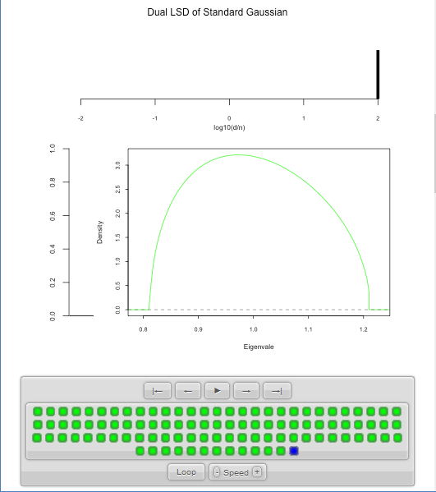
Random Matrix Theory
LSD: Dual Covariance Variation
$y=\frac{d}{n}=100$ Is
Close to Semi-Circle

Slide 56
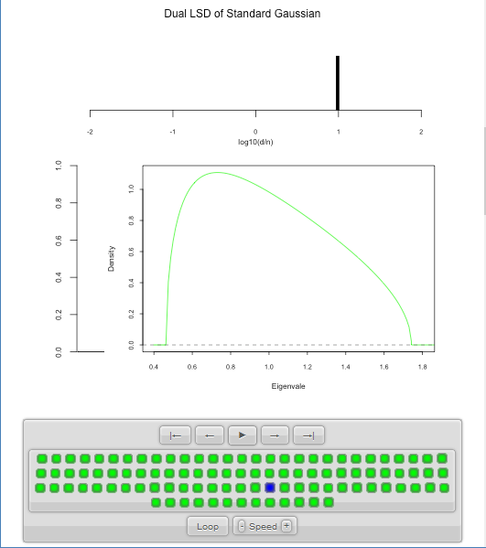
Random Matrix Theory
LSD: Dual Covariance Variation

Slide 57
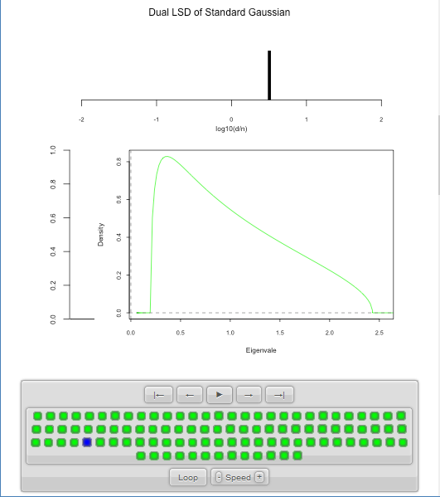
Random Matrix Theory
LSD: Dual Covariance Variation
Seem to Follow
Similar Pattern

Slide 58
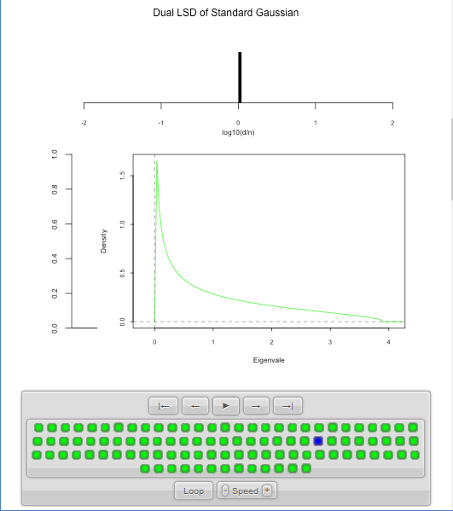
Random Matrix Theory
LSD: Dual Covariance Variation

Slide 59
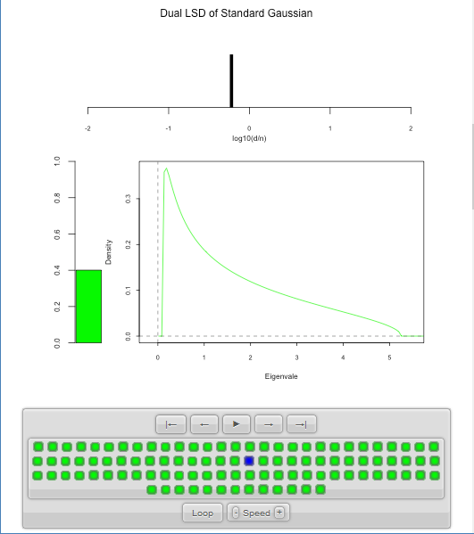
Random Matrix Theory
LSD: Dual Covariance Variation
For $d<n$ Now
Get 0 Eignevalues

Slide 60
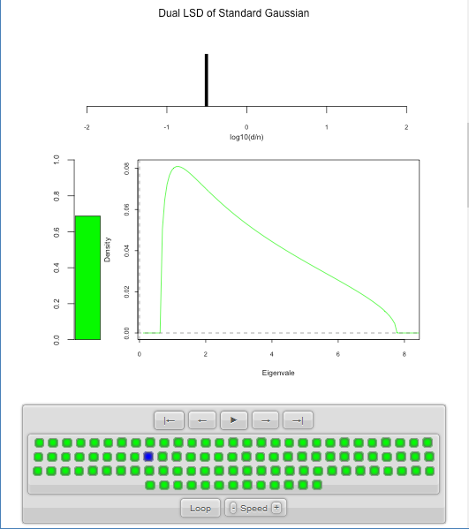
Random Matrix Theory
LSD: Dual Covariance Variation

Slide 61
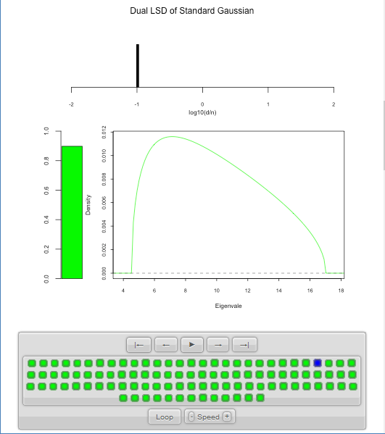
Random Matrix Theory
LSD: Dual Covariance Variation

Slide 62
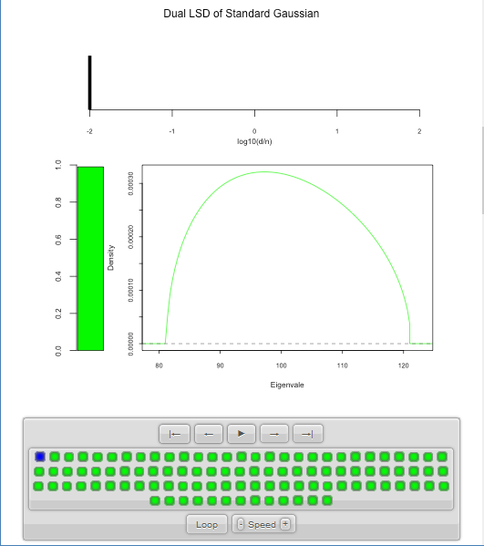
Random Matrix Theory
LSD: Dual Covariance Variation
Again Heads To
Semi-Circle

Slide 63
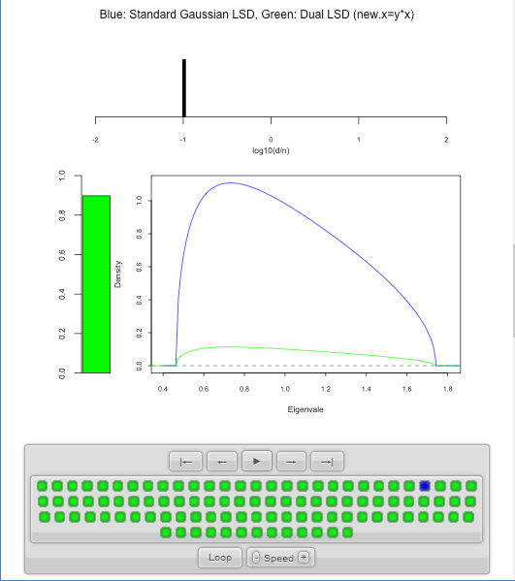
Random Matrix Theory
LSD: Primal & Dual
Overlaid For
Direct
Comparison
Notes:
Area = 1
Area = 1 - Bar

Slide 64
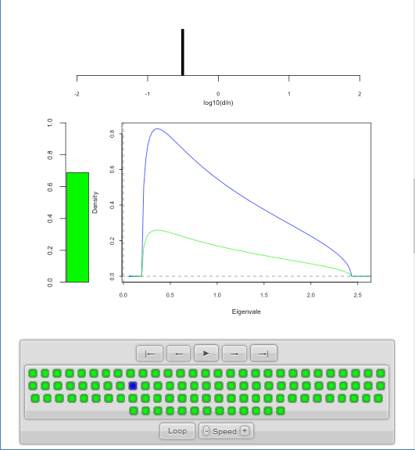
Random Matrix Theory
LSD: Primal & Dual

Slide 65
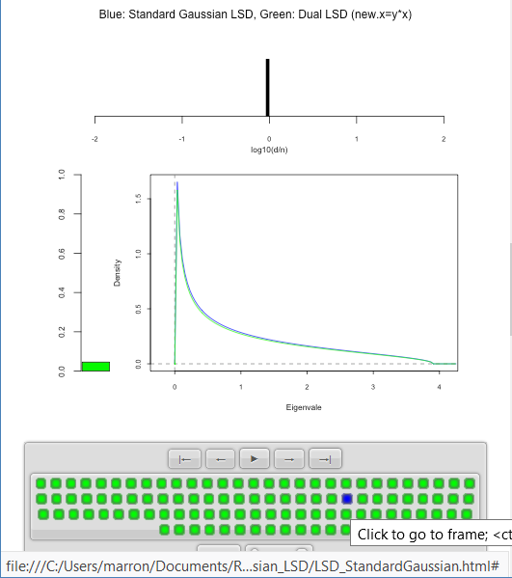
Random Matrix Theory
LSD: Primal & Dual
Very Close
For $d≈n$

Slide 66
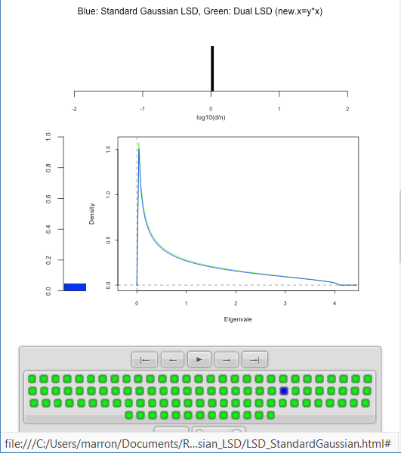
Random Matrix Theory
LSD: Primal & Dual
Very Close
For $d≈n$

Slide 67
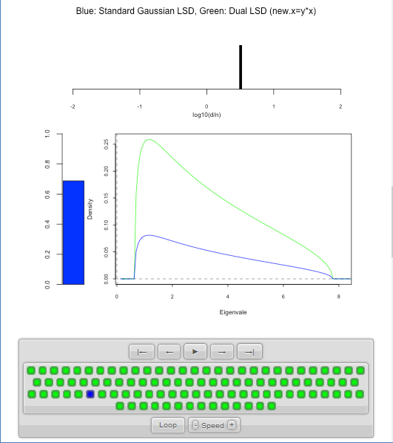
Random Matrix Theory
LSD: Primal & Dual

Slide 68
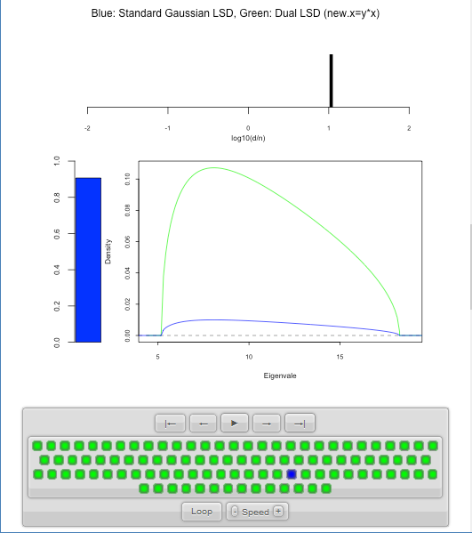
Random Matrix Theory
LSD: Primal & Dual

Slide 69
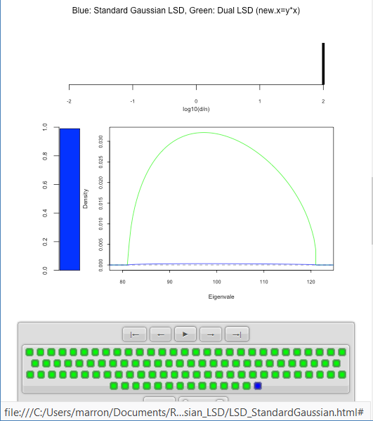
Random Matrix Theory
LSD: Primal & Dual

Slide 70
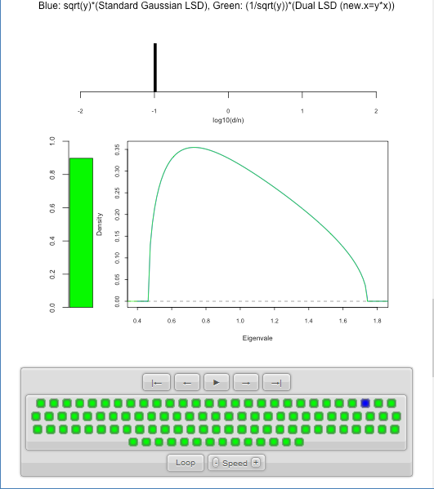
Random Matrix Theory
LSD: Rescaled
Primal & Dual
$\sqrt{y}×LSD$
(underneath)
$\frac{1}{\sqrt{y}}×Dual LSD$

Slide 71
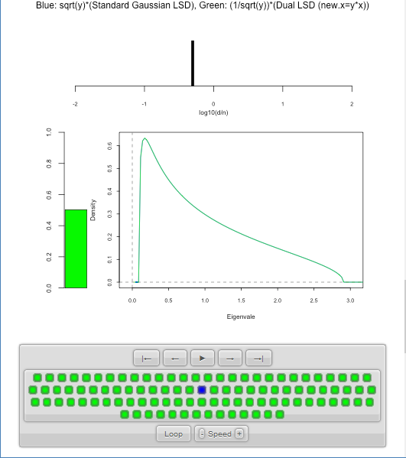
Random Matrix Theory
LSD: Rescaled
Primal & Dual

Slide 72
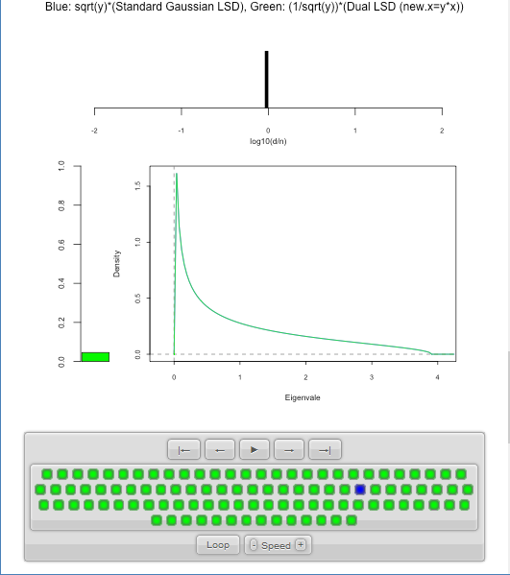
Random Matrix Theory
LSD: Rescaled
Primal & Dual

Slide 73
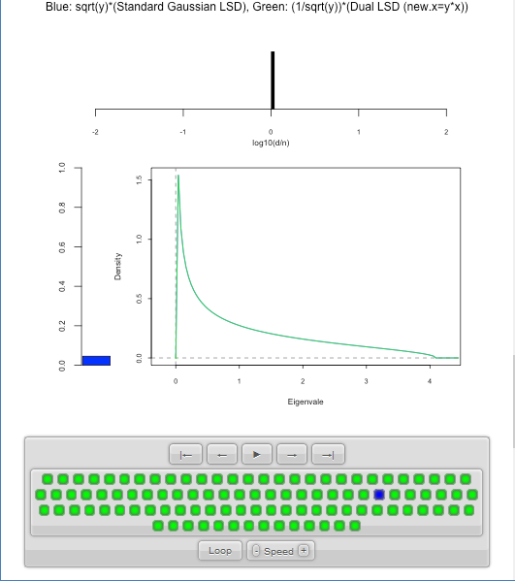
Random Matrix Theory
LSD: Rescaled
Primal & Dual

Slide 74
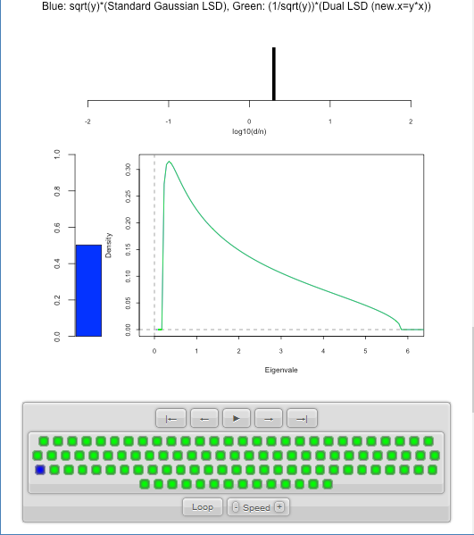
Random Matrix Theory
LSD: Rescaled
Primal & Dual

Slide 75
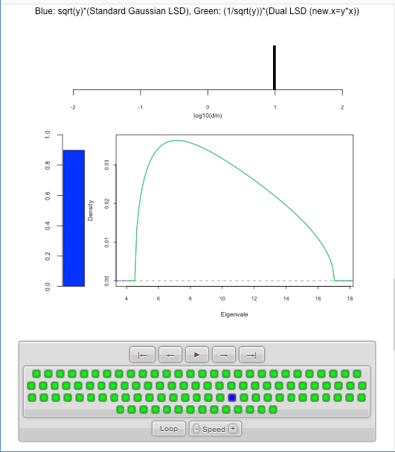
Random Matrix Theory
LSD: Rescaled
Primal & Dual

Slide 76
Random Matrix Theory
Conclusion:
Family of Marcenko – Pastur Distributions
Has Several Interesting Symmetries

Slide 77
Random Matrix Theory
Important Parallel Theory:
Distribution of Largest Eigenvalue
(Assuming Matrix of i.i.d. N(0,1)s)
Tracey & Widom (1994)
Good Discussion of Statistical Implications
Johnstone (2008)

Slide 78
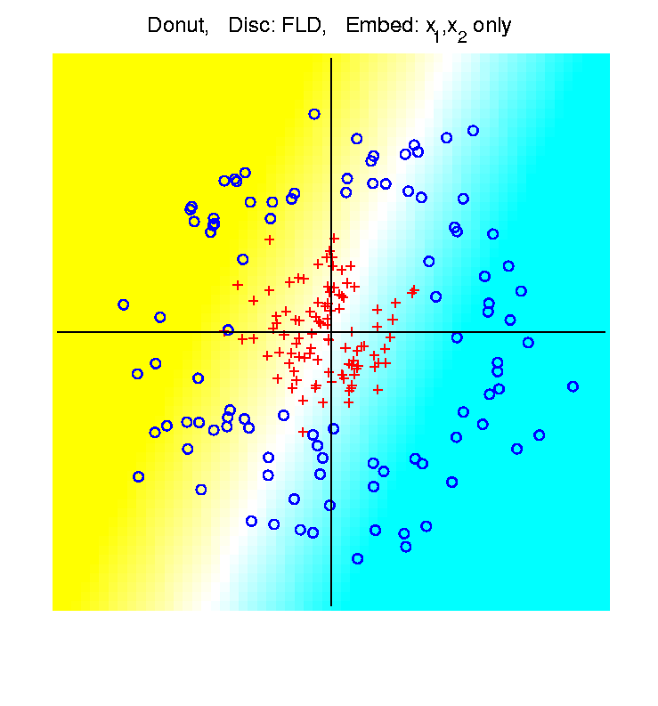
High $d$ Asymptotics & Kernel Methods
Recall
Flexibility
From
Kernel
Embedding
Idea

Slide 79
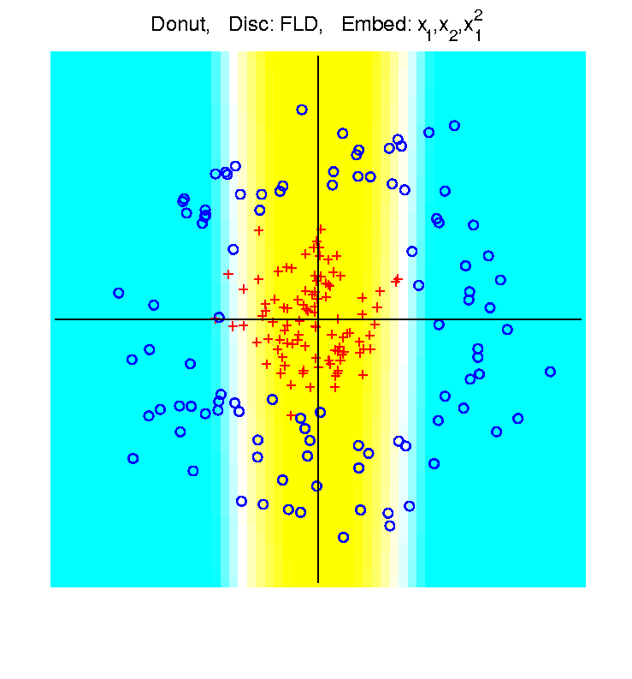
High $d$ Asymptotics & Kernel Methods
Recall
Flexibility
From
Kernel
Embedding
Idea

Slide 80
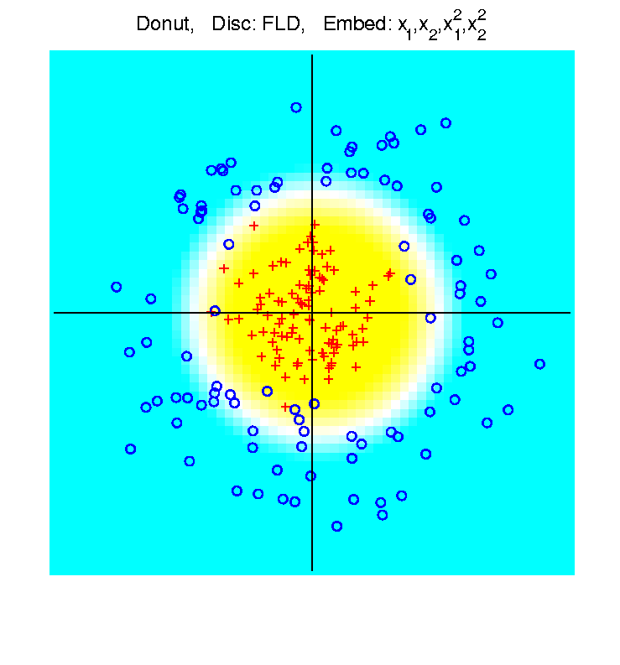
High $d$ Asymptotics & Kernel Methods
Recall
Flexibility
From
Kernel
Embedding
Idea

Slide 81
High $d$ Asymptotics & Kernel Methods
Interesting Question:
Behavior in Very High Dimensions?
Answer: El Karoui (2010)
In Random Matrix Limit, $n\sim d→∞$
Kernel Embedded Classifiers ~
~ Linear Classifiers

Slide 82
High $d$ Asymptotics & Kernel Methods
In Random Matrix Limit, $n\sim d→∞$
Kernel Embedded Classifiers ~
~ Linear Classifiers
Intuitively Sensible?
High Dimensional Space is Very Big
Recall HDLSS Geometric Represent’n
Linear Methods: “Enough Room to Work”

Slide 83
High $d$ Asymptotics & Kernel Methods
Interesting Question:
Behavior in Very High Dimensions?
Implications for DWD:
Recall Main Advantage is for High d
So Not Clear Embedding Helps
Thus Not Yet Implemented in DWD

Slide 84
Clustering
Text:
Chp 12
Idea: Given data ${\underline{X}}_{1},⋯,{\underline{X}}_{n}$
Assign each object to a class
Of similar objects
Completely data driven
I.e. assign labels to data
“Unsupervised Learning”
Contrast to Classification (Discrimination)
With predetermined given class labels
“Supervised Learning”

Slide 85
Clustering
Important References:
MacQueen (1967)
Hartigan (1975)
Gersho and Gray (1992)
Kaufman and Rousseeuw (2005)
See Also: Wikipedia

Slide 86
K-means Clustering
Main Idea: for data ${\underline{X}}_{1},⋯,{\underline{X}}_{n}$
Partition indices $i=1,⋯,n$
among classes $C_{1},⋯$, $C_{K}$
Given index sets $C_{1},⋯$, $C_{K}$
that partition $\left\{1,⋯,n\right\}$
represent clusters by “class means”
i.e, ${\overline{\underline{X}}}_{j}=\frac{1}{\#\left(C_{j}\right)}\sum_{i∈C_{j}}{{\underline{X}}_{i}}$ (within class means)
Each goes into
exactly 1 class

Slide 87
K-means Clustering
Given index sets $C_{1},⋯$, $C_{K}$
Measure how well clustered, using
Within Class Sum of Squares
$$\sum_{j=1}^{K}{\sum_{i∈C_{j}}{{\left\|{\underline{X}}_{i}−{\overline{\underline{X}}}_{j}\right\|}^{2}}}$$

Slide 88
K-means Clustering
Common Variation:
Put on scale of proportions (i.e. in [0,1])
By dividing “within class SS”
by “overall SS”
Gives Cluster Index:
$$CI\left(C_{1},⋯,C_{K}\right)=\frac{\sum_{j=1}^{K}{\sum_{i∈C_{j}}{{\left\|{\underline{X}}_{i}−{\overline{\underline{X}}}_{j}\right\|}^{2}}}}{\sum_{i=1}^{n}{{\left\|{\underline{X}}_{i}−\overline{\underline{X}}\right\|}^{2}}}$$

Slide 89
K-means Clustering
Notes on Cluster Index:
$$CI\left(C_{1},⋯,C_{K}\right)=\frac{\sum_{j=1}^{K}{\sum_{i∈C_{j}}{{\left\|{\underline{X}}_{i}−{\overline{\underline{X}}}_{j}\right\|}^{2}}}}{\sum_{i=1}^{n}{{\left\|{\underline{X}}_{i}−\overline{\underline{X}}\right\|}^{2}}}$$
$CI=0$ when all data at cluster means
$CI$ small when $C_{1},⋯,C_{K}$ are tight clusters
(within SS contains little variation)
$CI$ big when $C_{1},⋯,C_{K}$ gives poor clustering
(within SS contains most of variation)
$CI=1$ when all cluster means are same

Slide 90
K-means Clustering
Clustering Goal:
Given data ${\underline{X}}_{1},⋯,{\underline{X}}_{n}$
Choose classes $C_{1},⋯,C_{K}$
To miminize
$$CI\left(C_{1},⋯,C_{K}\right)=\frac{\sum_{j=1}^{K}{\sum_{i∈C_{j}}{{\left\|{\underline{X}}_{i}−{\overline{\underline{X}}}_{j}\right\|}^{2}}}}{\sum_{i=1}^{n}{{\left\|{\underline{X}}_{i}−\overline{\underline{X}}\right\|}^{2}}}$$

Slide 91
2-means Clustering
Study CI, using simple 1-d examples
Varying Standard Deviation

Slide 92
2-means Clustering

Slide 93
2-means Clustering

Slide 94
2-means Clustering

Slide 95
2-means Clustering

Slide 96
2-means Clustering

Slide 97
2-means Clustering

Slide 98
2-means Clustering

Slide 99
2-means Clustering

Slide 100
2-means Clustering

Slide 101
2-means Clustering

Slide 102
2-means Clustering
Study CI, using simple 1-d examples
Varying Standard Deviation
Varying Mean

Slide 103
2-means Clustering

Slide 104
2-means Clustering

Slide 105
2-means Clustering

Slide 106
2-means Clustering

Slide 107
2-means Clustering

Slide 108
2-means Clustering

Slide 109
2-means Clustering

Slide 110
2-means Clustering

Slide 111
2-means Clustering

Slide 112
2-means Clustering

Slide 113
2-means Clustering

Slide 114
2-means Clustering

Slide 115
2-means Clustering
Study CI, using simple 1-d examples
Varying Standard Deviation
Varying Mean
Varying Proportion

Slide 116
2-means Clustering

Slide 117
2-means Clustering

Slide 118
2-means Clustering

Slide 119
2-means Clustering

Slide 120
2-means Clustering

Slide 121
2-means Clustering

Slide 122
2-means Clustering

Slide 123
2-means Clustering

Slide 124
2-means Clustering

Slide 125
2-means Clustering

Slide 126
2-means Clustering

Slide 127
2-means Clustering

Slide 128
2-means Clustering

Slide 129
2-means Clustering

Slide 130
2-means Clustering
Study CI, using simple 1-d examples
Over changing Classes (moving b’dry)

Slide 131
2-means Clustering

Slide 132
2-means Clustering

Slide 133
2-means Clustering

Slide 134
2-means Clustering
C. Index for
Clustering
Greens
& Blues

Slide 135
2-means Clustering

Slide 136
2-means Clustering

Slide 137
2-means Clustering

Slide 138
2-means Clustering

Slide 139
2-means Clustering

Slide 140
2-means Clustering
Curve Shows CI for Many
Reasonable Clusterings

Slide 141
2-means Clustering
Study CI, using simple 1-d examples
Over changing Classes (moving b’dry)
Multi-modal data → interesting effects
Multiple local minima (large number)
Maybe disconnected
Optimization (over $C_{1},⋯$, $C_{K}$) can be tricky…
(even in 1 dimension, with $K=2$)

Slide 142
2-means Clustering

Slide 143
2-means Clustering
Study CI, using simple 1-d examples
Over changing Classes (moving b’dry)
Multi-modal data → interesting effects
Can have 4 (or more) local mins
(even in 1 dimension, with K = 2)

Slide 144
2-means Clustering

Slide 145
2-means Clustering
Study CI, using simple 1-d examples
Over changing Classes (moving b’dry)
Multi-modal data → interesting effects
Local mins can be hard to find
i.e. iterative procedures can “get stuck”
(even in 1 dimension, with K = 2)
Common, But Slippery,
Approach: Many
Random Restarts

Slide 146
2-means Clustering
Study CI, using simple 1-d examples
Effect of a single outlier?

Slide 147
2-means Clustering
Minimum CI
Splits in Half

Slide 148
2-means Clustering
Already Have
Local Minima

Slide 149
2-means Clustering

Slide 150
2-means Clustering
Global CI
Minimum
Now Here

Slide 151
2-means Clustering

Slide 152
2-means Clustering

Slide 153
2-means Clustering

Slide 154
2-means Clustering

Slide 155
2-means Clustering

Slide 156
2-means Clustering

Slide 157
2-means Clustering
Single Outlier Can Make CI Arbitrarily Small

Slide 158
2-means Clustering
Study CI, using simple 1-d examples
Effect of a single outlier?
Can create local minimum
Can also yield a global minimum
This gives a one point class
Can make CI arbitrarily small
(really a “good clustering”???)

Slide 159
K-Means Clustering
2-d Toy Example
Recall From Before
(When Studying
Kernel PCA)
Long Thin Cluster
Close Round Clusters
Outliers or Clusters???

Slide 160
K-Means Clustering
2-d Toy Example
$k=2$, Groups
All Small Ones
$k=3$, Splits
Round Ones
K-Means Can Be Slippery
$k=4$, Splits
Long Cluster
Local Minimum?
$k=5$, Splits
Outliers, Not
Round Ones?

Slide 161
K-Means Clustering
2-d Toy Example, More Careful Look
So Global Min’r
So Local Min’r
K-Means Can Be Slippery
$k=4$: $CI=0.91$
$k=5$, $CI=0.063$
$k=4$: Separated
Out Pair: $CI=0.161$
$k=5$: Split
Spheres $CI=0.059$

Slide 162
SWISS Score
Another Application of CI (Cluster Index)
Cabanski et al (2010)
Idea: Use CI in bioinformatics to
“measure quality of data preprocessing”
Philosophy: Clusters Are Scientific Goal
So Want to Accentuate Them

Slide 163
SWISS Score
Toy Examples (2-d):
Which are “More Clustered?”

Slide 164
SWISS Score
Toy Examples (2-d):
Which are “More Clustered?”

Slide 165
SWISS Score
SWISS =
Standardized Within class Sum of Squares
$$SWISS=CI\left(C_{1},⋯,C_{K}\right)=\frac{\sum_{j=1}^{K}{\sum_{i∈C_{j}}{{\left\|{\underline{X}}_{i}−{\overline{\underline{X}}}_{j}\right\|}^{2}}}}{\sum_{i=1}^{n}{{\left\|{\underline{X}}_{i}−\overline{\underline{X}}\right\|}^{2}}}$$

Slide 166
SWISS Score
SWISS =
Standardized Within class Sum of Squares
$$SWISS=CI\left(C_{1},⋯,C_{K}\right)=\frac{\sum_{j=1}^{K}{\sum_{i∈C_{j}}{{\left\|{\underline{X}}_{i}−{\overline{\underline{X}}}_{j}\right\|}^{2}}}}{\sum_{i=1}^{n}{{\left\|{\underline{X}}_{i}−\overline{\underline{X}}\right\|}^{2}}}$$

Slide 167
SWISS Score
SWISS =
Standardized Within class Sum of Squares
$$SWISS=CI\left(C_{1},⋯,C_{K}\right)=\frac{\sum_{j=1}^{K}{\sum_{i∈C_{j}}{{\left\|{\underline{X}}_{i}−{\overline{\underline{X}}}_{j}\right\|}^{2}}}}{\sum_{i=1}^{n}{{\left\|{\underline{X}}_{i}−\overline{\underline{X}}\right\|}^{2}}}$$

Slide 168
SWISS Score
Recall Graphical Introduction:
$$SWISS=CI\left(C_{1},⋯,C_{K}\right)=\frac{\sum_{j=1}^{K}{\sum_{i∈C_{j}}{{\left\|{\underline{X}}_{i}−{\overline{\underline{X}}}_{j}\right\|}^{2}}}}{\sum_{i=1}^{n}{{\left\|{\underline{X}}_{i}−\overline{\underline{X}}\right\|}^{2}}}$$

Slide 169
SWISS Score
Recall Graphical Introduction:
$$SWISS=CI\left(C_{1},⋯,C_{K}\right)=\frac{\sum_{j=1}^{K}{\sum_{i∈C_{j}}{{\left\|{\underline{X}}_{i}−{\overline{\underline{X}}}_{j}\right\|}^{2}}}}{\sum_{i=1}^{n}{{\left\|{\underline{X}}_{i}−\overline{\underline{X}}\right\|}^{2}}}$$

Slide 170
SWISS Score
Revisit Toy Examples (2-d):
Which are “More Clustered?”

Slide 171
SWISS Score
Toy Examples (2-d):
Which are “More Clustered?”

Slide 172
SWISS Score
Toy Examples (2-d):
Which are “More Clustered?”

Slide 173
SWISS Score
Now Consider $K>2$:
$$SWISS=CI\left(C_{1},⋯,C_{K}\right)=\frac{\sum_{j=1}^{K}{\sum_{i∈C_{j}}{{\left\|{\underline{X}}_{i}−{\overline{\underline{X}}}_{j}\right\|}^{2}}}}{\sum_{i=1}^{n}{{\left\|{\underline{X}}_{i}−\overline{\underline{X}}\right\|}^{2}}}$$
How well does it work?

Slide 174
SWISS Score
$K=3$, Toy Example:

Slide 175
SWISS Score
$K=3$, Toy Example:

Slide 176
SWISS Score
$K=3$, Toy Example:

Slide 177
SWISS Score
$K=3$, Toy Example:
But C
Seems
“Better
Clustered”

Slide 178
SWISS Score
K-Class SWISS:
Instead of using K-Class CI
Use Average of Pairwise SWISS Scores

Slide 179
SWISS Score
K-Class SWISS:
Instead of using K-Class CI
Use Average of Pairwise SWISS Scores
(Preserves [0,1] Range)

Slide 180
SWISS Score
Avg. Pairwise SWISS – Toy Examples

Slide 181
SWISS Score
Additional Feature:
Ǝ Hypothesis Tests:
H₁: SWISS₁ < 1
H₁: SWISS₁ < SWISS₂
Permutation Based
See Cabanski et al (2010)

Slide 182
Participant Presentations
12:00 Bongsoo Yi:
Adversarial Attack on Object Detection
12:05 Fengyu Yang:
Method of moments for protein structuring
from cryo-electron microscopy
12:10 Wan Zhang:
Nonparametric prediction distribution from resolution-wise regression with heterogeneous data
Next Class: Liubov Arbeeva, Shaleni Kovach, Puyao Ge

