Slide 1
Statistics – O. R. 881 Object Oriented Data Analysis
Start
Recording
Steve Marron
Dept. of Statistics and Operations Research
University of North Carolina

Slide 2
Current Sections in Textbook
Today:
Section 12.2, 13.2
Next Class:
Sections 15.1, 15.4

Slide 3
Request Your Opinion
“Students can access the Blue Course Evaluation System directly using thier onyen and password to log in at this url: https://blueeval.unc.edu/Blue/.”
Deadline April 27, 2022

Slide 4
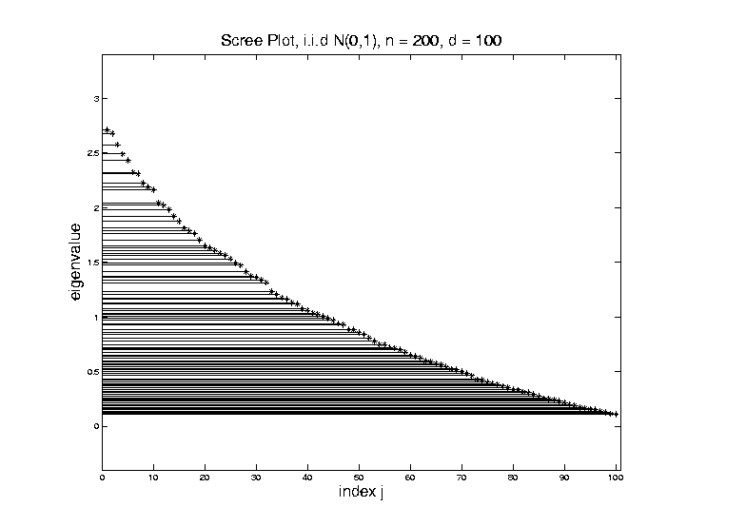
Random Matrix Theory
Shape is Captured by
Empirical Spectral Density
“Density”
Of These
Eigenvalues

Slide 5
Random Matrix Theory
Limiting Spectral Density
(in limit as $n, d→∞$, with $y=\frac{d}{n}$)
References:
Marčenko Pastur (1967)
Yao et al (2015)
Dobriban (2015)

Slide 6
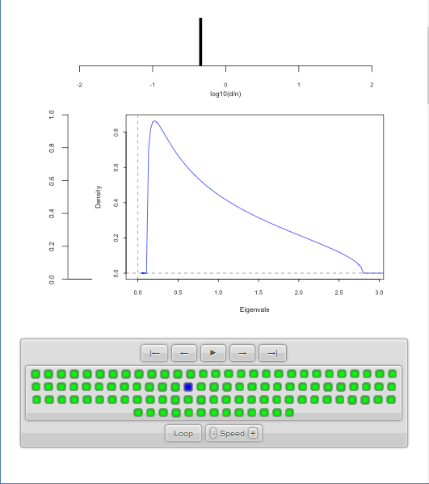
Random Matrix Theory
LSD
Note: These
Have Finite
Support
$⊂(0,∞)$

Slide 7
SWISS Score
Avg. Pairwise SWISS – Toy Examples

Slide 8
Clustering
A Very Large Area
K-Means is Only One Approach
Has its Drawbacks
(Many Toy Examples of This)
Ǝ Many Other Approaches
Important (And Broad) Class
Hierarchical Clustering

Slide 9
Hierarchical Clustering
Idea: Consider Either:
Bottom Up Aggregation:
One by One Combine Data
Top Down Splitting:
All Data in One Cluster & Split
Through Entire Data Set, to get Dendogram
Important Differences From
Computational Perspective

Slide 10
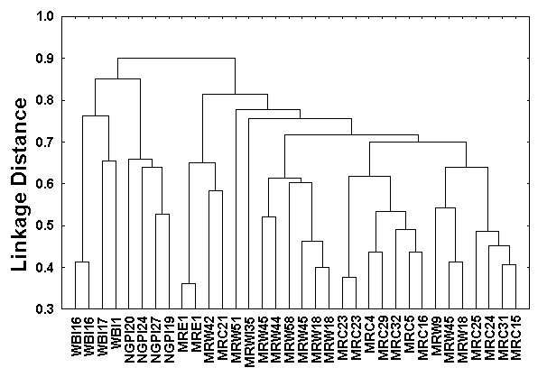
Hierarchical Clustering
Aggregate or Split, to get Dendogram
Thanks to US EPA: water.epa.gov

Slide 11
Hierarchical Clustering
Aggregate or Split, to get Dendogram
Aggregate:
Start With
Individuals

Slide 12
Hierarchical Clustering
Aggregate or Split, to get Dendogram
Aggregate:
Start With
Individuals,
Move Up
Join Pairs of Objects
That Are “Closest”

Slide 13
Hierarchical Clustering
Aggregate or Split, to get Dendogram
Aggregate:
Start With
Individuals,
Move Up
Also Join “Nearby” Clusters

Slide 14
Hierarchical Clustering
Aggregate or Split, to get Dendogram
Aggregate:
Start With
Individuals,
Move Up

Slide 15
Hierarchical Clustering
Aggregate or Split, to get Dendogram
Aggregate:
Start With
Individuals,
Move Up

Slide 16
Hierarchical Clustering
Aggregate or Split, to get Dendogram
Aggregate:
Start With
Individuals,
Move Up,
End Up With
All in 1 Cluster

Slide 17
Hierarchical Clustering
Aggregate or Split, to get Dendogram
Split:
Start With
All in 1 Cluster

Slide 18
Hierarchical Clustering
Aggregate or Split, to get Dendogram
Split:
Start With
All in 1 Cluster,
Move Down

Slide 19
Hierarchical Clustering
Aggregate or Split, to get Dendogram
Split:
Start With
All in 1 Cluster,
Move Down,
End With
Individuals

Slide 20
Hierarchical Clustering
Aggregate or Split, to get Dendogram
While Result
Is Same,
There Are
Computational
Considerations

Slide 21
Hierarchical Clustering
Vertical Axis in Dendogram:
Based on:
Distance Metric
(Ǝ many, e.g. $L^{2}$, $L^{1}$, $L^{∞}$, …)
Linkage Function
(Reflects Clustering Type)
A Lot of “Art” Involved
Personal 1st Choice
Since = Visual Distance

Slide 22
Hierarchical Clustering
Dendogram Interpretation
Branch
Length
Reflects
Cluster
Strength

Slide 23
Hierarchical Clustering
2-d Toy Example
Recall From Before
(When Studying
Kernel PCA)
Long Thin Cluster
Close Round Clusters
Outliers or Clusters???

Slide 24
Hierarchical Clustering
2-d Toy Example, Euclidean Distance
Ward’s Linkage (Cut at 4 Clusters)
Likes
Balanced
Splits

Slide 25
Hierarchical Clustering
2-d Toy Example, Euclidean Distance
Linkages: Distances Between Clusters
Based on Pairwise Distances

Slide 26
Hierarchical Clustering
2-d Toy Example, Euclidean Distance
Complete Linkage
Idea: Cluster Distance = Max Pairwise Dist.
Feels Farthest Points in Clusters

Slide 27
Hierarchical Clustering
2-d Toy Example, Euclidean Distance
Complete Linkage (Cut at 4 Clusters)
Clusters Tend To
Avoid Far Away
Members

Slide 28
Hierarchical Clustering
2-d Toy Example, Euclidean Distance
Average Linkage
Idea: Cluster Distance = Avg. Pairwise Dist.
All Cluster Members Are “Involved”

Slide 29
Hierarchical Clustering
2-d Toy Example, Euclidean Distance
Average Linkage (Cut at 4 Clusters)
Allows Outliers
To Split Off
But Still Groups
Round Clusters

Slide 30
Hierarchical Clustering
2-d Toy Example, Euclidean Distance
Single Linkage
Idea: Cluster Distance = Min Pairwise Dist.
Feels Closest Points in Clusters,
Hence Gaps Between Clusters

Slide 31
Hierarchical Clustering
2-d Toy Example, Euclidean Distance
Single Linkage (Cut at 4 Clusters)
Gives Intuitively
Natural Result
Good 2-d
Performance
Human Eye
Likes Gaps

Slide 32
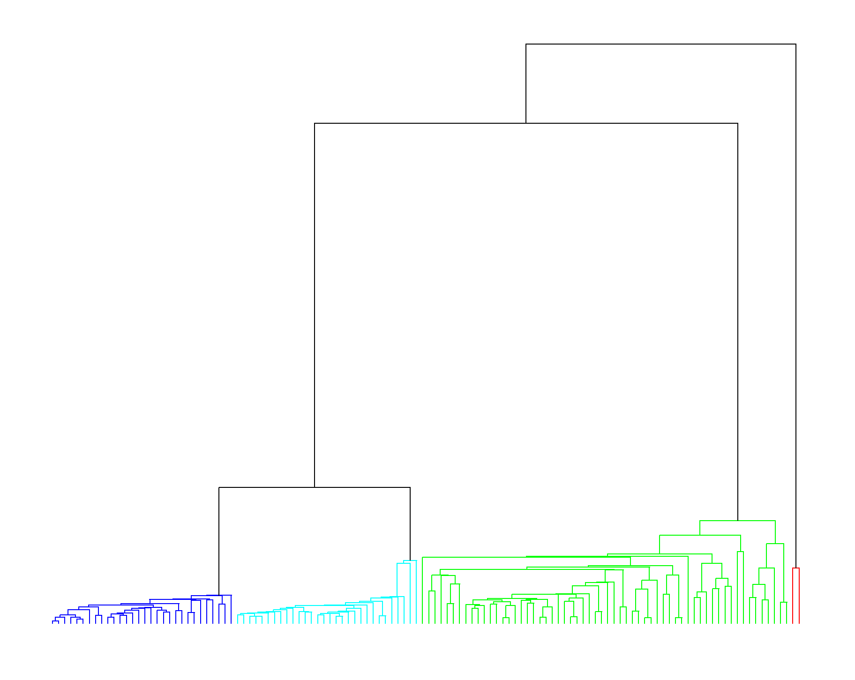
Hierarchical Clustering
2-d Toy Example, Euclidean Distance
Single Linkage Dendrogram
Reveals
Ordering
Of Clusters
Heights
Correspond
to Gaps
Because of

Slide 33
Hierarchical Clustering
2-d Toy Example, Euclidean Distance
Single Linkage (Cut at 3 Clusters)
Groups
Closest
Clusters

Slide 34
Hierarchical Clustering
2-d Toy Example, Euclidean Distance
Single Linkage (Cut at 5 Clusters)
Splits Long Cluster
But Finds Gap,
Not Cut In Half

Slide 35
Hierarchical Clustering
2-d Toy Example, $L^{1}$ Distance
Single Linkage (Cut at 4 Clusters)
Rather Similar
For This 2-d
Example

Slide 36
Hierarchical Clustering
2-d Toy Example, Spearman Distance
Single Linkage (Cut at 4 Clusters)
Yuck!
Distances Matter

Slide 37
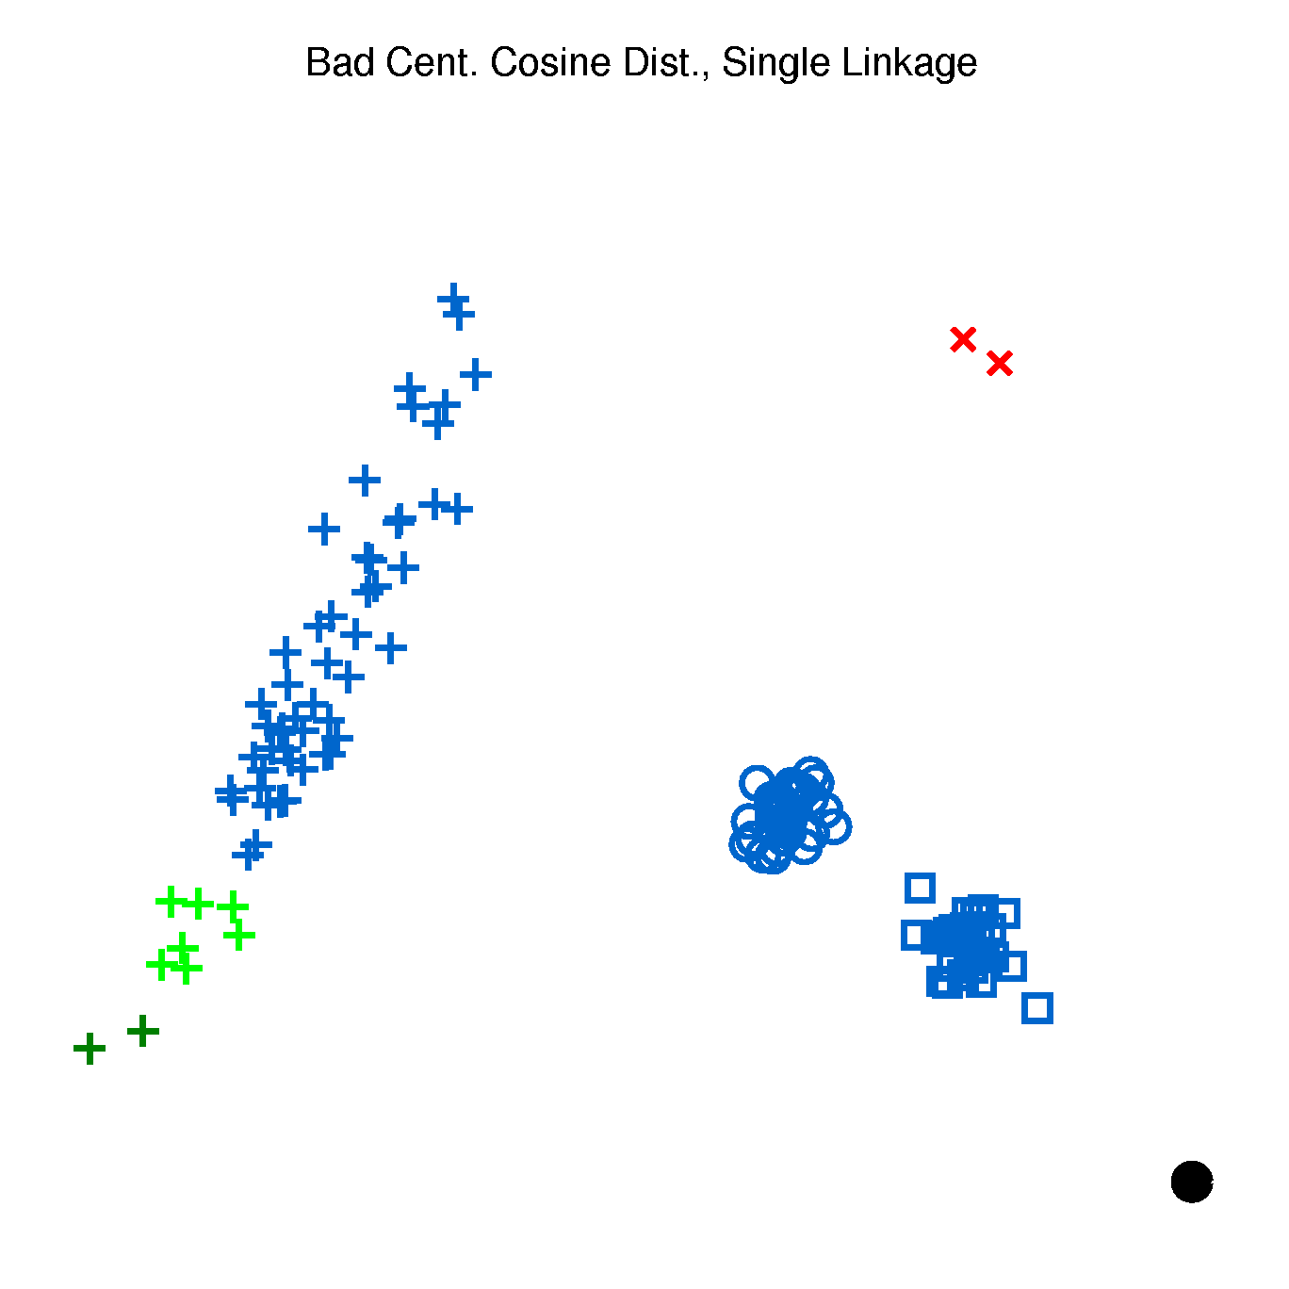
Hierarchical Clustering
2-d Toy Example, Cosine Distance
Single Linkage (Cut at 4 Clusters)
Think “Angle In
Polar Coordinates”
Depends On Center
Poor Choice

Slide 38
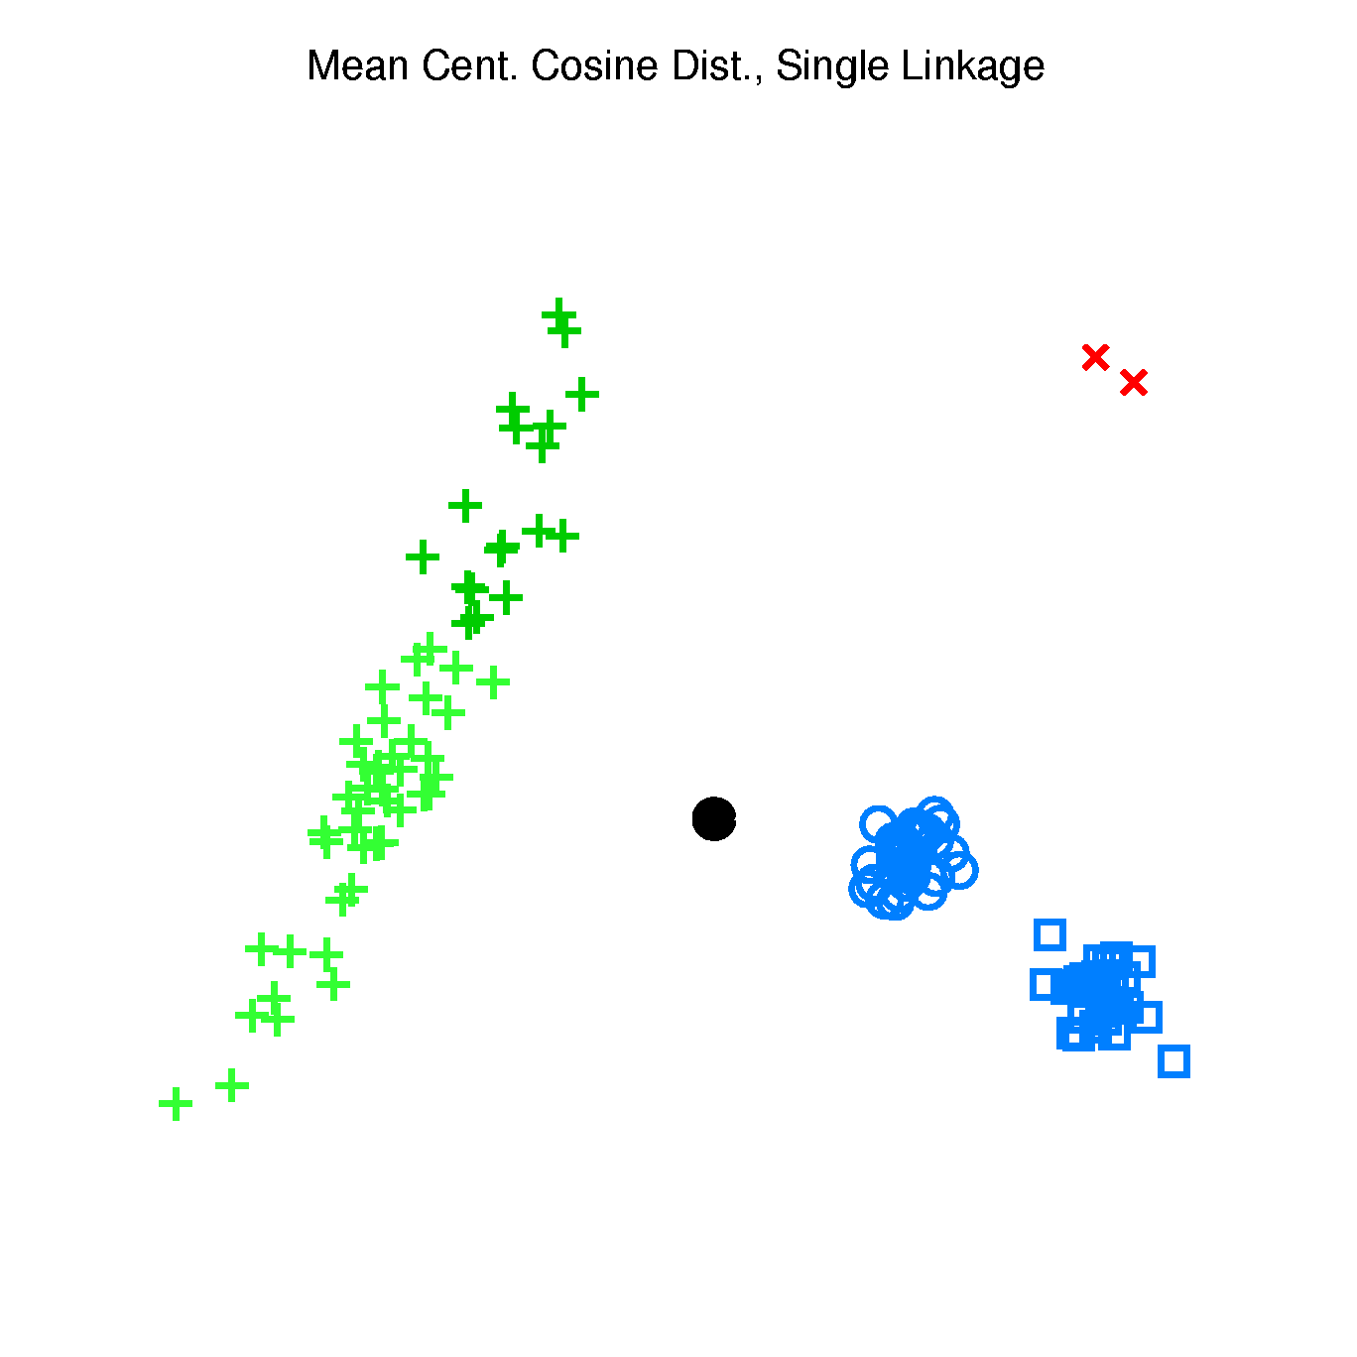
Hierarchical Clustering
2-d Toy Example, Cosine Distance
Single Linkage (Cut at 4 Clusters)
Better When
Centering At
Mean
Still Not Great

Slide 39
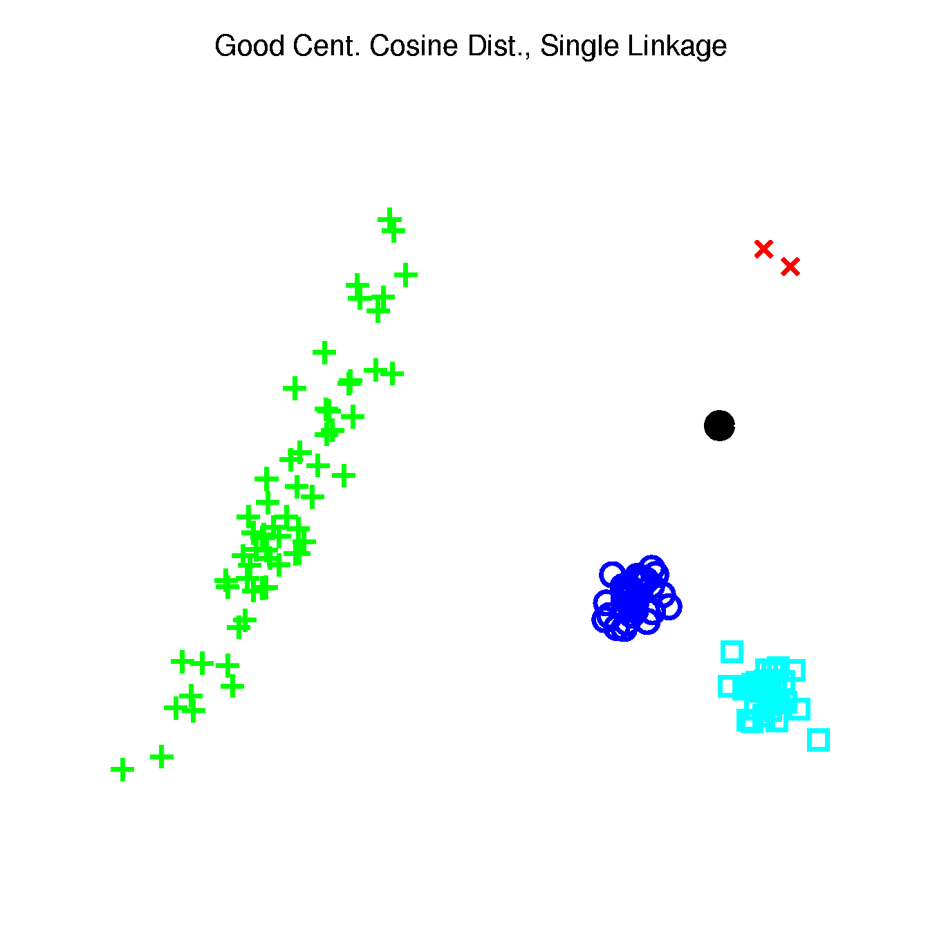
Hierarchical Clustering
2-d Toy Example, Cosine Distance
Single Linkage (Cut at 4 Clusters)
Careful Choice
Gives Good
Result
Think Sectors in
Polar Coordinates

Slide 40
Hierarchical Clustering
2-d Toy Example, Cosine Distance
Single Linkage (Cut at 4 Clusters)
Revisit Mean
Centering
With Sectors

Slide 41
Hierarchical Clustering
2-d Toy Example, Cosine Distance
Single Linkage (Cut at 4 Clusters)
Revisit Bad
Centering
With Sectors

Slide 42
Hierarchical Clustering
Higher Dimensions, $d=500$, $n=30$, $N(0,I)$
Recall HDLSS Geometry
All Points $\sim \sqrt{d}$ From Origin
All Points $\sim \sqrt{2d}$ From Each Other
All Angles $\sim {90}^{°}$
(Expect A Different Story?)

Slide 43
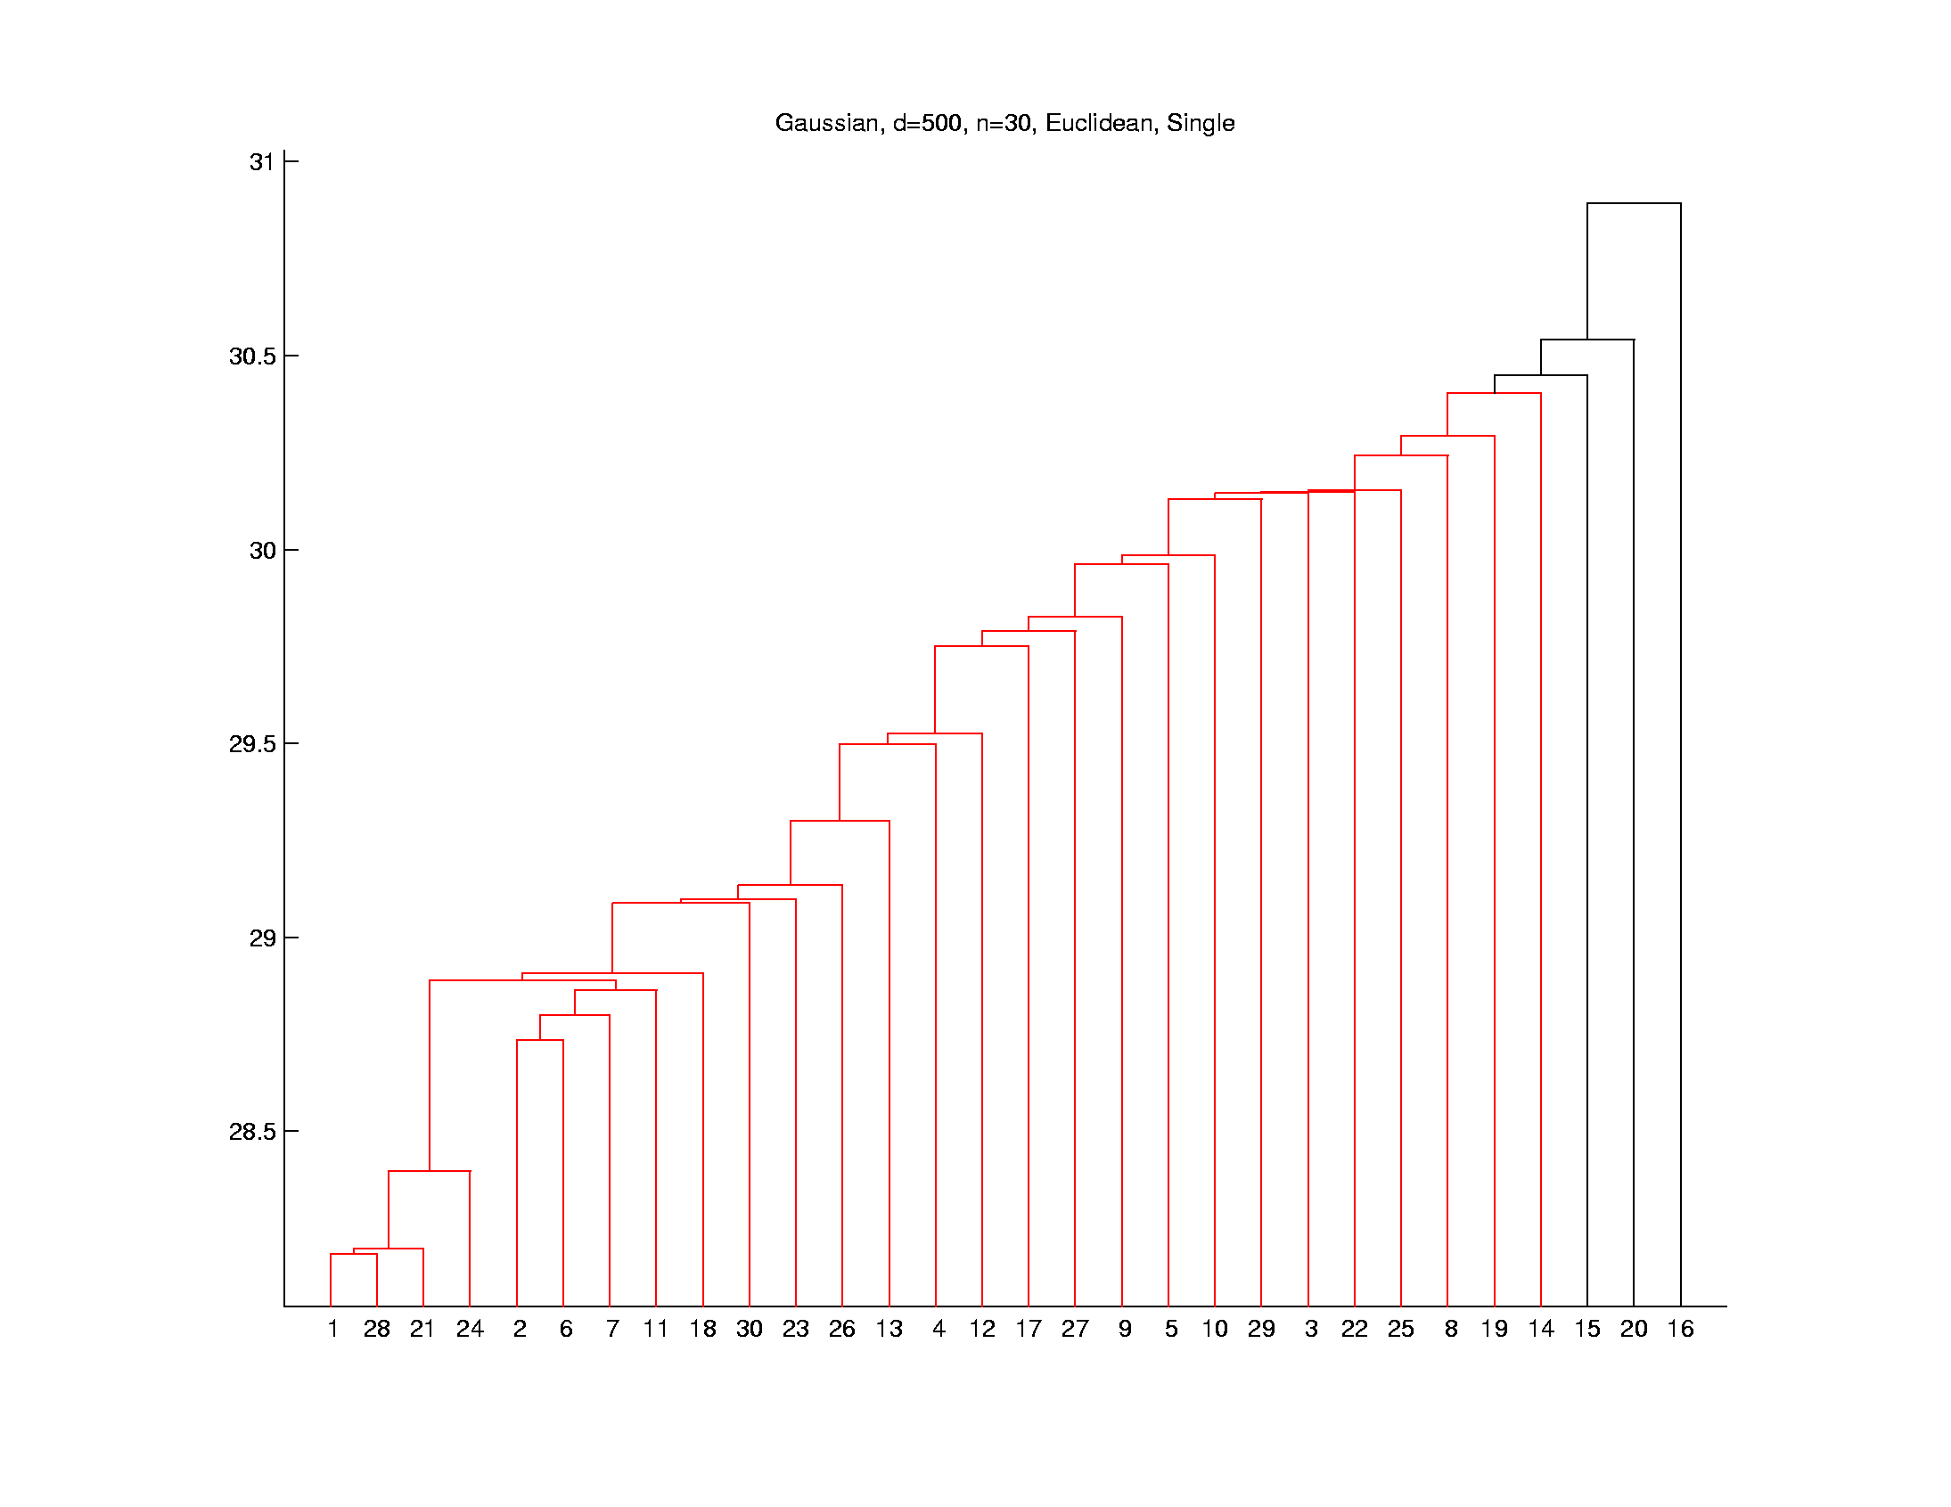
Hierarchical Clustering
Higher Dimensions, $d=500$, $n=30$, $N(0,I)$
Euclidean Dist.
Single Linkage
Peels Off
Points One
At A Time
Usually Less
Useful
Explore These
Farthest Three

Slide 44
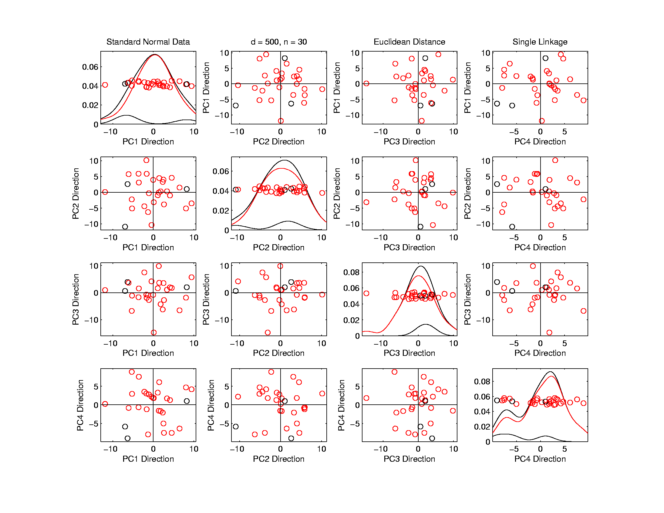
Hierarchical Clustering
Higher Dimensions, $d=500$, $n=30$, $N(0,I)$
Euclidean Dist.
Single Linkage
Visualize
With PCA
Blacks Are
Outliers?
No Clear Patterns?
“Larger Variation”
Dir’ns Feel Groups

Slide 45
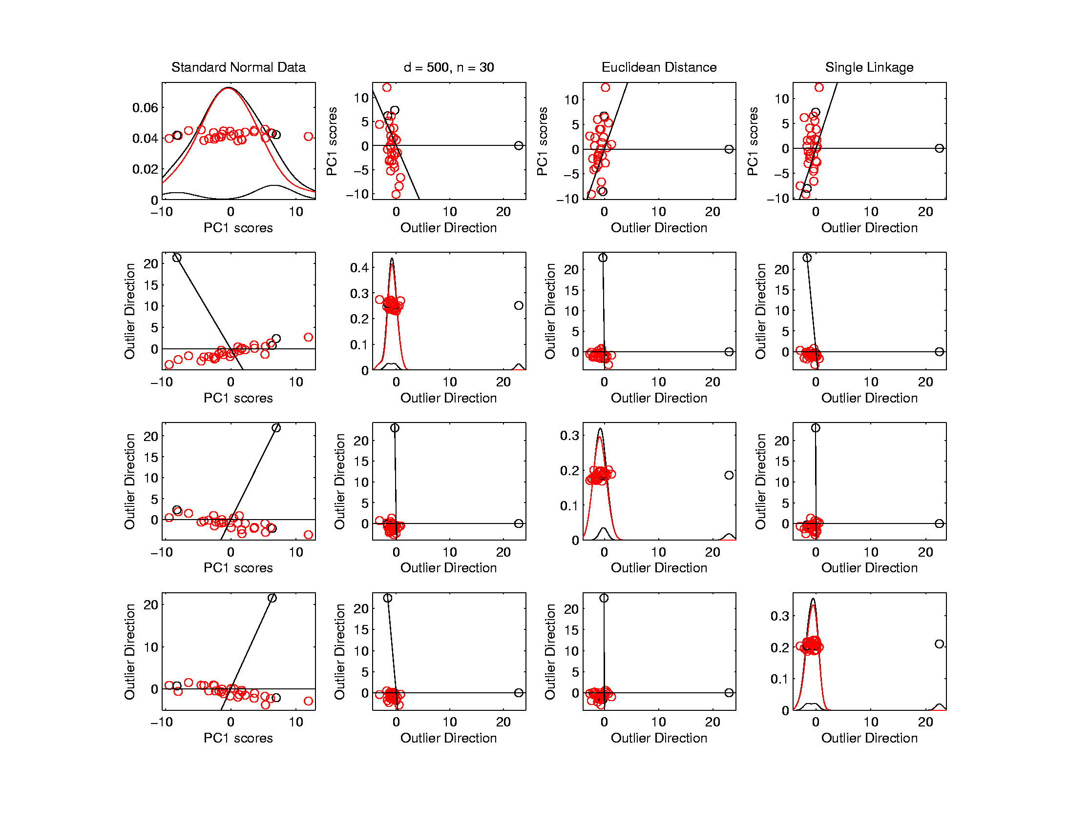
Hierarchical Clustering
Higher Dimensions, $d=500$, $n=30$, $N(0,I)$
Euclidean Dist.
Single Linkage
Use Outlier
Data Dir’ns
Better
Impression
Of Outliers
Recall HDLSS Space Is Very Big
$∃$ Many Interesting Directions Besides PCs

Slide 46
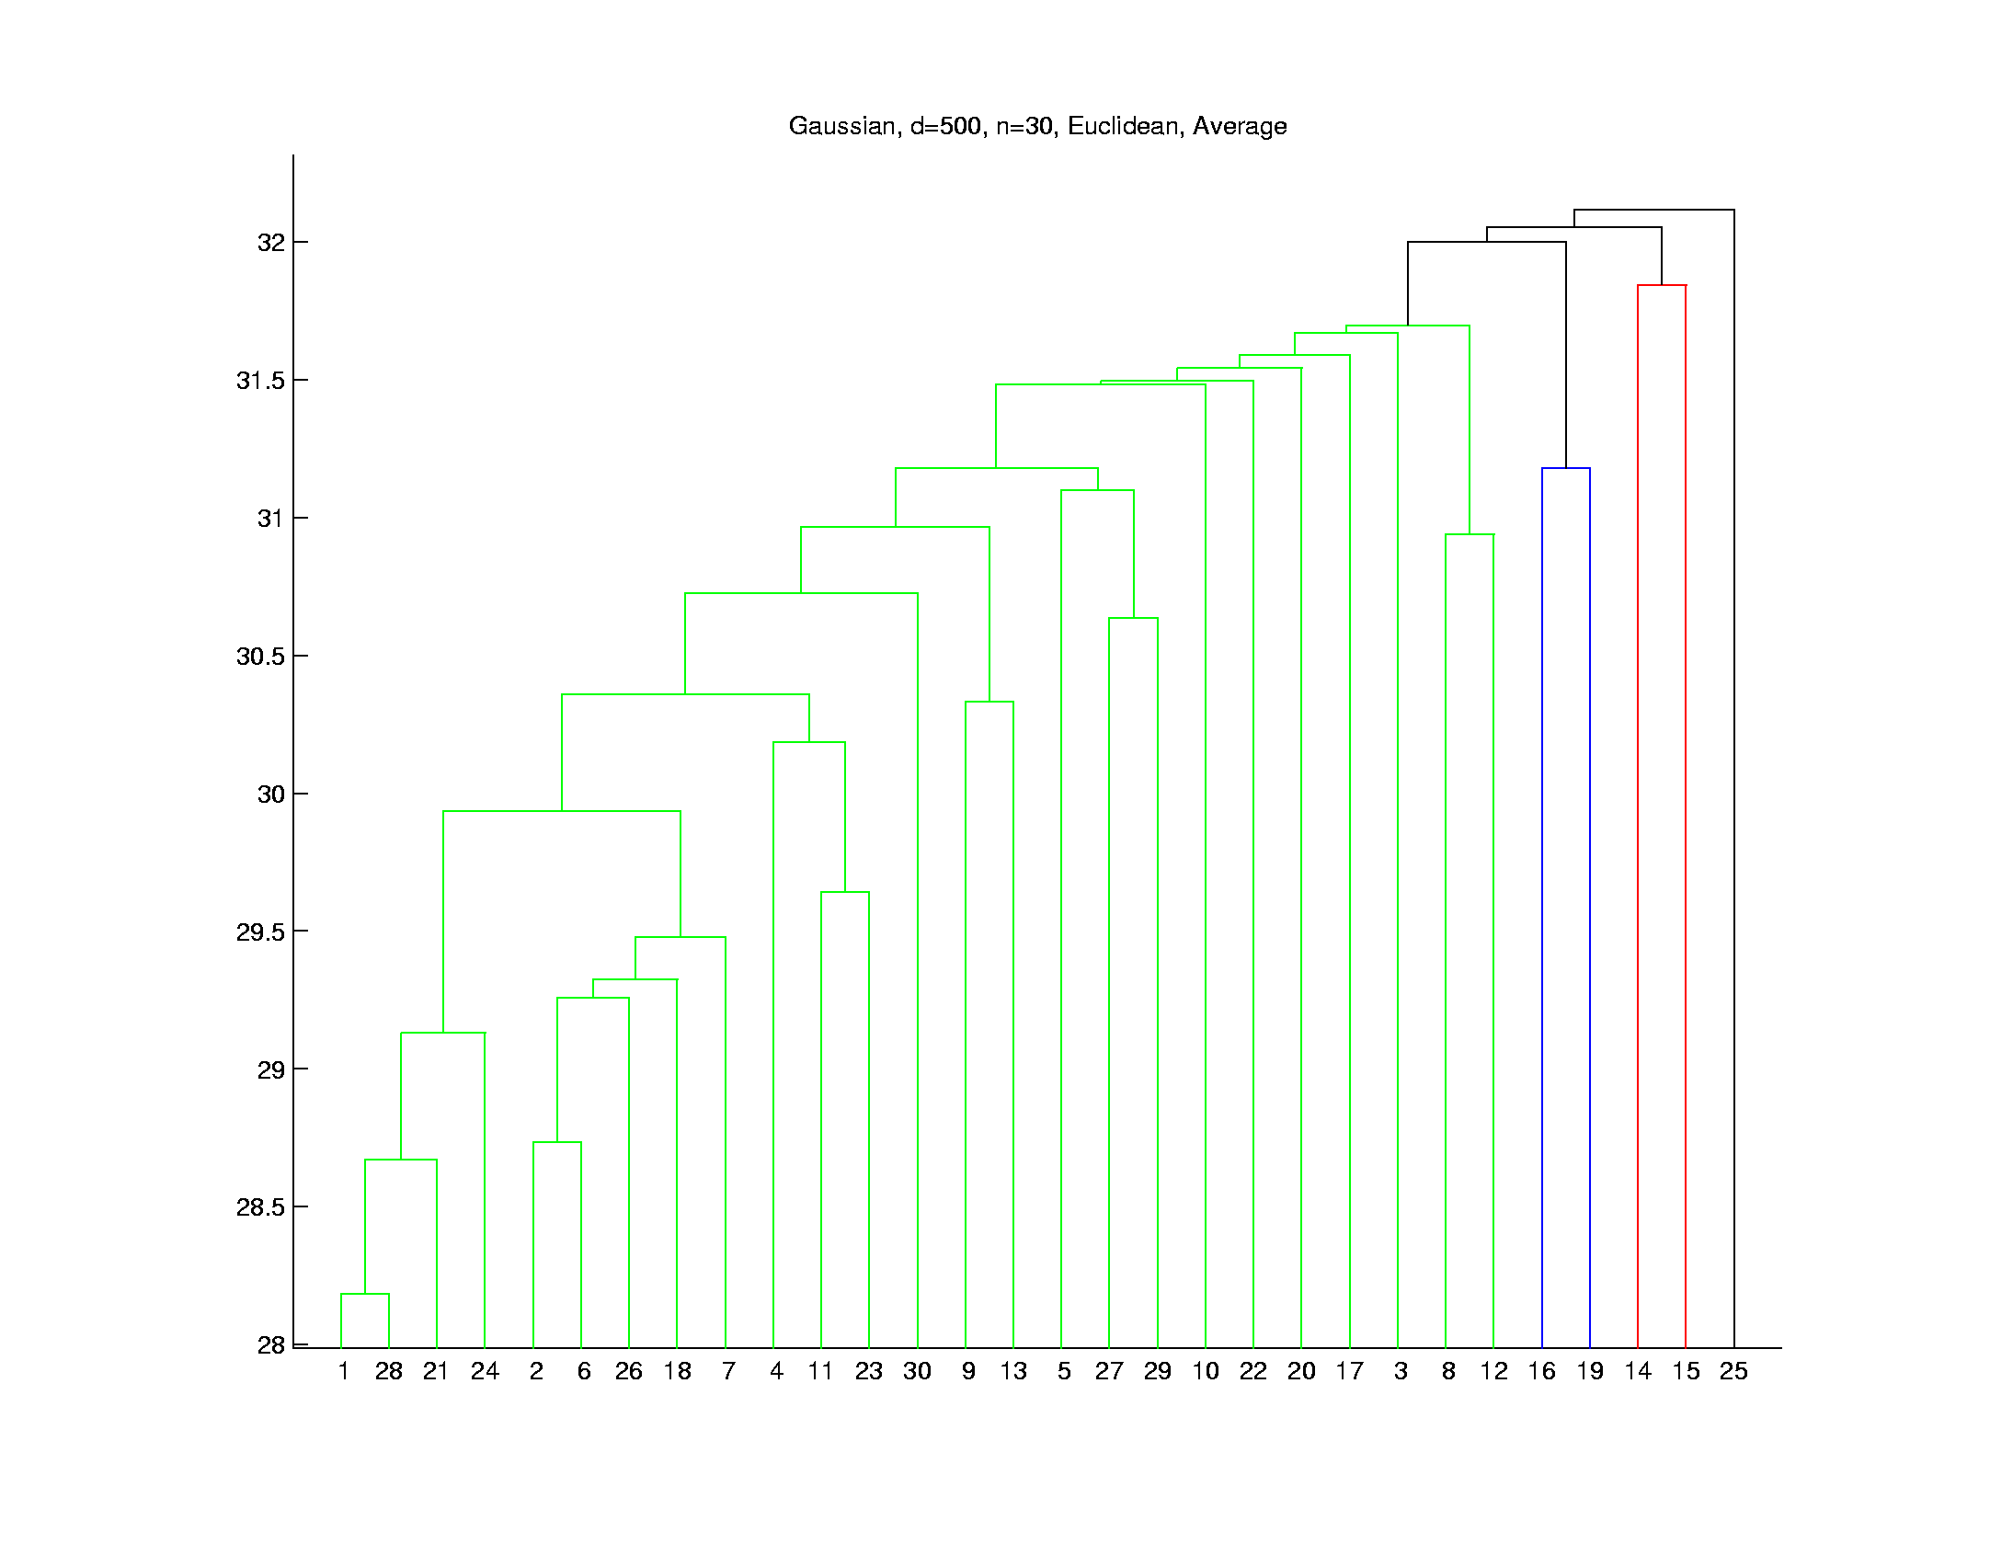
Hierarchical Clustering
Higher Dimensions, $d=500$, $n=30$, $N(0,I)$
Euclidean Dist.
Average Linkage
Get More
Grouping,
Lower
Singletons

Slide 47
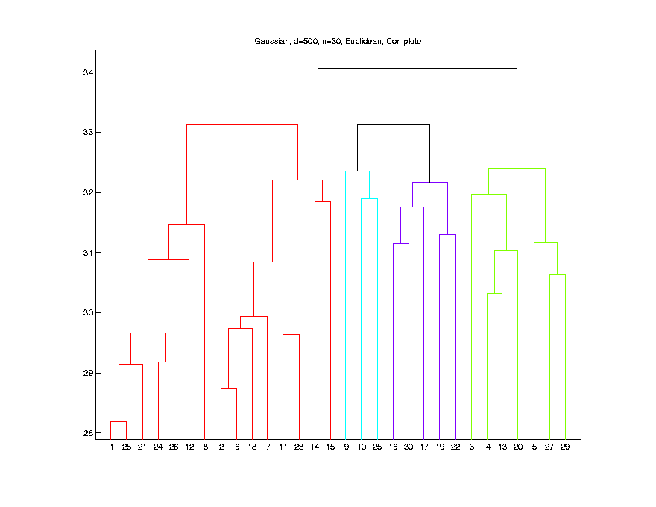
Hierarchical Clustering
Higher Dimensions, $d=500$, $n=30$, $N(0,I)$
Euclidean Dist.
Complete Linkage
Much More
Grouping,
Singletons
Much Lower

Slide 48
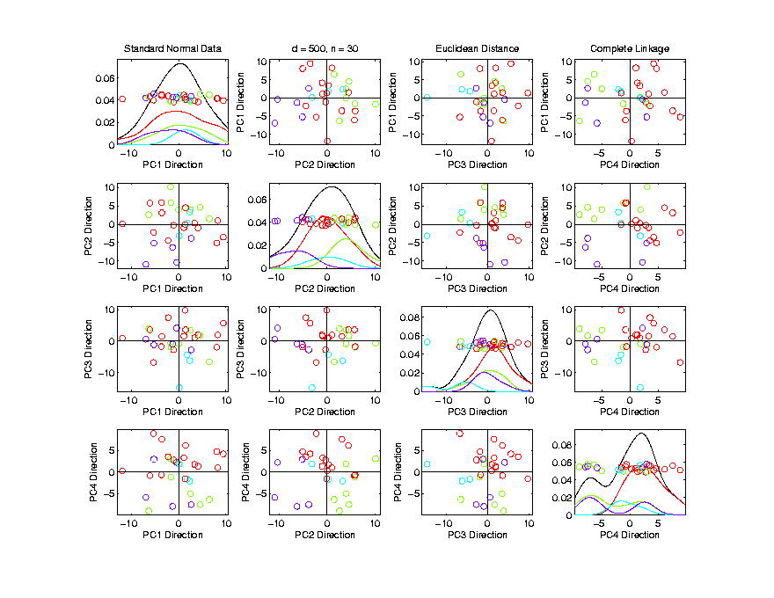
Hierarchical Clustering
Higher Dimensions, $d=500$, $n=30$, $N(0,I)$
Euclidean Dist.
Complete Linkage
Explore
With PCA
Some Patterns Visible
But Mostly in Higher PCs

Slide 49
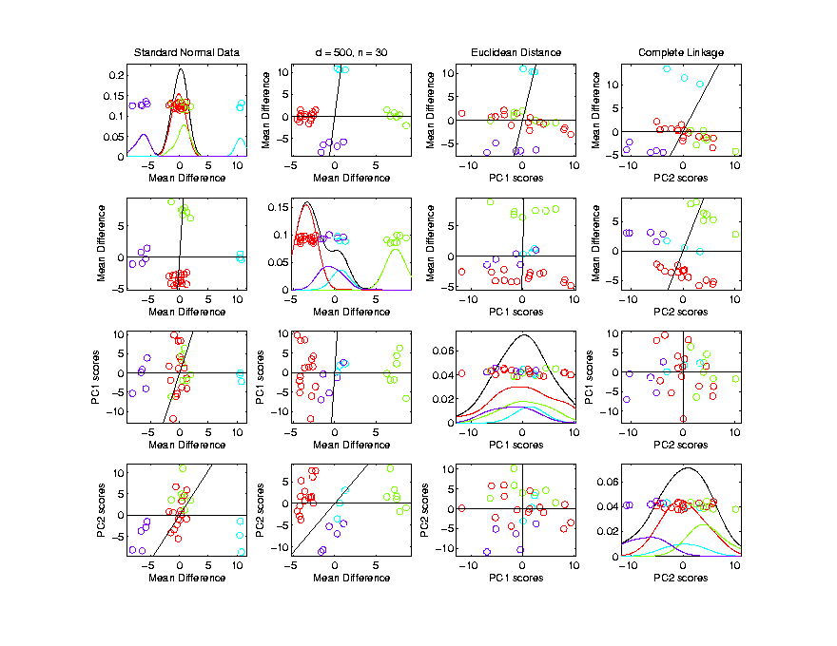
Hierarchical Clustering
Higher Dimensions, $d=500$, $n=30$, $N(0,I)$
Euclidean Dist.
Complete Linkage
Visualize
With MDs
Good Separation
MD spread
$≪$PC spread

Slide 50
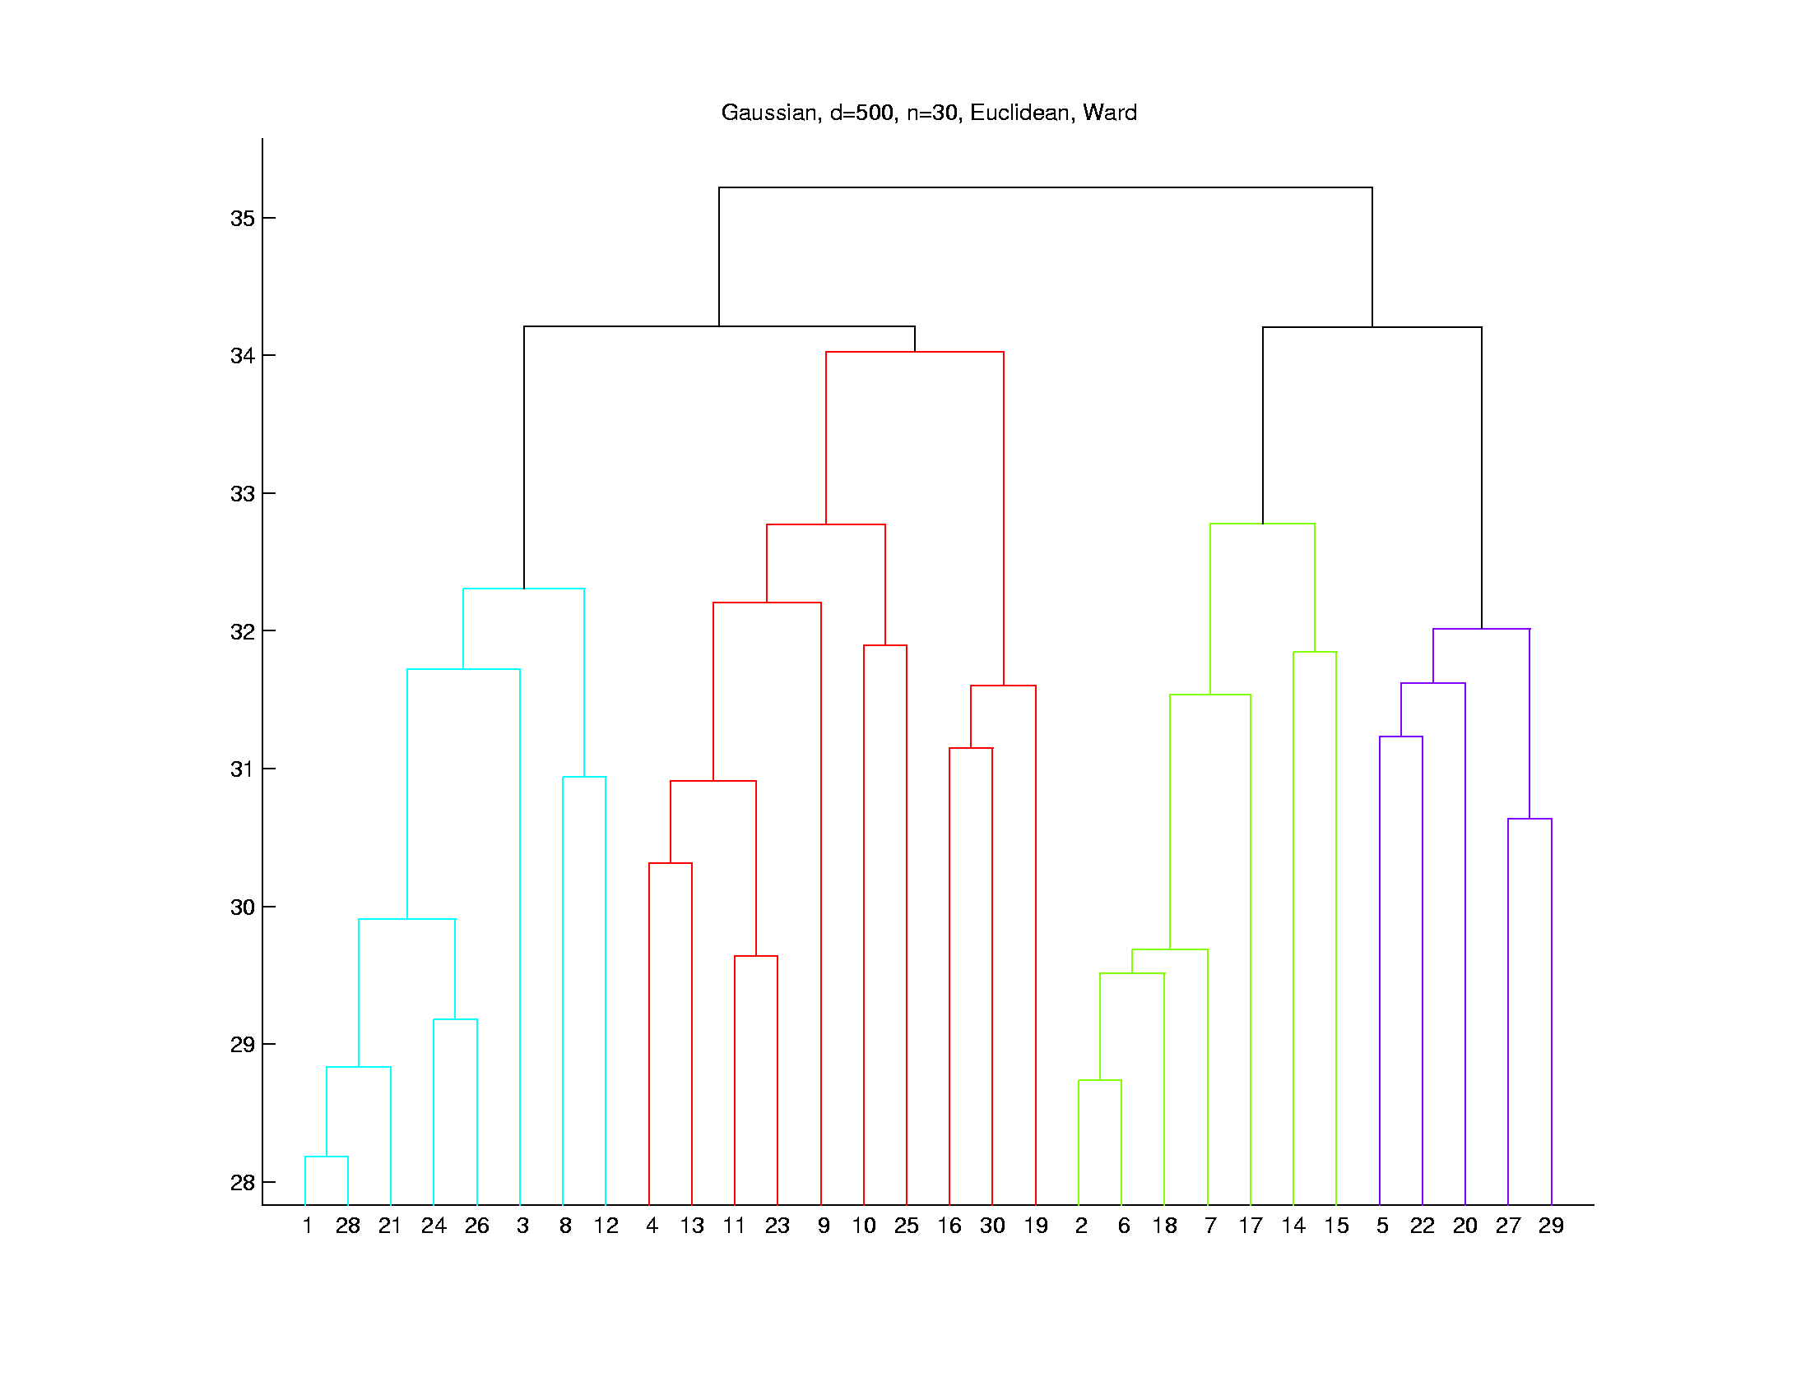
Hierarchical Clustering
Higher Dimensions, $d=500$, $n=30$, $N(0,I)$
Euclidean Dist.
Ward’s Linkage
Likes
Balanced
Cluster
Sizes
Note Sizes:
8
10
7
5

Slide 51
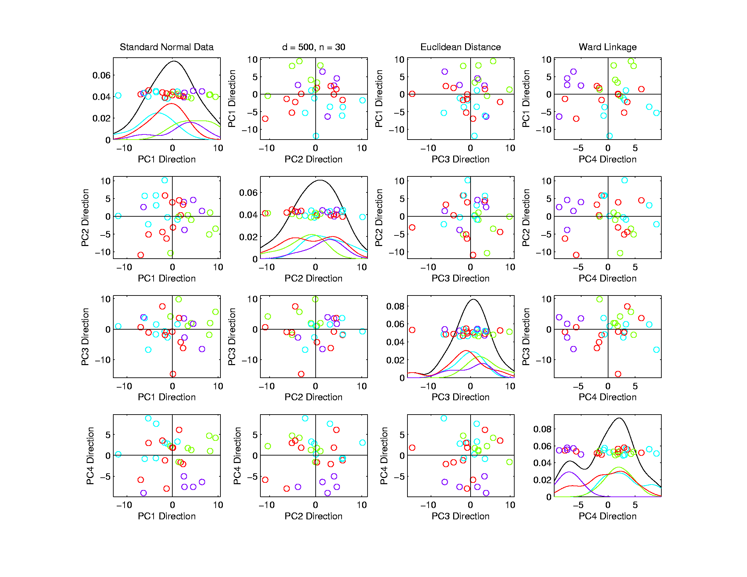
Hierarchical Clustering
Higher Dimensions, $d=500$, $n=30$, $N(0,I)$
Euclidean Dist.
Ward’s Linkage
Once Again
Not Very
Apparent
In PCA???

Slide 52
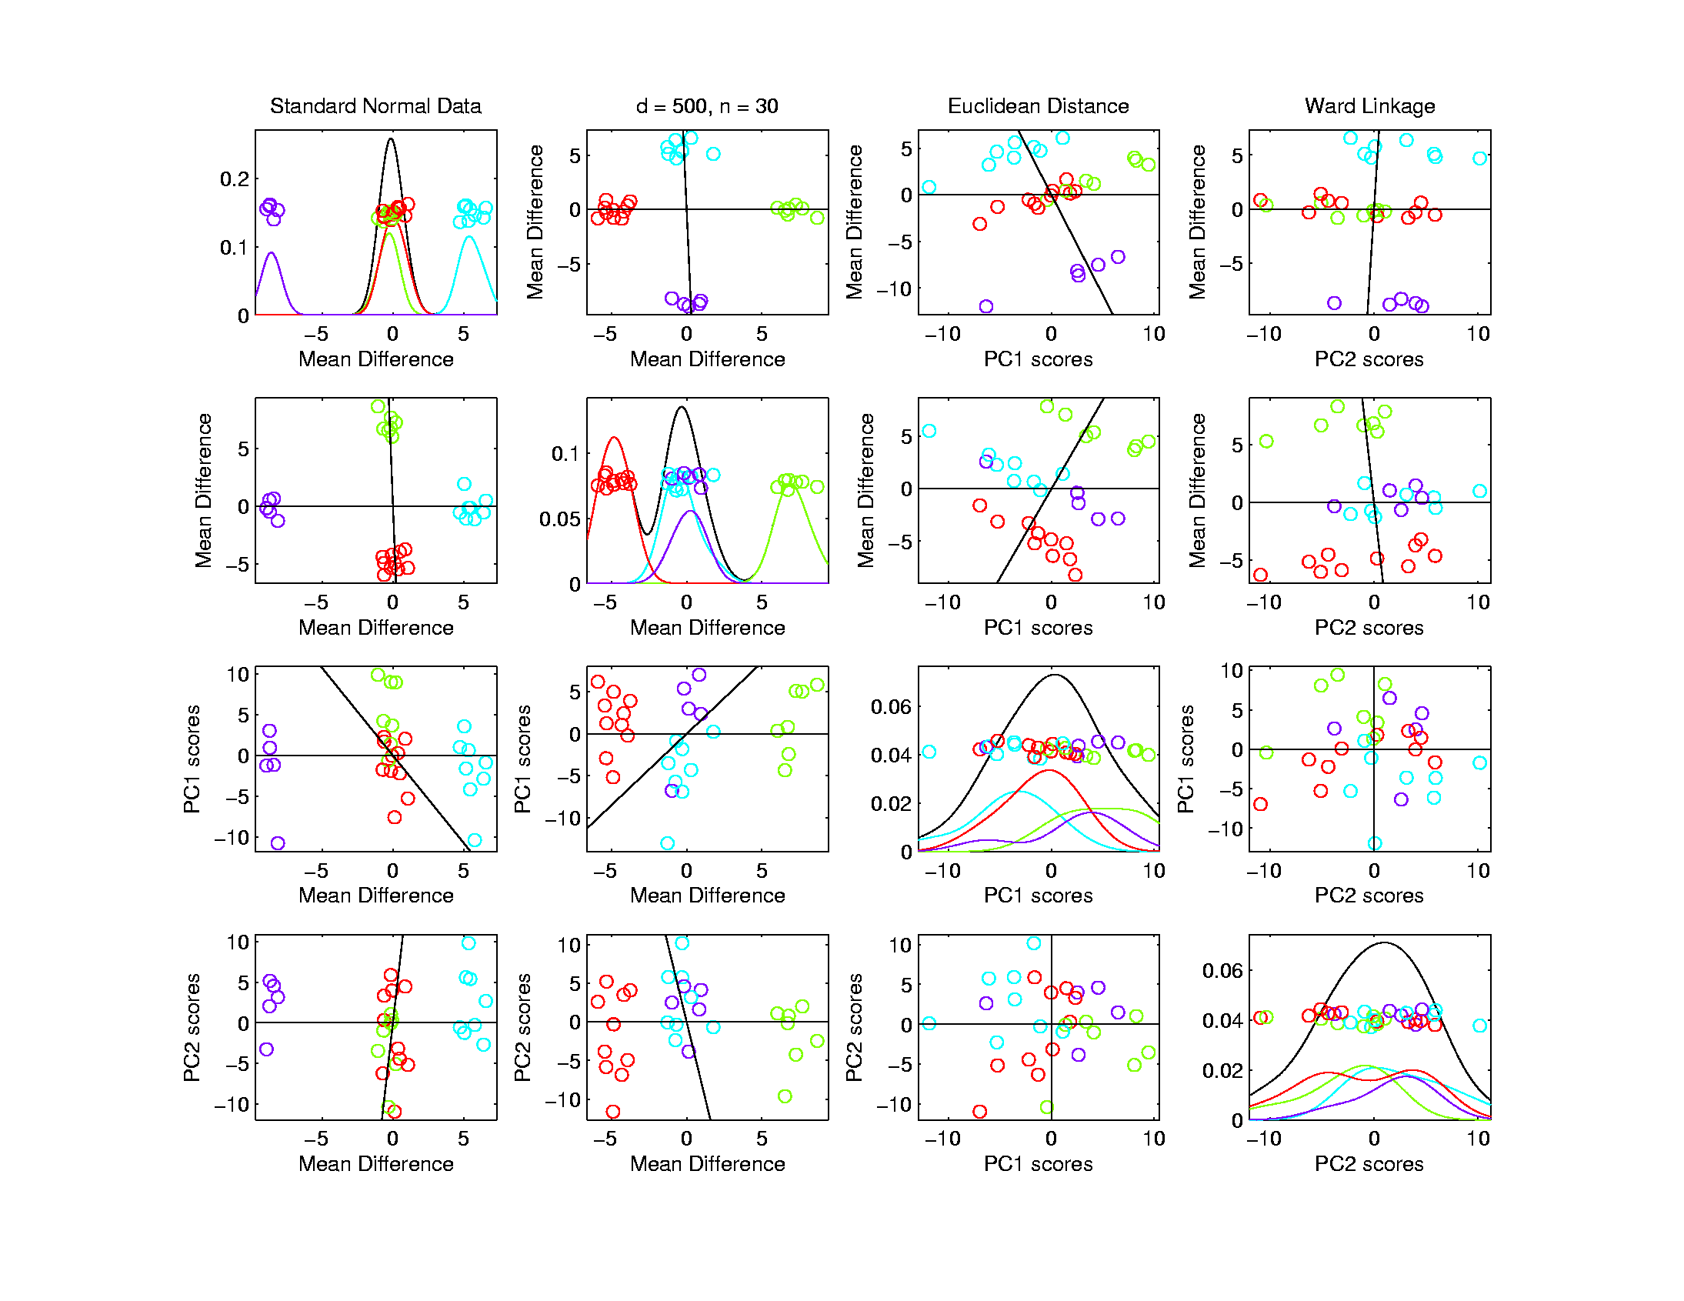
Hierarchical Clustering
Higher Dimensions, $d=500$, $n=30$, $N(0,I)$
Euclidean Dist.
Ward’s Linkage
Visualize
With Mean
Differences
Great Separation,
Slightly BetterThan Complete

Slide 53
Recall Earlier HDLSS Analysis
Used Simplex Calculation to Show:
Distance Between Cluster Means
of $n_{1}$ and $n_{2}$ is $\sqrt{\frac{d}{n_{1}}+\frac{d}{n_{2}}}$.
So have:
Cyan – Magenta: $\sqrt{\frac{500}{8}+\frac{500}{5}}≈12.7$
Green – Red: $\sqrt{\frac{500}{7}+\frac{500}{10}}≈11.0$

Slide 54
Hierarchical Clustering
Higher Dimensions, $d=500$, $n=30$, $N(0,I)$
Euclidean Dist.
Ward’s Linkage
Visualize
With Mean
Differences
$$≈12.7$$
$$≈11.0$$

Slide 55
Hierarchical Clustering
Linkage Observations:
Single Linkage
Visually Sensible in Low $d$
Peels Off Singleton’s in High $d$
Average Linkage
Generally In Between
Ward’s Linkage
Likes Balanced Cluster Sizes
Often Useful in High $d$
Every Dog Has His Day
Complete Linkage
Is Close, But Not
Quite as Good

Slide 56
SigClust
Statistical Significance of Clusters
in HDLSS Data
When is a cluster “really there”?
(Simpler Version of “What is $K$?”)
Liu et al (2007), Huang et al (2014)

Slide 57
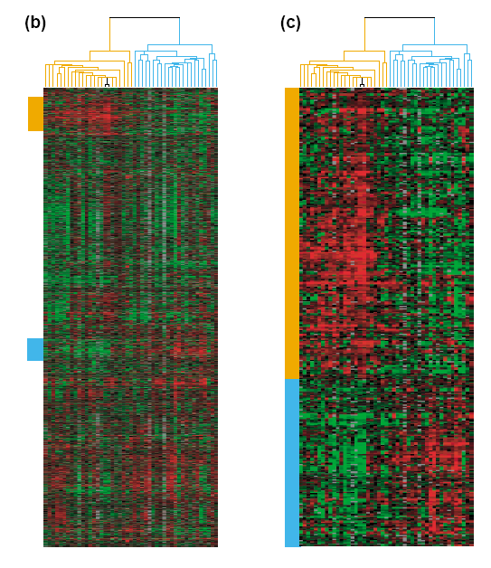
Common Genomic Analytic Approach: Clustering
From: Perou et al (2000)
d = 1161 genes
Zoomed to “relevant”
Gene subsets

Slide 58
Interesting Statistical Problem
For HDLSS data:
When clusters seem to appear
E.g. found by clustering method
How do we know they are really there?
Question asked by Neil Hayes
Define appropriate statistical significance?
Can we calculate it?

Slide 59
First Approaches: Hypo Testing
e.g. Direction, Projection, Permutation
Hypothesis test of:
Significant difference between sub-populations
Recall from Before

Slide 60
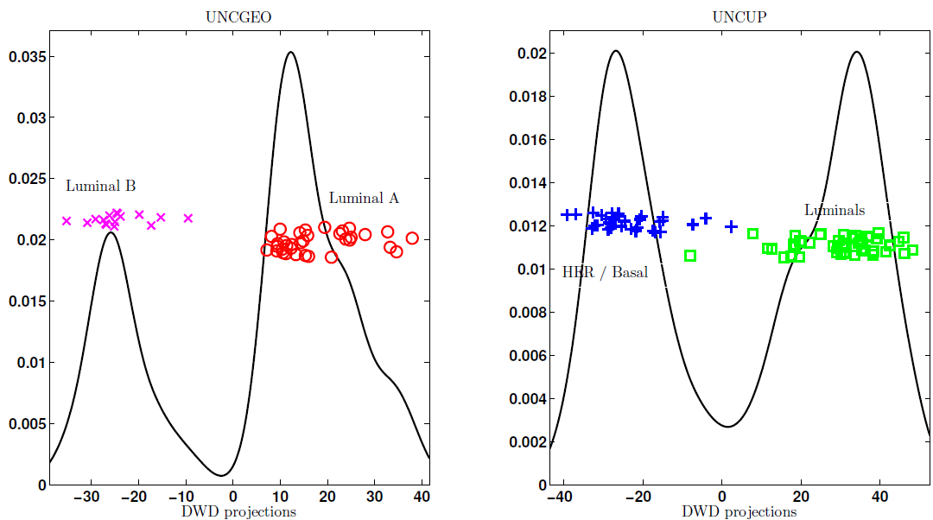
DiProPerm Hypothesis Test
Two
Examples
Which Is
“More
Distinct”?
Visually Better Separation?
Thanks to Katie Hoadley

Slide 61
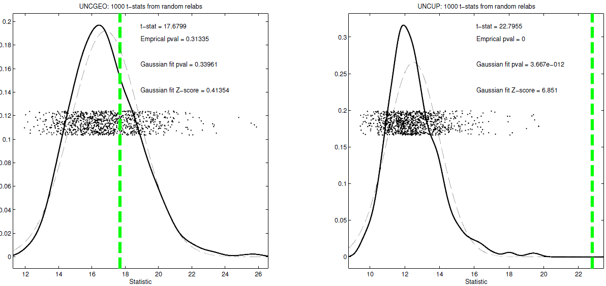
DiProPerm Hypothesis Test
Two
Examples
Which Is
“More
Distinct”?
Stronger Statistical Significance!
Thanks to Katie Hoadley
Due to Larger Sample Sizes

Slide 62
First Approaches: Hypo Testing
e.g. Direction, Projection, Permutation
Hypothesis test of:
Significant difference between sub-populations
Effective and Accurate
I.e. Sensitive and Specific
There exist several such tests
But critical point is:
What result implies about clusters

Slide 63
Clarifying Simple Example
Why Population Difference Tests cannot indicate clustering
Andrew Nobel Observation
For Gaussian Data (Clearly 1 Cluster!)
Assign Extreme Labels
(e.g. by clustering)
Subpopulations are signif’ly different

Slide 64
Clarifying Simple Example
2-d Standard Gaussian Data (i.e. N(0,1))

Slide 65
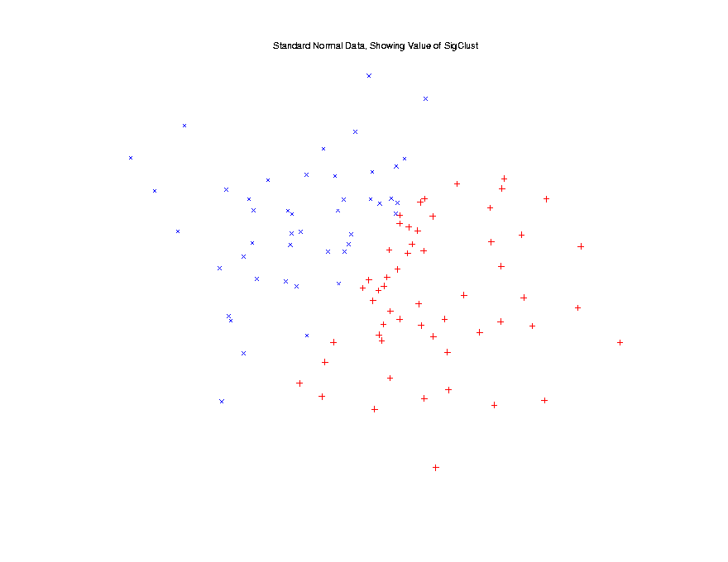
Clarifying Simple Example
2-d Standard Gaussian Data (i.e. N(0,1))
Apply
2-Means
Clustering

Slide 66
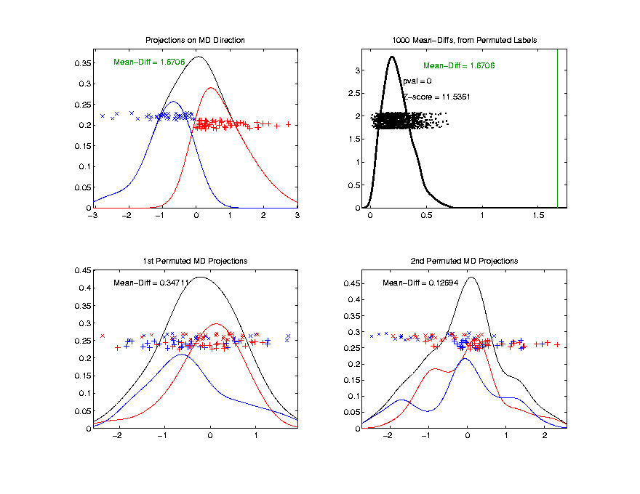
Clarifying Simple Example
2-d Standard Gaussian Data (i.e. N(0,1))
Apply
2-Means
Clustering
DiProPerm
Result
Note: Cluster Means Very Sig’tly Different

Slide 67
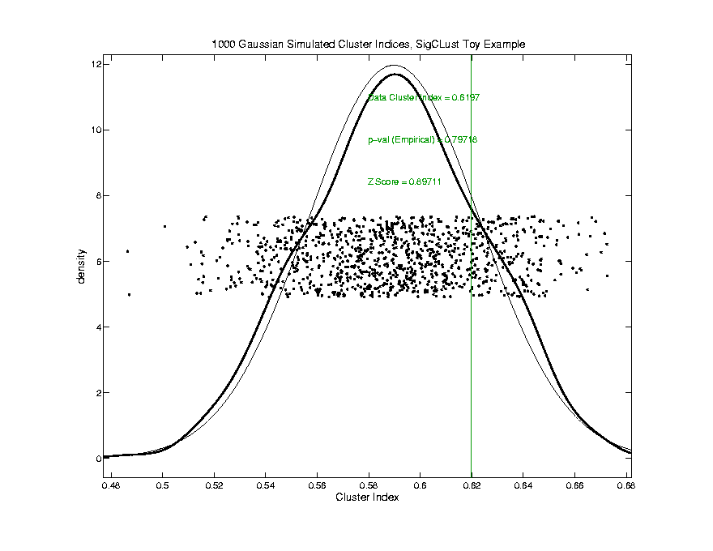
Clarifying Simple Example
2-d Standard Gaussian Data (i.e. N(0,1))
But Not
Significant
By
Sig Clust
Lies in Middle
Of Null Pop’n

Slide 68
Statistical Significance of Clusters
Basis of SigClust Approach:
What defines: A Single Cluster?
A Gaussian distribution (Sarle & Kou 1993)
So define SigClust test based on:
2-means cluster index (measure) as statistic
Gaussian null distribution
Currently compute by simulation
Possible to do this analytically???

Slide 69
SigClust Statistic – 2-Means Cluster Index
Measure of non-Gaussianity:
2-means Cluster Index
Familiar Criterion from k-means Clustering
Within Class Sum of Squared Distances to Class Means
Prefer to divide (normalize) by Overall Sum of Squared Distances to Mean
Puts on scale of proportions

Slide 70
SigClust Statistic – 2-Means Cluster Index
Measure of non-Gaussianity:
2-means Cluster Index:
$$CI\left(C_{1},⋯,C_{K}\right)=\frac{\sum_{j=1}^{K}{\sum_{i∈C_{j}}{{\left\|{\tilde{x}}_{i}−{\overline{x}}_{j}\right\|}^{2}}}}{\sum_{i=1}^{n}{{\left\|{\tilde{x}}_{i}−\overline{x}\right\|}^{2}}}$$
“Within Class Var’n” / “Total Var’n”
Class Index Sets
Class Means

Slide 71
SigClust Gaussian null distribut’n
Which Gaussian (for null)?
Standard (sphered) normal?
No, not realistic
Rejection not strong evidence for clustering
Could also get that from a-spherical Gaussian
Need Gaussian more like data:
Need Full $N_{d}\left(μ,Σ\right)$ model
Challenge: Parameter Estimation
Especially in HDLSS Context

Slide 72
SigClust Gaussian null distribut’n
Challenge: Parameter Estimation
Case 1: $n>d$ (Conventional)
Consider $\hat{μ}$ and $\hat{Σ}$
Case 2: Random Matrix or HDLSS
${\hat{Σ}}^{−1}$ is Very Slippery
Need Better Approach
Can Always Do This
But Can Be Very
Conservative

Slide 73
SigClust Gaussian null distribut’n
Estimated Mean, $μ$ (of Gaussian dist’n)?
1st Key Idea: Can ignore this
By appealing to shift invariance of CI
When Data are (rigidly) shifted
CI remains the same
So enough to simulate with mean 0
Other uses of invariance ideas?

Slide 74
SigClust Gaussian null distribut’n
Challenge: how to estimate cov. Matrix $Σ$?
Number of parameters: $\frac{d\left(d+1\right)}{2}$
E.g. Perou 500 data:
Dimension $d=9674$
so $\frac{d\left(d+1\right)}{2}=46,797,975$
But Sample Size $n=533$
Impossible in HDLSS settings????
Way around this problem?

Slide 75
SigClust Gaussian null distribut’n
2nd Key Idea: Mod Out Rotations
Replace full Cov. by diagonal matrix
As done in PCA eigen-analysis
$$Σ=MDM^{t}$$
But then “not like data”???
OK, since k-means clustering (i.e. CI) is
rotation invariant
(assuming e.g. Euclidean Distance)

Slide 76
SigClust Gaussian null distribut’n
2nd Key Idea: Mod Out Rotations
Only need to estimate diagonal matrix
But still have HDLSS problems?
E.g. Perou 500 data:
Dimension $d=9674$
Sample Size $n=533$
Still need to estimate $d=9674$ param’s

Slide 77
SigClust Gaussian null distribut’n
3rd Key Idea: Factor Analysis Model
Model Covariance as: Biology + Noise
$$Σ=Σ_{B}+{σ_{N}}^{2}×I$$
Where
$Σ_{B}$ is “fairly low dimensional”
${σ_{N}}^{2}$ is estimated from background noise

Slide 78
SigClust Gaussian null distribut’n
Estimation of Background Noise ${σ_{N}}^{2}$:
Reasonable model (for each gene):
Expression = Signal + Noise
“noise” is roughly Gaussian, common var.
“noise” terms independent
(across genes)

Slide 79
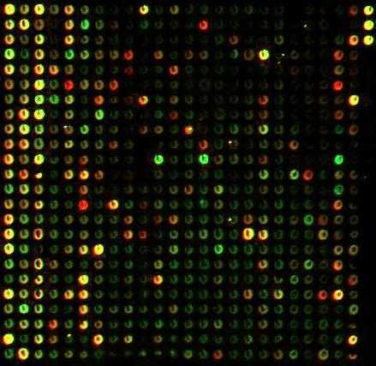
SigClust Gaussian null distribut’n
Estimation of Background Noise ${σ_{N}}^{2}$:
Microarrays:
Model OK, since
data come from
light intensities
at colored spots

Slide 80
SigClust Gaussian null distribut’n
Estimation of Background Noise ${σ_{N}}^{2}$:
For all expression values (as numbers)
(Each Entry of $d×n$ Data matrix)

Slide 81
SigClust Gaussian null distribut’n
Estimation of Background Noise ${σ_{N}}^{2}$:
For all expression values (as numbers)
Use robust estimate of scale
Median Absolute Deviation (MAD)
(from the median)
$${median}_{i}\left|x_{i}−{median}_{i^{′}}\left(x_{i^{′}}\right)\right|$$

Slide 82
SigClust Gaussian null distribut’n
Estimation of Background Noise ${σ_{N}}^{2}$:
For all expression values (as numbers)
Use robust estimate of scale
Median Absolute Deviation (MAD)
(from the median)
Rescale to put on same scale as s. d.:
$$\hat{σ}=\frac{{MAD}_{data}}{{MAD}_{N\left(0,1\right)}}$$

Slide 83
Participant Presentations
12:00 Liubov Arbeeva:
Accelerometer Data Analysis
12:05 Shaleni Kovach:
Generative models for brain imaging data
12:10 Puyao Ge:
Vaccine Distributoin Policy
Next Class: Jimin Choi, Kyungjin Sohn, Emma Mitchell

