Slide 1
Statistics – O. R. 881 Object Oriented Data Analysis
Start
Recording
Steve Marron
Dept. of Statistics and Operations Research
University of North Carolina

Slide 2
Current Sections in Textbook
Today:
Sections 13.2, 15.1, 15.4

Slide 3
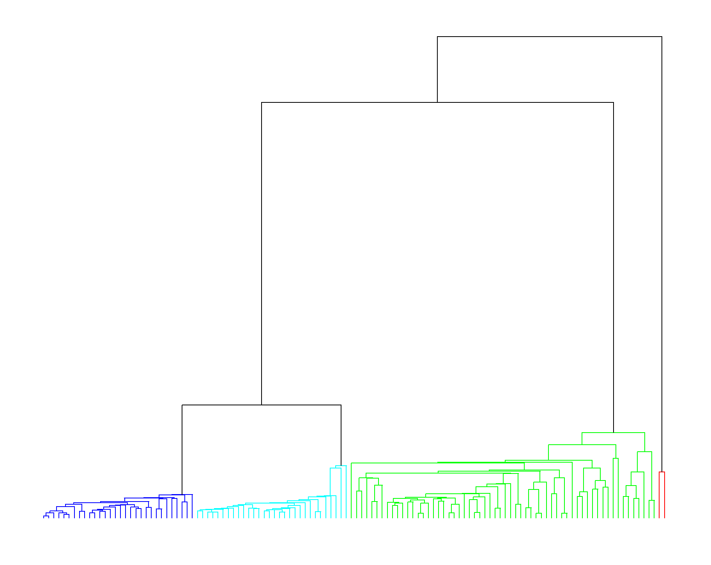
Hierarchical Clustering
2-d Toy Example, Euclidean Distance
Single Linkage Dendrogram
Reveals
Ordering
Of Clusters
Heights
Correspond
to Gaps
Because of

Slide 4
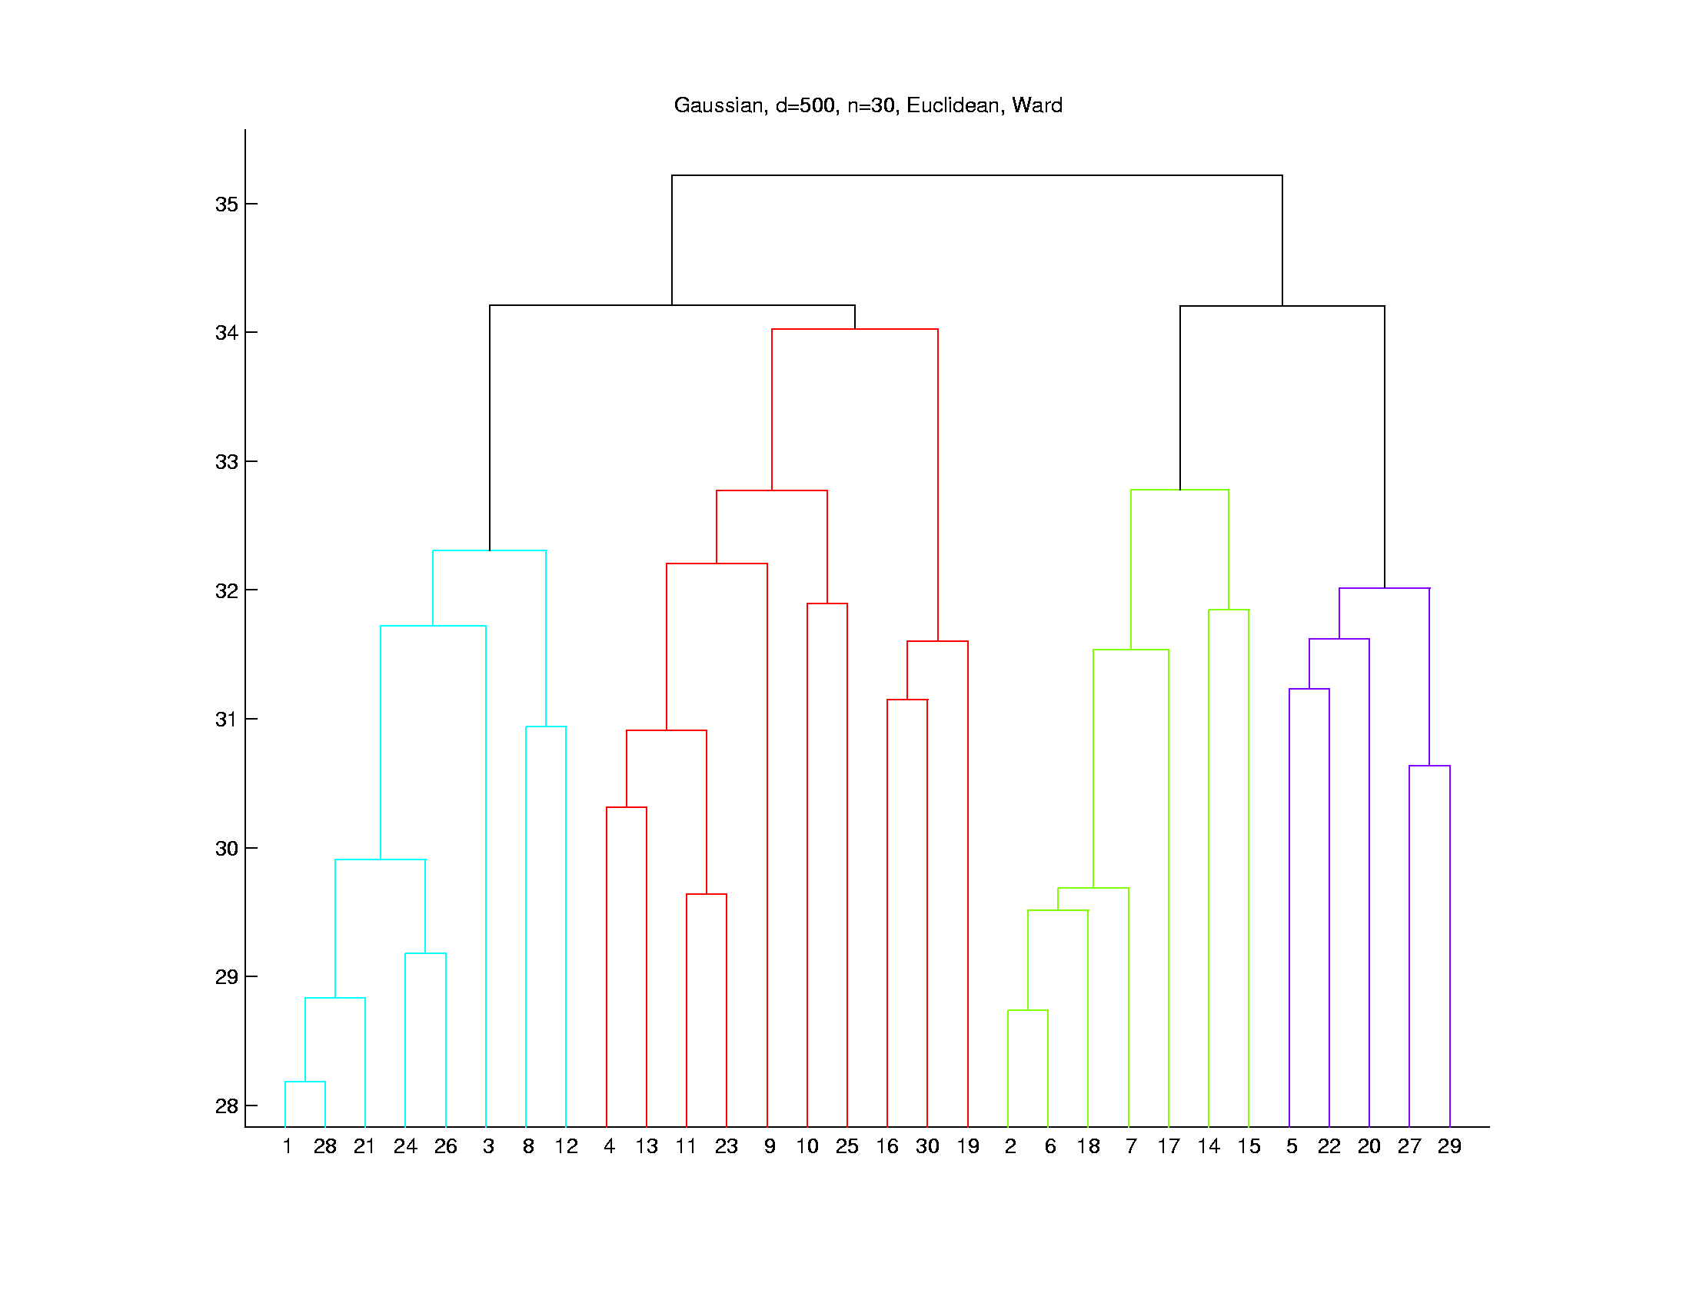
Hierarchical Clustering
Higher Dimensions, $d=500$, $n=30$, $N(0,I)$
Euclidean Dist.
Ward’s Linkage
Likes
Balanced
Cluster
Sizes
Note Sizes:
8
10
7
5

Slide 5
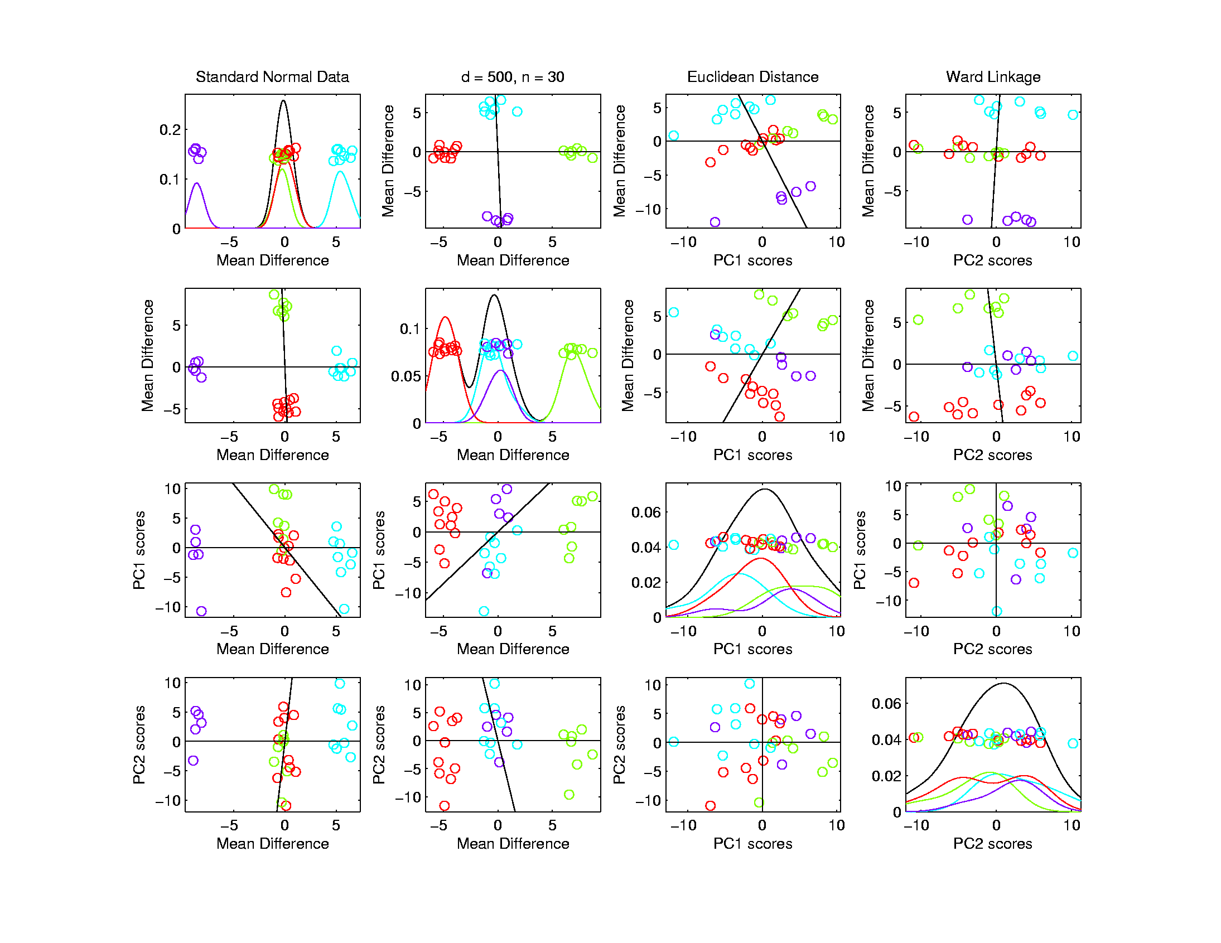
Hierarchical Clustering
Higher Dimensions, $d=500$, $n=30$, $N(0,I)$
Euclidean Dist.
Ward’s Linkage
Visualize
With Mean
Differences
$$≈12.7$$
$$≈11.0$$

Slide 6
SigClust
Statistical Significance of Clusters
in HDLSS Data
When is a cluster “really there”?
(Simpler Version of “What is $K$?”)
Liu et al (2007), Huang et al (2014)

Slide 7
Statistical Significance of Clusters
Basis of SigClust Approach:
What defines: A Single Cluster?
A Gaussian distribution (Sarle & Kou 1993)
So define SigClust test based on:
2-means cluster index (measure) as statistic
Gaussian null distribution
Currently compute by simulation
Possible to do this analytically???

Slide 8
SigClust Statistic – 2-Means Cluster Index
Measure of non-Gaussianity:
2-means Cluster Index:
$$CI\left(C_{1},⋯,C_{K}\right)=\frac{\sum_{j=1}^{K}{\sum_{i∈C_{j}}{{\left\|{\tilde{x}}_{i}−{\overline{x}}_{j}\right\|}^{2}}}}{\sum_{i=1}^{n}{{\left\|{\tilde{x}}_{i}−\overline{x}\right\|}^{2}}}$$
“Within Class Var’n” / “Total Var’n”
Class Index Sets
Class Means

Slide 9
SigClust Gaussian null distribut’n
Challenge: Parameter Estimation
Case 1: $n>d$ (Conventional)
Consider $\hat{μ}$ and $\hat{Σ}$
Case 2: Random Matrix or HDLSS
${\hat{Σ}}^{−1}$ is Very Slippery
Need Better Approach
Can Always Do This
But Can Be Very
Conservative

Slide 10
SigClust Gaussian null distribut’n
Estimated Mean, $μ$ (of Gaussian dist’n)?
1st Key Idea: Can ignore this
By appealing to shift invariance of CI
When Data are (rigidly) shifted
CI remains the same
So enough to simulate with mean 0
Other uses of invariance ideas?

Slide 11
SigClust Gaussian null distribut’n
2nd Key Idea: Mod Out Rotations
Replace full Cov. by diagonal matrix
As done in PCA eigen-analysis
$$Σ=MDM^{t}$$
But then “not like data”???
OK, since k-means clustering (i.e. CI) is
rotation invariant
(assuming e.g. Euclidean Distance)

Slide 12
SigClust Gaussian null distribut’n
3rd Key Idea: Factor Analysis Model
Model Covariance as: Biology + Noise
$$Σ=Σ_{B}+{σ_{N}}^{2}×I$$
Where
$Σ_{B}$ is “fairly low dimensional”
${σ_{N}}^{2}$ is estimated from background noise

Slide 13
SigClust Gaussian null distribut’n
Estimation of Background Noise ${σ_{N}}^{2}$:
Reasonable model (for each gene):
Expression = Signal + Noise
“noise” is roughly Gaussian, common var.
“noise” terms independent
(across genes)

Slide 14
SigClust Gaussian null distribut’n
Estimation of Background Noise ${σ_{N}}^{2}$:
For all expression values (as numbers)
Use robust estimate of scale
Median Absolute Deviation (MAD)
(from the median)
$${median}_{i}\left|x_{i}−{median}_{i^{′}}\left(x_{i^{′}}\right)\right|$$

Slide 15
SigClust Gaussian null distribut’n
Estimation of Background Noise ${σ_{N}}^{2}$:
For all expression values (as numbers)
Use robust estimate of scale
Median Absolute Deviation (MAD)
(from the median)
Rescale to put on same scale as s. d.:
$$\hat{σ}=\frac{{MAD}_{data}}{{MAD}_{N\left(0,1\right)}}$$

Slide 16
SigClust Estimation of Background Noise
n = 533, d = 9456

Slide 17
SigClust Estimation of Background Noise
Hope: Most
Entries are
“Pure Noise,
(Gaussian)”

Slide 18
SigClust Estimation of Background Noise
Hope: Most
Entries are
“Pure Noise,
(Gaussian)”
A Few (<< ¼)
Are Biological
Signal –
Outliers

Slide 19
SigClust Estimation of Background Noise
Hope: Most
Entries are
“Pure Noise,
(Gaussian)”
A Few (<< ¼)
Are Biological
Signal –
Outliers
How to Check?

Slide 20
SigClust Estimation of Background Noise
Overall distribution has strong kurtosis
Shown by height of kde relative to
MAD based Gaussian fit
Mean and Median both ~ 0
SD ~ 1, driven by few large values
MAD ~ 0.7, driven by bulk of data

Slide 21
SigClust Estimation of Background Noise
Central part of distribution
“seems to look Gaussian”
But density does not provide
great diagnosis of Gaussianity
Better to look at Q-Q plot
Not Done in Detail This Semester

Slide 22
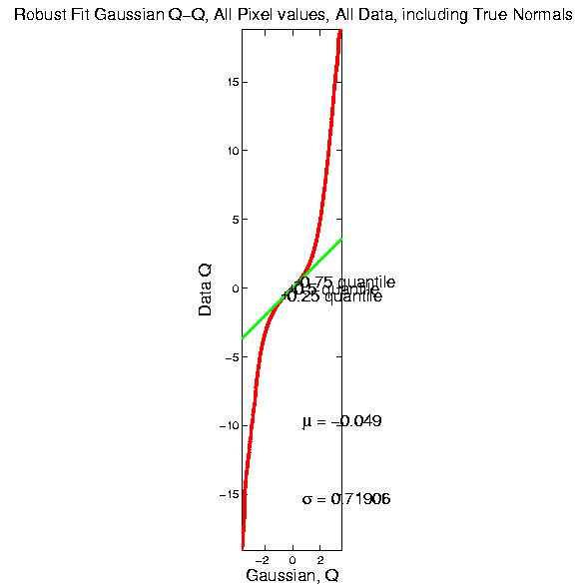
SigClust Estimation of Background Noise

Slide 23
SigClust Estimation of Background Noise
Distribution clearly not Gaussian
Except near the middle
Q-Q curve is very linear there
(closely follows 45º line)
Suggests Gaussian approx. is good there
And that MAD scale estimate is good
(Always a good idea to do such diagnostics)

Slide 24
SigClust Estimation of Background Noise
Now Check Effect of
Using SD, not MAD

Slide 25
SigClust Estimation of Background Noise
Checks that estimation of $σ$ matters
Show sample s.d. is indeed too large
As expected
Variation assessed by Q-Q envelope plot
Shows variation not negligible
Not surprising with n ~ 5 million

Slide 26
SigClust Gaussian null distribut’n
Early Estimation of Biological Covariance $Σ_{B}$:
Keep only “large” eigenvalues $λ_{1},λ_{2},⋯,λ_{d}$
Defined as $>{σ_{N}}^{2}$
So for null distribution, use eigenvalues:
$$\max_{}\left(λ_{1},{σ_{N}}^{2}\right),⋯,\max_{}\left(λ_{d},{σ_{N}}^{2}\right)$$

Slide 27
SigClust Gaussian null distribut’n
Improved Eigenvalue Estimation:
Soft Thresholding
Huang et al (2014)

Slide 28
SigClust Gaussian null distribution - Simulation
Now simulate from null distribution using:
$\left(\begin{matrix}{\tilde{x}}_{1,i} \\ ⋮ \\ {\tilde{x}}_{d,i}\end{matrix}\right)$ where ${\tilde{x}}_{j,i} \sim N\left(0,λ_{j}\right)$ (indep.)
Again rotation invariance makes this work
(and location invariance)

Slide 29
SigClust Gaussian null distribution - Simulation
Then compare data CI,
With simulated null population CIs
Spirit similar to DiProPerm
But now significance happens for
smaller values of CI

Slide 30
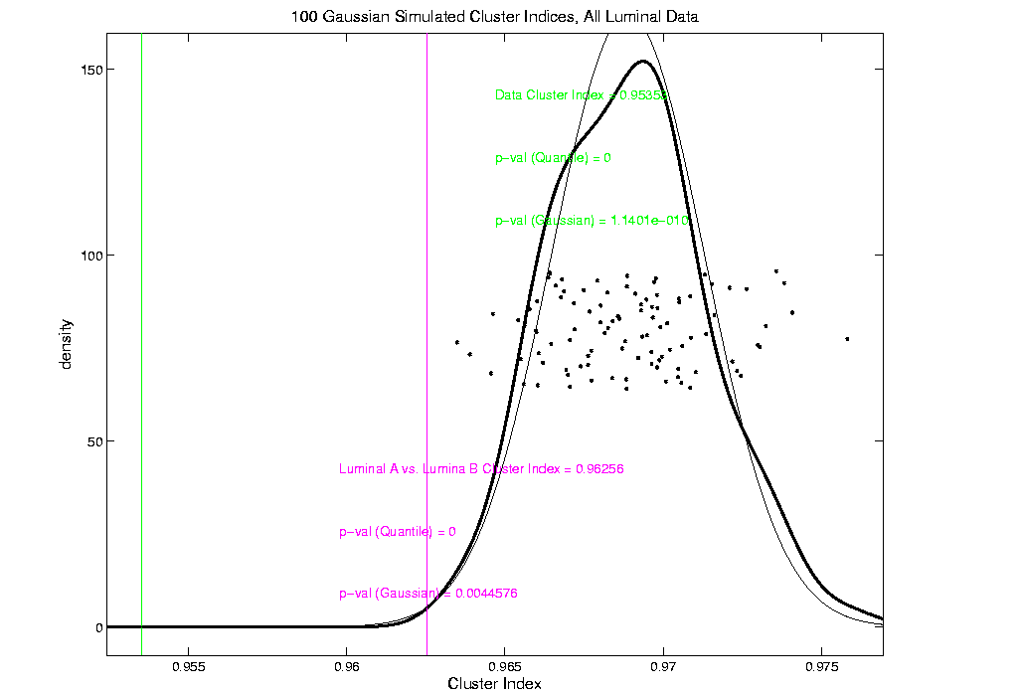
An example (details to follow)
P-val = 0.0045

Slide 31
SigClust Modalities
Two major modes:
Test significance of given clusterings
(e.g. for those found in heat map)
(Use given class labels)
Test if known cluster can be further split
(Use 2-means class labels)

Slide 32
SigClust Examples
Illustrate Using Earlier 4 Cluster Toy Data
First Investigate
Two Round Clusters

Slide 33
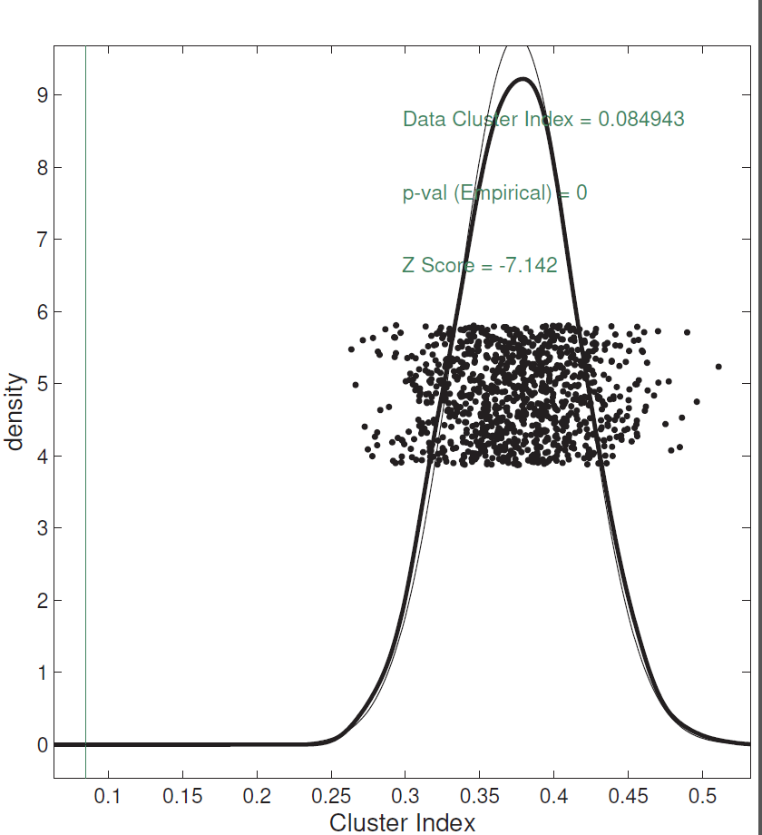
SigClust Examples
Investigate Two Round Clusters
= Actual Data CI
Gray Out
(Ignore)
Others
Compare for Significance
Fit Gaussian to Data
Conclude Clusters
Strongly Significant
Simulate from Gaussian
Record in Diagnostic Plot

Slide 34
SigClust Examples
Illustrate Using Earlier 4 Cluster Toy Data
Second Try To Split
Long Green Cluster

Slide 35
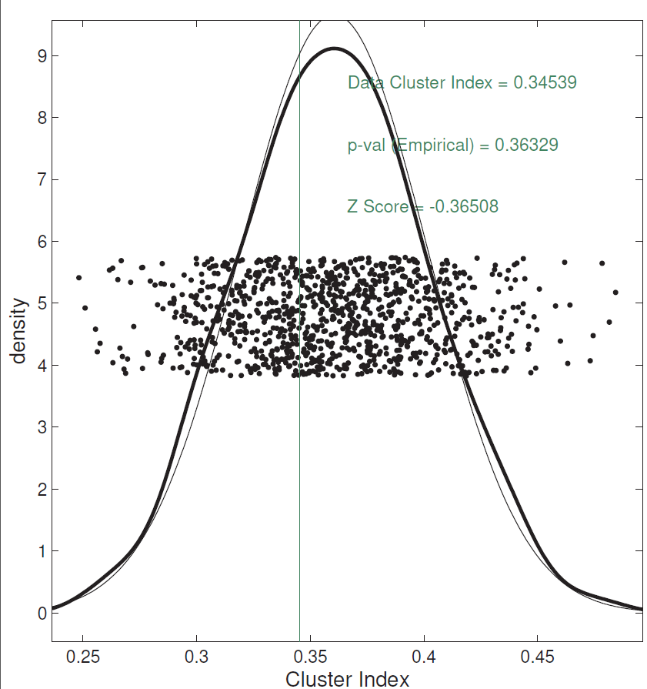
SigClust Examples
Try to Split Long Green Cluster
Can NOT Conclude
Two Clusters,
Accept Gaussian Null

Slide 36
SigClust Examples
Illustrate Using Earlier 4 Cluster Toy Data
Are Outliers A
Separate Cluster?

Slide 37
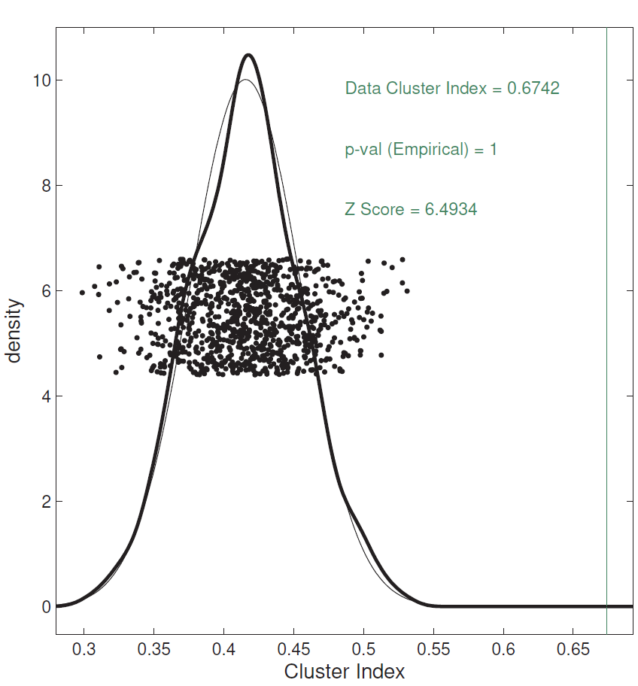
SigClust Examples
Are Outliers A Separate Cluster?
Note: No Conclusion Available
Since Random Labels → CI ≈ 1
Real CI on right side!?!
Artifact of Severe
Imbalance
Approach to Unbalanced
SigClust: Tom Keefe

Slide 38
SigClust Examples
Higher Dimensional RNAseq Data
From TCGA, random subset of $n=50$
KIRC (Kidney Cancer) Cases:
Are There Subtypes (Clusters)?
Gene Level RNAseq, log scale, satisfies:
Independent Errors
Common Variances
# genes,
$$d=12478$$

Slide 39
SigClust Examples
Split KIRC Cases? Diagnostic Plots

Slide 40
SigClust Examples
Split KIRC Cases? Check Soft Threshold

Slide 41
SigClust Examples
Split KIRC Cases?
Yes, using Soft
Thresholded Cov. Est.
No, Using Sample Cov. Est.
Too Conservative

Slide 42
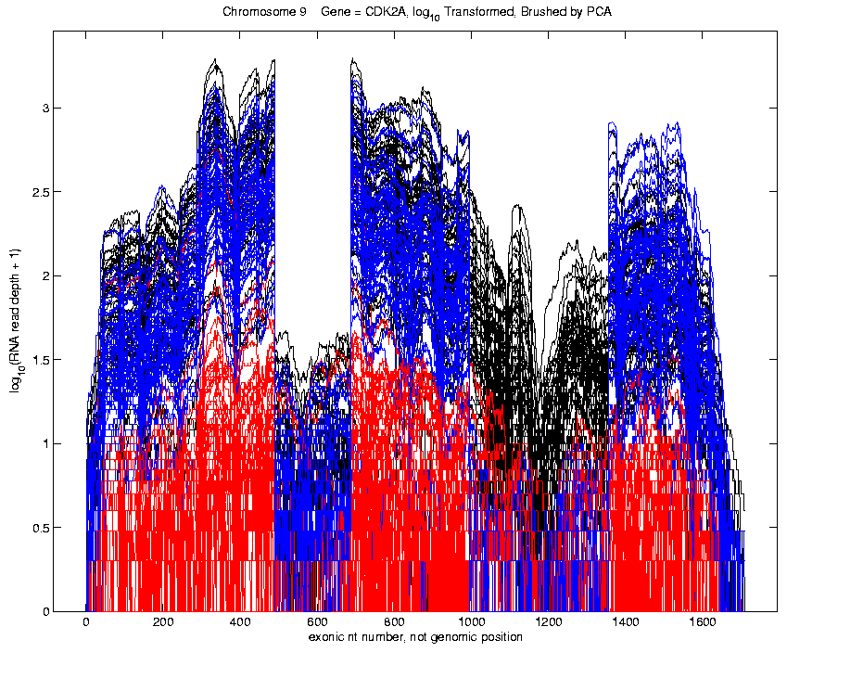
SigClust Examples
Previous LUAD Data, $n=180$, $d=1709$
RNAseq, at Base Pair Level,
Soft Thresholding
Assumptions Fail
(Esp’ly Indepen’ce)

Slide 43
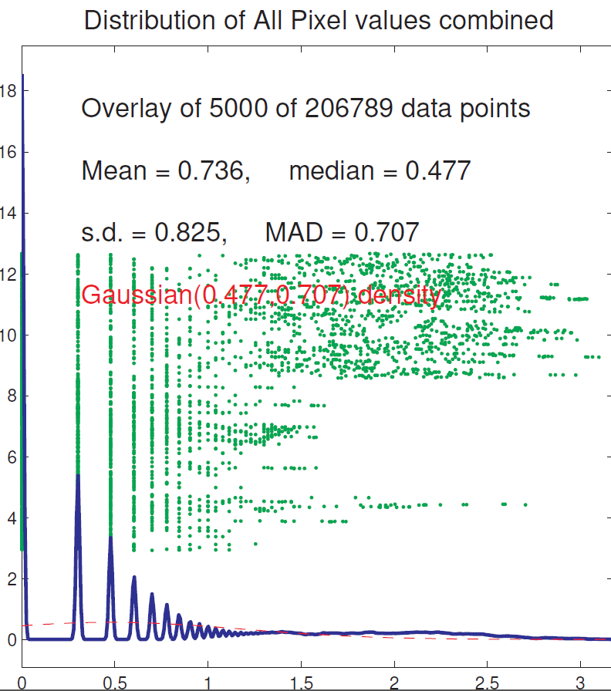
SigClust Examples
Previous LUAD Data, Diagnostic
Far From
Few Large Pixels
& Gaussian
Background Noise
Use Sample Cov. Est.
Not Soft Threshold

Slide 44
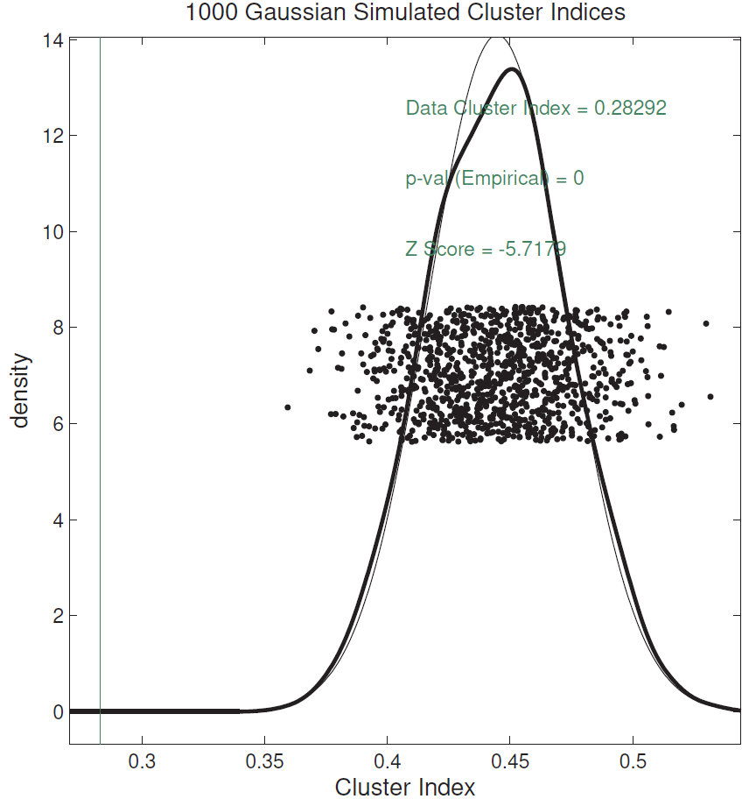
SigClust Examples
Previous LUAD Data, Conclusion
Can Split LUAD
Strong Evidence
For Clusters
(Recall Seen in PCA)

Slide 45
SigClust Examples
Previous LUAD Data, Conclusion
Can Split LUAD
Strong Evidence
For Clusters
(Recall Seen in PCA)

Slide 46
SigClust Extension
Adaptation to Hierarchical Clustering
Kimes et al. (2017)

Slide 47
Statistical Smoothing
In 1 Dimension
(Numbers as Data Objects)
Text: Chp. 15

Slide 48
Statistical Smoothing
In 1 Dimension, 2 Major Settings:
Density Estimation
“Histograms”
Nonparametric Regression
“Scatterplot Smoothing”

Slide 49
Density Estimation
Text: Sec. 15.1
E.g. Hidalgo Stamp Data
Thicknesses of Postage Stamps
Produced in Mexico
Over ~ 70 years
During 1800s
Paper produced in several factories?
How many factories? (Records lost)
Brought to statistical literature by:
Izenman and Sommer (1988)

Slide 50
Density Estimation
E.g. Hidalgo Stamp Data
Thicknesses of Postage Stamps
Produced in Mexico
Over ~ 70 years
During 1800s
Paper produced in several factories?
(Thicknesses vary by up to factor of 2)

Slide 51
Density Estimation
E.g. Hidalgo Stamp Data
A histogram
“Oversmoothed”
Bin Width too
large?
Miss important
structure?
Hard to Say Much
About # of Factories

Slide 52
Density Estimation
E.g. Hidalgo Stamp Data
Another histogram
Smaller binwidth
Suggests 2 modes?
2 factories making
the paper?

Slide 53
Density Estimation
E.g. Hidalgo Stamp Data
Another histogram
Smaller binwidth
Suggests 6 modes?
6 factories making
the paper?

Slide 54
Density Estimation
E.g. Hidalgo Stamp Data
Another histogram
Even smaller binwidth
Suggests many modes?
Really believe
modes are “there”?
Or just sampling
variation?

Slide 55
Density Estimation
E.g. Hidalgo Stamp Data
Critical Issue for histograms:
Choice of binwidth (well understood?)

Slide 56
Histograms
Less Well Understood Issue:
Choice of bin location
Major impact on number of modes (2-7)
All for same binwidth

Slide 57
Histograms
Choice of bin location:
What is going on?
Compare with Average Histogram

Slide 58
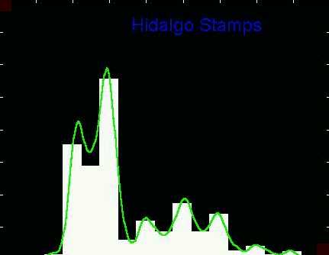
Density Estimation
Compare shifts with Average Histogram
For 7 mode shift
Peaks line up with bin centers
So shifted histo’s
find peaks

Slide 59
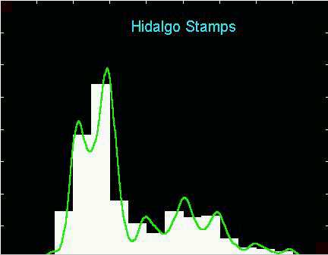
Density Estimation
Compare shifts with Average Histogram
For 2 (3?) mode shift
Peaks split between bins
So shifted histo’s
miss peaks
This Is Why Histograms
Were Not Used in Many
Displays of 1-d Dist’ns,
Earlier in Course

Slide 60
Density Estimation
Histogram Drawbacks:
Need to choose bin width
Need to choose bin location
But Average Histogram reveals structure
So should use that, instead of histo
Name: Kernel Density Estimate

Slide 61
Kernel Density Estimation
Chondrite Data:
Stony (metal) Meteorites (hit the earth)
So have a chunk of rock
Study “% of silica”
From how many sources?
Only 22 rocks…
Histogram hopeless?
Brought to statistical literature by:
Good and Gaskins (1980)

Slide 62
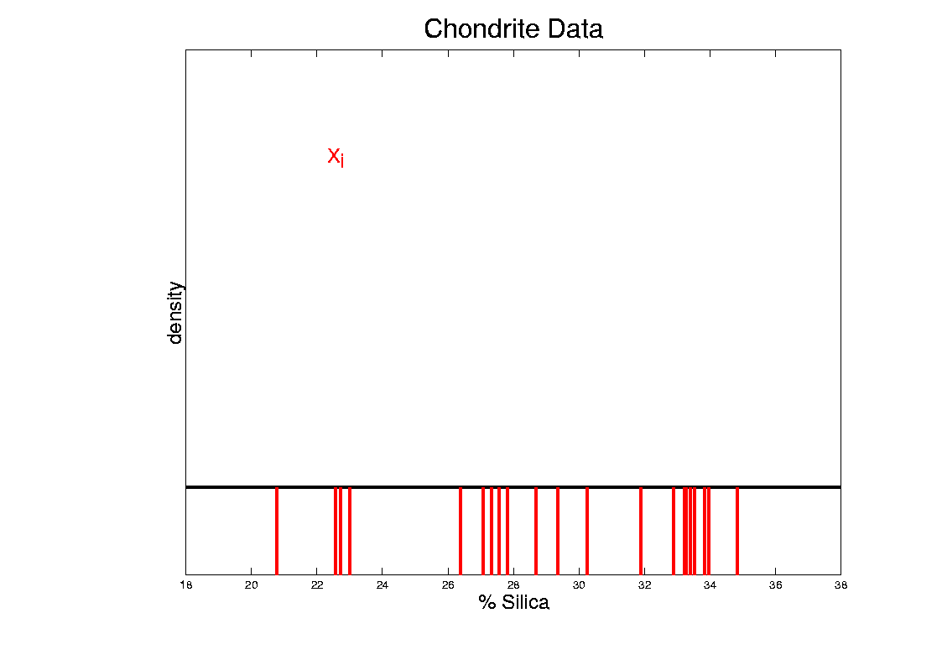
Kernel Density Estimation
Chondrite Data:
Represent points by red bars
Where are data “more dense”?

Slide 63
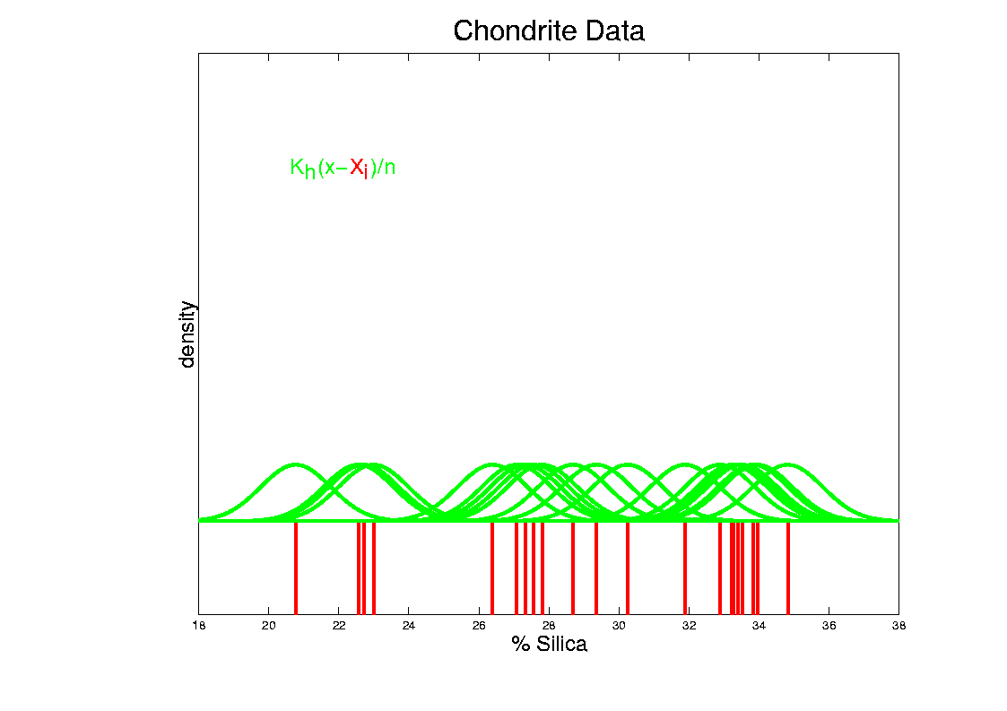
Kernel Density Estimation
Chondrite Data:
Put probability mass 1/n at each point
Smooth piece of “density”

Slide 64
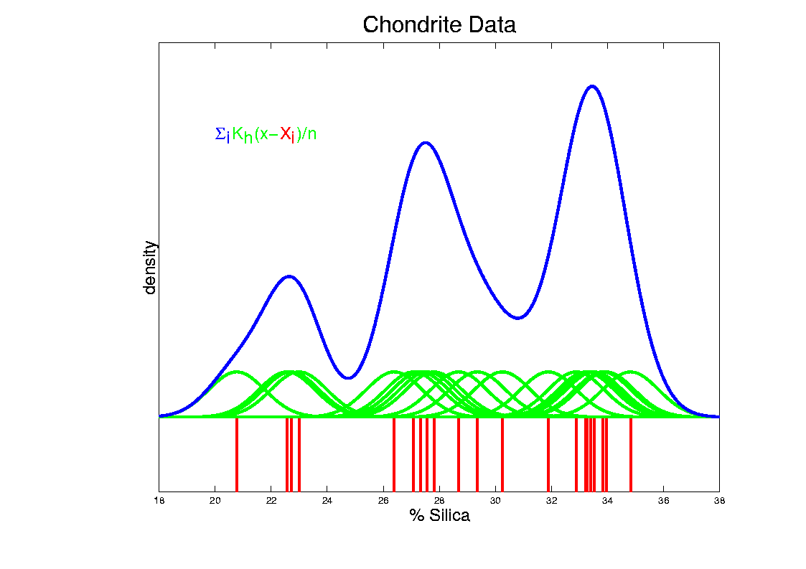
Kernel Density Estimation
Chondrite Data:
Sum pieces to estimate density
Suggests 3 modes (rock sources)

Slide 65
Kernel Density Estimation
Mathematical Notation:
$${\hat{f}}_{h}\left(x\right)=\frac{1}{n}\sum_{i=1}^{n}{K_{h}\left(x−X_{i}\right)}$$
Where
Window shape given by “kernel”,
$$K_{h}\left(∙\right)=\frac{1}{h}K\left(\frac{∙}{h}\right)$$
Window width given by “bandwidth”, $h$

Slide 66
Kernel Density Estimation
Mathematical Notation:
$${\hat{f}}_{h}\left(x\right)=\frac{1}{n}\sum_{i=1}^{n}{K_{h}\left(x−X_{i}\right)}$$
This
Was
Used
In PCA
Graphics

Slide 67
Kernel Density Estimation
Recall Subdensities For Different Groups
Black Curves
have Area = 1
Colored Curves
have Area = $\frac{n_{k}}{n}$
Use Same Window
Width, So They Sum

Slide 68
Kernel Density Estimation
Choice of kernel (window shape)?
Controversial issue
Want Computational Speed?
Want Statistical Efficiency?
Want Smooth Estimates?
There is more, but personal choice:
Gaussian
Good Overall Reference:
Wand and Jones (1994)
Looks the Best,
Minimal Distracting
Small Scale Noise

Slide 69
Kernel Density Estimation
Choice of bandwidth (window width)?
Very important to performance
Fundamental Issue:
Which modes are “really there”?

Slide 70
Density Estimation
How to use histograms if you must:
Undersmooth (minimizes bin edge effect)
Human eye is OK at “post-smoothing”

Slide 71
SiZer Background
Scale Space – Idea from Computer Vision
Goal: Teach Computers to “See”
Modern Research:
Extract “Information” from Images
Early Theoretical work

Slide 72
SiZer Background
Scale Space – Idea from Computer Vision
Conceptual basis:
Oversmoothing = “view from afar”
(macroscopic)
Undersmoothing = “zoomed in view”
(microscopic)
Main idea: all smooths contain useful information, so study “full spectrum”
(i. e. all smoothing levels)
Recommended reference: Lindeberg (1994)

Slide 73
SiZer Background
Survey of
$n=7145$
Household
Incomes 1985
Fun Scale Space Views
(of Family Incomes Data)
Expected
Strong
Skewness

Slide 74
SiZer Background
Fun Scale Space Views (Incomes Data)
Spectrum Overlay
Major
Implications
For
Modelling
Income
Distributions
Central Question:
Are 2 Modes “Real”?
Answer: Yes
Schmitz & Marron (1992)
Next Question:
Worth Time Investiment?

Slide 75
SiZer Background
Fun Scale Space Views (Incomes Data)
Surface View

Slide 76
SiZer Background
Fun Scale Space Views
(of Family Incomes Data)
Note:
The scale space viewpoint makes
Data Dased Bandwidth Selection
Much less important
(than I once thought….)

Slide 77
SiZer Background
SiZer:
Significance of Zero crossings, of the derivative, in scale space
Combines:
needed statistical inference
novel visualization
To get: a powerful exploratory + confirmatory data analysis method
Main references:
Chaudhuri & Marron (1999)
Hannig & Marron (2006)

Slide 78
SiZer Background
Basic idea: a bump is characterized by:
an increase
followed by a decrease
Generalization:
Many features of interest captured
by sign of the slope of the smooth
Foundation of SiZer:
Statistical inference on slopes,
over scale space

Slide 79
SiZer Background
SiZer Visual presentation:
Color map over scale space:
Blue: slope significantly upwards
(derivative CI above 0)
Red: slope significantly downwards
(derivative CI below 0)
Purple: slope insignificant
(derivative CI contains 0)

Slide 80
SiZer Background
SiZer analysis of British Incomes data:

Slide 81
SiZer Background
SiZer analysis of British Incomes data:
Oversmoothed: Only one mode
Medium smoothed: Two modes, statistically significant
Confirmed by Schmitz & Marron, (1992)
Undersmoothed: many noise wiggles, not significant
Again: all are correct,
just different scales

Slide 82
SiZer Background
E.g. - Marron & Wand (1992) Trimodal #9
Increasing $n$
Only 1 Signif’t Mode
Now 2 Signif’t Modes
Finally all 3 Modes

Slide 83
SiZer Background
E.g. - Marron & Wand Discrete Comb #15
Increasing $n$
Coarse Bumps Only
Now Fine bumps too
Someday: “draw” local
Bandwidth on SiZer map

Slide 84
SiZer Background
Finance "tick data":
(time, price) of single stock transactions
Idea: "on line" version of SiZer
for viewing and understanding trends

Slide 85
SiZer Background
Finance "tick data":
(time, price) of single stock transactions
Idea: "on line" version of SiZer
for viewing and understanding trends
Notes:
trends depend heavily on scale
double points and more
background color transition
(flop over at top)

Slide 86
SiZer Background
Internet traffic data analysis:
SiZer analysis of
time series of
packet times
at internet hub (UNC)
Hannig, Marron,
and Riedi (2001)
Notes:
86

Slide 87
SiZer Background
Internet traffic data analysis:
SiZer analysis of
time series of packet times
at internet hub (UNC)
across very wide range of scales
needs more pixels than screen allows
thus do zooming view
(zoom in over time)
zoom in to yellow bd’ry in next frame
readjust vertical axis
Notes:
87

Slide 88
SiZer Background
Internet traffic data analysis (cont.)
Insights from SiZer analysis:
Coarse scales:
amazing amount of significant structure
Evidence of self-similar fractal type process?
Fewer significant features at small scales
But they exist, so not Poisson process
Poisson approximation OK at small scale???
Smooths (top part) stable at large scales?
Notes:
88

Slide 89
SiZer Background
Historical Note & Acknowledgements:
Scale Space: S. M. Pizer
SiZer: Probal Chaudhuri
Main References:
Chaudhuri & Marron (1999)
Chaudhuri & Marron (2000)
Hannig & Marron (2006)
Fun & Surprising Mathematics of Scale Space
Advanced
Distribution
Theory for
Simultaneous
Inference

Slide 90
SiZer Background
Extension to 2-d:
Significance in Scale Space
Main Challenge: Visualization
References:
Godtliebsen et al (2002, 2004, 2006)
What Is Up and Down?
Significant
Gradients
& Contours
Significant
Curvature

Slide 91
SiZer Overview
Would you like to try smoothing & SiZer?
Marron Software Website as Before
In “Smoothing” Directory:
kdeSM.m
nprSM.m
sizerSM.m
Recall: “>> help sizerSM” for usage

Slide 92
Carry Away Concept
OODA is more than a “framework”
It Provides a Focal Point
Highlights Pivotal Choices:
What should be the Data Objects?
How should they be Represented?

Slide 93
Participant Presentations
11:55: Jimin Choi:
12:00: Kyungjin Sohn:
12:05: Emma Mitchell:
12:10: Elyse Borgert

